Slide 1
Detector R&D Roadmap: the context
development of the Detector R&D Roadmap initiated by ECFA in response to the 2020 ESPPU
"Organised by ECFA, a roadmap should be developed by the community to balance the detector R&D efforts in Europe, taking into account progress with emerging technologies in adjacent fields. The roadmap should identify and describe a diversified detector R&D portfolio that has the largest potential to enhance the performance of the particle physics programme in the near and long term." This Roadmap process has also been discussed at recent Plenary ECFA meetings.
web pages: https://indico.cern.ch/e/ECFADetectorRDRoadmap
schedule of the public symposia: maximum community input and participation encouraged
structure agreed with ECFA: Roadmap by technology areas to maximally emphasise synergies between the requirements of different future particle physics programmes, and beyond.
Particle physics community is invited to the nine all-day open online symposia, vital for guiding the process towards the development of the final Detector R&D Roadmap document: https://indico.cern.ch/event/957057/program - encourage everyone interested to participate (25 March, 31 March, 9 April, 12 April, 23 April, 29 April, 30 April, 6 May and 7 May)
The ECFA Detector R&D Roadmap Panel
(Phil Allport (chair), Nicolo' Cartiglia, Anna Colaleo, Johann Collot, Silvia Dalla Torre, Jorgen D'Hondt, Michael Doser, Roberto Ferrari, Erika Garutti, Anna Grasselino, Roxanne Guenette, Neville Harnew, Frank Hartmann, Karl Jakobs,
Manfred Krammer, Peter Krizan, Susanne Kuehn, Carlos Lacasta, Jocelyn Monroe, Dave Newbold, Giulio Pellegrini,
Roman Poeschl, Werner Riegler, Lenny Rivkin, Leszek Ropelewski, Felix Sefkow, Ian Shipsey and Francois Vasey)

Slide 2
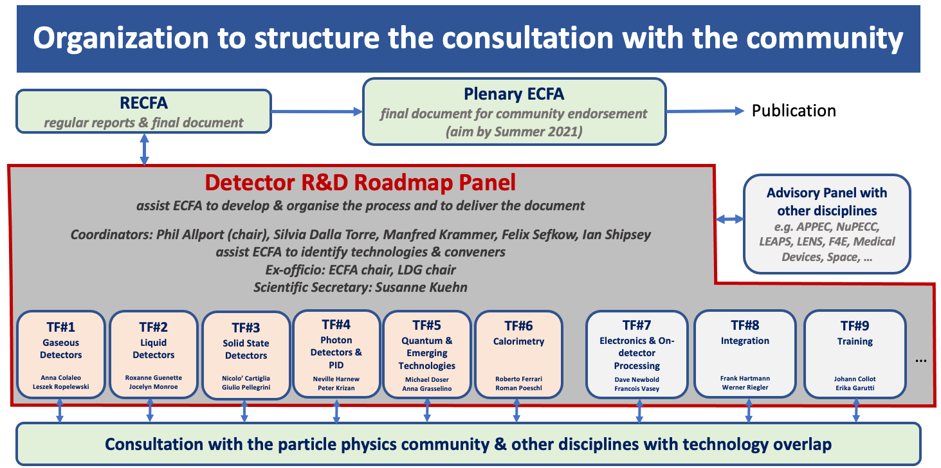

Slide 3
TF1 Gaseous Detectors
  Convenors: Anna Colaleo (INFN Bari), Leszek Ropelewski (CERN)
  Expert members: Klaus Dehmelt (Stonybrook),
  Laura Fabbietti (TUM Munich), Barbara Liberti (INFN
  Roma), Joao Veloso (Aveiro)
TF2 Liquid Detectors
  Convenors: Roxanne Guenette (Harvard), Jocely Monroe (RHUL)
  Expert members: Auke-Pieter Colijn (NIKHEF), Antonio Ereditato (Yale/Berne), Ines Gil Botella (CIEMAT), Manfred Lindner (MPI Heidelberg)
TF3 Solid State Detectors
  Convenors: Nicolo Cartiglia (INFN Turino), Giulio Pellegrini (IMB-CNM-CSIC)
  Expert members: Daniela Bortoletto (Oxford), Didier Contardo (IN2P3-IP2I), Ingrid Gregor (DESY and Bonn), Gregor Kramberger (Jozef Stefan Insitute), Heinz Pernegger (CERN)
TF4 Photon Detectors and Particle Identification Detectors
  Convenors: Neville Harnew (Oxford), Peter Krizan (Jozef Stefan Insitute)
  Expert members: Ichiro Adachi (KEK), Christian Joram (CERN), Eugenio Nappi (INFN Bari), Christian Schultz-Coulon (Heidelberg)
TF5 Quantum and Emerging Technologies
  Convenors: Michael Doser (CERN), Anna Grasselino (Fermilab)
  Expert members: Caterina Braggio (Padova), Marcel Demarteau (ORNL), Andy Geraci (NWU), Peter Graham (Stanford), John March Russell (Oxford), Stafford Withington (Cambridge)
TF6 Calorimetry
  Convenors: Roberto Ferrari (INFN Pavia), Roman Poeschl (IN2P3-IJCLab)
  Expert members: Martin Aleksa (CERN), Dave Barney (CERN), Frank Simon (LMU Munich), Tommaso Tabarelli de Fatis (INFN Milano-Bicocca)
TF7 Electronics and On-detector Processing
  Convenors: Dave Newbold (RAL), Francois Vasey (CERN)
  Expert members: Niko Neufeld (CERN), Valerio Re (INFN Pavia), Christophe de la Taille (IN2P3-OMEGA), Marc Weber (KIT)
TF8 Integration
  Convenors: Frank Hartmann (KIT), Werner Riegler (CERN)
  Expert members: Corrado Gargiulo (CERN), Filippo Resnati (CERN), Herman Ten Kate (Twente), Bart Verlaat (CERN), Marcel Vos (IFIC Valencia)
TF9 Training
  Convenors: Johann Collot (IN2P3-LPSC), Erika Garutti (DESY and Hamburg)
  Expert members: Richard Brenner (Uppsala), Niels van Bakel (Nikhef), Claire Gwenlan (Oxford), Jeff Wiener (CERN)

Slide 4
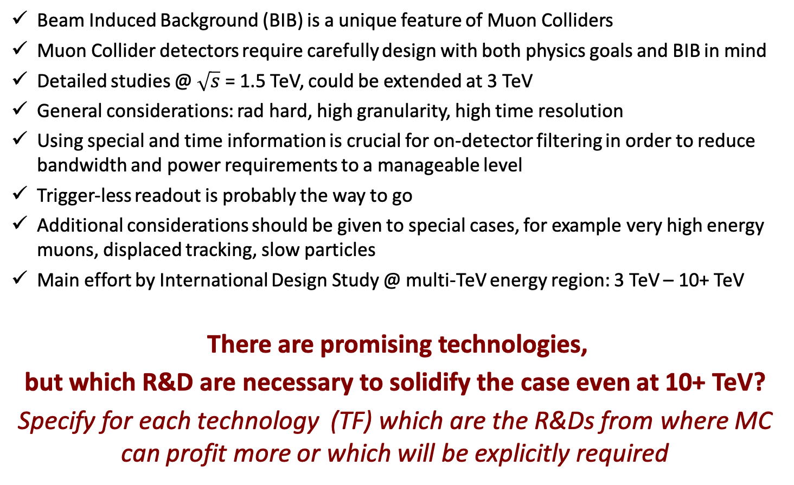
Detector R&D for Muon Colliders
2010
Beam Induced Background (BIB) is a unique feature of Muon Colliders
Muon Collider detectors require carefully design with both physics goals and BIB in mind
Detailed studies @ $\sqrt{s}$ = 1.5 TeV, could be extended at 3 TeV
General considerations: rad hard, high granularity, high time resolution
Using special and time information is crucial for on-detector filtering in order to reduce bandwidth and power requirements to a manageable level
Trigger-less readout is probably the way to go
Additional considerations should be given to special cases, for example very high energy muons, displaced tracking, slow particles
Main effort by International Design Study @ multi-TeV energy region: 3 TeV – 10+ TeV
  There are promising technologies,
  but which R&D are necessary to solidify the case even at 10+ TeV?
  Specify for each technology (TF) which are the R&Ds from where MC can profit more or which will be explicitly required
Illustration: Sandbox Studio

Slide 5
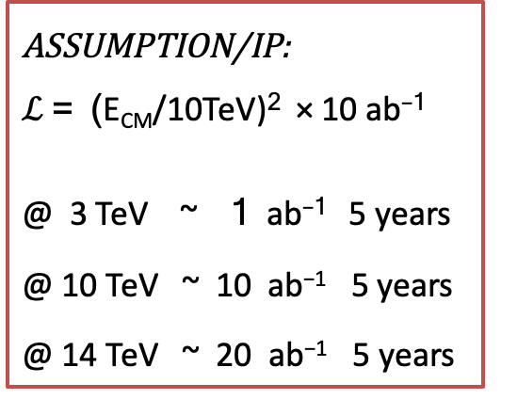
Sketch of the facility – working points
ASSUMPTION/IP:
$ℒ$ = (E_{CM}/10TeV)² × 10 ab⁻¹
@ 3 TeV ~ 1 ab⁻¹ 5 years
@ 10 TeV ~ 10 ab⁻¹ 5 years
@ 14 TeV ~ 20 ab⁻¹ 5 years

Slide 6
Beam Induced Backgroud
For each collider energy the machine elements, the MDI and interaction region
have to be properly designed and optimized
In particular, the two tungsten nozzles, cladded with a 5-cm layer of borated polyethylene, play a crucial role in background mitigation inside the detector.
JINST 13, P09004 (2018)
MAP developed realistic simulation of beam-induced backgrounds in the detector:
model of the tunnel ±200 m from the interaction point, with realistic geometry, materials distribution, machine lattice elements and magnetic fields, the experimental hall and the machine-detector interface (MDI)
secondary and tertiary particles from muon decay are simulated with MARS15 then transported to the detector borders
          FLUKA ????

Slide 7
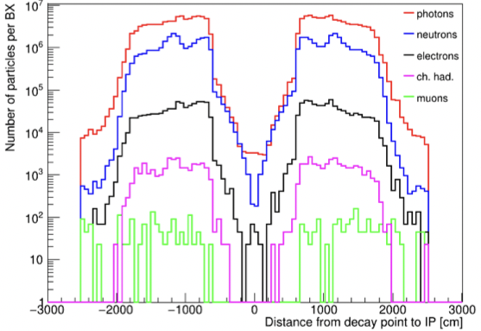
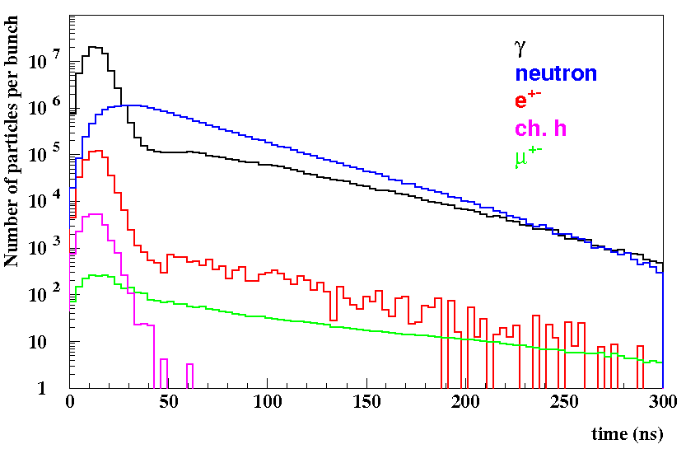
Beam Induced background @ 1.5 TeV
JINST 15 (2020) 05, P05001
Beam muons decay products interact with machine elements and cause a continuous flux of secondary and tertiary particles (mainly γ, n, e±, h±) that eventually reach the detector
The amount and characteristics of the beam-induced background (BIB) depend on the collider energy and the machine optics and lattice elements
muon beams of 0.75 TeV with 2⨉10¹²muons/bunch
➔ 4⨉10⁵ muon decays/m in single bunch crossing
Secondary and tertiary particles have low momentum and different arrival time in the Interaction Point
7

Slide 8

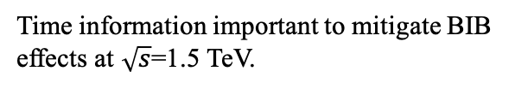
BIB characteristics at $\sqrt{s}=1.5$TeV, 125 GeV
arXiv:1905.03725
BIB characteristics strongly effect detectors design, ➞ BIB has to be studied in details
BIB behavior at higher than 1.5 TeV center of mass energies is still unknown.
Time information important to mitigate BIB effects at $\sqrt{s}$=1.5 TeV.
Secondary and tertiary particles have low momentum

Slide 9
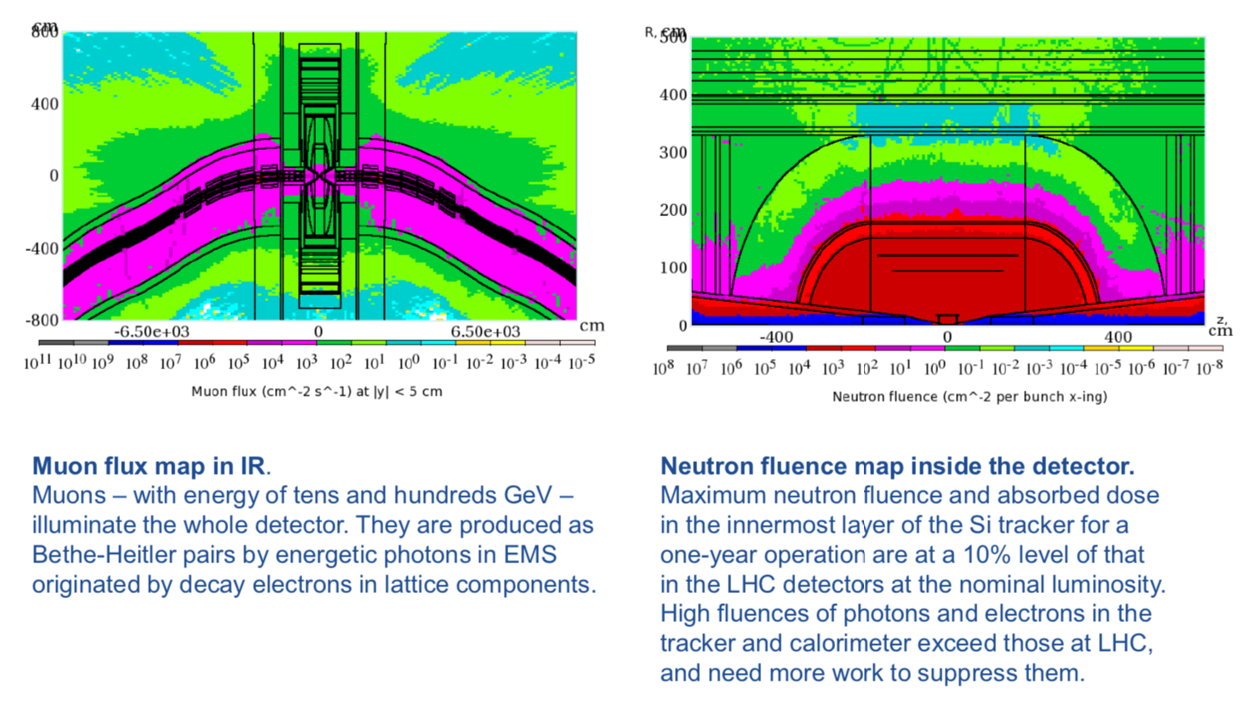
Muon and neutron fluences @ 1.5 TeV
Expected fluence < HL-LHC
HL-LHC < Expected dose < FCC-hh
Still expecting radiation hardness
to play a significant role, but unlikely
to be a major problem
Leaves more flexibility in adapting
detector design to such requirements
Environment somewhat different than LHC
Dominated by neutrons and photons
Weak radial dependence

Slide 10
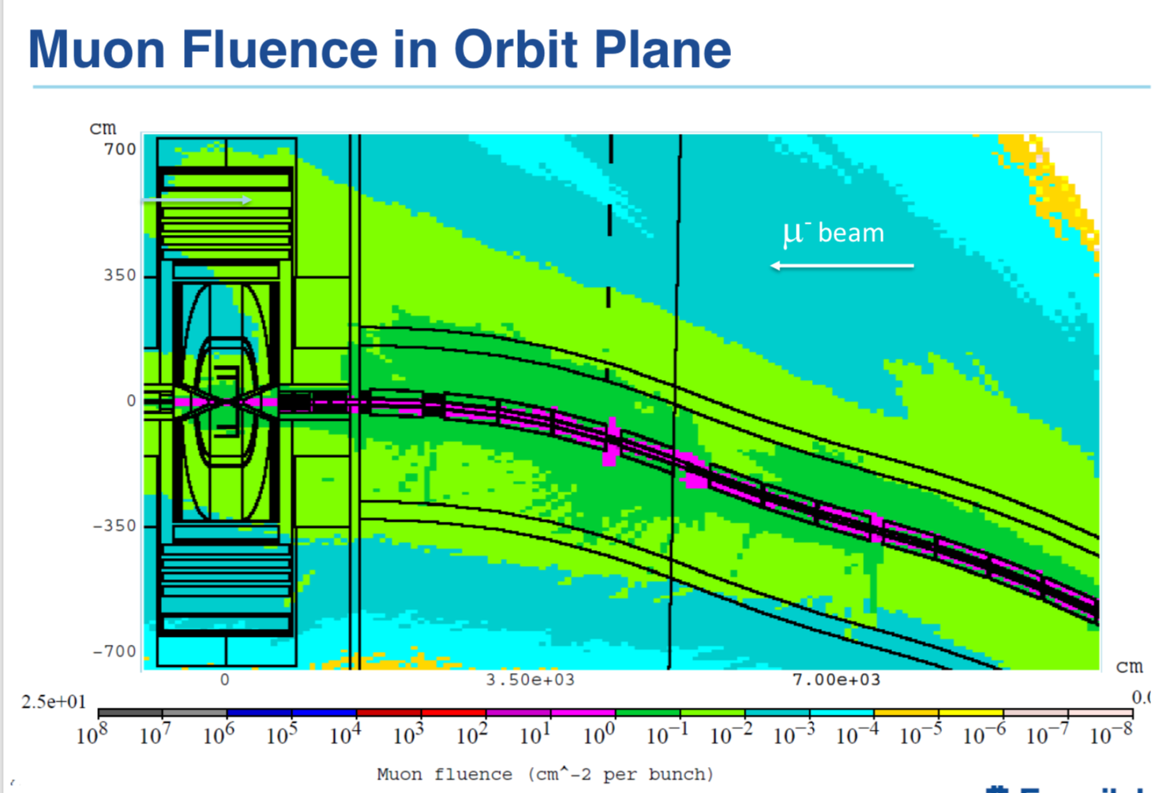
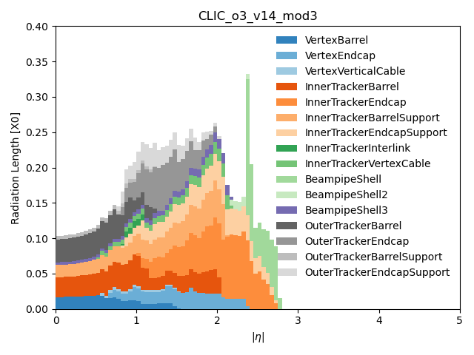
Key considerations
We know how to deal with these doses in silicon
Operate at low temperature(CO₂ cooling and some additional mass)
Operating voltage increases with dose
  Increased leakage currents as well – means large VI, power dissipation and danger of thermal runaway
Prefer thin sensors, high drift fields to minimize charge trapping and improve speed
Many of these considerations drive increased mass:
  from .1-.3% RL/layer for ILC designs to >1% with cooling, power delivery, support structures for MUC

Slide 11
Requirements for the detector
Track efficiency and momentum resolution – for feasibility and precision of many physics studies e.g. final states with leptons
Good ECAL energy and position resolution for e/gamma reconstruction
Good jet energy resolution
Efficient identification of a secondary vertex for heavy quark tagging
Other considerations ( Missing Energy/MET, taus, substructure )
Many ILC or CLIC considerations apply to Muon Collider detectors, although it is important to remember that beam background conditions are different and much more challenging in the case of the Muon Collider
Detector design considerations should be driven by physics requirements and BIB considerations
Optimal design will very likely be different for different collision energies

Slide 12
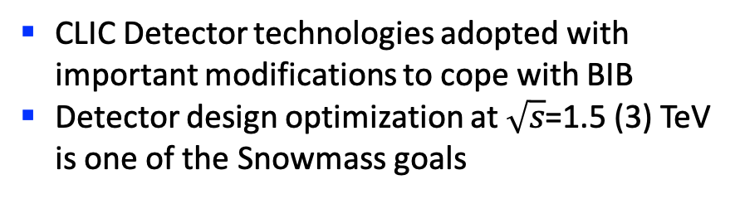

Detector @ $\sqrt{s}=1.5$TeV – full simulation
CLIC Detector technologies adopted with important modifications to cope with BIB
Detector design optimization at $\sqrt{s}$=1.5 (3) TeV is one of the Snowmass goals
Vertex Detector (VXD)
4 double-sensor barrel layers 25x25µm²
4+4 double-sensor disks 25x25µm²
Inner Tracker (IT)
3 barrel layers 50x50µm²
7+7 disks ’’
Outer Tracker(OT)
3 barrel layers 50x50µm²
4+4 disks ’’
Electromagnetic Calorimeter (ECAL)
40 layers W absorber and silicon pad sensors, 5x5 mm²
Hadron Calorimeter (HCAL)
60 layers steel absorber & plastic scintillating tiles, 30x30 mm²
Different stages of design depending on CoM energy
Quite advanced conceptual design for Higgs factory, 1.5 TeV and 3 TeV

Slide 13
Experiment design to be improved
Key findings for background discrimination:
  Precise timing and Directional information (not from IP)
  Energy deposit (especially for low-energy γ/n interaction in Si)
  Majority of particles with low transverse momentum

Slide 14
Key considerations
Most of the tracker hits and calorimeter clusters produced in the detector originate from the BIB
Example: inner layers of the vertex tracker detector have occupancy ~x10 larger than CMS pixels in HL-LHC
  Requires large bandwidth for sending data off the detector
  High complexity of data reconstruction
Applying filtering at various stages of data processing (both on and off the detector) is important.
Explore characteristics of the BIB that are different from the hard scatter:
  Position, Time, Energy, Particle ID, Correlations of the above.
Higher bandwidth requires power, filtering on detector requires power.
Considering large bunch crossing intervals at the muon collider (~10 us), it is probably best to consider a triggerless DAQ system.
Bunch crossing time is ~20-30 ps, defines natural time resolution.

Slide 15
TF8 Integration

Slide 16
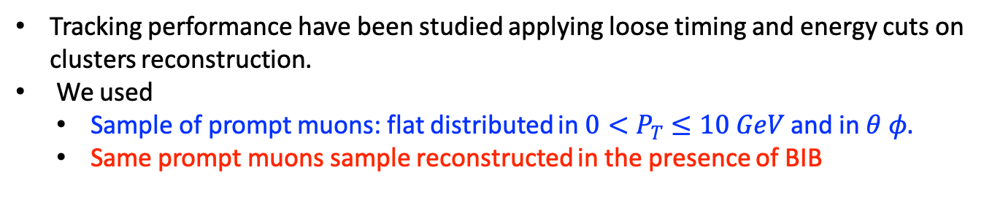
Tracking performances
The impact of BIB on tracking system could be severe if not mitigated:
vertex detector barrel designed in such a way not to overlap with the BIB hottest spots around the interaction region
Tracking performance have been studied applying loose timing and energy cuts on clusters reconstruction.
We used
  Sample of prompt muons: flat distributed in $0<P_{T}≤10 GeV$ and in $θ φ.$
  Same prompt muons sample reconstructed in the presence of BIB

Slide 17
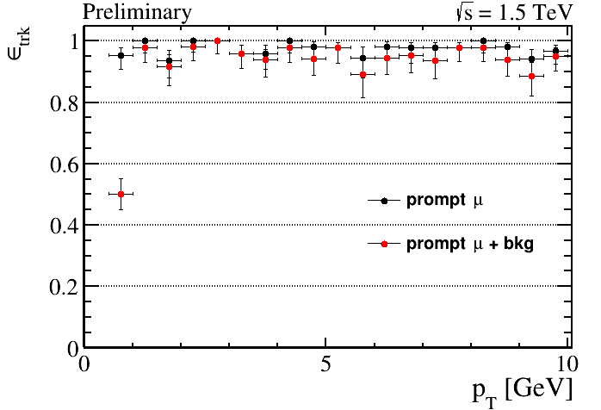
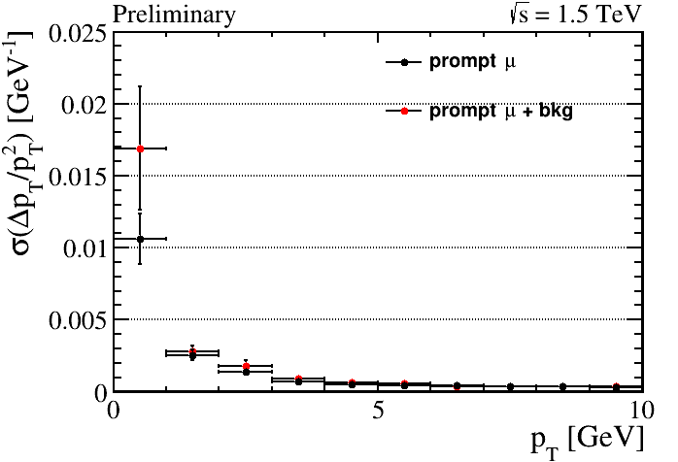
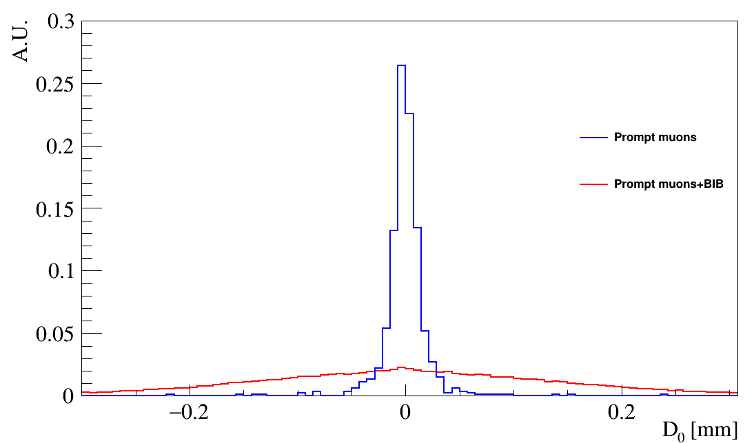
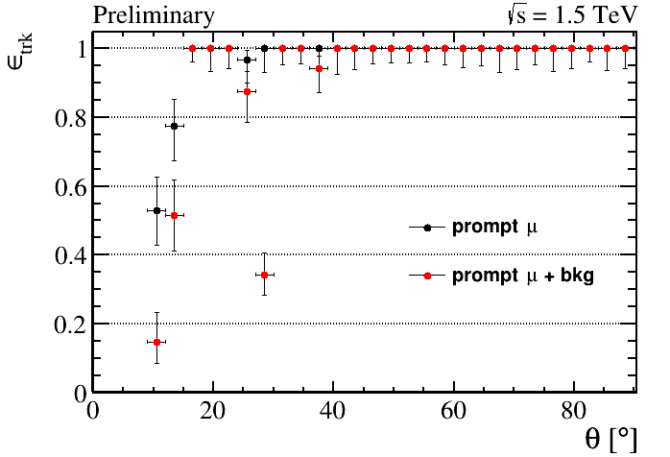
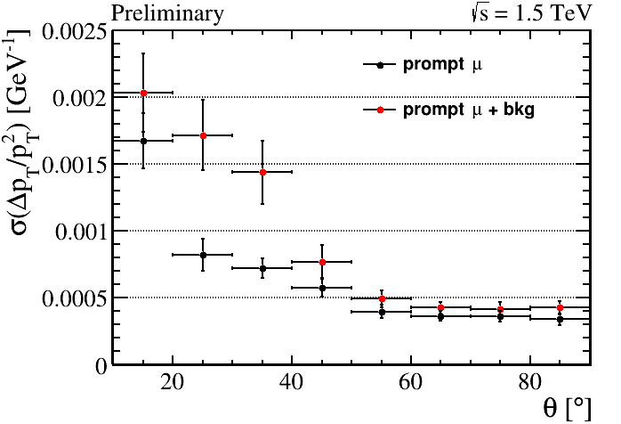
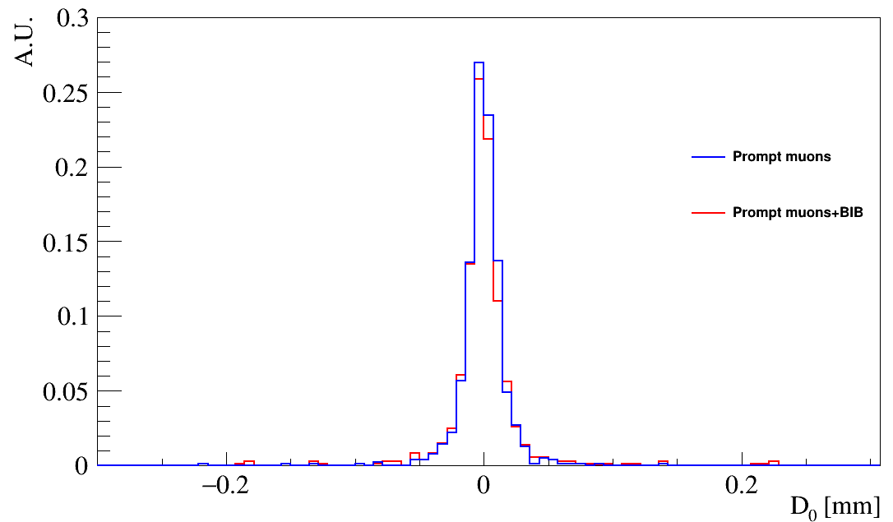
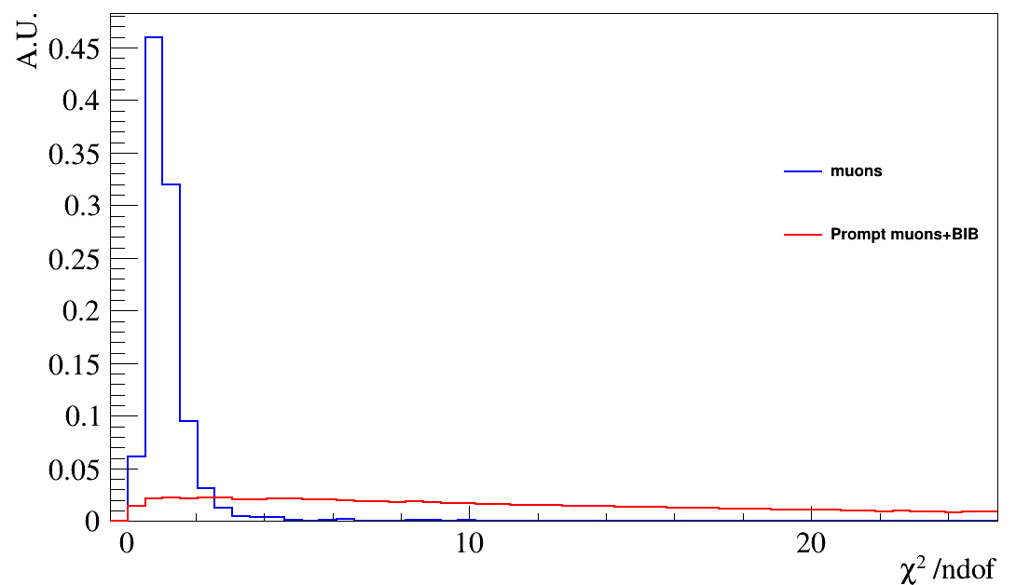
Tracking @ 1.5 TeV – present design
cuts

Slide 18
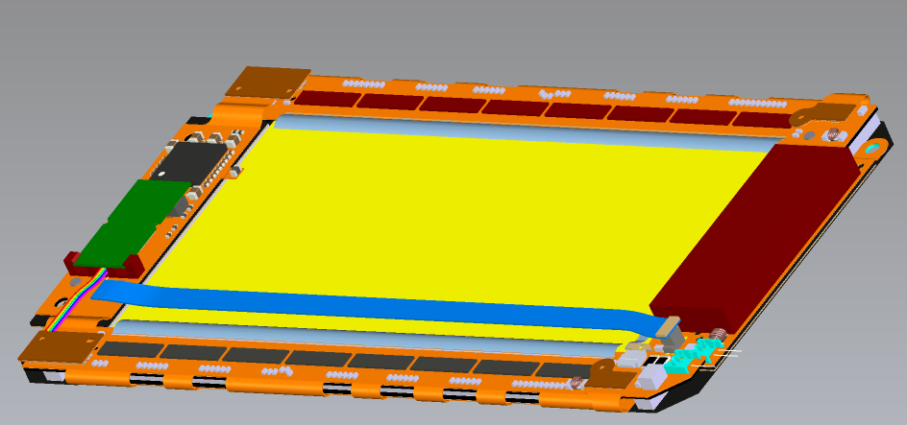
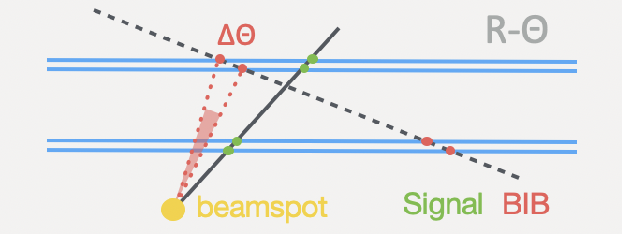
Tracker: position
CMS pTmodule
Angles can be measured by correlating hits between adjacent sensors ➔ used by CMS track trigger
The PS module uses short and long strips and is essentially a 1D problem
  Pixels are 2D and there is the additional complexity of encoding and decoding of hit positions to the target IC for position correlation. This will add power and complexity
Studies of single sensor track angle filter (based on cluster shapes) are valuable

Slide 19
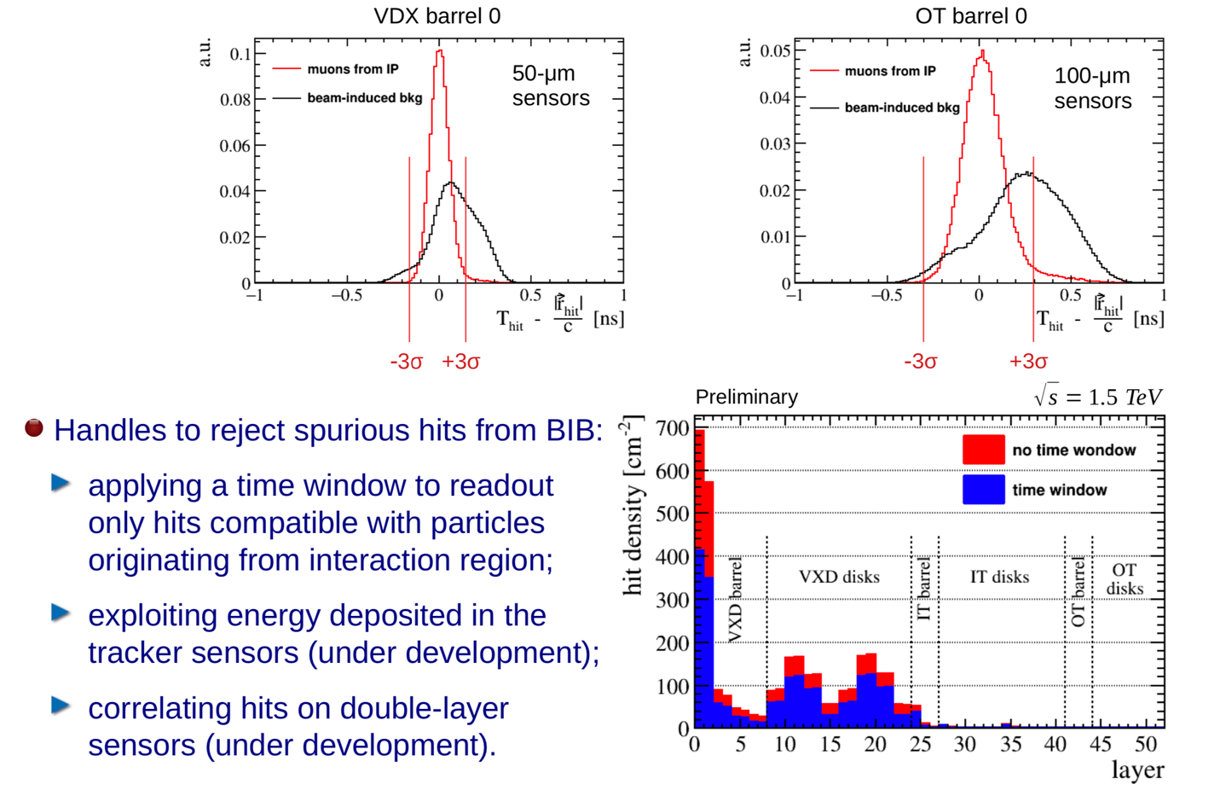
Tracking requirements
σt = 50ps
σt = 100ps

Slide 20
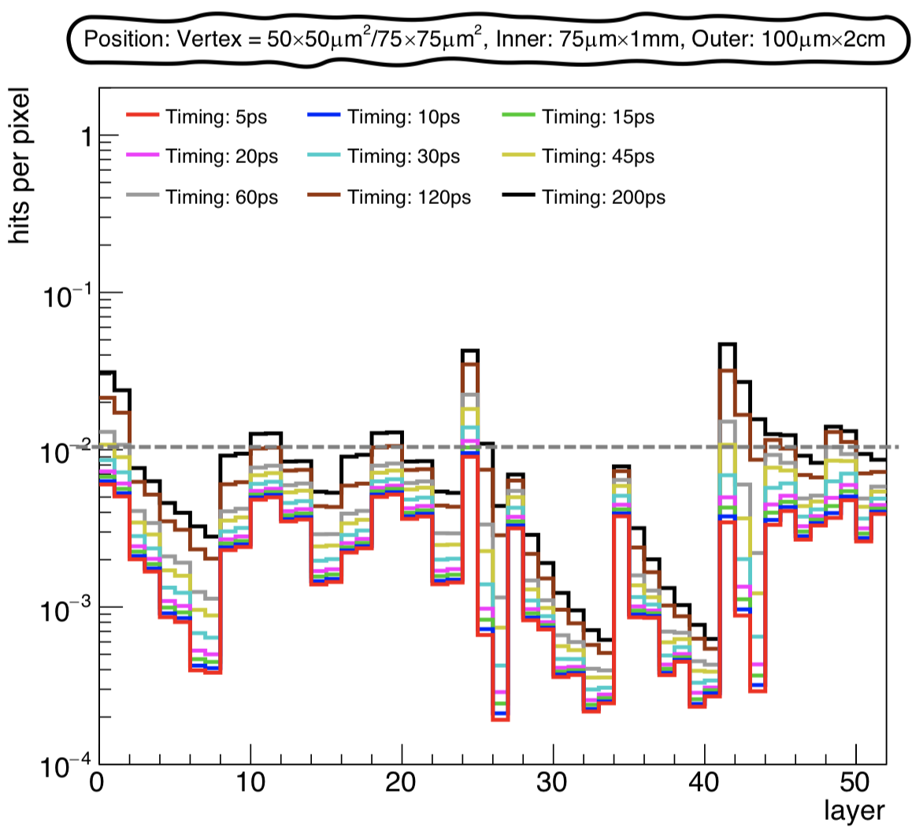
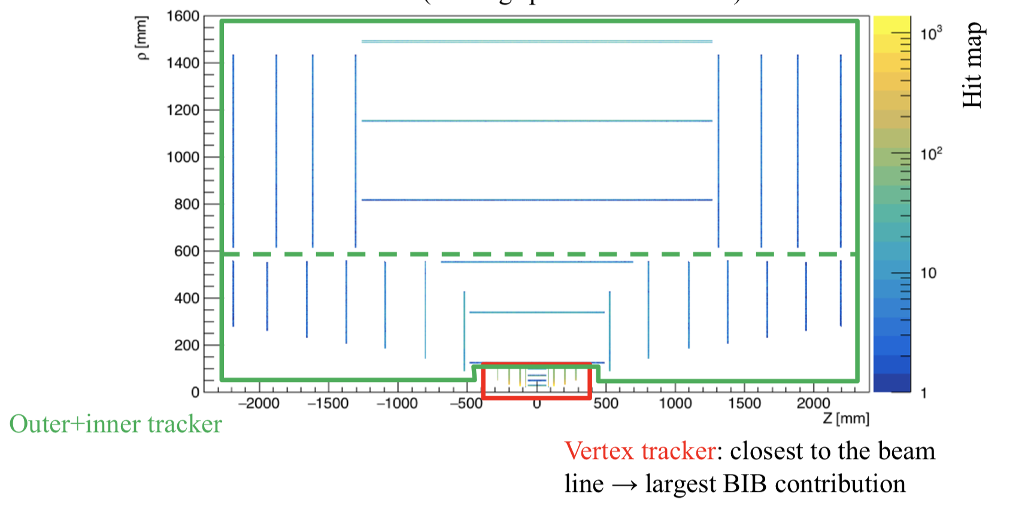
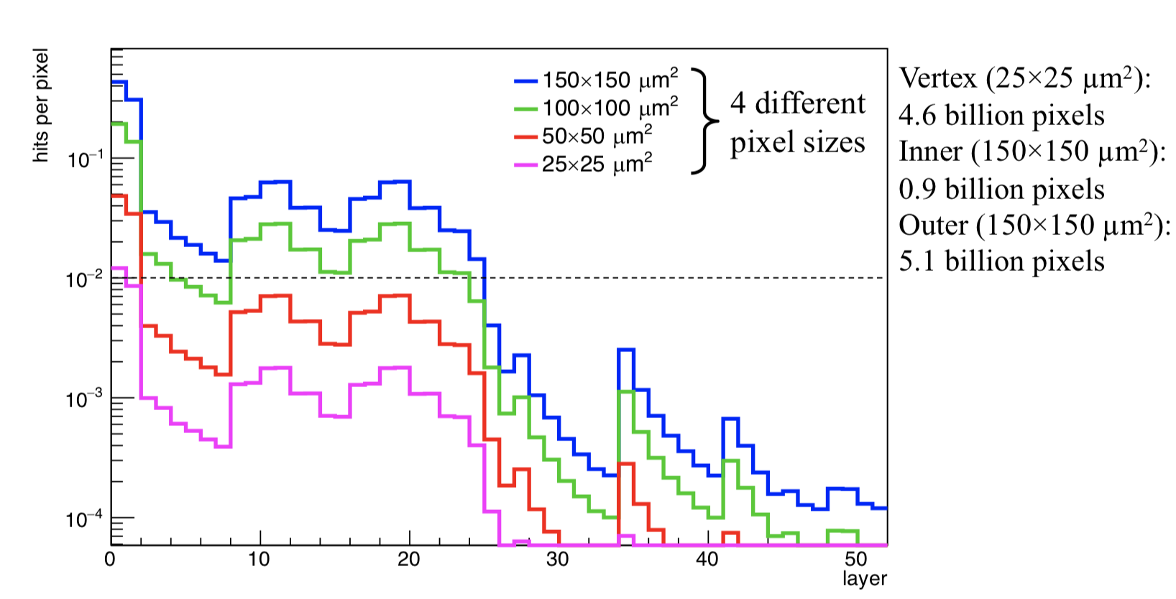
Tracker: timing
Smaller pixel/strip size ➔most of the detector can reach timing resolution of ~60 ps
Innermost vertex/inner barrel layer, will benefit for better timing of 20-30 ps
Leads to tracker with total number of channels ~ 2B (similar to Phase-2 ATLAS/CMS)
The goal of occupancy in the tracker is under ~1%
Without timing information, this is achievable with small pixel size ~25-25 microns
This would lead to the pixel detector with very large number of channels

Slide 21
TF3 Solid State Detectors
Double layers: size, material budget, timing

Slide 22
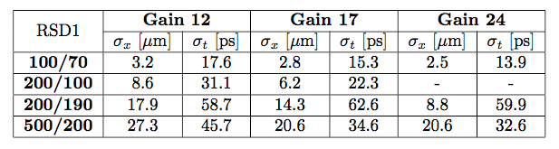
4D-tracking with RSD
Resistive AC-Coupled Silicon Detectors (RSD)
FBK able to reproduce the optimal physical-technological parameters we found at INFN through numerical modeling with high precision, reproducibility and homogeneity.
We also demonstrated to reach the challenging goal of producing (working) 100% fill-factor Silicon detectors with internal gain and high-segmentation level:
Measurements, confirmed by a testbeam analysis, show that both space and time resolution are gain- and geometry-dependent.
Laser measurements
FNAL testbeam
⇨ σ_{x} = ~5 μm and σ_{t} = ~40 ps
(rate capability: 50-100 MHz)
all the main signal properties are conserved in large-area RSD detectors
Notes:
Spiegare I ritardi:
• rinnovo licenze
• mancanza fette
• blocco macchine FBK

Slide 23
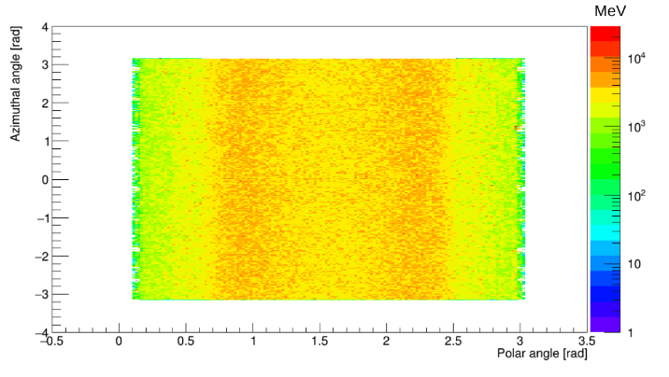
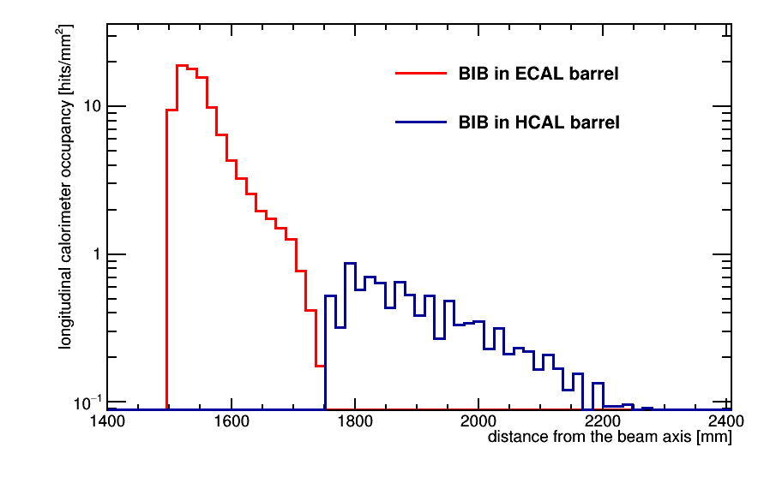
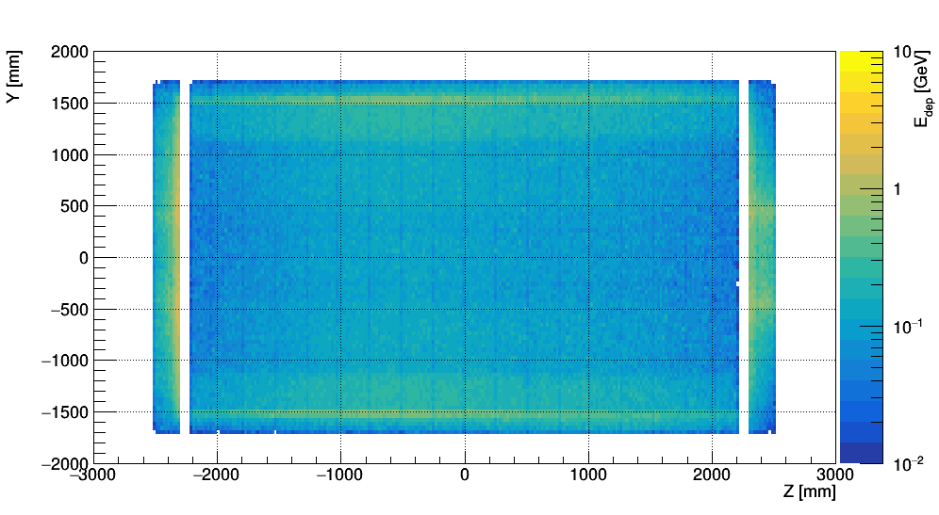
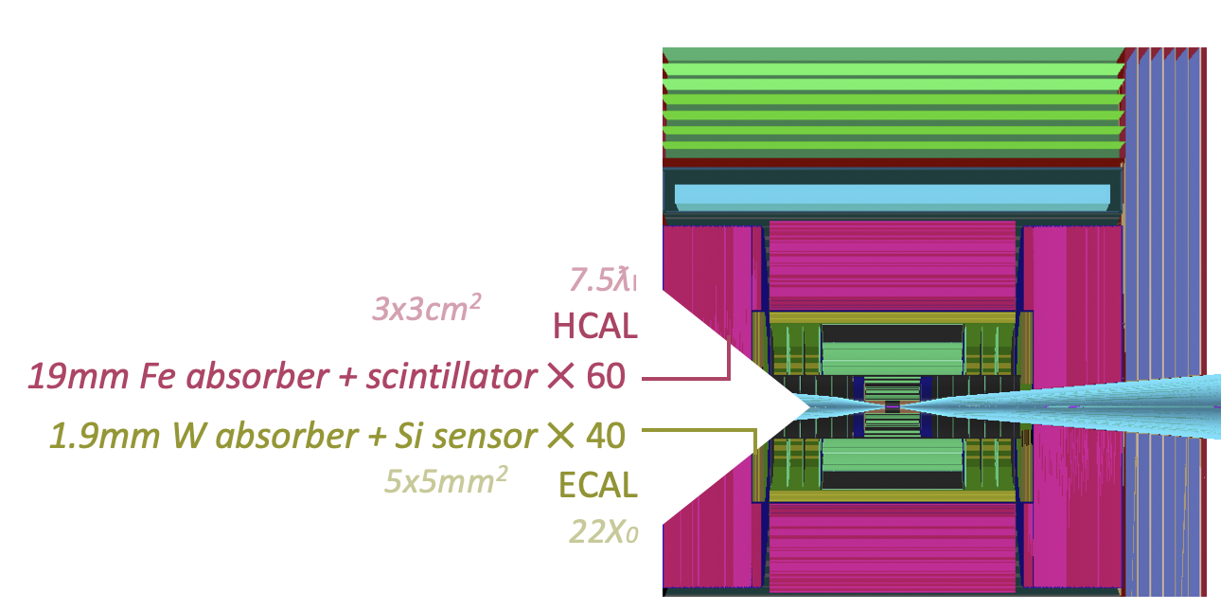
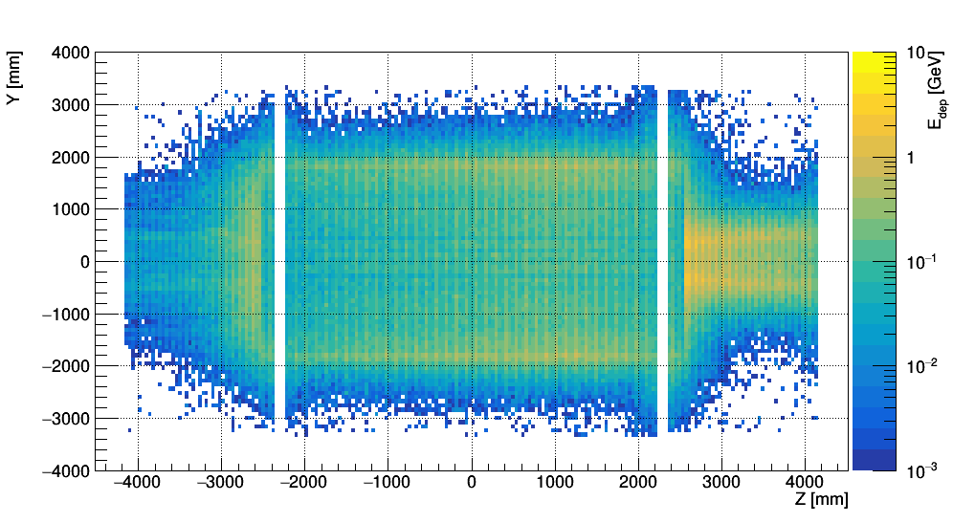
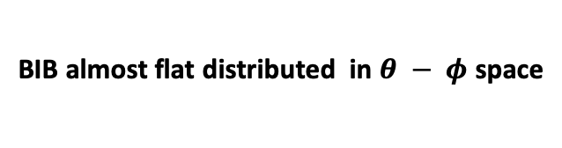
Calorimeter @ 1.5 TeV
BIB almost flat distributed in $θ − φ$ space
based on CLIC configuration
  Silicon + tungsten for ECAL, Iron+Scintillator for HCAL
BIB deposits large amount of energy in both ECAL and HCAL
Jets with energies larger than the COM energy of the collision
ECAL
HCAL

Slide 24
Calorimeter performance
Jet momentum resolution
Jet reconstruction efficiency
Jet ParticleFlow reconstruction algorithm under optimization.
Jet b-tag efficiency
b-jet identification
very simple, based on secondary vertices
Determined with the “MAP” detector with dual-readout calorimeter and very “rough” jet reconstruction and b-tag algorithms

Slide 25
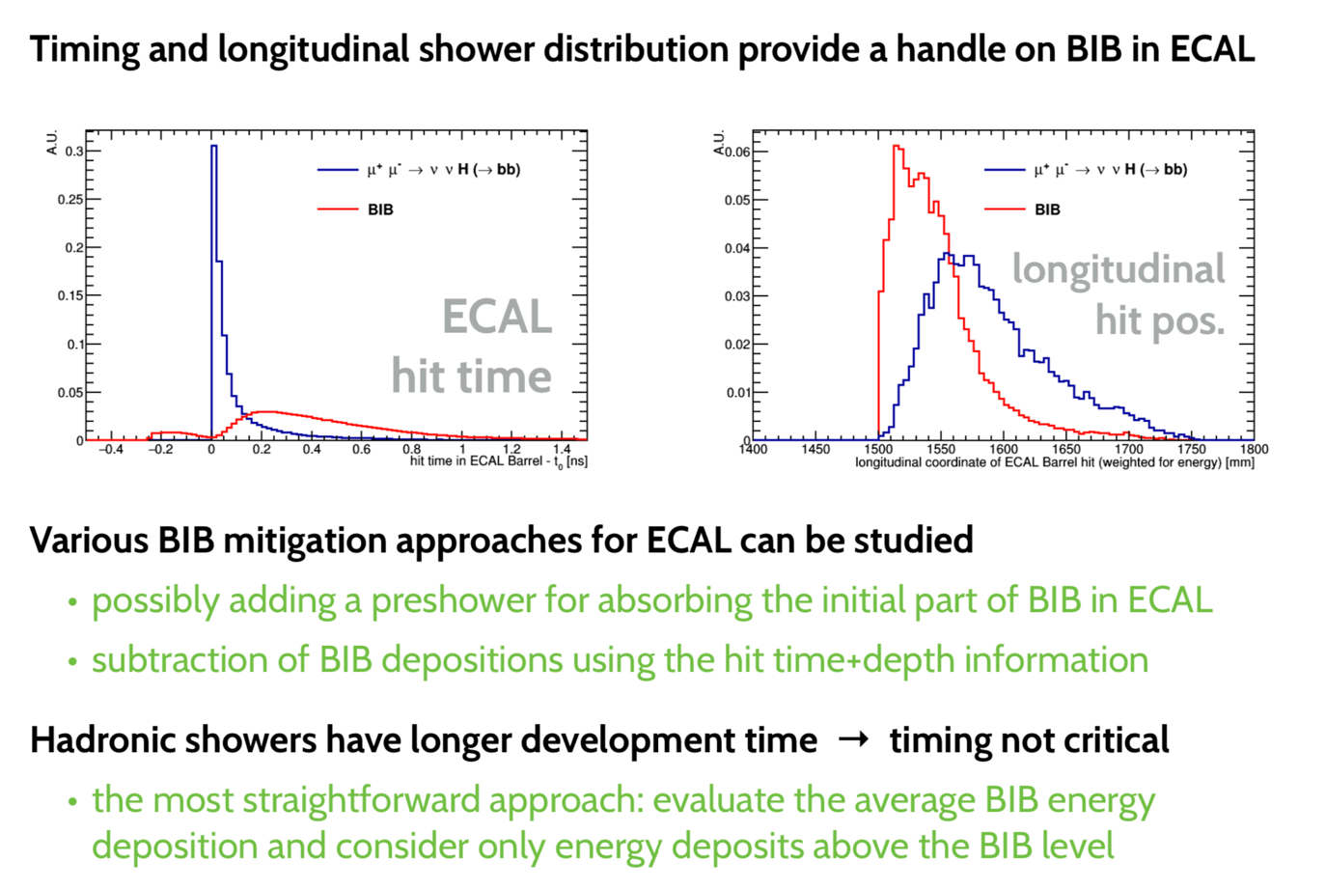
Calorimeter optimization

Slide 26
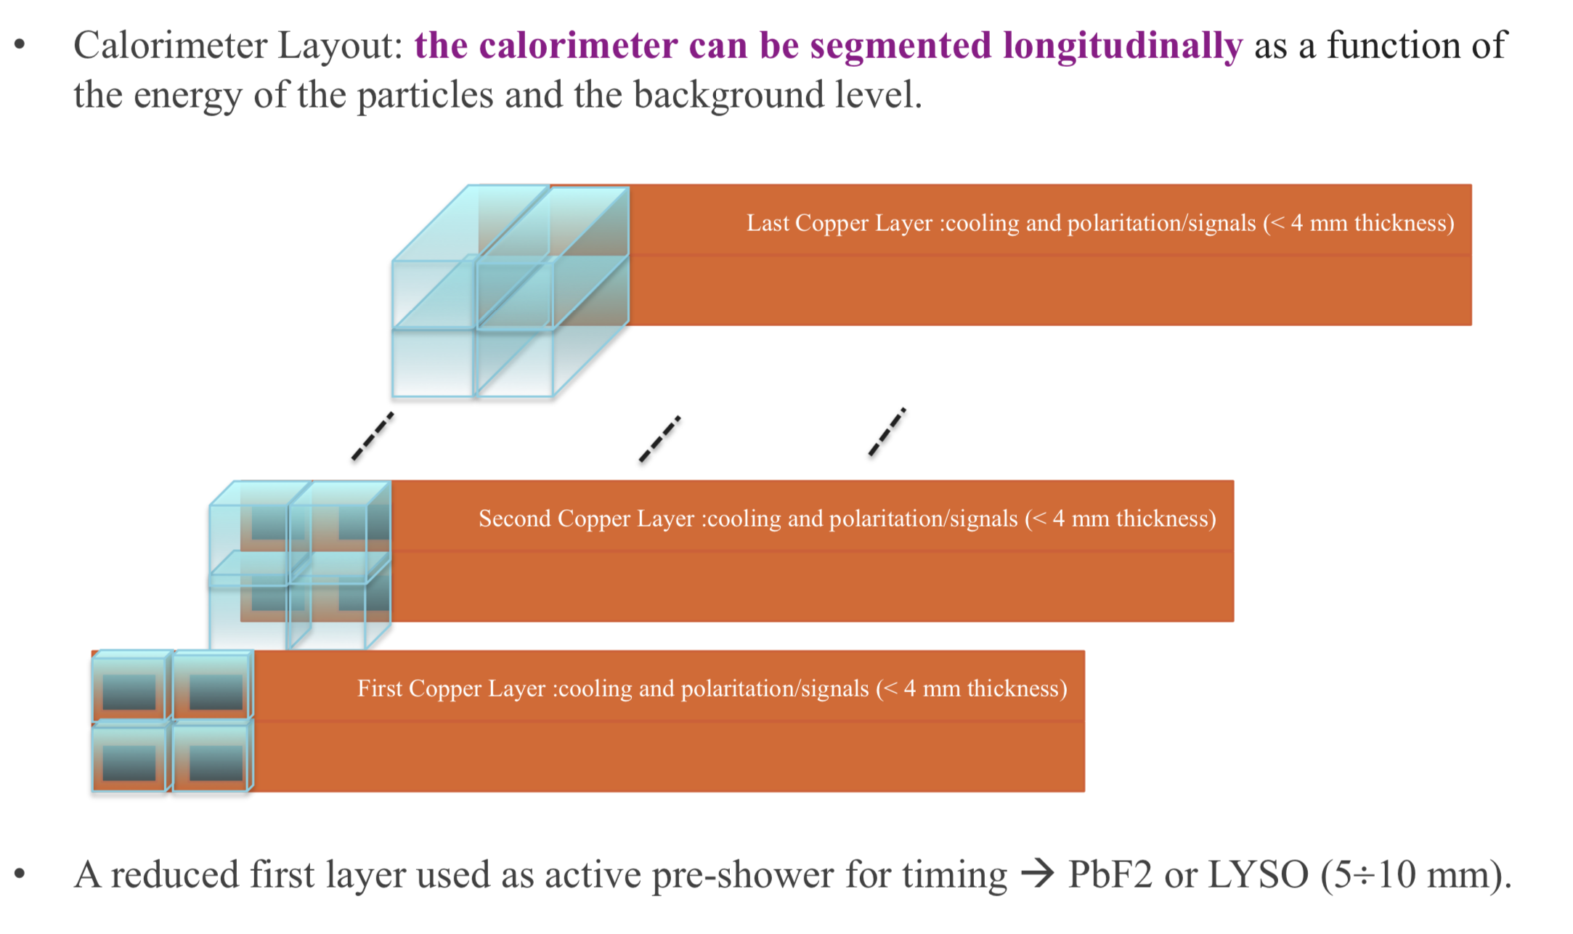
TF6 Calorimetry
Timing and longitudinal shower distribution provide a handle on BIB in ECAL
Readout energy is reduced by x3 when loose timing cuts are applied
high granularity + precise timing of each channel would allow to use sophisticated BIB subtraction at the Particle Flow reconstruction level
Could be expensive : other technologies e.g. use Cherenkov calorimeter with PbF2 crystals read out by SiPMs. Good timing, flexible granularity, much cheaper.
R&D on Rad-hard fast crystals (PbF2, Ba2F, PbWO_4…)
Synergy with KLEVER + LHCb….

Slide 27

TF4 Photon Detectors and Particle Identification Detectors
Crystal calorimeter SiPM readout
  Rad hardness up to ${10}^{12}$ n(1MeVeq)
  Size
  To be better defined:
  100 krad at SiPM level (1 Mrad on crystals)

Slide 28
Muon reconstruction @ 1
BIB in the muon detector
Central detector low occupancy
Backward/Forward detector sizeable occupancy close to nozzle
Central detector
Backward/Forward
detector

Slide 29
TF1 Gaseous Detectors
MPGDs or also improved RPCs, ... for readout of high-granularity hadronic calorimeters and for muon detectors in high rate areas where high precision is required (eg endcaps, first station in barrel,…)

Slide 30
Read-out considerations
Data => bandwidth => power
Assuming module size of 20 cm²
    With 50x50 microns pixel size, get ~800k pixels per module
    With 1% occupancy, this is 8k hits per module
  32 bits to encode x/y/amp/time
  Time between collisions is 10 us= 100 kHz
Data rates: 8000 * 32 bit * 100 kHz * 2(safety factor) ~ 50 Gbps
This number is factor of ~5-10 higher than HL-LHC
  Not obvious that the technology will get us there in ~10-20 years
  More handles should be explored:
    Data compression, some front-end clustering, pT-module based suppression (preliminary estimates indicate more than x5)

Slide 31
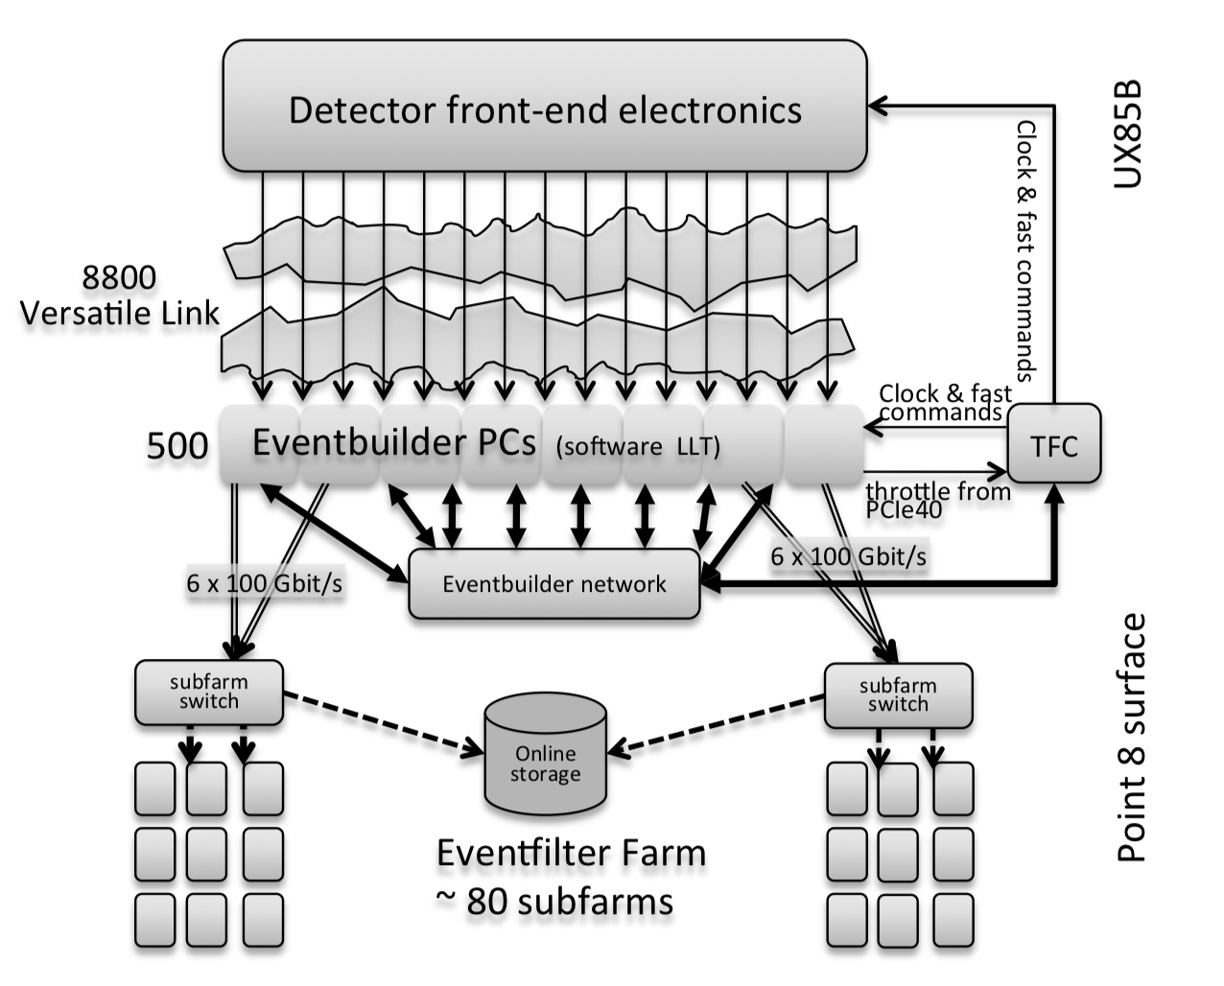
Trigger/read-out considerations
Assume data volume is tracker dominated
Total number of hits per event ~10M (less with timing-based filtering)
Total tracker data rate: 10M*32bits*100 kHz ~ 30 Tbps
E.g. tracker readout system could consist of <100 readout boards running 25G Links
  Similar to total bandwidth for LHCb triggerless DAQ
    LHCb has smaller data volumes (~8800 5Gbps links) but operates at 40MHz (vs 100kHz)
  Does not look crazy even with today’s commercial technology.
    Time between collision is very important
The architecture of the LHCb readout-system

Slide 32
TF7 Electronics - On-detector Processing

Slide 33
Final remarks

Slide 34
extras

Slide 35
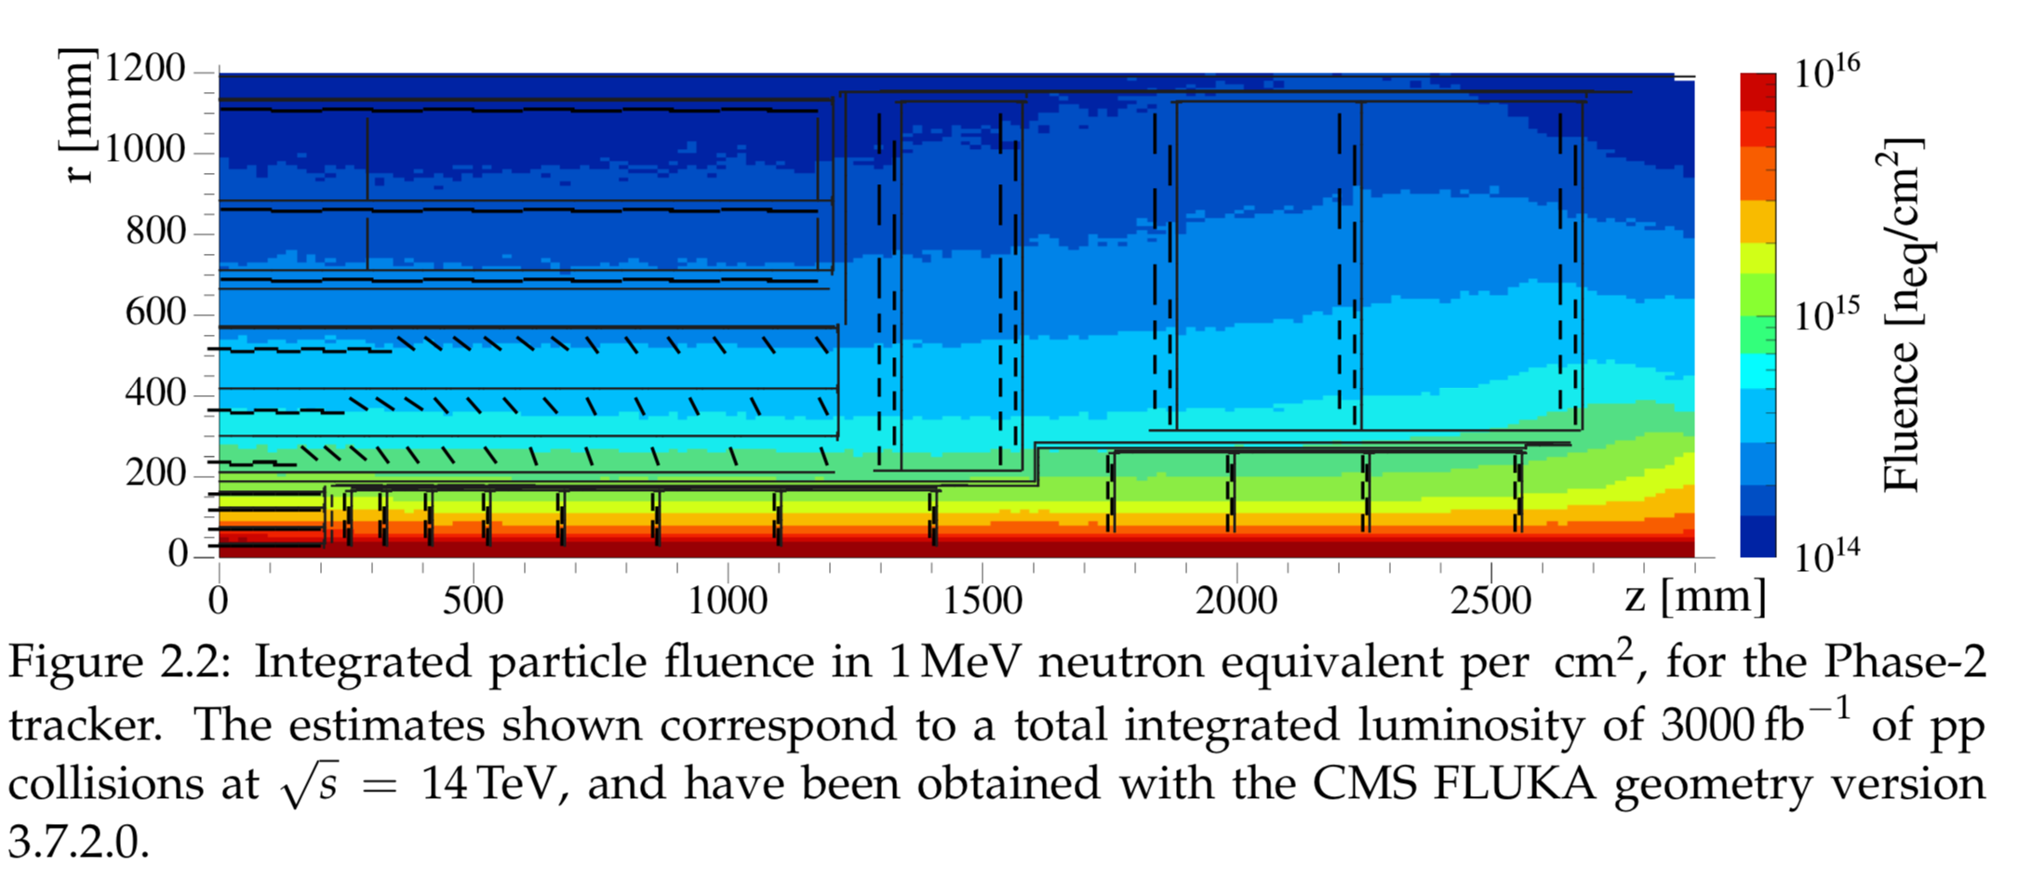
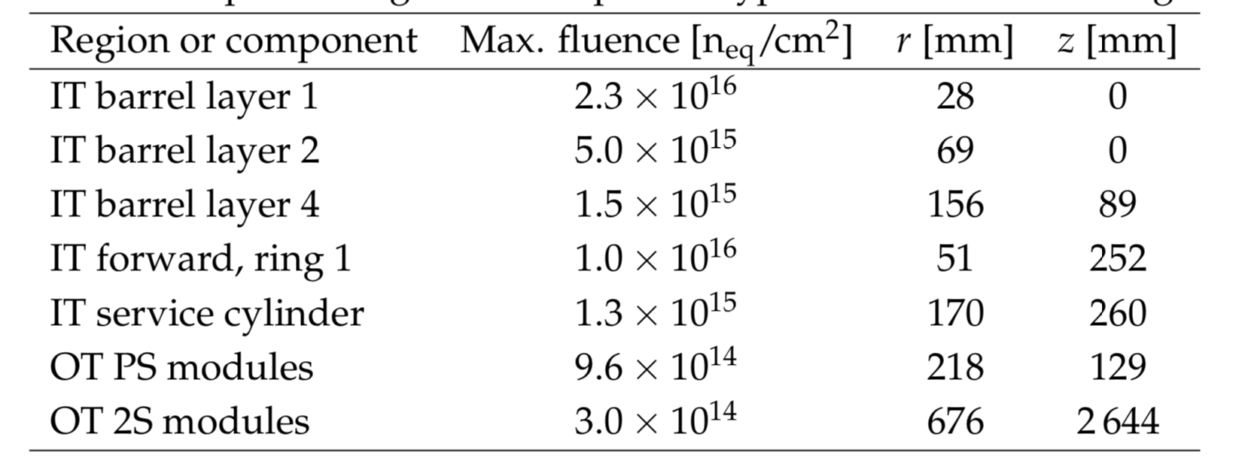
HL-LHC

Slide 36
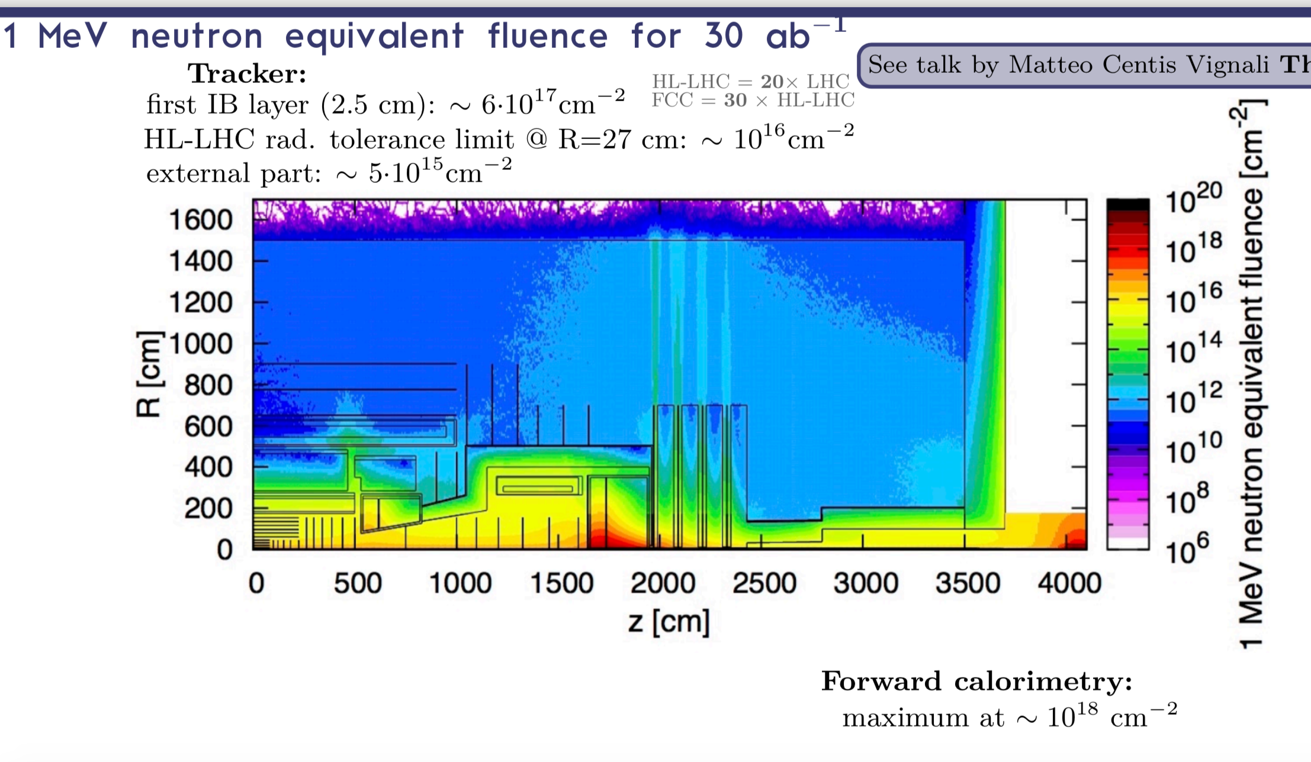
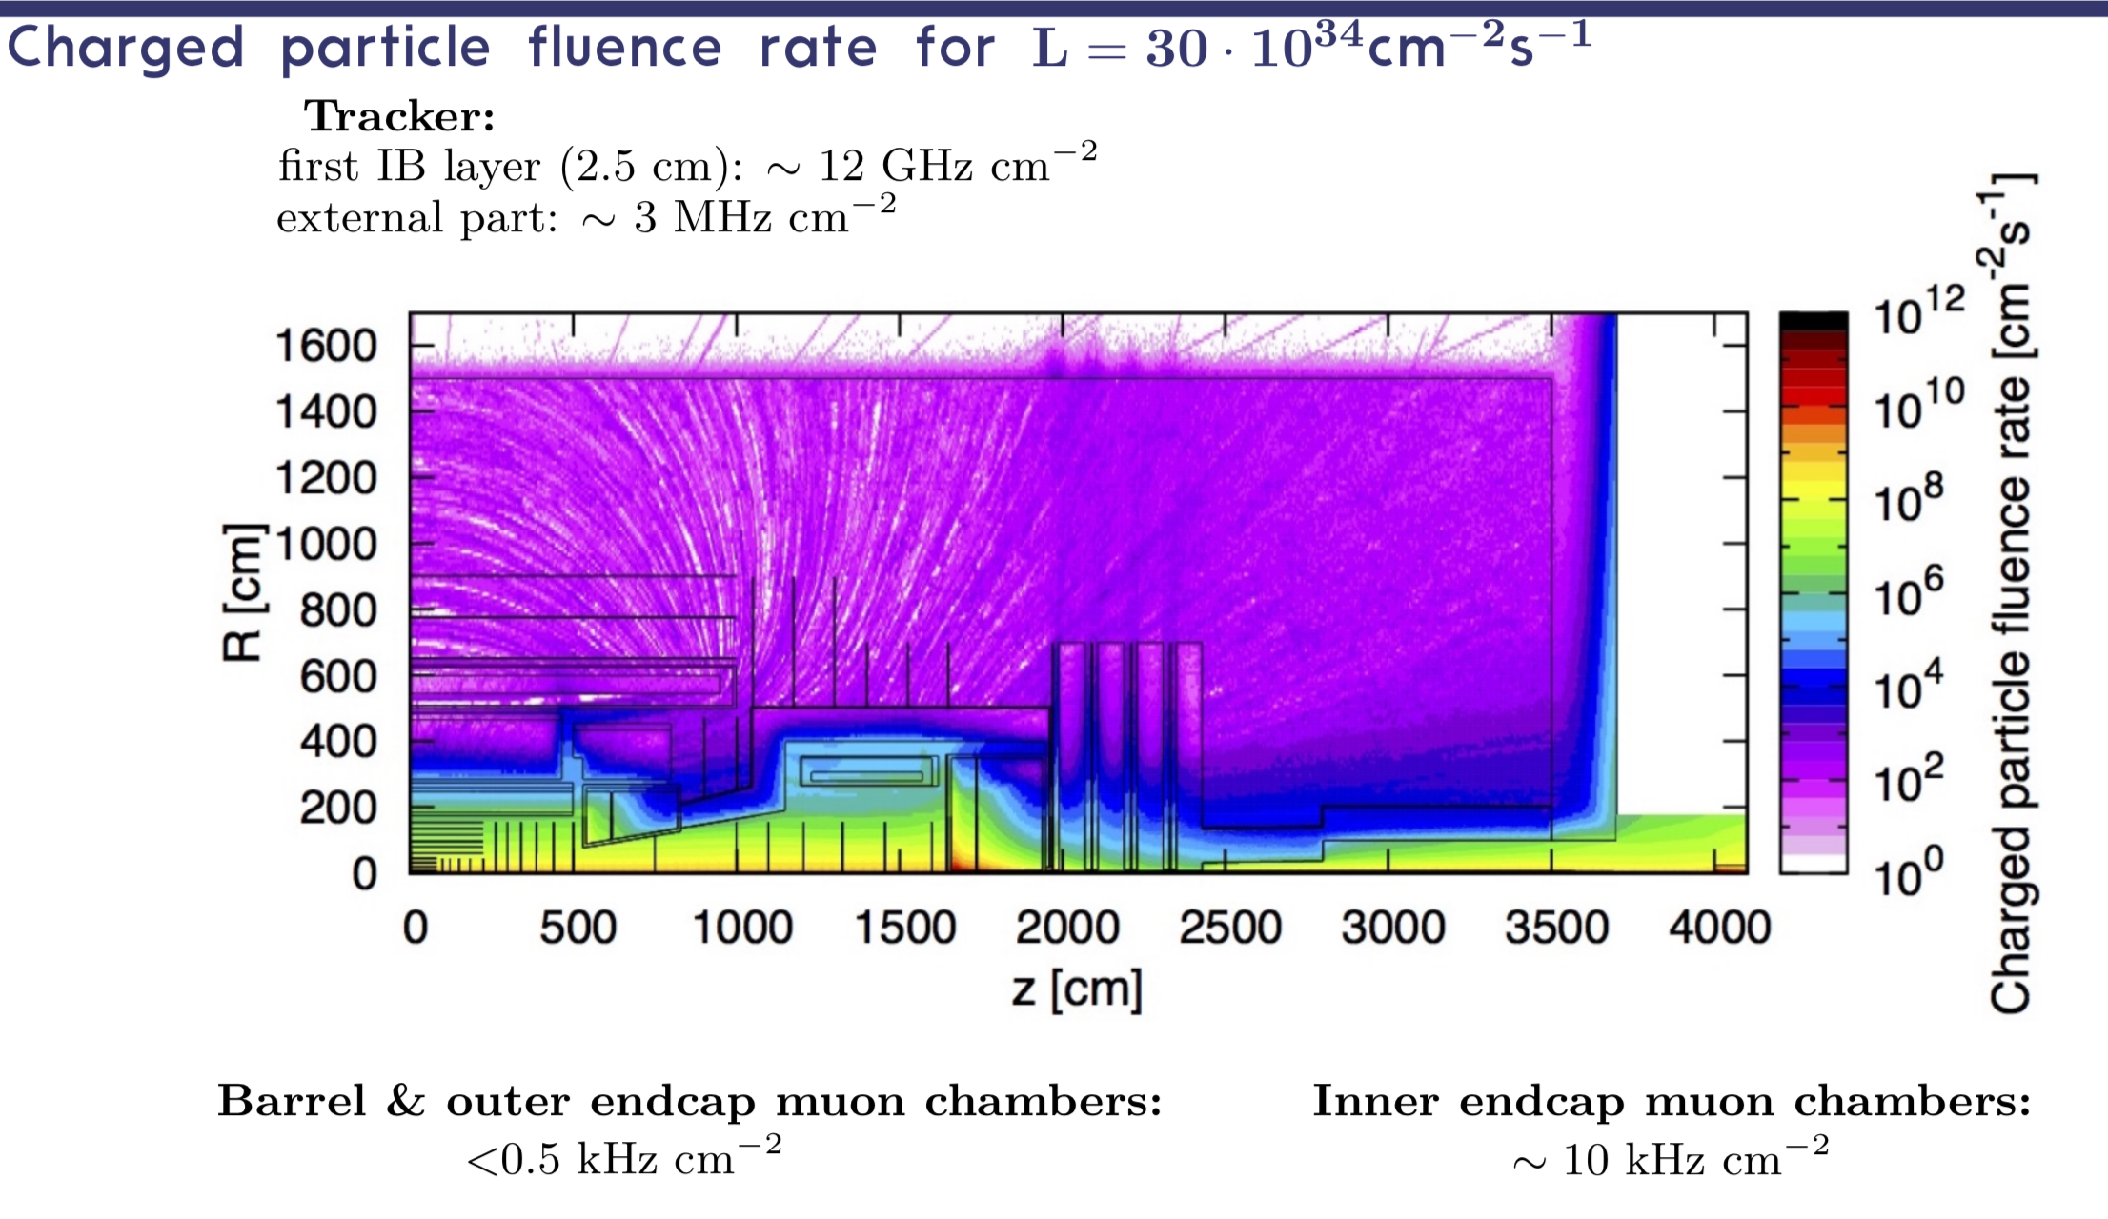
FCC_hh

