Slide 1
Combined function magnet modeling

Slide 2
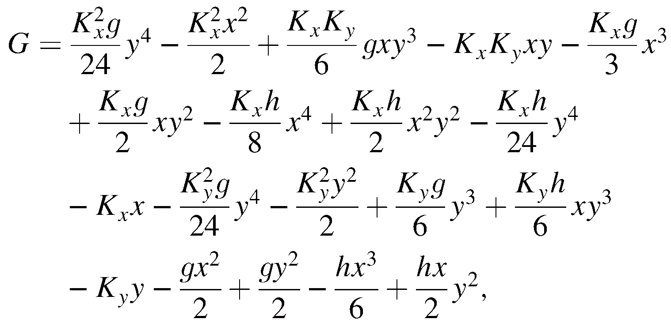
Malte’s Publication 1 of 4 PRSTAB 19, 054002 (2016) Potential G
Included fields up to sextupoles “h” and used an expansion of up to total order 4. In the implementation we have treated K_{x} and K_{y} separated and ignored sextupoles/

Slide 3
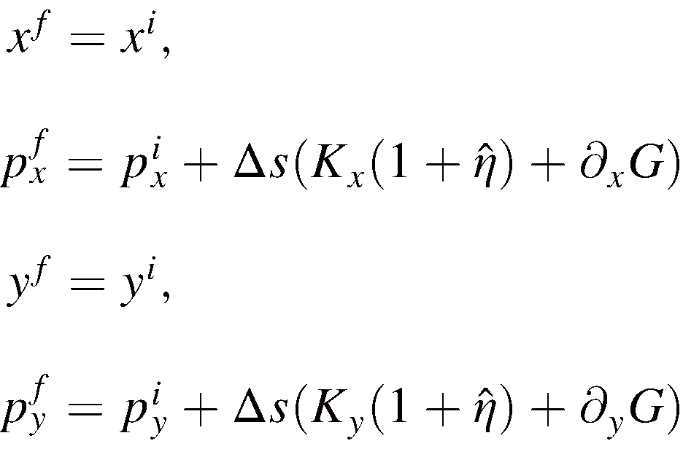
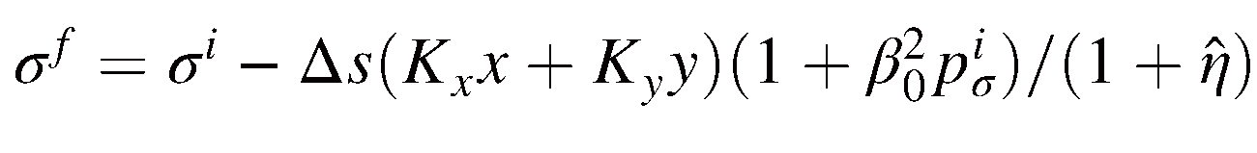
Malte’s Publication 2 of 4
PRSTAB 19, 054002 (2016)
Symplectic Map EQ. 38

Slide 4
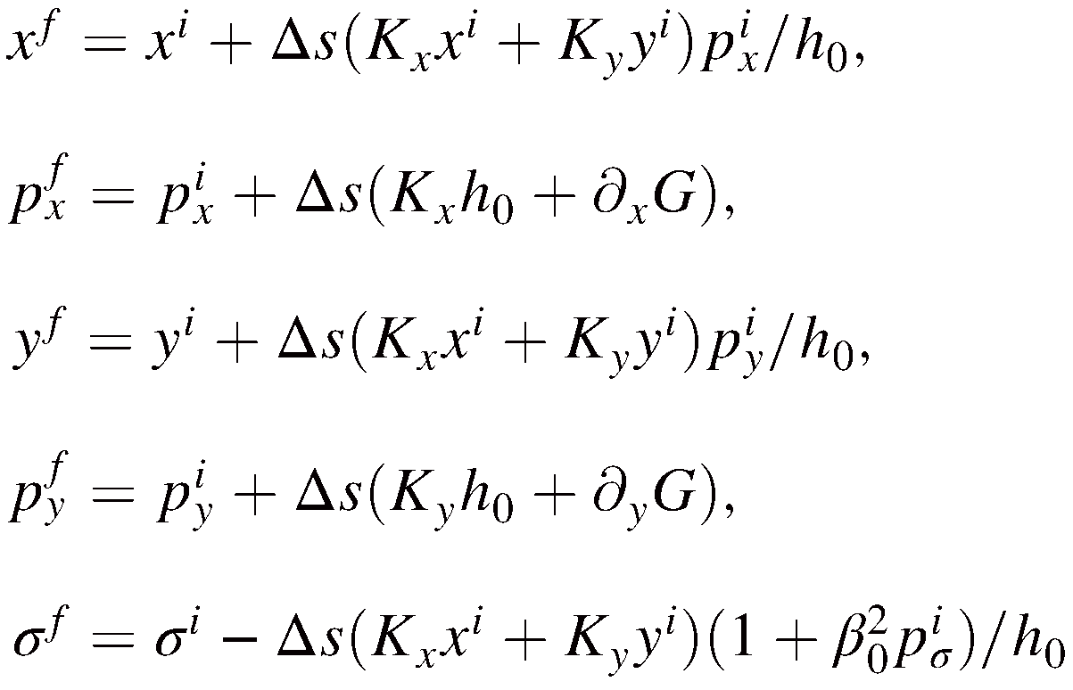
Malte’s Publication 3 of 4
PRSTAB 19, 054002 (2016)
Drift-Kick Map EQ. 39

Slide 5
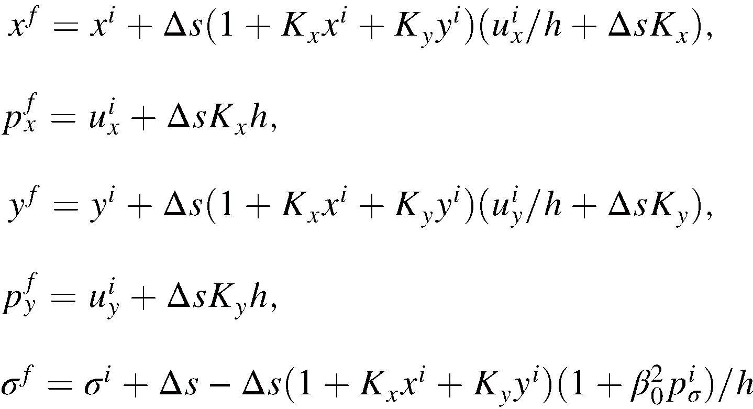
Malte’s Publication 4 of 4
PRSTAB 19, 054002 (2016)
Slice Map EQ. 34

Slide 6
Interlude: RE/TE versus DA Maps
Despite decade-long developments (early ‘80s) and since ~2001 even at CERN, with the explicit effort to construct PTC (Forest et al.) DA Maps and NormalForm techniques have not truly entered our culture.
In desperate need to properly implement Malte’s formalism into SixTrack, I have made a first attempt to turn RE & TE, i.e. first and second terms, into the equivalent DA Map. Mind you the substantial advantage to get at the MAD-X RE & TE terms automatically, by just properly defining the equations of motion!
This allows to either compare each term in my case at the location of a single CFM or to compare directly either one-turn DA Mapd by getting at the chromaticity using NormalForm.
This was very useful because MAD-X and SixTrack differ in their conventions and since there are: signs, factors and choices of canonical coordinates that this is far from trivial to get it right! I could get it clarified in the present state.
I strongly suggest that we create a small MAD-X module that produces DA Maps as a benchmarking tool. Mine has only been a first start.

Slide 7
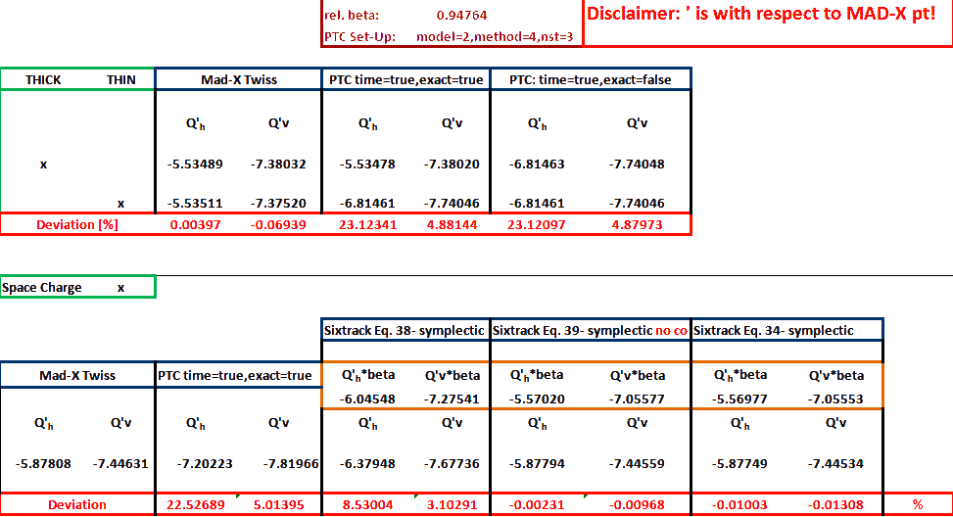
Simulation Results for the PS

Slide 8
Implementation into SixTrack 1 of 3
Eq. 38
! M. Titze, PRSTAB 19, 054002 (2016), EQ. 38
!FOX CRKVE=XL ;
!FOX CIKVE=ZL ;
!FOX YV1J=BBIV(2,I)*DKI(IX,1)/DKI(IX,3)*(HALF*ZL*ZL-XL*XL)*C1M3-
!FOX DKI(IX,1)*DPDA*C1E3DKI(IX,1)*DKI(IX,1)/DKI(IX,3)*XL ;
!FOX YV2J=-BBIV(2,I)*DKI(IX,1)/DKI(IX,3)*(C1M6*DKI(IX,1)/DKI(IX,3)*ZL*ZL*ZL/SIX-XL*ZL*C1M3) ;
! M. Titze, PRSTAB 19, 054002 (2016), EQ. 38
!FOX SIGMDA=SIGMDA+DKI(IX,1)*XL*(ONE+(EJ1-E0)/E0)/(ONE+DPDA) ;

Slide 9
Implementation into SixTrack 2 of 3
Eq. 39
! M. Titze, PRSTAB 19, 054002 (2016), EQ. 39
!FOX CRKVE=XL ;
!FOX CIKVE=ZL ;
!FOX TEMPI(2) = Y(1)*(ONE+DPDA) ;
!FOX TEMPI(4) = Y(2)*(ONE+DPDA) ;
!FOX H0=SQRT((ONE+DPDA)*(ONE+DPDA)-TEMPI(2)*TEMPI(2)*C1M6-TEMPI(4)*TEMPI(4)*C1M6) ;
!FOX CRKVE=CRKVE-DKI(IX,1)*XL*TEMPI(2)*C1M3/H0 ;
!FOX CIKVE=CIKVE-DKI(IX,1)*XL*TEMPI(4)*C1M3/H0 ;
!FOX YV1J=BBIV(2,I)*DKI(IX,1)/DKI(IX,3)*(HALF*ZL*ZL-XL*XL)*C1M3+DKI(IX,1)*(ONE-H0)*C1E3-
!FOX DKI(IX,1)*DKI(IX,1)/DKI(IX,3)*XL ;
!FOX YV2J=-BBIV(2,I)*DKI(IX,1)/DKI(IX,3)*(C1M6*DKI(IX,1)/DKI(IX,3)*ZL*ZL*ZL/SIX-XL*ZL*C1M3) ;
!FOX XL=CRKVE ;
!FOX ZL=CIKVE ;
! M. Titze, PRSTAB 19, 054002 (2016), EQ. 39
!FOX SIGMDA=SIGMDA+DKI(IX,1)*XL*(ONE+(EJ1-E0)/E0)/H0 ;

Slide 10
Implementation into SixTrack 3a of 3
Eq. 34
! M. Titze, PRSTAB 19, 054002 (2016), EQ. 34
!FOX CRKVE=XL ;
!FOX CIKVE=ZL ;
!FOX TEMPI(2) = Y(1)*(ONE+DPDA) ;
!FOX TEMPI(4) = Y(2)*(ONE+DPDA) ;
!FOX PZ=SQRT((ONE+DPDA)*(ONE+DPDA)*C1E6-(TEMPI(2)*TEMPI(2)+TEMPI(4)*TEMPI(4)))*C1M3 ;
!FOX CRKVE=CRKVE-HALF*DKI(IX,3)*TEMPI(2)/PZ ;
!FOX CIKVE=CIKVE-HALF*DKI(IX,3)*TEMPI(4)/PZ ;
if(idp.eq.1.and.iabs(ition).eq.1) then
!FOX SIGMDA=SIGMDA-HALF*DKI(IX,3)*(ONE-RV/PZ*(ONE+DPDA))*C1E3 ;
endif
!FOX XL=CRKVE ;
!FOX ZL=CIKVE ;
!FOX UX=TEMPI(2)+BBIV(2,I)*XL+BBIV(2,I)*DKI(IX,1)/DKI(IX,3)*(HALF*ZL*ZL-XL*XL)*C1M3+DKI(IX,1)*C1E3-
!FOX DKI(IX,1)*DKI(IX,1)/DKI(IX,3)*XL ;
!FOX UY=TEMPI(4)-BBIV(2,I)*ZL-BBIV(2,I)*DKI(IX,1)/DKI(IX,3)*(C1M6*DKI(IX,1)/DKI(IX,3)*ZL*ZL*ZL/SIX-XL*ZL*C1M3) ;
!FOX XI= -UX*DKI(IX,1)/(ONE+DKI(IX,1)*DKI(IX,1)) ;
!FOX ZETA=(UX*UX+UY*UY-C1E6*(ONE+DPDA)*(ONE+DPDA))/(ONE+DKI(IX,1)*DKI(IX,1)) ;
!FOX HH=-XI+SQRT(XI*XI-ZETA) ;
!FOX CRKVE=CRKVE+(DKI(IX,3)*C1E3-DKI(IX,1)*XL)*(UX/HH-DKI(IX,1)) ;
!FOX CIKVE=CIKVE+(DKI(IX,3)*C1E3-DKI(IX,1)*XL)*UY/HH ;
!FOX YV1J=UX-TEMPI(2)-DKI(IX,1)*HH ;
!FOX YV2J=UY-TEMPI(4) ;
if(idp.eq.1.and.iabs(ition).eq.1) then
!FOX SIGMDA=SIGMDA+DKI(IX,3)*C1E3-DKI(IX,3)*(C1E3-DKI(IX,1)/DKI(IX,3)*XL)*(ONE+(EJ1-E0)/E0)/HH*C1E3 ;
endif

Slide 11
Implementation into SixTrack 3b of 3
Eq. 34
!FOX TEMPI(2) = Y(1)*(ONE+DPDA)+YV1J ;
!FOX TEMPI(4) = Y(2)*(ONE+DPDA)+YV2J ;
!FOX PZ=SQRT((ONE+DPDA)*(ONE+DPDA)*C1E6-(TEMPI(2)*TEMPI(2)+TEMPI(4)*TEMPI(4)))*C1M3 ;
!FOX CRKVE=CRKVE-HALF*DKI(IX,3)*TEMPI(2)/PZ ;
!FOX CIKVE=CIKVE-HALF*DKI(IX,3)*TEMPI(4)/PZ ;
if(idp.eq.1.and.iabs(ition).eq.1) then
!FOX SIGMDA=SIGMDA-HALF*DKI(IX,3)*(ONE-RV/PZ*(ONE+DPDA))*C1E3 ;
endif
!FOX XL=CRKVE ;
!FOX ZL=CIKVE ;

Slide 12
Todo List
I have also done the purely vertical dipole “Kx=0 & Ky != 0” should be benchmarked at some point
One could also add the CFM including a sextupole component
Creating DA Maps from co, RE & TE, i.e. 0th, 1st and 2nd terms as a benchmarking tool
More implementations are sorely needed!!!
  Tracking in SixTrack
  MAD-X needs to be moved to Eq. 34 both in Twiss and Tracking!!! Presently, it is not generally symplectic!
  Unfortunately, also true for PTC, where thin CFM are simply ignored!

