Slide 1
Relationships between User Groups, Department & Stores
Lars Jensen, Bruno Vercoutter EN/IM

Slide 2
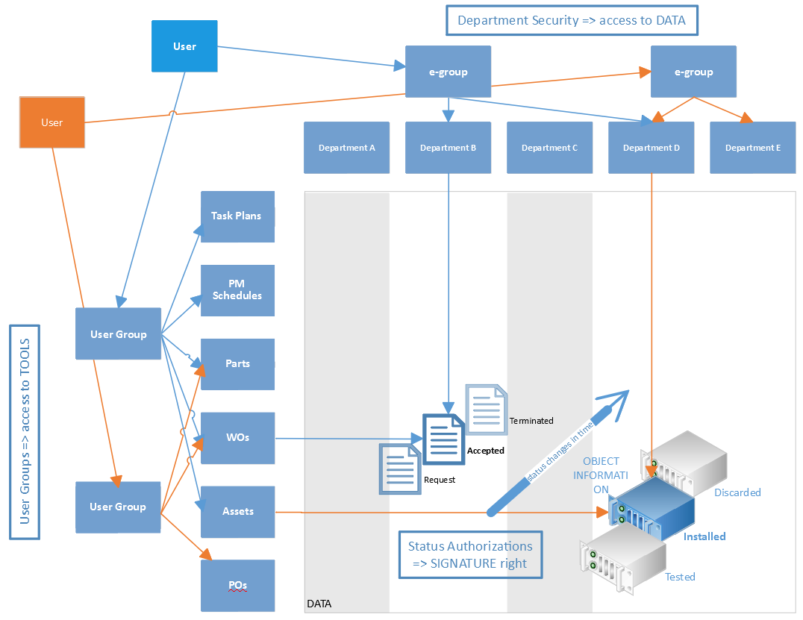
Access rights summary

Slide 3
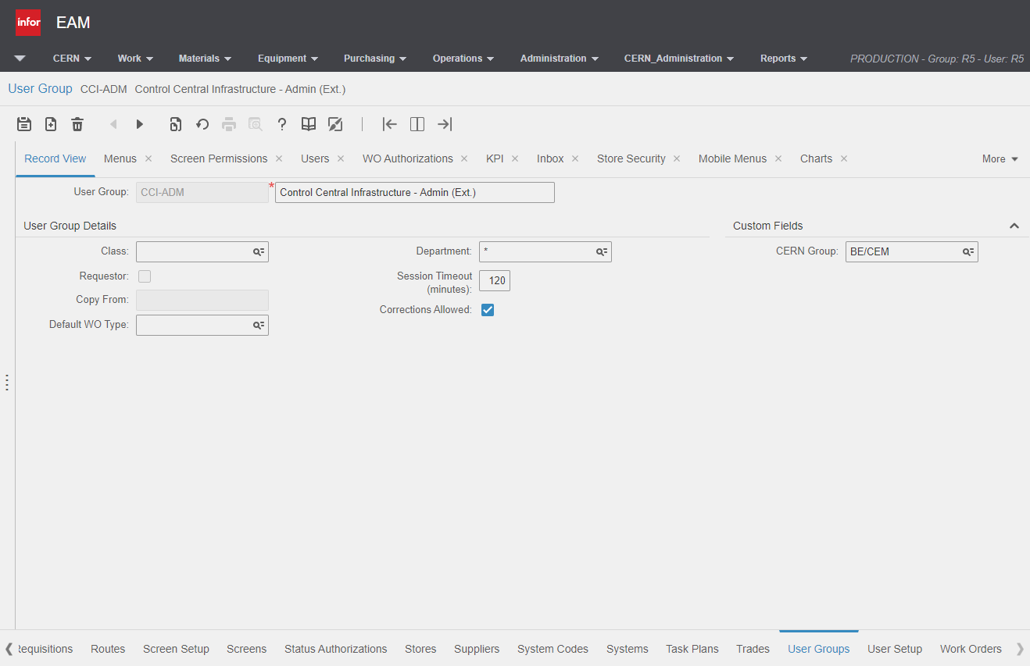
User Group
* Means access to
several departments

Slide 4
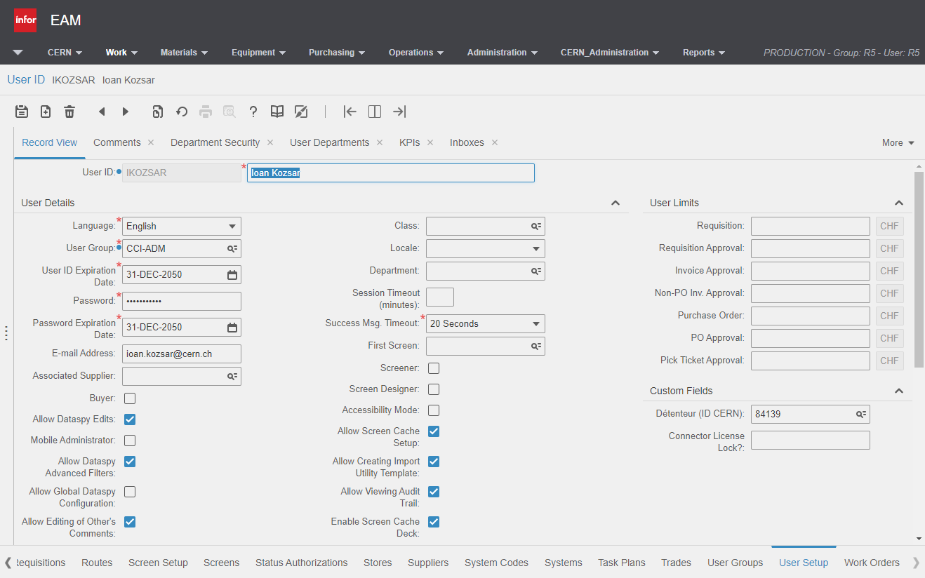
User Setup

Slide 5
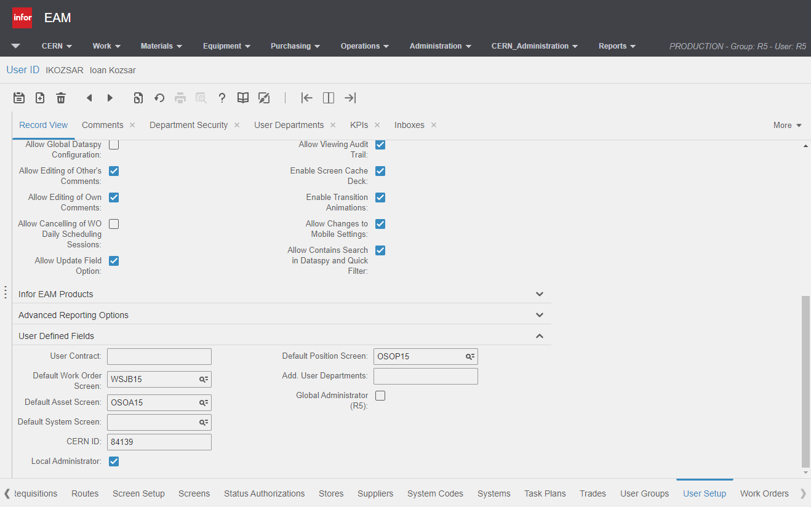
User Setup

Slide 6
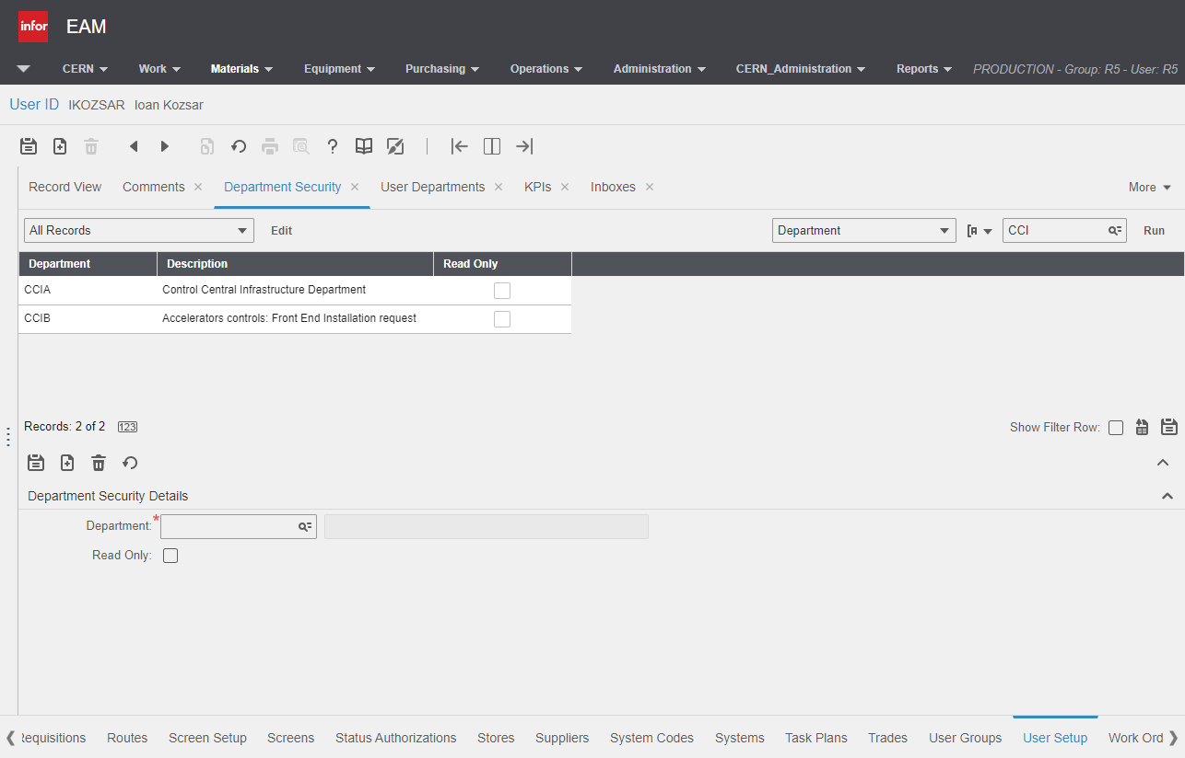
User Setup
Department Security provides access to Data

Slide 7
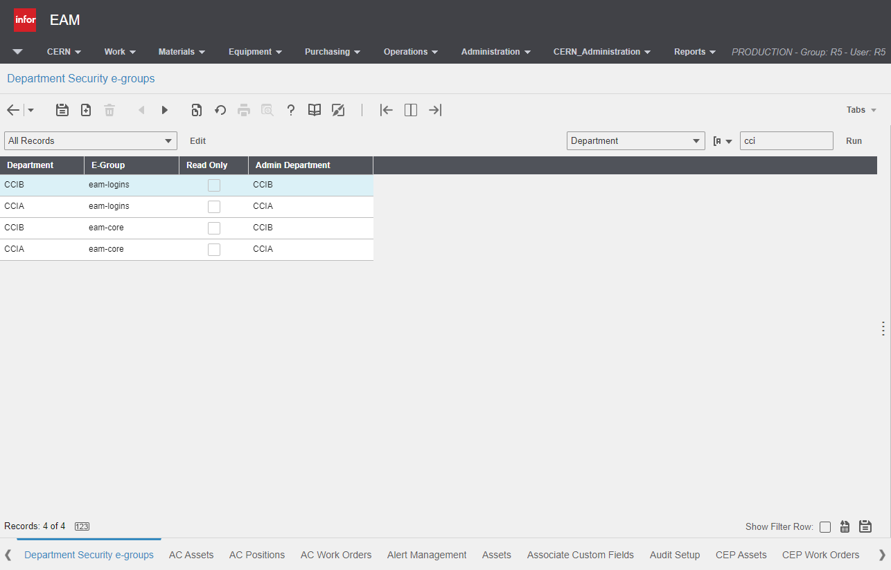
CERN Administration

Slide 8
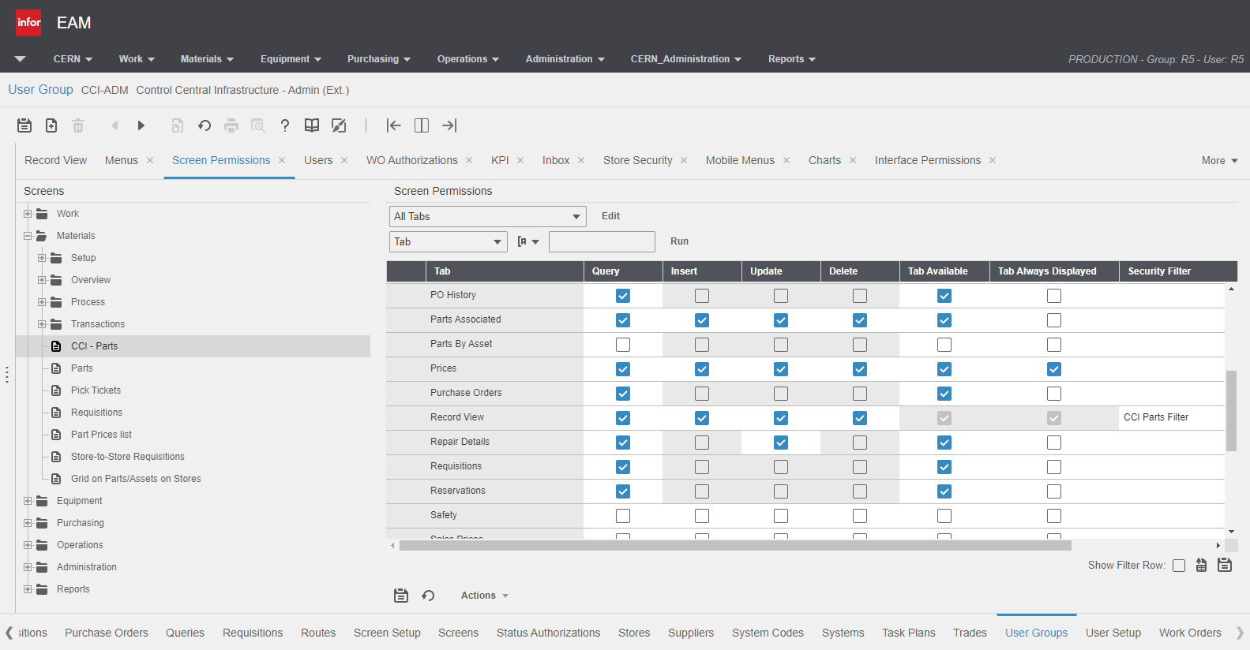
Screen Permission
Permissions
EAM
EAM + EAM Light
Filtering Data

Slide 9
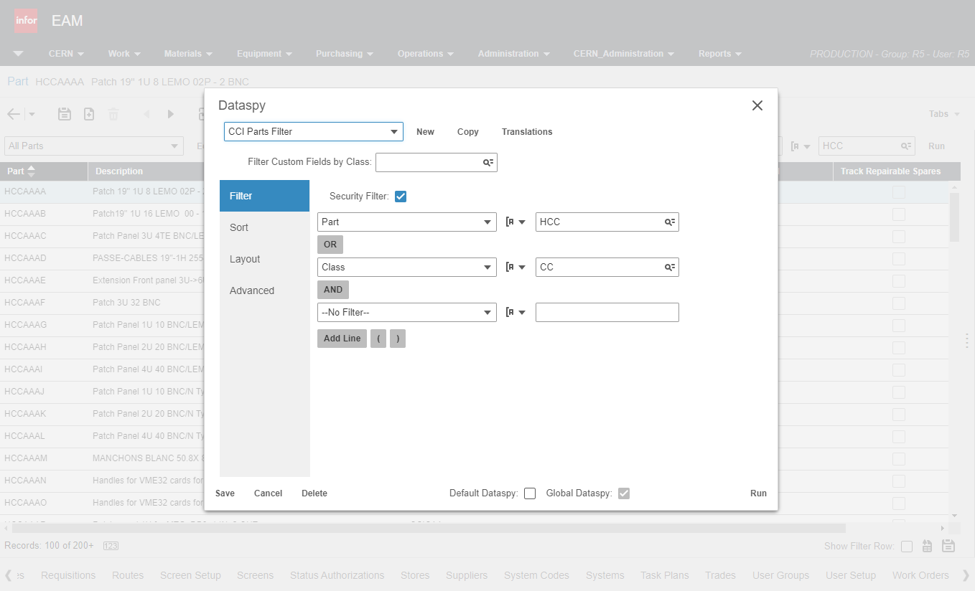
CCI Parts
Security Filter

Slide 10
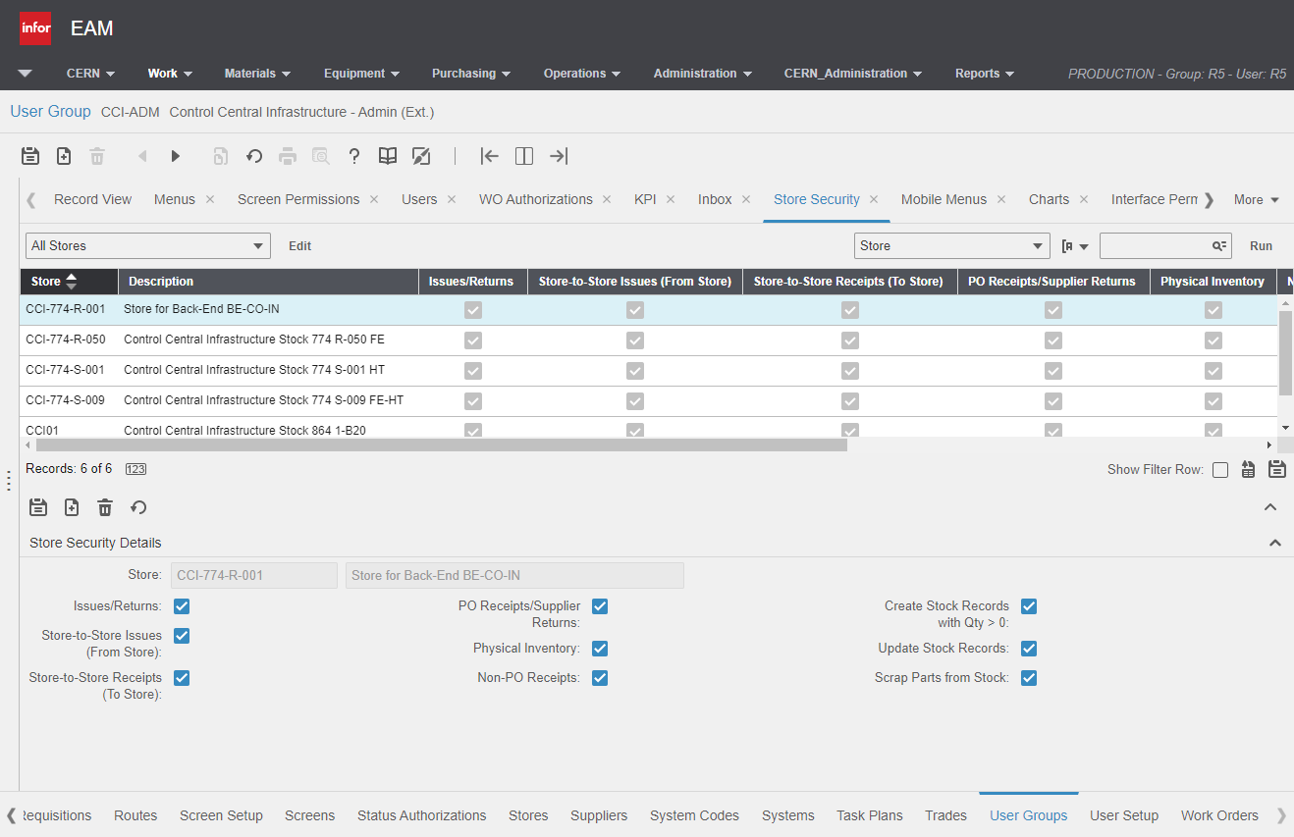
Store
Security

Slide 11
Thank you for your attention!

