Slide 1
TD18 post-mortem SEM observation: Update
Markus Aicheler
10. Nov. 2010

Slide 2
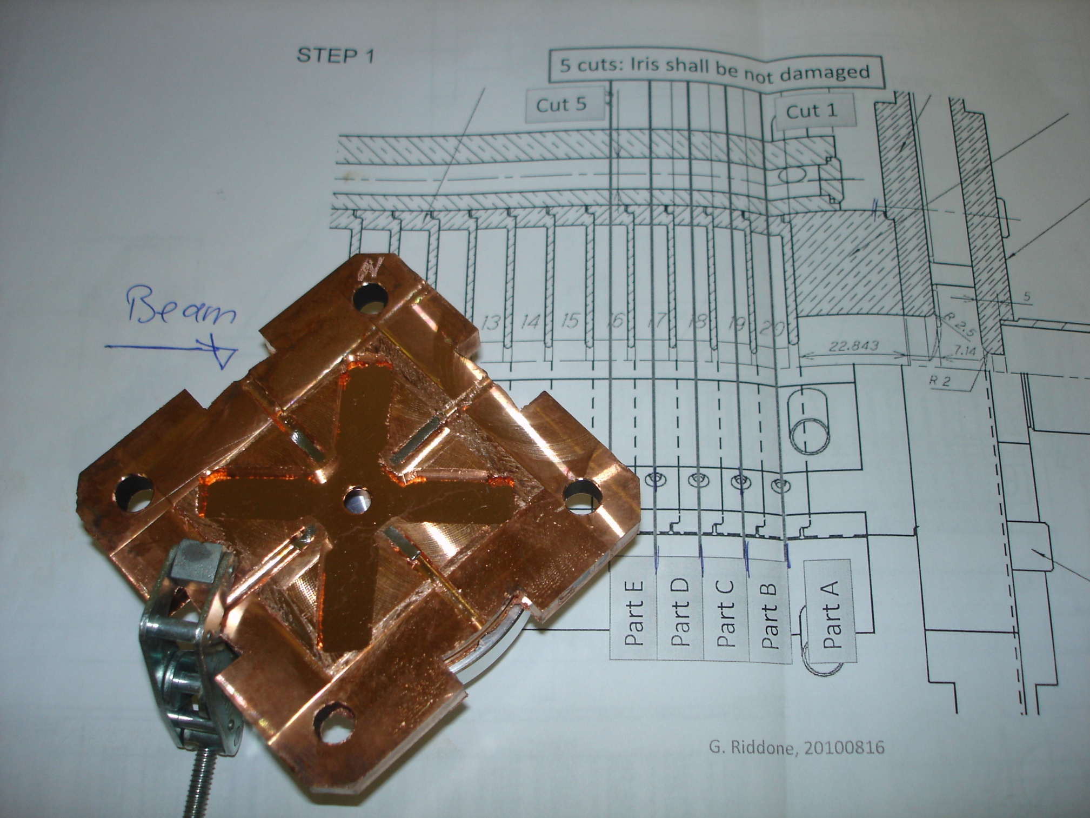
North sign!

Slide 3
Contents:
Joining gap everywhere?
“To break down and not to break down”
Breakdown distributions between cells
Breakdown distributions in cell
What comes next

Slide 4
Joining gap everywhere?

Slide 6
Only accumulation, no pit below
Molten accumulation with molten pit below

Slide 7
Gap is everywhere along the waveguides
Accumulation of chips visible in gaps?

Slide 8
“To break down and not to break down”

Slide 10
Fatigued surface
Splashes on fatigued surface
=> No breakdown!

Slide 11
Breakdown distributions between cells

Slide 12
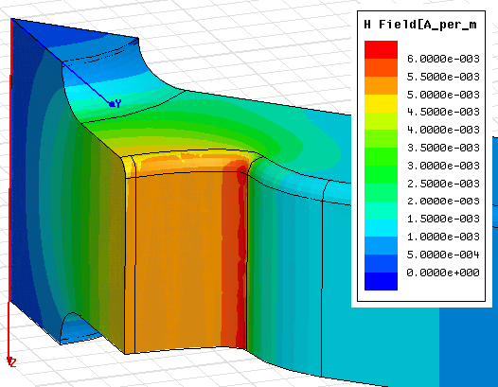
REMEMBER:
Facts for part C down-stream side:
6 of 8 highest magnetic field regions exhibit this “B-Field arc”
numerous breakdown sites are located around this feature expanding in direction to the waveguide entry
wall
waveguide
waveguide
H_{s}/E_{a}
iris

Slide 13
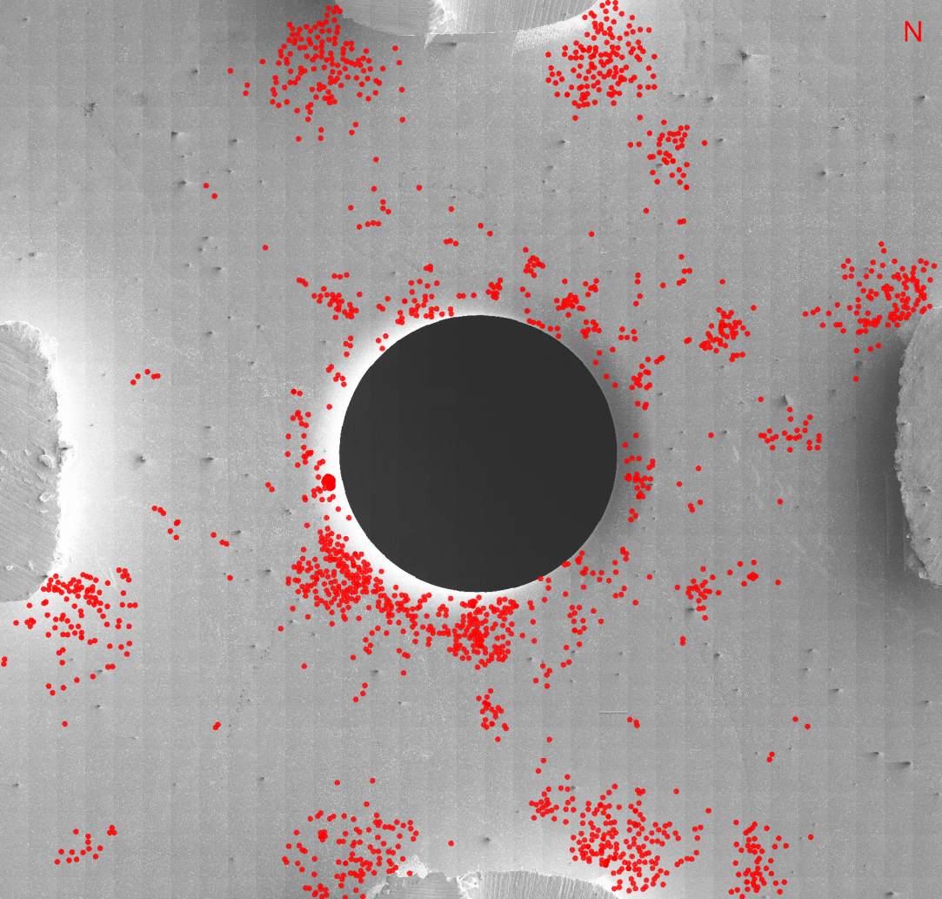
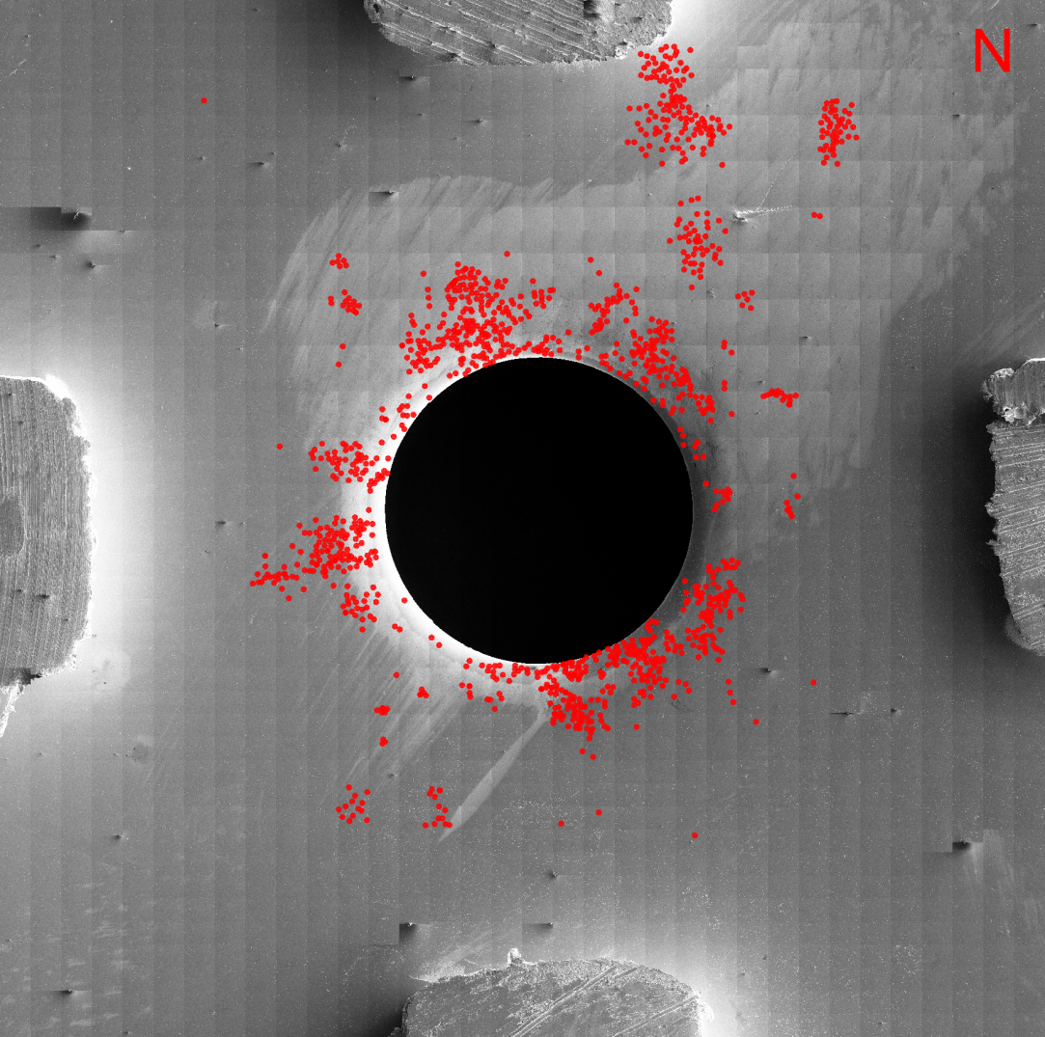
Part D – down stream
(Cell 18 – up stream)
Part E – down stream
(Cell 17 – up stream)
?
6 out of 8 sites with B-Arcs
Excellent link between B-Arc and secondary craters
No symmetry in BD distribution detectable
3 out of 8 sites with B-Arc initiations!
Poor link between B-Arc and secondary craters
No symmetry in BD distribution detectable

Slide 14
Part D – down stream
(Cell 18 – up stream)
Part E – down stream
(Cell 17 – up stream)

Slide 15
Part D – down stream
(Cell 18 – up stream)
Part E – down stream
(Cell 17 – up stream)

Slide 16
Breakdown distributions in cell

Slide 17
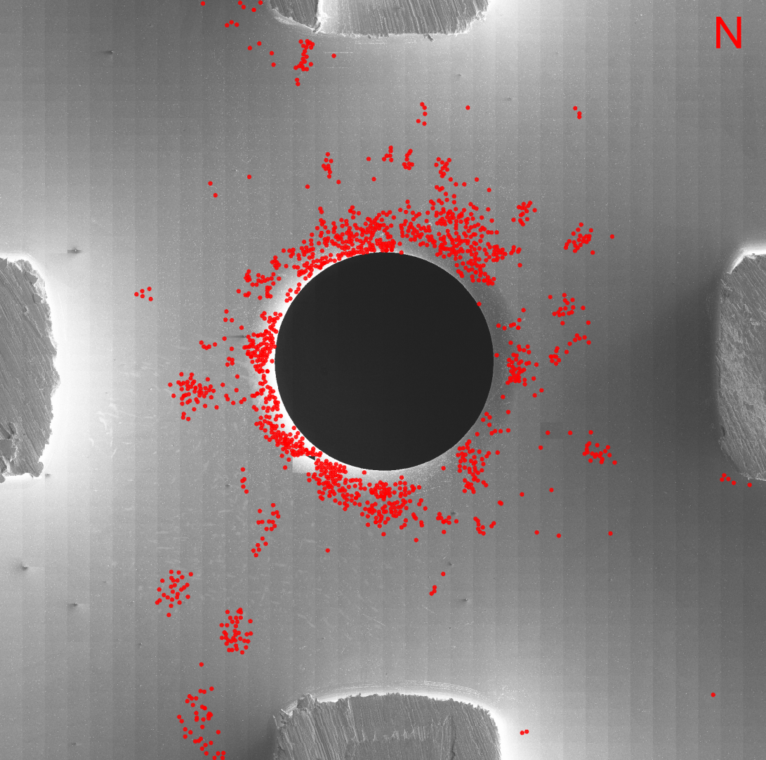
Part E – down stream
(Cell 17 – up stream)
Part D -- up stream
(Cell 17 – down stream)
No good correlation!
Orientation correct?

Slide 18
What comes next:
Breakdown distribution on iris
Cross section through gap and B-Arc in order to assess where the gab is coming from
Breakdown distribution of Part C in order to compare both cell walls of cell 18
Strange waveguide features…

