Slide 1
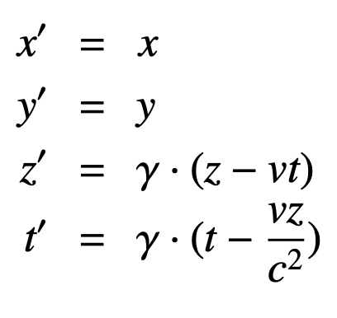
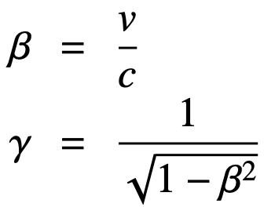
Special theory of Relativity: Lorentz Transformation
Fixed Frame
Moving Frame
y
y’
x
x’
v
z
z’
Transformation with velocity, v, along the z-axis.
In moving frame an object has always the same length (it is invariant !)
From fixed frame moving objects appear contracted by a factor γ (Lorentz contraction)
L’ = γ L
L = L’/γ
Pb ion
Moving with velocity, v
Pb ion
at rest
For v = 0.999999991 c
γ = 7453.
Radius of Pb ion: L
(~ 7fm)
Length (radius) along z-axis appear contracted by 7453 times.
Only the longitudinal direction gets contracted – not the transverse ones.

