Slide 1
FCC-ee arc quadrupoles and sextupoles
M. Koratzinos
FCC-ee Optics Design Meeting
5/2/2021

Slide 2
Contents
Review of situation of CDR
Can we do something more sexy and cheaper?
Many thanks to Katsunobu Oide and Glyn Kirby

Slide 3
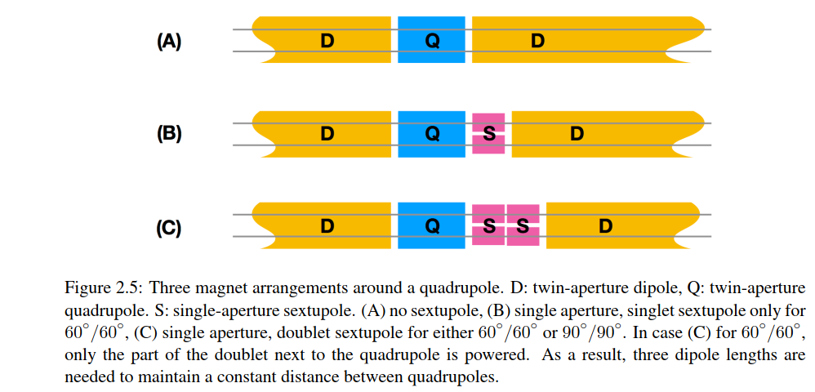
The optics cell
Three families of dipoles
If we can embed the sextupoles in the quads, only a single dipole size will be needed

Slide 4
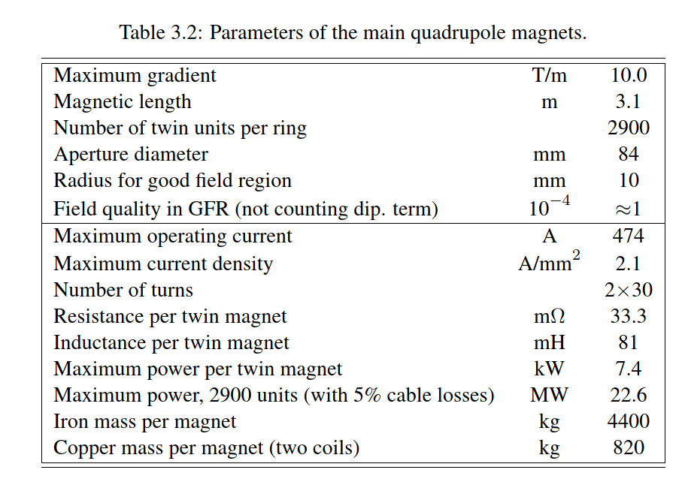
Arc quads
3.1 m long (cannot be shorter due to SR)
2900 double aperture units
Power consumption 23MW!

Slide 5
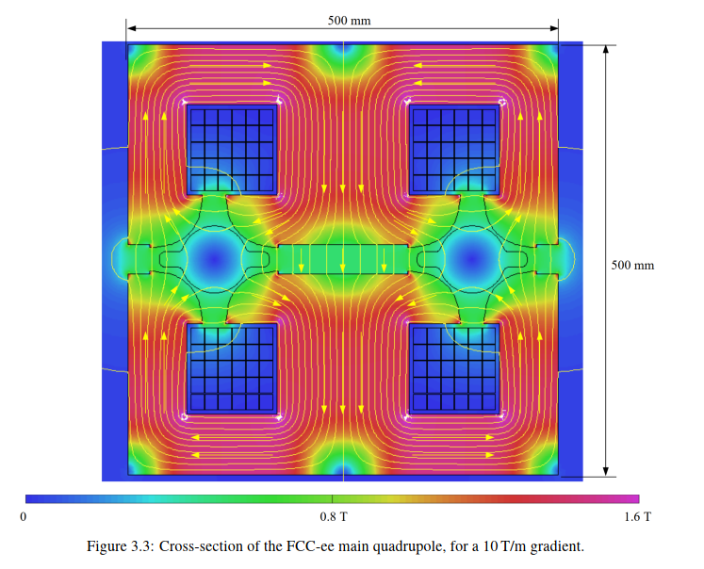
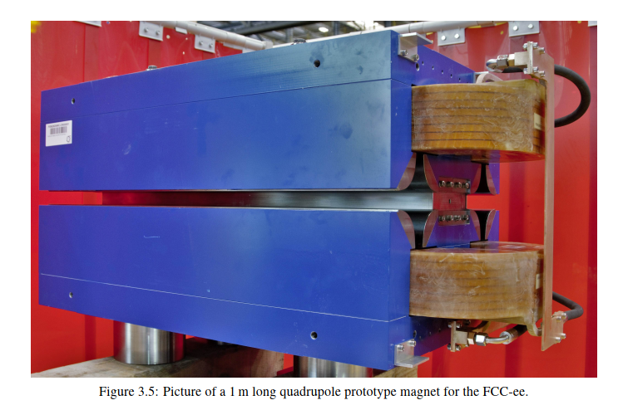
Economic design with shared poles

Slide 6
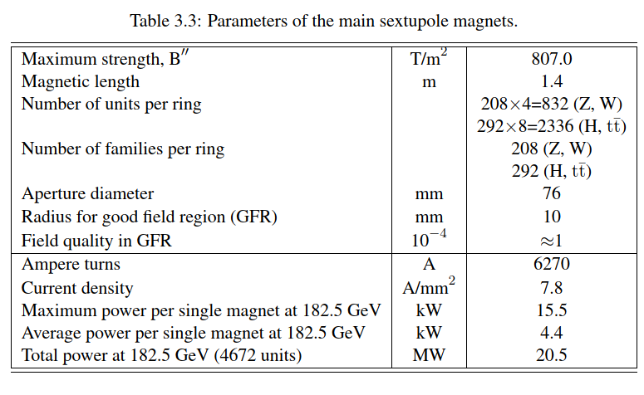
Arc sextupoles
(832+2336)*2= 6336 units
Power consumption 20MW

Slide 7
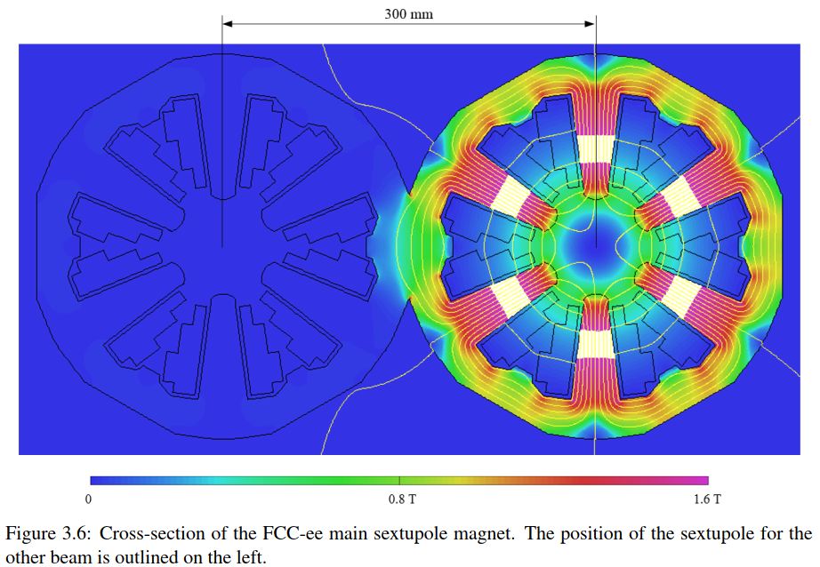
Arc sextupoles
No prototype shown in the CDR. In the text it is mentioned that the maximum current will be 200A, and that we need 6270Ampere turns.
From this I deduce that we need ~30 turns

Slide 8
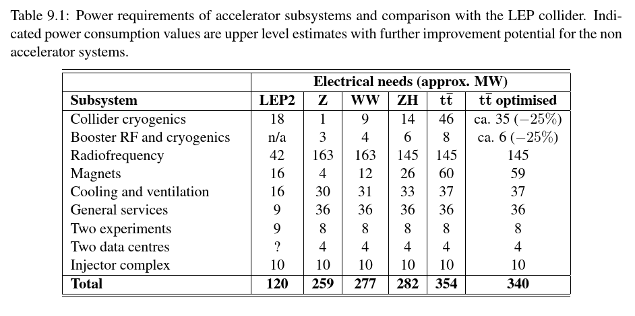
Power consumption
Discussed here
Magnet power consumption is ~40% of the power dissipated in the tunnel

Slide 9
A crazy idea
What if: we make quads and sextupoles superconducting
Make them CCTs
We can embed sextupoles and quads in the same volume
If we use HTS, we can operate at liquid nitrogen temperatures
Advantages:
  Power consumption reduced drastically
  Better filling factor
  Cheaper to make (*) yoke shared between quad and sextupole, much lighter
(*) needs to be demonstrated

Slide 10
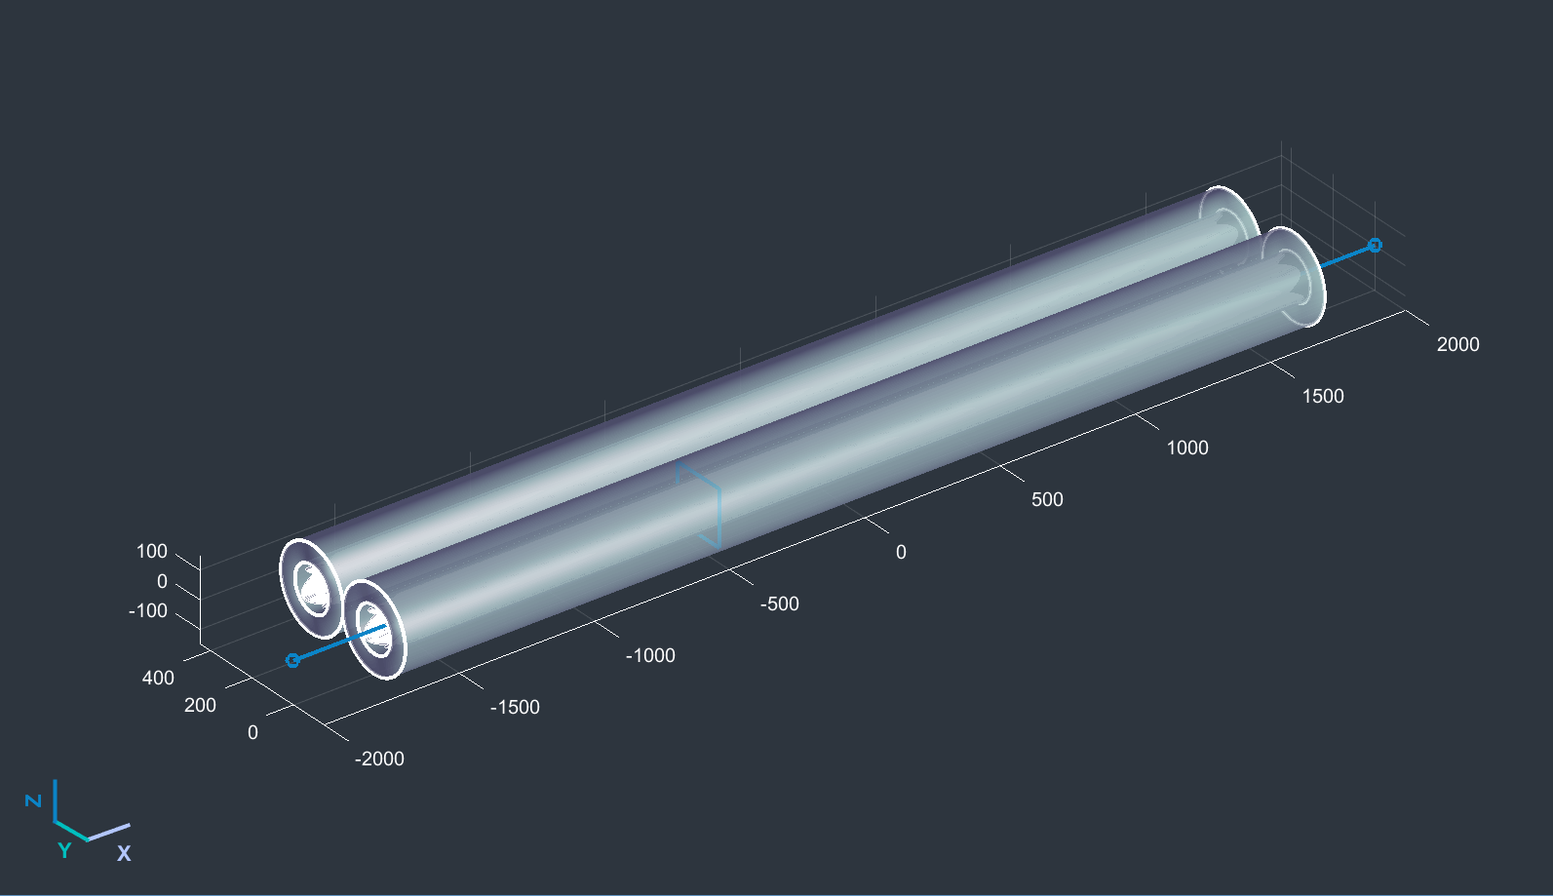
Nested arc quads-sextupoles

Slide 11
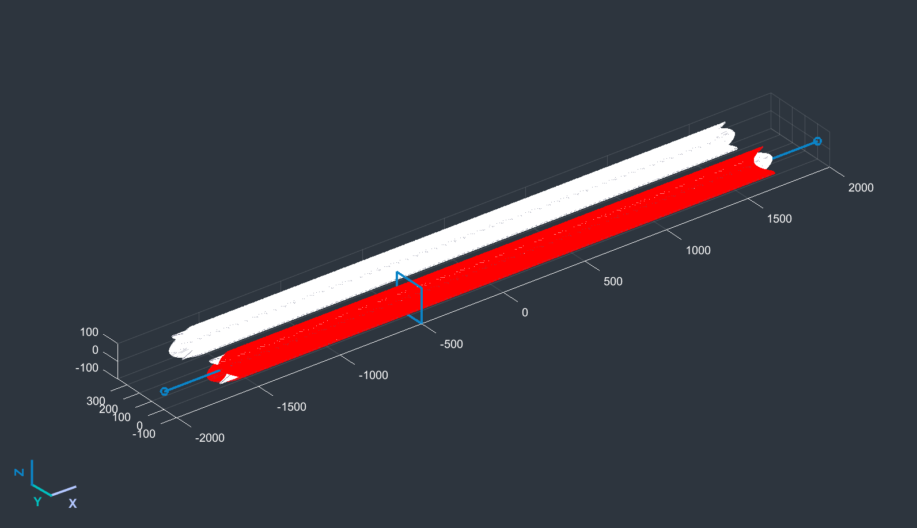
Nested arc quads-sextupoles

Slide 12
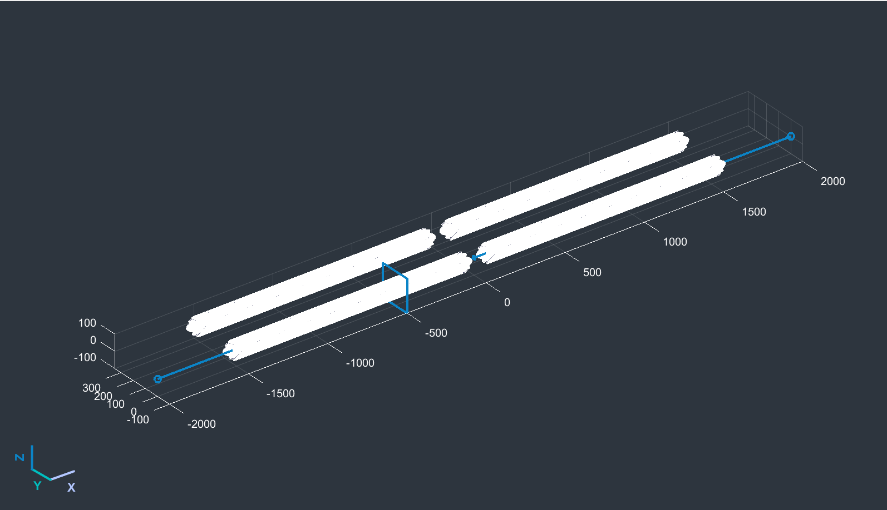
Nested arc quads-sextupoles

Slide 13
Which way nested?
If we move the sextupole inside the quad (inner diameter from 124mm to 84mm), the strength goes up by 100%
If we move the quad outside the sextupole (inner diameter 124mm from 84mm) the strength reduces by 33%
It makes sense to have the sextupole closest to the beam and the quad outside.

Slide 14
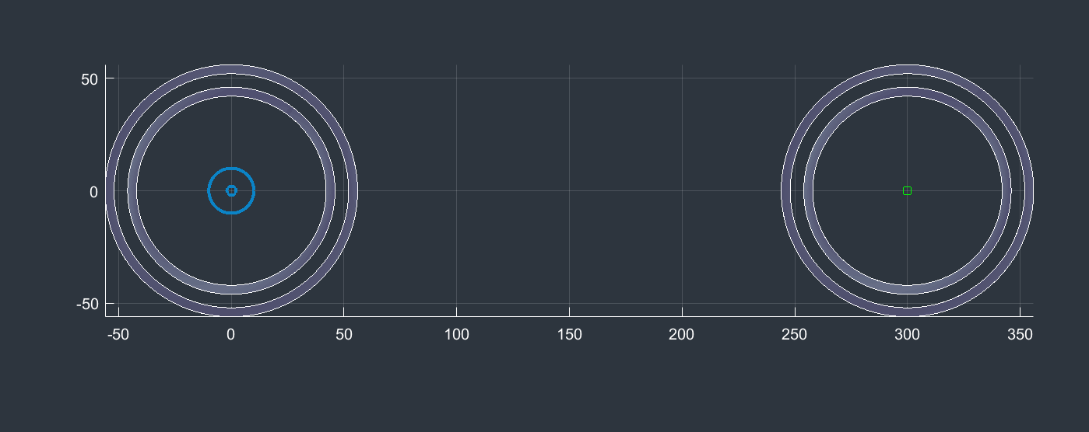
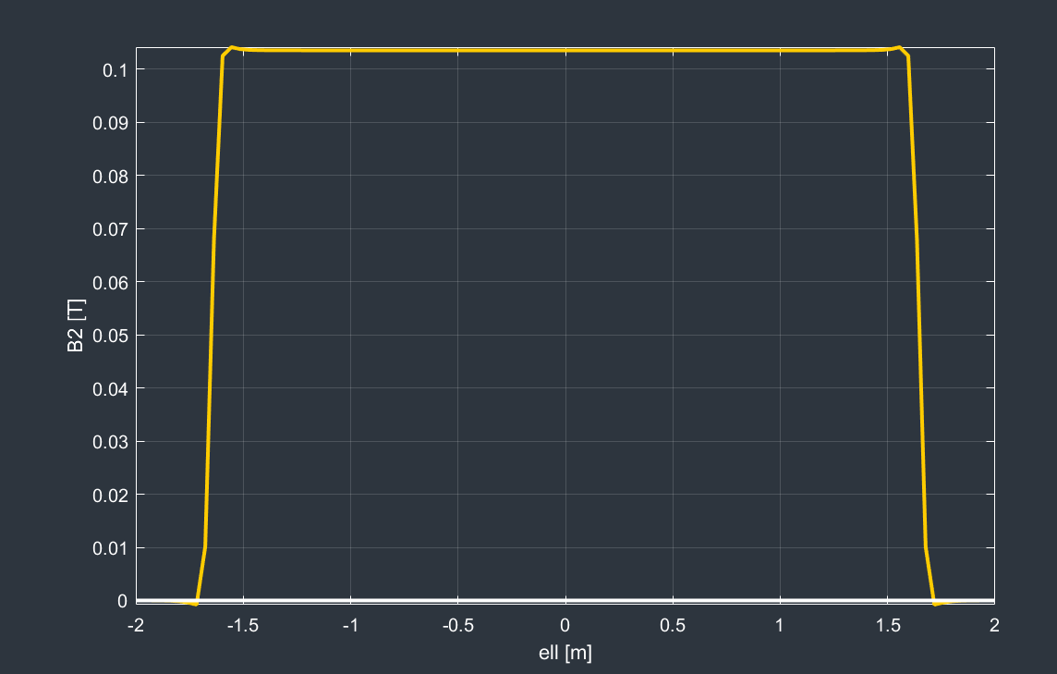
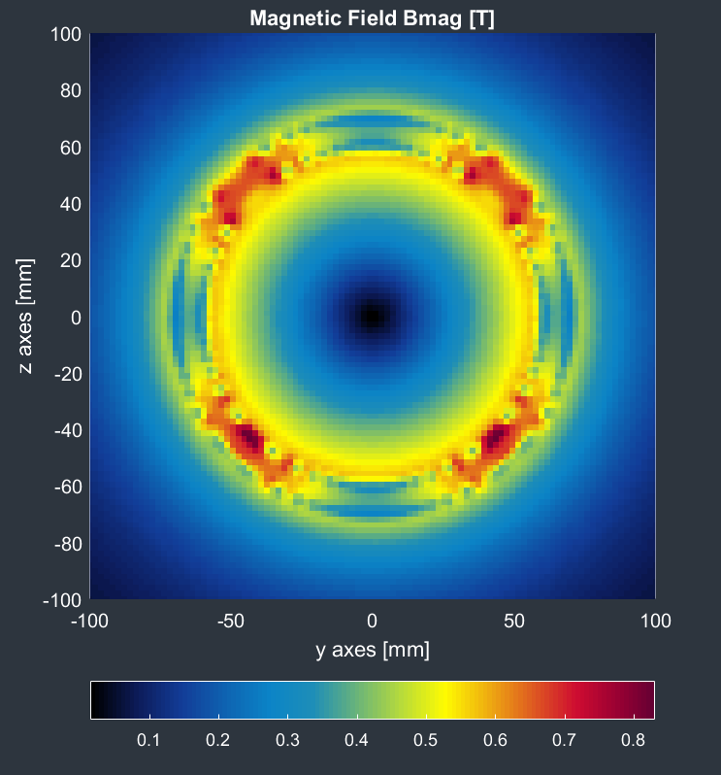
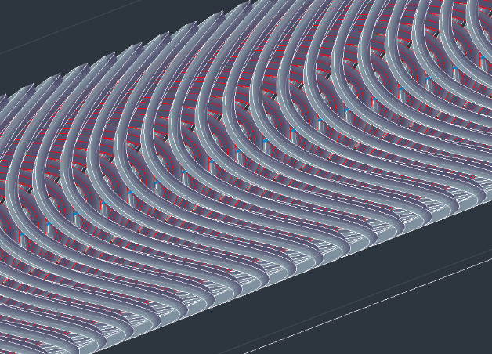
Arc quads
Inner conductor diameter: 96mm
Distance between apertures: 300mm
Field gradient: 10T/m
Conductor xsection 2x5mm
Pitch: 5mm
Conductor length:240+280=520m
Current: 2400A (240A/mm²) no yoke
300mm
B2 field @10mm

Slide 15
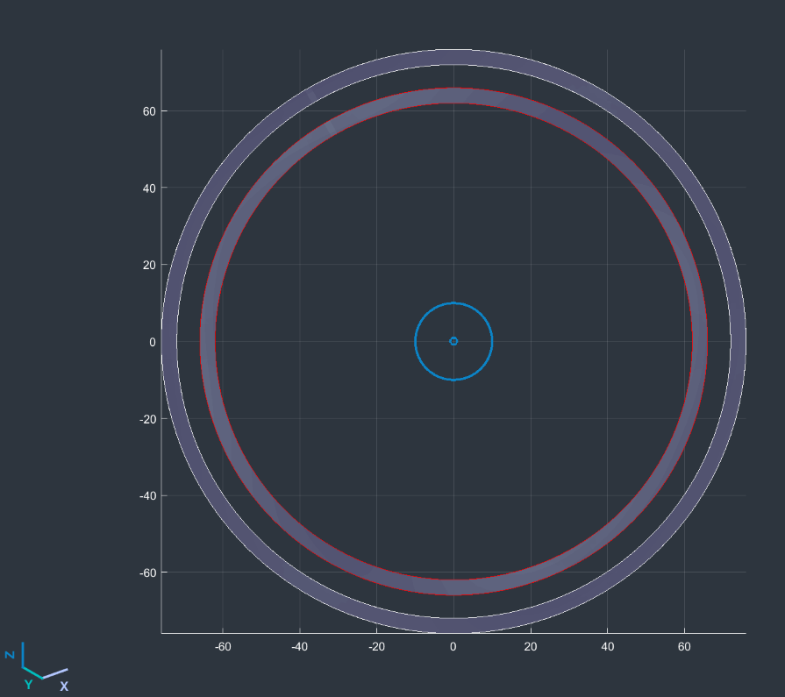
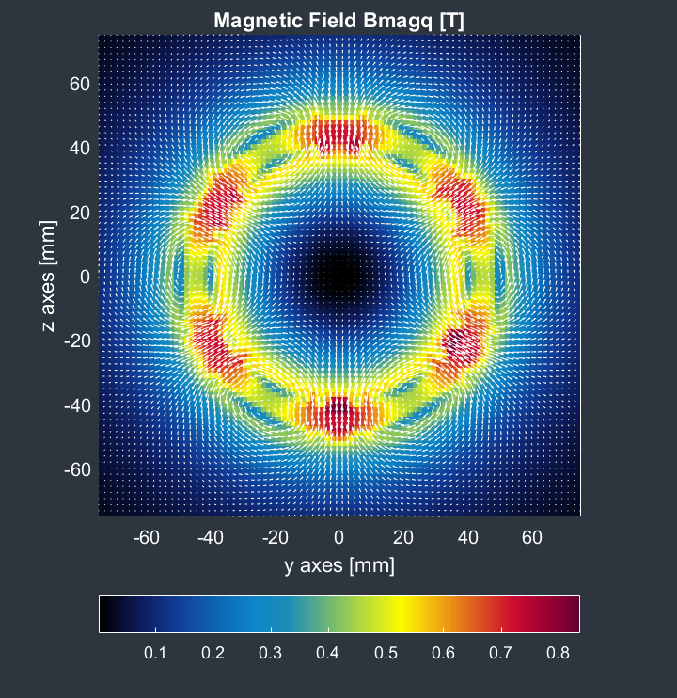
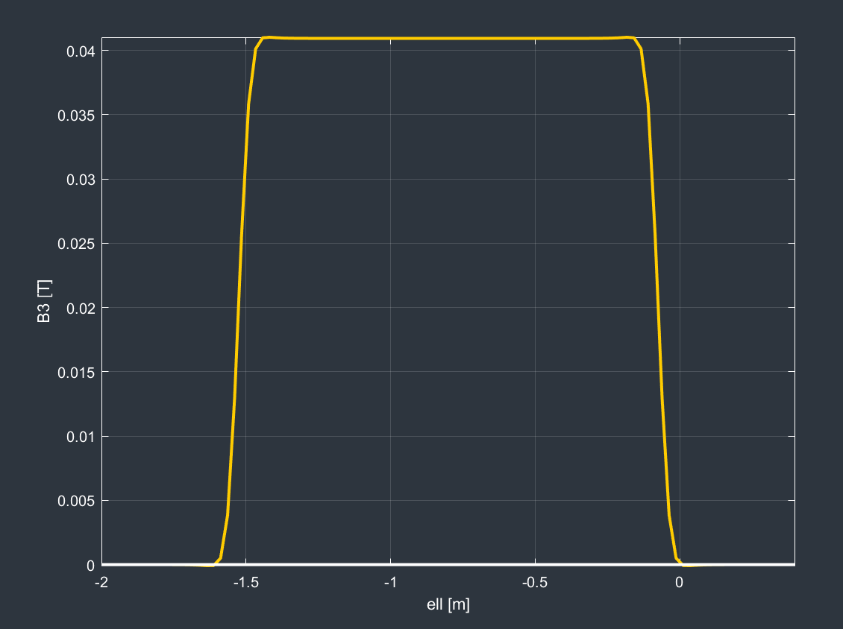
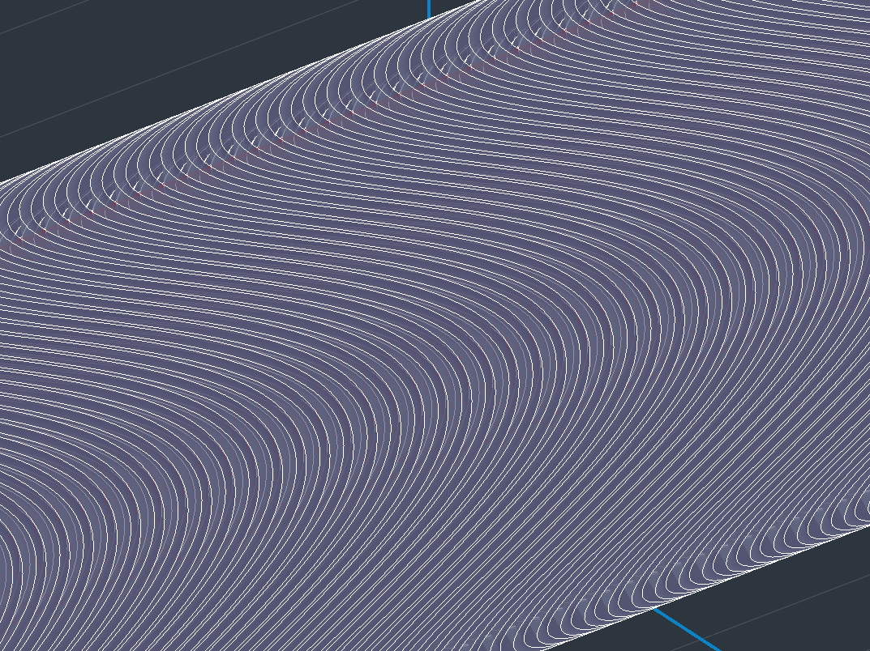
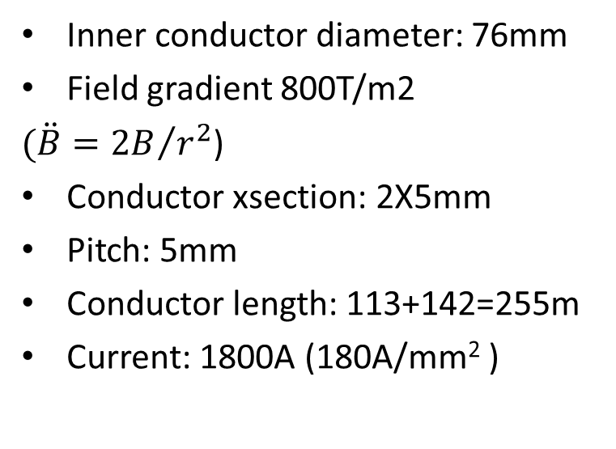
Arc sextupoles
Inner conductor diameter: 76mm
Field gradient 800T/m2
$(\ddot{B}={2B}/{r^{2}}$)
Conductor xsection: 2X5mm
Pitch: 5mm
Conductor length: 113+142=255m
Current: 1800A (180A/mm² )

Slide 16
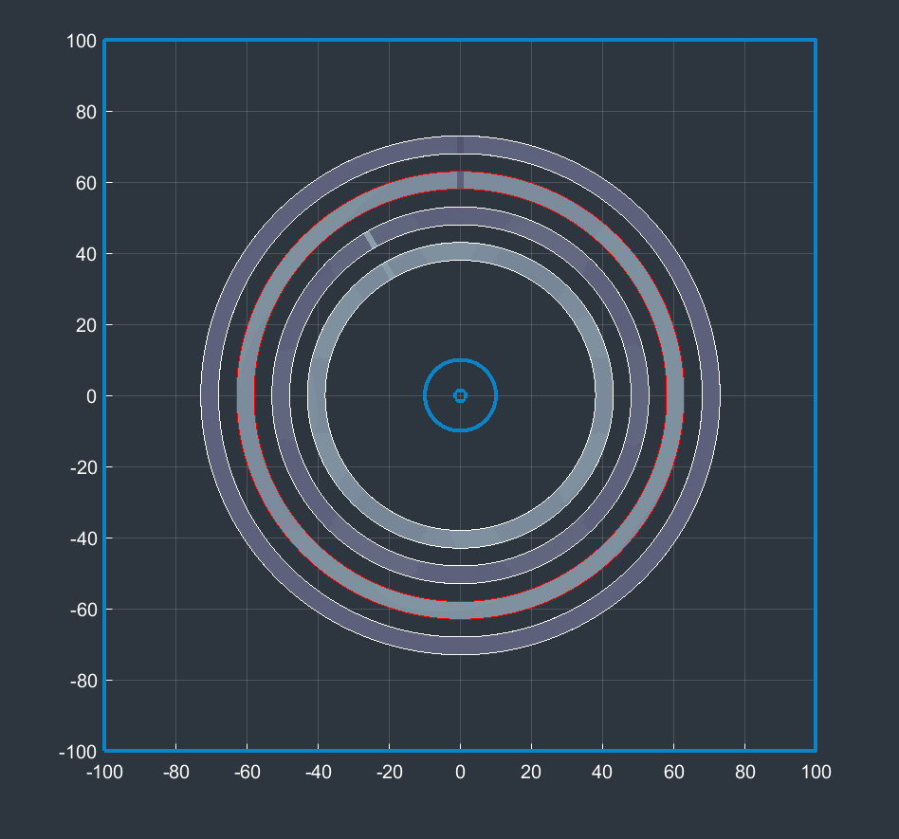
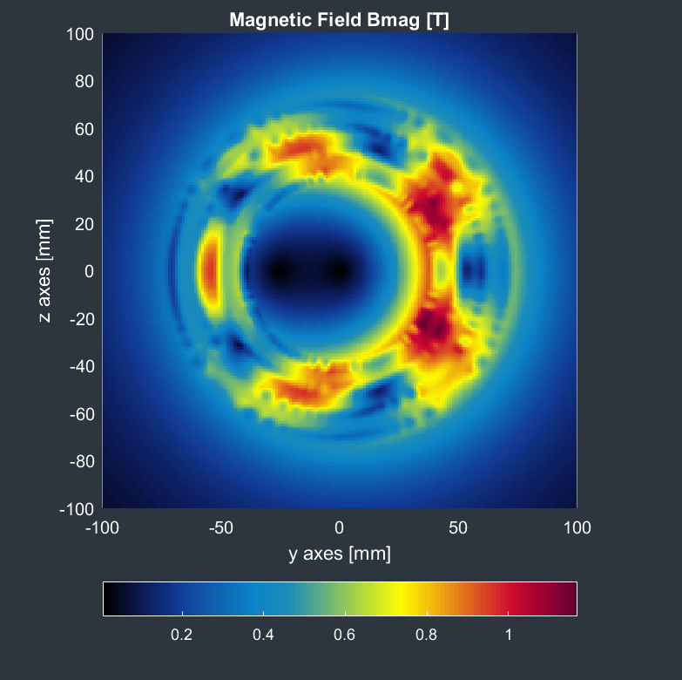
Field map
with both magnets at full current
Recap no iron:
Quad: I= 2400A
Sext: I=1800A

Slide 17
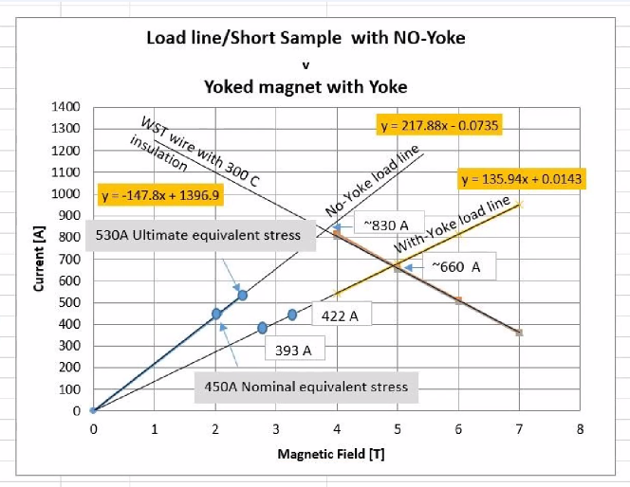
From no-yoke to yoke
The program I am using for my analysis cannot handle iron yokes. So the analysis is done with no iron yoke.
To get an idea what an iron yoke gives, consider the plot on the left, done for a similar magnet (LHC HiLumi MCBRD)
To reach a field of 3T one needs about 400A (with iron yoke) or 650A (no yoke)
So at these field levels, the presence of iron yoke improves performance by 60%

Slide 18
Performance with iron yoke
This is an extrapolation, but the maximum currents with the presence of an iron yoke will become:
I_max_quad: 1500A with iron
I_max_sext: 1150A with iron
If this is spread over 25 HTS tapes of 75um thickness and 5mm width:
I_max_quad per tape: 60 A
I_max_sext per tape: 46 A
This is feasible with todays technology operating at 77K.
As tape performance increases, we will reduce the number of tapes in the groove, hence reducing cost

Slide 19
Formers
How would the formers be manufactured?
For the FF quad prototype, the former is CNC machined.
For the arc components, accuracy requirements are not so high and the formers can be cast in aluminium or molded out of radiation resistant plastic

Slide 20
Choice of operating temperature
Running at 77 K (liquid nitrogen temperatures) has important cost benefits.
Is HTS conductor performance adequate at 77K for our application?
Very active field with applications outside HEP driving improvements and reducing costs

Slide 21
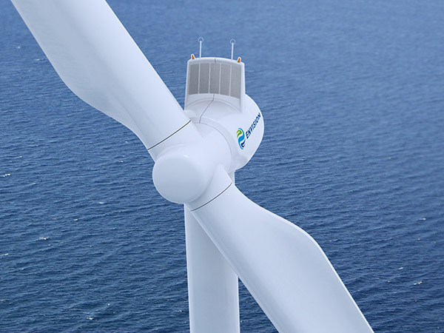
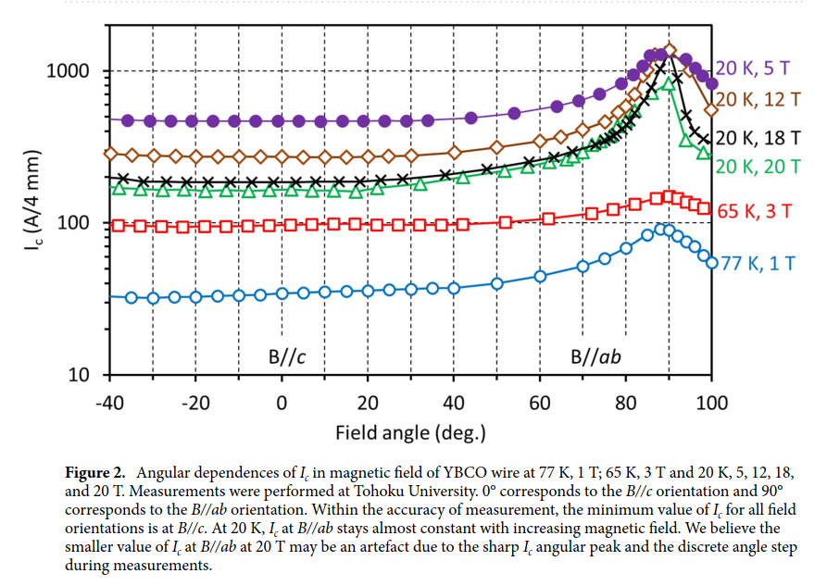
HTS performance at 77K
Technology driver:
Performance today:
@1T critical current is 40-110 A/ 5mm tape
Typical tape width: 75um
For a groove size of 2 mm, we can fit 25 tapes, so projecting from this plot we can have 1000-2800A… getting close to our requirements
Nature, Scientific Reports | (2021) 11:2084 | https://doi.org/10.1038/s41598-021-81559-z

Slide 22
HTS cost
Nature, Scientific Reports | (2021) 11:2084 | https://doi.org/10.1038/s41598-021-81559-z
HTS cost decreases every year.
Each one of our quads needs 520*2.4=1250 kiloAmpere-meter
If future cost is ~20 dollars per kAm, then the cost of conductor is 25k per quad (times 6000 units = 150MCHF)
Ditto, each sextupole needs 255*1.8 kAm= 460kAm
At future cost of ~20 dollars per kAm, the cost of the conductor for each sextupole is 10k per sextupole (times 6000 units = 60MCHF)
This is not a cost estimate!

Slide 23
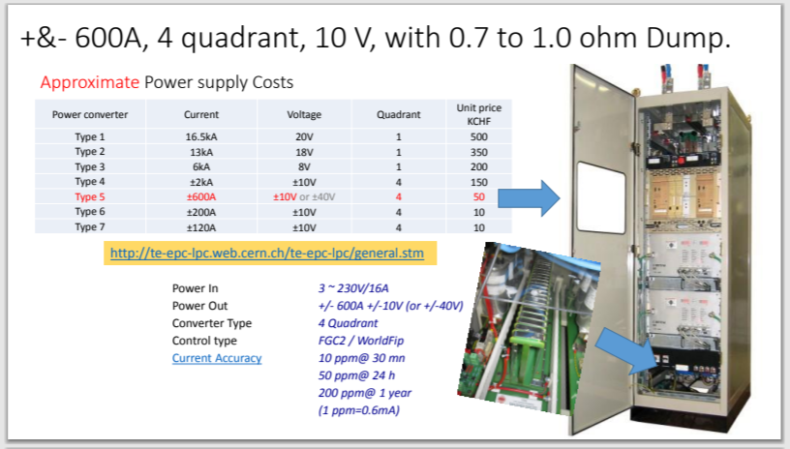
Choice of power supply
Quad maximum operating current for the CDR design: 474A
The distribution losses of such current are also important, as is the cost of the distribution lines.
The situation with the sextupoles is: CDR design: 6270 A*turns, 200A per turn
This design has a maximum current per tape of <~100A
This may lead to further reductions in outlay costs and operating costs
➔ in this approach we could reduce the current requirement of the power supplies by a factor 2 to 4
➔ power converter cost is a steep function of output current

Slide 24
Conclusions
Replacing the normal-conducting arc quads and sextupoles of FCC-ee with HTS ones is a very exciting prospect with the following advantages:
Sizable reduction in energy consumption and operating costs
Improvement of the packing factor
Reduced initial cost for the two systems
Lower spec power supplies with associated reduction in cost
This will make the FCC-ee a sexy, 21-century accelerator that will deploy modern technologies like HTS conductors operating at liquid nitrogen temperatures. This point by itself is sufficient, to my opinion, to initiate a study.

Slide 25
Extra slides

Slide 26
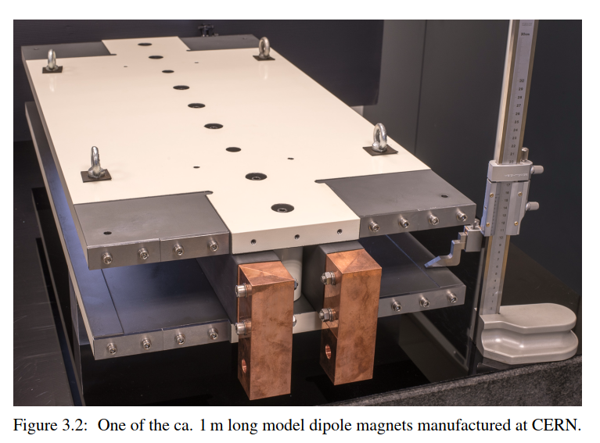
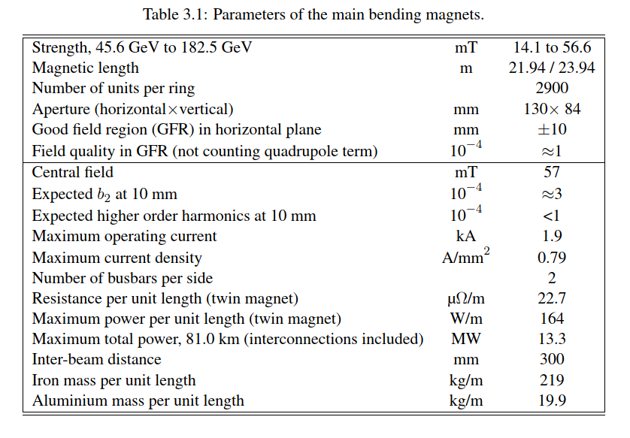
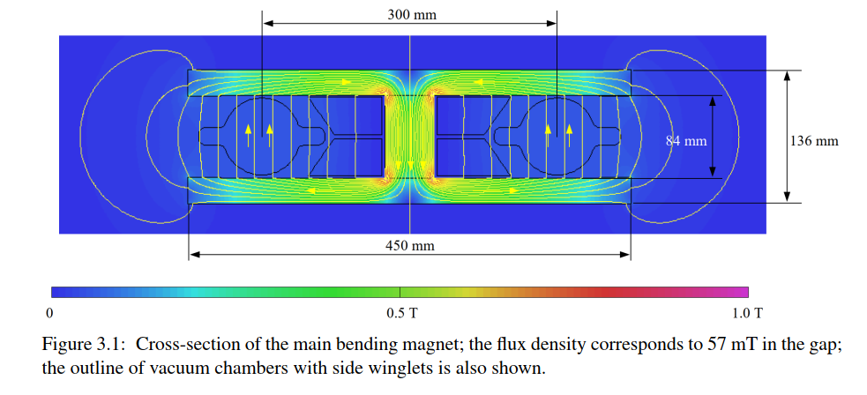
Arc dipoles

