Slide 1
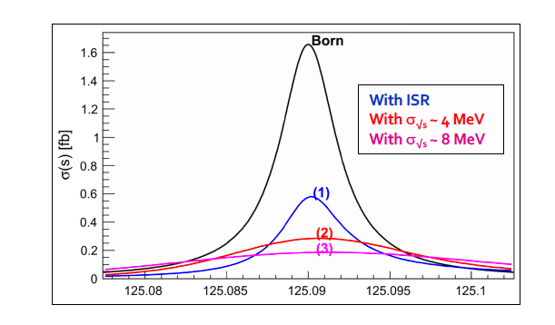
A first look at beam energy monitoring issues for the ee→ H run
Basic requirements (to be spelled out more precisely)
-- need to know the Higgs mass beforehand with precision better than Higgs width (±2 MeV) (ZH run of FCC-ee)
-- highest possible luminosity *and* monochromatization (not addressed here, but presumably requires Z machine)
At any moment during the run:
-1- run at nominal centre-of-mass energy that *is* the Higgs mass within ±2 MeV
-2- and stable well within Higgs width (±2 MeV)
-3- know the nominal center of mass energy to better precision (±1 MeV)
-4- know the centre-of-mass energy spread with similar precision (±1 MeV results in 20% cross-section uncertainty)
reference arXiv:1909.12245 -- will be included in EJP issue on challenges NB these specifications can be refined

Slide 2
-- the centre-of-mass energy with similar precision (±2 MeV OK?)
➔ this requires use of the transverse polarization and resonant depolarization.
Unlike for the Z line shape and W, we cannot chose the centre of mass energy, it has to be the Higgs mass.
One condition is that the beam energies should be located around the half integer spin tune ν_{s} =E_{b} /0.4406486
if m_{H} =125.09 GeV, then: ν_{s} =(m_{H}/2) /0.4406486 = 141.938 which is too close to integer.
-- A possibility is to shift the energies of the two beams in opposite way by Δν_{s} = + and - 0.5,
to 141.438 and 142.438 (Oide) Can we do that?
-- This works as long as we can achieve polarization and depolarization for frac(ν_{s} ) ∈[0.25 , 0.75]
(Could there be an elegant way to combine this with OSHD* ? )
➔ then we should use the same method as for the Z run which should be somewhat easier since the
polarization time is ~5 times shorter τ_{P} (125)/τ_{P}(91) = 250h * (91/125)⁵≈ 50h → 3 h for 5%
Probably need tu use wigglers at relatively weak power at filling time.
Precision at time of measurement will be similar (±100 keV) as for the Z run and should be sufficient
*) Opposite Sign Horizontal Dispersion

Slide 3
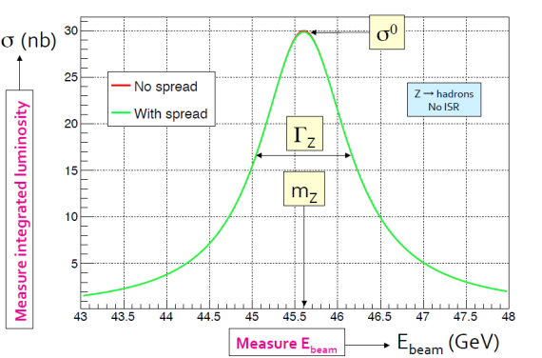
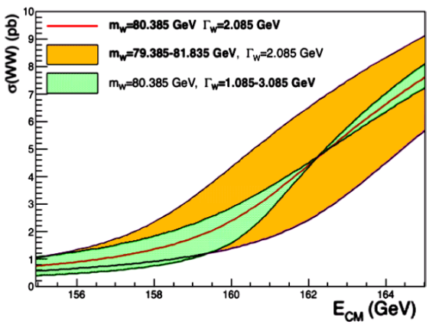
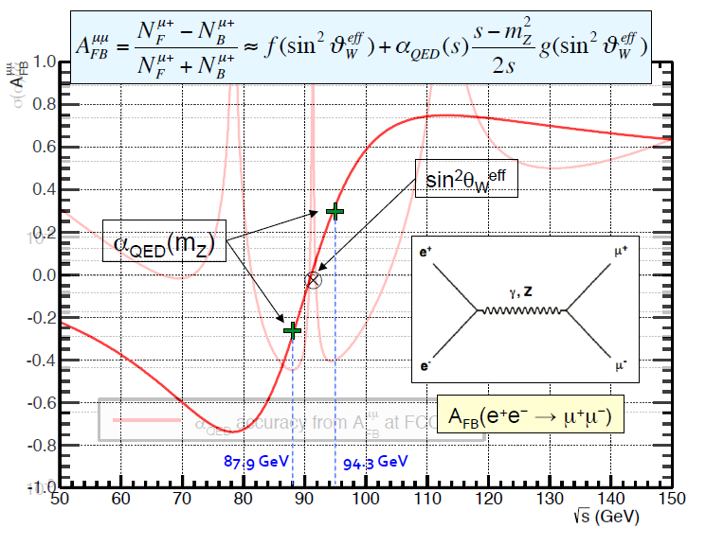
Physics: scan points and output quantities
Use half integer spin tune energies
for Z line shape, lucky:
ν= 99.5, 103.5, 106.5/107.5
and
W W threshold ν= 178.5, 184.5
for the Higgs, bad luck!
ν = m_{H}/2/.4406486 (1) = 141.94
--too close to integer for polarizazion–
141.44 for e+ and 142.44 for e-
at Z: 200 ‘pilot’ bunches will be stored at the beginning of fills with polarization wigglers ON, for about 1 hour to develop about 5-10% transverse polarization.
After a first energy calibration, the full luminosity run will comprise regular calibrations (1/10 min) on pilot bunches.
Z line shape → m_{Z} and Γ_{Z}
WW threshold→ m_{W} and Γ_{W}
at the same time A_{FB}^{μμ}(√s)
→ sin²θ_{W}^{eff}, α_{QED} (m_{Z})
Higgs s-channel production
need to know E_{cm} σ_{ECM} → y_{e}=m_{e}?

Slide 4
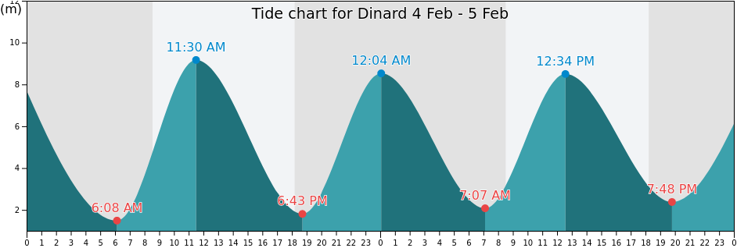
full swing in 6h
STABILITY At any moment during the run:
-- run at nominal centre-of-mass energy that is stable (±2 MeV)
This requirement is more stringent than that for the Z line shape scan where the requirement is
“well within the center-of-mass energy spread (so that it does not worsen it) of O(80 MeV)”
The full swing at the Higgs will be ±125 MeV... for each beam, i.e. ±250 MeV for E_{CM} (over 6hrs)
This corresponds to a maximum variation of +-125 MeV over 2 hours, or ~2 MeV per minute.
This will require a good model of the FCC-ee machine and its energy variations
-- benchmarked at the Z pole with great precision
and a correction mechanism using the RF frequency, based on e.g. beam position monitors, that is valid at that precision.
Must also use the ‘spectrometer’ function of the polarimeter in an operational way.
If we are able to achieve an average ECM measurement of ±100 keV at the Z, we can achieve 1 MeV at H.
The beam energy measurements by RDP needs to be adapted to this constant resetting of RF frequency.
➔ it is essential that the ee→ H measurement is performed after the Z line shape run

Slide 5
Measuring the centre-of-mass energy spread
A discussed in arXiv:1909.12245 the centre-of-mass energy spread σ_{ECM} cannot be measured from the bunch length when
using crab-waist crossing.
A method was therefore devised to measure σ_{ECM} from the resulting spread in the measured boost of μ+μ- pairs.
This method assumed that the widening of the boost distribution was entirely due to
-- uncorrelated energy spread of beams
-- ISR
-- angular resolution in the detector.

Slide 6
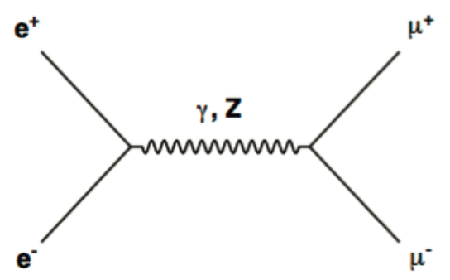
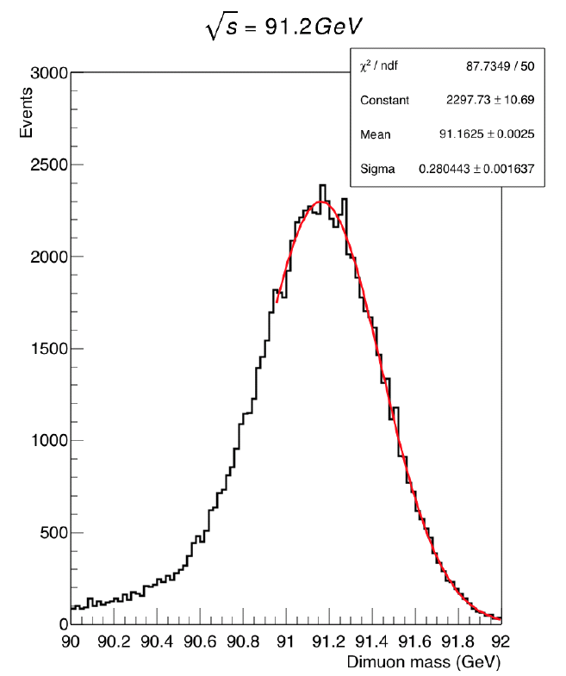
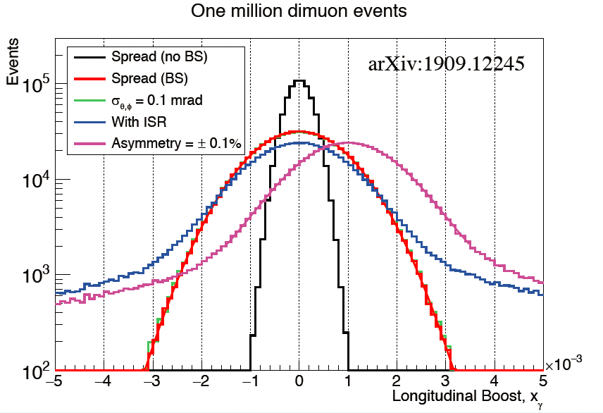


A thousand recipes to use up dimuon events at the FCC-ee
P. Janot
Here at the Z with 3000 muon pairs per second.
E,P conservation –>
allow E_{CM} and P_{CM} (boost)
on event-per-event basis.
10⁶ evts/5 min/expt @Z
~10⁴ evts/5 min/exp @H
→Determine ECM, ECM spread
and collision angle,
in addition to A_{FB}^{μμ}(√s) !
(also: control of ISR spectrum)
The measurement of CM boost
distribution allows control of
beam energy spread as well as the
difference between e+ vs. e- energies.
±2.5 MeV ECM meast
in 30 seconds of data
~40keV per day at
each scan point….
challenge for QED calculations!
$$E_{e^{−}}$$
Very useful also for control of
Monochromatization!
$$E_{e^{+}}$$

Slide 7
However in the monochromatization, we introduce deliberately correlated spread of beam energy.
In this scheme for monochromatization the average boost varies with horizontal position and
integrating it leads t
o a measurement of the centre-of-mass energy spread in absence of monochromatization. Not good.
We are saved by the fact that the beam is artificially spread around for the monochromatization (σ_{x} ~ ±100 μm)
and that the detector will be able to measure the x-coordinate of each event with a precision of ≤ ±3μm
Monochromatization D_{x}(e+) = - D_{x}(e-)
<ECM>(x) ~constant
σ_{ECM} (x)~constant ~ <σ_{ECM} (x)>
Boost measurement:
<(E(e+)-E(e-)> ∝ x (D_{x}(e+)-D_{x}(e-))
rms((E(e+)-E(e-))(x) ~constant << <rms((E(e+)-E(e-))>
$$E_{e^{−}}$$
x
~200 microns
$$E_{e^{+}}$$
this is very elegant: we can measure from the {boost of the muon pairs vs. x} the true energy spread *and*
verify the variation of boost across the beam crossing point → Verify the very principle of monochromatization.
NB we can also verify the ECM is constant vx x.
1/29/2021
Alain Blondel EPOL at FCC-ee
5

Slide 8

For the s-channel Higgs production
$$E_{e^{−}}$$
Monochromatization
<ECM>(x) ~constant
σ_{ECM} (x)~constant ~ <σ_{ECM} (x)>
Boost measurement:
<(E(e+)-E(e-)> ∝ x (D_{x}(e+)-D_{x}(e-))
rms((E(e+)-E(e-))(x) ~constant < <rms((E(e+)-E(e-))>
x
~200 microns
$$E_{e^{+}}$$
Chromatization along x axis:
across the x axis:
<ECM>(x) ~ x (Dx(e+)+Dx(e-))
σECM (x)~constant < <σECM (x)>
Boost measurement:
<(E(e+)-E(e-)> (x)
Rms((E(e+)-E(e-))(x) ~constant ~<Rms((E(e+)-E(e-))>
“Measure” ECM on evt by evt basis
$$E_{e^{−}}$$
~200 microns
x
$$E_{e^{+}}$$
Measurement uncertainty in x for muon pairs ≈ 3microns/sin(phi)
Investigate other variables ( z or time coordinates)

Slide 9
Some numbers and a remark
A more precise simulation can be done. Here are the orders of magnitude for a beam energy of 62.5 GeV
At the Z the muon pair cross-section is 1.4 nb (10⁻³³ cm² ) and luminosity is 2.3 10³⁶ /cm²/s → 3000 μμ /second
At the Higgs the high-mass muon pair cross-section is 10pb (10⁻³⁶ cm²) and luminosity 2. 10³⁵ /cm² /s → 2 μμ /second
The 0.1 mrad angular resolution spec corresponds to a boost spread measurement of ~ 6.2*sqrt(2)= 9 MeV
We are assuming a rms σ_{ECM} of 8 MeV
(NB ➔ the angular resolution spec should probably be tightened to 0.04 mrad I have not assumed this)
At 125 GeV ECM:
A measurement of the energy spread to ± 10% (±0.8 MeV) will require O(1000) muon pairs but it must be done in bins of x.
if one wants 20 bins in x, this is 200 minutes or 3 hours for a full boost and σ_{ECM} characterization
If one wants in addition to verify the energy is independent of x (as it should in monochromatization scheme)
we need about 40 hours or ~2 days... so this will be verified only on a long fill basis.
It will be essential and much faster to develop the monochromatization scheme at the Z!

Slide 10
CONCLUSIONS AND IMPLICATIONS
The s-channel production ee→ H at ECM=m_{H} requires that
-- first a measurement of m_{H}at ECM = 240 GeV
-- then a run at ECM = 125 GeV with the high luminosity optics (the Z machine)
-- this would have implications on the run plan (ZH first, then Z and H)
2. ECM=m_{H} must be exact within ∼± 2 MeV -- do not have a choice and must use RDP for calibration.
this might require running the machine with 440 MeV difference between e+ and e- energies.
is this possible?
3. We should run in a way similar to the Z run – wigglers needed for shorter time for pilot bunches
ECM must remain at all times equal to m_{H} within above spec. This will require a good model
and constant RF frequency adjustments. The running mode must be adapted to this.
4. the energy spread is a basic input to the physics result (not a small correction) and must be measured in bins of
the coordinate on which the opposite dispersion is expanded (assumed x) using muon pairs.
This can be done, and constitutes a superb verification of the monochromatization.
at ECM=125GeV this is too slow to allow machine set-up and debugging but useful for full lumi run.
5. the monochromatization scheme should be debugged at the Z energy where there are 300 times more muon pairs.

