Slide 1
a few aspects of the 4 IP configuration
Frank Zimmermann
thanks to
Michael Benedikt, Antoine Chance, Katsunobu Oide, Daniel Schulte, Dmitry Shatilov + …
FCC-ee Optics Design Meeting #132, 5 February 2021

Slide 2
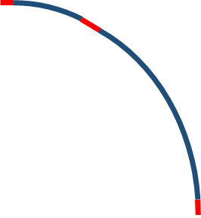
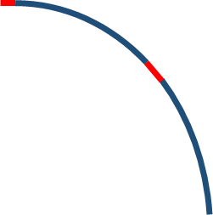


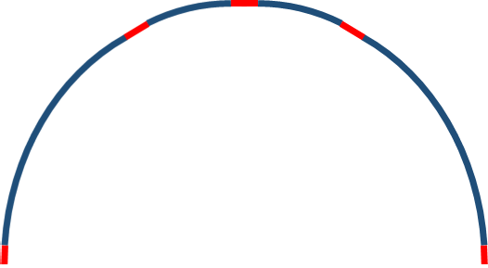
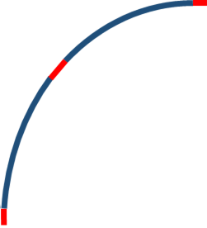
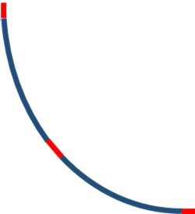
FCC-ee
CDR baseline
superperiodic layout w 4 IPs
1.4
1.4
1.4
1.4
4.3
RF
2.1
10.5
2.1
(RF)
16.6
10.5
2.8
RF
(RF)
2.8
1.4
1.4
2.1
2.1
(RF)
(RF)
1.4
1.4
1.4
1.4
4+4 beam crossings
2x impedance of el.-st. separators
RF at 4 locations
16 ( ) or 8 surface sites?
2+2 beam crossings
RF at 2 locations
12 surface sites

Slide 3
FCC-hh
CDR baseline
superperiodic layout w 4 IPs
1.4
1.4
1.4
4.3
1.4
2.1
10.5
2.1
16.6
10.5
β collimation
2.8
extraction
2.8
1.4
1.4
2.1
2.1
1.4
1.4
1.4
1.4
total transfer line length
~22 km (from SPS)
~24 km (from LHC)
solution for extraction & collimation ?
2 experimental caverns not at same location
total transfer line length
10 km (from SPS)
11.7 km (from LHC)

Slide 4
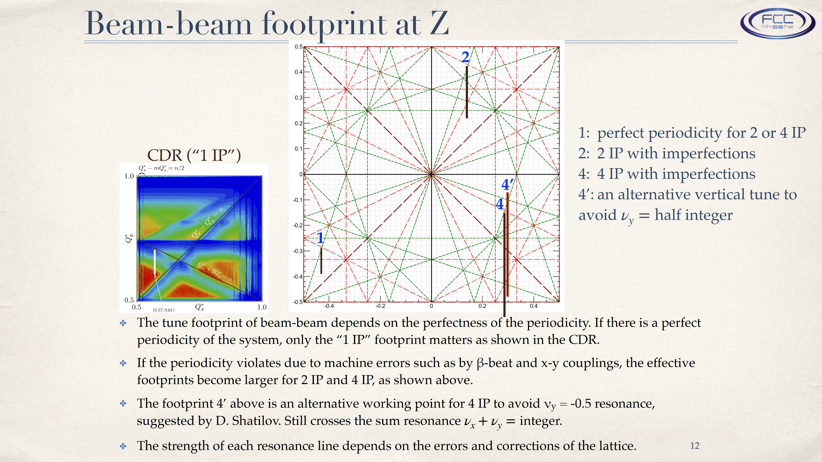
with 4 IPs we need a (much) better optics correction than with two IPs (D. Shatilov)
K. Oide, IAC Meeting,
October 2019
beam-beam limit with errors,
dynamic aperture, top-up injection background … ?!

Slide 5
numerous unsolved questions
realistic performance better or worse than with 2 IPs?
maximum distance between shafts?
hadron collider collimations & extraction
background, tuning, commissioning time
placement and actual layout for this configuration? ..
drawbacks of 4 IPs
FCC-ee RF & cryogenics at 4 locations, more impedance,
much tighter optics tolerances
FCC-hh injection lines more than twice as long
6 experimental caverns
..
potential advantage: reduction of surface sites from 12 to 8 ?

