Slide 1
MCBXFBP2b reassembly
J. A. García Matos, C. Martins, F. Toral (CIEMAT)
J. C. Pérez, E. Todesco (CERN)
Special thanks to 927, Michael’s and Lucio’s teams for all the nice work!!
4th February 2021

Slide 2
Index
Target: minimal preload.
Review of last assembly of MCBXFBP1.
Shimming proposal for MCBXFBP2.
Collaring test results.
Conclusions.

Slide 3
Target: minimal preload
The objective of the coil preload is to avoid cable movements during powering.
The minimal preload for the outer dipole coils at cold is 40 MPa in single operation and 50 MPa in combined operation (electromagnetic forces, no margin).
The minimal preload at room temperature is 120/130 MPa, due to the differential thermal contraction of the coils.
In the first prototype, peak stress was 250 MPa to keep 56 MPa (average) at cold.
MCBXFBP1 coil preload (MPa) at different steps and assemblies

Slide 4
Review of first assembly of MCBXFBP2 (a)
First MCBXFBP2 collar assembly was checked with Fuji film and strain gauges, both inner and outer dipole.
Final assembly was made without instrumentation.
Inner collar strain gauges were measured again at disassembly.
MCBXFBP2 inner collar stress (MPa) at different gaps of collaring tool after power tests
MCBXFBP2 outer collar stress (MPa) at different gaps of collaring tool at assembly

Slide 5
ID shimming proposal for MCBXFBP2b
The objective is to increase the preload about 20 MPa, with better support at the coil ends.
50 micron will be added at the pole and 50 micron at the midplane.

Slide 6
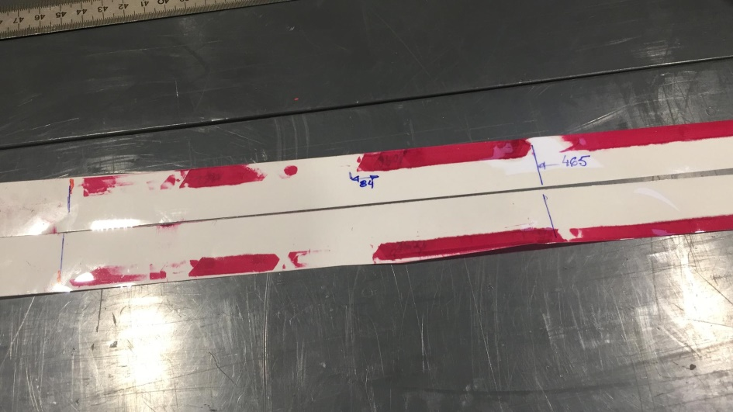
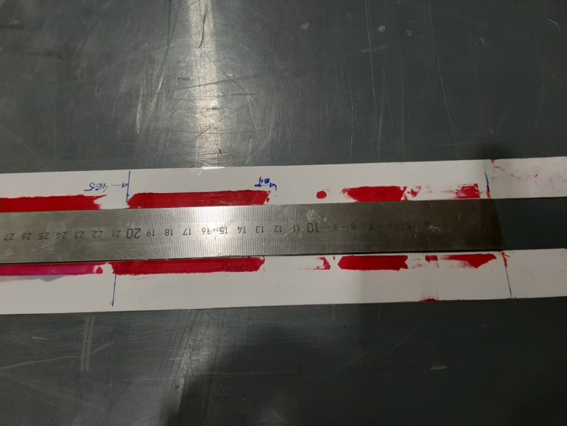
First ID collar assembly for MCBXFBP2b
The pressure increase at NCS collars measured by the gauges is not as high as expected.
Fuji film shows step transitions at the coil ends.
MCBXFBP2b inner collar stress (MPa) at different gaps of collaring tool

Slide 7
Second ID shimming proposal for MCBXFBP2b
The shimming is increased by 100 micron at NCS pole turn.
Shimming transitions at coil ends are smoothed.

Slide 8
Second ID collar assembly for MCBXFBP2b
The pressure increase is slightly above 20 MPa during assembly.
Spring-back behaves as expected (stress close to 0.3 mm gap; slightly increase wrt. P1->122 MPa).
Uniform pressure at coil ends (Fuji film).
MCBXFBP2b inner collar stress (MPa) at different gaps of collaring tool (with Fuji film)
MCBXFBP2b inner collar stress (MPa) at different gaps of collaring tool

Slide 9
OD shimming proposal for MCBXFBP2b
The objective is to increase the preload about 20 MPa, with better support at the coil ends.
125 micron shim will be added. All the shims are moved to midplane to improve field quality.

Slide 10
OD collar assembly for MCBXFBP2b
The pressure increase is above 20 MPa during assembly.
Some erratic behaviour at 0.2 mm gap.
No Fuji film test. No instrumented collars at final assembly.
MCBXFBP2b outer collar stress (MPa) at different gaps of collaring tool

Slide 11
Warm magnetic measurements
Analysis is still ongoing.
 |  |  | Nominal | P2a expected | P2a measured | P2b expected | P2b measured
ID | b3 | X-Section | -13.4 | -16.3 | -10.1 | -16.9 | -11.5
 |  | 3D | -9.2 |  | -5.7 |  | 0.1
 | b5 | X-Section | 0.2 | -10 | -7.6 | -14.8 | -8.5
 |  | 3D | -1.6 |  | -7.3 |  | -9.5
OD | b3 | X-Section | 10.9 | 9.3 | 5.1 | 16 | 18.7
 |  | 3D | 8.5 |  | -5.1 |  | 7.4
 | b5 | X-Section | 1.3 | 0.8 | -0.4 | 0.3 | 1
 |  | 3D | 0.5 |  | -1.1 |  | 0.1

Slide 12
Conclusions
Performance at combined operation of MCBXFBP2 did not improved the first prototype results.
Reassembly has been done at 927 workshop to increase the preload at coils (about 20 MPa) and achieve uniform pressure at coil ends.
Mechanical measurements were close to expectations: slightly below 20 MPa at inner coils, above 20 MPa at outer coils.
Analysis of warm magnetic measurements is ongoing.

