Slide 1
Macs Column Computing Environment

Slide 2
What‘s new
2 National Instruments Crates
Schroff cPCI Crate with FC fanouts
MTS System
  MRF EVG and EVR

Slide 3
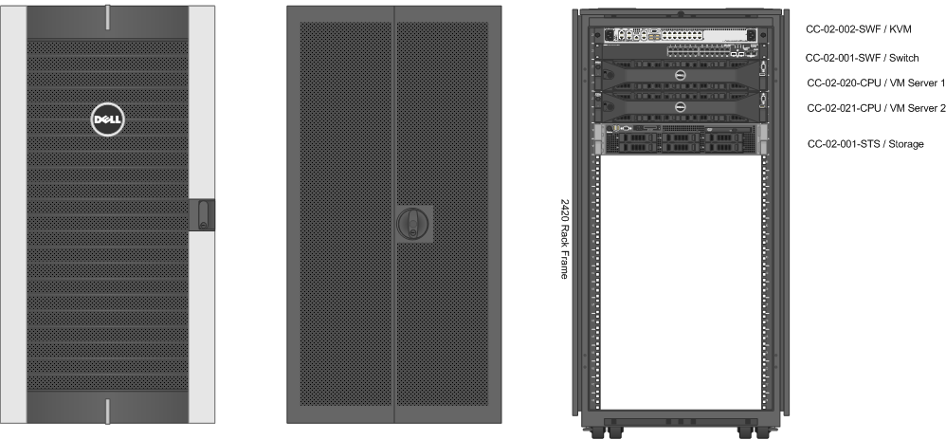
Last time

Slide 4
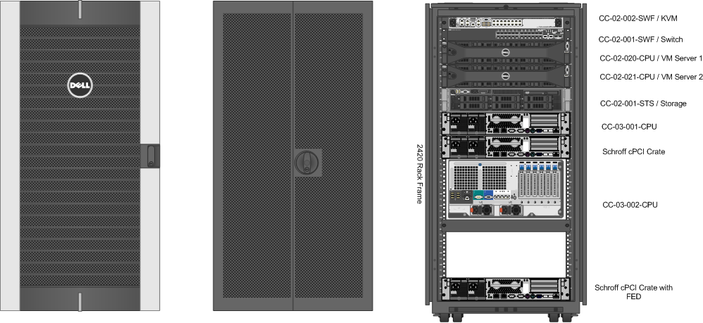
Today

Slide 5
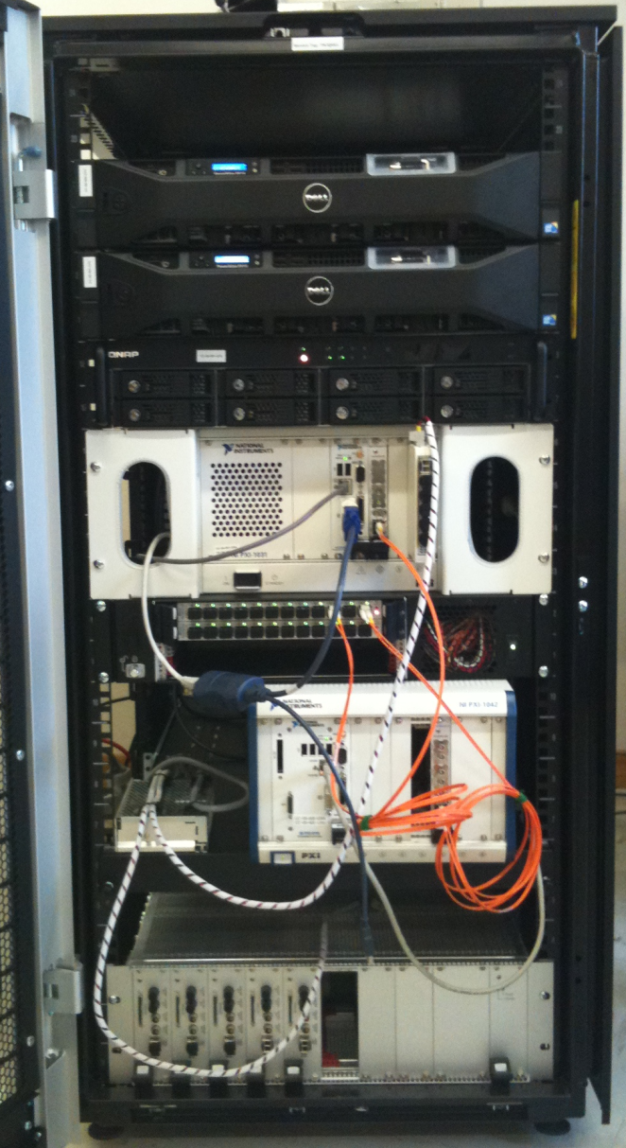
Today
MTS System
MTR
FC Link Rx
Fanouts
FC Link Tx
MTG
FED Crate
FC Link FlexRIO to FED

Slide 6
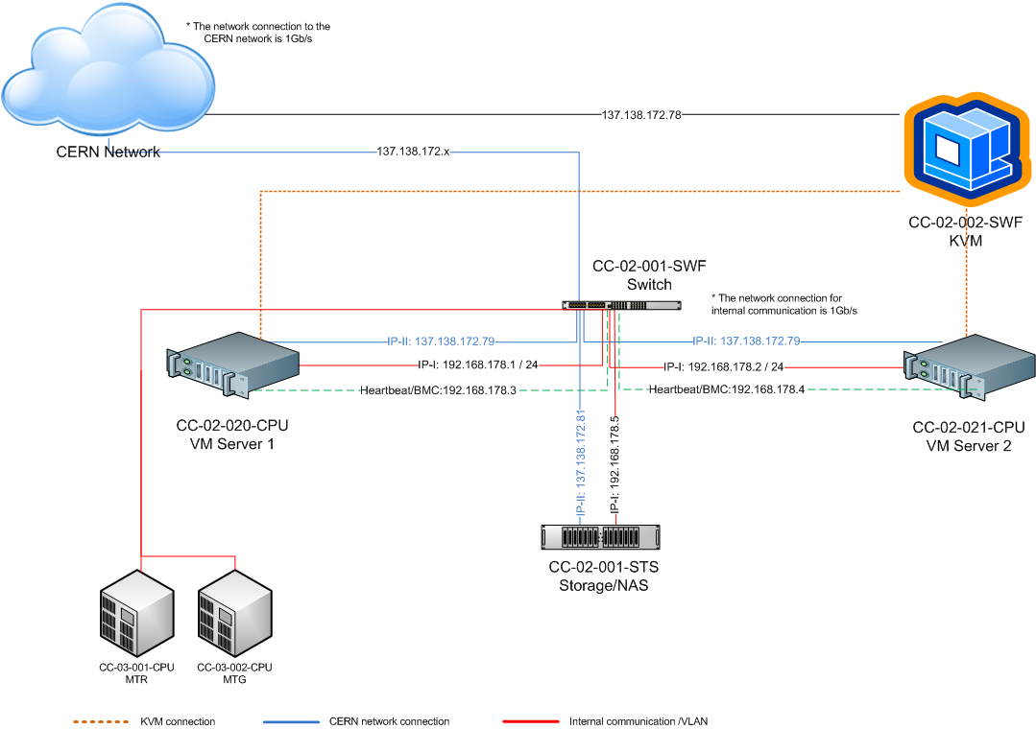
Network changes

Slide 7
Software
VMware System
Development Environment
Repository Management Software “RMS”
MTG RT
PCC DEMO

Slide 8
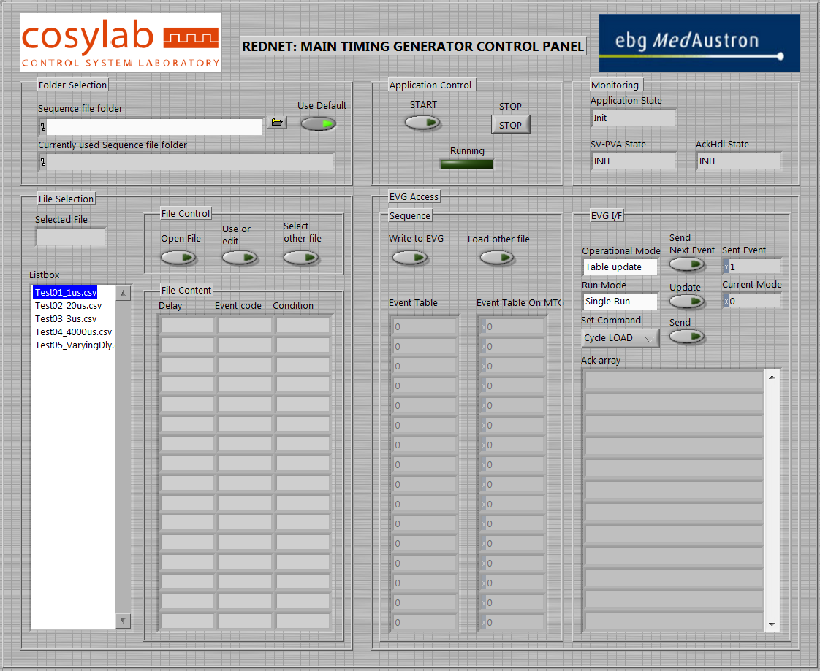
MTG RT

Slide 9
Documentation for
VMware access
How to use the KVM-IP-Switch
Accessing the storage
Using SVN and TRAC “in short”
https://espace.cern.ch/macs/infradev

Slide 10
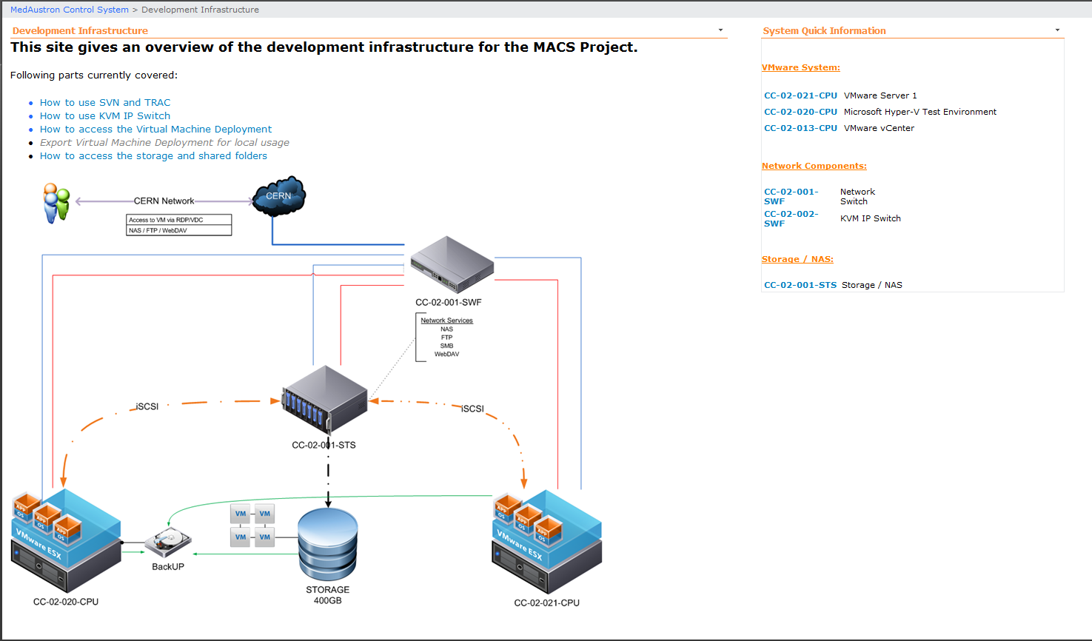
Documentation for

Slide 11
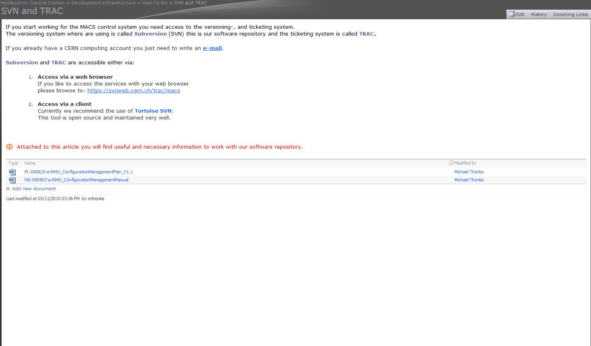
Documentation for

Slide 12
Forthcoming…
Reconfiguration of the RACK components
Evaluation of Virtualization Solutions
Enhancements for TRAC/SVN
  Workflow enhancements
  Additions for reports (e.g Iteration report)

Slide 13
Thank you for your attention

