Slide 1
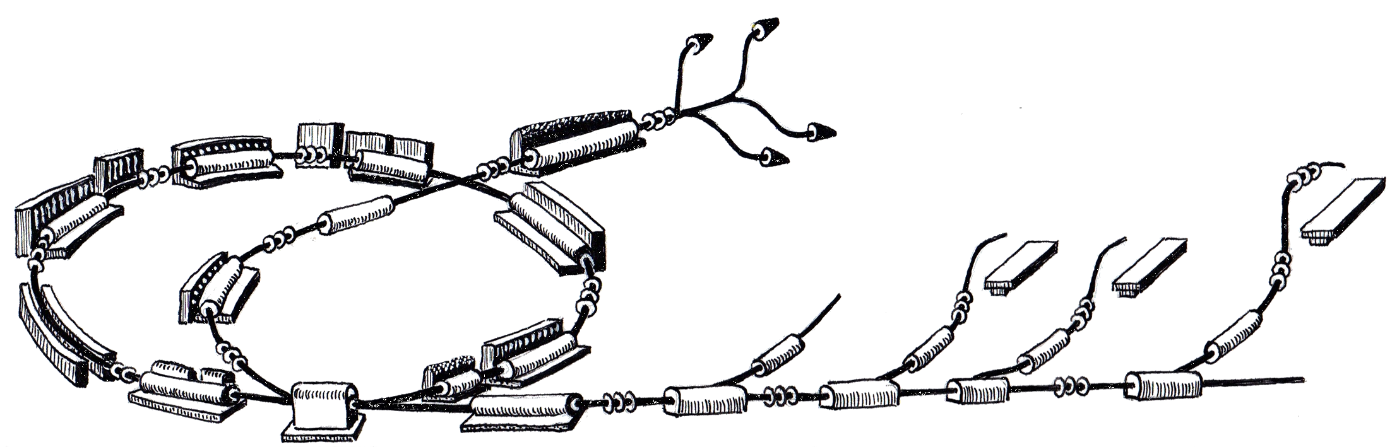
WP CO
Status and Progress
December 8th, 2010
Johannes Gutleber
R. Gutleber

Slide 2

Status Report

Slide 3
Current Phase (Elaboration)
Focus on requirements, architecture, design
Prototype implementation and technology evaluation
Prepare development setup

Slide 4
Goals for 2010 (Reminder)
Complete architecture and implementing first components
Complete and MTS design and demo core functionality
Complete PCC design and demo core functionality
Make PCO FED ready for production
Elaborate ProShell design and API skeleton
Demonstrate use of RMS, database filler, PVSS filler
Have development infrastructure (HW, SW) operational

Slide 5


Achievements for 2010
Complete architecture and implementing first components
Complete and MTS design and demo core functionality
Complete PCC design and demo core functionality
Make PCO FED ready for production
Elaborate ProShell design and API skeleton
Demonstrate use of RMS, database filler, PVSS filler
Have development infrastructure (HW, SW) operational

Slide 6
Additional Achievements!
FECOS documented and ready for pre-release
Virtual Accelerator Allocator first iteration completed
requirements, design, implementation

Slide 7
Original Plan (Dec. 14, 2009)
JAN
FEB
MAR
APR
MAY
JUN
JUL
AUG
SEP
OCT
NOV
DEC
Framework Agreement
Power Converter Interface Recommendation
PC Interface Def./Impl.
Interface Prod.
MTS Definition
MTS Functional Product Development
PCC Def.
PCC Functional Product Development
Tech. Eval.
Procedure Fw Definition
Procedure Fw Skeleton Development
T4 framework definition
T4 framework development
Repo Sw. Adoption
Repo Sw. Package 1
Repo Sw. Package 2
Repo Sw.
Beam Interlock System Specification and Development
1 SW Eng.
1 engineer,
Junior
partner
5 FTE
Contractor
Column
Demo

Slide 8
Actual Plan (Dec. 8, 2010)
JAN
FEB
MAR
APR
MAY
JUN
JUL
AUG
SEP
OCT
NOV
DEC
Framework Agreement
Power Converter Interface Recommendation
PC Interface Def./Impl.
Interface Definition
Production
MTS Definition
MTS Functional Product Development
PCC Def.
PCC Functional Product Development
PCC Def.
PCC Functional Product Development
Tech. Eval.
Procedure Fw Definition
Procedure Fw Skeleton Development
Procedure Fw Definition
Development
T4 framework definition
T4 framework development
RMS not available
Repo Sw.
Repo Sw. Adoption
Repo Sw. Package 1
Repo Sw. Adoption
Repo Sw. Package 2
Repo Sw. Package 1
Beam Interlock System Specification and Development
On Hold
1 SW Eng.
1 engineer,
Junior
partner
5 FTE
Contractor
Column
Demo

Slide 9






Status of Work with Other WPs
WP/Subsystem | Requirements | Design | Implementation | Integration
Power
BTS
Vacuum
Injector RF
Synchrotron RF
BDI
BID
Magnets
Sources
MSS
BDS
Building
IT

Slide 10
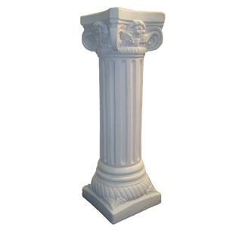
MACS Column
2010

Slide 11
Column Overview
Presentation tier (1)
Functional vertical cut through the control system architecture for
  confirming technology choices
  Refining the design
  Improving project cost/time estimate
  Providing users with a working infrastructure skeleton
To be replicated for each subsystem
Leads to a scalable system
  In terms of performance
  In terms of management
Processing tier (2)
Equipment tier (3)
Frontend tier (4)

Slide 12

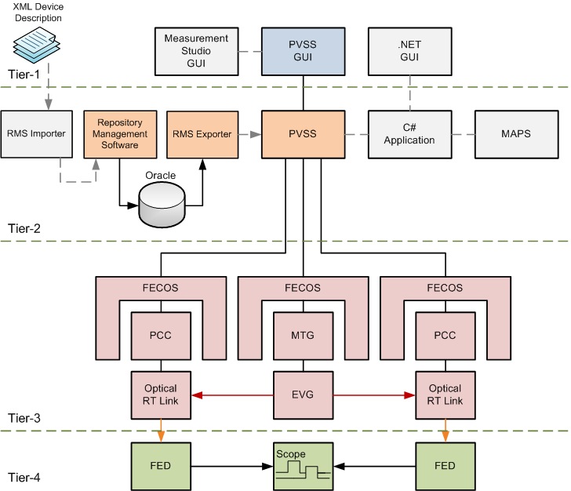

Slide 13
Technical Work for 2011
Continuous integration of MACS column
Finalize development of MTS and PCC
Finalize VAA, dummy BDS and operation chain
Develop & integrate ion source slow control FEC
Develop & integrate injector LLRF FEC
SADS development
CRB integration related work
Integrate family A PCOs into PCC
Vacuum controls technology validation

Slide 14
Technical Work for 2011 (contd.)
RMS importer, management, exporter chain
Fill RMS with first devices and cycle data
ProShell minimal framework release to users
Beam Interlock System technology validation
Finalization of IT infrastructure definition
Functional integration of control system for ITS

Slide 15
Support Work
Configuration Management
  Followup of tickets
  Extension of Trac/SVN system
  Training of MA team and supervision of environment
Maintenance of development infrastructure
  Hardware and software administration, scale-up, evaluation
Interaction with WPs
  Interactions with WPs at CERN and Austria
  Interactions with WP suppliers and AE
Risk Management
  Accelerator control system risk analysis (not medical device!)

Slide 16

Summary and outlook

Slide 17
Summary
Behind Schedule
  ProShell development
  Finalization of requirements (Linac, SADS, Sources)
  Beam Interlock System development (risk analysis)
  Use of RMS (device specification, filling of database)
Ahead of Time
  FECOS development and provision
  Supervisory Control System architecture/design
  VAA development
In Time
  Development of timing system
  Development of power converter controller
  RMS adaption to MedAustron needs

