Slide 1

Power Converter Controller Prototype overview
Luka Sepetavc (luka.sepetavc@cosylab.com)
the best people make cosylab

Slide 2
Outline
Very quick overview
Hardware prototypes
CWO-3
Notes:
-very quick overview of the system
-see what we have developed
-what remains to be done in future CWOs

Slide 3
PCC – quick overview
Notes:
system architecture
PXI controller runs LabVIEW RT
accepts commands from the PVSS, sequences from the webserver, receives events from the MTS, monitors/sets interlock status
has FlexRIO FPGA Modules with custom developed Adapter Modules
FEDs connect to the PCC over an real-time optical link
FED has different interfaces to which different types of PCOs can be connected to

Slide 4
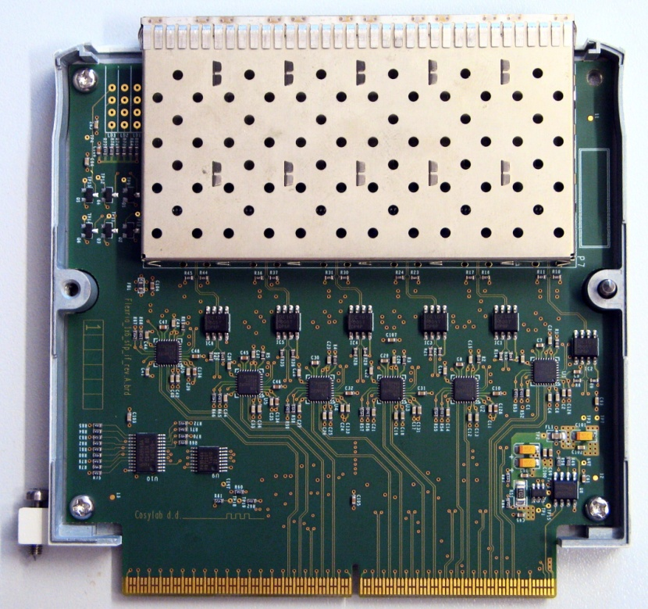
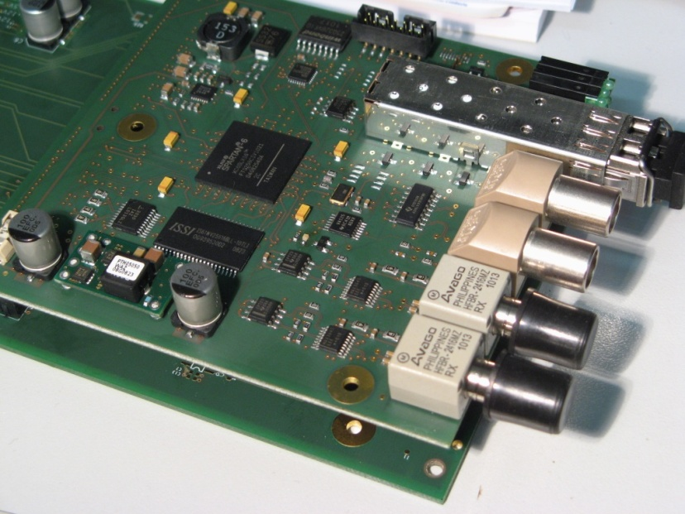
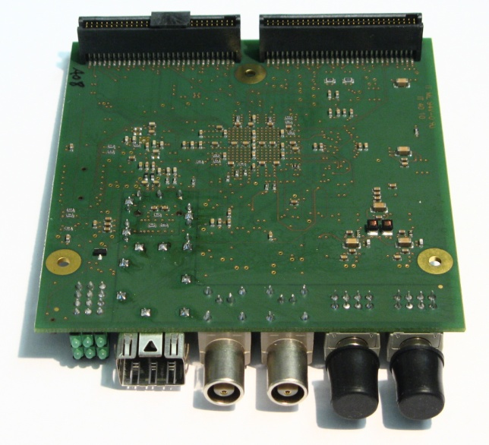
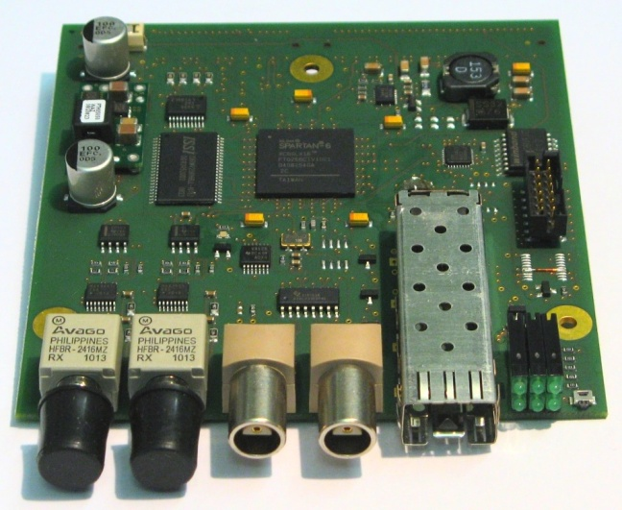
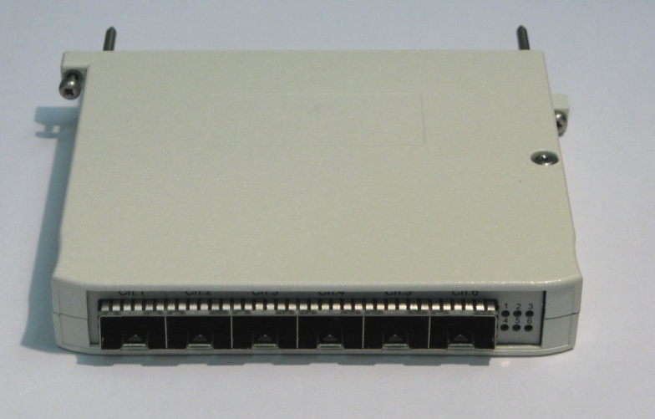
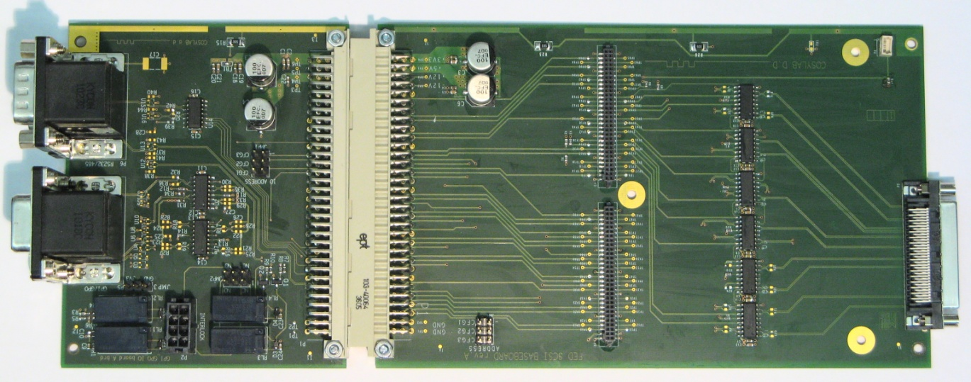
Prototypes – fun stuff!

Slide 5
PXI controller
Notes:
-FlexRIO Modules are inserted into PXI crates
-aproximately 10 PXI crates will be used in the whole system (in different locations throughout the entire accelerator)
-for example, first slot will holds an Event Receiver card from MRF which distributes received events over dedicated lines on the backplane bus
-there will be up to 5 FlexRIO FPGA Modules with FlexRIO Adapter Modules per crate (responsible for fiber communication with FEDs, waiting for events...)
- FlexRIO Adapter Modules require an external power supply
-the last card in the crate is used to interface with the interlock system

Slide 6
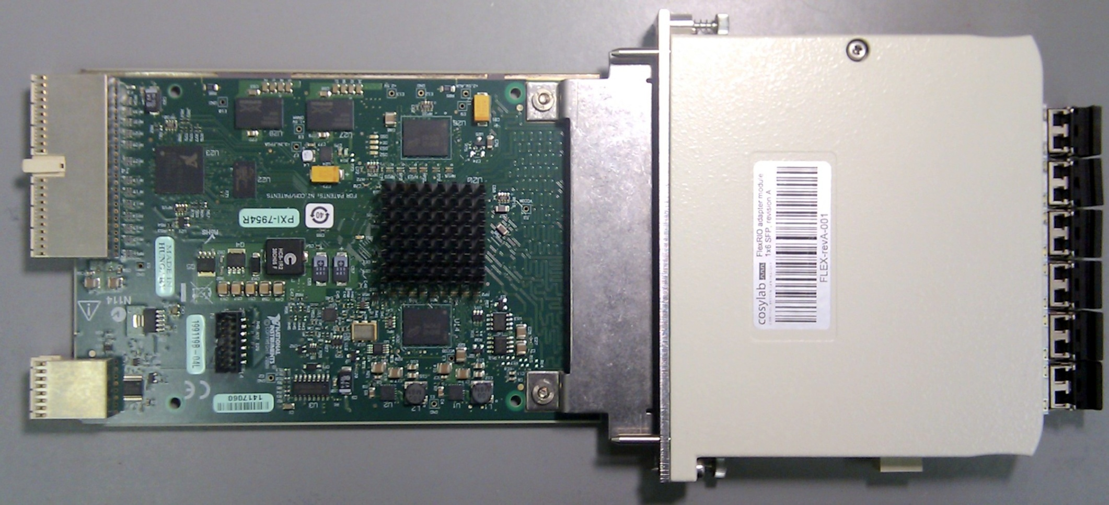
FlexRIO Adapter Module
FlexRIO FPGA Module
Notes:
-example of 2 FlexRIO FPGA Modules and a FelxRIO Adapter Module
FlexRIO FPGA Modules are “smart”, they have an FPGA inside it ☺
FlexRIO Adapter Module provides an external interface to the world

Slide 7

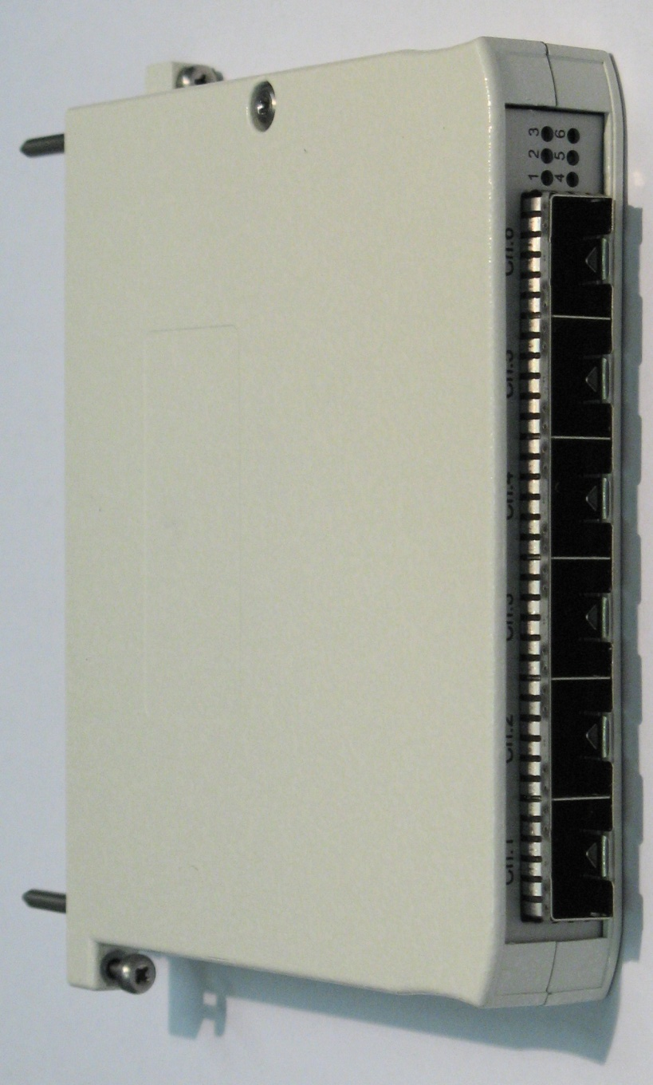
FlexRIO Adapter Module
Notes:
- custom developed FlexRIO Adapter Module
left: PCB
right: encased in a metal case

Slide 8
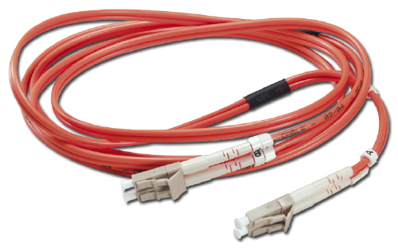
Real-time serial link
custom developed protocol
100 Mbit/s transfer rate
high-priority data
  low latency, deterministic delay
low-priority data
  non-deterministic delay
Notes:
-the communication link between the PCC and FEDs
-custom protocol to meet the requirements
-100 Mbit/s is enough
-high-priority interface will be used only for sequence driven PCOs which are fast (* range of ~10kHz)
-deterministic delay is very important to achieve synchronization among multiple receivers
-low-priority interface will be used for slow PCOs and configuration
-low-priority data can be transmitted constantly
-high-priority data pauses transmission of low priority data which is continued afterwards

Slide 9

Front End Device (FED)
Notes:
-at the other end of the link is the Front End Device = FED
-provides different types of interfaces so that different types of PCOs can be controlled with it
-diagram on the left
-photograph of an actual prototype on the right

Slide 10

Baseboard, IO board
IO board
Baseboard
DIN backplane connector
Notes:
-FED plugs on top of the baseboard
baseboard provides power and additional connectors on the front panel
IO board provides additional connecters on the back panel
baseboard, FED and IO board plugi into a 19” Schroff 3U crate, using a DIN backplane

Slide 11

FED + baseboard
Baseboard
FED
Notes:
-example photo of FED on top of the baseboard

Slide 12
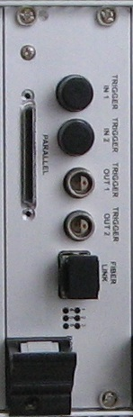
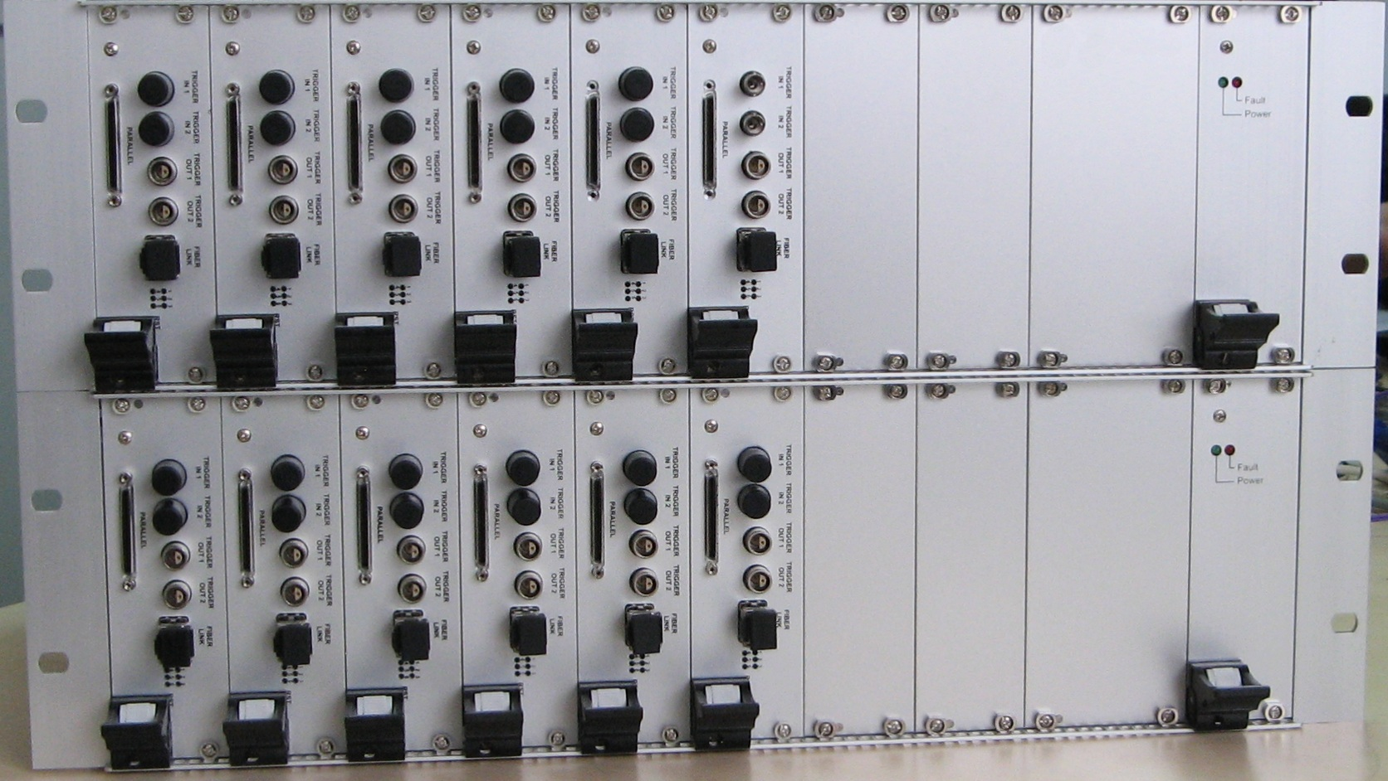
FED + baseboard + IO board
19” 3U subrack
2 subracks – front
close up of the front panel

Slide 13
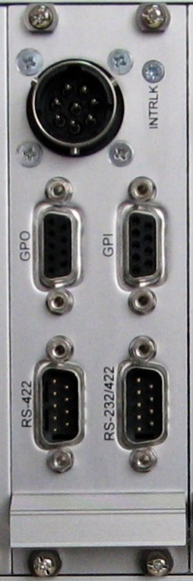
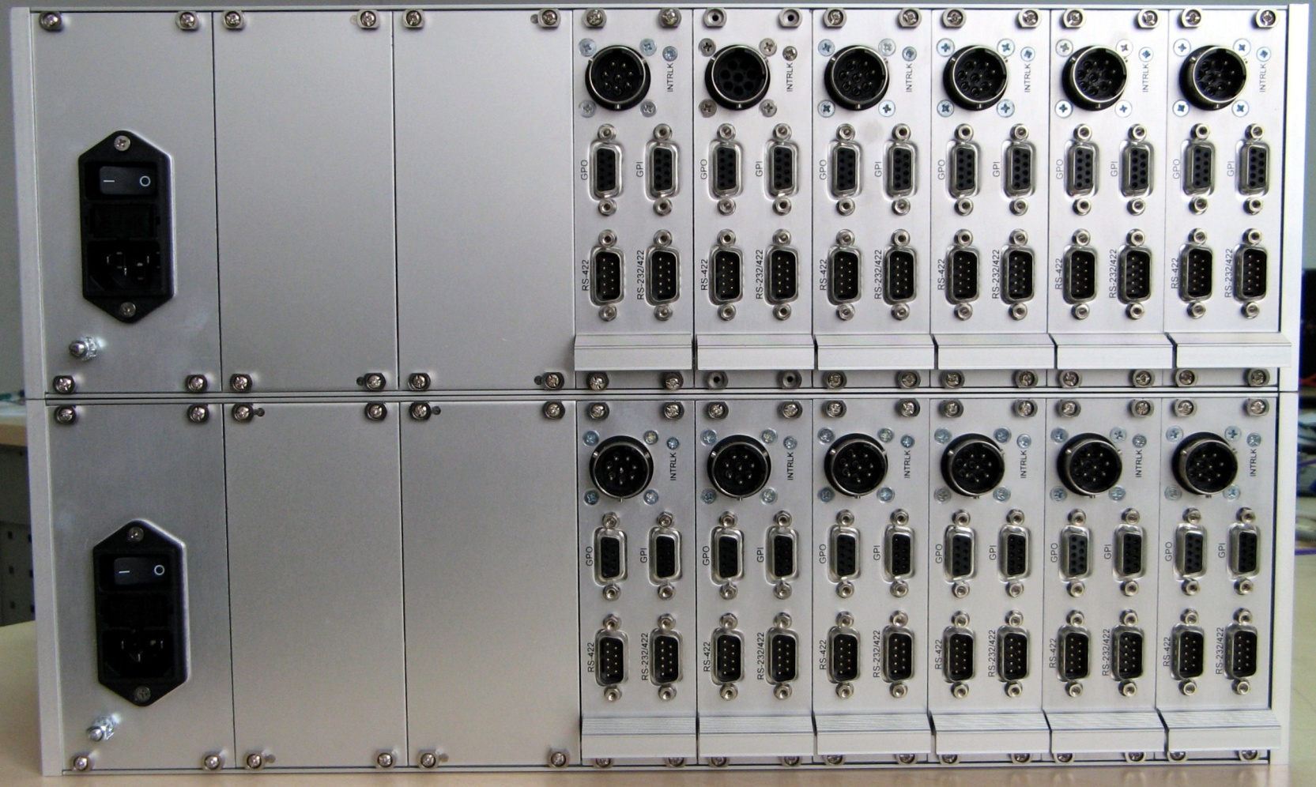
FED + baseboard + IO board in a 19” 3U subrack
2 subracks – back
close up of the back panel

Slide 14
CWO-3
PCC
  full featured sequences and measurements
  communication with the PVSS
  driver support for serial driven PCOs
  ...
FED
  new hardware revision of the board
  low priority pipes on real-time link
  FED status and configuration
  ...
Notes:
-implement all the remaining features in LabVIEW (PXI controller) and VHDL (FlexRIO FPGA Module and FED)
-support for all types of measurements such as continuous and systematic measurements
-support the complete command set of all PCOs
-decompression of sequences (these will be compressed to save storage and bandwidth)
-pulse synchronization (stop and start generation of sequences upon external signals)
-Graphical User Interfaces
-support for the CRB = UHPI interface
-parallel interface over SCSI-5 connector
-PCC will be able to update FED’s FPGA bitstream image over the fiber link
-FED will have multiple bitstream images stored in its flash; depending on the type of the baseboard (CRB, parallel, serial), FED will reconfigure its FPGA and load an appropirate image to work with it *(FED will detect the type of the baseboard through 3 external configuration pins which the baseboard will set to an apropriate levels, e.g. CRB = 000, SCSI = 001, serial = 010...)

Slide 15
That’s all
☺

