Slide 1
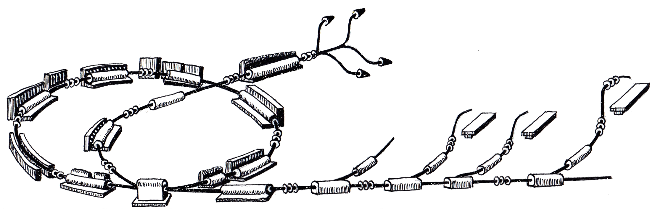
ProShell Procedure Framework Status
MedAustron Control System Week 3
December 8th, 2010
Roland Moser
R. Gutleber

Slide 2
Scope
Overview of ProShell Procedure Framework architecture
Current status
  What was achieved since September 2010
  Plan till March 2011

Slide 3
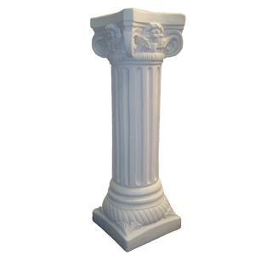
OVERVIEW

Slide 4
General Terms
ProShell Procedure Framework
  Windows C# Application managing procedures
Procedure
  a module that performs an automated supervisory control task
  E.g. Emittance measurement, Procedure to change mode to clinical, Quality assurance procedures, etc.
Resource
  Device, Working Set, Virtual Accelerator
Driver
  Provides a high-level interface to a component
  E.g. PVSS

Slide 5
Overview

Slide 6
ProShell Procedure Framework
provides a graphical user interface that
dynamically loads procedures,
Manages procedures‘ lifecycles,
provides APIs to interact with control system components
  Allocate resources through VAA
  Communicate with resources for control and monitoring purposes
Notes:
Note: API will not be get/set Key-value pair based

Slide 7
Architecture

Slide 8
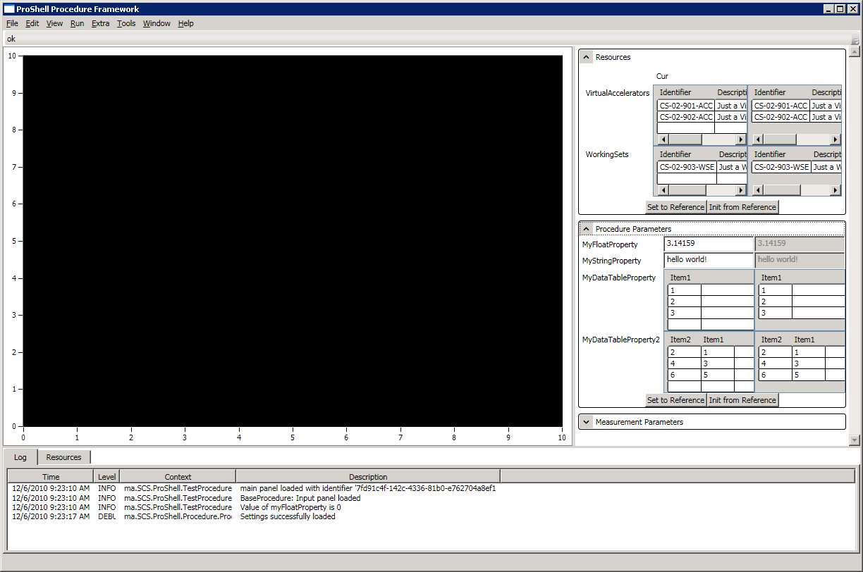
Screenshot

Slide 9
Screenshot
Menu Bar
Main Panel
Input Panel
Log Panel
Status Bar

Slide 10
Procedure
implements a well-defined API in C# to perform a task
  Example: „Emittance measurement“
operates on resources (devices, WS, VAccs)
inherits from BaseProcedure
  default implementations for each function
may override default implementations to customize functions
Handling of user events (button pressed)
Notes:
BaseProcedure: such as the input panel

Slide 11
ProcedureContext
Manages a minimal set of data required by every procedure
  User Interface Elements
  Dynamic loading of procedure
  Loading and saving Configurations
  Provide logging capabilities
  Allocation and deallocation of resources
  A coloured PetriNet used for executing a procedure

Slide 12
Procedure Class Diagram

Slide 13
Resources
Procedures operate on the following types of resources
Basic Devices
  E.g. Vacuum Valve
State Driven Devices
  May contain a list of basic devices
  E.g. Vacuum Control System for a sector
Working Sets
  List of state driven devices
Virtual Accelerators
  List of working sets
Implement
state driven device interface

Slide 14
Resource Hierarchy

Slide 15
Devices
Basic devices provide an API to
  Read default properties (e.g. Name)
State driven devices provide an API to
  control the state machine
  change the mode
  etc.
Additional device types can be added with a custom interface that extends one of the above APIs
  API simplifies the source code in the procedures by not using PVSS dpGet/dpSet directly
  Power converter: ground(), unground() functions
  Beam stopper: moveIn() and MoveOut() functions

Slide 16
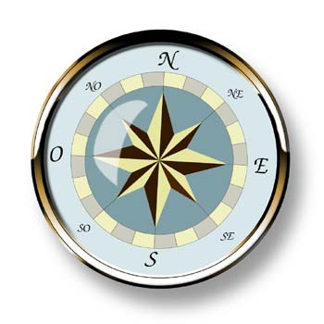
STATUS

Slide 17
Plan since October 2010
Working on the Enterprise Architect Model
  requirements
  architecture and design
Provide an initial ProShell skeleton
  Procedure interface finalized
  Eventually provide integration with PVSS
  Dynamic loading of procedures in progress
  Editor for Coloured PetriNets in progress

Slide 18
Enterprise Architect Model Progress
ProShell Enterprise Architect Model updated
  Now an accurate representation of what is implemented
  Contains initial Requirements
    further time needed
  Architecture and Design
    Cleaned up document
    Aligned to implementation

Slide 19
Implementation Progress
ProShell
  Revised procedure interface
    Only minor changes expected till next MACS week
  Loading and saving of configurations (settings)
  Revised and improved input panel
  Embed NI graph widget
Resource hierarchy
  Basic and state driven devices
  Working Sets (WS) and Virtual Accelerators (VAcc)
  Feedback for PVSSProxy
Petri Net Editor
  Initial implementation (Cosylab, Sunil Sah)

Slide 20
Plan since October 2010
Working on the Enterprise Architect Model
  Requirements
  architecture and design
Provide an initial ProShell skeleton
  Procedure interface finalized
  Integration with PVSS
  Dynamic loading of procedures
  Editor for Coloured PetriNets
    Slow progress
    Very good progress
    Done
    Initial implementation
    (Cosylab) Post-poned to CWO-3
    (Cosylab) Initial implementation

Slide 21
Plan till March 2010
Enterprise Architect Model
  Requirements
Implementation
  Complete resource hierarchy
  Dynamic loading of procedures (Cosylab, Sunil Sah)
  Petri Net Editor (Cosylab, Sunil Sah)
  (Eventually Integration PetriNet Visualization)
Procedure example
  e.g. Dummy emittance measurement
Notes:
Resource hierarchy:
- Adapt to agreed changes

Slide 22
Summary
Ahead of Time
  None
In-Time
  ProShell architecture and design
Behind schedule
  ProShell requirements
  ProShell implementation

Slide 23
Questions?

Slide 24

ADDITIONAL
SLIDES

Slide 25
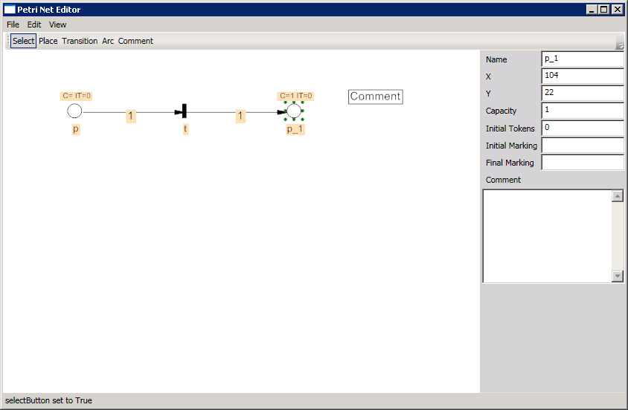
Petri Net Editor

Slide 26
Additional Information
can be found on SVN
  ES-100722-a-RMO ProShell Enterprise Architect Model
  Implementation on SVN
    Proshell: /trunk/SCS/ProShell
    Resource hierarchy: /trunk/common/utils
    PetriNet Editor: /trunk/common/PetriNedEditor

