Slide 1
PVSS State Machine
A library for PVSS control scrips

Slide 2
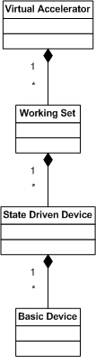
Control Structure
Virtual Accelerator
Working Set
State Driven Device
(e.g. PCC)
Basic Device
(e.g. PCO, VVS)

Slide 3
General State Machine
Each state driven device MUST include the same state machine.
Each state driven device MUST include the same commanding interface.

Slide 4
General State Machine
Each state driven device must understand a set of standard commands state:
  Commands for state transitions
  Prepare (in Op state only)
  Activate (in Op state only)
  Deactivate (in Op state only)
  Finalize (in Op state only)

Slide 5
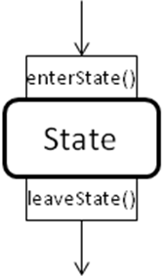

Concept
States
  enterState(): allocate needed resources
  leaveState(): deallocate needed resources
State transition
  Consists out of a leaveState() and a enterState() sequence

Slide 6

Devices connected to NI PXI
Implementation as FEC using FECOS
Processing tier (2)
Equipment tier (3)
State machine
Frontend tier (4)
Basic
Devices

Slide 7
Problems
What to do with basic devices that are connected directly to PVSS?
What to do with PLCs where it is not convenient or possible to implement the state machine?
Processing tier (2)
Equipment tier (3)
interface
Equipment tier (3)
State machine
Basic
Devices
Frontend tier (4)

Slide 8
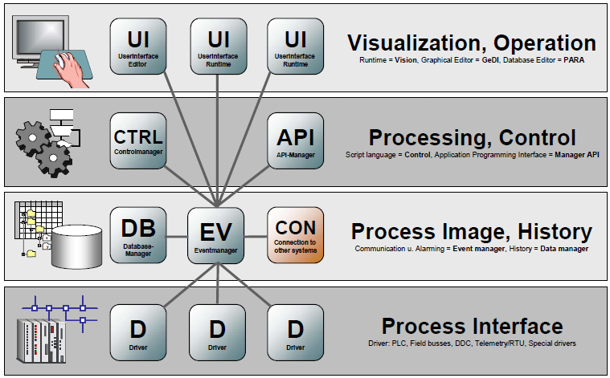
How to implement in PVSS?
With PVSS control scripts
Control scripts running in a PVSS control manager
Presentation tier (1)
State machine control script
Processing tier (2)
Equipment tier (3)

Slide 9
Library and templates
PVSS state machine consists of 3 script files
State Machine library
  Covers all common state machine functions
Device Class template
  For defining device specific functions
Device instance script template
  For creating an instance of a device class

Slide 10
State Machine library
Covers the general state machine
Provides the standard commanding interface
Handles received commands
Handles fail and fault conditions
Provides functions to register and deregister from data point elements
Provides logging functions to the PVSS log

Slide 11
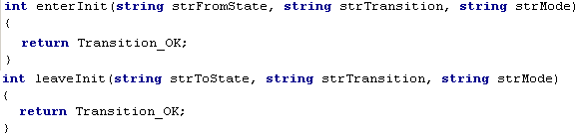

Device Class template
Provides blank functions for enter/leave states
Provides blank functions for the four standard commands
Provides the possibility to add device specific functions

Slide 12
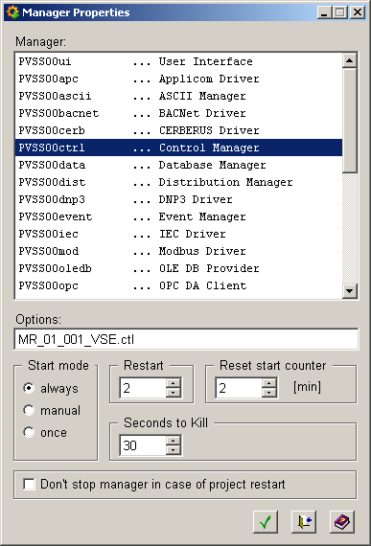

Running a PVSS state machine device
Example: device class VSE, device MR-01-001-VSE
state machine
library
device instance
script
device class
library

Slide 13

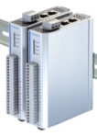
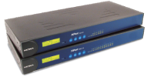
Usage of the PVSS state machine
Vacuum control system
Integration of RF Amplifiers
Integration of special magnet slow control system
Digital I/O
RS485/422/232
Vacuum
Devices

Slide 14
Status/Conclusion
PVSS state machine provides the general state machine functions and commanding interface as all state driven devices within the MACS
Version 1.0.0 is released
All library and template files are available under:
https://svn.cern.ch/reps/macs/trunk/SCS/PVSS/StateMachine
A programmers manual is available under:
https://svn.cern.ch/reps/macs/trunk/sdp/documents/Deployment/PVSSStateMachine/doc

