Slide 1

Device XML Definition

Slide 2

MACS configuration chain
XML documents for device definition
Database filled from XML documents
Configuration created in RMS
Configuration exported to configuration files
Configuration files are read by the individual systems
MACS
XML
File
RMS
DB
config
files
Importer
Exporter

Slide 3
What is needed
Properties of the device
Data type of the properties
Data direction
Property dimension (single or array)
Property unit
Cycle code dependency
Default values
At which tier is the property needed
…

Slide 4
Finding Properties
What will I do with the device and what do I need from the device?
Example: Valve
Statement:
I will open and close the valve and get a response if the valve has opened or closed.
Device investigation:
The valve is operated via a electro magnetic coil. Powering the coil leads the valve to open, removing the power leads the valve to close. In addition the valve has two position switches. One switch is closed when the valve is closed, the other one is closed when the valve is open. If both switches are open, the valve is moving.
M

Slide 5
Finding Properties
Derived properties from the statement and the investigation:
One Boolean to write to the coil. If it is true → powers the coil → opens the valve, if it is false → no power to the coil → closes the valve
Two Boolean to read the position switches. Each Boolean is connected to one position switch, switch open → false, switch closed → true
Name of the properties:
  open_ccv
  isOpen_aqn
  isClosed_aqn

Slide 6
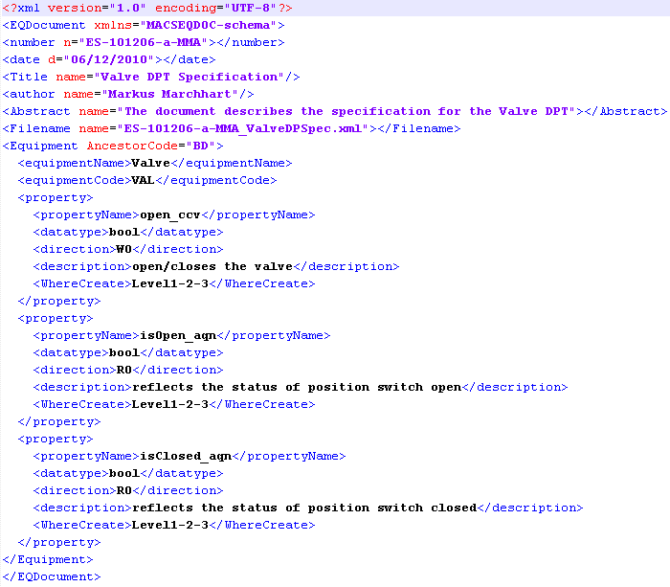
Put it into XML

Slide 7
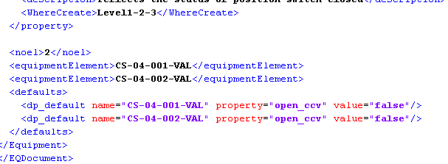
Create device instances
In the same XML document
As separate XML document

Slide 8
Import it into the RMS system
Current status:
Importer parses XML and creates SQL statements
SQL statements need to be copied into an external program and are committed manually to the RMS data base
Outlook:
A graphical user interface that guides through all necessary steps

Slide 9
Next Steps
Q1 2011
  Definition of RMS Importer software
    Parses XML
    Fills DB automatically
  Definition of XML definitions within WP CO
    Power Converter Controller
    Main Timing System
    Conventional magnets
Q2 2011
  Work with WP VAC on definition of devices
Q3 2011
  Work with WP RF and WP SRC on definition of devices

