Slide 1




Thermomechanical material properties of 11T dipole constituents
C. Scheuerlein
With a lot of help of F. Wolf, F. Lackner, Federal Laboratory for Materials Research (BAM), Berlin Heinz Meier Leibnitz Zentrum (MLZ) at TU Munich National High Magnetic Field Laboratory at Florida State University
This is a shortened and updated version of the MSC seminar of the 26th May 2020 “Thermomechanical behaviour of Nb₃Sn magnet constituent materials”
https://indico.cern.ch/event/920016/

Slide 2
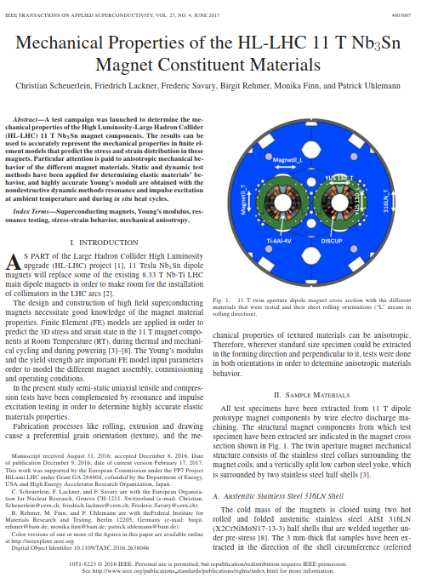
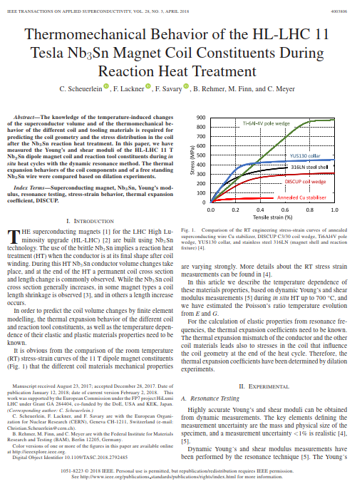
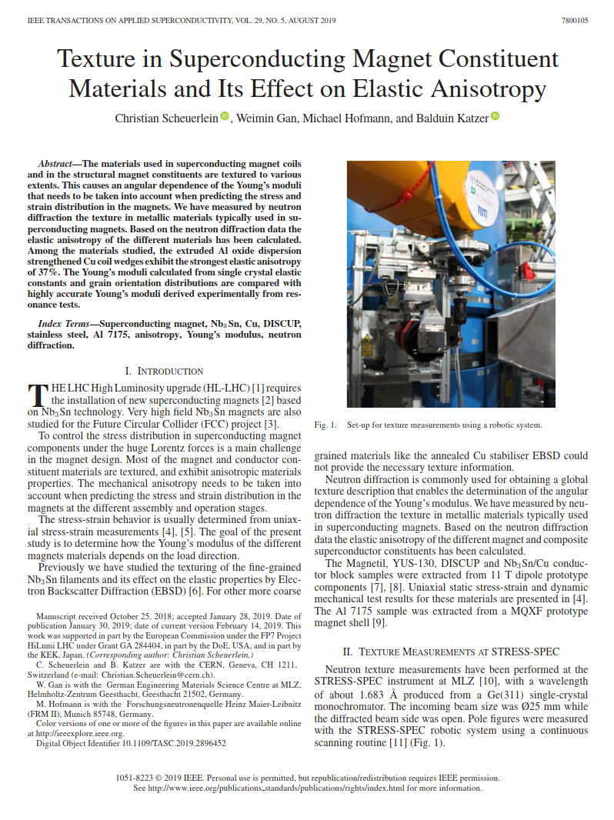
11 T dipole materials thermomechanical behaviour

Slide 3
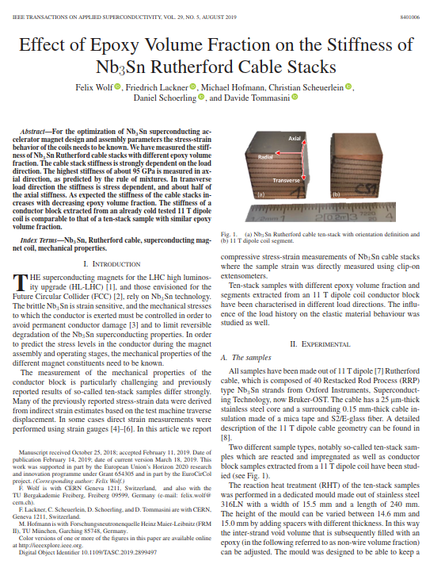
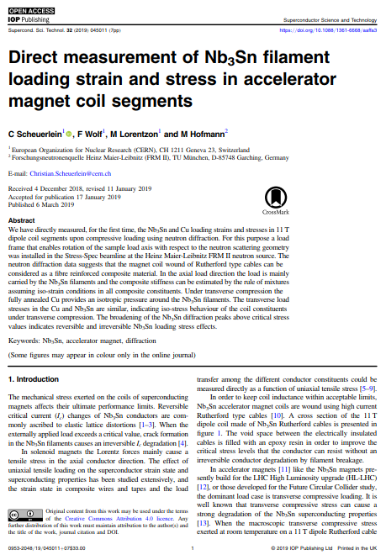
11 T dipole conductor block mechanical behaviour

Slide 4
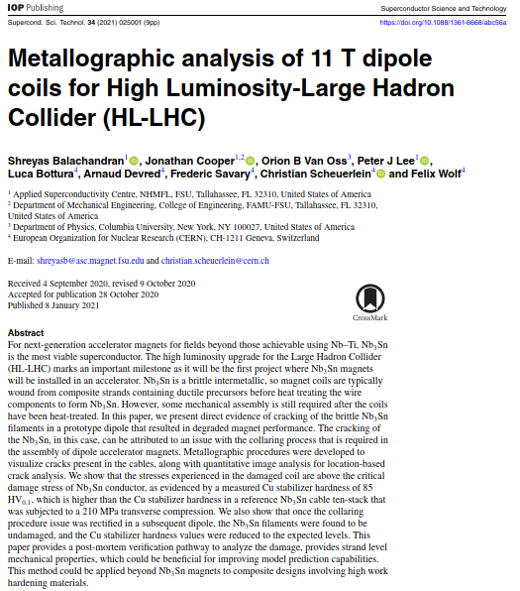
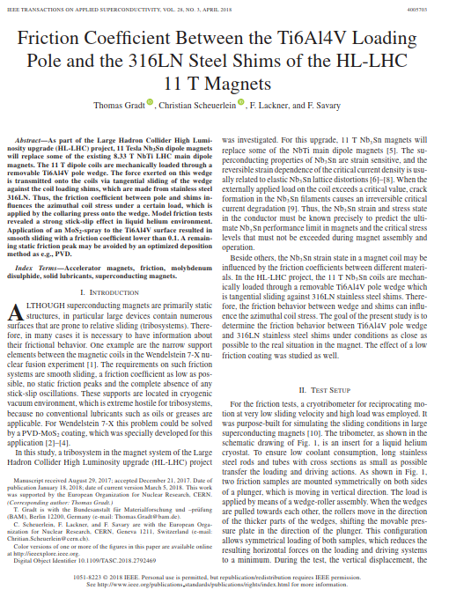
Friction coefficients in ambient air and in liquid He
Post mortem analysis of coil loading peak stress

Slide 5
Friction coefficients in ambient air and in liquid He

Slide 6
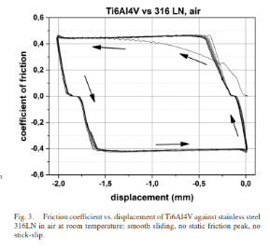
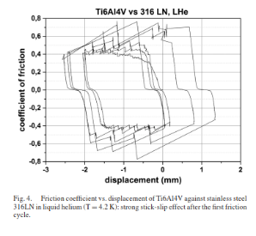
Friction coefficients: effect of temperature
Example: Ti-6Al-4V against 316LN under conditions close to those between the pole wedge and the stainless-steel shims of the 11 T Nb₃Sn magnets [10].
At RT in air stable sliding with a friction coefﬁcient of about 0.4.
At 4.2 K strong stick-slip effect. Maximum friction coefficient of about 0.8.
[10] T. Gradt et al., “Friction-coefficient between the Ti6Al4V loading pole and the 316LN steel shims of the HL-LHC 11 T magnets”, IEEE Trans. Appl. Supercond., 28(3), 2018, Art. no. 4005703
[11] T. Gradt et al., “Cryogenic vacuum tests of scaled down narrow support elements for the W7-X coil system,” Fus. Eng. Des., vol. 84, pp. 840–843, 2009.

Slide 7
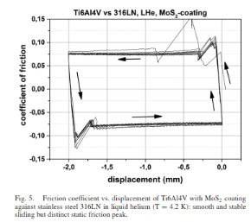
Friction coefficients: effect of lubricant
Application of MoS₂ spray lowers the friction coefﬁcient by nearly one order of magnitude to about 0.08 [10].
Lack of knowledge of friction coefficients may be one of the major uncertainties in FE simulations.

Slide 8
Yielding materials

Slide 9
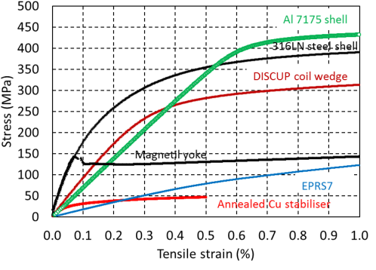
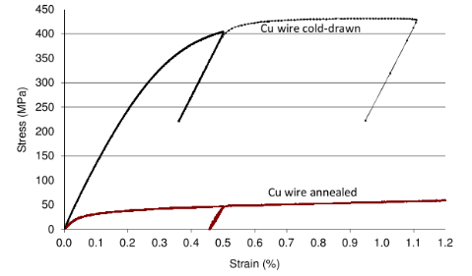
Yielding magnet materials
Many magnet materials do not exhibit linear elastic behaviour, even at low loads.
In particular fully annealed high purity Cu starts to yield at very low stress in the order of 10 MPa.
Annealed Cu is a strain hardening material, i.e. its yield stress increases with increasing plastic deformation.
Cu flows (creeps) when the flow stress (the applied stress needed to maintain plastic flow of a material) is exceeded.
The yielding of annealed Cu is very beneficial, but causes also a major challenge in the modelling of Nb₃Sn accelerator magnets thermomechanical behaviour.
Stress-strain curves of different SC magnet materials
Stress-strain curves of Cu wire cold-drawn and after subsequent 695 °C HT [16].
[16] C. Scheuerlein, F. Lackner, F. Savary, B. Rehmer, M. Finn, P. Uhlemann, “Mechanical properties of the HL-LHC 11 Tesla Nb₃Sn magnet constituent materials”, IEEE Trans. Appl. Supercond., 27(4), (2017), 4003007

Slide 10
Nb₃Sn conductor block Young’s moduli

Slide 11
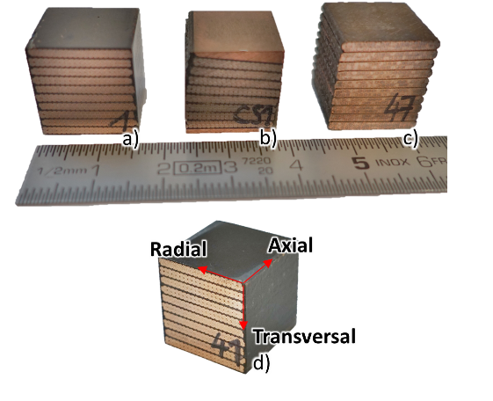
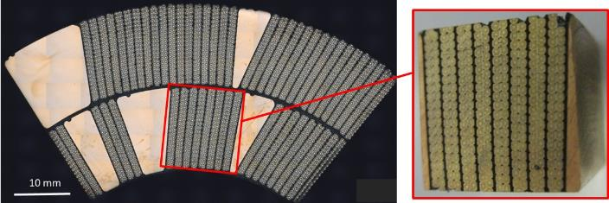
Samples for uniaxial compressive stress-strain measurements
Samples made of Nb₃Sn 11 T dipole Rutherford cables with mica and S2 glass insulation.
(a) Ten-stack samples impregnated with epoxy resin CTD-101K with different epoxy volume fractions.
(b) Cubes machined out of 11 T dipole conductor block, containing 8 Rutherford cables and part of the adjacent coil wedges to compensate for the cable keystone angles.
(c) Non impregnated ten-stack samples.
Courtesy Felix Wolf 11 T conductor block sample was prepared by CERN central workshop team
[24] F. Wolf, F. Lackner, M. Hofmann, C. Scheuerlein, D. Schoerling, D. Tommasini, “Effect of epoxy volume fraction on the stiffness of Nb₃Sn Rutherford cable stacks” IEEE Trans. Appl. Supercond., 29(5), (2019), Art. no. 8401006

Slide 12
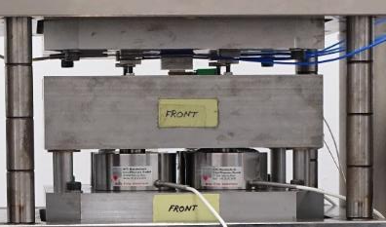
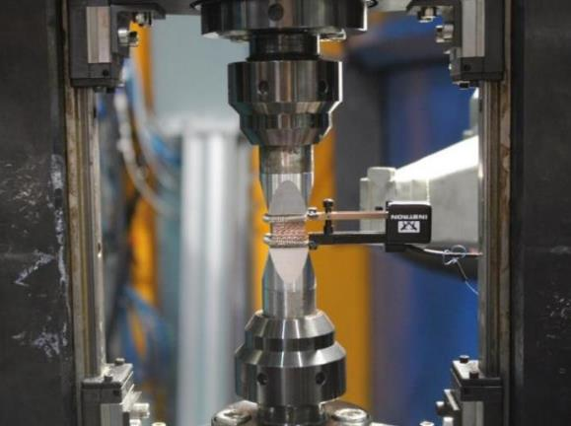
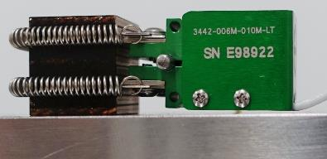
Two set-ups used for compressive stress-strain measurements
Set-up at CERN inserted in a hydraulic press
Set-up at MLZ StressSpec materials science neutron beam line
Ten-stack sample with clip-on extensometer Epsilon 3442-006M-010-LT Class B-1 with 6 mm gauge length.
Sample with clip-on extensometer Instron 2620-602 with 12 mm gauge length. 50 kN load frame with load cells (HBM Typ 03, 50 kN)
Courtesy Felix Wolf
Courtesy M. Hofmann and MLZ StressSpec team

Slide 13
Axial Young’s modulus: Experiment vs rule of mixture (ROM) estimate
Stress strain measurements in axial compression with ten-stack samples with different epoxy volume fraction.
Assuming E_{wire-axial}=126 GPa and E_{epoxy}=4 GPa.
Ten-stack stiffness can be predicted assuming iso-strain conditions (according to Voigt). The load is essentially carried by the wire, and the stress in the epoxy remains small.
Comparison of stress-strain curves of Nb₃Sn wire (axial tension) and ten-stack samples wire different volume fraction (V_{wire}) (axial compression) [24].
ROM estimation (upper bound) of the axial compression stiffness dependence on V_{wire} and comparison with experiment.
Courtesy Felix Wolf

Slide 14
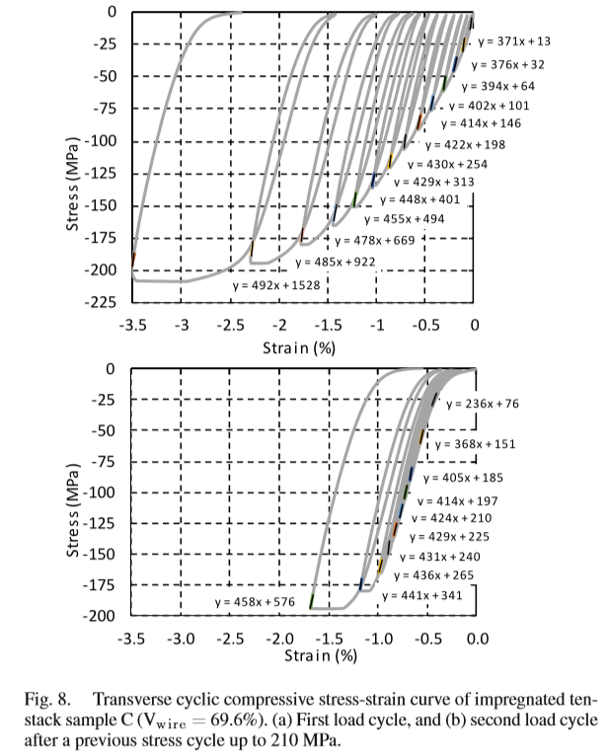
Transverse Young’s modulus: Effect of previous load cycles and unloading stress
Cyclic loading hysteresis is strongly reduced in second load cycle.
A strong creep behaviour is observed when the transversal load exceeds about 125 MPa.
Small effect of previous load cycle on ten-stack Young’s modulus.
Courtesy Felix Wolf

Slide 15
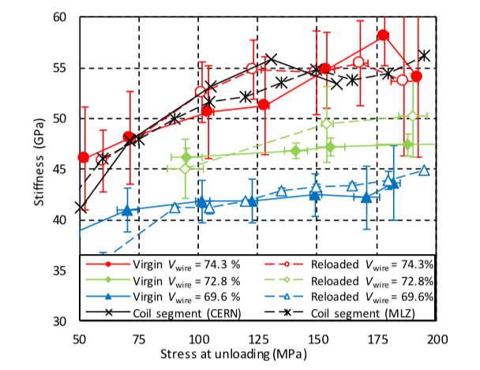
Transverse Young’s modulus of the 11 T dipole conductor block and effect of epoxy volume fraction
Young’s modulus decreases with increasing epoxy volume fraction in the ten-stack samples.
11 T dipole conductor block Young’s modulus corresponds with that of ten-stack with about 25% epoxy.
Identical Young’s modulus vs unloading stress behaviour measured with CERN and MLZ set-ups, with extensometer gauge lengths of 6 mm and 12 mm, respectively.
40 GPa < E_{transverse} < 55 GPa in the unloading stress range from 50 to 125 MPa
Transverse Young’s modulus of 11 T dipole cable stacks dependence on epoxy volume fraction, unloading stress [24].
Courtesy Felix Wolf

Slide 16
Nb₃Sn conductor block constituents stress-strain behaviour in axial and transverse load directions

Slide 17
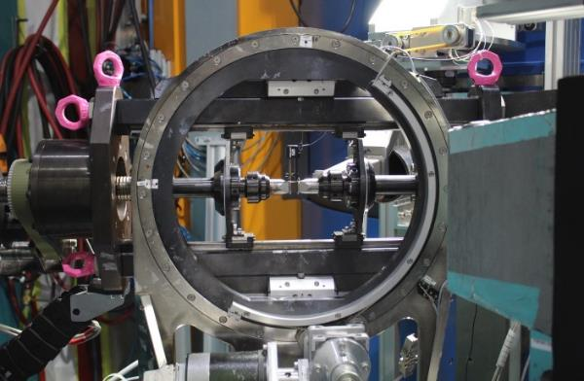
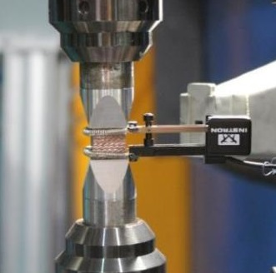
Set-up for combined stress-strain and diffraction measurements
Lattice strain (elastic strain) in Nb₃Sn and Cu is measured by neutron diffraction in axial, radial and transverse directions.
Gauge volume 5×5×5 mm³ in the centre of the samples.
Macroscopic sample strain is measured simultaneously with an extensometer.
(a)
(b)
(a) Load frame mounted in Eulerian cradle in the Stress-Spec beamline. (b) Ten-stack sample and extensometer mounted for combined stress-strain and diffraction measurements.
[25] C. Scheuerlein, F. Wolf, M. Lorentzon, M. Hofmann, “Direct measurement of Nb₃Sn filament loading strain and stress in accelerator magnet coil segments”, Supercond. Sci. Technol., 32, (2019), 045011 (7pp)

Slide 18
Transverse compression: Nb₃Sn and Cu loading strain and stress
Loading strains and stresses are calculated from the relative changes of the diffraction angles.
Cu is under similar compressive stress in all three directions.
The magnitude of the Cu pressure corresponds approximately with the externally applied transverse compressive stress.
Uniaxial transverse compression induces an important axial tensile stress in the Nb₃Sn filaments.
(a) Nb₃Sn (321) and (b) Cu (220) lattice strains and (c) Nb₃Sn (321) and (d) Cu (220) loading stresses as a function of externally applied transverse compressive stress.

Slide 19
Transverse compression: Nb₃Sn and Cu loading stresses
Transverse Nb₃Sn and Cu loading stresses increase linearly with the externally applied transverse stress (iso-stress conditions in the composite in transverse load direction).
In axial and radial directions, the isotropic Cu pressure induces an important axial and radial tensile stress in Nb₃Sn upon uniaxial transverse compression.
Comparison of Nb₃Sn (321) and Cu (220) loading stress evolution in (a) transverse, (b) axial and (c) radial direction [25].

Slide 20
Axial compression: Nb₃Sn and Cu loading stresses
When the macroscopic axial pressure on the cable stack exceeds about 100 MPa, the Cu elastic strain remains constant and the load is mainly carried by Nb₃Sn (and Nb) filaments.
At 150 MPa externally applied pressure the axial Nb₃Sn (321) and Cu (220) loading stresses are about 300 MPa and 100 MPa, respectively.
(a) Nb₃Sn and (b) Cu loading stresses in impregnated cable stack as a function of axial compressive stress. Encircled data points show the residual strain when the external stress is released.

Slide 21
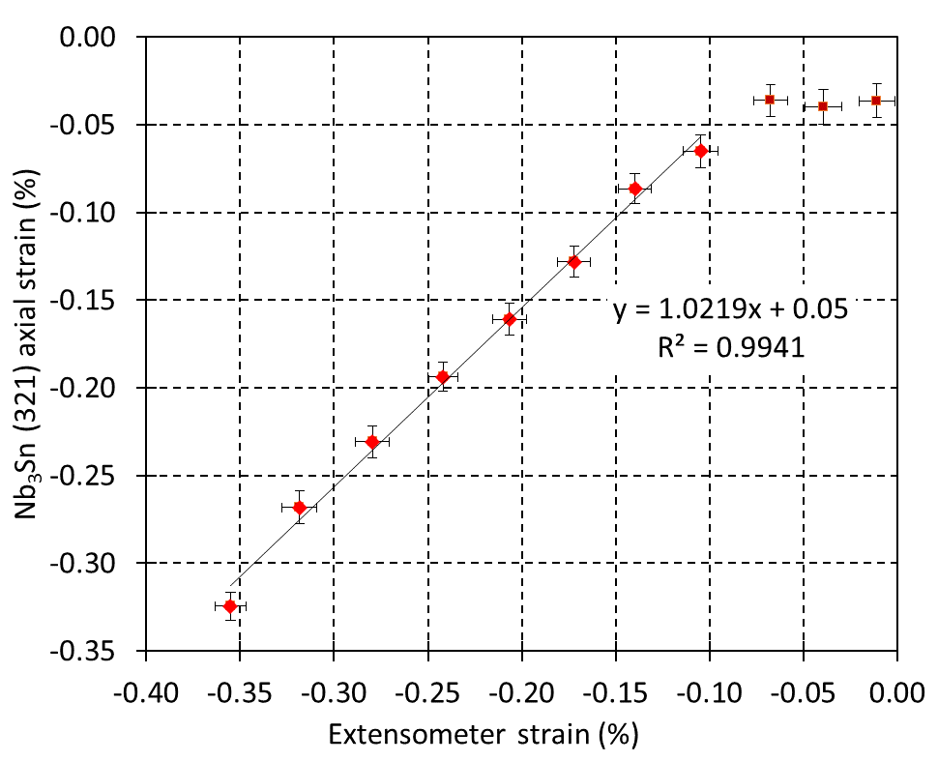
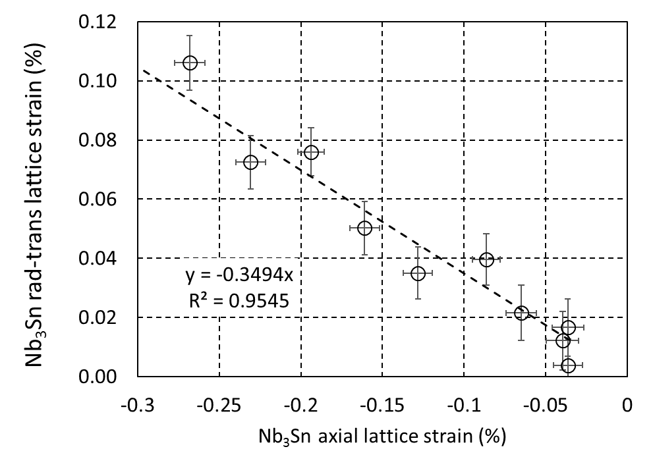
Axial compression: Nb₃Sn loading strain vs macroscopic sample strain
When the macroscopic strain exceeds 0.1%, the elastic Nb₃Sn strain increases with a slope close to unity, confirming that the strain in all conductor constituents is equal.
Transverse and radial Nb₃Sn lattice spacing changes are mainly caused by the Poisson effect (assuming a Poisson’s ratio of about 0.36).
Elastic axial strain derived from neutron diffraction data as a function of the macroscopic sample strain measured with an extensometer.
Average transverse and radial Nb₃Sn (321) strain as a function of axial strain.

Slide 22
Post mortem analysis of 11 T dipole coil

Slide 23
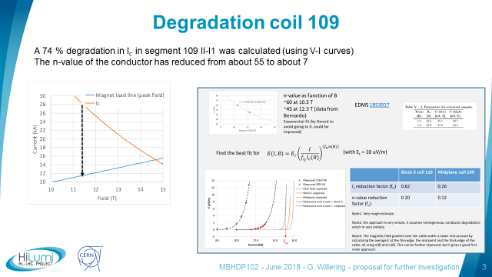
Critical current limitation of 11 T dipole short model coil #109
During cold testing of 11 T dipole short model MBHDP102 critical current limitations at the coil mid-plane turns were detected.
Precise voltage-current measurements revealed a particularly strong critical current and n-value degradation of coil #109, indicating Nb₃Sn filament cracking.
The degradation is presumably due to excessive mechanical stresses applied during collaring.
V-I curves measured during cold test , indicating a strong critical current degradation in 11 T dipole coil #109. Courtesy G. Willering https://indico.cern.ch/event/739669/
[30] G. Willering et al, “Comparison of cold powering performance of 2m long Nb3Sn 11T model magnets”, IEEE Trans. Appl. Supercond. 28, 2018, 4007205

Slide 24
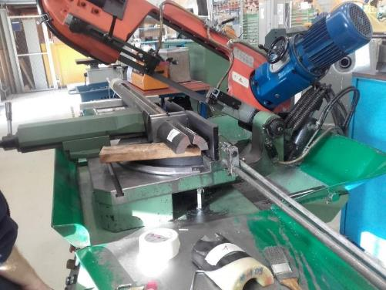
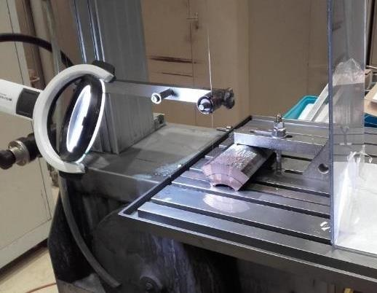

Post mortem analysis of coil #109
Rough cutting of about 30 cm long coil segments
Precision cutting of 10 mm and 20 mm thick segments with diamond saw.
rough and (b) precision cutting of 11 T dipole short model coil #109. Courtesy Sylvain Caille‎

Slide 25
Visualisation of Nb₃Sn cracks in coil #109 metallographic cross section
Metallographic examination reveals:
Cracks in some Nb₃Sn filaments
Deformation contrast in copper
Cu grains appear smaller in certain regions.
Metallographic cross section of 11 T dipole coil #109 segment with Nb₃Sn cracks. Courtesy S. Balachandran, P.J. Lee, J. Cooper, and NHMFL-ASC team

Slide 26
Nb₃Sn crack distribution in coil #109 metallographic cross section
Distribution of cracks in 11 T dipole coil #109 Courtesy S. Balachandran, P.J. Lee, J. Cooper, and NHMFL-ASC team

Slide 27
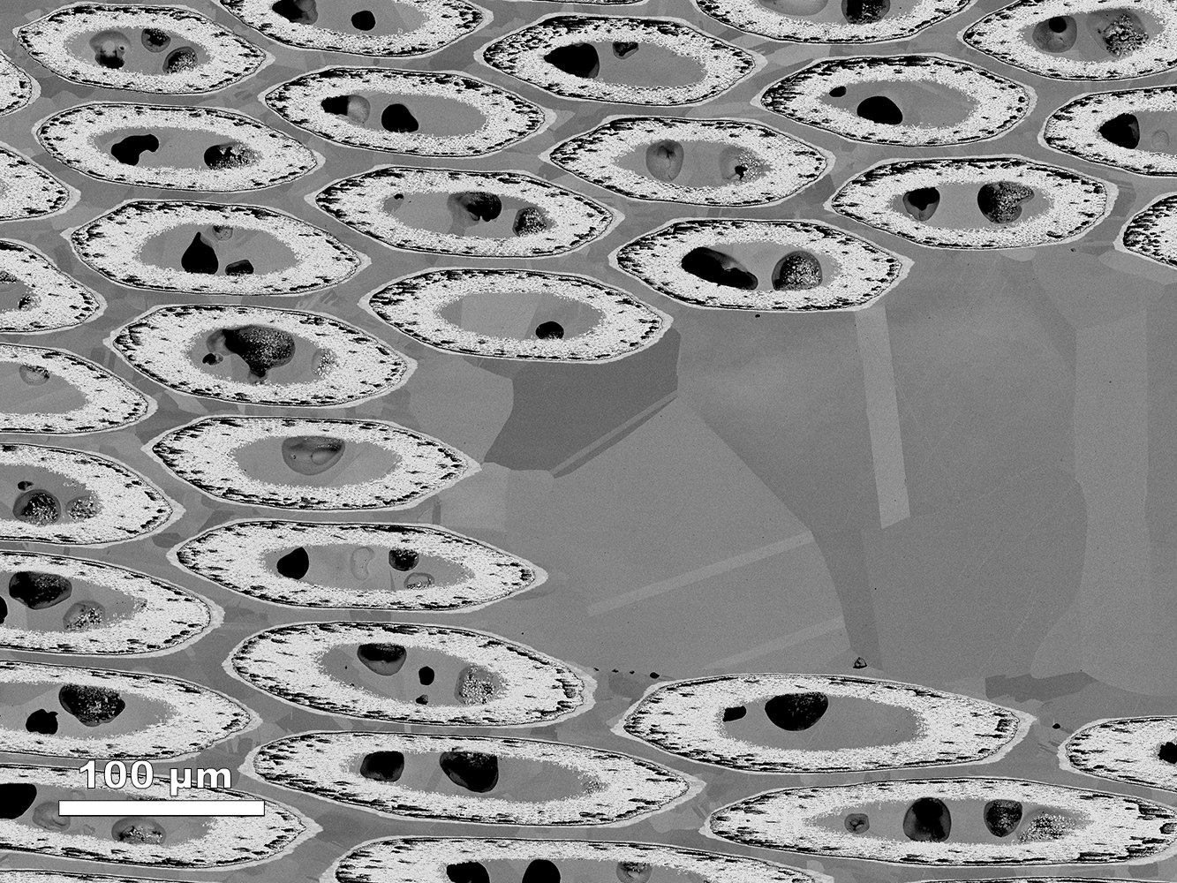
Absence of cracks in the Nb₃Sn filaments in coil GE-C02 metallographic cross section
Coil GE-CO2 is a series 11 T dipole coil with optimised insulation scheme.
It is assumed that the mechanical stress on the conductor during the improved collaring procedure did not exceed the critical stress above which filament breakage occurs.
V-I measurements during magnet cold test did not reveal any signs of a critical current limitation in the investigated coil part.
Metallographic cross sections of coil GE-CO2 have been studied in order to confirm the absence of Nb₃Sn cracks in series production coils, and as additional confirmation that the cracks visualised in #109 metallographic cross sections are not caused by experimental artefacts.
Metallographic cross sections of Nb3Sn subelements in coil GE-C02 Courtesy S. Balachandran, P.J. Lee, J. Cooper, and NHMFL-ASC team

Slide 28
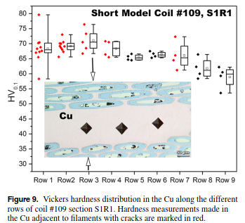
Cu Vickers hardness distribution in coil #109 metallographic cross section
Nb₃Sn crack density and Cu stabiliser hardness in #109 appear to be correlated.
Nb₃Sn cracks are formed when the stress exceeds approximately the stress needed for Cu work hardening to HV₁₀₀=70.
Vickers hardness distribution in 11 T dipole coil #109 metallographic cross sections Courtesy S. Balachandran, P.J. Lee, J. Cooper, and NHMFL-ASC team

Slide 29
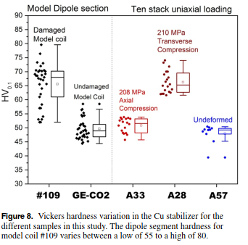
Vickers hardness for assessing Cu loading stress
Cu hardness measurement in 11 T dipole coil segments and cable stacks at NHMFL-ASC
Cu hardness in the 210 MPa axial loaded ten stack is comparatively small (iso-strain, the load is mainly carried by Nb₃Sn).
Substantial Cu work hardening in the 210 MPa transverse loaded ten stack (iso-stress, the Cu stress corresponds with the applied stress).
Maximum loading stress in the straight coil part:
model coil #109 >210 MPa.
series coil GE-C02 <<210 MPa.

Slide 30
Conclusion
Strongly different friction behaviour and coefficients in ambient air and in LHe. Application of lubricant can reduce friction coefficients in LHe by one order of magnitude.
Non-linear and non-elastic stress strain behaviour of many magnet materials, in particular of annealed Cu.
Nb₃Sn coil conductor block can be considered as a fibre reinforced composite:
Iso-strain in axial load direction
Iso-stress in transverse load direction
The 11 T dipole conductor block materials properties are strongly anisotropic. Young’s moduli at RT are:
E_{axial}=95 GPa
40 GPa < E_{transverse} < 55 GPa (in the unloading stress range from 50 to 125 MPa)
Post mortem metallographic characterisation of 11 T dipole short model coil #109 reveal:
Nb₃Sn filament cracks that can explain the critical current limitation of this coil revealed during magnet cold test (no Nb₃Sn cracks are found in the metallographic cross sections of the optimised 11 T dipole series coil GE-C02).
Indentation hardness measurements in the Cu stabiliser are an opportunity for post mortem analysis of the stress distribution during collaring (Nb₃Sn filament crack density and hardness of adjacent Cu stabiliser appear to be correlated).
Comparison with the Cu hardness in 11 T dipole cable ten-stacks that were submitted to well defined loads allows to conclude that the coil #109 peak loading stress was >>210 MPa.

Slide 31
Back-up slides

Slide 32
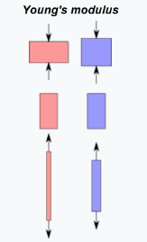
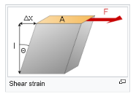
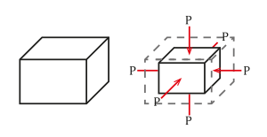
Elastic modulus definitions
Young’s modulus
“Specifying how stress and strain are to be measured, including directions, allows for many types of elastic moduli to be defined. The three primary ones are:”
“Young's modulus (E), is a mechanical property that measures the stiffness of a solid material …. in the linear elasticity regime of a uniaxial deformation.
The shear modulus (G) describes an object's tendency to shear (the deformation of shape at constant volume).
The bulk modulus (K) describes the material's response to (uniform) hydrostatic pressure.“
Shear modulus
Bulk modulus
From: https://en.wikipedia.org/wiki/Elastic_modulus

Slide 33
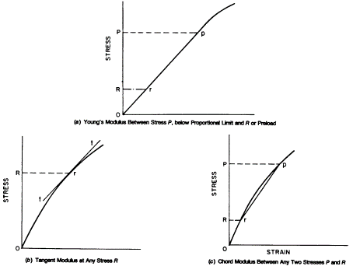
Young’s modulus vs tangent and chord moduli
Young’s modulus is a materials property (which ideally is independent on strain and stress).
For materials that exhibit nonlinear stress-strain behaviour (for instance stainless steel), the value of tangent or chord modulus is sometimes used to describe the magnitude of strain at a certain applied stress.
Tangent modulus is stress dependent and chord modulus is stress range dependent.
Young’s modulus
Tangent modulus Chord modulus
“Standard Test Method for Young’s Modulus, Tangent Modulus, and Chord Modulus”, ASTM E111, 2004. https://cds.cern.ch/record/1463298 /files/BO2kndPxouGDY.pdf?

Slide 34
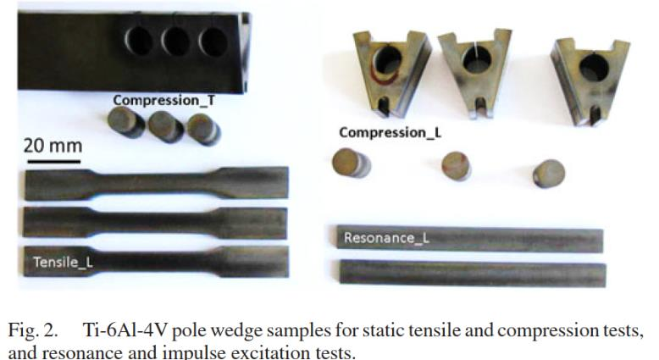
Samples for Young’s modulus measurements
Dynamic tests with long thin beams with rectangular cross section (3 mm × 9 mm × 100 mm)
Uniaxial static tensile tests with ﬂat samples DIN 50125-E3 × 8 × 30
Uniaxial static compression tests with cylinder samples ∅ 10 mm, height 15 mm
Standardized test samples for dynamic and static tensile and compression tests. All samples have been extracted from a Ti-6Al-4V pole wedge by electrical discharge machining. Courtesy CERN central workshop team.

Slide 35
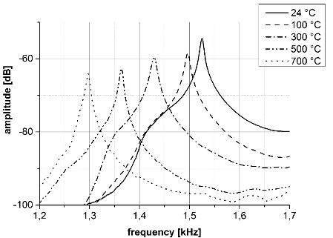
Dynamic E-modulus measurements
Highly accurate Young’s moduli can be derived from dynamic tests.
Measurement uncertainty is mainly defined by the mass and the dimensions of the specimen [1].
A measurement uncertainty < 1 % is realistic [2,3].
Typical differences between dynamic and static Young’s moduli (adiabatic vs isothermal modulus) are <1 % [2].
Temperature dependent dynamic Young’s modulus measurements are possible when the thermal expansion coefficients are precisely known.
Resonance peak of the first bending oscillation of rectangular 316LN specimen at different temperatures [4].
[1] J.D. Lord, R. Morrell, NPL Good Practice Guide No. 98 “Elastic Modulus Measurement”, NPL London 2006
[2] F.H. Newmann, V.H.L. Searle, The general properties of matter. Issue 5, Edward Arnold, 1962
[3] ASTM E 1875 “Standard Test Method for Dynamic Young´s Modulus, Shear Modulus, and Poisson´s Ratio by Sonic Resonance”. 2013, ASTM International.
[4] C. Scheuerlein, F. Lackner, F. Savary, B. Rehmer, M. Finn, C. Meyer, “Thermomechanical behavior of the HL-LHC 11 Tesla Nb₃Sn magnet coil constituents during reaction heat treatment”, IEEE Trans. Appl. Supercond., ”, IEEE Trans. Appl. Supercond., 28(3), 2018, Art. no. 4003806

Slide 36
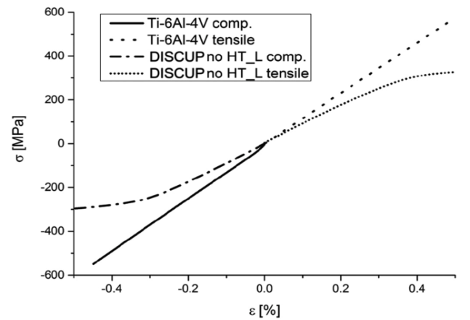
Static Young’s modulus measurement in tension and compression
For the materials discussed here, stress strain curves in tension and compression are nearly identical.
Direct strain measurement using an extensometer is crucial.
Static Young’s modulus measurement by tensile tests uncertainty is typically 3%.
For materials that do not exhibit pronounced linear stress strain behaviour (e.g. stainless steel), the uncertainty of the E-modulus derived from static tests can be >10% [5].
Static Young’s modulus measurement by compression tests uncertainty is typically 5%.
Additional constraints for compression tests:
Sample height to diameter ratio should be small in order to avoid buckling.
Friction between contact surfaces needs to be minimised.
Comparison of tensile and compressive stress-strain curves of Ti-6Al-4V and DISCUP up to 0.5 % strain [iv].
[5] Ch. Weißmüller, H. Frenz, “Messunsicherheit bei der Ermittlung des E‑Moduls im Zugversuch an Stahl“, Materials Testing, vol. 55, no. 9, 2013, pp. 643-647

Slide 37

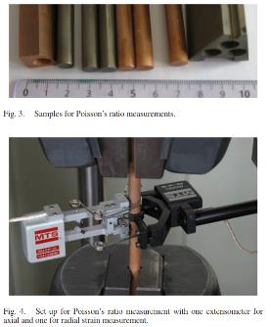

Relation of elastic constants in homogeneous isotropic materials
The Young’s modulus (E), shear modulus (G), bulk modulus (K) and Poisson’s ratio (ν) of homogeneous isotropic materials are related (Equation 1):
$E$=2G(1+ν)=3K(1-2ν) Equation 1
Comparison of static and dynamic Young’s moduli (E), dynamic shear modulus (G), Poisson’s ratio (ν) measured by extensometry, and ν calculated from E and G (ν=E/2G-1).
 | E-static tension (GPa) | E-static compr. (GPa) | E-dynamic (GPa) | G-dynamic (GPa) | ν=(E/2G-1) | ν measured
Ti-6Al-4V | 115±1 (L) | 120±2 (L) 116±2 (T) | 115 (L) | 43.6 | 0.32 | 0.32±0.03
Al 7175 | 68.9 | not measured | 68.5 | 25.4 | 0.35 | 0.33 [7]
316 LN | 183±7 (L) | not measured | 191 (L) | 74.5 | 0.28 | 0.25 [8]
[6] E=114 GPa, G=42.1 GPa, and ν=0.34 reported in: http://www.matweb.com/search/DataSheet.aspx?MatGUID=10d463eb3d3d4ff48fc57e0ad1037434
[7] E=72 GPa, G=27 GPa, and ν=0.33 reported in: http://www.matweb.com/search/datasheet_print.aspx?matguid=13ca3d21315b4632b4330965f0e01c31
[8] E=193 GPa, G=77 GPa and ν=0.25 reported in: http://www.matweb.com/search/datasheet.aspx?matguid=5edc39d3b0fd44efa9fdd90d049c3737

Slide 38
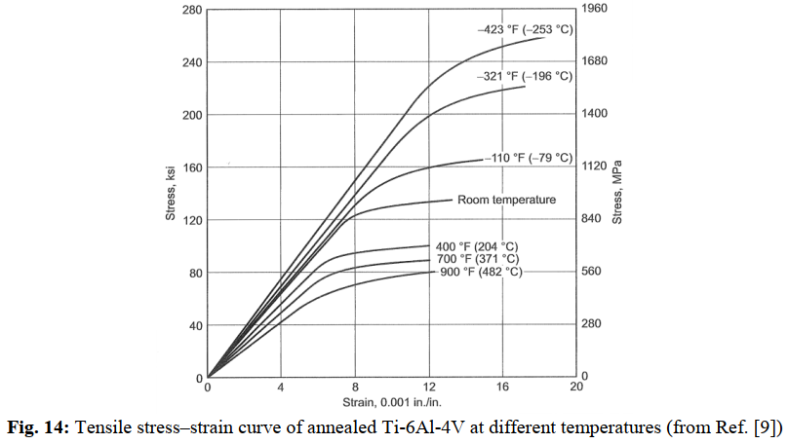
Young’s modulus temperature dependence-example Ti-6Al-4V
Young’s modulus is determined by the binding forces between atoms.
Young’s modulus is not strongly influenced by alloying elements and by the degree of strain work.
Young’s modulus is temperature dependent (for many metals it is at 4.2 K roughly 10% higher than at RT.
[9] P. Duthil, “Materials at low temperature” http://cds.cern.ch/record/1973682/files/arXiv:1501.07100.pdf
Atlas of Stress-Strain Curves, 2nd ed. (ASM International, 2002)

Slide 39
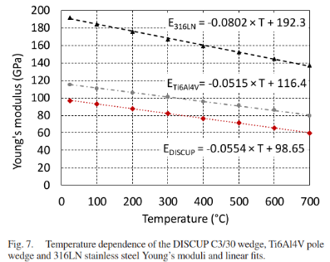
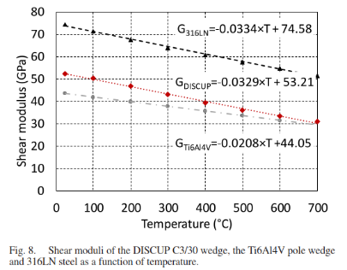
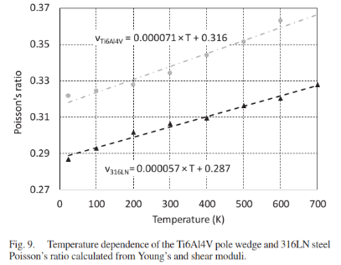
Resonance test for measuring the temperature dependence of E, G, and ν
During Nb₃Sn reaction heat treatment the coil materials and the reaction mold are heated to typically 650 °C.
The temperature dependence of the elastic properties of different coil and reaction mold materials has been derived from the resonance frequencies measured in situ during heat cycles in a vacuum furnace.
Stainless steel 316LN, Ti-6Al-4V and DISCUP C30 temperature dependence of (a) Young’s modulus (E) and (b) shear modulus (G). (c) Poisson’s ratio (ν) temperature dependence of 316LN and Ti6Al4V [4].

Slide 40
Calculation of Young’s modulus from resonance frequencies
For long thin beams with rectangular cross section the Young´s modulus (E) is calculated from the mass (m), length (L), width (b) and thickness (t) of the beam, and its fundamental frequency in bending (f_{f}).
where
ASTM E 1875 “Standard Test Method for Dynamic Young´s Modulus, Shear Modulus, and Poisson´s Ratio by Sonic Resonance”. 2013, ASTM International

Slide 41
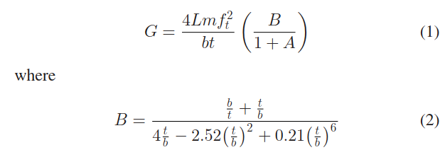
Calculation of shear modulus from resonance frequencies
For long thin beams with rectangular cross section the shear modulus (G) is calculated from the mass (m), length (L), width (b) and thickness (t) of the beam, and its fundamental frequency of the beam in torsion (f_{t}).
The term A can be ignored if the ratio 1 < b/t < 2.
ASTM E 1875 “Standard Test Method for Dynamic Young´s Modulus, Shear Modulus, and Poisson´s Ratio by Sonic Resonance”. 2013, ASTM International

Slide 42
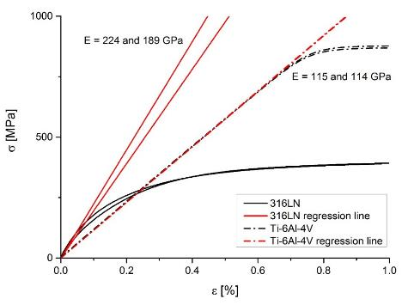
Young’s modulus measurement: uniaxial tensile tests
Precise Young’s moduli can be derived from stress-strain measurements of materials that exhibit pronounced linear elastic behaviour (e.g. Ti6Al4V).
For materials that do not exhibit pronounced linear stress strain behaviour (e.g. stainless steel and annealed copper), the uncertainty of the E-modulus derived from static tests can be >10%.
.
Comparison of the RT engineering stress-strain curves of different coil and magnet materials [iv].
Comparison of 316LN and Ti6Al4V stress-strain curves and linear fits for the determination of Young’s modulus.
[5] Ch. Weißmüller, H. Frenz, “Messunsicherheit bei der Ermittlung des E‑Moduls im Zugversuch an Stahl“, Materials Testing, vol. 55, no. 9, 2013, pp. 643-647
[] “Mechanical properties of the HL-LHC 11 Tesla Nb₃Sn magnet constituent materials”, IEEE Trans. Appl. Supercond., 27(4), (2017), 4003007

Slide 43
Linear thermal expansion coefficients
Coefﬁcient of thermal expansion of different polymers and metallic magnet constituents (reference temperature T₀=20 °C).
Relative length changes of Cu, DISCUP C3/30, Ti-6Al-4V, stainless steel 316LN and Nb (literature). Reference temperature T₀=20 °C) [4].

Slide 44
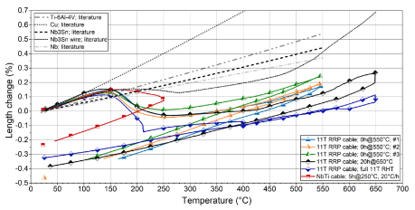
Thermal expansion of unconfined Nb₃Sn conductor during RHT
Nb₃Sn RRP type wire axial and radial expansion during RHT. The thermal expansion of Cu is shown for comparison [20].
11 T dipole Nb3Sn Rutherford cable axial length change during RHT [23].
[22] C. Scheuerlein, J. Andrieux, M. Michels, F. Lackner, C. Meyer, R. Chiriac, F. Toche, M. Hagner, D. Michiel, “Effect of the fabrication route on the phase and volume changes during the reaction heat treatment of Nb3Sn superconducting wires”, Supercond. Sci. Technol., 2020, https://doi.org/10.1088/1361-6668/ab627chttps://iopscience.iop.org/article/10.1088/1361-6668/ab627c/pdf
[23] M. Michels et al, “Length Changes of Unconfined Nb3Sn Rutherford Cables during Reaction Heat Treatment”, IEEE Trans. Appl. Supercond., 29(5), (2019), Art. no. 6000605

Slide 45
Calculation of the angular dependence of the Young’s moduli: The models of Reuss, Voigt and Hill
In order to determine the angular dependence of Young’s moduli, neutron texture measurements have been performed and elastic anisotropy was calculated from the diffraction data and single crystal elastic constants (courtesy W. Gan, STRESS-SPEC materials science beamline at MLZ ).
Young’s moduli of polycrystalline materials can be calculated with the assumptions that either the strain (Voigt) [12] or the stress (Reuss) [13] are constant in the entire material.
In most cases, the experimentally determined Young’s moduli of polycrystalline metals are between the upper (Voigt) and lower (Reuss) bounds predicted by these models.
For many materials, the experimentally determined Young’s moduli are close to those calculated according to the Hill model (arithmetic mean of the Reuss and Voigt values) [14].
[12] W. Voigt,LehrbuchderKristallphysik.Berlin,Gerrmany:Springer,1910
[13] A. Reuss, “Berechnung der Fieẞgrenze von Mischkristallen auf Grund der Plastizittsbedingung ﬁir Einkristalle” Zeitschrift Angewandte Math. Mech., vol. 9, pp. 49–58, 1929
[14] R. Hill, “The elastic behaviour of a crystalline aggregate,” Proc. Phys. Soc., vol. A65, pp. 349–354, 1952

Slide 46
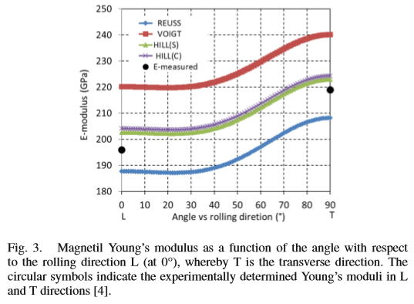
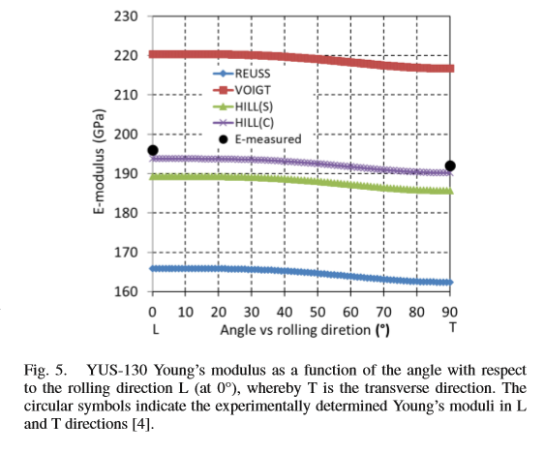
Magnetil yoke and YUS-130 collar elastic anisotropy
The yoke of the LHC dipole and the 11 T dipole is made of hot rolled sheets of an ultralow carbon steel (trademark “Magnetil”). The texturing produced by the rolling process is optimised for the magnetic properties of the yoke.
The 3 mm-thick collars of the 11 T dipole magnets are made by ﬁne-blanking of austenitic steel X8CrMnNiN19-11-6 sheet (tradename YUS-130)
Young’s moduli measured by the resonance method are within the upper and lower bounds calculated according to Reuss and Voigt, and are close to the calculated Hill values (E_{magnetil-L}=196 GPa, E_{magnetil-T}=219 GPa, and E_{YUS−130L} =196 GPa, E_{YUS−130T}=192GPa).
Voigt
[15] C. Scheuerlein , W. Gan, M. Hofmann, B. Katzer, “Texture in Superconducting Magnet Constituent Materials and its Effect on Elastic Anisotropy”, IEEE Trans. Appl. Supercond., 29(5), 2019, Art No. 7800105

Slide 47
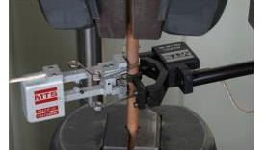
DISCUP coil wedges elastic anisotropy
The strong texture causes an elastic anisotropy of about 40%.
The simple relation between E, G and ν does not apply in the case of anisotropic materials (note the Poisson’s ratio calculated with ν=E/2G-1 is negative).
The DISCUP Poisson’s ratio determined directly by extensometry is ν=0.43.
Voigt
Hill
Angular DISCUP Young’s modulus dependence with respect to the wedge extrusion direction. Calculated assuming equal strains (Voigt) and equal stresses (Reuss) in all grains, respectively. Young’s moduli derived from stress-strain compression tests are shown for comparison [15].
 | E-tension (GPa) | E-compr. (GPa) | E-dyn. (GPa) | G-dyn. (GPa) | ν=E/2G-1 | ν meas.
DISCUP C30/3 | 96.5 (L) | 91±1 | 87±2 | 54 | -0.2 | 0.43 ±0.02

Slide 48
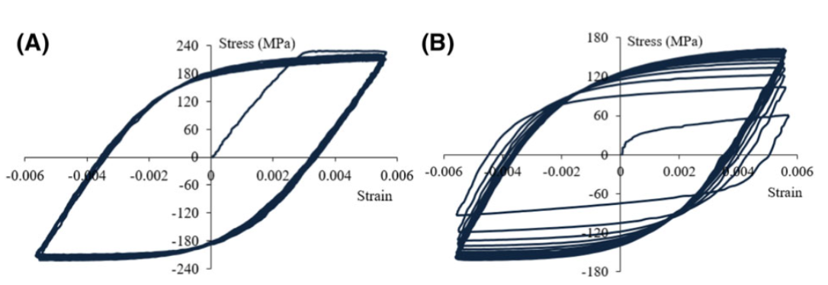
Strain hardening of Cu
Effect of Cyclic loading of copper in tension and compression:
(A) Strain worked copper.
(B) Annealed copper: the initial yield surface expands (significant isotropic hardening).
Hysteresis loops measured during cyclic reversed strain controlled ( ±0.55% strain) loading of (A) strain hardened and (B) annealed copper [17].
Monotonic stress strain curve and unloading hysteresis loop of annealed Cu wire [16].
[17] R. Hosseini, R. Seifi, “Study of hardening and cyclic plastic behaviour around the crack tip of C(T) specimen made by as‐received and annealed copper”, https://onlinelibrary.wiley.com/doi/pdf/10.1111/ffe.12862

Slide 49
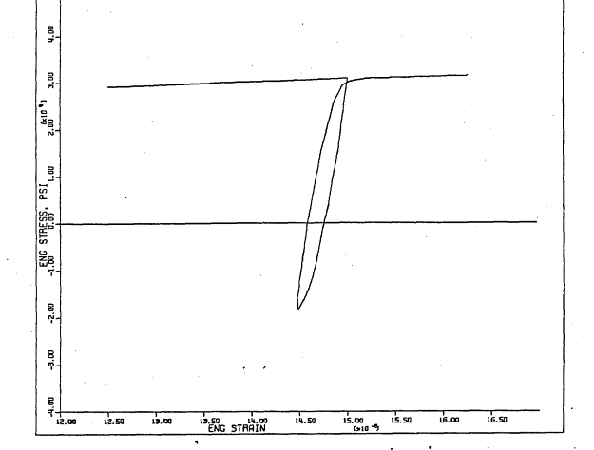

Measuring Young’s modulus from linear part of the hysteresis loop
Young’s modulus of materials that do not exhibit pronounced linear elastic behaviour is often determined from the slope of unloading stress-strain curves.
When stress is released the elastic strain is recovered, but also reverse plastic straining may occur upon unloading (the Bauschinger strain).
In order to measure Young’s modulus the slope of the initial straight part of the unloading curve is measured.
Reverse plastic straining during unloading is also observed in composites.
Hysteresis loop of annealed Cu [18]
[18] J.H. Doyle, “Fatigue softening of copper and copper-aluminium alloys”, PhD thesis Iowa State University (1967)
https://lib.dr.iastate.edu/cgi/viewcontent.cgi?referer=https://www.google.de/&httpsredir=1&article=4151&context=rtd

Slide 50



Extensometry for wire uniaxial stress-strain measurements
The precision of stress-strain measurements relies mainly on careful extensometer strain measurements.
Extensometer calibration at RT can be performed by the supplier.
Calibration at 77K and 4.2 K is not easily available and requires the setting up of dedicated calibration tools [vii].
(a)
(b)
(a) MTS-clip on extensometer type 632.27F-21 with gauge length of 25 mm and (b) calibration tool.
[31] http://snf.ieeecsc.org/abstracts/stp466-simultaneous-measurement-critical-current-stress-strain-and-lattice-distortions

Slide 51


Mechanical behaviour of Nb₃Sn wire constituents under tensile axial loading
Combined synchrotron X-ray diffraction and uniaxial tensile stress-strain measurements at 4.2 K [19]:
Almost no load is carried by the annealed Cu matrix
Linear elastic behaviour of Nb and Nb₃Sn
Brittle Nb₃Sn fracture at a wire stress of about 270 MPa and a strain of about 0.7% (load transfer from Nb₃Sn to the ductile Nb )
Nb₃Sn
4.2 K Nb₃Sn, Nb and Cu axial lattice strain vs composite uniaxial tensile wire stress.
Nb barrier
Cu matrix
[19] C. Scheuerlein, M. Di Michiel, F. Buta, B. Seeber, C. Senatore, R. Flükiger, T. Siegrist, T. Besara, J. Kadar, B. Bordini, A. Ballarino, L. Bottura, “Stress distribution and lattice distortions in Nb₃Sn/Cu multifilament wires under uniaxial tensile loading at 4.2 K”, Supercond. Sci. Technol. 27, (2014), 044021

Slide 52



Comparison of calculated Nb₃Sn, and measured wire and subelement Young’s moduli
[20] Elastic Anisotropy in Multifilament Nb₃Sn Superconducting Wires”, IEEE Trans Appl. Supercond., 25(3), (2015), 8400605

Slide 53

Nb₃Sn Young’s modulus
Preferential Nb₃Sn grain orientation in RRP and PIT wires causes elastic anisotropy.
Nb₃Sn elastic anisotropy was calculated from:
Nb₃Sn grain orientation distribution determined by neutron diffraction [14] and by Electron Backscatter Diffraction (EBSD) [20],
Nb₃Sn single crystal elastic constants (SEC) determined from ultrasonic measurements [21].
Nb₃Sn Young’s moduli calculations rely on the availability of accurate SEC.
Young’s moduli in axial direction of the RRP and PIT wires are 140 GPa and 130 GPa, respectively with an estimated uncertainly <±10% [20].
Nb₃Sn Young’s modulus as a function of the angle with respect to the drawing direction (in 11 T dipole short model coil #107, made with RRP wire). Open symbols show the Young’s moduli determined from SEC and EBSD data of a RRP wire [20].
[20] “Elastic Anisotropy in Multifilament Nb₃Sn Superconducting Wires”, IEEE Trans Appl. Supercond., 25(3), (2015), 8400605
[21] K. R. Keller and J. J. Hanak, “Lattice softening in single crystal Nb₃Sn” Phys. Lett., vol. 21, no. 3, pp. 263–264, 1966

Slide 54

The unusual temperature dependence of the Nb₃Sn Young’s modulus
During cool down to below about 40 K a Nb₃Sn lattice softening occurs [21].
The reduction of Nb₃Sn Young’s modulus in recent Nb₃Sn RRP and PIT type wires is confirmed by combined XRD-stress-strain measurements at RT and at 4.2 K.
At 4.2 K the axial PIT Nb₃Sn subelement Young’s modulus is 27% smaller than the corresponding RT value.
Comparison of RT and 4.2 K Nb₃Sn filament stress strain curves (stress is normalised to non-Cu cross section of the PIT wire) [19].
[21] K. R. Keller and J. J. Hanak, “Lattice softening in single crystal Nb₃Sn” Phys. Lett., vol. 21, no. 3, pp. 263–264, 1966

Slide 55
Nb₃Sn Poisson’s ratio at 4.2 K
Derived from Nb₃Sn lattice parameter measurements by high energy synchrotron X-ray diffraction during uniaxial tests in liquid He.
It is assumed that the Nb₃Sn lattice changes are not strongly effected by the annealed Cu matrix.
Poisson’s ratio can be calculated as the quotient of the transverse and axial lattice parameter change.
ν_{Nb3Sn-4.2K}=0.36
Nb₃Sn transverse lattice strain as a function the axial lattice strain measured during uniaxial tensile loading of BR, PIT and RRP wires in liquid He [19].

Slide 56

Comparison of the Cu mechanical properties in LHC Nb-Ti and in HL-LHC Nb₃Sn wires
The Cu in the LHC Nb-Ti wires is partly annealed during a 1 h-190 °C HT at the end of the wire production (Cu Vickers hardness HV0.05 = 79.7±2.0).
 | R_{p0.2} (MPa) | R_{m} (MPa)
RRP wire #7419 | - | 185±4.5
Fully annealed Cu ( as in HL-LHC wire) | 46.2±2.6 | 204±1.6
LHC wire 01K152 | 282±8 | 747±8
Partly annealed Cu in LHC wire | roughly 250 | -
RT stress-strain curve of (a) inner LHC Nb-Ti wire 01K152 [33] and (b) reacted RRP type Nb₃Sn wire (OST billet #7419). Courtesy R. Bjoerstad.
[33] C. Scheuerlein, T. Boutboul, D. Leroy, L. Oberli, B. Rehmer, “Hardness and tensile strength of multifilamentary metal–matrix composite superconductors for the LHC”, J Mater Sci (2006), DOI 10.1007/s10853-006-0633-3

Slide 57
Calculation of loading strain and stress
The Nb₃Sn and Cu loading strains caused by the externally applied stress are determined from the Nb₃Sn (321) and Cu (220) scattering angles.
Loading strains in transverse, axial, and radial directions are calculated with respect to the assumed stress-free scattering angle.
Loading stresses are calculated assuming that the transverse, axial and radial directions are the principal stress directions in the sample, and that there are no shear stresses in the sample.
Elastic constants and Poisson’s ratios have been calculated from single crystal elastic constants (E_{Nb3Sn(321)}=131 GPa, ν_{Nb3Sn(321)}=0.363, E_{cu(220)}=138.9 GPa, ν_{Cu(220)}=0.333) [21,26,27].
[21] K.R. Keller, J.J. Hanak, “Lattice softening in single crystal Nb₃Sn”, Phys. Lett., vol. 21(3), (1966), 263-264
[26] H. Wern, R. Johannes, H. Walz, “Dependence of the X-Ray Elastic Constants on the Diffraction Plane“, phys. stat. sol. (b) 206(2), (1998), 545-557
[27] E. Kröner, “Berechnung der elastischen Konstanten des Vielkristalls aus den Konstanten des Einkristalls“, Zeitschrift für Physik, 151(4), (1958), 504–18

Slide 58
Transverse compression: Nb₃Sn and Cu loading strain and stress
Loading strains and stresses are calculated from the relative changes of the diffraction angles.
Cu is under similar compressive stress in all three directions.
The magnitude of the Cu pressure corresponds approximately with the externally applied transverse compressive stress.
Uniaxial transverse compression induces an important axial tensile stress in the Nb₃Sn filaments.
(a) Nb₃Sn (321) and (b) Cu (220) lattice strains and (c) Nb₃Sn (321) and (d) Cu (220) loading stresses as a function of externally applied transverse compressive stress.

Slide 59
Residual strain in RRP type conductor and in the straight part of 11 T dipole coils

Slide 60

Residual strain in unconfined Nb₃Sn wires
The strong mismatch of thermal expansion coefficients of different conductor materials can lead to residual stresses in the composite.
The Nb₃Sn strain state in different straight wires was measured by synchrotron X-ray diffraction in liquid He.
In unconfined RRP and PIT type Nb₃Sn conductors the residual Nb₃Sn strain is small [19].
Since annealed Cu yields at low stress, it cannot impose substantial stresses on the Nb₃Sn filaments in unconfined RRP type and PIT type wires.
The Cu yielding is a huge advantage in terms of superconductor critical current, in particular in high applied field.
Relative length change of unconfined coil materials during cooling from the Nb₃Sn RHT peak temperature [4].

Slide 61
Residual strain in 11 T dipole magnet coils
Residual Nb₃Sn (321) strain in the four largest conductor blocks of the 11 T coil segment extracted from short model coil #107 was measured by neutron diffraction [26].
In conductor blocks P1, P2 and P3 the residual Nb₃Sn strain is smaller than the uncertainty of the residual strain measurements (<0.02%).
A significant Nb₃Sn residual strain value of -0.056±0.010% is found in P4 conductor block at the coil midplane, which was presumably submitted to the highest stress during prior magnet assembly and cold test.
Conductor block position
Residual Nb₃Sn (321) strain in axial, hoop and radial directions in the center of the four largest conductor blocks of the coil segment extracted from 11 T dipole short model after prior cold test.
[28] C. Scheuerlein, M. Di Michiel, M. Hofmann, M. Lorentzon, F. Lackner, R. Flükiger, F. Savary, L. Bottura, “Residual strain in the Nb₃Sn 11 T dipole magnet coils for HL‑LHC”, Supercond. Sci. Technol., 30 (2017) 125002 (10pp)

Slide 62
Nb₃Sn lattice parameter changes in a PIT wire as a function of externally applied stress
Measured by high energy synchrotron X-ray diffraction.
Nearly linear lattice spacing vs stress dependence, both in axial tension and transverse compression.
Nb₃Sn axial pre-strain in the free standing PIT wire is 0.03% [19].
Nb₃Sn axial pre-strain of the same PIT wire on a VAMAS barrel is about 0.14% (measured by neutron diffraction) [32].
[19] Supercond. Sci. Technol. 27, (2014), 044021.
[32] IEEE Trans. Appl. Supercond. 19(3), (2009), 2645-2648
Nb₃Sn lattice parameter in axial and transverse direction as a function of axial tensile or transverse compressive stress. The lattice parameters for the same PIT wire on a VAMAS barrel are shown for comparison.
62

Slide 63
Strain hardened Cu Vickers hardness load dependence
At very low loads the HV result depends strongly on experiments and experimental procedures.
Comparison of the strain worked Cu HV load dependence obtained by instrumented and conventional indentation measurements.

Slide 64

Correlation between OFE Cu Vickers hardness and RRR
The residual resistivity ratio (RRR) of pure Cu depends on the degree of strain work.
For Cu Vickers hardness HV<70 the effect of strain work on Cu RRR remains comparatively small.
Cu residual resistivity ratio
[31] S. Heck et al, “The RRR of the Cu components of the LHC main bus bar splices” http://cds.cern.ch/record/1233953/files/Tech%20Note%202010%20005.pdf

Slide 65
11 T dipole materials properties
Material | R_{p0.2} (MPa) | R_{m} (MPa) | A (%) | Z (%) | Young’s modulus dynamic (GPa) |  | Young’s modulus static (GPa)
 |  |  |  |  | Resonance | Impulse | Tensile | Compr.
316LN_L | 351±12 | 674±2 | 54±5 | 63±2 | 191±0.3 | 191±0.3 | 183±7 | n.m.
316LN_T | 324±4 | 658±1 | 53±5 | 63±1 | n.m. | n.m. | 203±15 | n.m.
Magnetil_L | 117±3 | 241±1 | n.m. | 73±3 | 196±0.8 | 196±0.3 | 208±19 | n.m.
Magnetil_T | 124±2 | 267±1 | 47±2 | 71±4 | 219±0.1 | 218±0.3 | 213±3 | n.m.
YUS-130_L | 401 | 793 | 71 | 66 | 196±0.9 | 196±0.3 | 196 | n.m.
YUS-130_T | 415 | 749 | 51 | 66 | 193±1.1 | 192±0.3 | 189 | n.m.
Ti-6Al-4V_L | 868±5 | 930±12 | 17±1 | 28±2 | 115 | 114 | 115±1 | 120±2
Ti-6Al-4V_T | n.m. | n.m. | n.m. | n.m. | n.m. | n.m. | n.m. | 116±2
DISCUP no-HT_L | 332±2 | 387±1 | 22±2 | 43±4 | 92.9±0.2 | 93.8±0.3 | 87±1 | 89±1
DISCUP no-HT_T | n.m. | n.m. | n.m. | n.m. | n.m. | n.m. | n.m. | 96±2
DISCUP HT_L | 284±1 | 376±1 | 26±1 | 48±1 | 96.7 | 96.3 | 91±1 | 87±2
IEEE Trans. Appl. Supercond., 27(4), (2017), 4003007

Slide 66

Elastic properties of some polymers used in superconducting magnets

