Slide 1

Status of Project preparation
M. Vretenar, CERN
Project Coordinator
Open Steering Committee meeting, 3 March 2021
From May 1st, 2021

Slide 2
Why this meeting
Temporary logo
Thank you for taking part in this preparation meeting!
Start of the project is confirmed for May 1st (good to start on a holiday!), less than 2 months from now.
A lot of preparation work is going on, mainly at CERN, and it is important to inform you on the preparation status and on the few ongoing issues.
We are also progressing in the branding of IFAST, and before finalising we want to collect your feedback, more in general on our communication strategy.
We need to agree when and how we will organise our kick-off meeting.
I would also like to know where you are with the preparation work in the different Work Packages, to be sure that in May we can start at full speed.

Slide 3
I.FAST in a nutshell
Innovation Fostering in Accelerator Science and Technology
4 years duration, 01 May 2021 – 30 April 2025
48 beneficiaries (SigmaPhi left the project), 14 partner organisations, >20 collaborating institutes.
13 Work Packages, 55 Tasks.
Full cost budget 18.7 M€, EC contribution 10 M€.
One goal: identify and develop in collaboration with industry the technologies for tomorrow’s particle accelerators.

Slide 4
I.FAST Structure
Difficult to read, but please check the names of Coordinators and Task Leaders and if changes are needed send a mail to myself and to Valerie.
Additional:
WP14 Ethics Requirements
Added by the EC, on data protection and health and safety procedures.

Slide 5
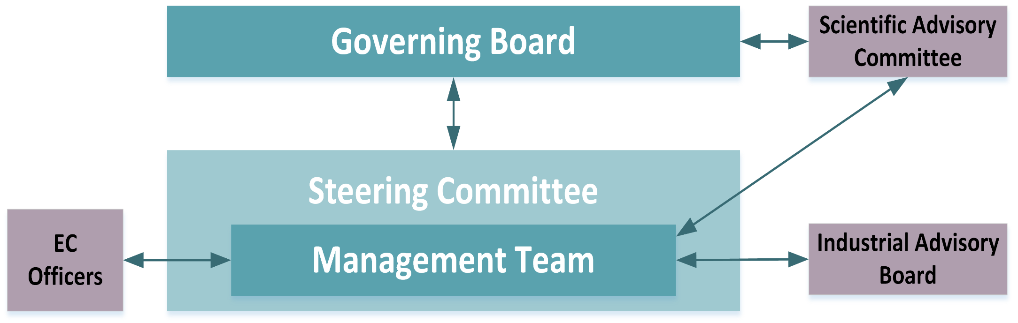
I.FAST Governance and Communication
Body | Composition | Goal | Meetings
Governing Board | Representatives of all parties | Changes to contract, financial matters | 1 / year
Steering Committee | All WP Coordinators | Scientific decisions on work programme | 2 / year
Enlarged Steering Comm. | WP Coordinators + Task Leaders | Information, feedback on activities | 2 / year
Project Management Team | Coordinator, 2 Deputies, Admin. Manager, Assistant, Comm. officer | Day-to-day follow up of administrative, financial and communication issues | 6 / year
Advisory Bodies | Experts nominated by Gov. Board |  | 1 / year
My committment: keep the meetings and the administration at the minimum, to leave you time to do the work!
Today:
1st Enlarged Steering Committee Meeting

Slide 6

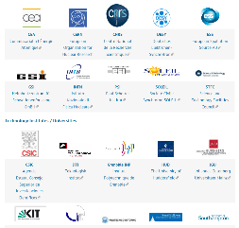
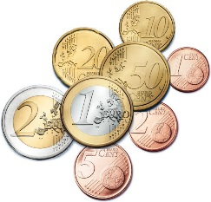
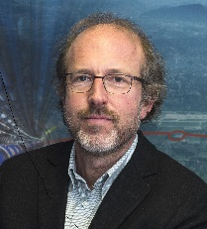



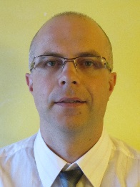
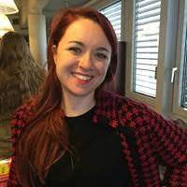

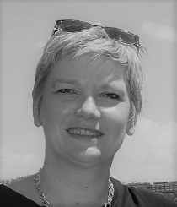
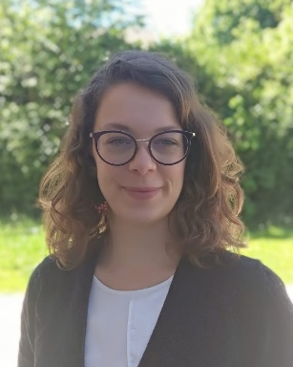

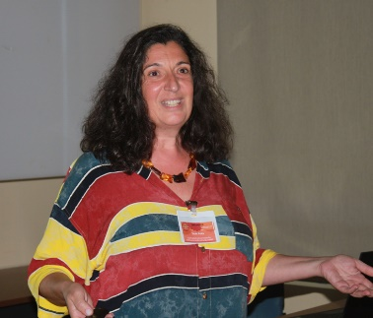
Quick I.FAST User Guide
Partners
Project coordinator
Deputies:
Toms Torims (RTU)
Marcello Losasso (CERN)
Maurizio Vretenar
Admin. Support:
Sabrina El Yacoubi
Administrative Manager
European Commission
Svetlomir Stavrev
Project assistant
Deliverables and reporting
Valérie Brunner
Communication:
D. Antonio (CERN)
Dissemination:
Y. Foka (GSI)
Science and Innovation
Revision of the mill (servicing):
Every year at the annual project meeting (April – May)

Slide 7
Project Status
All documentation and information for the Grant Agreement was submitted on 20 January, and is in the process of being reviewed in Brussels. We expected to be invited to sign the Agreement in early March.
The draft Consortium Agreement was sent to all partners (beneficiaries and partner organisations) by the CERN Legal Service with deadline for comments 26 February. Minor requests for changes received, a remaining issue on ethics clause with Thales is being solved.
From May 1st, you will be able to charge IFAST-related eligible expenditures to the European Commission.
My advice: start preparing your work now, so that you can start at full speed in May.

Slide 8
Proposals for I.FAST Committees
I.FAST will have 2 external committees:
Scientific Advisory Committee (SAC): external advisory panel nominated by the Governing Board based on their expertise. Will advise the GB on technical and strategic matters. The SAC will provide an internal assessment to the Project Management on the mid-term review and status of the project.
Ideal composition: 3 people, not from IFAST participants, possibly one from outside Europe, with a good balance of genders.
We ask you to send me proposals of names for the SAC before May 1st
Industrial Advisory Board (IAB): appointed in WP3 with the mandate to provide industry opinion regarding the potential of technologies developed in I.FAST, and help defining suitable business plans.
Again 3 people as ideal composition, I assume that WP3 (Mauro) will take care of it.

Slide 9
Composition of the Governing Board
In May we will organise the first meeting of the Governing Board (GB), the highest body of the Consortium (in other projects called “General Assembly”).
Each partner (beneficiaries and partner organisations) has to nominate a representative in the Governing Board. We will soon contact the scientific contacts of partners, and in parallel send the official request for nomination to the legal representatives of the partners (the directors who sign the Grant Agreement).
The GB representative might be the Director himself or a person appointed by him, external to the project or internal – might be a Task Leader, a WP Coordinator, or the IFAST scientific contact for the partner.
For CERN, the new Director for Accelerators and Technologies Mike Lamont has already agreed to represent CERN in the Governing Board – a very positive signal.

Slide 10
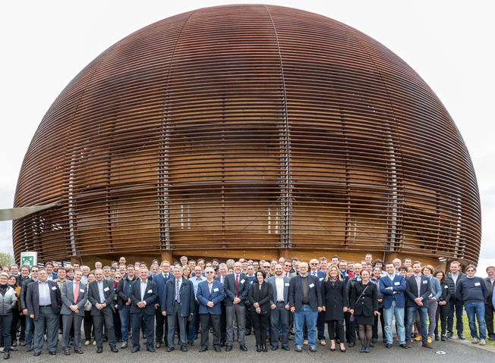
Options for kick-off meeting
It is usually very important that project teams meet in person, to know each other and to create the team spirit that is essential for our work (we don’t want to work in closed compartments!), at least at the beginning and at the end of a project.
The kick-off meeting should be in person, my idea was to invite you all at CERN, and we have optimistically booked the CERN Globe on two alternative dates, May 4-6 and June 8-11.
But now the pandemic is still active, and on top of that the CERN DG has just asked us to cancel our reservations because she needs the Globe…
My proposal at this point is:
  Organise a virtual kick-off meeting on one day on Tuesday 8 May, with presentations by WP Coordinators only, and parallel Work Package meetings.
  Find a date in October-November for a plenary IFAST Meeting in presence at CERN, with presentations by all Task Leaders, on the programme and on first results.

Slide 11
Communication material
Temporary logo
The next presentation by Daniela will cover all what we are preparing for you to use:
Web site https://ifast-project.eu/ ;
Sharepoint to share internal documents and information and to follow-up milestones and deliverables;
Zenodo to publish notes, reports, presentations and other documents for an external audience.

Slide 12

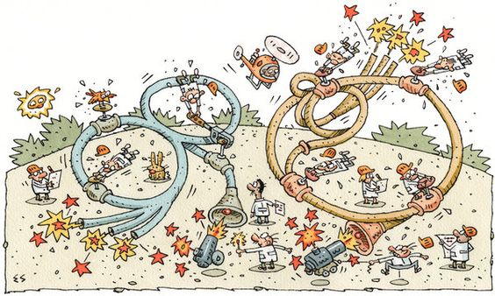
Questions?
Thank you for your attention! maurizio.vretenar@cern.ch

