Slide 1
Contractual and reporting aspects of the I.FAST project
Steering Committee meeting, 3 March 2021
Svet Stavrev (CERN)
IFAST Coordination Office

Slide 2
Contents
Contractual status of IFAST
Project reporting lines
Project reporting schedule
Project reporting workflow (technical report)
Project reporting at M12 (Y1)
Mid-term review at M24
Periodic reporting to the EC at M18, M36, M48
Resources monitoring
Periodic financial reporting to the EC
Resources monitoring & reporting workflow
Deliverable & milestone reports
EC payments to ARIES
Pre-financing 1st instalment
Conclusions
Based on:
Provisions of the EC Grant Agreement (GA)
IFAST Consortium Agreement (CA)
Acronyms used:
StCom = Steering Committee
GB = Governing Board

Slide 3
Contractual status of ARIES
Grant Agreement = contract with the EC
To be signed by the EC and CERN soon.
Accession Forms to be signed by the other 47 beneficiaries afterwards.
Consortium Agreement = internal agreement of the Consortium
Final version sent out for signature: hopefully in March / April 2021
Signed by all 48 beneficiaries, and 12 partner organisations
Pre-financing of 4.83 M€ = initial payment by the EC
To be received by Coordinator
Individual payments to the beneficiaries will be made after the signature of the Consortium Agreement as follows:
70% → at the beginning of the project, subject to the signature of the CA
30% → after the end of the 1st year, subject to the approval of the Y1 report by the GB
Note: beneficiaries with a total EC contribution of < 100,000 € → will receive the full amount of
pre-financing in a single instalment at the start of the project.

Slide 4
Project reporting lines
There will be two project reporting lines in ARIES:
External = reporting to the EC, covering:
the Periodic Technical Report
the Financial Summaries of all beneficiaries and third parties
Internal = reporting to the project management, serving:
as necessary input for the preparation of the Periodic Reports
as means for the Coordinator, StCom and the GB to follow-up the technical progress and full costs of the project, and in case of problems, to take adequate measures on time, as needed

Slide 5
Project reporting schedule
P1 report
P2 report
P3 & Final reports
M1
M12
M18
M24
M36
M48
May 2021
Apr 2025
Y1 report
Mid-term review

Slide 6
Project reporting workflow (technical reports)
P = the last day of the reporting period
Input from Beneficiaries & Partner organisations
Contact persons from each participant in a Task provide input to Task Leaders
Task Activity Report
Task Leaders assemble the Task Activity Report & submit it to the WP Coordinators
P-10 days
WP Activity Report
WP Coordinators assemble the WP Activity Report & submit it to the Scientific Coordinator
P+0 days
Scientific Coordinator
StCom & GB approval
P+10 days

Slide 7
Project reporting at M12 (Y1)
Purpose: to allow the StCom/GB to follow-up the progress in the 1st year of the project
Content (based on the template of the Periodic Reports to the EC)
A brief description of the work performed on the Tasks in Y1, achievements, problems encountered and corrective actions taken, as well as major deviations from Annex 1.
Description of progress towards Deliverables and Milestones and expected delays, if any, as well as reasons for such delays.
Plans for the work to be completed during the next year.
Length: ~4 pages/WP + pictures, tables, graphs
Periodicity: once, at M12 (April 2022)
Covers: M1-M12

Slide 8
Mid-term review at M24
Purpose: to allow the EC Project Officer and the external reviewer to assess the progress in the first 2 years of the project (complementary to the 1st periodic report)
Content (presentations based on the content of the Periodic Reports to the EC)
A brief description of the work performed on the Tasks in M19-M24, achievements, problems encountered and corrective actions taken, as well as major deviations from Annex 1.
Description of progress towards Deliverables and Milestones and expected delays, if any, as well as reasons for such delays.
Length: 10-12 slides/WP incl. pictures, tables, graphs
Periodicity: once, at M24 (April 2023)
Covers: M1-M24

Slide 9
Periodic reporting to the EC at M18,M36,M48
Periodic reports = official reports to the EC
→ Must be sent to the EC at the end of each reporting period (+2 months for preparation)
Content
Publishable summary
Work performed by the beneficiaries in the WP during the period, progress towards objectives, milestones and deliverables and the main results achieved so far
Progress beyond the state of the art and expected potential impact
Overview on the use of resources during the reporting period (per WP and beneficiary)
Deviations from Annex 1 and Annex 2
Dissemination and exploitation of results (scientific publications, dissemination and communication activities)
Critical implementation risks and mitigation actions
Gender statistics
Length: ~ 4 pages/WP + pictures, tables, graphs
Periodicity: at M18 (Oct 2022), M36 (Apr 2023), M48 (Apr 2025)

Slide 10
Resources monitoring
I.FAST budget
→ all partners contribute with a certain amount of matching funds and the funding rate for the beneficiaries is variable but typically 40-50%.
Full costs = 18.7 M€
EC contribution = 10 M€
Internal Resource Utilisation Summaries (IRUS)
Purpose: to allow the Coordinator and the GB to monitor the utilisation of resources of each participant, WP and project as a whole.
Content: an estimate (not necessarily actual expenditure) of the full costs related to the project.
Periodicity:
M12, M18, M36, M48 for the beneficiaries
M12, M24, M36, M48 for the partner organisations
IRUS for beneficiary |  | no. | Period
CERN |  | 1 | 01.05.2021 - 31.10.2022
WP no. | Person-months used (PM) | Estimated personnel costs € | Estimated other direct costs* € | Total direct costs € | Total indirect costs € | Total estimated costs €
WP1 |  |  |  | 0 | 0 | 0
WP2 |  |  |  | 0 | 0 | 0
Total | 0 | 0 | 0 | 0 | 0 | 0
* Equipment, consumables, travels, computing, services, goods
Provide a brief explanation for any significant deviations from the planned man-power utilisation (over-spending or under-spending exceeding 20% with respect to the planning)
The IRUS summaries will NOT be sent to the EC and do not have to be formally certified.
Only the costs reported and claimed on the Individual Financial Statements need to be verified and may be subject to EC and/or external audits.

Slide 11
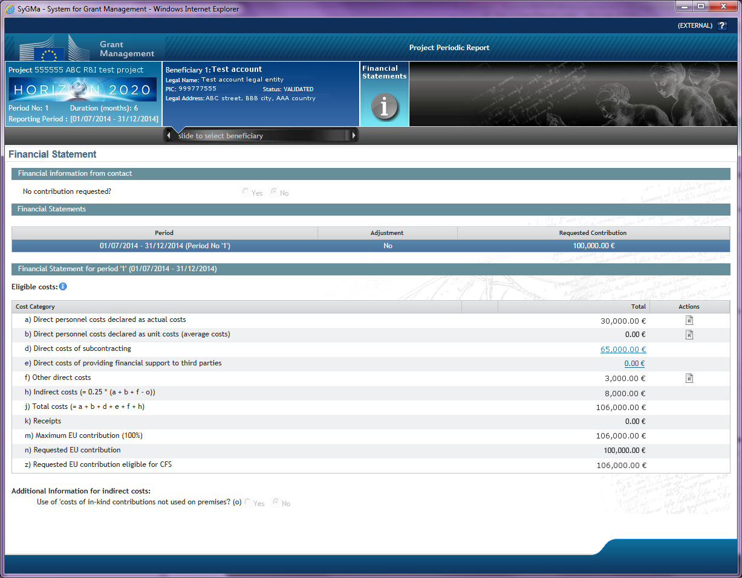
Periodic financial reporting to the EC
Financial Statements: special forms on the Participant Portal where beneficiaries will report and claim to the EC their EC contribution from Annex 2 of the Grant Agreement
Each beneficiary will need to complete on the Participant Portal its Financial Statement (and the financial report of their Third Parties), including explanations on the use of resources (UoR)
The PDFs of the Financial Statements and UoR will be generated automatically by the system
Periodicity: at M18, M36, M48

Slide 12
Resources monitoring & reporting workflow
P = the last day of the reporting period
Input from Participants
Contact persons for admin/financial matters from each beneficiary and partner organisation
P+45 days
IRUS Summary Report
(Excel table)
Financial statements (Participant Portal)
Project Office assembles the report
Verified and submitted to the EC by the Coordinator
P+60 days
Administrative Manager
StCom
Administrative Manager informs the StCom
Administrative Manager
GB
Administrative Manager reports to the GB at the Annual Meetings

Slide 13
Deliverable and milestone reports
Deliverables = committed contractual outputs of the project
Milestones = checkpoints indicating the progress of the project
N.B. each Deliverable and Milestone has to be associated with a written report, regardless of their nature (website, prototype, database etc.)
Deadlines → the reports must be sent to the EC according to the timetable indicated in Annex 1. All delays will be flagged on the Participant Portal and will require a written justification.
Lead beneficiaries assemble and produce the Deliverable and Milestone reports
Due date in Annex 1 - 15 days
Task Leaders and WP Coordinators review and validate the reports
Due date in Annex 1 - 7 days
Scientific Coordinator
StCom approval
EC
Last day of the due month in Annex 1

Slide 14
EC payments to I.FASTS
 | Amount | Percentage
Max EC grant | 10 M€ | 100%
Pre-financing | 5.33 M€ | 53.3%
Guarantee Fund | 0.5 M€ | 5%
→
Effective pre-financing received = 4.83 M€
 | Percentage
1st pre-financing instalment | 70% *
2nd pre-financing instalment | 30%
P1 payment | According to the spending profile**
P2 payment | According to the spending profile**
Final payment | 10% + 5% after the Final report is approved
When?
At the start of the project
After Y1
M18+2+3
M36+2+3
M48+2+3
* beneficiaries with a total EC contribution < 100,000 € = 100% pre-financing
** cumulative payments to beneficiaries are limited to a maximum of 85% of their EC contribution
5%
48.3%
Max. 36.7%
Likely 0%
10%
M0
M1
M18
M24
M36
M42
M48
1st Reporting Period
2nd Reporting Period
3rd Reporting Period

Slide 15
Pre-financing 1st instalment (~May 2021)

Slide 16
Conclusions
The success of I.FAST will be measured by the EC by the acceptance (or rejection) of the Periodic and Deliverable Reports → cooperation and commitment from all participants, as well as Task Leaders and WP Coordinators will be essential for the success of the project.
The Internal Project Reporting line:
  will help the beneficiaries, WP Coordinators and Project Office in the preparation of the Periodic (and Final) Reports
  will allow the Management, StCom and GB to follow-up the progress of the project and the utilisation of resources (full costs)
The preparation of the Periodic Reports is the responsibility of the Project Office:
  input from all WP Coordinators for the Scientific Report
  input from all beneficiaries for the Financial Statements
The preparation of the Deliverable Reports is the responsibility of the Lead Beneficiary, under the coordination of the Task Leaders and WP Coordinators, with input from all contributing participants.
The Coordination Office will endeavour to ensure efficient follow-up and monitoring of the progress of the project, keeping the reporting workload at a reasonable level → templates and Reporting Guidelines will be made available to the beneficiaries.

