Slide 1
KEKB crab RF architecture & controls
K.Nakanishi
KEK
Dec. 16 , 2010
LHC-CC10

Slide 2
Comparison between crab and SCC
Qext of the cavities
Crab : 1.6~2x10⁵ SCC : ~7x10⁴
Tuning strategy
Crab : Insert the coaxial coupler. SCC : deform the cavity.
Required mode
Crab mode : 509MHz Lowest mode : ~410MHz acc mode : 509MHz
Beam loading
Crab : Depend on beam alignment, cavity phase and voltage.
SCC : Depend on the cavity phase and voltage.
Damped by the coaxial coupler
(Lowest mode)

Slide 3
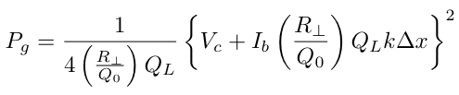
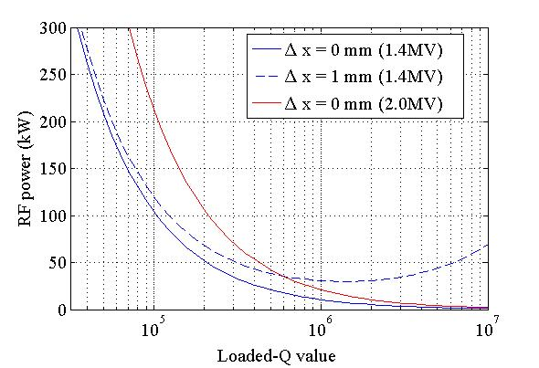
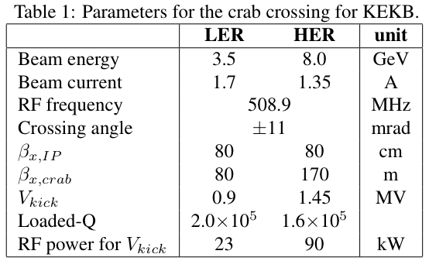
Crab RF system_1
KEKB review on 2008
The required RF power to maintain the crabbing voltage is given as:
(for a simple case of β>>1, crab phase=π/2, and loading angle =0)
We have chosen Q_{L}=1~2 x10⁵ for a good compromise.
  This value is suitable for operating the system with a possible error of ΔX=1mm, and
  A high power source of 200 kW is sufficient for conditioning the cavity up to 2 MV.
Typical parameters for the crab crossing.
Dependence of RF power on the loaded Q value and a horizontal beam orbit for a beam current of 2 A.

Slide 4
Crab Cavity & Coaxial Coupler in Cryo-module
KEKB review on 2007
Support Rod
Jacket Type Main He vessel
SUS316L
Jacket Type Sub He vessel
Support Pipe
Tuning Rod
Input Coupler
Notch Filter
Crab Cavity Cell
RF Absorber
Coaxial Coupler (Nb)
Extract TM₀₁₀, TE₁₁₁ Mode
Frequency Tuning
Stub Support
Bellows

Slide 5
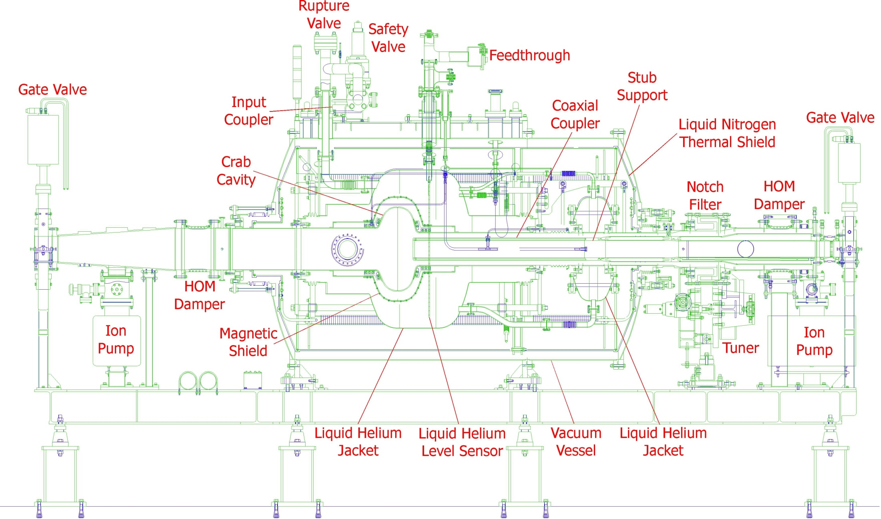
Schematic Drawing of Cryostat
KEKB review on 2007

Slide 6
Cryostat Conceptual Design
KEKB review on 2007
Top View
RF Input coupler
Magnetic Shield
(Jacket Type)
Frequency Tuning
by Adjusting Distance
Stub Support
HOM
Absorber
HOM
Absorber
I.D. 240
Coaxial Coupler
I.D.100
Bellows
Crab Mode Reject Filter
(Notch Filter)
Liq. He
RF Monitoring
Port
Liq. He
80 K Liq. Nitrogen Shield

Slide 7
Crab RF system_2
KEKB review on 2008
Two new RF stations, each for one crab cavity, were constructed in the D11 building.
  Two reused klystrons that have been tested up to 600 kW were set.
  The high-power system and most of the low-level RF system are similar to those of the SC accelerating cavity stations.
  Conventional amplitude and phase feedback loops are used to control the cavity field and the klystron output.
  The resonant frequency of the cavity is controlled by the main tuner system consisting of a motor and piezo element, which moves the coaxial beam pipe in the longitudinal direction with respect to the cavity cell.
  The interlock system includes a quench detector, arc sensors at the input coupler, vacuum pressure gauges, temperature sensors, etc.

Slide 8
KEKB review on 2006
RF system for crab cavity will be similar.

Slide 9
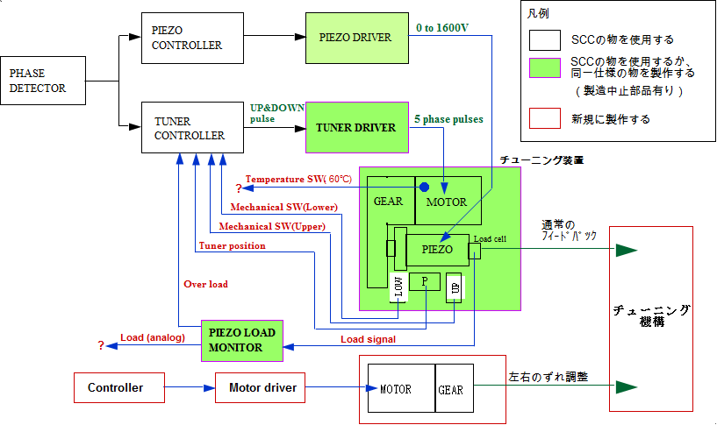
Diagram of tuning control system for crab cavity
KEKB review on 2006
Use component for SCC
Prepare similar component
for SCC control.
Prepare new component
tuner
Frequency tuning
Coaxial coupler mover
Adjust horizontally

Slide 10
Tolerance_Timing (RF phase)
KEKB review on 2006
Timing error (RF phase error) gives rise to horizontal displacement at the IP.
  Here, φ_{cross} is the half crossing angle.
  A is the ratio of allowed offset to horizontal beam size, σ_{x}*.
  The value A should be determined from beam-beam view point.
 | KEKB | Super-KEKB | LC
σ_{x}* | 100μm | 70μm | 0.24μm
A (assumed) | 0.05? | ~0.05? | ~0.2?
φ_{cross} | +/- 11mrad | +/- 15mrad | +/- 3.5mrad
Δt | 1.5 ps | 0.8 ps | 0.05 ps
0.27 deg (509MHz)

Slide 11
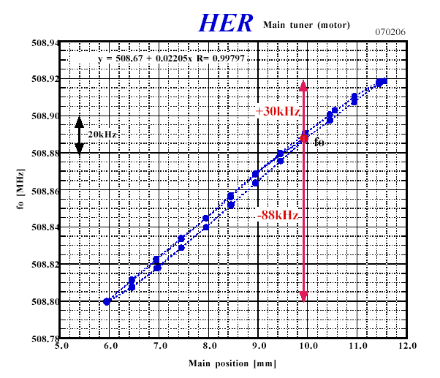
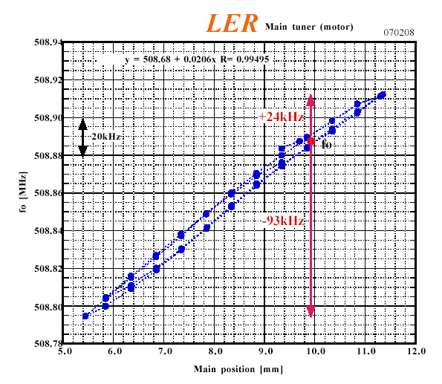
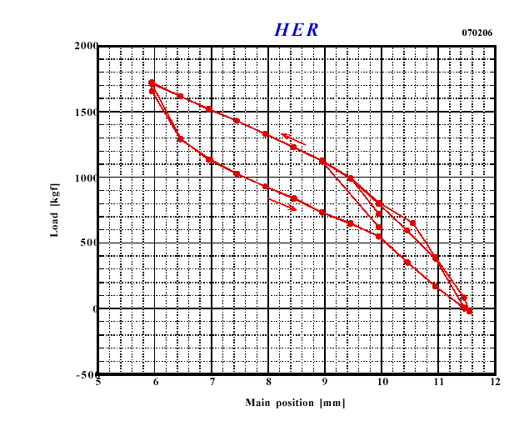
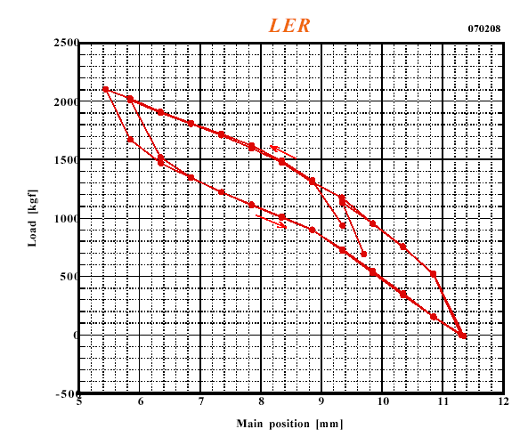
Frequency Tuning by Main Tuner
by A. Kabe
Resonance Frequency
Main Tuner Position (mm)
Main Tuner Position (mm)
Load [kg]

Slide 12
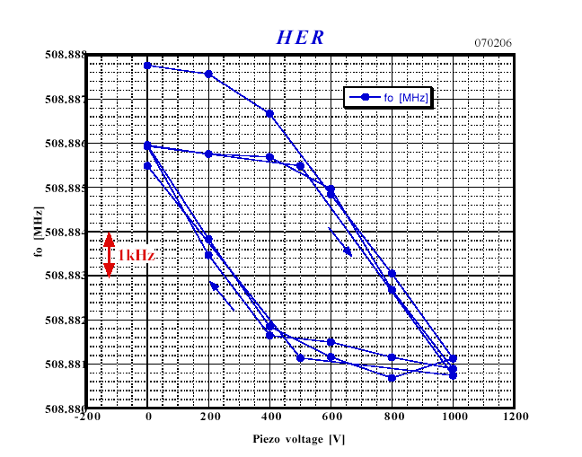
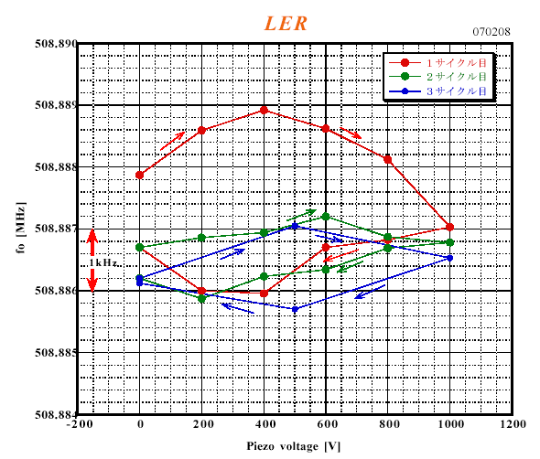
Frequency Tuning by Piezo Tuner
by A. Kabe

Slide 13
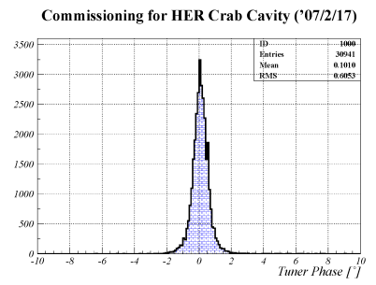
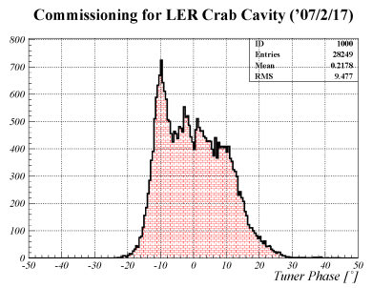
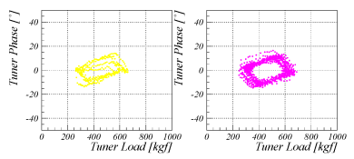
LER tuning mechanism problem
Problem of LER frequency tuner:
  Suffers from something like mechanical backlash. This results in a large fluctuation of tuner phase, even tuning feedback system is working.
  Although some efforts were effective to reduce it, we still have a tuning error of about ±15 degree.
Consequences:
  Cavity phase is successfully stabilized to a required level by a phase lock loop (next two slides).
  Cavity input power inevitably fluctuates to keep the cavity voltage constant.
  Some of the LER trips seem associated with this fluctuation (discussed later).
Distribution of tuner phase for Vc > 0.3 MV
HER
manual
Piezo on
LER
LER
LER

Slide 14
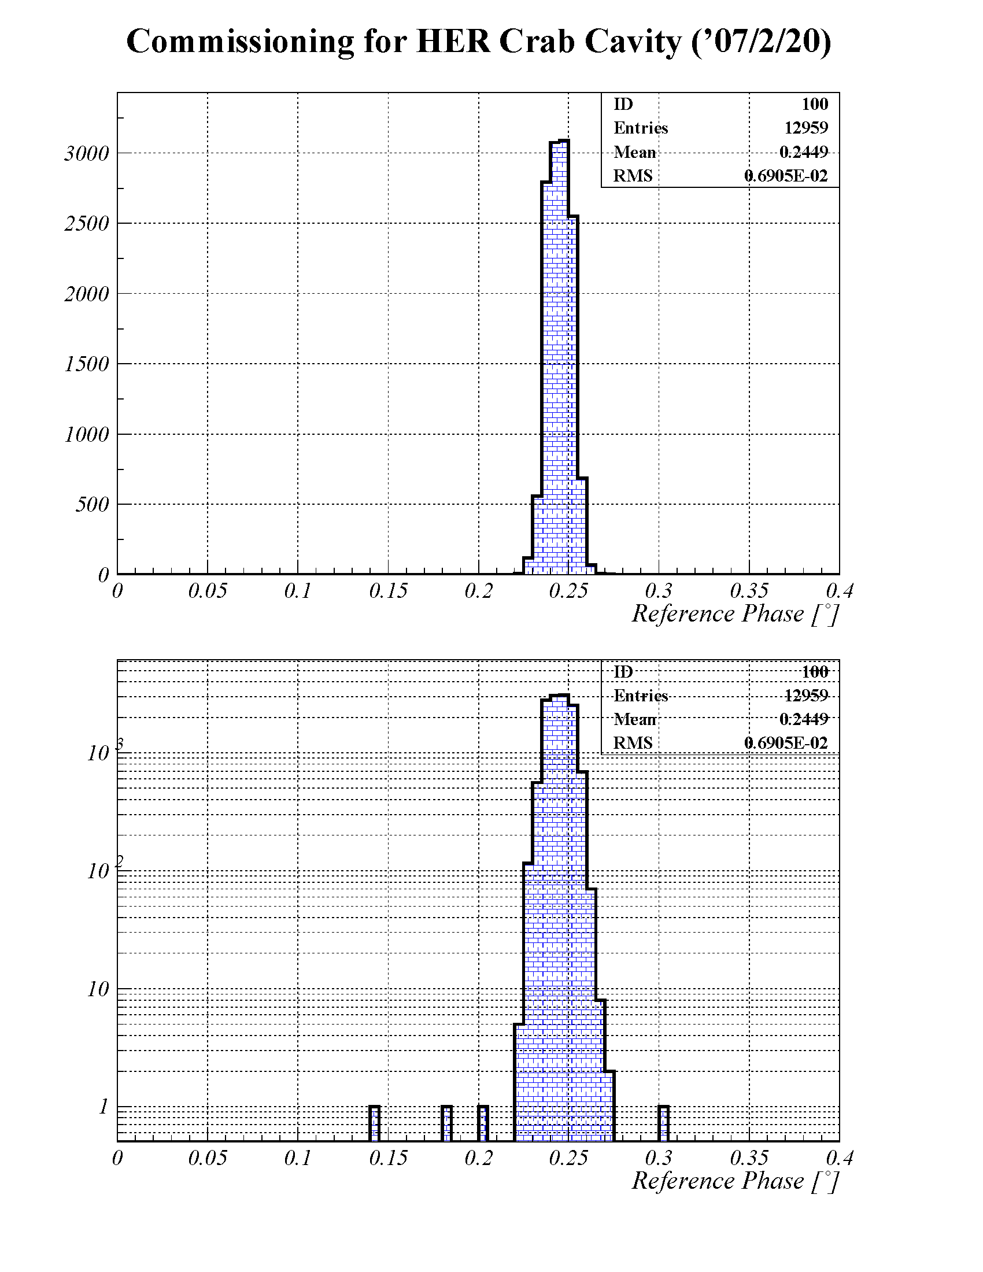
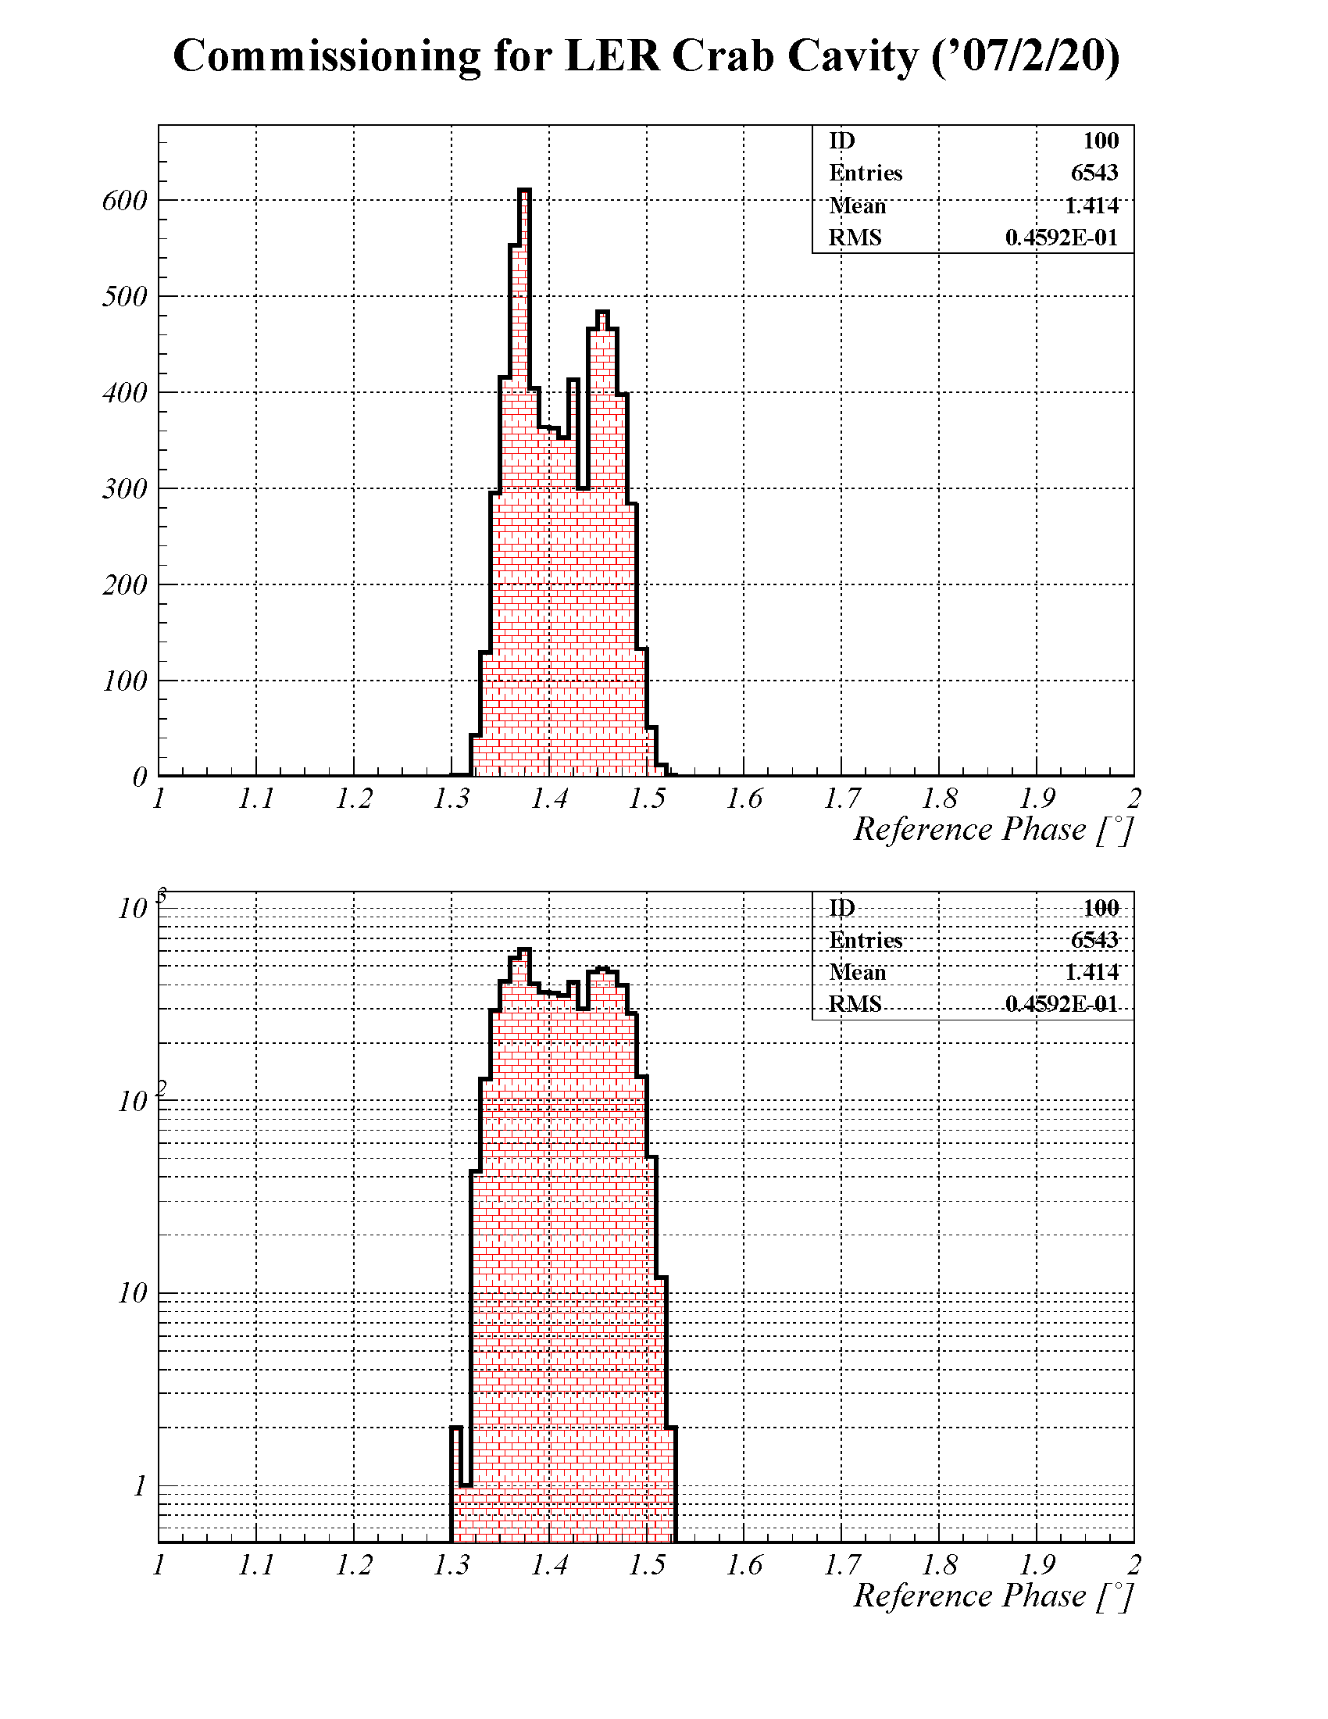
Phase stability (histogram of phase detector signal)
HER
LER
0.007°
0.046°
Linear scale
Log scale
Distribution of cavity phase (cavity feedback loops on)
The required stability is 0.27degree.

Slide 15
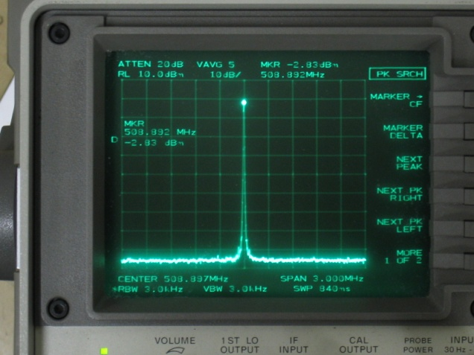
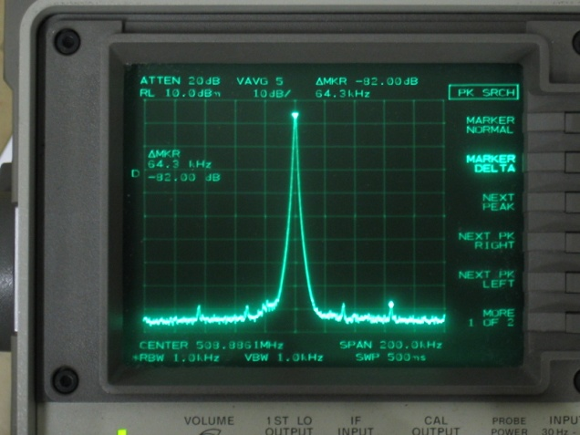
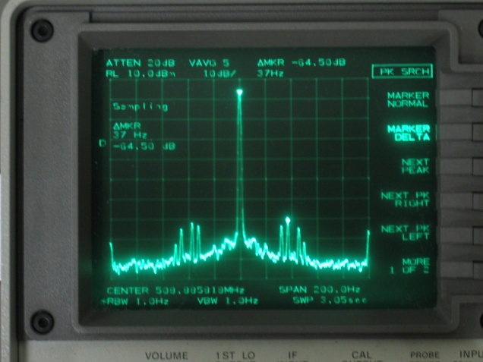
Phase stability (cavity pick up signal)
LER
Span 3MHz
No significant sidebands seen.
Span 200 kHz
Sideband peaks at 32kHz, 64kHz.
Phase error < ± 0.01 deg (fast)
Span 200 Hz
Sideband peaks
at 32, 37, 46, 50, 100 Hz.
Phase error < ± 0.07 deg (slow)
According to b-b simulation by Ohmi-san, allowed phase error
for N-turn correlation is 0.1×√N (degree).
Spectrum of pick up signal is consistent with phase detector data.
The measured phase error is much smaller than the allowed values given by beam-beam simulation.

Slide 16
Crab RF system_3
KEKB review on 2008
Special cares are taken for the coaxial beam pipe.
  A sub tuner is added to align the coax horizontally in order to minimize the coupling of the crabbing mode between the cell and the coax.
  RF signals monitored at seven pickup ports located in the coax are connected to the fast interlock system. It protects the ferrite damper at the end of the coax from abnormally large crabbing-mode power that can leak through the coax on the occasion of a discharge at the coax or the notch filter.
Sub-tuner
Monitor ports
With band path filters

Slide 17
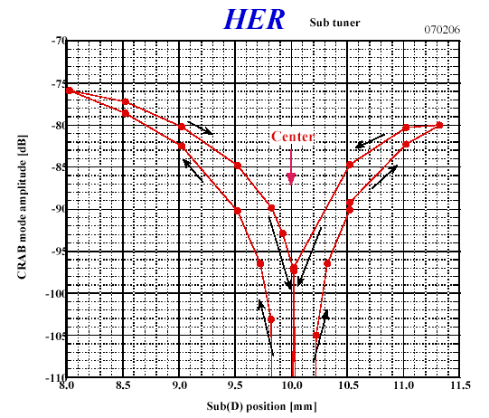
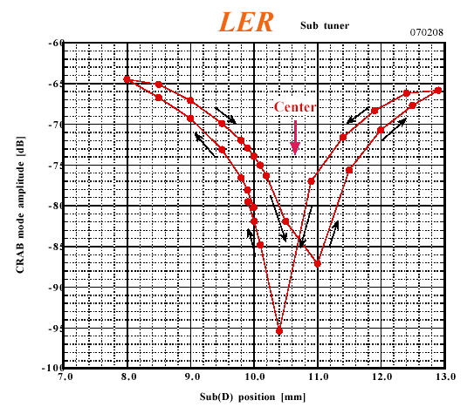
Adjustment of Coaxial Coupler Position by Sub Tuner
by A. Kabe
By adjusting coaxial coupler on the axis of crab cavity,
the crab mode can be prevented going out.
The coupler position can be controlled by sub-tuner.

Slide 18
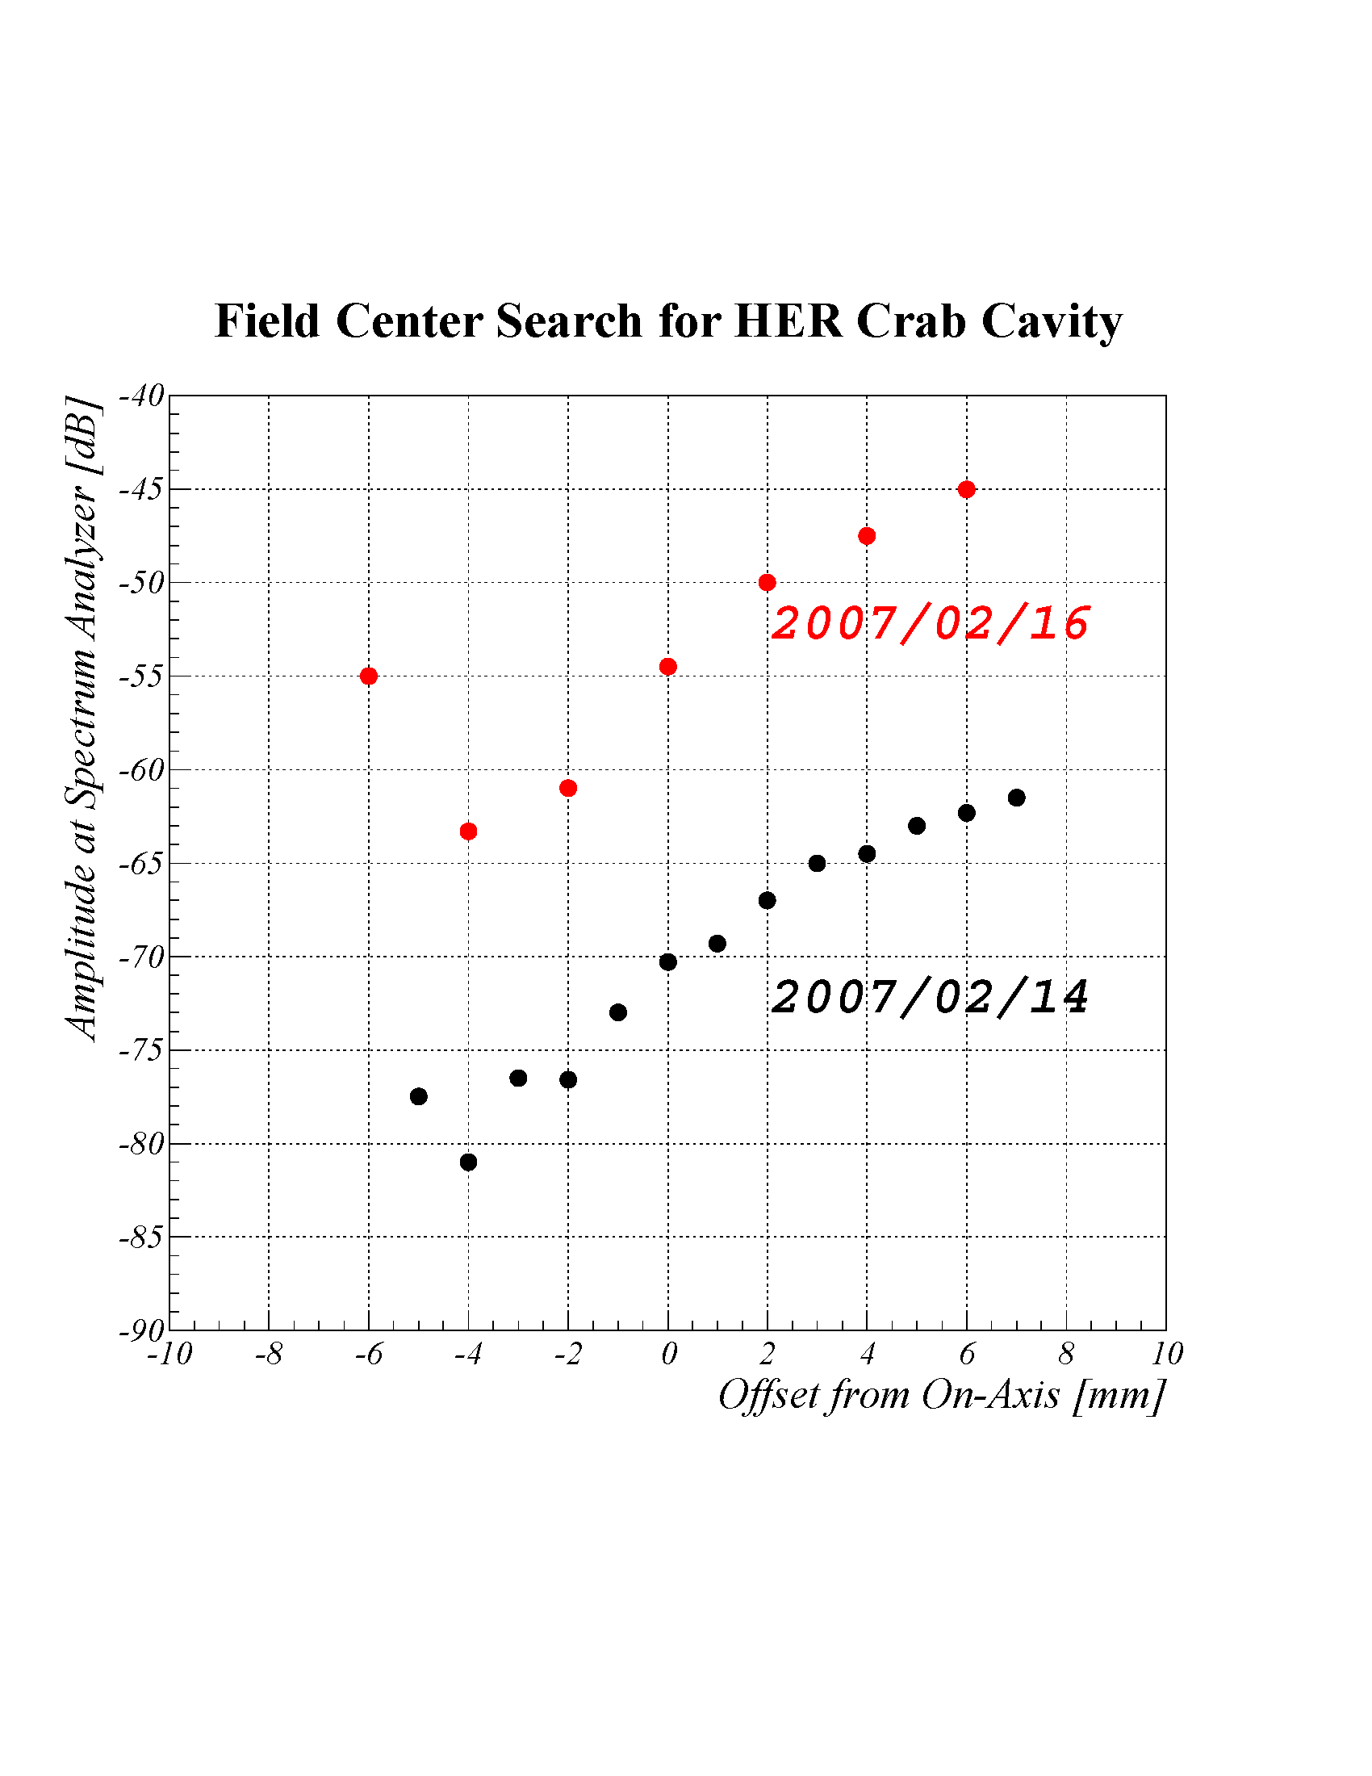
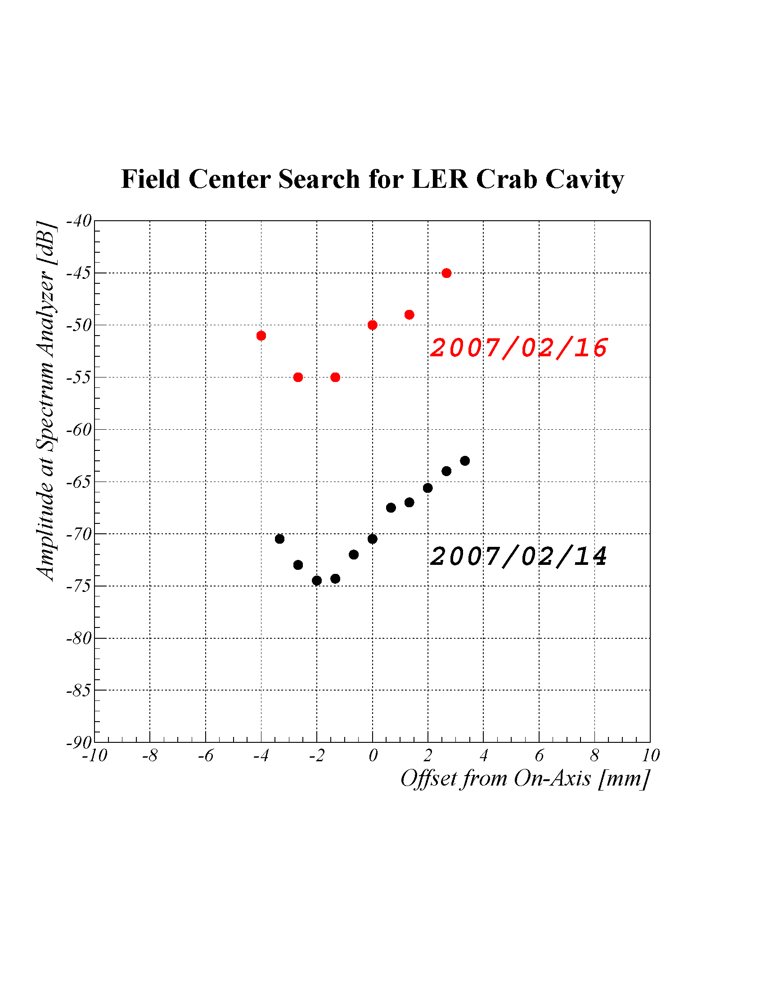
KEKB review on 2007
Searching Field Center in Crab Cavity
HER
LER
5kHz
5kHz
40kHz
40kHz
Inner
Outer
Inner
Outer
Field center was searched by measuring the crabbing mode amplitude excited by a beam with the crab cavity detuned. Two measurements with different detuning frequencies agreed to each other.
A local bump orbit was set to make the beam aligned on the field center.

Slide 19
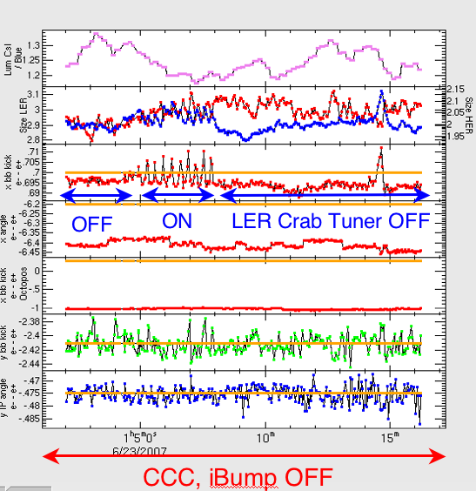
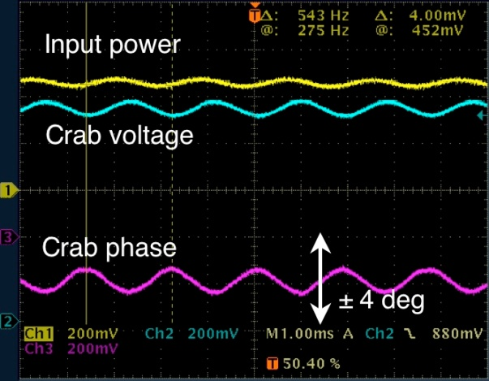
Oscillation of high-current crabbing beams
KEKB review on 2008
A large-amplitude oscillation was observed in high-current crab-crossing operation in June.
  It caused unstable collision, short beam life time and luminosity degradation.
  Crab amplitude and phase were modulated at 540 Hz. Horizontal oscillation of beams was also observed at the same frequency.
  None of the beam orbit feedback systems is responsible, since their time constants are 1 to 20 sec, much slower than the oscillation.
  The oscillation occurred when the LER tuning phase migrated to the positive side. This gave us a hint to understand the phenomena.
Beam-beam kick is shaken.

Slide 20
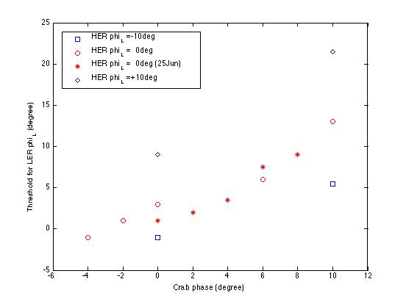
A remedy for the oscillation was found
KEKB review on 2008
Observations at a machine study
  The oscillation occurred only with high-current colliding beams: it never occurred with a single beam, even at a high current.
  Both beams oscillates coherently.
  The threshold for the oscillation is dependent on the crab phase and tuning phase (see left).
Cause and remedy
  We concluded that the oscillation is caused by beam loading on crab cavities together with beam-beam force at the IP (see, next slide).
  We found that it can be avoided by shifting the crabbing phase by +10° and controlling the tuning offset angle appropriately.
HER tuning offset:
φtun (HER)
oscillation
occurs
φtun (HER) = +10°
LER tuning offset (degree)
φtun (HER) = 0°
φtun (HER) = -10°
stable
Both crab phase (degree)
Dependence on the crab phase and tuning phase.
Beam current was 1150 mA (LER) and 620 mA (HER).

Slide 21
Possible mechanism of the oscillation
KEKB review on 2008
Phase control
Kick bunch
LER
Input rf phase
Crab phase
Horizontal displacement at crab and IP
Input rf power
Crab voltage
Level control
Beam-loading on crab cavity
Kick by beam-beam force
IP
Phase control
HER
Crab phase
Kick bunch
Input rf phase
Horizontal displacement at crab and IP
Input rf power
Crab voltage
Level control
Beam-loading on crab cavity

Slide 22
summary
The RF systems for crab cavities were established by using available components for SCC.
The required phase stability was obtained nevertheless the poor LER tuner performance.
In high beam current operation, a phase instability was observed. It was suppressed to adjust the tuning offset and the cavity phase.

