Slide 1
KEK-B crab trips & RF signals
K.Nakanishi
KEK
Dec. 16 , 2010
LHC-CC10

Slide 2
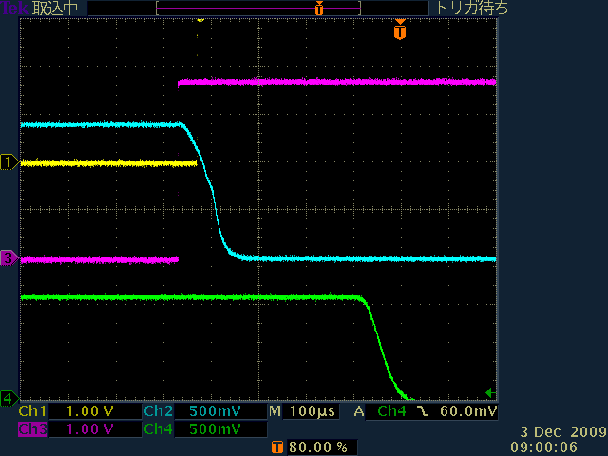
DCCT signal delay 80microsecond, when that is caught at RF station
Cavity voltage
Abort request
~300 μs
RF switch
Beam current (DCCT)
~200 μs
Beam abort
In KEKB, the beam was aborted 300us after the RF trips.
It corresponds to 30 turns of beam circulation.

Slide 3
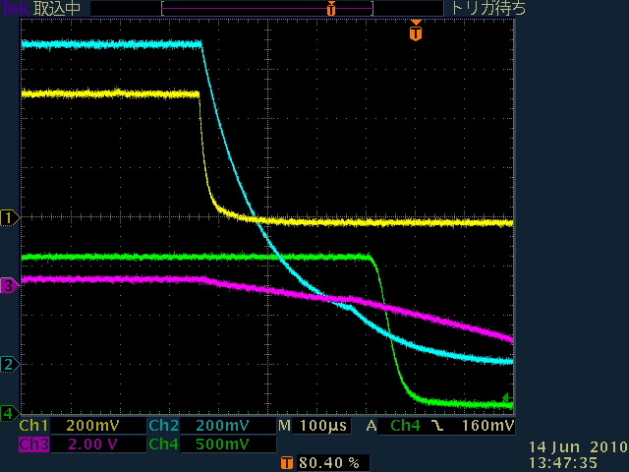
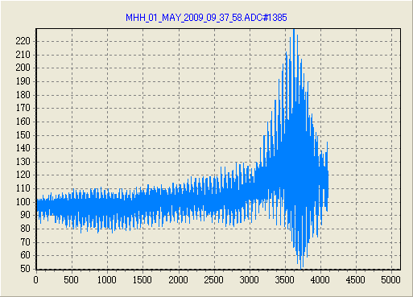
Data taking
Various data measured by RF abort monitor and BOR are introduced in this report.
RF abort monitor
BOR
When a beam abort is required, the snapshot of an oscilloscope is saved.
LLRF
It is an oscilloscope attached to LLRF
It is triggered by beam decaying.
HER H:0.0118
HER V:0.00655
LER H:0.00570
LER V:0.0169 mm mA/count
KEKB HER(High Energy Ring) and LER(Low Energy Ring) have a bunch-by-bunch feedback system respectively. The beam positions in 4096 turns of every bunches are stored in ring buffer of them.
When a beam loss is observed by DCCT, the data is saved.
e^{+/-}
BPM
DCCT
Trigger
At first, I searched characteristic signals in data of RF abort monitor. And corresponding data was find in the BOR data.
Bunch by bunch feedback system

Slide 4
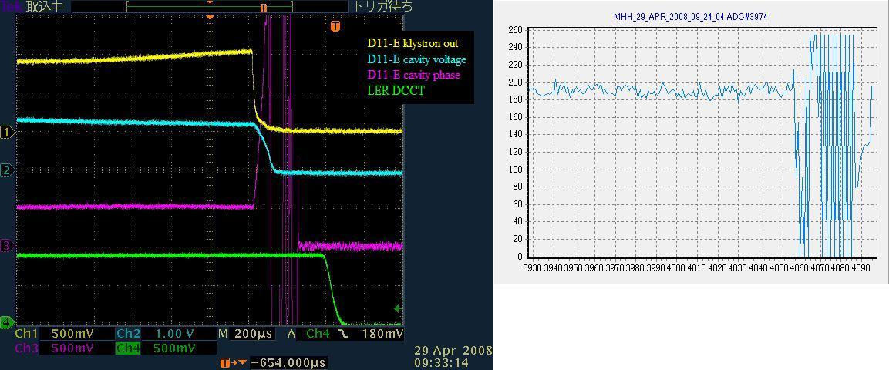
Yellow :Klystron output power
Blue :Power form pick up antenna at the cavity.(∝Vc²)
Purple :Cavity phase
Green :Beam current
HER DCCT
~1mm
horizontal
10deg
turns
The vertical axis shows a quantity related to a displacement and bunch current.
The beam was kicked when a quench was occurred.

Slide 5
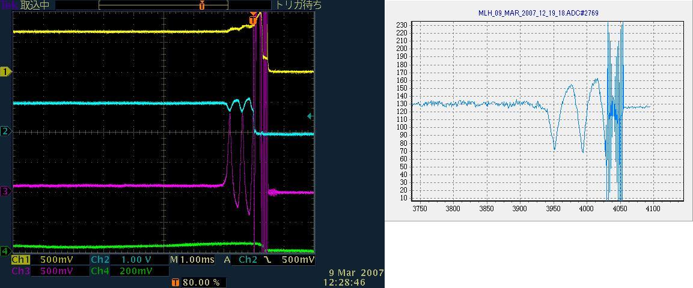
Yellow :Klystron output power
Blue :Pick up power(∝Vc²)
Purple :Cavity phase
Green :Beam current
~1.5mm
horizontal
40deg
turns
Some turbulence occurred in the cavity. Corresponding displacement was observed.
Finally, the cavity phase was lost, and the beam was kicked.
Because the betatron tune is very close to half integer, the beam observed with alternative displacement turn by turn.
Beating structure is observed, because the betatron tune is not half integer.

Slide 6
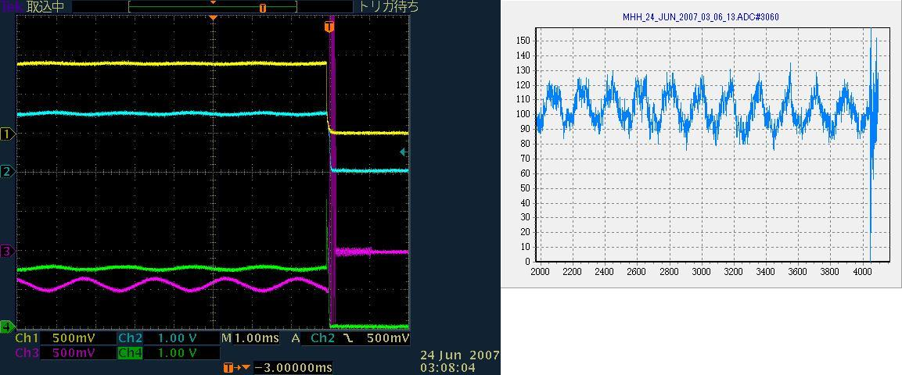
Yellow :Klystron output power
Blue :Pick up power(∝Vc²)
Purple :Cavity phase
Green :Beam current
~0.4mm
horizontal
10deg
turns
When LLRF feedback was oscillated at 540Hz, corresponding displacement was observed.

Slide 7
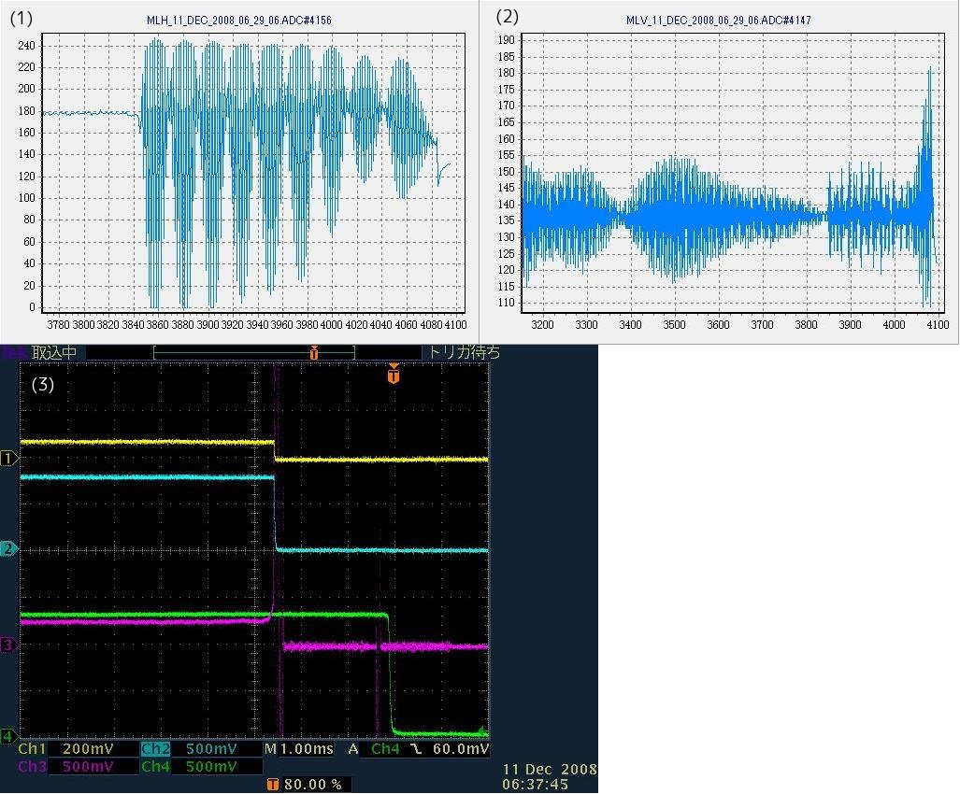
~0.3mm
~1.5mm
horizontal
vertical
In this case, the beam was not aborted after turn off the RF.
After turned off the RF, a horizontal oscillation was started. And it seems decaying. Finally, the beam was aborted due to discharge caused by the beam induced field. The beam survived for 2msec after turned off the RF.
10deg
Yellow :Klystron output power
Blue :Pick up power(∝Vc²)
Purple :Cavity phase
Green :Beam current

Slide 8
Crab kickによるCOD
Horizontal COD by crab kick
Arc部でのCOD
(COD at arc section)

Slide 9
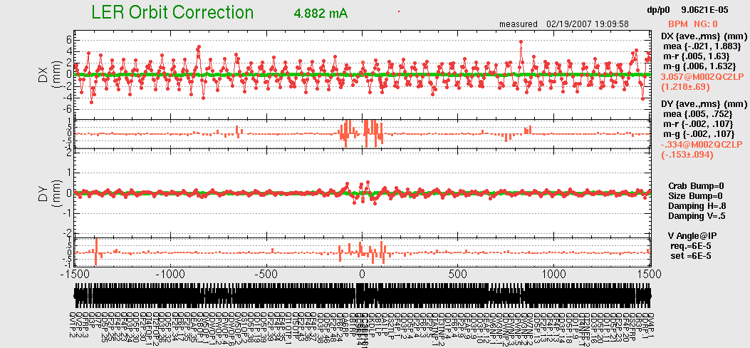
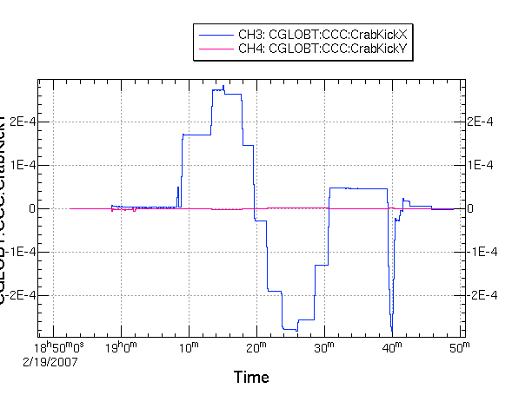
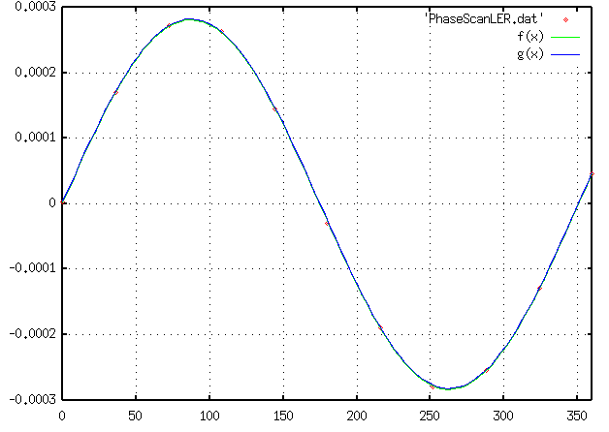
Crab Phase Scan (LER)
H. Koiso, A. Morita
Horizontal orbit by crab kick
crab
crab
Horizontal kick by crab cavity (rad)
(Estimated from orbits around the ring)
72
108
36
144
360
0
180
324
216
252
288
Phase 0：174.8 deg.
Vcrab set:1.0MV, estimated: 0.987MV
agree very well

Slide 10
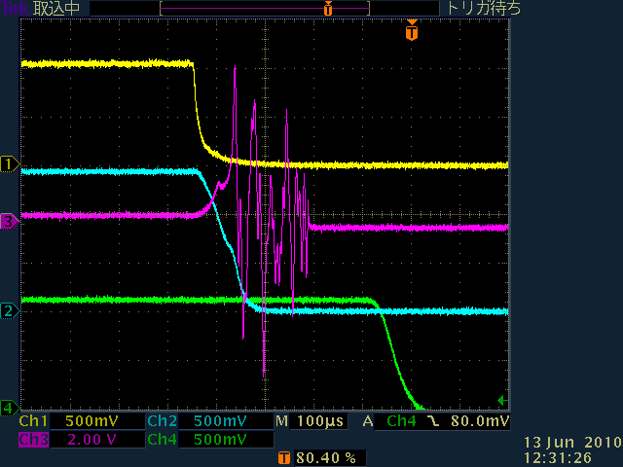
The HER beam was aborted by intentional abort request.
Yellow :Klystron output power
Blue :Pick up power(∝Vc²)
Green :Beam current
Purple :Cavity phase
Yellow :Klystron output power
Blue :Pick up power(∝Vc²)
Green :Beam current
Purple :Cavity phase
Yellow :Klystron output power
Blue :Pick up power(∝Vc²)
Green :Beam current
Purple :Cavity phase
The arc sensor was lighten by a LED.
noise?
The expected decay time of stored energy was 42 μsec.
(84 μsec for cavity voltage)
40deg

Slide 11
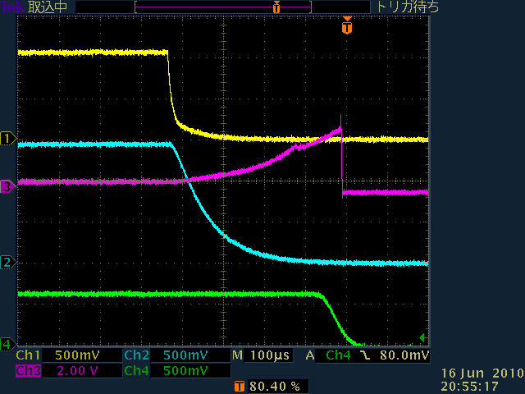
Yellow :Klystron output power
Blue :Pick up power(∝Vc²)
Green :Beam current
Purple :Cavity phase
The HER beam was aborted.
Sometimes the cavity voltage decays cleanly.
What is different from previous page?
40deg

Slide 12
Yellow :Klystron output power
Blue :Pick up power(∝Vc²)
Purple :Cavity phase
Green :Beam current
The LER beam was aborted by intentional abort request.
The expected decay time of stored energy was 65 μsec.
(130 μsec for cavity voltage)
40deg
The beam induced field vanish here

Slide 13
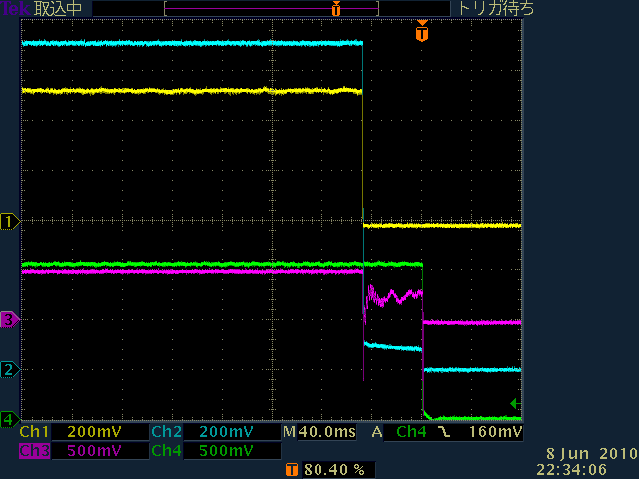
Yellow :Klystron output power
Blue :Pick up power(∝Vc²)
Purple :Cavity phase
Green :Beam current
The RF power for LER crab cavity was turned off.
The beam was aborted in 50 msec.
Anyway the beam could circulate, and it seems to stabilized by the beam induced field.
10deg

Slide 14
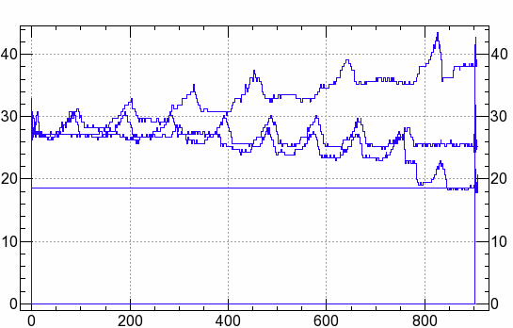
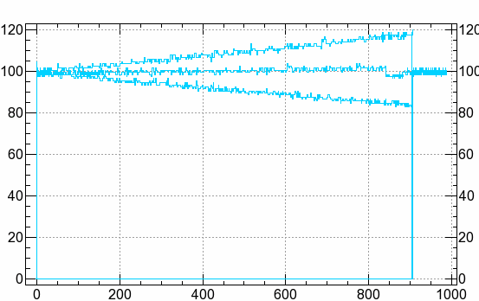
Beam loading depend on the beam position
LER
HER
RF power [kW]
RF power [kW]
Beam current [mA]
Beam current [mA]
The beam position is adjusted to center.
The conditions that the beam is offset 2mm for both sides are prepared.

Slide 15
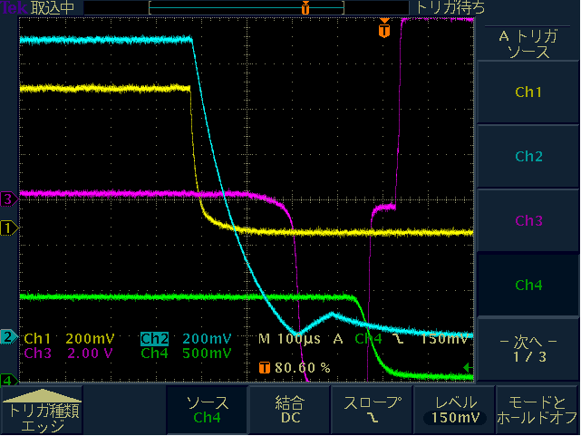
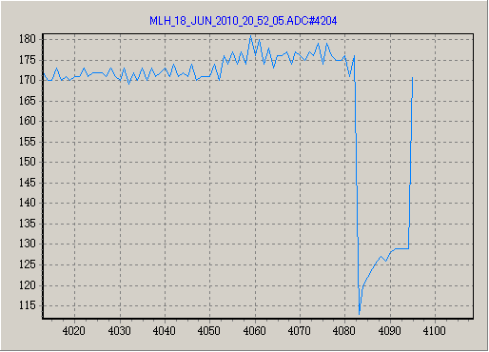
In LER negative beam loading case
In LER negative beam loading case, opposite phase beam induced field was observed.
But the phase behavior was rather gentle.
Even in this condition, the beam was not kicked hard.
40deg
~0.3mm
In case of on axis and positive beam loading, the beam was also not kicked.
horizontal

Slide 16
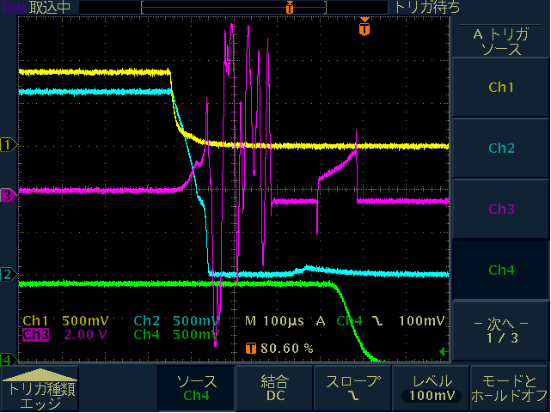
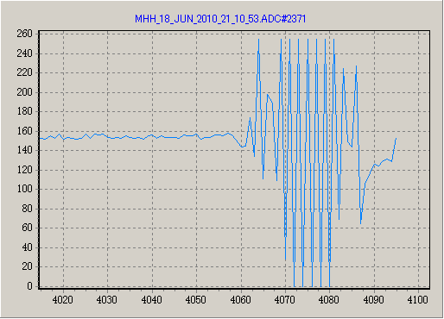
In HER positive beam loading case
In this case, the positive beam loading don’t help the phase stabilization.
In these experiments, other beam positions tests show same result.
~1.3mm
horizontal

Slide 17
summary
The beam oscillation due to decaying crabbing field was observed.
The beam oscillation was related to the turbulence of the crab cavity phase.
In most case, the crab cavity phase turbulence is observed at the HER crab cavity.
Possible hypothesis
Strong traveling wave RF field induce discharge at input coupler.

Slide 18
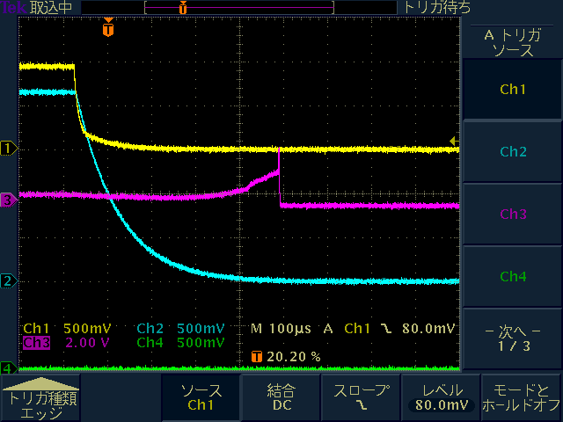
Yellow :Klystron output power
Blue :Pick up power(∝Vc²)
Purple :Cavity phase
Green :Beam current
The HER RF power is turned off without beam.

Slide 19
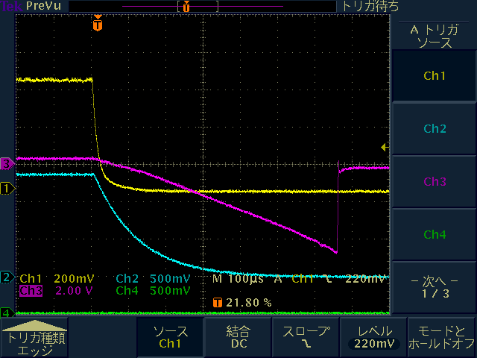
Yellow :Klystron output power
Blue :Pick up power(∝Vc²)
Purple :Cavity phase
Green :Beam current
The LER RF power is turned off without beam.

Slide 20
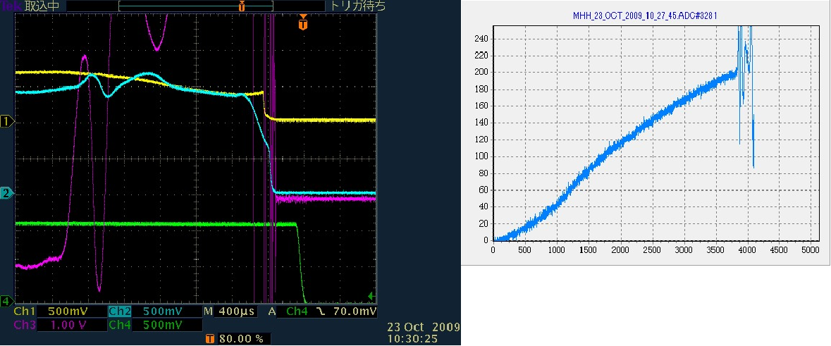
Yellow :Klystron output power
Blue :Pick up power(∝Vc²)
Purple :Cavity phase
Green :Beam current
20deg

Slide 21
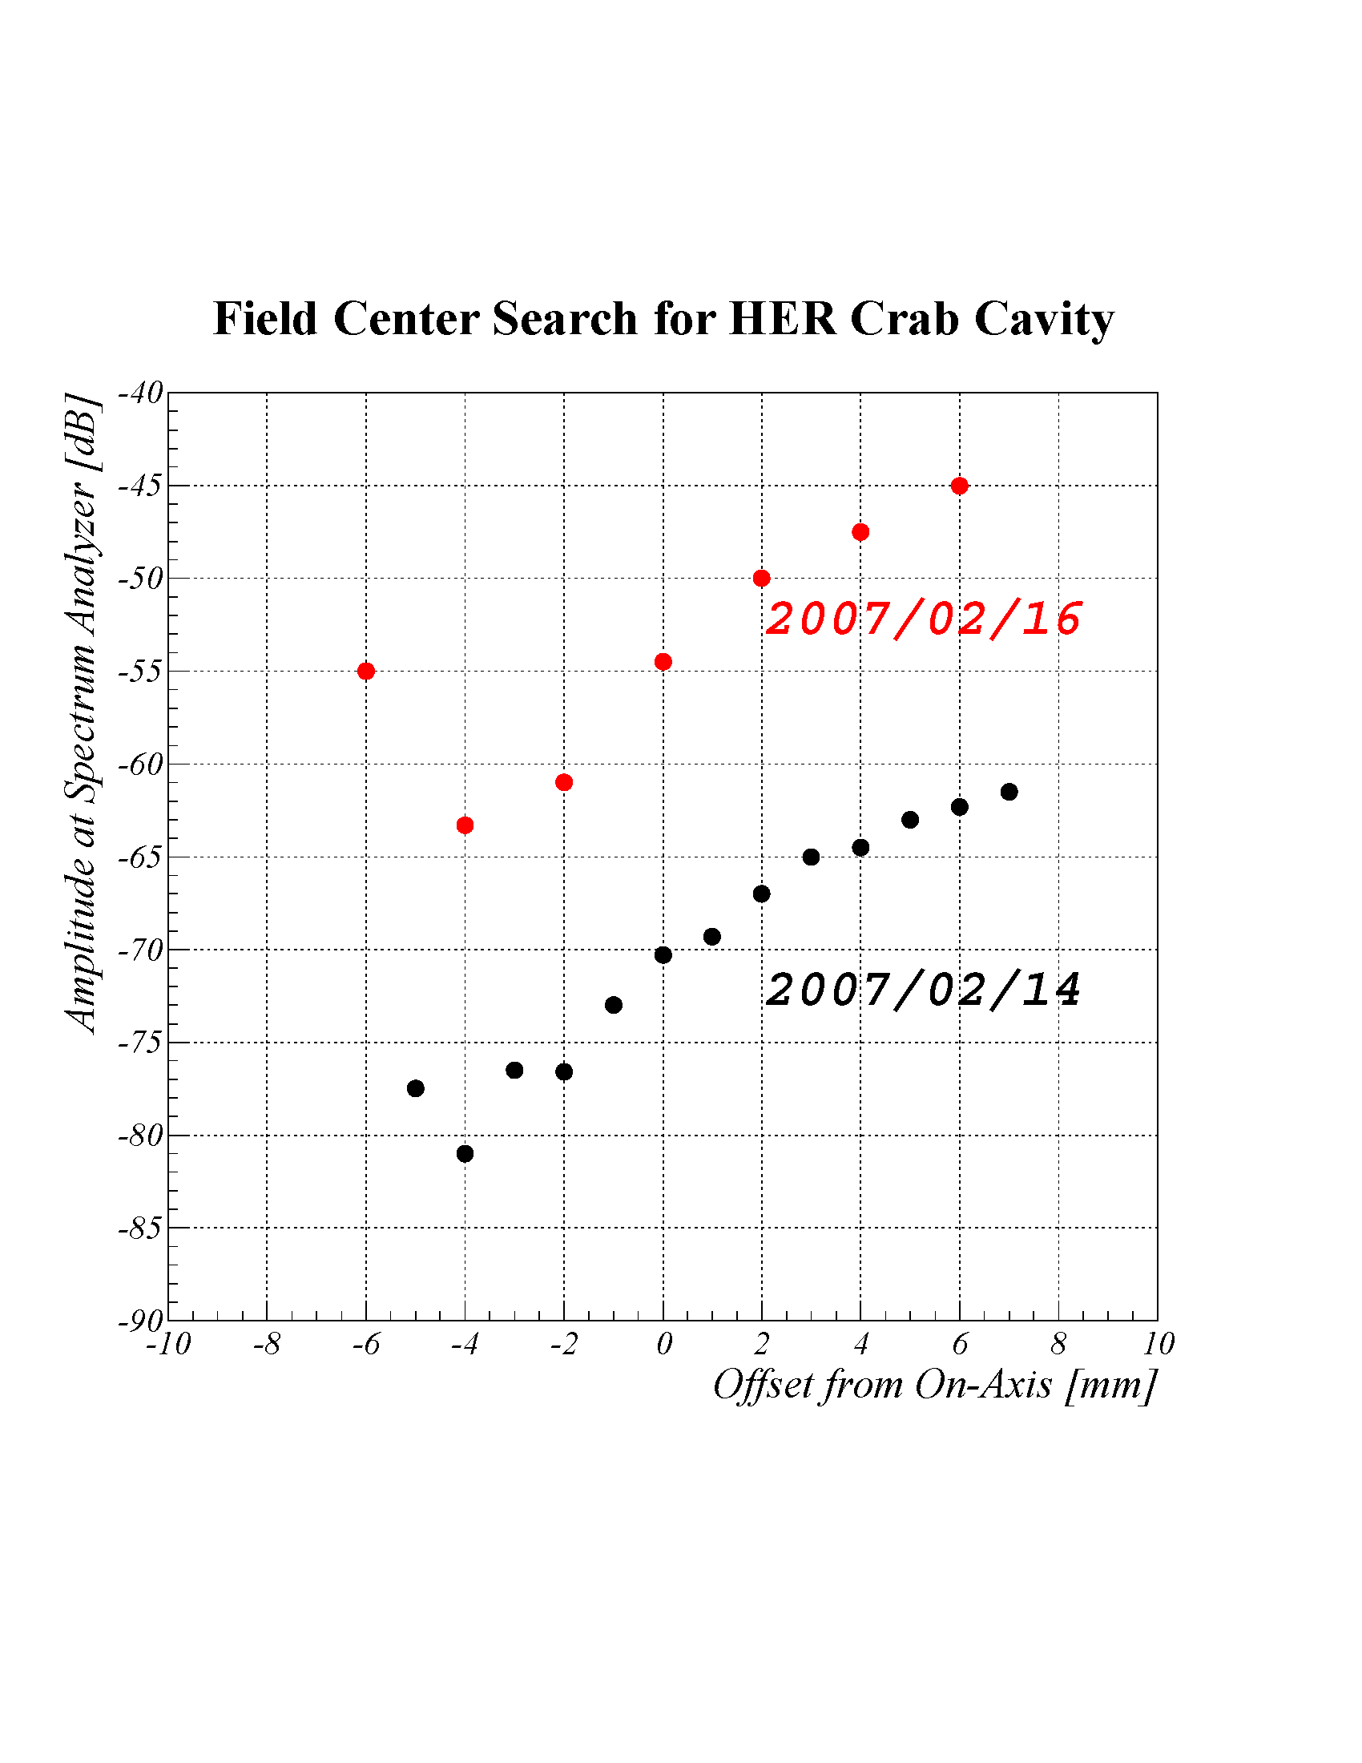
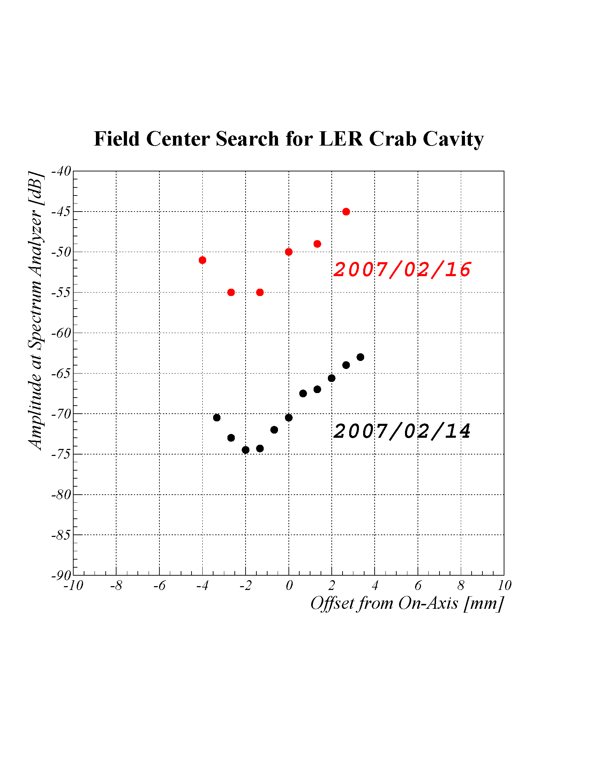
KEKB review on 2007
Searching Field Center in Crab Cavity
HER
LER
5kHz
5kHz
40kHz
40kHz
Inner
Outer
Inner
Outer
Field center was searched by measuring the crabbing mode amplitude excited by a beam with the crab cavity detuned. Two measurements with different detuning frequencies agreed to each other.
A local bump orbit was set to make the beam aligned on the field center.

Slide 22
Typical parameters
 | LER | HER | unit
β x* | 80 | 80 | cm
β x monitor | 21 | 39 | m
β x cavity | 73 | 162 | m
νx | 44.506 | 45.511 | -
I bunch | 1.0 | 0.75 | mA
φ cavity | 0.35 | 0.35 | rad
V cavity | 0.95 | 1.45 | MV
τ crab | 130 | 84 | μsec

