Slide 1
WP3/WP6 joint studies update
WP3 => Positron Source: Target and Capture System
WP6 => Proof of principle positron source in SwissFEL
Iryna Chaikovska and Riccardo Zennaro
on behalf of the WP3 and WP6 team
11 March 2021

Slide 2
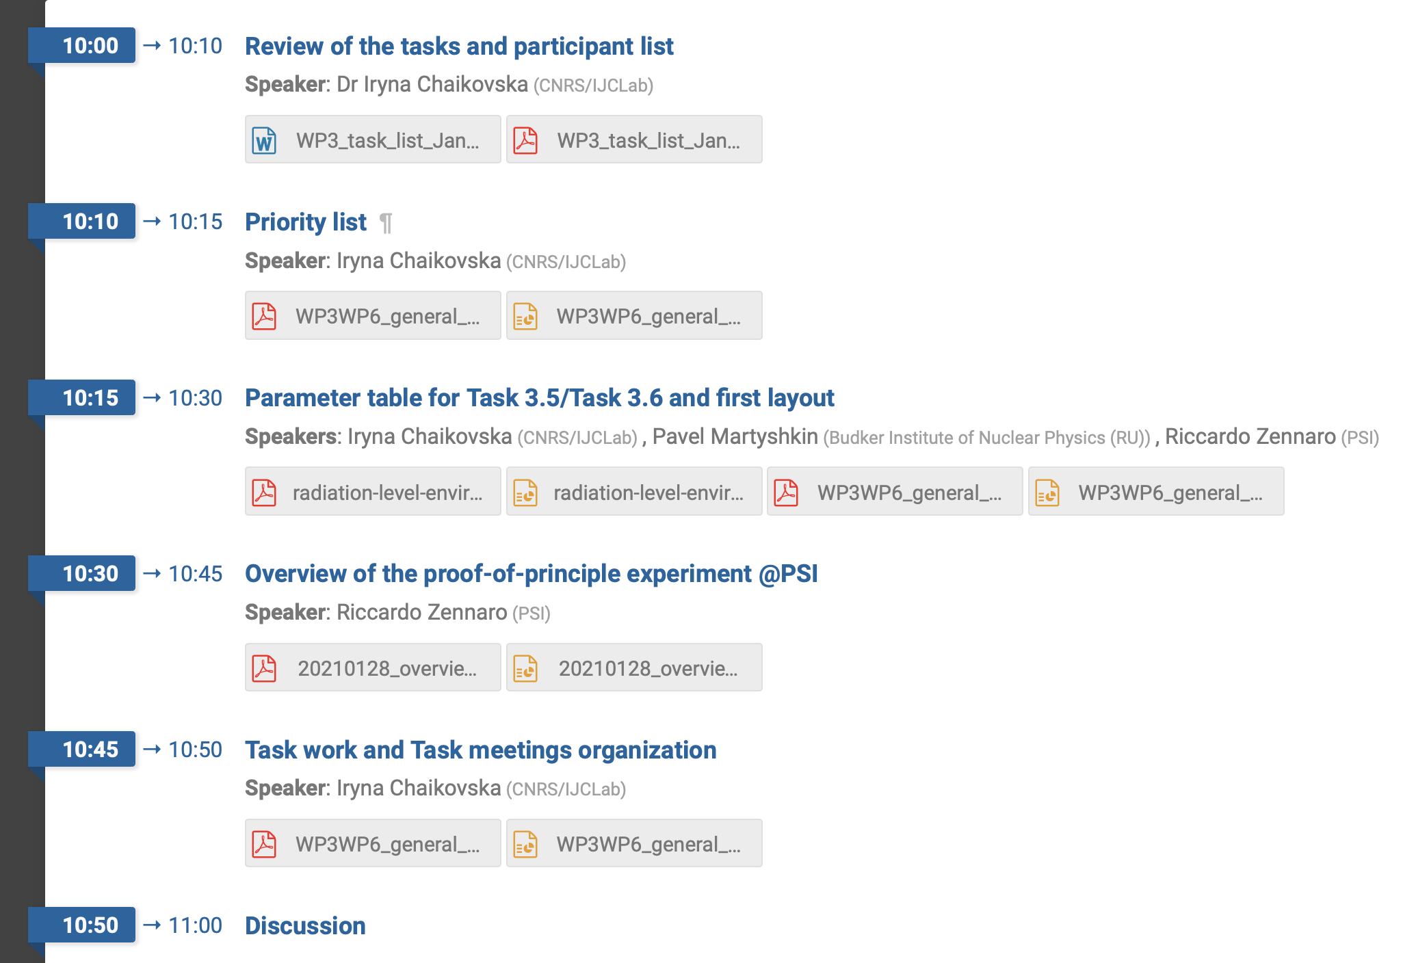
Update on the joint WP3/WP6 activity
WP3/WP6 general meeting #1 on 28/01/2021
- Simulation of the radiation environment and energy deposition (target, matching device, acc. structure) => needed for SC solenoid design
- Target design
- Setting up the simulation tools ongoing (production and beam dynamics) => FCC-ee positron source and PoP @PSI
Discussion with CERN STI group on 11/02/2021
- The strategy to design the targets for the FCC-ee and the PoP @PSI should be clarified and validated.
- We propose to start with the FCC-ee target as it may involve more studies/investigations (2 bunches or multi-bunch ??)
- The target for the PoP (fixed W plate) can be realized without any particular difficulties
https://indico.cern.ch/event/995947/

