Slide 1
WP6: e+ production at PSI
FCC injector coordination meeting #4 R. Zennaro 11.03.2021

Slide 2
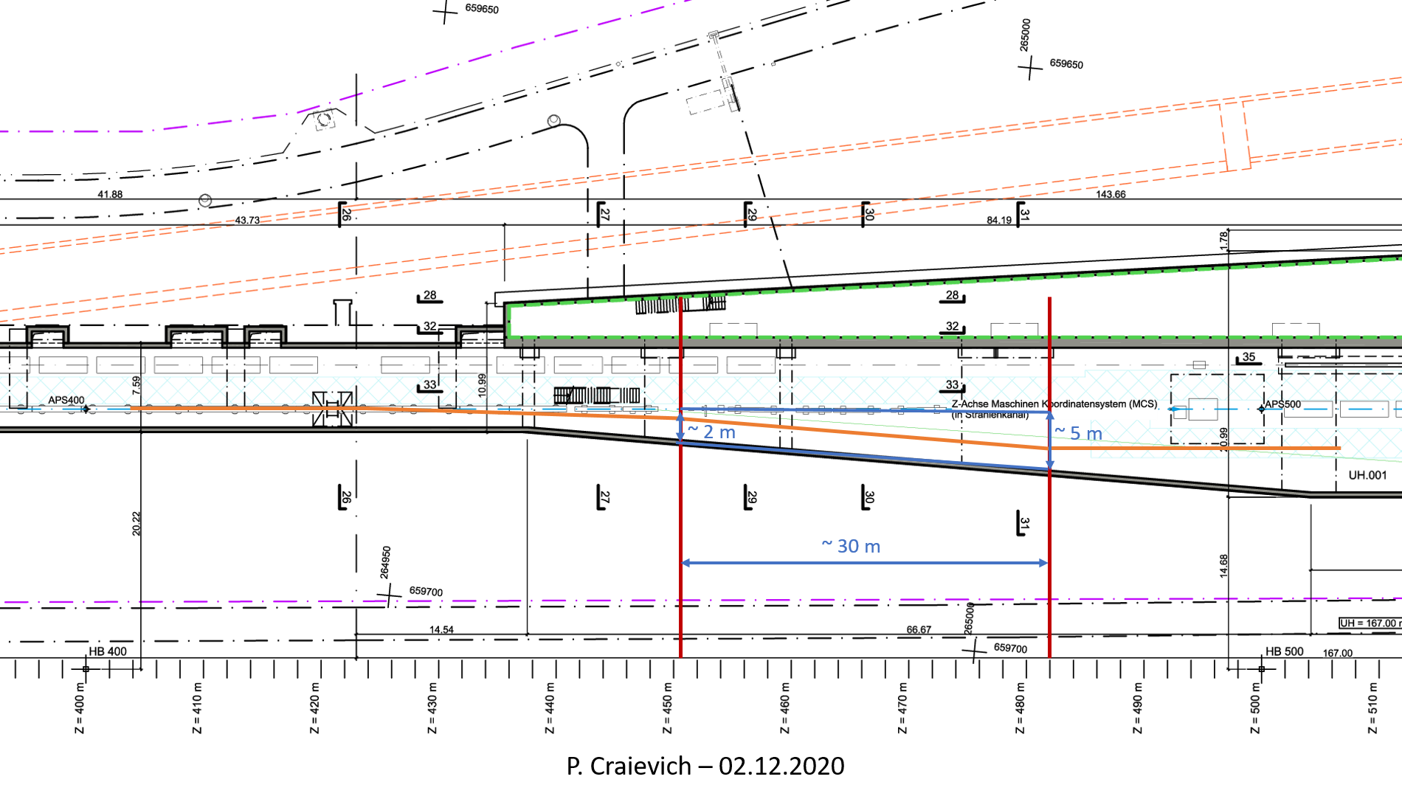
e- beam line from Aramis
Courtesy of S. Reiche

Slide 3
Experimental area
Goal: have a comparative study between direct and hybrid scheme
Diagnostic not yet defined
Crystal in/out
AMD+target
RF cavities + solenoids
spectrometer
e-
e+
light
Circulator
Circulator
6 GeV
Simplified beam stopper + permanet dipole
e- beam dump or beam stopper + beam dump?
(huge e- energy distribution)
Klystron 35 MW 3.5 10^-6 s?
NB: both e- and e+ have huge energy spread, beam dump design and shielding problems. Option: operate with extremly low beam charge <<200 pC, <<100 Hz

Slide 4
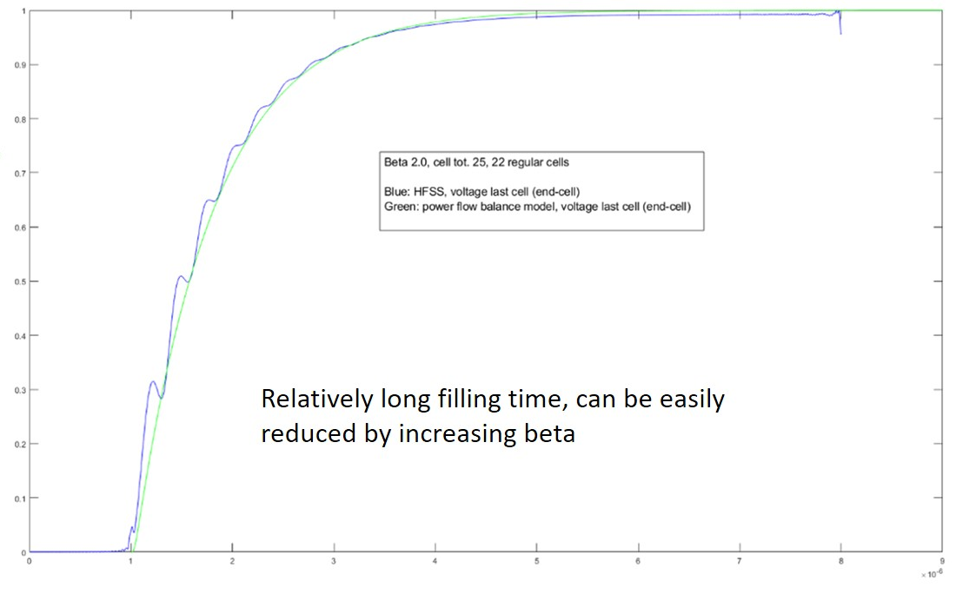
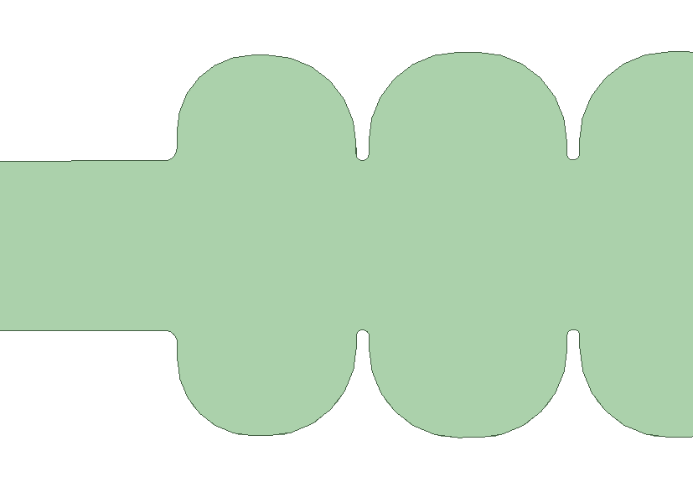
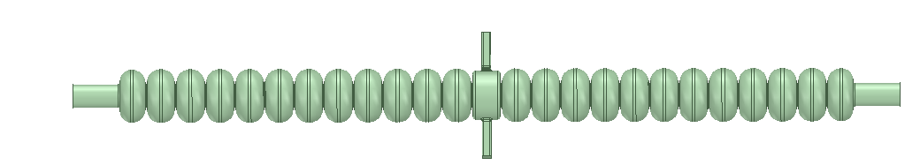
S-band SW π mode cavity
25 cells max.
2998.5 MHz
Q= 21000
β= to be defined, in this example 2
R/Q=939 (for β=2)
mode separation 3.8 MHz R/Q=939 (for β=2)
18 MV/m @ 15 MW (for β=2)
Ez field din the last cell, relative value
0 0.1 0.2 0.3 0.4 0.5 0.6 0.7 0.8 0.9 1.0
HFSS computation
Analytical model
3
40
89.7
50
0 1 2 3 4 5 6 7 8 9
T filling (10^-6 s)
1400

Slide 5
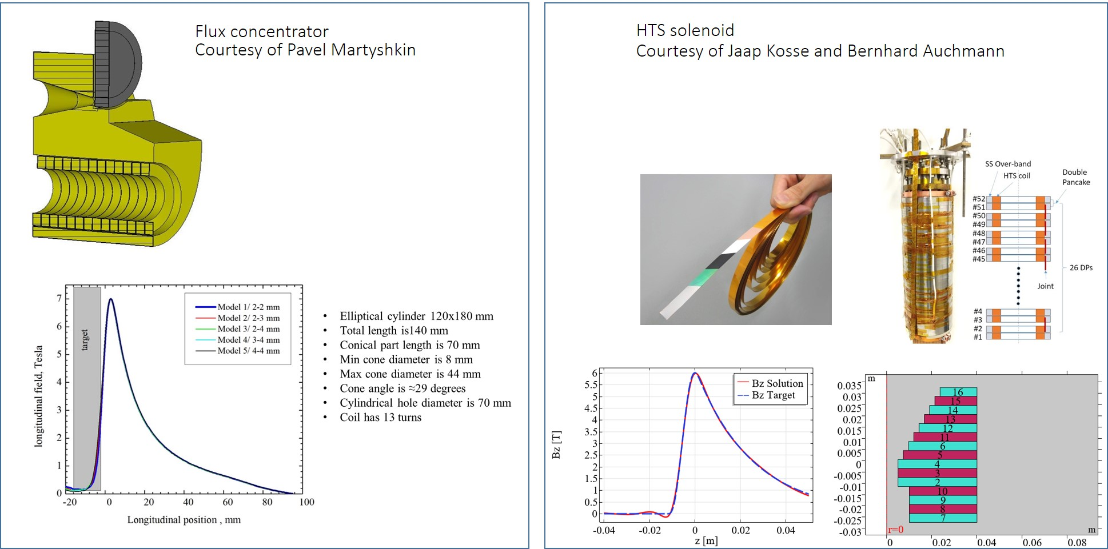
AMD: possible solutions
PSI is designing a superconductive AMD as alternative to the pulsed magnet flux concentrator

Slide 6
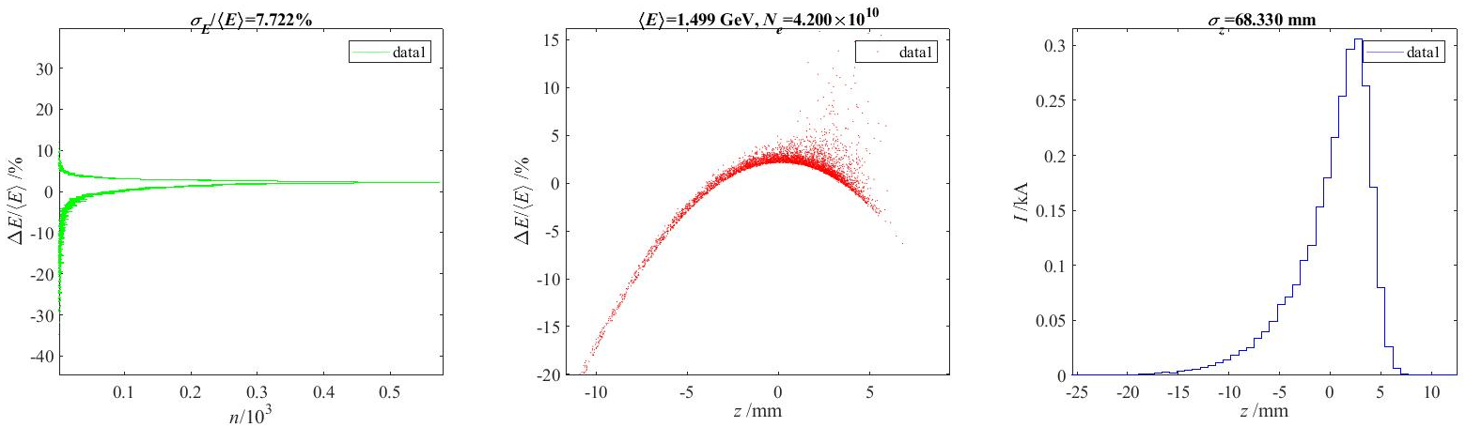
Preliminary results (Astra up to 200 MeV, LiTrack up to 1.5 GeV) as validation of the superconducting AMD+ S-band SW cavities
e+ distribution at target (from Iryna);
Positron Yield at target = 13.8 e+/e-
Conventional scheme,
tungsten target-converter 5X0 (~ 1.75 cm)
e- energy = 6 GeV; Bunch length (rms) = 1 mm
Beam divergece (rms) = 1e-5
Energy spread (rms) = 1e-3
Beam size on target (rms) = 1.5 mm
10+52 SW 3 GHz cavities 18 MV/m, 1st and 2nd AS @-30°
7 T peak field for the SMD
27% e+ in the CLIC DR longitudinal acceptance.
(±3.8% dE/E; ±8.9 mm σz,??)
Total Yield 13.8*0.27= 3.7

