Slide 1
WP3 update
Positron Source: Target and Capture System
Iryna Chaikovska
on behalf of the WP3 team
11 March 2021

Slide 2
General updates
Common workspace (indico, cernbox, gitlab, notes, etc. ) is deployed for the FCC-injector studies/CHART collaboration (thanks to Andrea) and ready to be used by everybody. https://espace.cern.ch/FCC-ee-injectors/WP3/_layouts/15/start.aspx#/SitePages/Home.aspx
Work within the WP3 is mainly focused now on the benchmark of simulation codes and simulations of the capture system (different matching devices, RF structures, production schemes).
Setting up the working environment with CERN STI group => the general strategy for the target design should be clarified and validated.
Abstract of the IPAC-2021 has been submitted by Y. Zhao (Title: Comparison of Different Capture Schemes for the FCC-ee Positron Source Design) and contributions to the FCC-France workshop on 20-21 January 2021 (I. Chaikovska) and LCWS-2021 on 15-18 March 2021 (I. Chaikovska and Y. Zhao) was/will be given.

Slide 3
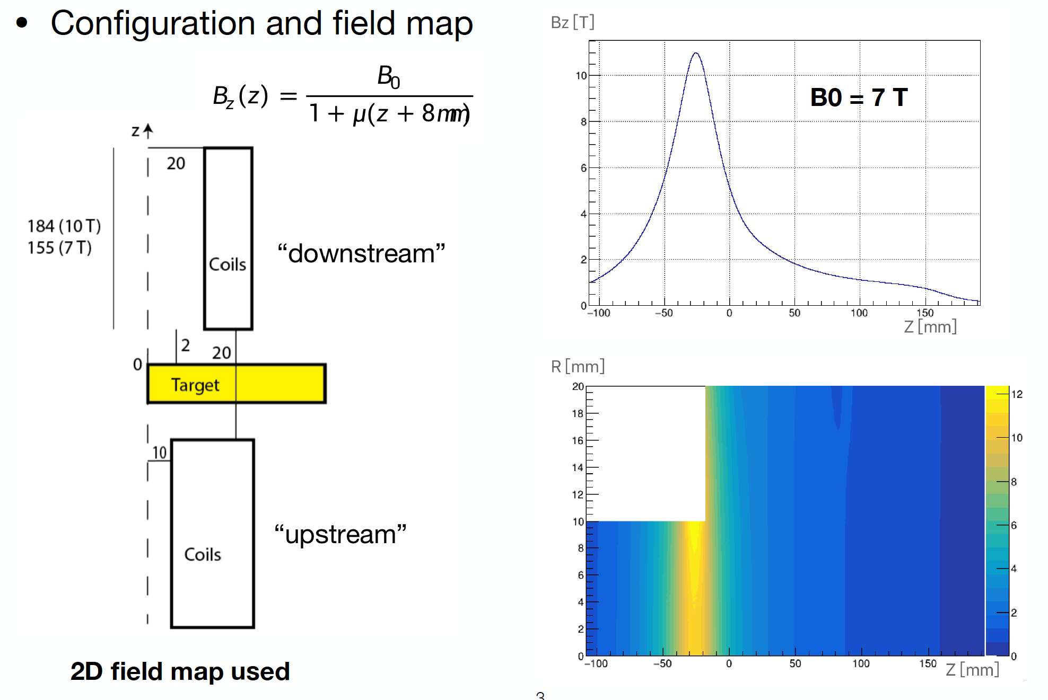
Some highlights (work ongoing)
Courtesy of J. Kosse and Y. Zhao
HTS as the AMD
Design studies of the SC solenoid have been started @PSI. The HTS technology is proposed.
Two fieldmaps are provided by the PSI magnet group (with peak field of 7 and 10 T).
Goal: 4.2 ⨯ 10¹⁰ e+/bunch (7 nC)
The e- drive beam parameters are kept the following:
  6 GeV,
  beam spot size 1.8 mm,
  bunch length 1 mm*
  25-30 bunches per pulse,
  100 Hz rep. rate.
* zero bunch length was used in the presented simulations.
Conventional production scheme
L-band TW structures (same as CLIC)
Gradients: 22 MV/m for dec. 16.5 MV/m for acc. Already optimised to achieve the maximum positron yield, with the energy at the exit as close to 200 MeV as possible
Next step: simulation of the radiation environment in target vicinity

Slide 4
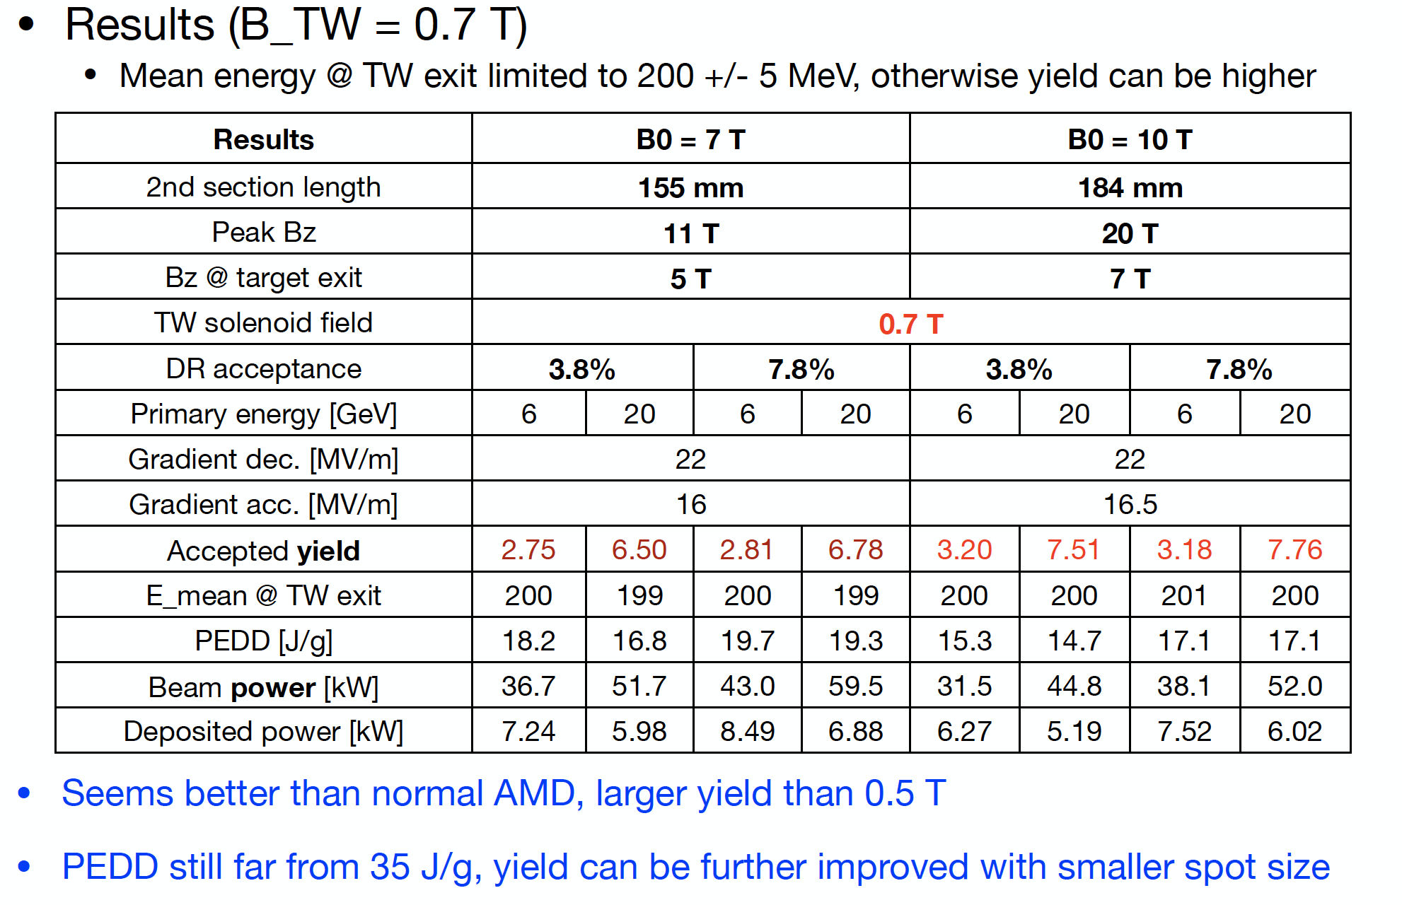
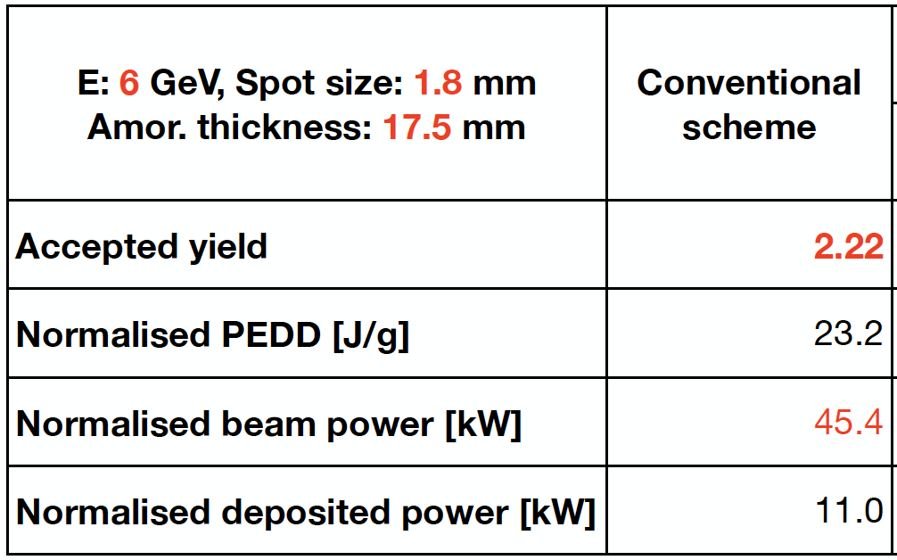
Some highlights (work ongoing)
Courtesy of Y. Zhao
HTS as the AMD
Effect of the magnetic field upstream the target has been evaluated:
px, py spread increased by a factor of 40 @Target entrance
Difference in positron yield @Target: the same, @Solenoid exit: ~0.1%, accepted by the DR: ~1%, PEDD: ~2% => small effect
Results obtained with the FC 7 T, B_TW = 0.7 T, DR acceptance 3.8% (ceteris paribus)

Slide 5
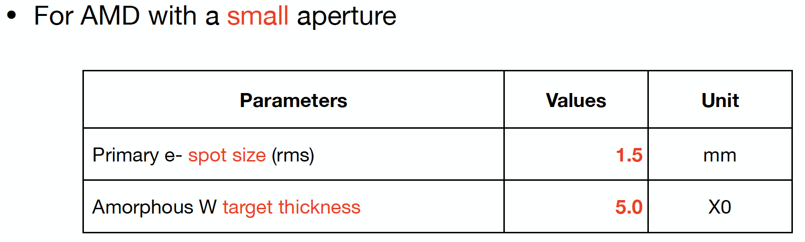
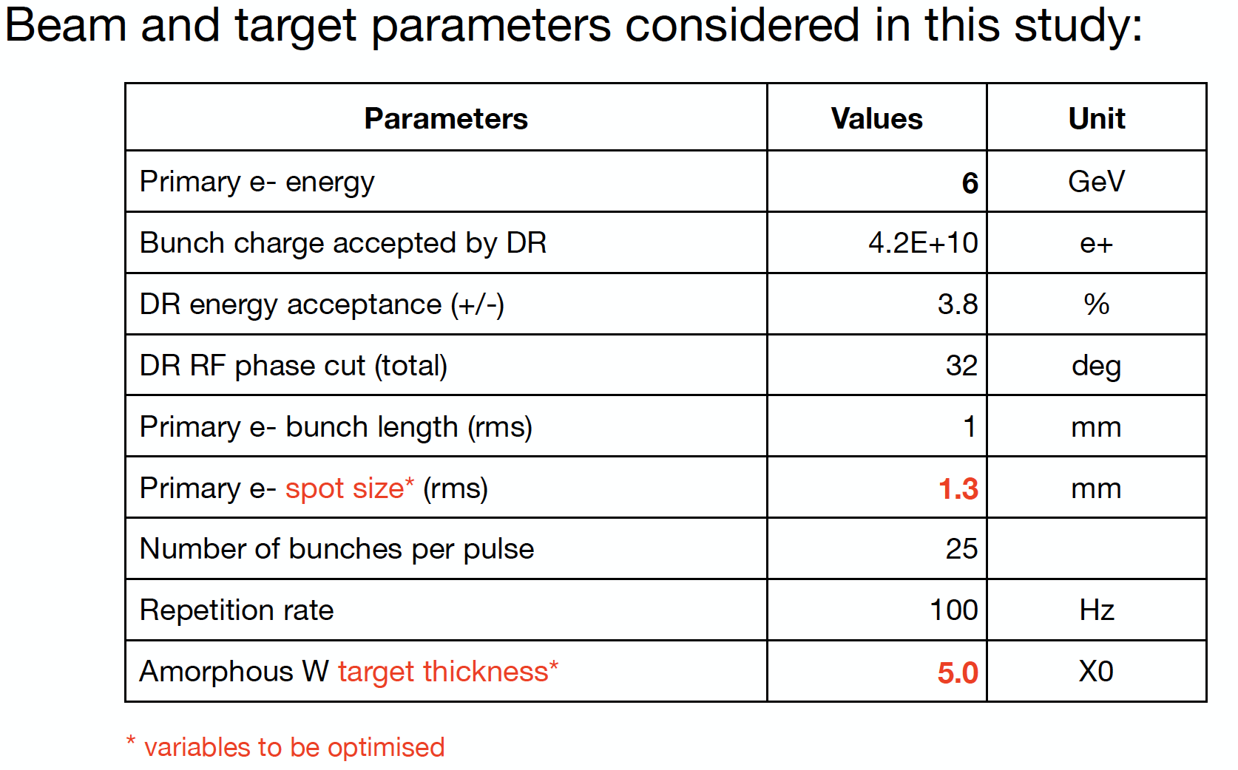
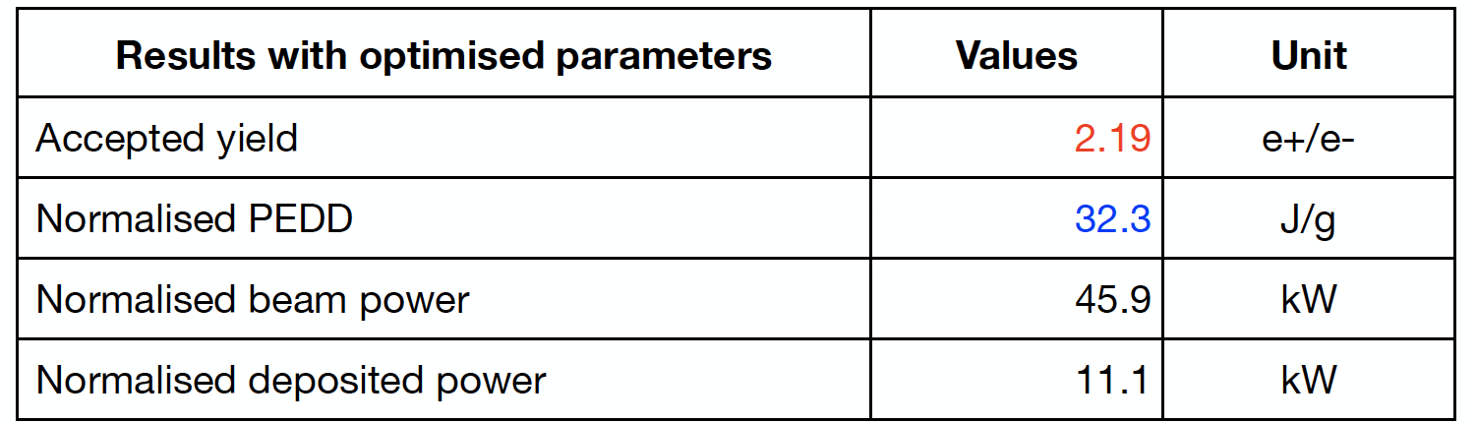
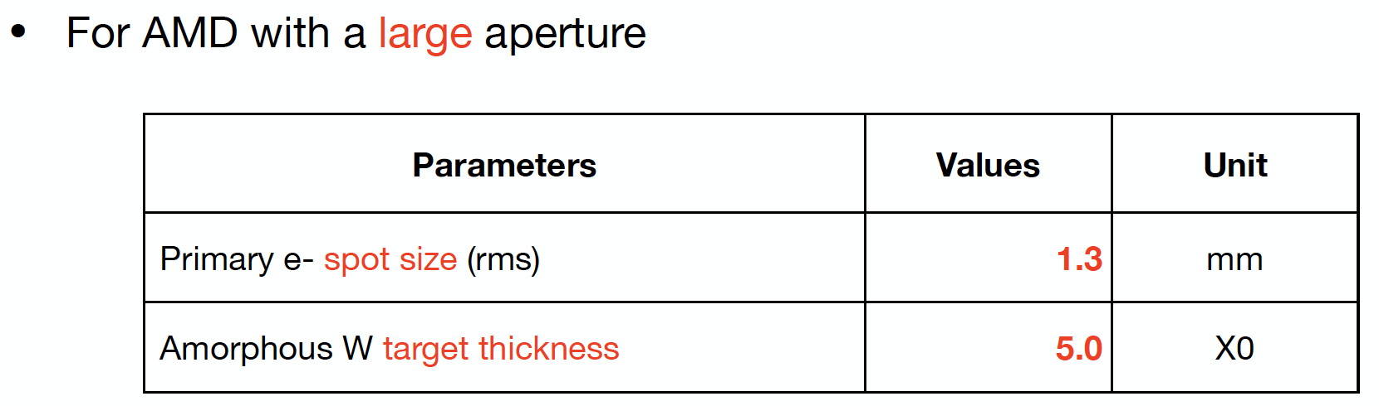
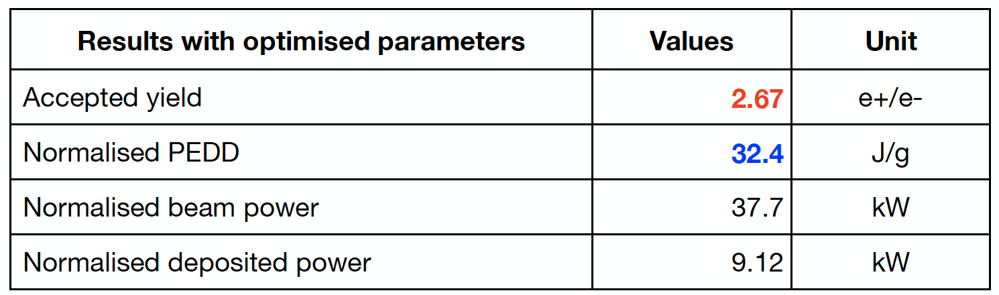
Some highlights (work ongoing)
Courtesy of Y. Zhao
Conventional scheme
Motivation: optimise conventional target thickness, as well as primary electron beam parameters.
AMD: FC with a small (7 T , 8 mm) and large aperture (5 T, 16 mm)
TW structures: CLIC-like L-band with 0.5 T DC field
Injector linac: analytic formula without simulation

Slide 6
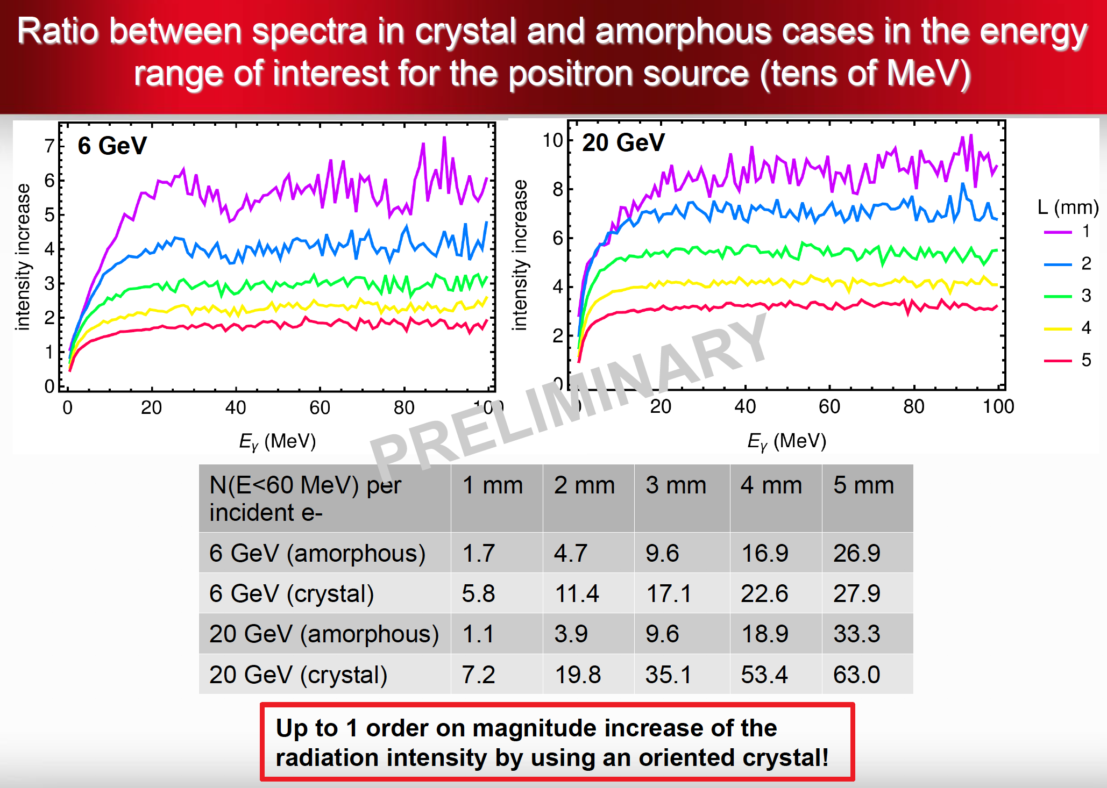
Some highlights (work ongoing)
Courtesy of Y. Zhao and A. Sytov
Hybrid scheme
Design studies of the hybrid scheme for the FCC-ee have been started. Next steps: optimization of the crystal, distance between the targets, target-converter, drive beam parameters, large aperture AMD, etc.)
Crystal optimization
Benchmark of the codes to simulate the radiation in the oriented crystals (FOT vs. Ferrara’s code) is ongoing
The difference in positron yield is small (< 13%).
The difference in photon energy spectrum (low energy part E < 13 MeV) and transverse momenta of the charged particles after the crystal is under investigation.

