Slide 1
WP0.2 report
Overall parameter optimization
Alexej Grudiev on behalf of WP0.2
11/03/2021

Slide 2
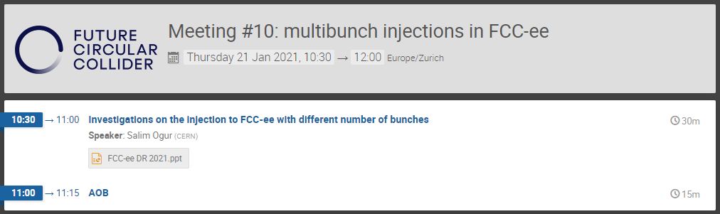
10th meeting in the WP0.2
Two topics have been discussed
  Preliminary design of the DR for multi-bunch operation
  Filling of the collider in multi-bunch operation

Slide 3
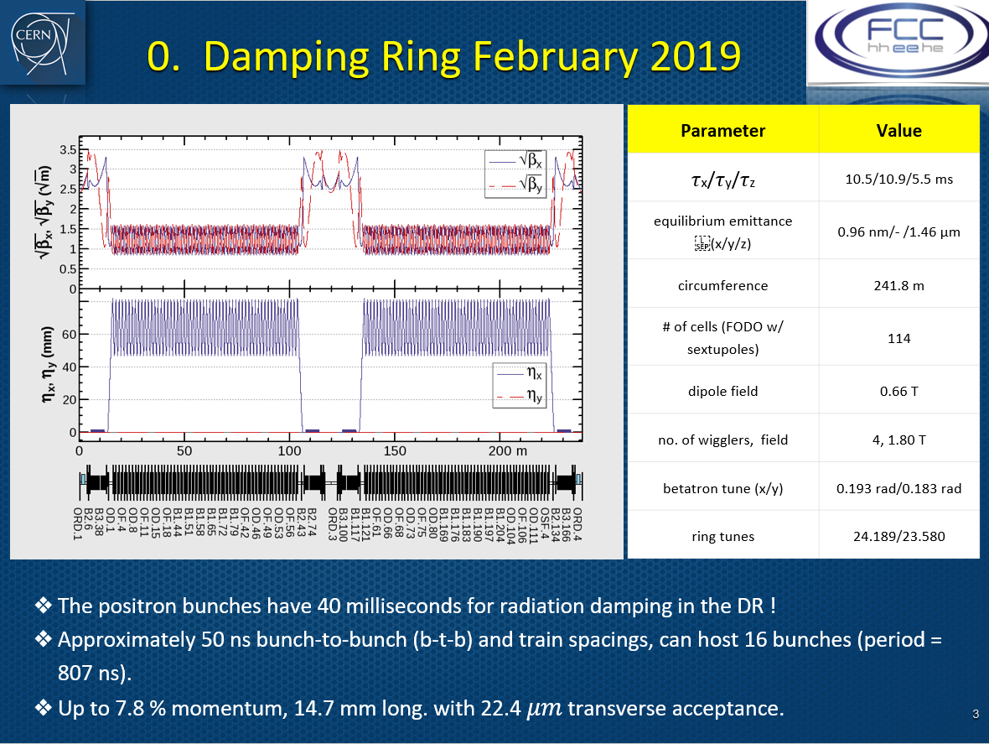
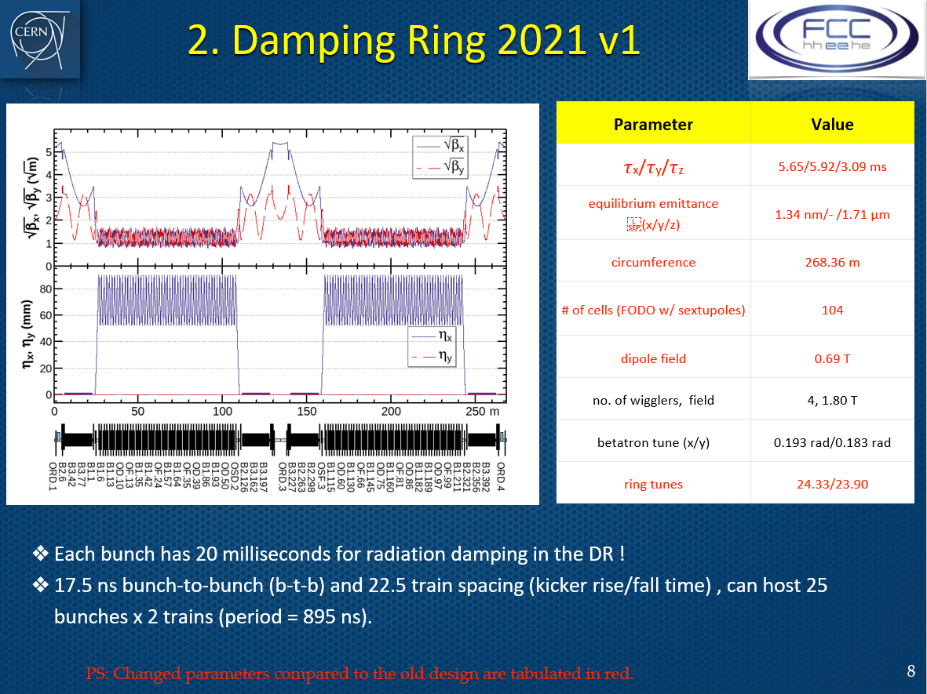
Preliminary DR design: first step towards DR design for multibunch trains
2 bunches per train
25 bunches per train

Slide 4
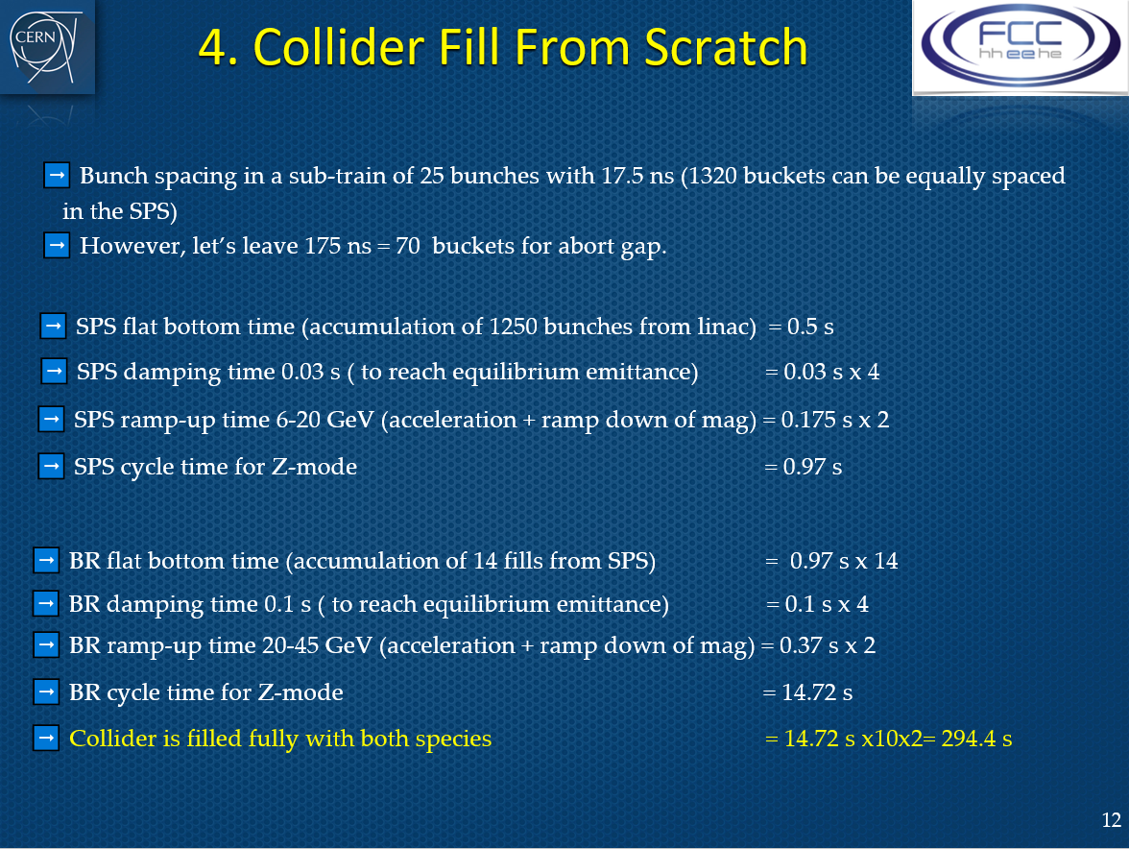
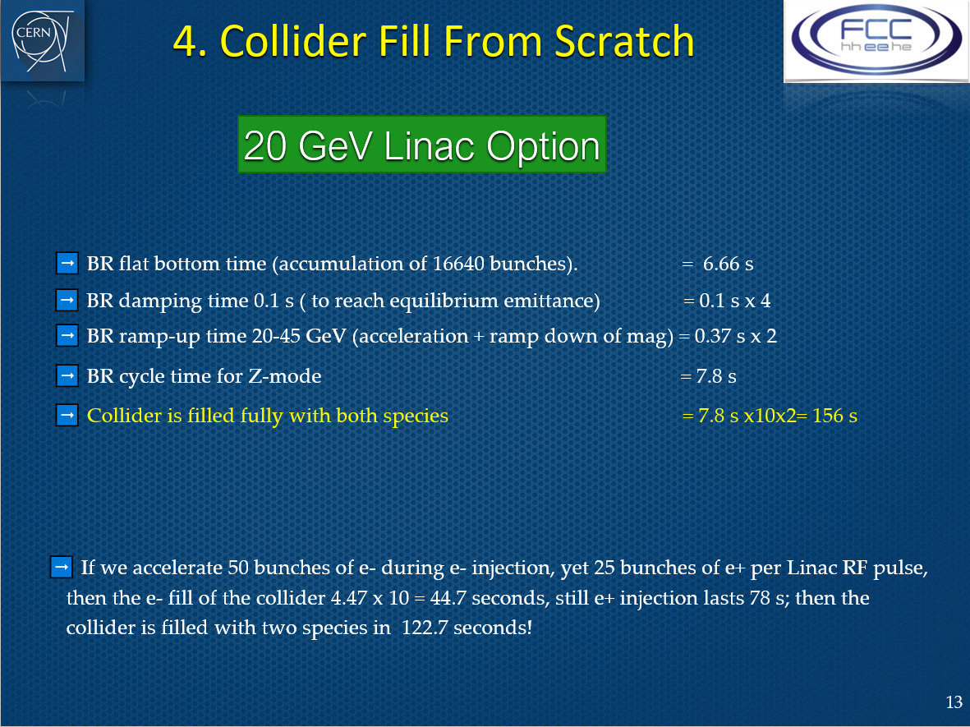
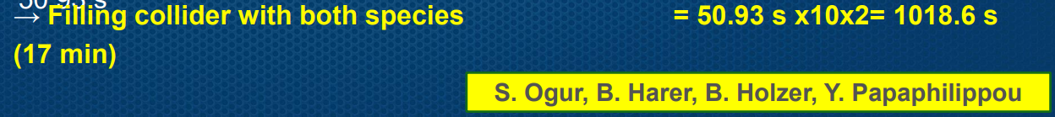
Filling Collider with trains of 25 bunches
294 s
156 s
Baseline (2 bunches per train):
PowerPoint Presentation (cern.ch)

Slide 5
Some conclusions and questions
Using 25 bunches per train at 100 Hz instead of 2 at 200 Hz reduces filling time of the collider by factor 3.5 from 1019 to 294 seconds
Extending linac up to 20 GeV (no PBR) reduces filling time down to 156 seconds: factor 6.5
Question 1: how strong is the impact of this reduction of the filling time on the overall performance of the collider: integrated luminosity ?
Answer to this question is important for the injector parameter choice (2 <-?-> 25). It should come from FCC-ee collider team
Question 2: What are the requirements on the bunch-to-bunch intensity in the top-up operation?
The answer also should come from FCC-ee collider team. It is important for finding the best way of controlling it in the injectors

