Slide 1
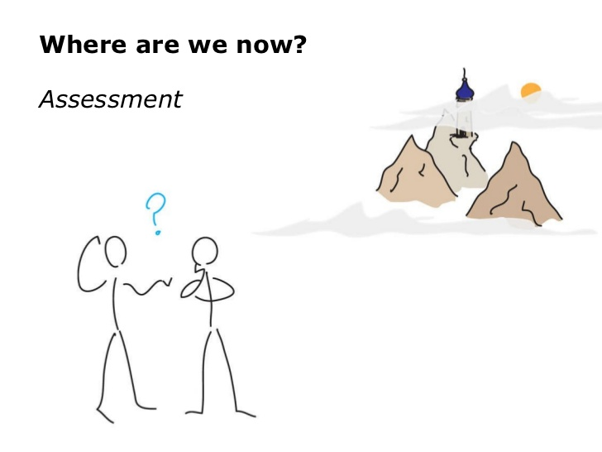
FCC-ee Injector Design and Test Stand at PSI Coordination meeting 04
AGENDA
Administrative aspects, Overview of the meetings, organization aspects
Update on WPs and Tasks
Next meetings and open points
Notes:
Welcome to everyone. We can start the meeting.

Slide 2
Administrative aspects
Internal PSI administrative issues are slowly being addressed:
  Process to hire a staff is started, anyway we are still discussing with the candidate
  Announcement for a PhD program soon, preliminary program ready (to be discussed with Iryna)
2x Project Report for year are due to CHART council (financial and scientific reports)
The FCC addendum between CERN and PSI is still pending and under discussion
WP3: Addendum between CERN and JICLAB expires in April 2021
WP4/Damping ring and transfer lines: Addendum between CERN and INFN signed Contact person at LNF is Catia Milardi. Postdoc hired?
P. Craievich – 11.03.2021

Slide 3
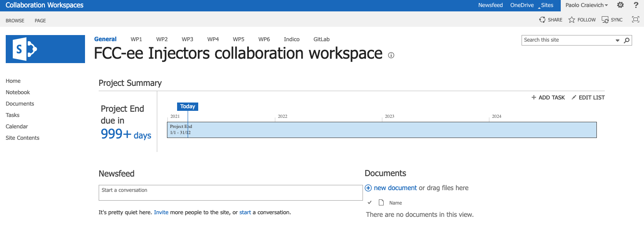
Workspace for the collaboration
Many thanks to Andrea!
Link: https://espace.cern.ch/FCC-ee-injectors/_layouts/15/start.aspx#/default.aspx
Top menu: links to the other WPs, to the Indico page of the meetings, and to the Gitlab repository (which, unfortunately, seems to be accessible for writing only to people with a CERN computing account)
Left menu: several links to useful features of the Share Point workspace, and a link to a CERNbox space where everyone has read/write access. We should use this as a repository for datafiles, fieldmaps, reference papers, etc. We could also maintain a mirror of the GitLab repository

Slide 4
Review meeting for Injector parameters
(M. Benedikt)
Premise: We are proposing a new injector baseline design (parameter changes from CDR0)
  Bunch train instead of single or two bunches
  Different beam energies at the sub system interfaces
Outcomes from review meeting should provide a solid basis for further design work in all WPs
Michael has recently discussed with the FCC advisory committee chair and the review will take place in the week of 19 – 23 April 2021. Please keep in mind
Our work plan in the coming weeks should be also adjusted to that goal.
A preliminary agenda will be prepared and send around next week

