Slide 1


5th Meeting of the PBC Conventional Beams Working Group
Lau Gatignon, Markus Brugger, Johannes Bernhard (BE-EA)
12.02.2021

Slide 2
Communications
The next PBC Annual Workshop will take place from March 1st to 4th as already announced by the PBC chair persons: https://indico.cern.ch/event/1002356/ (registration is open).
The aim of today’s meeting is to collect new information that will be relevant for the workshop and for the work of this Working Group.
Alexander Gerbershagen was proposed to summarise the Conventional Beams status at the workshop.
For the internal organisation, we propose to keep the division by experimental area with an update on the convenors:
  For EHN1, Alexander Gerbershagen as chair, Nikos Charitonidis and Dipanwita Banerjee as staff physicists
  For EHN2, Dipanwita Banerjee as chair, Alexander Gerbershagen and Johannes Bernhard as staff physicists

Slide 3
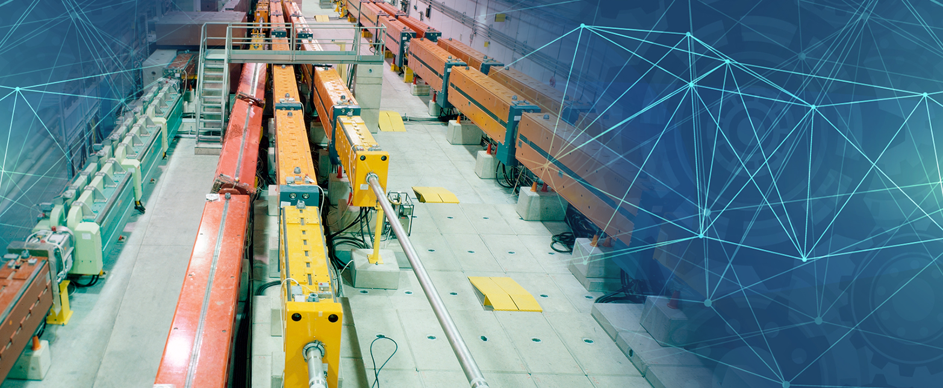
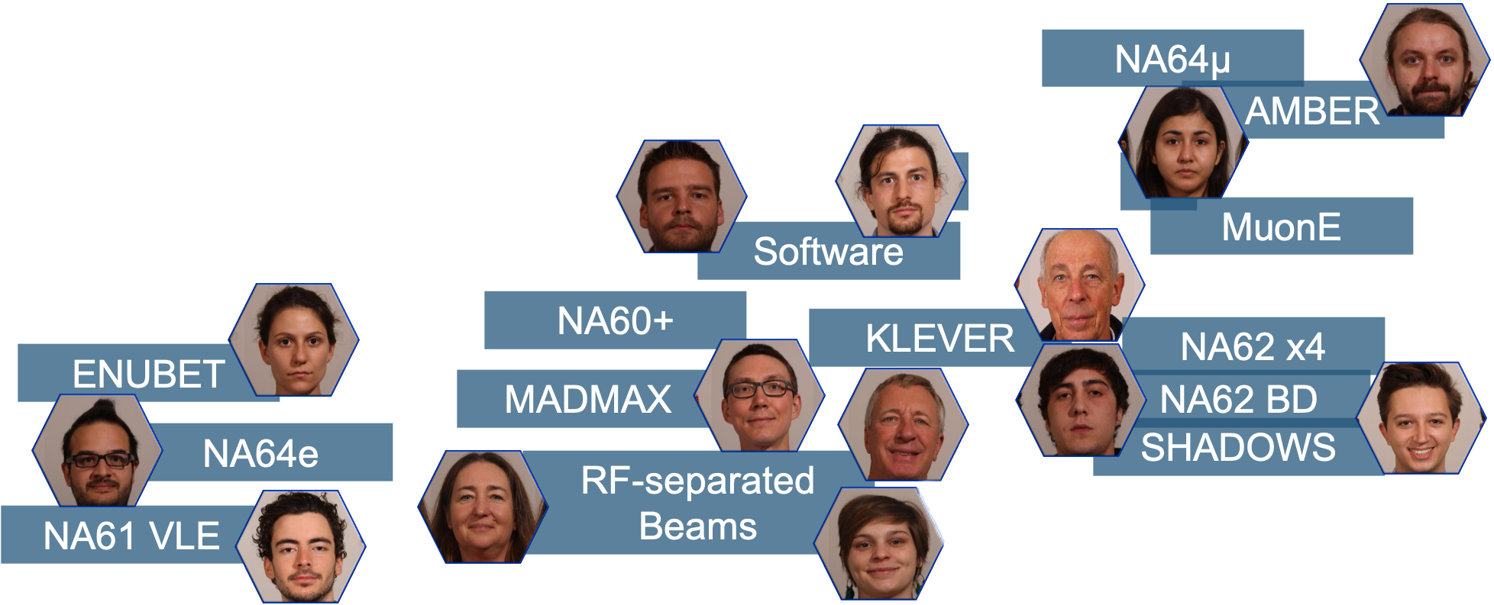
PBC CB Support
Support for studies in context of PBC CB
plus integration, engineering and design teams of BE-EA on demand

Slide 4
Thank you very much for your attention!

