Slide 1
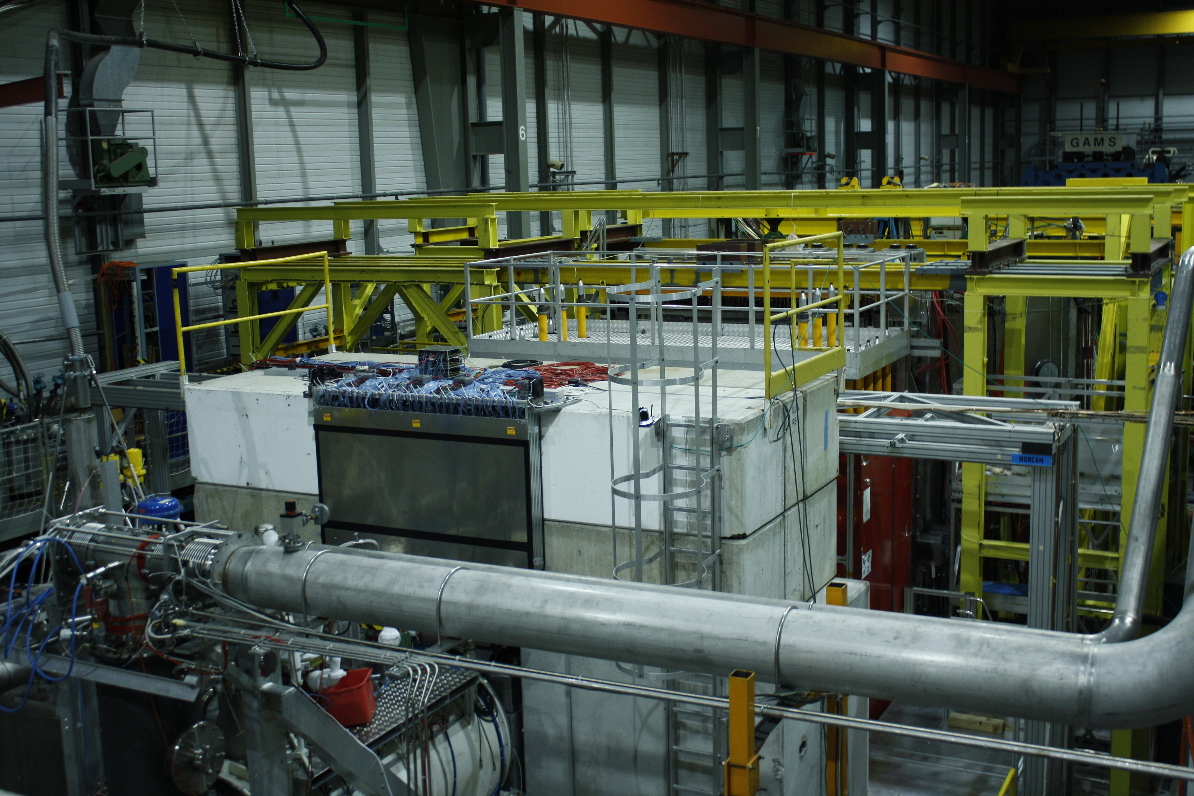
AMBER (New QCD facility at CERN SPS)
Physics Beyond Colliders, Conventional Beams subgroup meeting 12.02.2021

Slide 2
Outline
AMBER Intro
  Phase-1
  Phase-2
RF-separated beam requirements
Series of workshop on Emergence of the Hadron Mass
Summary

Slide 3
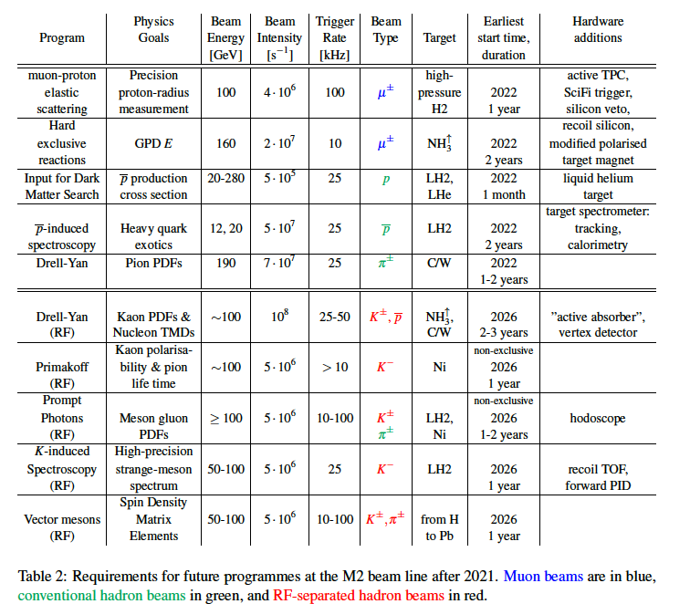
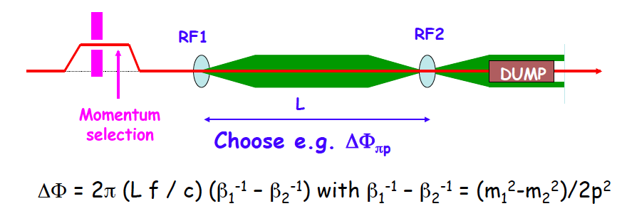
COMPASS++/AMBER
A New QCD Facility at CERN SPS M2 beam line
Conventional muon/hadron
M2 beams

Slide 4
COMPASS++/AMBER PHASE-1
PHASE-1
Conventional hadron and
muon beams
2022 ➔ 2029 and beyond
PHASE-2
RF-separated
Hadron
beam
2030 and beyond

Slide 5
AMBER recommendation by the SPSC on Oct. 12th 2020
AMBER* approval by RB on Dec. 2nd 2020
"The Committee recommends approval of the proposal SPSC-P-360 by the AMBER Proto-Collaboration to use the M2 beam-line before LS3 to perform measurements related to:
(i) Drell-Yan and J/Psi production using the conventional M2 hadron beam;
(ii) proton-induced antiproton production cross sections for dark matter
searches;
(iii) the proton charge radius using muon-proton elastic scattering.
The proton-radius program is contingent on a successful pilot run previously approved for the first year of SPS operation after the Long Shutdown LS2.
The SPSC _emphasises_ that the beam time allocated to AMBER for any of the measurements is subject to the available time in run3, and to annual discussions in the Committee on the use and sharing of the M2 beam line."
Dear ……….,
Yes, I am happy to inform you that the AMBER proposal was discussed at the Research Board yesterday, and was approved. This means that it will be assigned a new experiment reference number, likely to be NA66. The actual beam time allocation will depend on arbitration with the other requests that are received, so will be subject to separate approval as part of the annual exercise of scheduling beam time. This should be confirmed in the minutes of the Research Board, and I will let you know when they are available in the next month or so.
Best regards, Roger

Slide 6
Tentative C++/AMBER running plan as indicated by PBC/ESPP process
AMBER ➔

Slide 7
COMPASS++/AMBER PHASE-2 (RF-separated beam: our goal is to submit the Proposal by the end of 2021)
PHASE-1
Conventional hadron and
muon beams
2022 ➔ 2025 and beyond
PHASE-2
RF-separated
Hadron
2030 and beyond

Slide 8
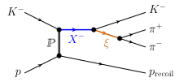
RF separated beam – Hadron spectroscopy
Strange Meson Spectrum
RF separated K⁻ beam ~ 8 x 10⁶ /s, beam momentum ~100 GeV
  State-of-the-art high-resolution spectrometer with full PID
  Advanced analysis techniques being developed in the light-quark sector
  Method to be used: Kaon beam diffraction scattering on LH₂ and thin nuclear targets
- Goal: ~10 larger data sample than existing worldwide
what would make possible to have similar to pion diffraction
wave set: 88 waves in 11 t’ bins;
- COMPASS could rewrite PDG tables for strange mesons
particle type / beam composition: K⁻ or K⁺ depends on beam purity and maximum beam evergy
beam intensity: 5x10⁶ kaon/sec
beam energy: ~ 100 GeV, optimal value would be close to 190 GeV (but seems unfeasible)
beam momentum spread: 1% . Larger spreads could be tolerated if novel beam-momentum stations with low material budget will be used (preferred solution)
beam spot size: Requirements are quite relaxing - below approx. 2x2 cm² (target size)
beam particle identification: unless RF separation reduces the contribution of other beam-particle species to the single-digit percent level, CEDAR PID would be mandatory

Slide 9
RF separated beam: specification from Primakoff program with Kaon beam
Compatible with the specification for Spectroscopy
particle type / beam composition: K⁻ beam (no pion component), moderate intensity muon beam
beam intensity: 5x10⁶ particles/second of total flux (both muon sand kaons)
beam momentum: ~ 100 GeV
beam momentum spread: 1%
beam spot size: ~5x5 mm²
beam particle identification: essential in case of other particle type contamination

Slide 10
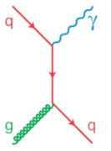

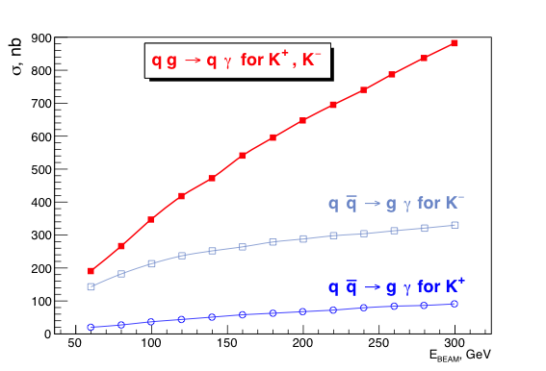
RF separated beam: specification from direct photons program
Production of direct photons
K N → X γ
First direct test of gluon
Structure of Kaons
(Gluon PDFs)
particle type / beam composition: K⁺ beam,
if not possible K⁻
beam intensity: 5x10⁶ particles/second of total
flux (both muons and kaons)
beam momentum: ≥ 100 GeV
beam momentum spread: 3%
beam spot size: ~5x5 mm
beam particle identification: essential in case of other particle type contamination

Slide 11
RF separated beam – Drell-Yan
RF separated antiproton/kaon beam, the maximal possible beam intensity
(very rough estimate) of ~3-4x10⁷ /s can be reached (antiprotons) and ~8x10⁶ /s (kaons)
Assuming flux of 1x10⁷ /s for kaon/antiproton,
background free high mass range 4 < M_{μμ} < 9 GeV/c² and
140 days of data taking with the efficiency of 2015 Drell-Yan Run.
particle type / beam composition RF separated negatively charged hadron beam, 50% antiprotons, 50% of Kaons?
beam intensity 10⁸ particles/second of total flux
beam momentum: preferably ~ 100 GeV
beam momentum spread (no energy scan is required). Beam momentum spread of 1-2% for a beam of 100GeV/c momentum seems reasonable and enough.
beam spot size. Beam spot in the target should be not smaller than 2cm (meaning σ_{x,y} = 1 cm), as we had in 2015.
beam particle identification: Essential.

Slide 12
Perceiving the
Emergence of Hadron Mass through AMBER at CERN
The next (fifth in this series) workshop “Perceiving the Emergence of Hadron Mass through AMBER at CERN” for March 23-25.
It will be mostly dedicated to physics with RF-separated beams.
Indico page of the previous one (fourth): https://indico.cern.ch/event/971469/

Slide 13
Summary
AMBER Phase-1 Proposal is approved by RB on Dec. 2nd 2020
We plan to submit Phase-2 Proposal (RF-separated beams) by the end of 2021

Slide 14
BACK UP

