Slide 1
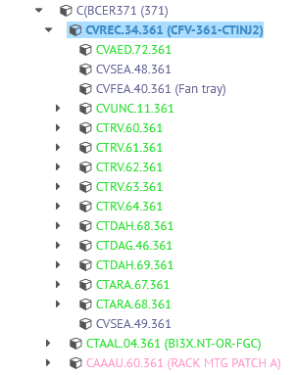
Other follow-up
User statistics (Lukasz extracted) from BE-CEM (6 months):
BARRIERE BNINET EFORTESC ESAID GENUARDI IKOZSAR JPALLUEL LEROY MAZEVEDO MBJORK PLEROUX SARAH SLALOUET
Structure: move full crate with assets to new position
  Not convinced it makes sense
Automatic part creation with new code
  Waiting for news from naming service

Slide 2
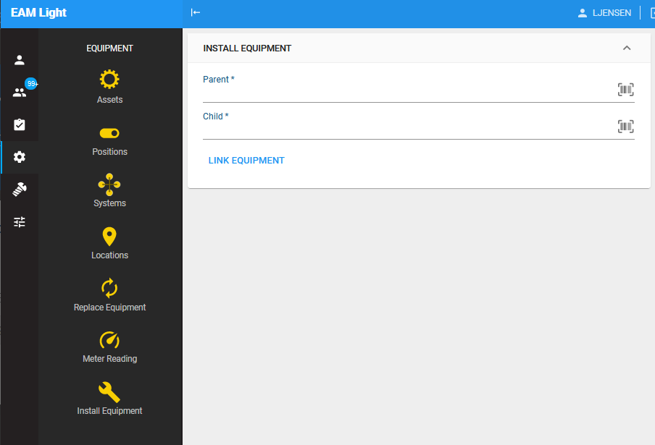
Assign assets to positions
https://cmmsx.cern.ch/SSO/eamlight/installeqp

