Slide 1
Functionality to scan a set of HW modules, and issue them without switching stores
Lars Jensen, Bruno Vercoutter EN/IM

Slide 2
Possibilities that we have…
Kiosk Application cannot provide this functionality because this application has been developed on the basis of a specific store.
This functionality already exists in Infor EAM to issue parts from store(s) on a Work Order (EAM Extended)
  The demand on Service Now can generate a Work Order (WO) in EAM
  (Optional) A Standard WO can prefield the WO generated by Snow.
  EAM Light should be improved

Slide 3
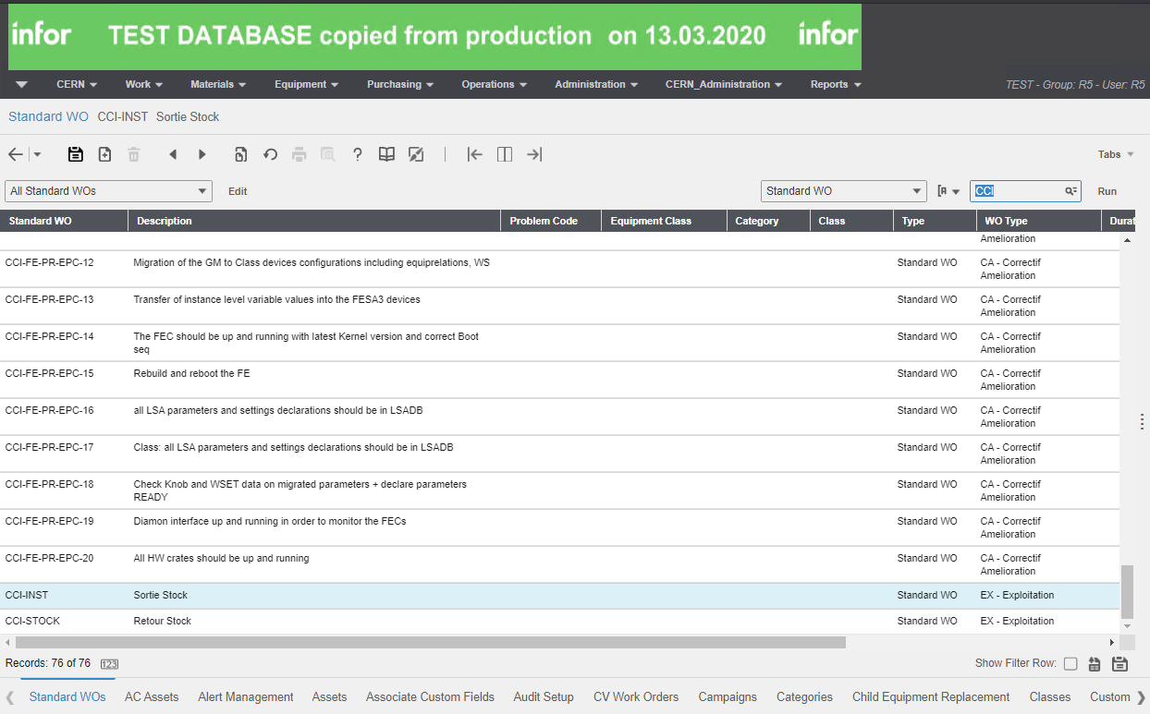
Standard WO

Slide 4
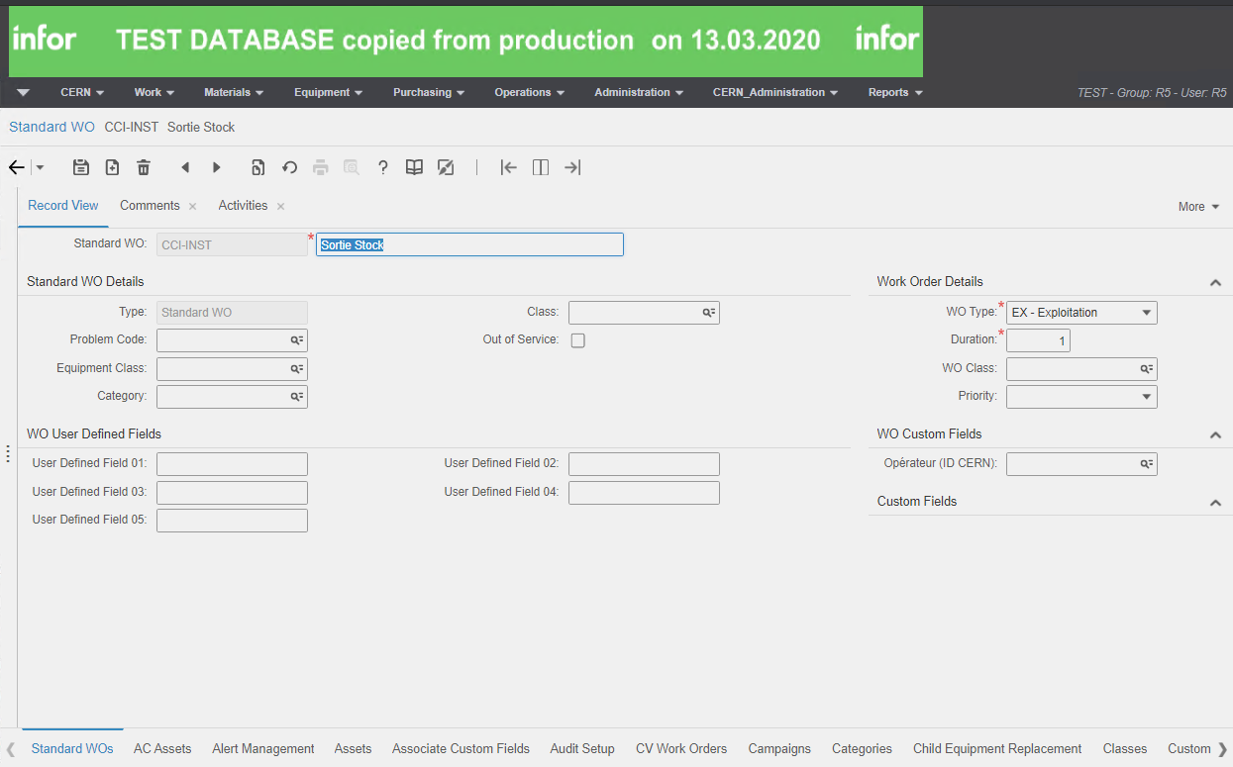
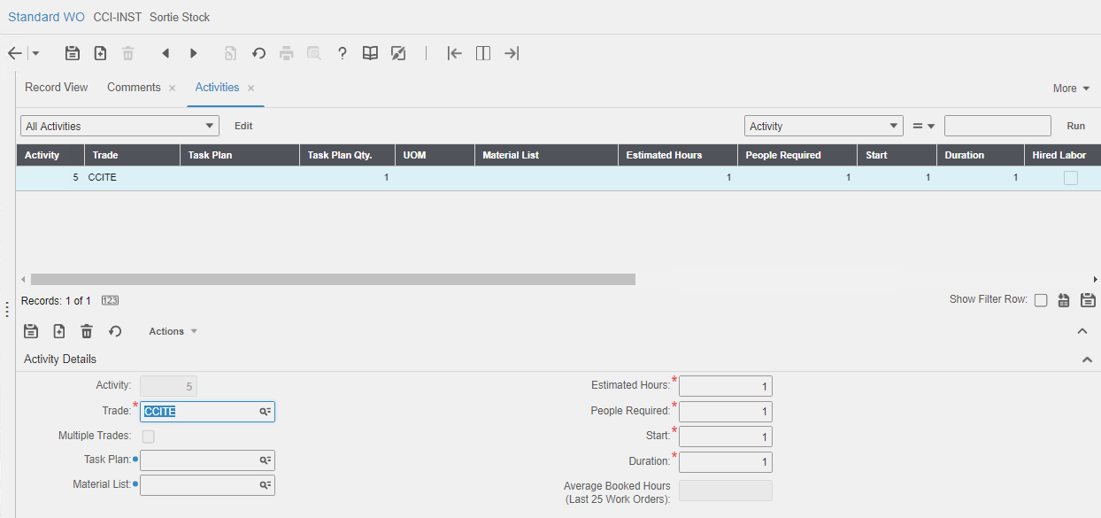
Standard WO

Slide 5
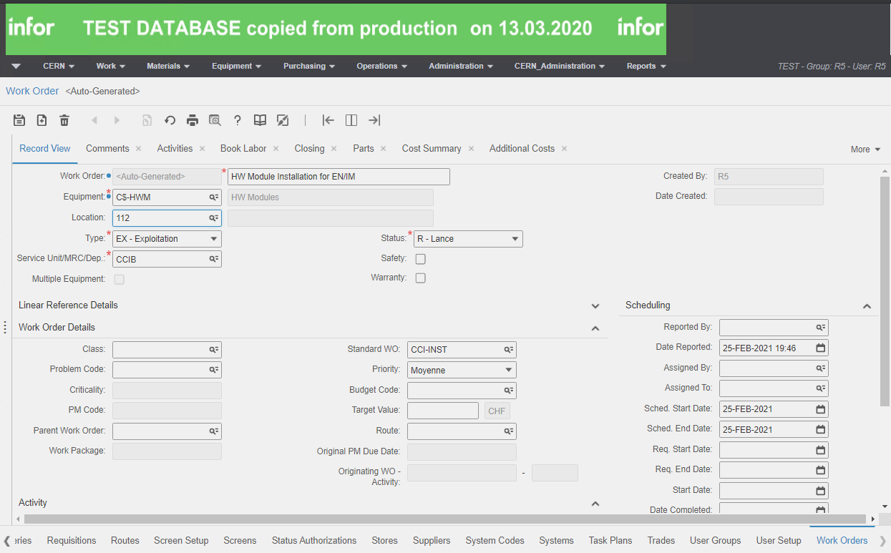
Work Order

Slide 6
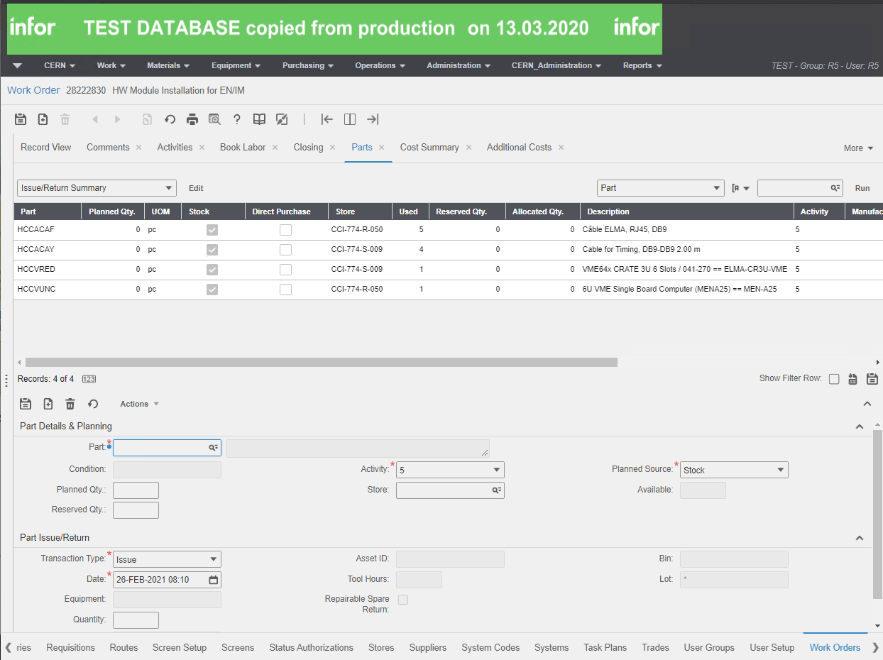
Work Order

Slide 7
Thank you for your attention!

