Slide 1
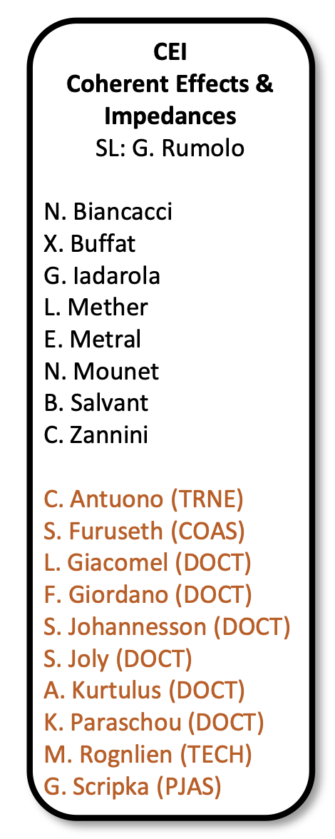
Coherent Effects and Impedances section (CEI) – general information
Giovanni Rumolo
CEI Section Meeting, 08/04/2020
https://indico.cern.ch/event/1007416/

Slide 2
General information from department/group/section
Covid-19 general info
  Current teleworking measures have been extended up to the 14 May 2021. Please keep your EDH leave status up to date.
  The absence management table has been updated, in particular the B5 line has been re-activated for parents of children who got back to home schooling in France
    This applies to the current week (general home schooling)
    Due to the highly probable cancelation of the activités périscolaires and extrascolaires, it also extends to the next two weeks (mid-term school break, vacances de Printemps), under production of proof that the child care facility initially considered for the Spring school break is closed because of the most recent COVID-19 measures taken by the French government
    It extends further for children younger than 16 who will still be in home schooling then
Please take careful note of the information
  Found on the CERN Covid-19 info page (especially links recently updated)
  Spread through the weekly ‘Covid-19 updates’ e-mail

Slide 3
General information from department/group/section
Announcement of summer session of USPAS:
  Dates are June 7 – July 2, fully on-line, duration according to the specific course
  Applicants must send
    a cover letter explaining why the USPAS is important to their career and describing prior research experience, work with or as a user of particle accelerators;
    their CV/resume;
    one letter of recommendation.
  University and college students may request a scholarship to cover registration fee
  Classes offered
    Four-week full courses on Fundamentals of Accelerator Physics, Accelerator Physics, Proton and Ion Linear Accelerators
    Two-week half courses on Cyclotrons, Spin Dynamics in Particle Accelerators, Industrial Application of Accelerators (first two weeks)
    Two-week half courses on Practical Issues in Cyclotron Design and Construction, Optimisation and Machine Learning for Accelerators, Cryogenic Engineering (second two weeks)

Slide 4
General information from department/group/section
IPAC21 papers, production and submission:
  IPAC approval submission deadline for DH’s approval is set on the 5th May 2021
  Group deadline is therefore 28th April 2021
  By this date please make sure papers have been revised by me and project leader (if presented in the framework of a project)

Slide 5
General information from department/group/section
Beam commissioning in the injectors
We are here

Slide 6
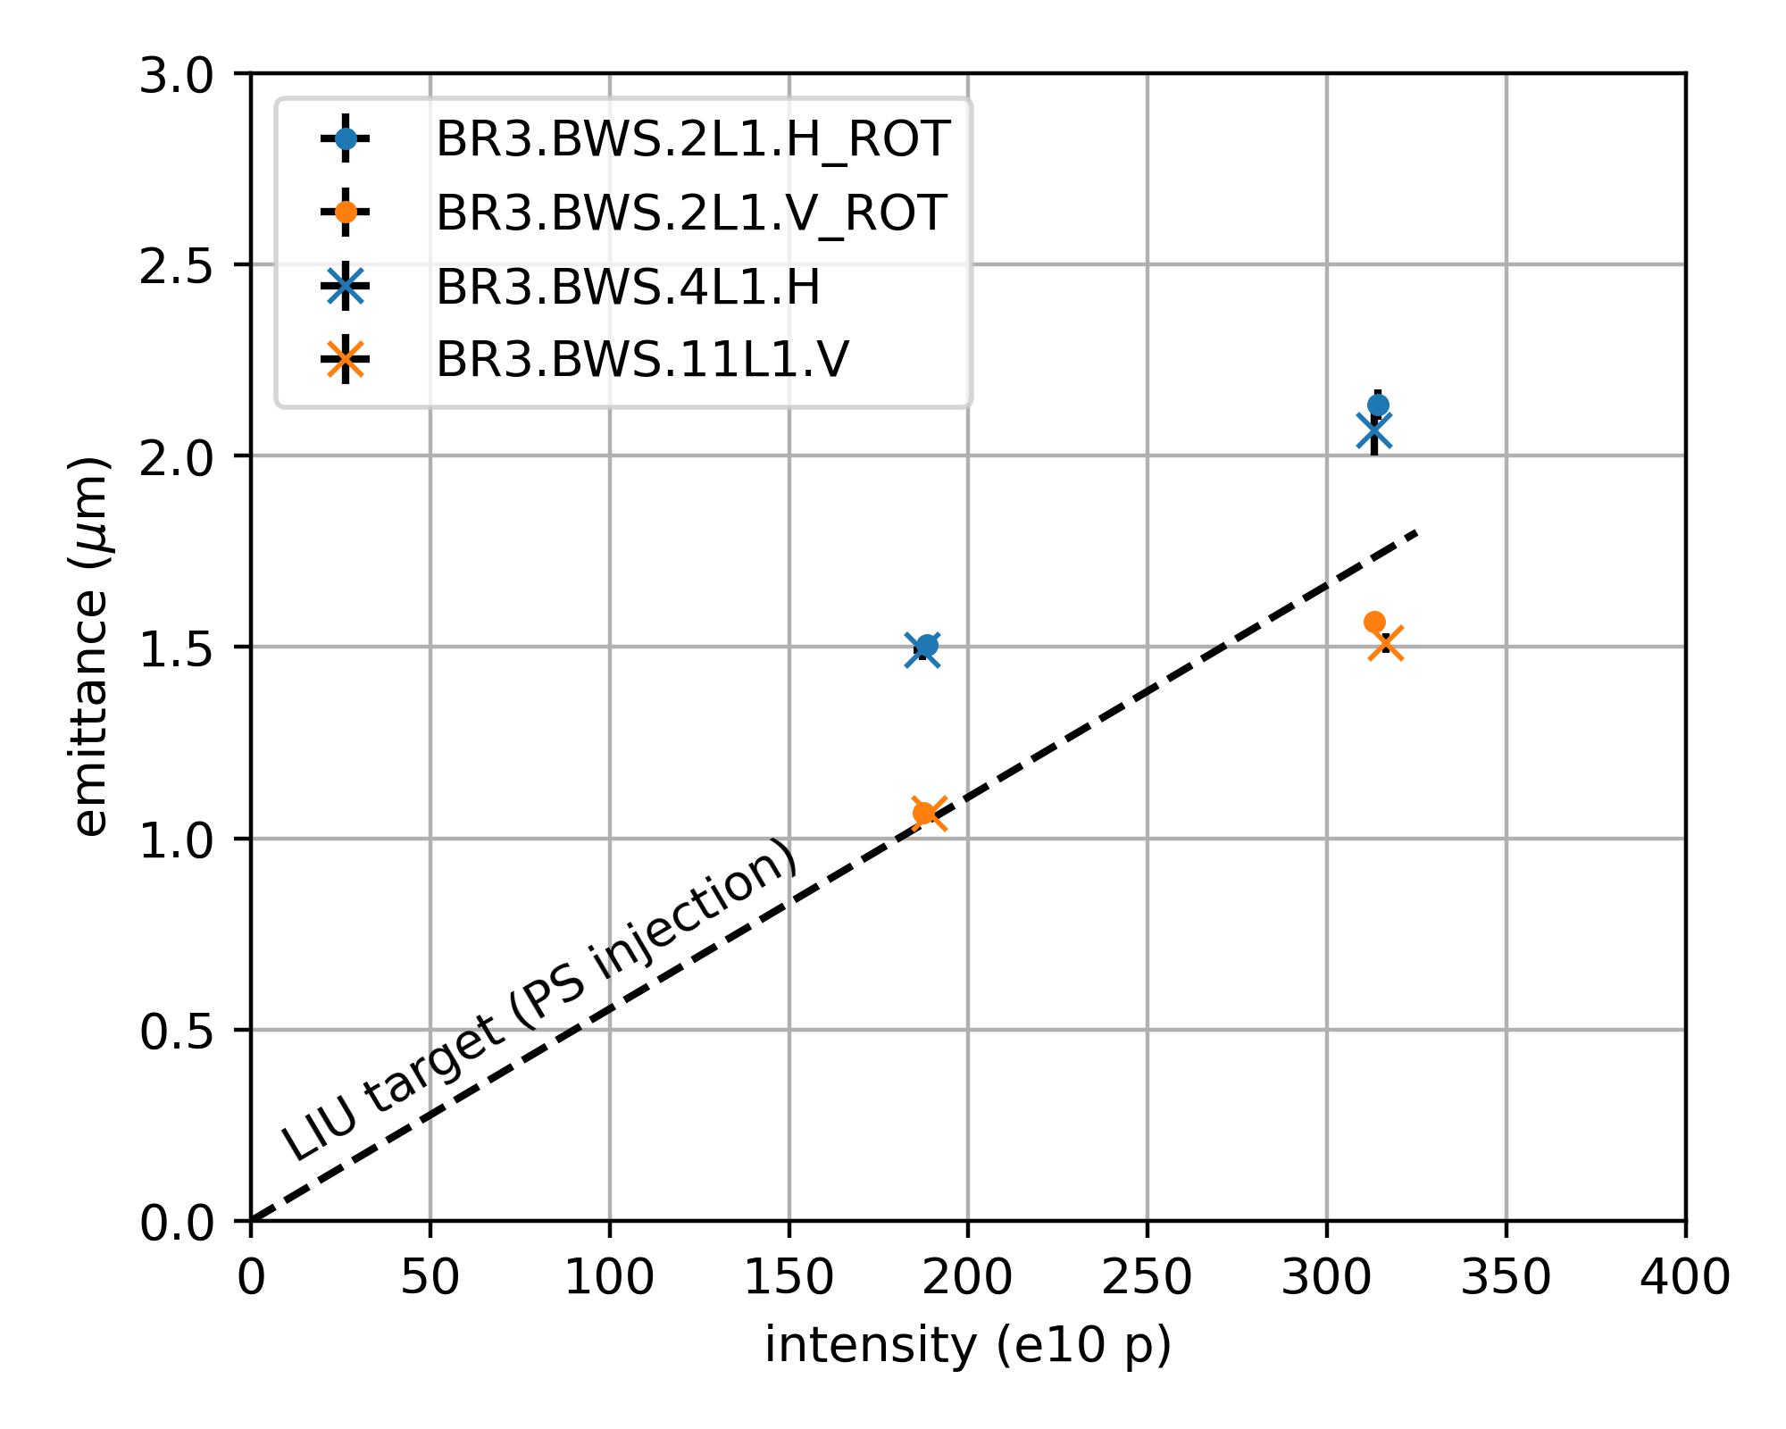
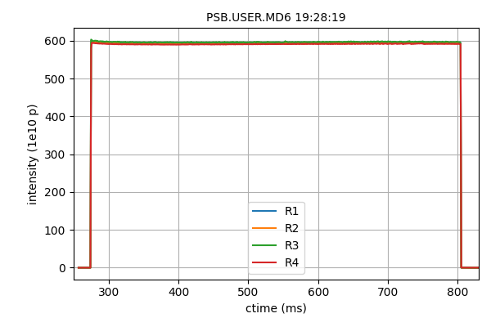
General information from department/group/section
Beam commissioning in the injectors
  Detailed presentations this morning at the ABP Information meeting
    Foteini showed the progress at the PSB, with highlights on the production of the flat MTE beam and the bright LHC25 beam
MTE beam
LHC beam: LIU brightness line
Notes:
LCH

Slide 7
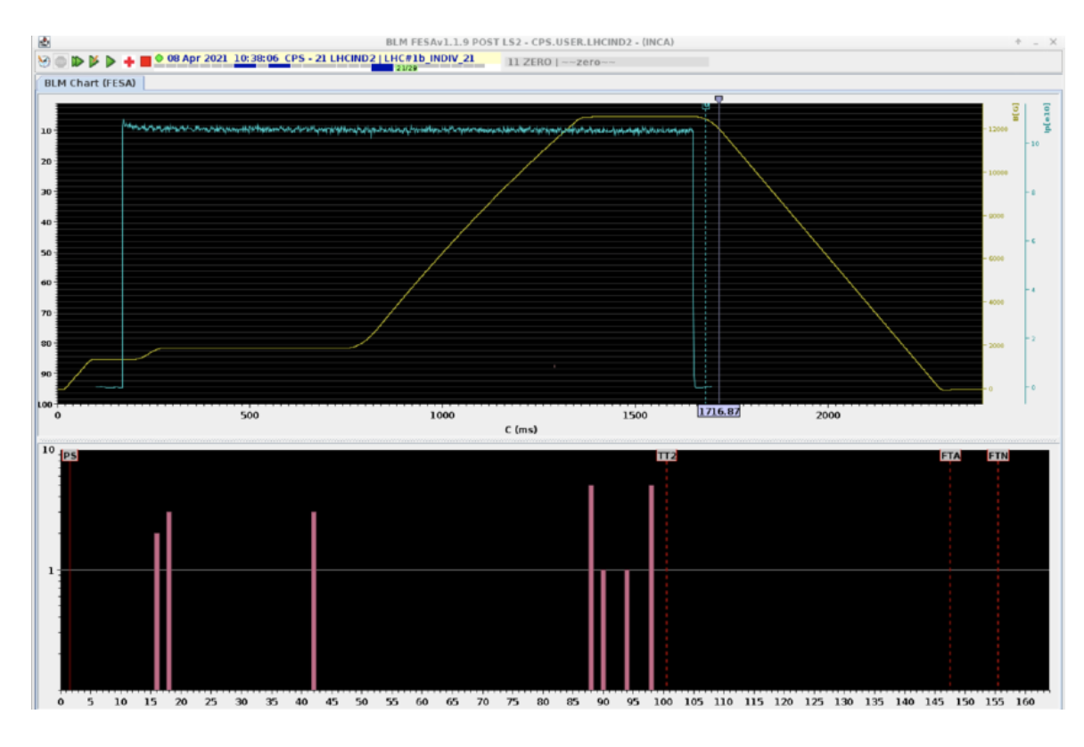
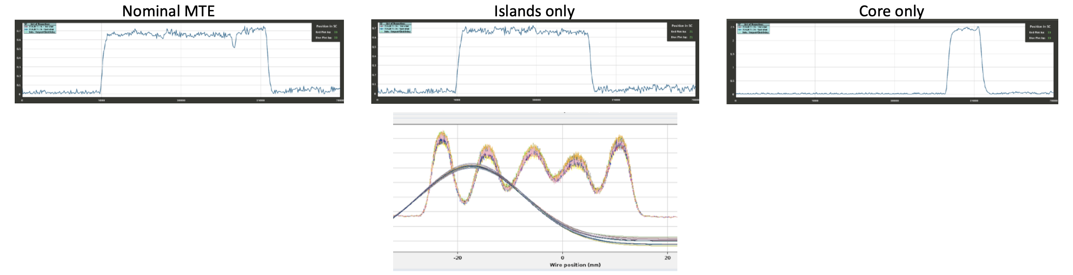
General information from department/group/section
Beam commissioning in the injectors
  Detailed presentations this morning at the ABP Information meeting
    Foteini showed the progress at the PSB, with highlights on the production of the flat MTE beam and the bright LHC25 beam
    Alex showed the progress at the PS, ready to send LHCINDIV beam to the SPS and having produced already possible flavours of MTE low intensity also for the SPS beam commissioning
MTE beam
LHCINDIV
Notes:
LCH

Slide 8
General information from department/group/section
Beam commissioning in the injectors
  Detailed presentations this morning at the ABP Information meeting
    Foteini showed the progress at the PSB, with highlights on the production of the flat MTE beam and the bright LHC25 beam
    Alex showed the progress at the PS, ready to send LHCINDIV beam to the SPS and having produced already possible flavours of MTE low intensity also for the SPS beam commissioning
  LHCINDIV will be indeed injected into the SPS on Monday 12 April to keep the milestone
    Restore circulating beam at injection energy
    Then the machine will be given back to LLRF team to complete their work
      Estimated time needed ~2 weeks
      Probably a global delay currently estimated at about 1 week – assuming that one week can later on be recovered on the commissioning of the new systems with beam
Notes:
LCH

