Slide 1
PS horizontal instability during commissioning
Acknowledgments : A. Huschauer, A. Lasheen, N. Mounet, B. Salvant
Sebastien Joly
06/05/2021

Slide 2
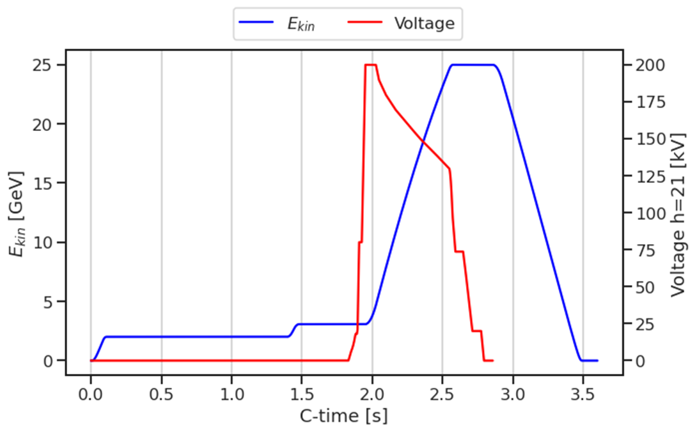
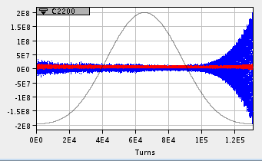
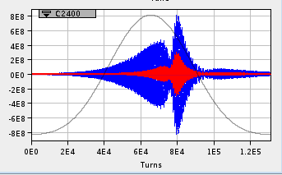
Horizontal instabilities observed during ramp

Slide 3
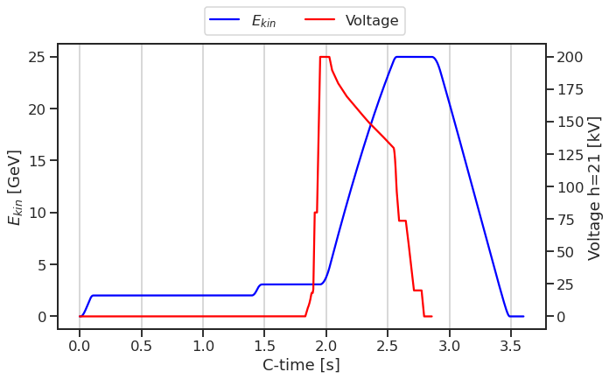
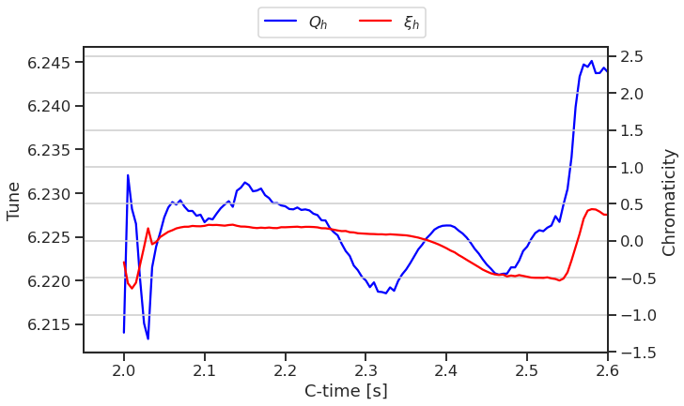
Ramp parameters
Parameters changing during the ramp :
Kinetic energy, tunes, chromaticities, RF voltage (and wall impedance because of indirect space charge)

Slide 4
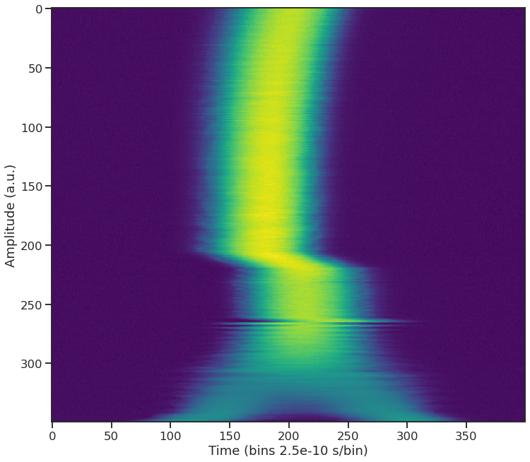
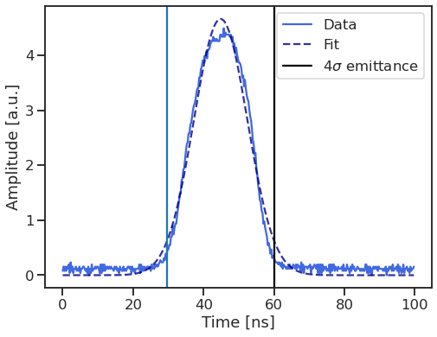
Bunch length
Bunch length constant through the ramp
Rms bunch length was obtained by fitting a gaussian on the signal at a given time
r.m.s bunch length = 30 ns

Slide 5
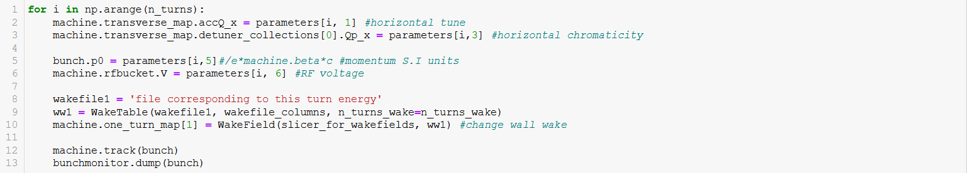
PyHEADTAIL implementation
parameters is an array with one row per turn and one column per parameter (tune, chromaticity, etc)
The wall wake has been computed for several energies, it can be interpolated for all the ramp energies
It might be a better idea to change the wall wake every X turns instead of every turn
Is the multi-turns wake applied the same turn it is generated ?

