Slide 1
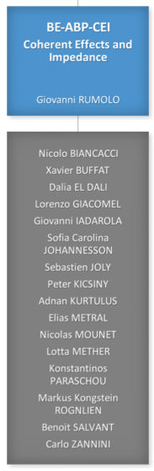
Coherent Effects and Impedances section (CEI) – general information
Giovanni Rumolo
CEI Section Meeting, 06/05/2020
https://indico.cern.ch/event/1007418/

Slide 2
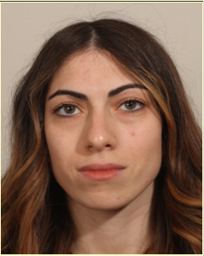
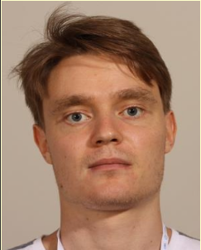
General information from department/group/section
Welcome to two new arrivals in our section
  Dalia El Dali (TECH)
  Peter Kicsiny (DOCT)
  You should have both received notification that you are enlisted to participate in the CAS “Introduction to Accelerator Physics”, foreseen to take place in Kaunas, Lithuania, from 5 to 18 September 2021 (tbc at the beginning of August)
  Please follow instructions for registration as provided by our administrative assistant (Alessia)

Slide 3
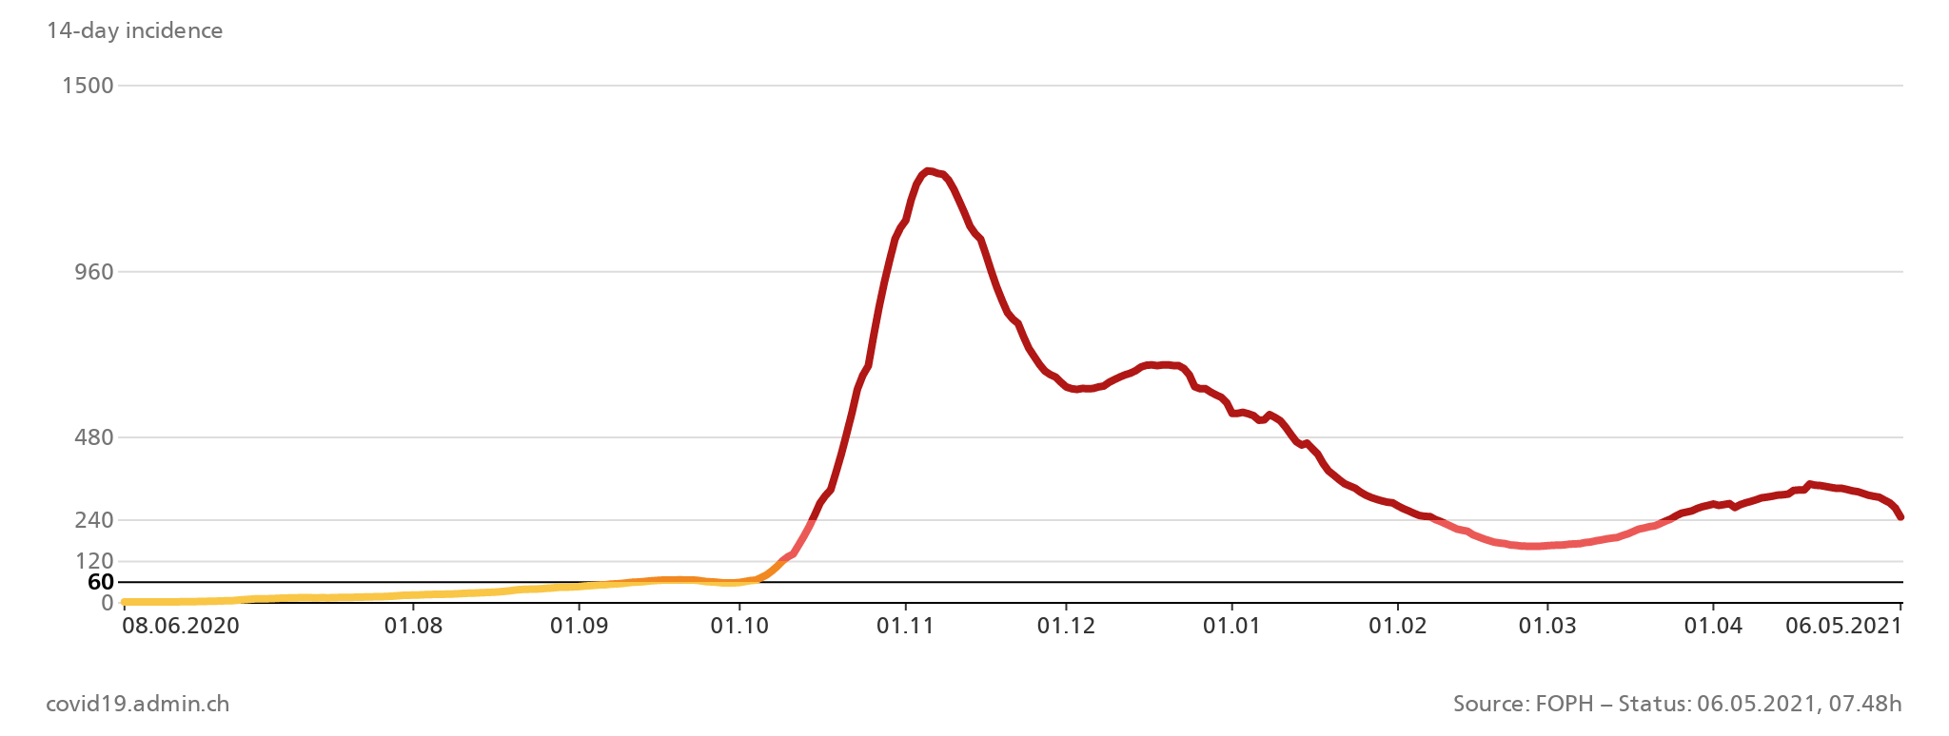
General information from department/group/section
Covid-19 general info
  Current teleworking measures have been extended up to the 14 May 2021. Please keep your EDH leave status up to date.
  It is under discussion and on track for approval that even after Covid teleworking @CERN will still be possible for up to 40% of the time (2 days per week) only with the agreement of the supervisor and with no previous arrangement plans
  Covid caseload seems to be gradually improving in the host countries ☺
More information to be found in
  CERN Covid-19 info page (especially links
  recently updated)
  Weekly ‘Covid-19 updates’ e-mail
  List of high-risk countries/areas for
  Switzerland here (constantly updated)
CH

Slide 4
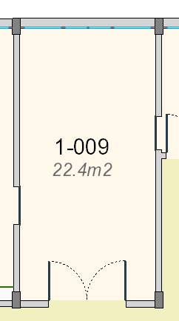
General information from department/group/section
Space management, what’s in store for ABP (G. Roy):
  Rearrangement of ABP-HSL labs + storage space currently spread over Bldgs. 6, 9 and 152
  Reduction of occupancy of all shared offices in post-Covid
    Originally large modules (20 to 24 m²) equipped with 6
    desks and storage cabinets
    Move to a configuration with 4 desks and storage cabinets
    Mainly driven by noise perturbation, lack of concentration,
    possibly amplified in the future with more and more online
    meetings
    Need to identify at least five additional large modules with
    respect to what we have today

Slide 5
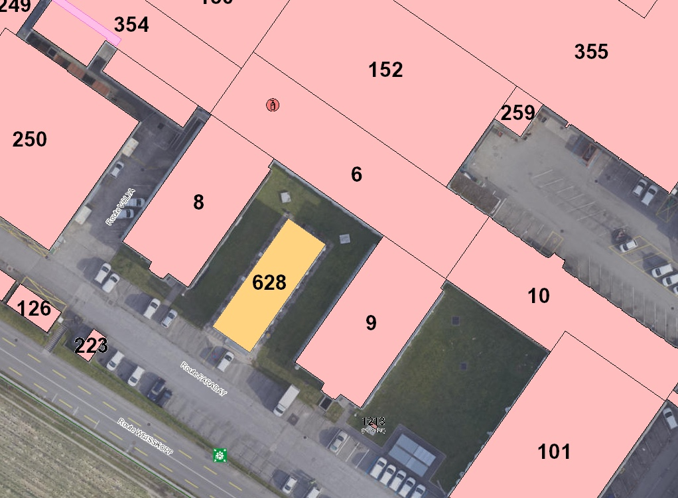
General information from department/group/section
Space management, what’s in store for ABP (G. Roy):
  Rearrangement of ABP-HSL labs + storage space currently spread over Bldgs. 6, 9 and 152
  Reduction of occupancy of all shared offices in post-Covid
  Regroupment of AWAKE personnel currently spread over several buildings
  Relocation of impedance lab, Ghislain is aware of ‘specifications’ for possible new location
  BE-CEM will be relocated to new building 937 (foreseen delivery end of summer 2021)
    Building 628 will be dismantled by September 2021
    New space available for ABP in Bldg. 18 (additional offices,
    bureautel, space for honorary members currently in Bldg. 561)

Slide 6
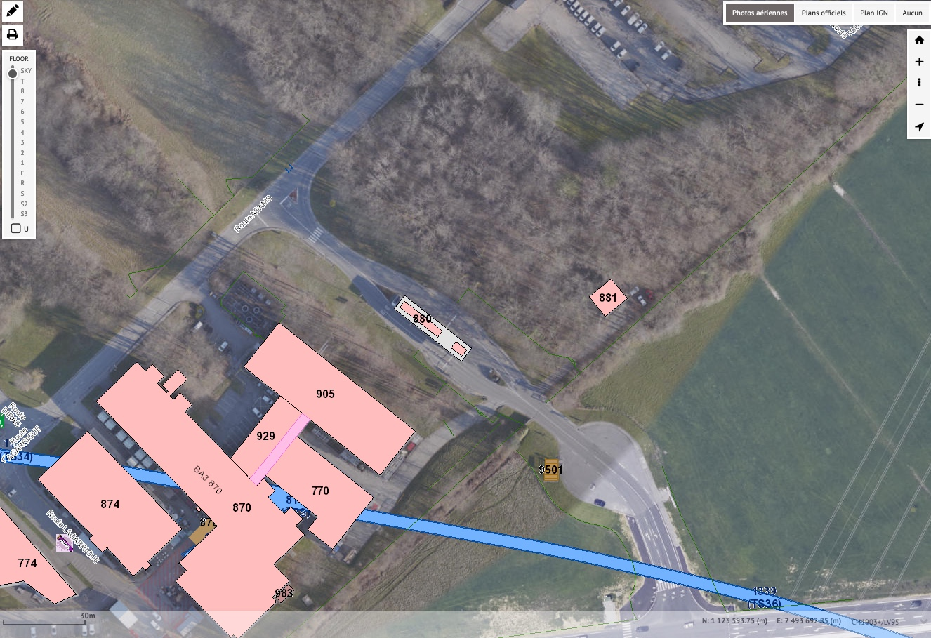
General information from department/group/section
Space management, what’s in store for ABP (G. Roy):
  Rearrangement of ABP-HSL labs + storage space currently spread over Bldgs. 6, 9 and 152
  Reduction of occupancy of all shared offices in post-Covid
  Regroupment of AWAKE personnel currently spread over several buildings
  Relocation of impedance lab, Ghislain is aware of ‘specifications’ for possible new location
  BE-CEM will be relocated to new building 937 (foreseen delivery end of summer 2021)
    Building 628 will be dismantled by September 2021
    New space available for ABP in Bldg. 18 (additional offices,
    bureautel, space for honorary members currently in Bldg. 561)
  ABP hot desking space will be possibly made available at
  the new 777 building in Prevessin for people who may need
  to be closer to the CCC (e.g., doing machine supervision,
  development or development coordination) → expected
  timeline ~3 years to have the building ready
777

Slide 7
General information from department/group/section
From Space Management Forum:
  Mobility @CERN
    Car sharing pilot, glide.io new technology under test, may be implemented after covid to all CERN as free-floating scheme
    Soft mobility: improvement of bike lanes and bike storage infrastructure (number, robustness, long term storage spaces), encouragement to participate in bike to work challenge
    Shuttle service
      Improve/increase number of shuttle stops (real bus stops with timetable)
      Increase of frequency around lunch time to encourage usage to reach restaurants
    Under discussion (need to clear legal issues)
      Opening of intra-site tunnels to bicycles and pedestrians
      Charging points for electrical vehicles
  New buildings: 777 (Prevessin welcome centre), Science Gateway, Bldg 140, Bldg 90 for directorate and management

Slide 8

General information from department/group/section
FCC week 2021:
  The Future Circular Collider (FCC) Collaboration Week 2021 will take place remotely from 28 June to 02 July 2021.
  The aim is to bring together the FCC community to share results, to solidify the vision of a circular post-LHC particle-collider research infrastructure and to discuss and plan together for the upcoming study phase that should demonstrate the feasibility of the FCC by end 2025.
  The FCC Week programme will follow the same format as in previous years:
    First day (28 June) dedicated to plenary sessions
    Parallel sessions from 29 to 01 July, covering physics cases (experiments and detectors), accelerator physics for ee and hh, RF, civil engineering, technology R&D, technical infrastructures
    Summaries in the morning of the last day, on 02 July.
  Presentations will be by invitation only.
  Registration through the conference website is now open.

Slide 9
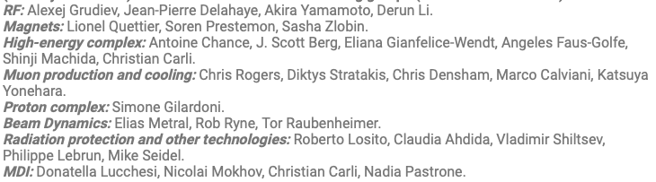
General information from department/group/section
First muon community meeting:
  Taking place on 20-21 May, 2021, Indico site here
  First checkpoint (out of three within 2021) for the preparation of the Muon Accelerator R&D Roadmap for the next ten years.
  This Roadmap will consider different funding scenarios and contain deliverables and demonstrators. Council is expected to decide on the Roadmap by the end of the year.
  Goal is to identify the R&D to be carried out before the next ESSU-PP to scientifically justify
  investment into a full CDR for muon collider and corresponding demonstration programme.
  8 WGs will work together to define baseline concept, performance expectations, risks,
  demonstration programme
  Beam Dynamics meeting are
  taking place in preparation
  organized by Elias (link)

Slide 10
General information from department/group/section
News from LHC:
  Observed voltage spikes after quench triggered extensive measurements on B28L8
  These measurements unfortunately confirmed that the instrumentation and one quench heater of the magnet are damaged
  These defects justify the magnet replacement since it is impossible to repair the faults in the tunnel. Therefore, ATS management decided last Friday to proceed with the full warming up of the sector 78 and preparation for the replacement of the magnet
  The risks of continuing training in other sectors have been deemed acceptable
  The warming up started last Monday, details and outline of the recovery plan will be presented and discussed at next LMC
    Impact on LHC beam test in Weeks 39 and 40?
    Impact on LHC restart in 2021? → Meeting on 7 June between ATS management and LHC experiments to confirm roadmap of LHC physics restart

Slide 11
General information from department/group/section
Beam commissioning in the injectors
We are here

Slide 12
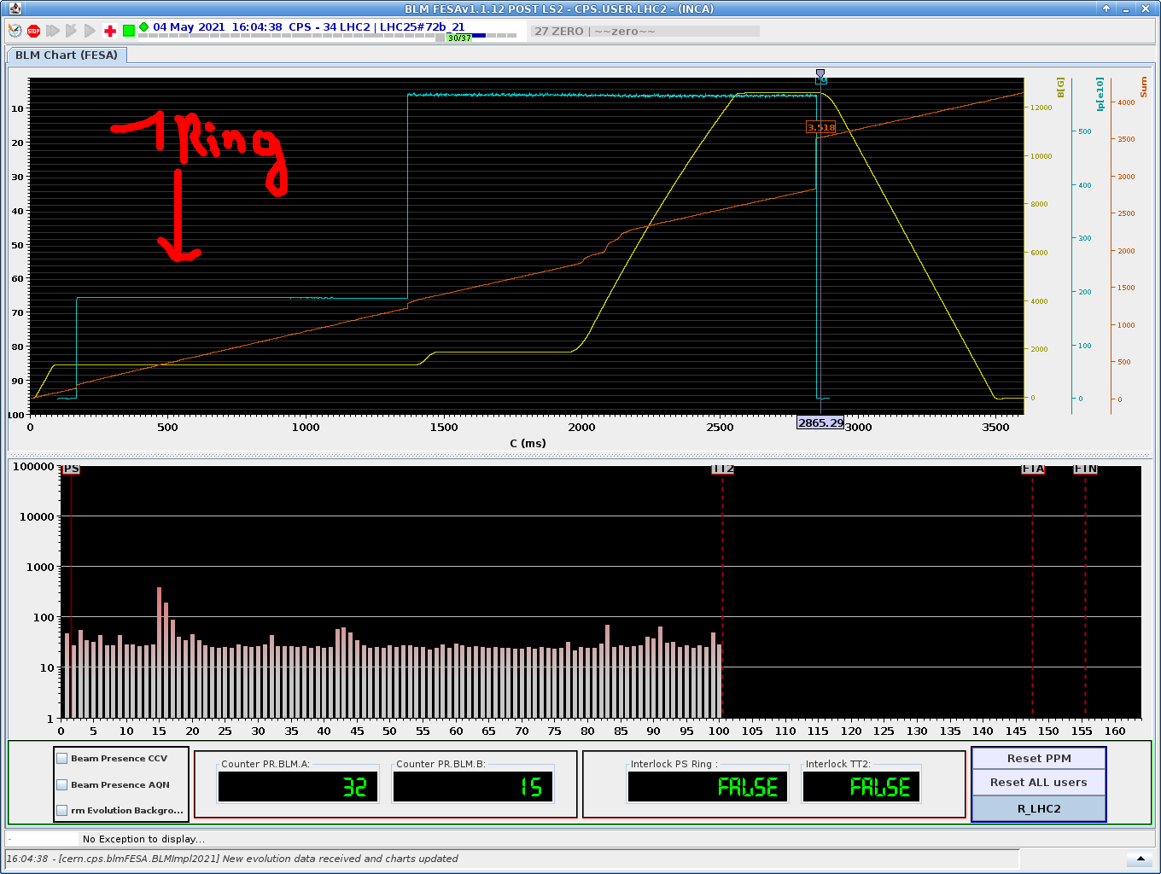
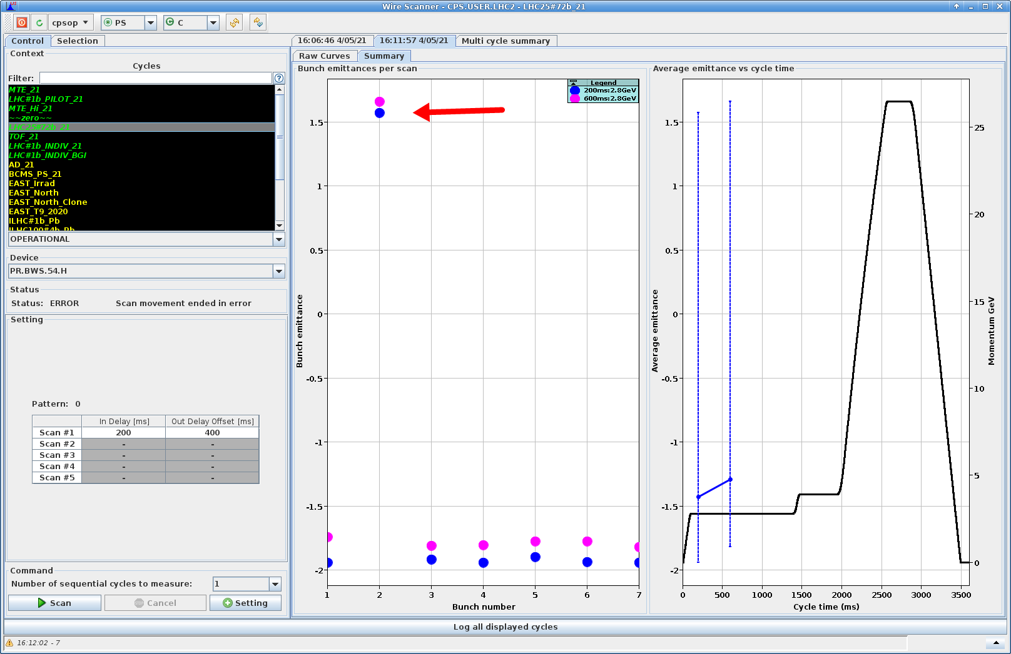
General information from department/group/section
Beam commissioning in the PS
  Starting systematic studies of emittance growth with LHC beams
  Space charge at injection will be the big challenge in the PS for emittance preservation
Notes:
LCH

Slide 13
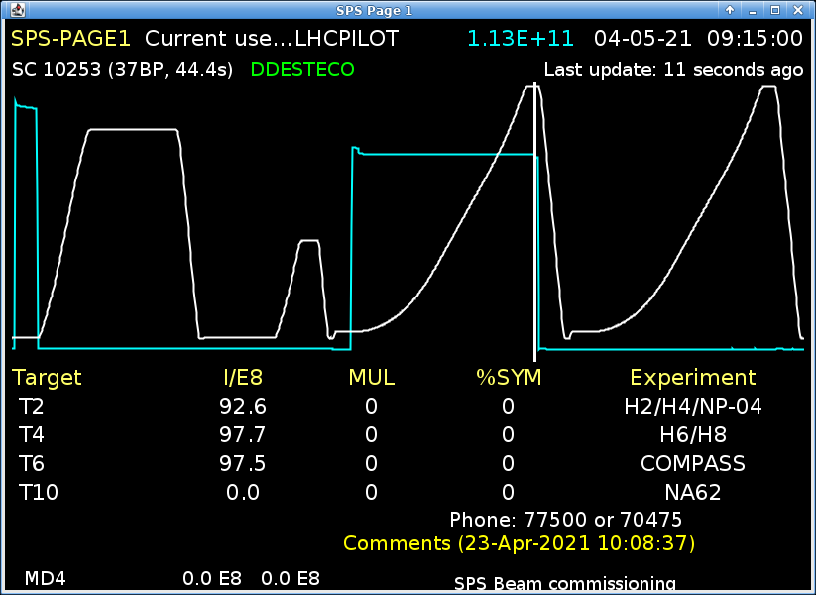
General information from department/group/section
Beam commissioning in the SPS
  LHCPILOT now accelerated to 450 GeV
  Using low MTE beam for aperture scan, possible vertical aperture restriction at ZS location, requires the exchange of a vacuum chamber – intervention to be coordinated to possibly install a sample in in-situ SEY measurement device (rotatable sample)
Notes:
LCH

