Slide 1
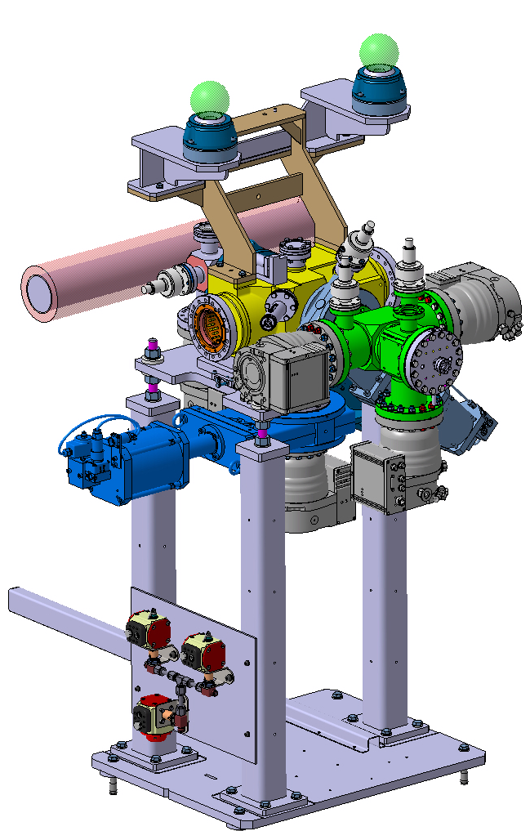
CERN BGC updates
Gerhard Schneider and Giannis Papazoglou,
12 March 2021

Slide 2
Bellows up-date
Bellows company Skodoc finally not bankrupt but communication is difficult – still no delivery date but working on it
Alternative options:
  Flexomat similar bellows proposed some modifications needed, price unknown yet
  Astroflex very close to what we have, 2.000-euro fixed cost and then about 450-euro per bellow.

Slide 3
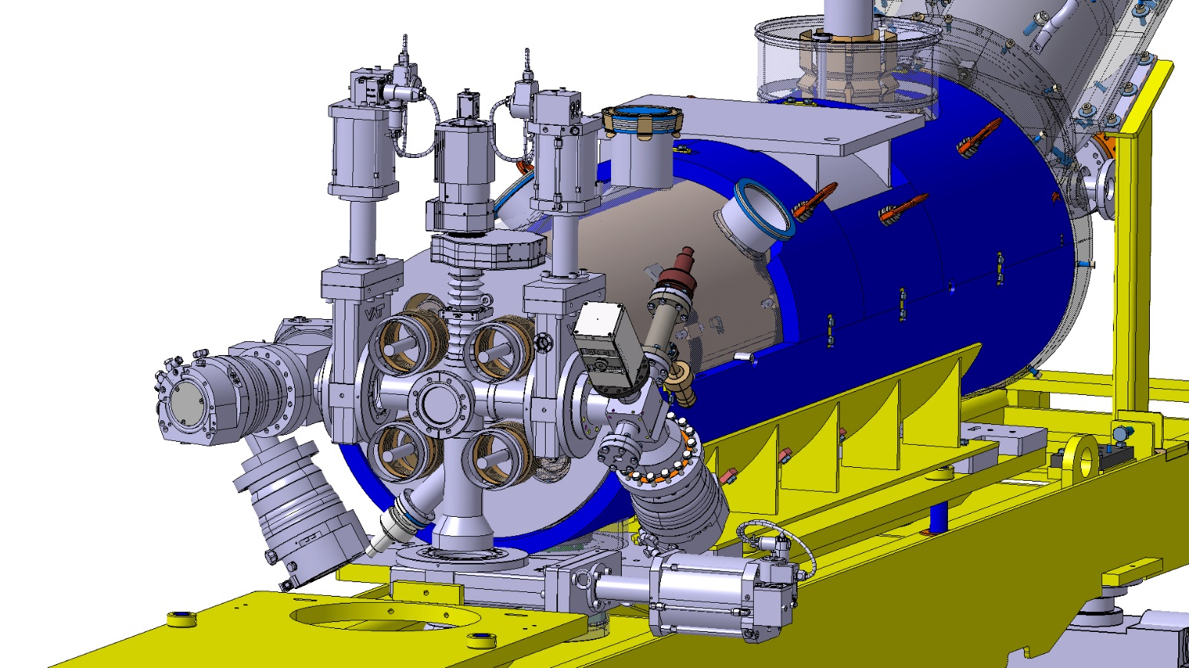
V4 Avancement
Agreed that we will have a bellows on either side of the BGC V4
Disagreement without advacement: Space availability for BGC → need to escalde the issue
TPM need shielding
~50 mT field
Assembly not possible

Slide 4
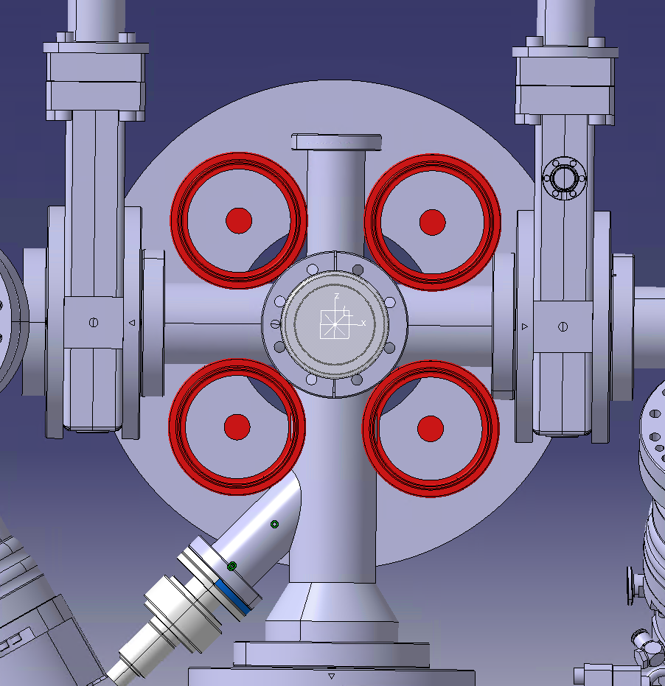
Limitations on V4 design
Magnet spacers increased on diameter

Slide 5
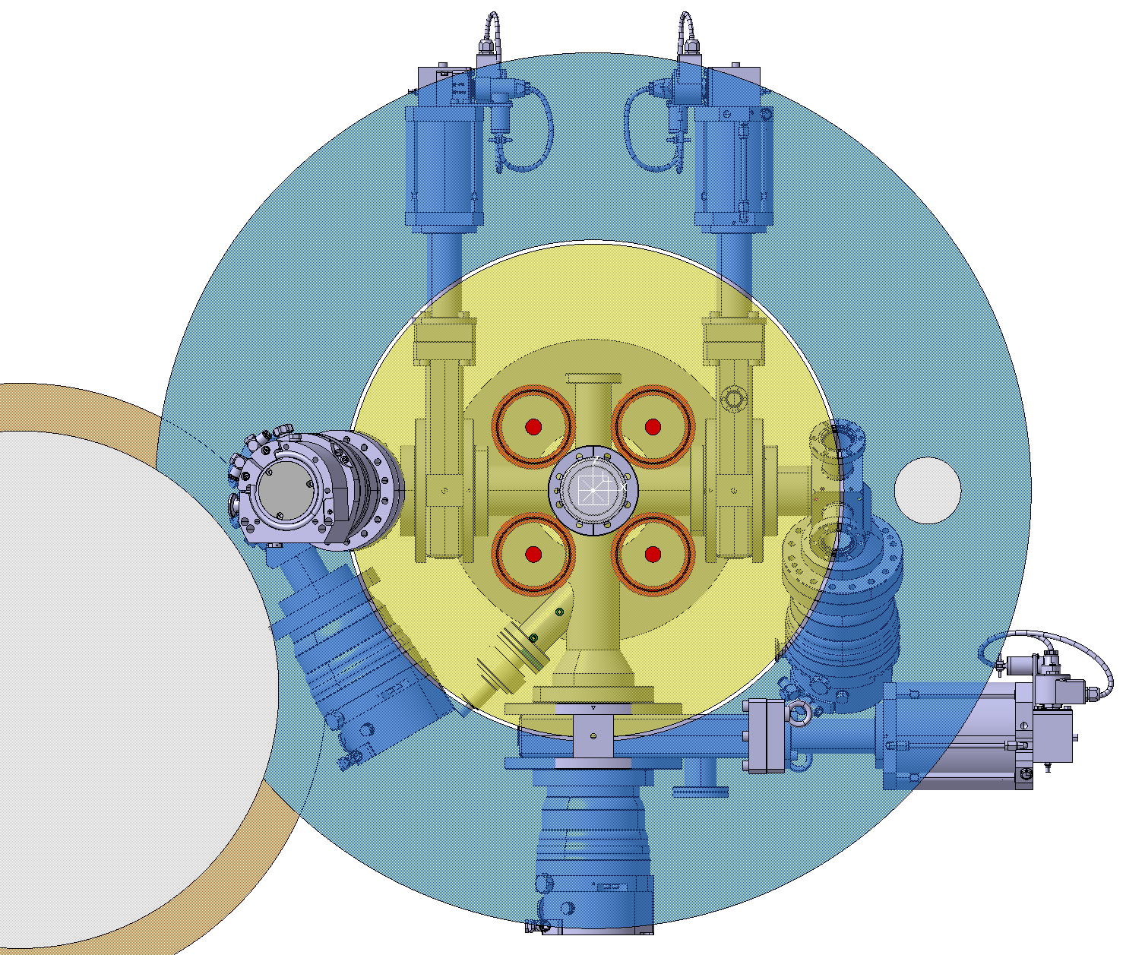
Limitations on V4 design
Magnetic field mapping creates problems with the TMPs placement
5 mT
50 mT

Slide 6
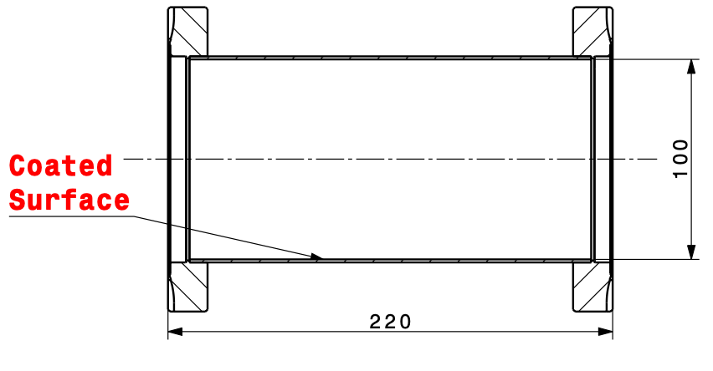
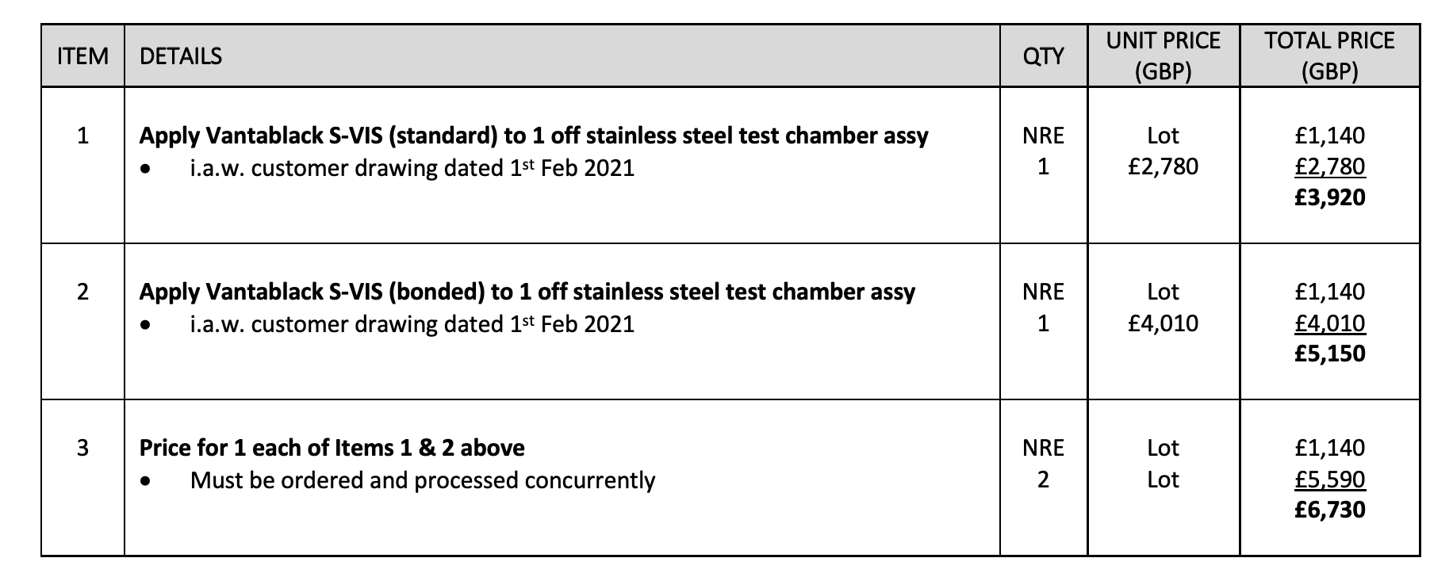
New Vantablack test pieces
New test piece proposed by Chiara
Price about 5.000 euro only the coating

Slide 7
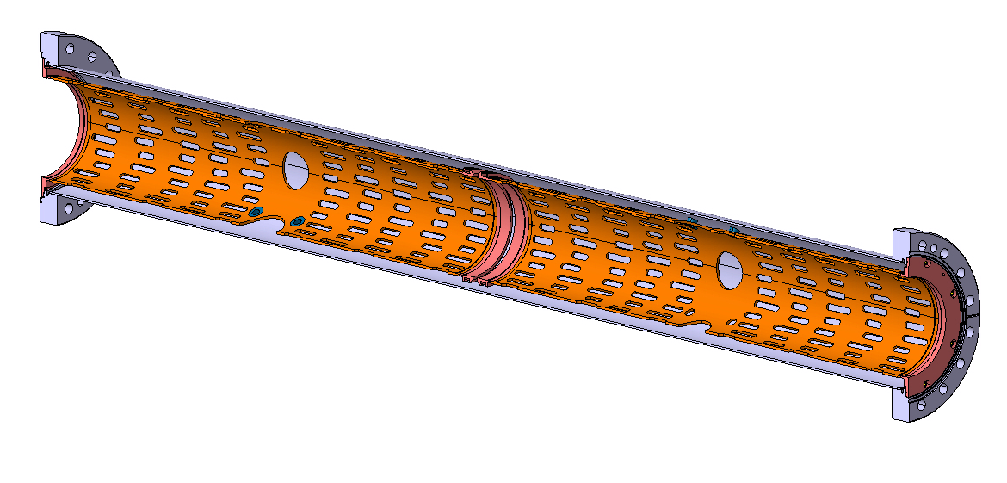
2nd Copper liner to CI
Test the complete assembly if we send it
The α-C should not be exposed to air for long time
Additional cost for shipping the 1m long tube + tolls costs to UK

Slide 8
Next meeting:
Review general action list
Review HEL test stand action list
Up-date on V4 mock-up
Advancement on V4 space conflict

