Slide 1
CI update

Slide 2
Pressure in each chamber
Configuration | Nozzle chamber | Skimmer chamber I | Skimmer chamber II | Interaction chamber
Nozzle :30µm 1st skimmer: 180µm 2nd skimmer: 400µm | 6.03e-3 | 1.69e-05 | 5.33e-07 | <5e-9
Nozzle :30µm 1st skimmer: 180µm 2nd skimmer: 2mm | 5.9e-3 | 7.91e-6 | 8.03e-7 | <5e-9
Nozzle :30µm 1st skimmer: 400µm 2nd skimmer: 2mm | 5.56e-3 | 1.13e-5 | 1.52e-6 | <5e-9
Pressure in each chamber given in (mbar) at the specified configuration.
The last configuration offered the highest gas-curtain density(tested at two locations- before and after third skimmer), as well as a more uniform jet.

Slide 3
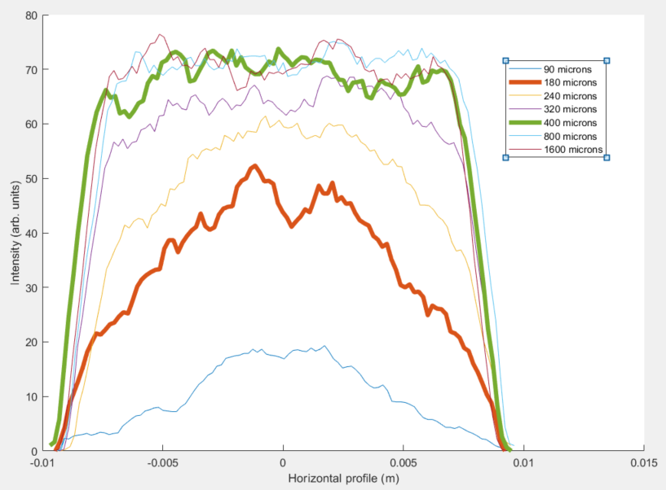
First skimmer optimisations – Distribution simulations
Simulated for a
  30 micron nozzle
  90micron to 1.6mm 1st skimmer.
  2mm 2nd skimmer
180 microns and 400 microns skimmers were tried experimentally and agree with the simulations.
No noticeable increase in intensity of the jet or change in distribution past 320microns.

Slide 4
First skimmer optimisation - Absolute Density
Possible issues:
  Pressure in each chamber is needed for various first skimmer sizes to estimate the density attenuation of the jet as it passes through each chamber. This is provided experimentally and is not available for untested configurations.
  The model assumes that the flow at the first skimmer is a molecular one, with the quitting surface being set before the first skimmer. An increase in the peak density for the larger first skimmer may show that this is not the case, This is consistent between the simulations and the experimental data but not yet fully understood.

Slide 5
Planning 2021
1
2
3
4
1
2
3
4
Jan
Feb
Mar
Apr
May
Jun
Jul
Vacuum control system
Assemble and
vacuum test
Measurement with Lab electron beam
Test stand integration
Chamber inspection
from Daresbury ETS
Jet density measurement
Report the device and ship
Alignment
Compared with initial plan, there are two months delay!!
Dec
Jan
Feb
Mar
Apr
May
Jun
Jul
Aug
Sep
Oct
Nov
Dec
Stage 1
Stage 2
EBTS
- Reconfiguration
- BGC installation
- BPM installation
- New solenoids
EBTS Assembly
BDB & HV Commissioning
EBTS Commissioning
Including new magnets
Tests with Electron Beam at EBTS
  Tests:
  Gun (extracted current, beam shape)
  Anode Modulator (rise time)
  BPM (signal vs position, current, shape)
  BGC (sensitivity, profile, etc)

