Slide 1




The LHCb Upgrade
Marcel Merk
Nikhef and the Vrije Universiteit
Beauty 2011, Amsterdam
April 8, 2011
On behalf of the LHCb Collaboration
Contents:
Detector Upgrade
Physics Program

Slide 2
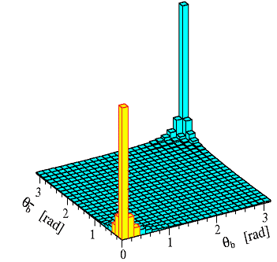
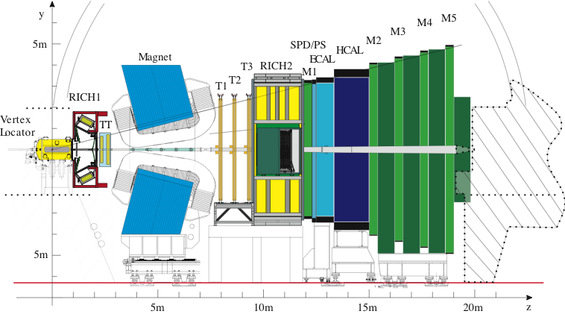
Current LHCb (“Phase-1”)
Mission of current LHCb:
  Indirect search for new physics via CP asymmetries and rare decays
  Focus on flavour physics with b and c decays
Until recently physics potential based on MC predictions
  Measurement sensitivities in “roadmap” documents
Since this winter (results in this conf) extrapolate from real data
  Roadmap expectations being validated/calibrated
LHCb Phase-1: Collect ~5 fb⁻¹ before 2nd LHC shutdown 2017
Notes:
LHCb works!

Slide 3
Upgrade LHCb (“Phase-2”)
Change HPD’s to MAPMT’s
TORCH
LHCb Phase-2:
  Collect 50 fb⁻¹ with upgrade detector at √s = 14 TeV
Detector upgrades:
  Main installation in second long shutdown (2017-2018)
  Allow staged upgrade
RICH-2
RICH-1
New pixel detector
New TT
New IT
Replace OT electronics
Remove PS & SPD
Update
Readout
Mission of upgrade LHCb:
  General purpose detector in the forward region with full software trigger (40 MHz)
  Quark flavour physics main component but expand physics program to include:
    Lepton flavour physics
    Electroweak physics
    Exotic searches
  Possible due to full software trigger
Notes:
Staged upgrade: the new trigger rate can be increased as the detector and HLT allow.

Slide 4
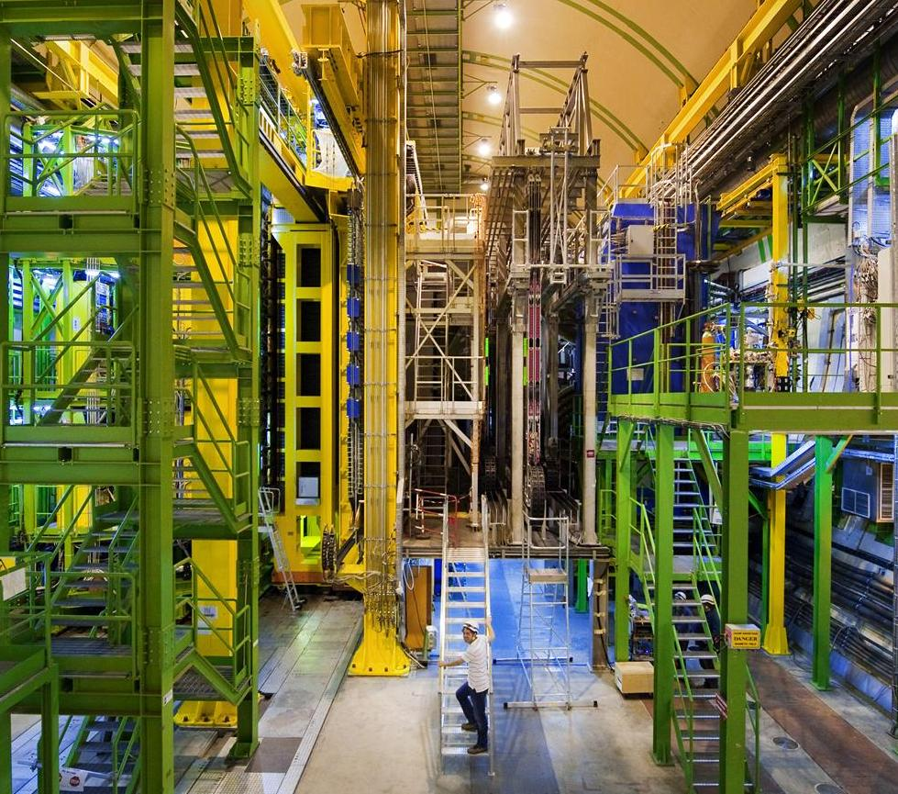
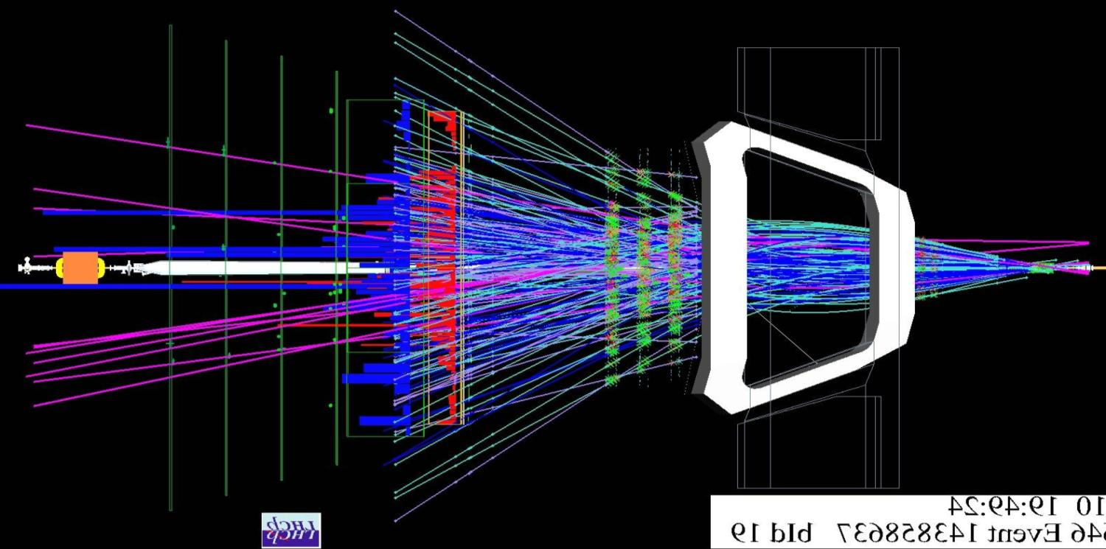
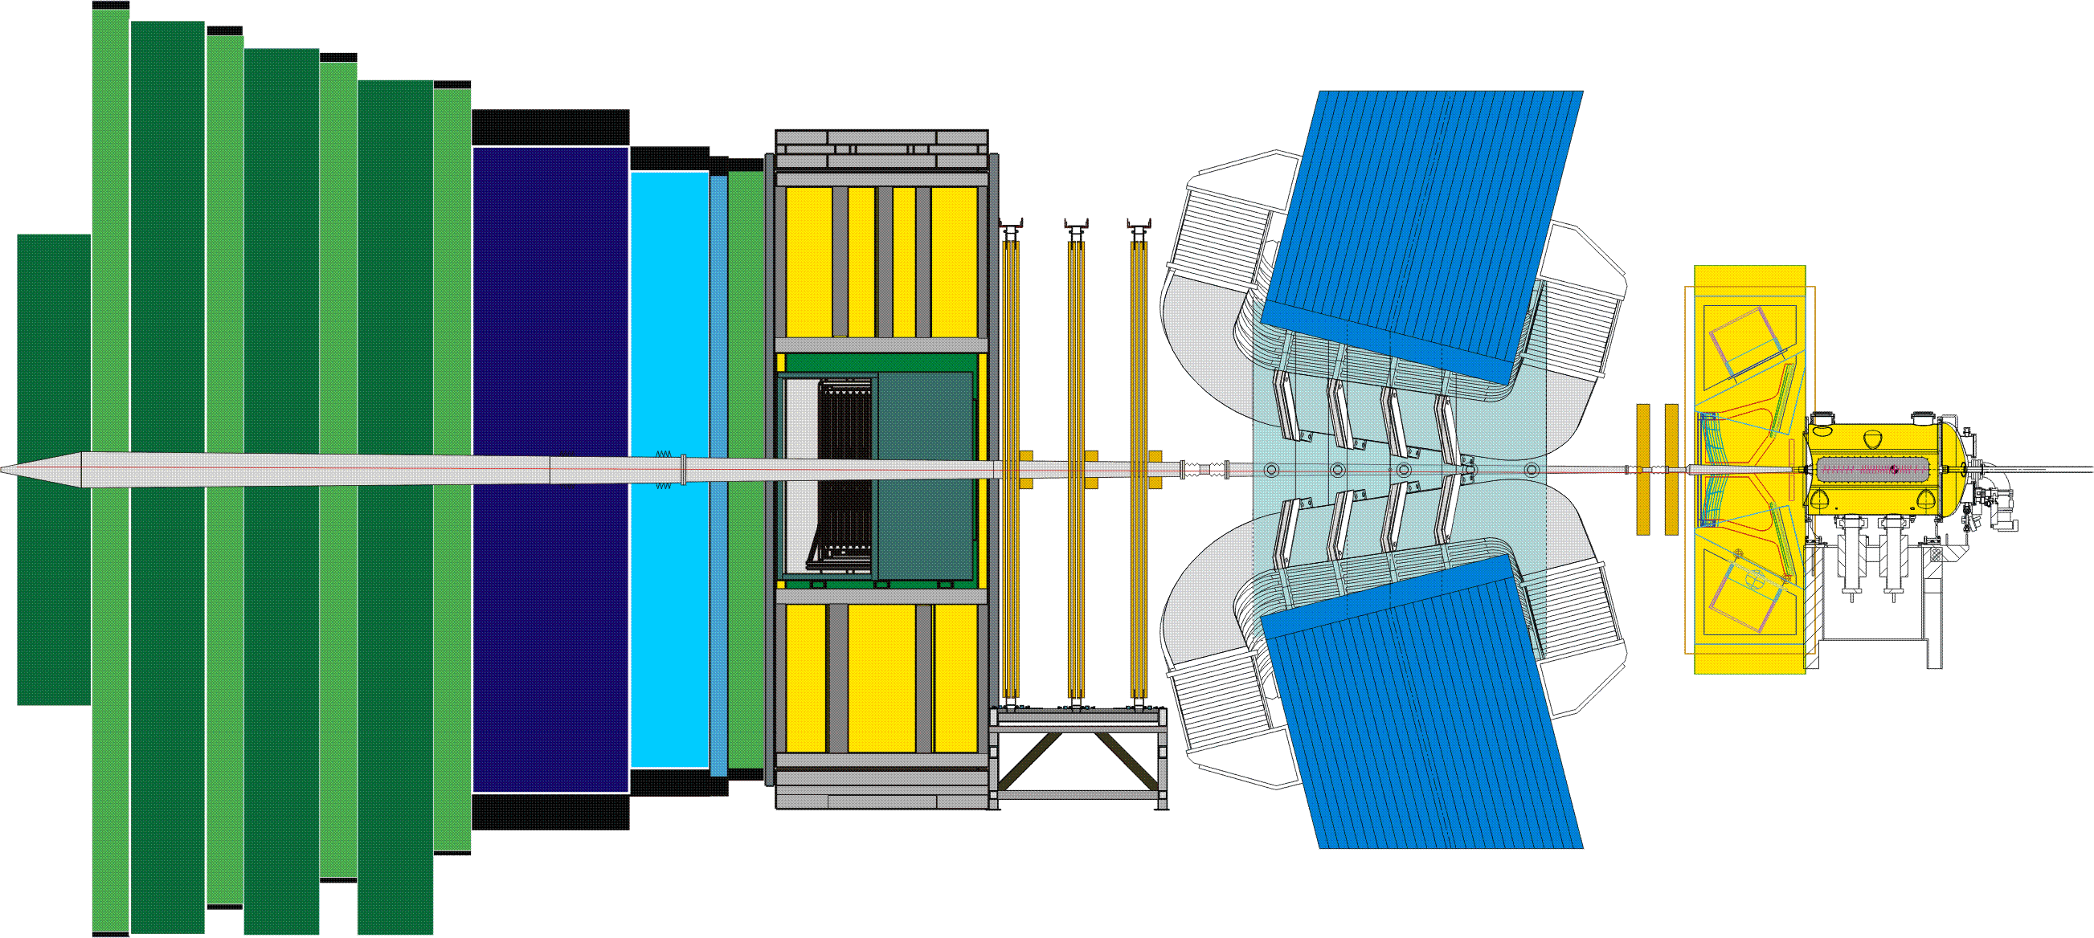
The LHCb Detector
23 sep 2010 19:49:24
Run 79646 Event 143858637
Tracking environment of the upgrade already present now!

Slide 5
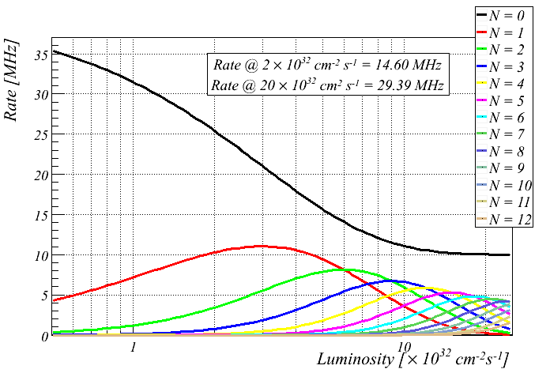
Luminosity and Pile-Up
25 ns BX = 2622 colliding bunches
Nominal LHCb operation:
  L ~ 2x10³² cm⁻² s⁻¹ with 25 ns BX-ings → <PileUp> = 0.4
Upgrade LHCb operation:
  L ~ 1x10³³ cm⁻² s⁻¹ with 25 ns BX-ings → <PileUp> = 2

Slide 6
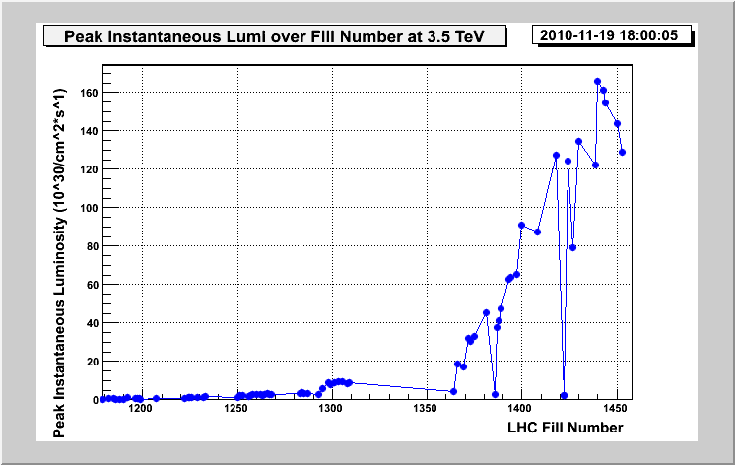
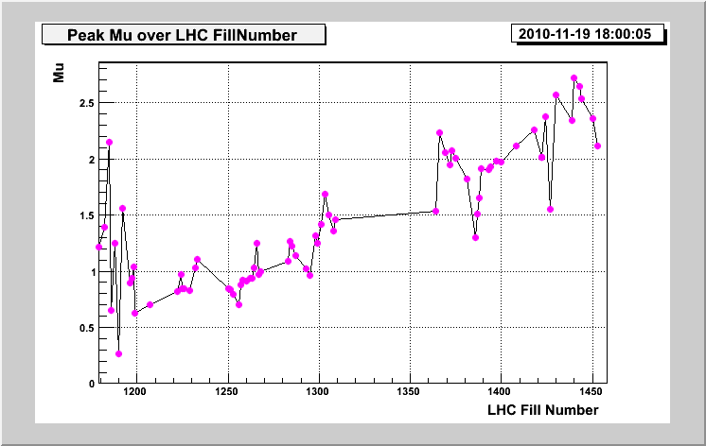
LHCb running in 2010
LHC and LHCb have shown excellent performance
Recorded ≈38 pb⁻¹
L=10³² cm⁻²s⁻¹
L_{inst} = 1.6 x 10³² cm⁻²s⁻¹
Few bunches
Price to pay is large pile-up…
Tracking environment of upgrade already present in 2010!
μ = 2
μ = avg visible pp interactions per BX
Pileup: P(n) = μ^{n}e^{–μ}/n!

Slide 7
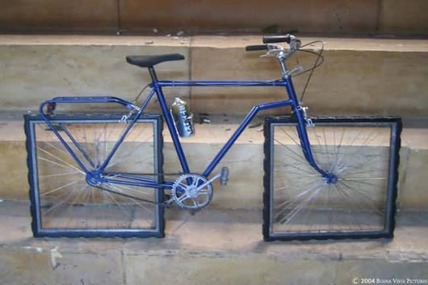
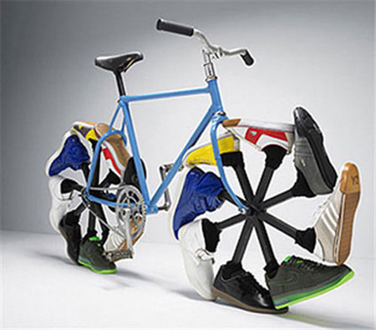
Detector Modifications for the Upgrade

Slide 8
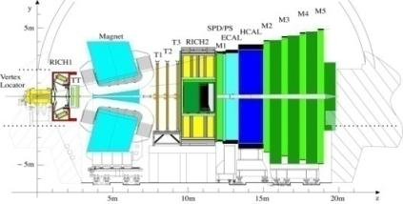
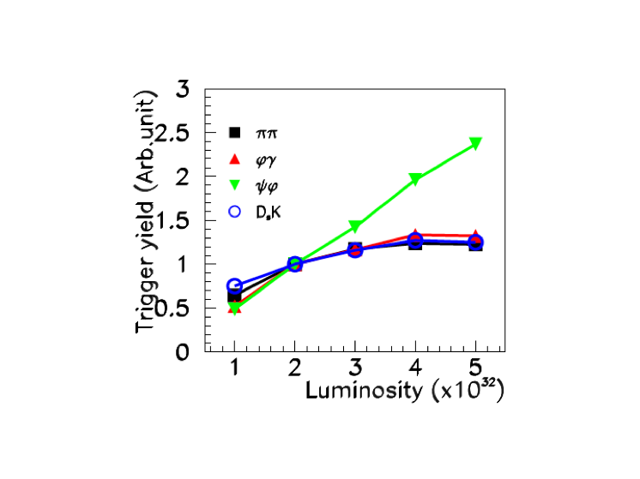
LHCb Trigger
Lumi dependence of L0 trigger yields:
  Muon trigger profits from higher lumi
  E_{T} trigger channels fill up bandwidth; higher E_{T} cuts cost efficiency
Solution:
  Increase the bandwidth for L0 or remove completely
  Requires new front end electronics
Notes:
The current LHCb trigger allows to read out the full detector at 1.1 MHz. The purpose of L0 is reduce the event rate to that level .

Slide 9
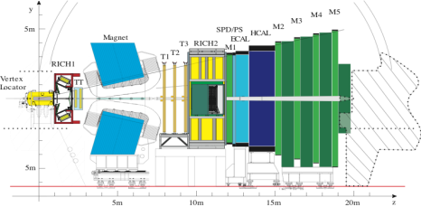
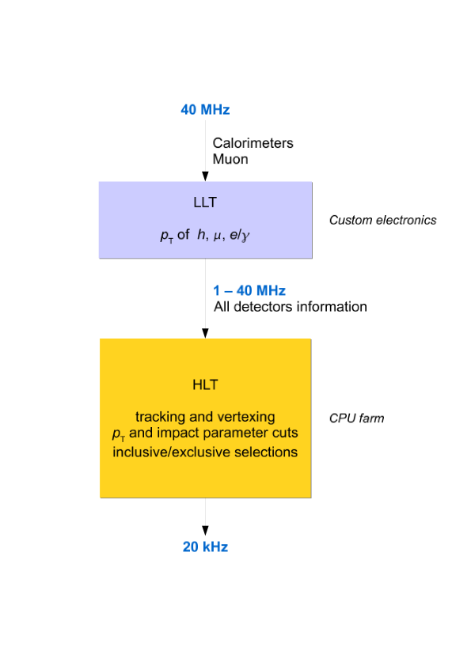
Current Trigger Upgrade
Allow staging
Custum electronics
CPU farm
Flexible trigger, factor ~2 gain for hadronic channels
Notes:
The FE electronics will be upgraded to readout at the LHC clock rate; in principle 40 MHz. The purpose of the tuneable Low Level Trigger are: 1) to allow a staged DAQ system which cannot handle the full rate 2) to deal with occupancy fluctuations preventing full readout 3)insuffieient CPU power in the event filter farm.
In the HLT not all tracks can be tracked in the downstream detector. IP requirement and number hits on track are used to select tracks. Keep HLT1 / HLT2 functionality

Slide 10
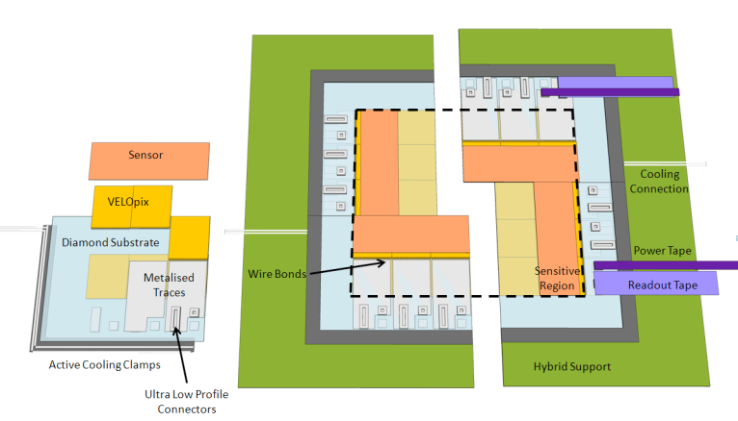
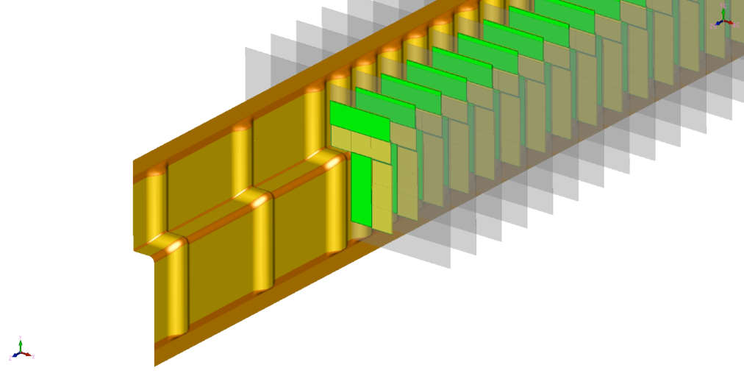
Velo Upgrade
New Velo @40 MHz readout
  Baseline option: pixel detector: VELOPIX based on Timepix chip
    55 μm x 55 μm pixel size
  Alternative option: strip detector
R&D program
  Module structure (X₀)
  Sensor options
    Planar Si, Diamond, 3D
  CO₂ cooling
  Electronics
  RF-foil of vacuum box

Slide 11
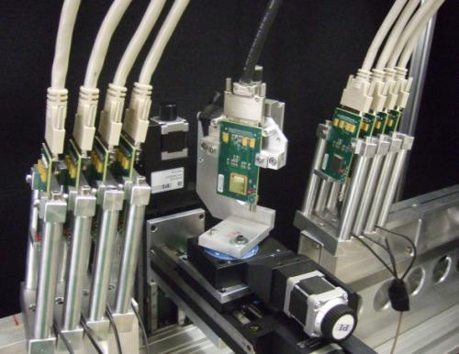
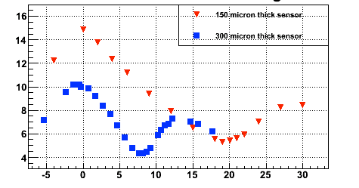
Velo-pixel R&D .
Test beam timepix telescope
Results:
σ(μm)
Sensor Angle (deg)

Slide 12
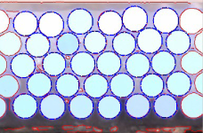
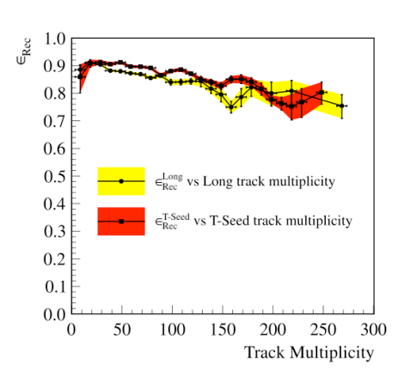
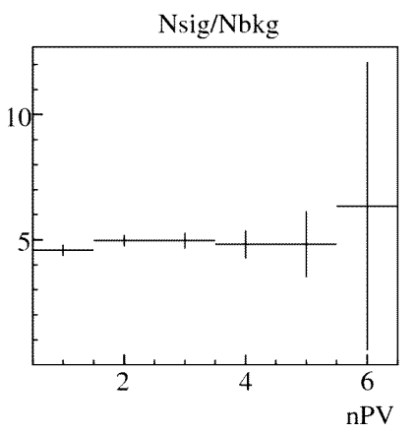
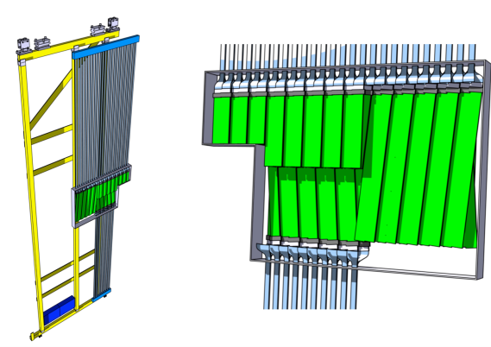
Main Tracker
IT fibers:
Current tracker works with upgrade level pile-up
Keep OT straw detector
  Detector aging in hot area is still an unknown
  Consider module replacements with 1mm Scintillating Fiber Tracker in hottest region
  Replace on-detector electronics by 40 MHz version (FPGA-TDCs)
IT and TT detectors must be replaced (1 MHz electronics integrated)
  Options: Silicon strips and 0.25 mm Scintillating Fiber Tracker
Tracking efficiency
vs multiplicity
Nsig/Nbkg for B→J/ψK⁺
IT-fiber detectors:
Notes:
Readout of Sci Fi is Silicon Photomultipliers SiPM (20 p.e. per mip) – radiation protection. Alternative MAPMT a la RICH – same readout
Fibers by Kuraray
Nsig/Nbck = constant due to the fact that the primary vertices are well separated!

Slide 13
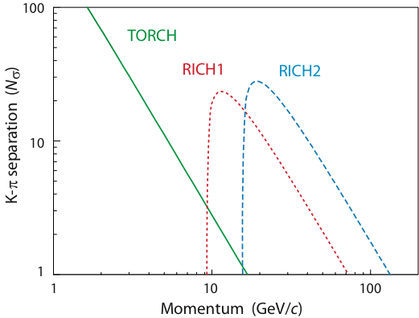
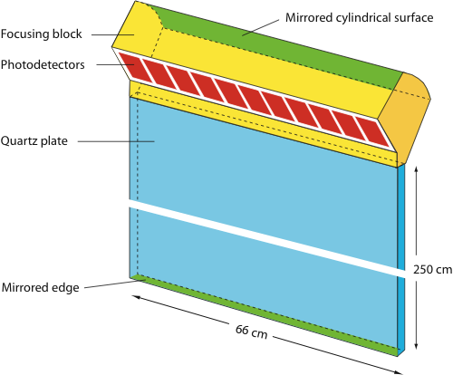
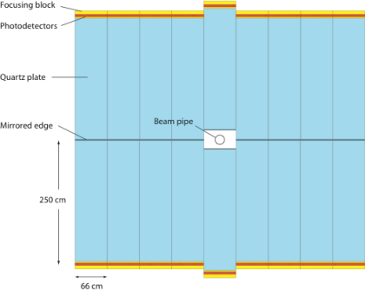
Particle ID
RICH-1 and RICH-2 detectors remain
  Readout baseline: replace pixel HPDs by MaPMTs & readout out by 40 MHz ASIC
  Alternative: new HPD with external readout
Low momentum tracks: replace Aerogel by Time-of-Flight detector “TORCH” (=Time Of internally Reflected CHerencov light)
  1 cm thick quarz plate combining technology of time-of-flight and DIRC
  Measure ToF of tracks with 10-15 ps (~70 ps per foton).
K-π separation vs p in upgrade:
TORCH detector:
Notes:
HPD electronics are limited to 1 MHz and is integrated within the vacuum envelope of the HPD tube. Therefore whole HPD must be replaced. Pixel HPD’s are custom made
The low photon yield of the aerogel leads to too much background in high trackmultiplicity environment.
TORCH time-of-flight and DIRC technology work coherently. Readout: Micro-Channel Plate photon detectors (MCP). TORCH is related to PID detectors TOP of Belle II and endcap DIRC of PANDA
The MaPMT option is baseline for RICH-1 and RIC-2. Magnetic field effects are being tested, shielding is required. Front end is 40 MHz ASIC, perhaps Maroc-3 readout chip.
Alternatives: HPD with external readout, MCP photon detector with Timepix readout

Slide 14
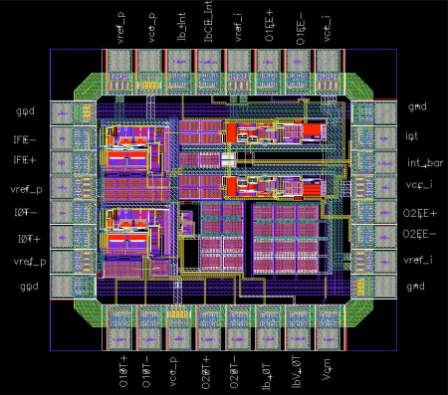
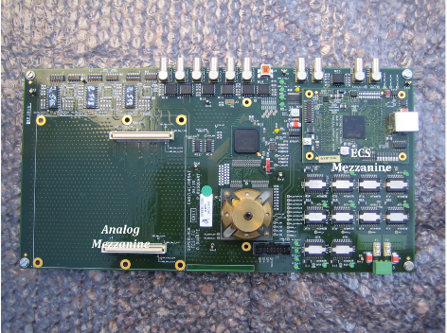
Calorimeters
ECAL and HCAL are maintained
  Keep all modules & photomultipliers (reduce gain in upgrade)
PS and SPD will be removed
  (e/γ separation provided by tracker)
Front End electronics modified for lower yield and to allow 40 MHz readout
ASIC prototype
New digital electronics prototype
Notes:
Reduce the photomulitplier gain by a factor 5 to keep the same current after lumi increase. New electronics: New FE card

Slide 15
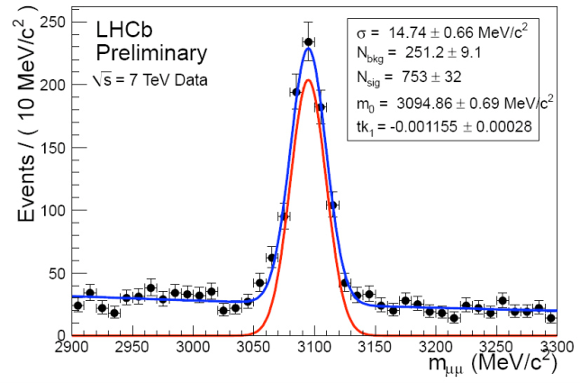
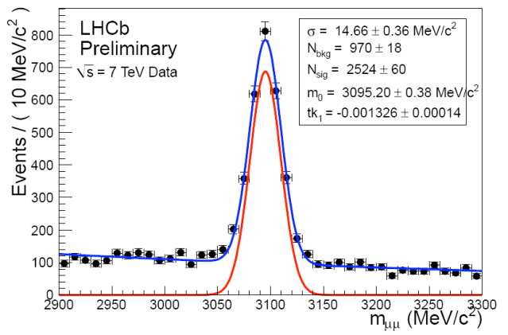
Muon Detectors
Muon detectors are already read out at 40 MHz in current L0 trigger
  Front end electronics can be kept
  Remove detector M1
Performance at higher occupancy: OK
Investigations:
  MWPC aging : tested at CERN to 10³³ level and 50 fb⁻¹,
  Rate capabilities for HV being investigated
    Malter like effect that can be cured by conditioning the chambers,
J/ψ → μ ⁺ μ – for single PV events
J/ψ → μ ⁺ μ – for events with <PV>=2.3
Notes:
M1 will be removed as the momentum measurement at the LLT will be done using the T stations
M_J/psi S/B reduction is 15%
Expect to replace 1-2% of the chambers per year

Slide 16
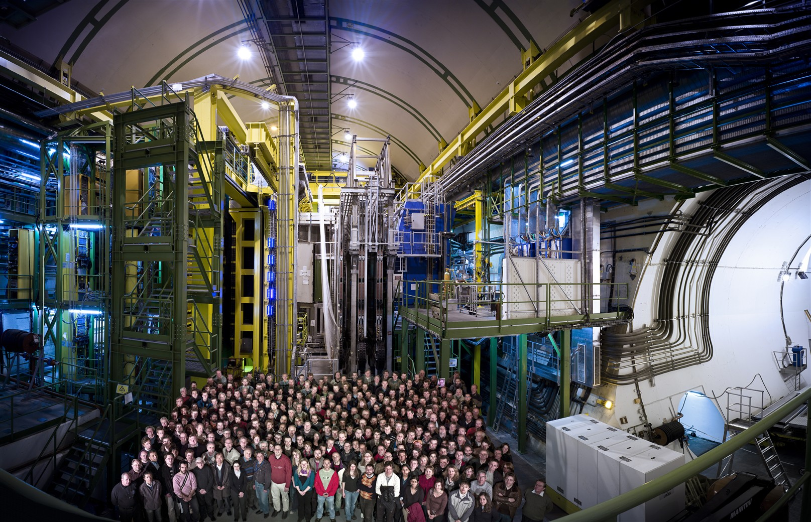
The Collaboration preparing the upgrade

Slide 17
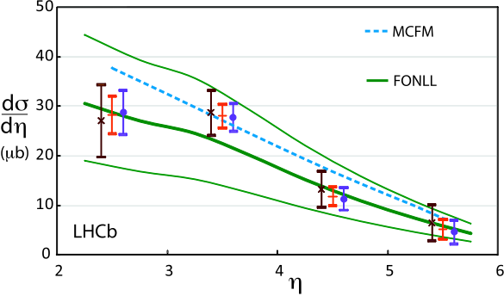
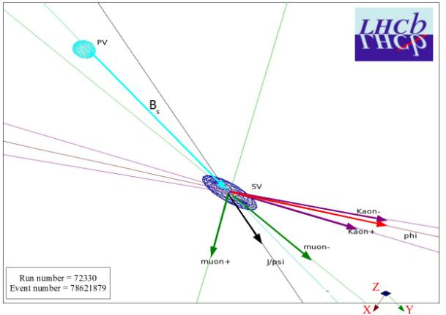
LHCb Upgrade Physics Program
Phys.Lett.B 694 (2010) 209 ; arXiv:1009.2731v2
B cross section from semileptonics:
Quark Flavour Physics
  CPV in b-decays:
    in B_{s} oscillations
    in charmless hadronic decays
    measurement of gamma
  Rare b-decays
  Charm Physics
Lepton Flavour Physics
  Searches for Majorana neutrinos
  Lepton Flavour Violating tau decays
Physics Beyond Flavour
  Electroweak Physics
  Exotics
  Central Exclusive Production
B_{s}→J/ψ ϕ event candidate:

Slide 18

Quark Flavour Physics

Slide 19
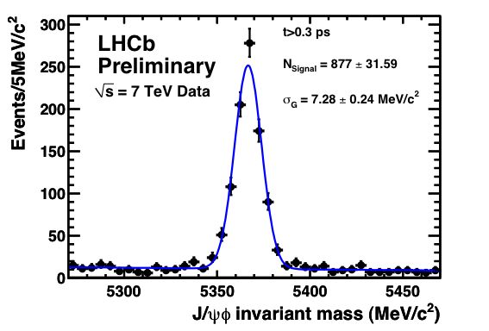
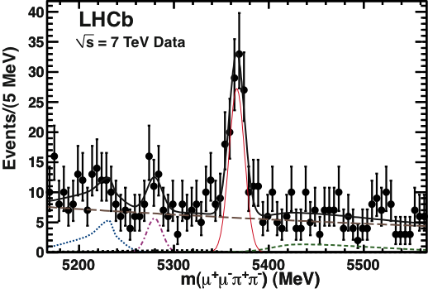
ϕ_{s} : Mixing induced CPV in B_{s}
B_{s}→J/ψ ϕ :
LHCb-CONF-2011-002
Phase 1:
Observe NP in ϕ_{s} with B_{s}→J/ψϕ if larger than 3xSM
Phase 2:
Beyond SM precision measurement: σ≈0.006
  Add B_{s}→D_{s}⁺D_{s}⁻ and B_{s}→J/ψ f₀ (pure CP states)
  Fit S-wave K⁺K⁻ contributions (5-10%)
    Biased ϕ_{S} if ignored
    S. Stone and L. Zhang, Phys. Rev. D 79 (2009) 074024
  Study suppressed penguin SM contrib with B_{s}→J/ψ K*
    S. Faller et al, Phys. Rev. D 709 (2009) 014005; K. De Bruyn et al, arXiv:1012.0840
B_{s}→J/ψ f₀ :
B_{s}→J/ψ K* :
LHCb-CONF-2011-025
f₀ resonance: |M(π⁺π–) – 980 MeV | < 90 MeV
B_{S}→ J/ψ f₀(980)
33 pb⁻¹
arXiv:1102.0206
Phys.Lett.B 698 (2011)
Notes:
J/psi phi requires angular analysis. Pure CP states don’t. Spin 0 S-wave contributions of K+K- under the phi peak could be 5 - 10

Slide 20

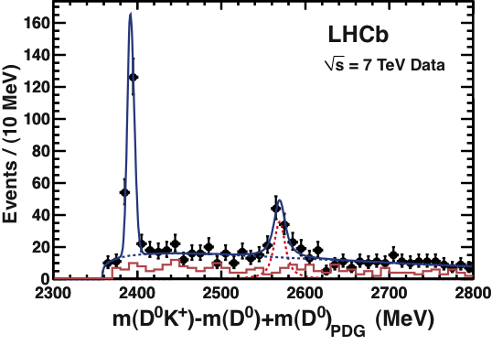
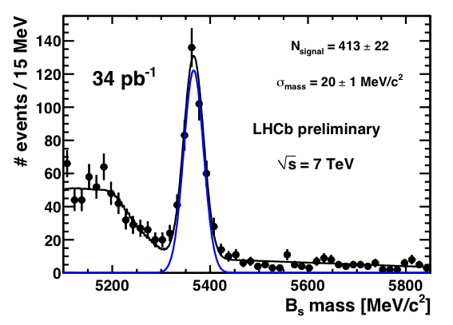
A_{fs}(B_{s}) : CP Violation in B_{s} Mixing
CP Violation in mixing (measures ε_{Bs})
SM: A_{fs}(B_{s}) = (2.06 +- 0.57) x 10⁻⁵ A. Lenz and U. Nierste, JHEP 0706 (2007)
Phase 1: Flavour specific semileptonic decays
  D0: A_{sl}^{b}=-0.00957 ± 0.00251 (stat) ± 0.00146 (syst)
  (Phys. Rev. D82 (2010) 032001, Phys. Rev. Lett. 105 (2010) 081801)
  Measure A_{fs}(B_{s}) – A_{fs}(B⁰) via:
    B_{s} → D_{s}–μ⁺ X and B→D⁻μ⁺ X
  Identical final state B⁰ and B_{s} to reduce biases
Phase 2: Measure A_{fs}(B⁰) and A_{fs}(B_{s}) with hadronic decays
  “B_{s}-only” via B_{s}-> D_{s}(KKπ) π
  Suppress detector asymmetry with fully charge symmetric final state
First Observation of B_{s}→D_{s2}^{*+} Xμ⁻ ν:
B_{s}→ D_{s}(ϕπ) π
D_{s1}⁺(2536)
seen by D0
Phys Lett B 698 (2011) 14
arXiv:1102.0348
D_{s2}*⁺(2573)
LHCb-CONF-2011-005
Notes:
D0 excitement of more than 3 sigma effect.
Systematics is important:
Phase 1: Difference of B0 and Bs falvour specific asymmetries, using semileptonics with identical final states
Phase 2: Afs(B0) also from future B-factories, Afs(Bs) only from LHCb

Slide 21
Charmless hadronic B-decays
Rare penguin decay topologies are sensitive to NP
Phase-1:
  Direct CP violation in B_{s} and Λ_{b}
  Time dependent CPV in B_{s}→K⁺K⁻
  Observe channels B_{s}→K*⁰K*⁰ ,B_{s}→ϕϕ
    σ(ϕ_{CP}) ≈ 0.08
Phase-2:
  Precision time dependent CPV in penguin dominated B_{s}→K*⁰K*⁰ , B_{s}→ϕϕ : σ ~ 0.02
    SM predicts CP < 2% due to cancellation of mixing and decay phases
    Control S-wave contributions
  CP asymmetry in B⁰→ϕ K_{s} with σ ~ 0.03
B_{(s)}→ K π
LHCb-CONF-2011-011
B_{s}→ K K
LHCb-CONF-2011-011
B_{s}→ K*⁰K*⁰
LHCb-CONF-2011-019
B_{S}→ K*K*
Notes:
Charmless hadronic B decays are sensitive to NP since they proceed through penguin diagrams. Penguin dominated decays Bs->phi phi and Bs->K* K*. They have similar sensitivities.
All numbers come from the upgrade LoI.
First direct CP observation in Bs and Lambda_b. Bs->KK gives angle gamma. Phase one about 0.1 precision.
B→ phi Ks is equivalent

Slide 22
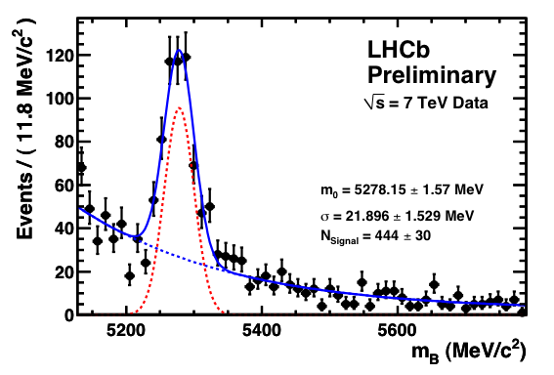
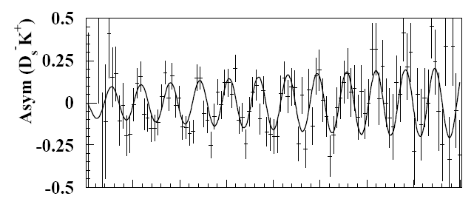
CKM angle γ
B⁺→DK⁺, B⁰→DK*⁰, B_{s}→ D_{s}± K±
Phase 1: combined B→DK and B_{s}→D_{s}K give σ(γ) ≈ 3^{ο} for 5 fb⁻¹
Phase 2: σ(γ) < 1^{ο} to give high precision test for NP in global fits of CKM triangle
  Precision lattice calc’s expected: V_{ub} and Δm_{d}/Δm_{s}
  LHCb offers sufficient stat’s
  Exploit possibility to trigger on fully hadronic modes
B⁺→ D(Kπ) K⁺ (Cabibbo allowed D decay)
34 pb⁻¹
B_{s}→ D_{s}(ϕπ) π
LHCb-CONF-2011-005
B_{s}/B_{s} →D_{s}–K⁺ (10 fb⁻¹)
CP Asymmetry (MC):
Time→
Notes:
Use GLW (Gronau London Wyler – common CP eigenstate of D) triangle relations or ADS (Atwood Dunietz Soni common flavour final state) methods. All self tagging. Here the mass plot is the cabibbo allowed decay, not the forbidden one needed for CP measurement.
ADS method uses double Cabibbo suppressed D0 decays: D0->K+pi-
B0->DK*: Use D0 –D0bar mixingMeasure 6 time integrated rates: B0->D0 K*, D0-bar K*, D0_CP K* and same three for anto-B

Slide 23
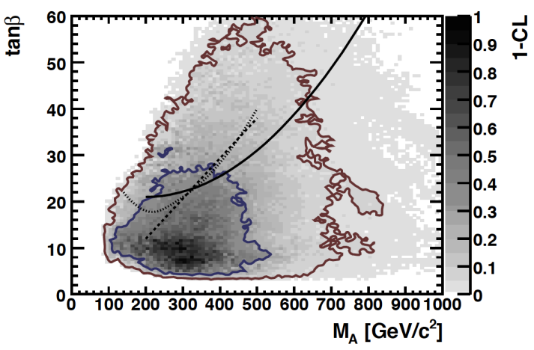
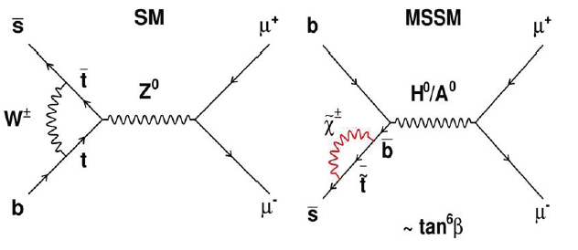
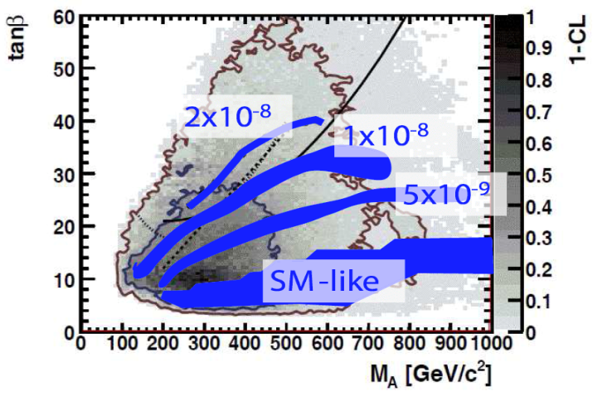

B_{s,d}→μ⁺μ⁻
Tanβ vs M_{A} plane
Sensitive to many NP models
jets
jet + μ
Jet + e
MSSM:
NUHM1:
  Best fit contours in tanβ vs M_{A} plane
    O. Buchmuller et al, arXiv:0907.5568
  CMS direct search (5σ) contours 30 or 60 fb⁻¹
    H/A → τ+τ-, arXiv:0704.0619
  Indirect limit from BR B_{s}→μ⁺μ⁻ very discriminative
Notes:
Contours include electroweak data, g-2,higgs mass bound, CDM (cold dark matter from cosmology). Bsmumu cab help to discriminate between CMSSM and NUHM1. NUHM1 predicts larger BR for Bsmumu.
Best limits come from indirect searches: Bs->mumu, b->s gamma, B- ->tau nu. Direct searches demonstrated by CMS H,A->tau+ tau^- either to Jets: solid line or jet + mu dashed or jet +e dotted
CMSSM: soft supersymmetry breaking scalar m_0 and gaugino m_1/2 masses are constrained to universal values.
NUHM1: equal non-universal SUSY breaking contributions to Higgs mass
NUHM2: independent non-universal SUSY breaking contributions to Higgs mass

Slide 24
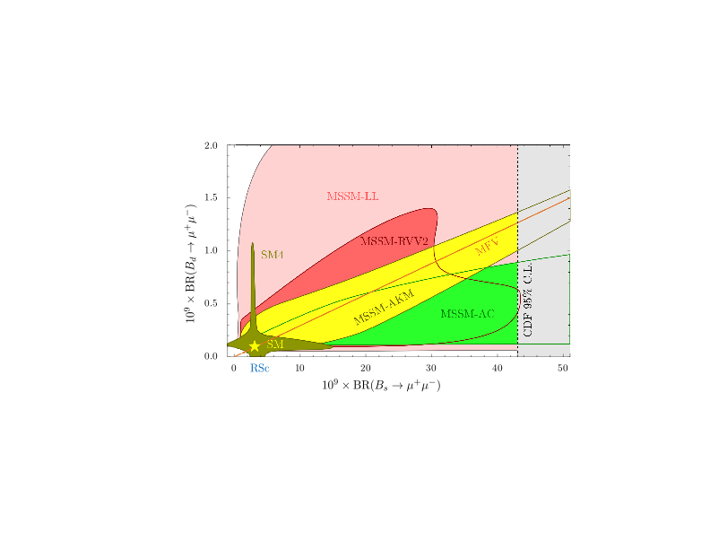
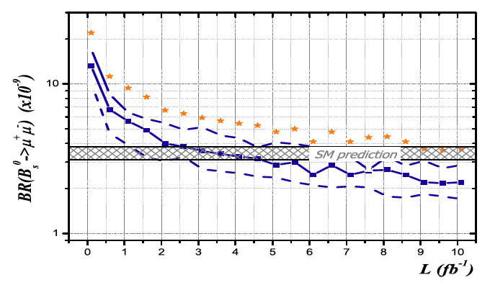
B_{s,d}→μ⁺μ⁻
Exploit statistical power LHCb
Sensitivity of current limit (43 10⁻⁹ @ 90% C.L. with 40 pb⁻¹) in agreement with MC roadmap
Measurement of f_{s}/f_{d} is currently stat. limited
Upgrade:
  SM {BR (B_{s}→μ⁺μ⁻)} can be measured to 8% precision @ 50 fb⁻¹
    Strong constraints for NP models
  Correlation B_{s}→μ⁺μ⁻ vs B_{d}→μ⁺μ⁻ can be done in upgrade ≈ 35%
    Challenge: low BR B_{d}→μ⁺μ⁻ and background
Limit of
current LHCb
Roadmap
For 14 TeV
10⁹ x BR (B_{d}→ μ+μ-)
3σ observation
5σ observation
10⁹ x BR (B_{s}→ μ+μ-)
Notes:
We saw in this conference how BR B-mumu/ Bs->mumu can help discriminating between NP models

Slide 25
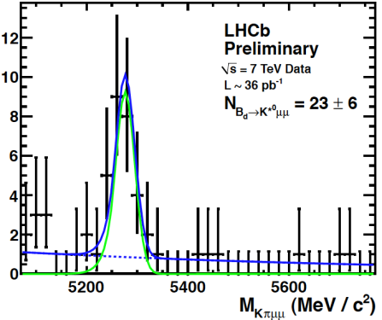
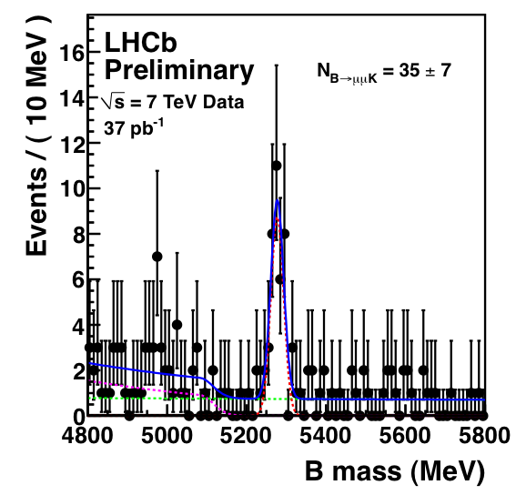
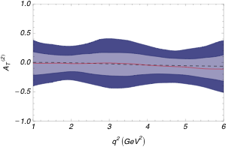

B⁰→K*⁰μ⁺μ⁻
Hadron decays H_{b}→H_{s} μ⁺μ⁻ sensitive to new physics via angular distribution
  B⁰→ K*μ⁺μ⁻ , B⁺→K⁺μ⁺μ⁻, B_{s}→ϕ μ⁺μ⁻, Λ_{b}→Λ⁽*⁾μ⁺μ⁻
Phase-1: Measure A_{FB}
  Expect 5100 events, measure zero-crossing point in A_{FB} to 0.4 GeV²
Phase-2: More kinematic observables: transversity asymmetry: A_{T}⁽²⁾
  A_{T}⁽²⁾ is sensitive to new right handed currents
  BR(B⁺→K⁺e⁺e⁻) / BR(B⁺→K⁺μ⁺μ⁻) sensitive to Neutral Higgs Bosons
  B_{s}→ϕ μ⁺μ⁻, Λ_{b}→Λ⁽*⁾μ⁺μ⁻
B⁰→ K* μ⁺μ⁻
1σ and 2σ bands for A_{T}⁽²⁾ at 10 fb⁻¹ vs q² of muon pair.
(Central value is SM)
B⁺→K⁺ μ⁺μ⁻
Notes:
In principle any decay Hb→Hs mu+mu- with H=hadron is sensitive to NP
The forward-backward asymmetry of the muons in the dimuon rest-frame.
A_T^2 parallel and perpendicular spin amplitudes of K*

Slide 26
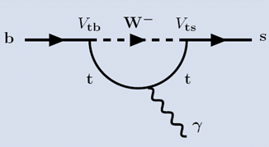
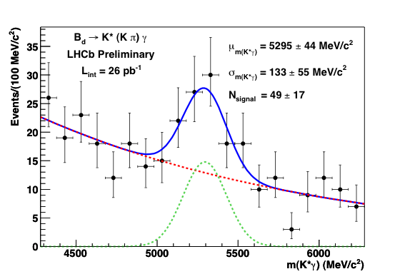
b→s γ : B_{s}→ϕ γ
b → γ (L) + (m_{s}/m_{b}) × γ(R)
Bs→ϕγ: Time dependent decay rate
  SM: photons are predominantly (O(m_{s}/m_{b})) left polarized: no interference B_{s} and B_{s}
  Observed CP violation depends on polarization and weak phase.
    Sizeable ΔΓ_{s} allows measurement A_{Δ}:
  Phase 1: expect 5500 B_{s}→ϕγ/year; photon polarisation measurement to 0.10
  Phase 2: expect 40000 B_{s}→ϕγ/year; precision to percent level
SM:
Related decay B_{d}→K*(Kπ) γ
A_{dir} ≈ 0, A_{mix} ≈ sin2ψ sin2φ_{s}, A_{Δ} ≈ cos 2ψ cosφ_{s}
tan ψ = |b→s γ _{R}| / | b→s γ _{L}| , cos φ_{s} ≈ 1
A_{Δ} measures fraction “wrong” γ polarization
Notes:
Measurement of the photon polarization in b->s gamma.
In SM helicity suppression gives predominantly left handed photons. – no CO violation since the final states are distinguishable
Sensitivity event with phi_s = 0

Slide 27
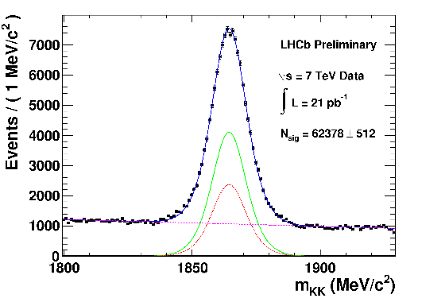
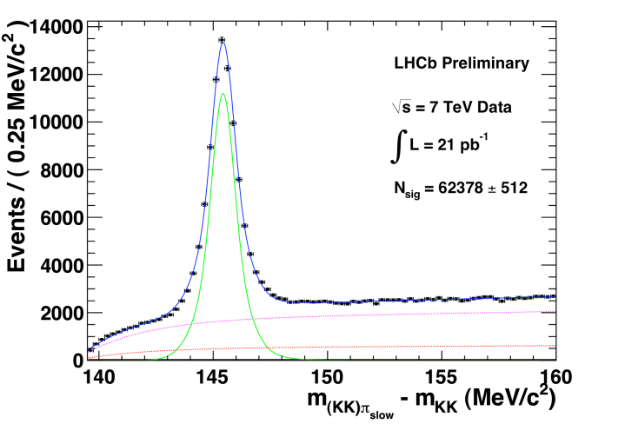
Charm Physics
2010:
  With 37 pb⁻¹ collected charm samples of D⁰→h⁺h⁻ comparable to B-factories
Phase-1:
  Good efficiency for 2-body decays, lower eff for higher multiplicity due to E_{T} trigger in L0
Phase-2:
  Full software trigger allowing selection of topology of interest
  High statistic available for CPV study in mixing and decay:
    Lifetime asymmetry D⁰→K⁺K⁻ and D⁰→K⁺K⁻ probes CPV in D mixing
    Difference in time integrated CP asymmetry D⁰→K⁺K⁻ and D⁰→π⁺π⁻ probes CPV in decay of D
    Rare charm decay: D→μ⁺μ⁻, lepton flavour violation: D→e μ
D⁰→K⁺K⁻
D^{*+}→D⁰π⁺
Notes:
Question: Will LHCb statistics on charm beat BES-III?
Very high statistics in combination with high detector resolution allow control/calibration of systematic effects

Slide 28
Sensitivities to key flavour channels

Slide 29


Lepton Flavour Physics

Slide 30



Search for ~1 GeV Majorana Neutrinos
Majorana neutrinos predicted by many NP models (low mass neutrino origin):
  νMSM: 3 Majorana right handed singlet particles added to SM: N₁, N₂, N₃
    N1: mass ~ 1-50 keV/c² ➔ dark matter candidate
    N2, N3: mass ~O(1 GeV) ➔ give mass to neutrino’s via see-saw ➔ BAU: degenerate masses
  Direct search of long lived neutrinos via neutrino mixing in B or D decays
    BR ~10⁻⁷, recognizable by long decay distance ➔ Upgrade offers large statistics
Direct search producing sterile neutrinos that decay after flight
D. Gorbunov and M. Shaposhnikov,
JHEP 0710 (2007) 015
  Indirect search of Majorana neutrinos in resonant production:
    Same sign charged leptons in lepton number violating D, B , tau decays ➔ Upgrade offers flexible trigger
Resonant contribution to Lepton number violating
Decays (similar to neutrinoless double beta decay)
Atre et al, JHEP, 0905 (2009) 030
e.g. B⁺→D_{s}⁻μ⁺μ⁺
Very low background
Explore BR at 10⁻⁹ range
Flexible Trigger!
Notes:
Neutrino Minimal SM. Search for GeV neutrino’s.
Direct search: Weakly interacting neutrino’s so decay after long lifetime, ~10^-4 should dcay in detector. Charm have sensitivity for lower masses.
Indirect search: Lepton number violating decay a la neutrinoless double beta decay. N4 is massive neutrino

Slide 31
Lepton Flavour violating τ-decays
Never observed:
  Forbidden in classical SM
  Vanishing small in SM with mixing
LHC mainly produces τ’s from B and D_{s} decays
B-factory upper limits:
  τ→μγ : 4.4 x 10⁻⁸ (90% CL)
    CMSSM: ~ 10⁻⁹
  τ→3μ : 2.1 x 10⁻⁸ (90% CL)
    CMSSM: ~ 10⁻¹⁰ – 10⁻¹²
    Can be higher in other Models: NUHM, R-parity violating, Little Higgs, Z’ with LFV
  LHCb : τ→3μ
    Phase-1: match B-factories with few years
    Phase-2: 10⁻⁹ level
Babar, Phys. Rev. Lett. 104 (2010);
Belle, Phys. Lett. B687 (2010)D82 (2010)
B. O’Leary et al, arXiv:1008.1541
B. O’Leary et al, arXiv:1008.1541

Slide 32


Physics Beyond Flavour

Slide 33


Electroweak Physics
LHCb can contribute until ILC/CLIC becomes operational
  sin² θ_{eff}^{lept :} measure A_{FB} of leptons in Z-decays
    Due to q q production, the raw A_{FB} asymmetry is factor 5 larger than @ LEP
    Upgrade: statistical precision sin² θ_{eff}^{lept} ~ 0.0001
      Systematics (PDF’s) to be understood
  M_{W} measurement at LHC is challenging.
    LHCb can contribute by measuring PDFs
W⁺-W⁻ production asymmetry:
Z →μ⁺μ⁻
16 pb⁻¹
16 pb⁻¹
Notes:
Z asymmetry need to know the direction of the partons that created the Z. Dilution is large in central region. Z follows quark direction because proton-proton u-ubar or d-dbar

Slide 34

Exotics
Hierarchy problem: why is Higgs mass not at Planck scale?
  Many models (Susy, Xtra dimensions, Technicolour, Little Higgs) predict new states at TeV scale: Z’, 4th generation, leptoquarks, Hidden Valley particles
Hidden Valley particles carry “v” quantum number and can be low mass
  Lightest v-particle is a dark matter candidate
  V-neutral particles might have long lifetime and decay, e.g. to b b
  V flavoured particles could be produced by Higgs;
    Decay of Higgs to two π_{v}⁰ particles could even lead to Higgs discovery
M.J. Strasser and K.M. Zurek, Phys. Lett. B 661 (2008) 263
Notes:
Hidden valley motivated by string theory

Slide 35

Central Exclusive Production
CEP: pp → p + X + p where “+” indicates a rapidity gap:
  Photon or pomeron exchange
  Observe and study exotic particles in clean environment (exclusive χ_{c} is seen)
LHCb Velo region event display of CEP J/ψ→μ⁺μ⁻ with pile-up:
Notes:
A centrally exclusive produced J/psi is identified on top of a pile-up event, seen by another vertex. Note how clean it is. Much less pile-up than Atlas or CMS

Slide 36
Summary & Conclusion
The LHC spectrometer has demonstrated to be able to operate in a high multiplicity track environment
Given its forward geometry, its excellent tracking and PID capabilities and a flexible software trigger, the LHCb upgrade:
  is an ideal detector for quark flavour physics
  provides unique and complementary capabilities for New Physics studies beyond flavour physics
Since the LHC is expected to provide the required luminosity the upgrade LHCb is a golden opportunity

Slide 37


Further Upgrade Suggestions?

Slide 38
In overview

Slide 39
The LHCb Detector
23 sep 2010 19:49:24
Run 79646 Event 143858637
Tracking environment of the upgrade already present now!

