Slide 1
WebLogic at CERN
WebLogic Server Rome Summit
Antonio Nappi
15/ 05 / 2019

Slide 2
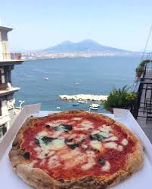
Few words about the speaker
Antonio Nappi
DevOps Engineer at CERN
Linkedin: https://www.linkedin.com/in/nappiantonio/
https://www.identitainsorgenti.com/a-santantonio-napoli-celebra-i-pizzaioli-patrimonio-mondiale-con-una-giornata-di-festa/

Slide 3
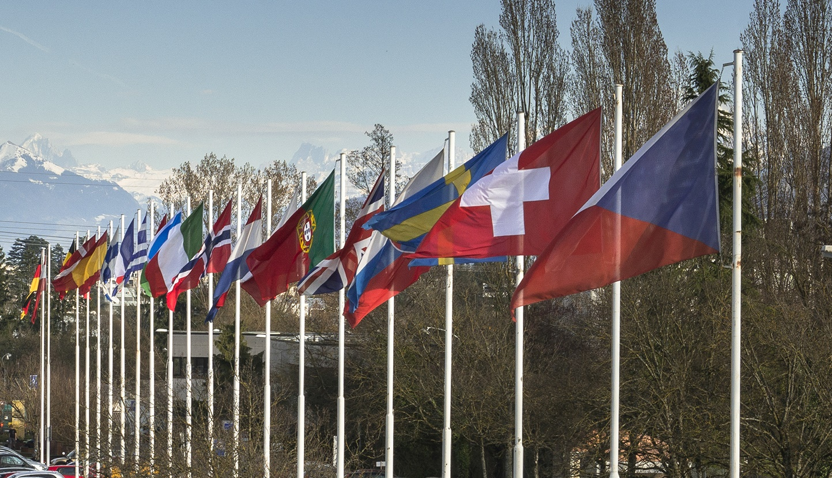
What is CERN?
European Organization for Nuclear Research
Member States:
Austria, Belgium, Bulgaria, Czech
Republic, Denmark, Finland, France, Germany,
Greece, Hungary, Israel, Italy, Netherlands, Norway,
Poland, Portugal, Romania, Slovakia, Spain, Sweden,
Switzerland and United Kingdom
Associate Members in the Pre-Stage to Membership:
Cyprus, Serbia
Associate Members:
India, Pakistan, Turkey, Ukraine
Observers to Council:
Japan, Russia, United States of
America, the European Commission, Joint Institute for
Nuclear Research and UNESCO
~ 3 000 members of personnel
Users from 100 different countries
Budget ~ 1 100 MCHF per year
FOUNDED IN 1954

Slide 4
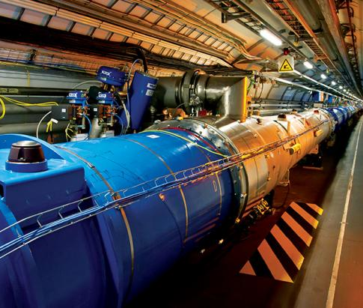
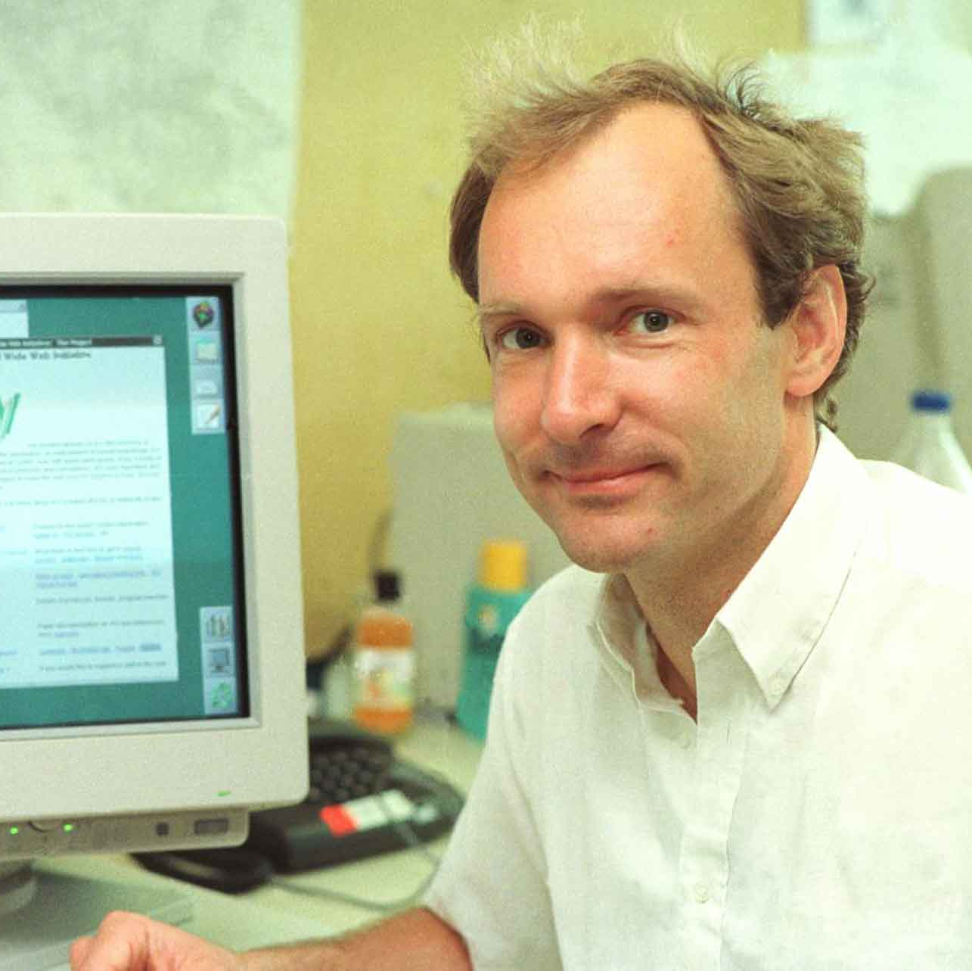
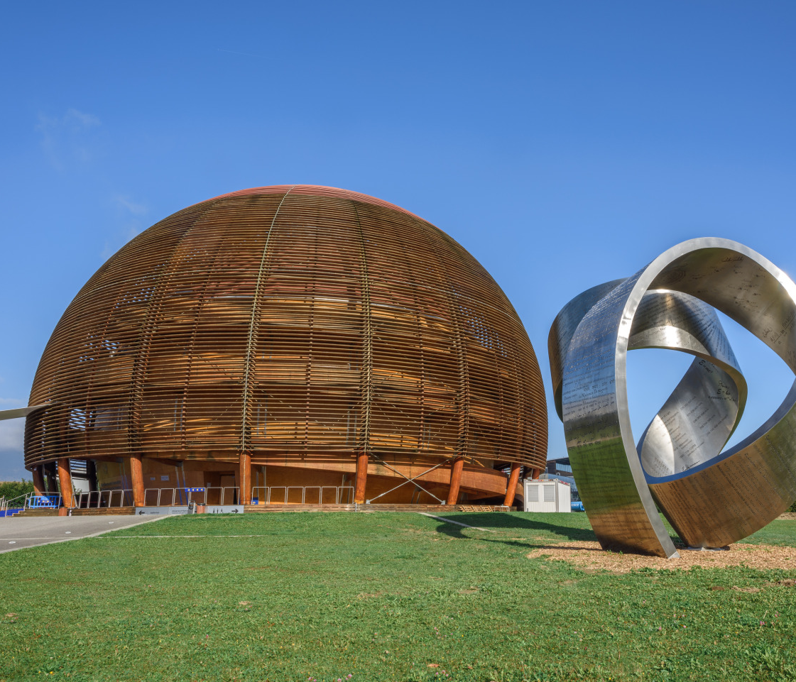
CERN: a unique environment
Study fundamental particles
  How they interact
  Understand the fundamental laws of nature
Large Hadron Collider ( LHC )
  Largest particle collider in the world
  27 km in circumference
  Thousand of magnets
  Collaboration with over 10000 scientists
Place where the Web was born
Science for peace
  Melting pot
Notes:
CERN
what it is
Collaboration among countries from all around the world
What it does
Research, physics
Values
Diversity
Science for Peace
Speech :
What we do at CERN ? We study the interaction of fundamental particles in order to understand the major laws of nature. To help scientist to do it, CERN build the largest particles collider in the world, made of thousand of magnet and long 27km. CERN is also the place where Tim Bernes invented the Web, used by scientist to share information.
As I said before, CERN want to promote peace throught science and it is the perfect of representation on successful collaboration between people of different culture, race, religion.

Slide 5
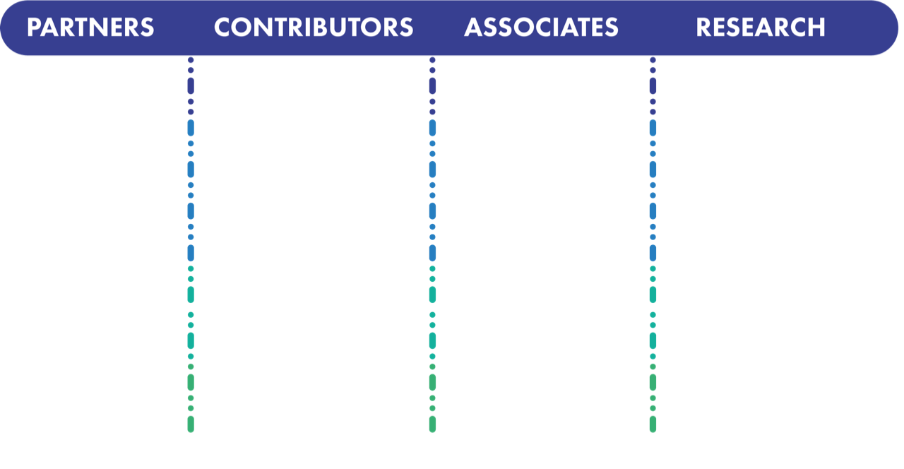









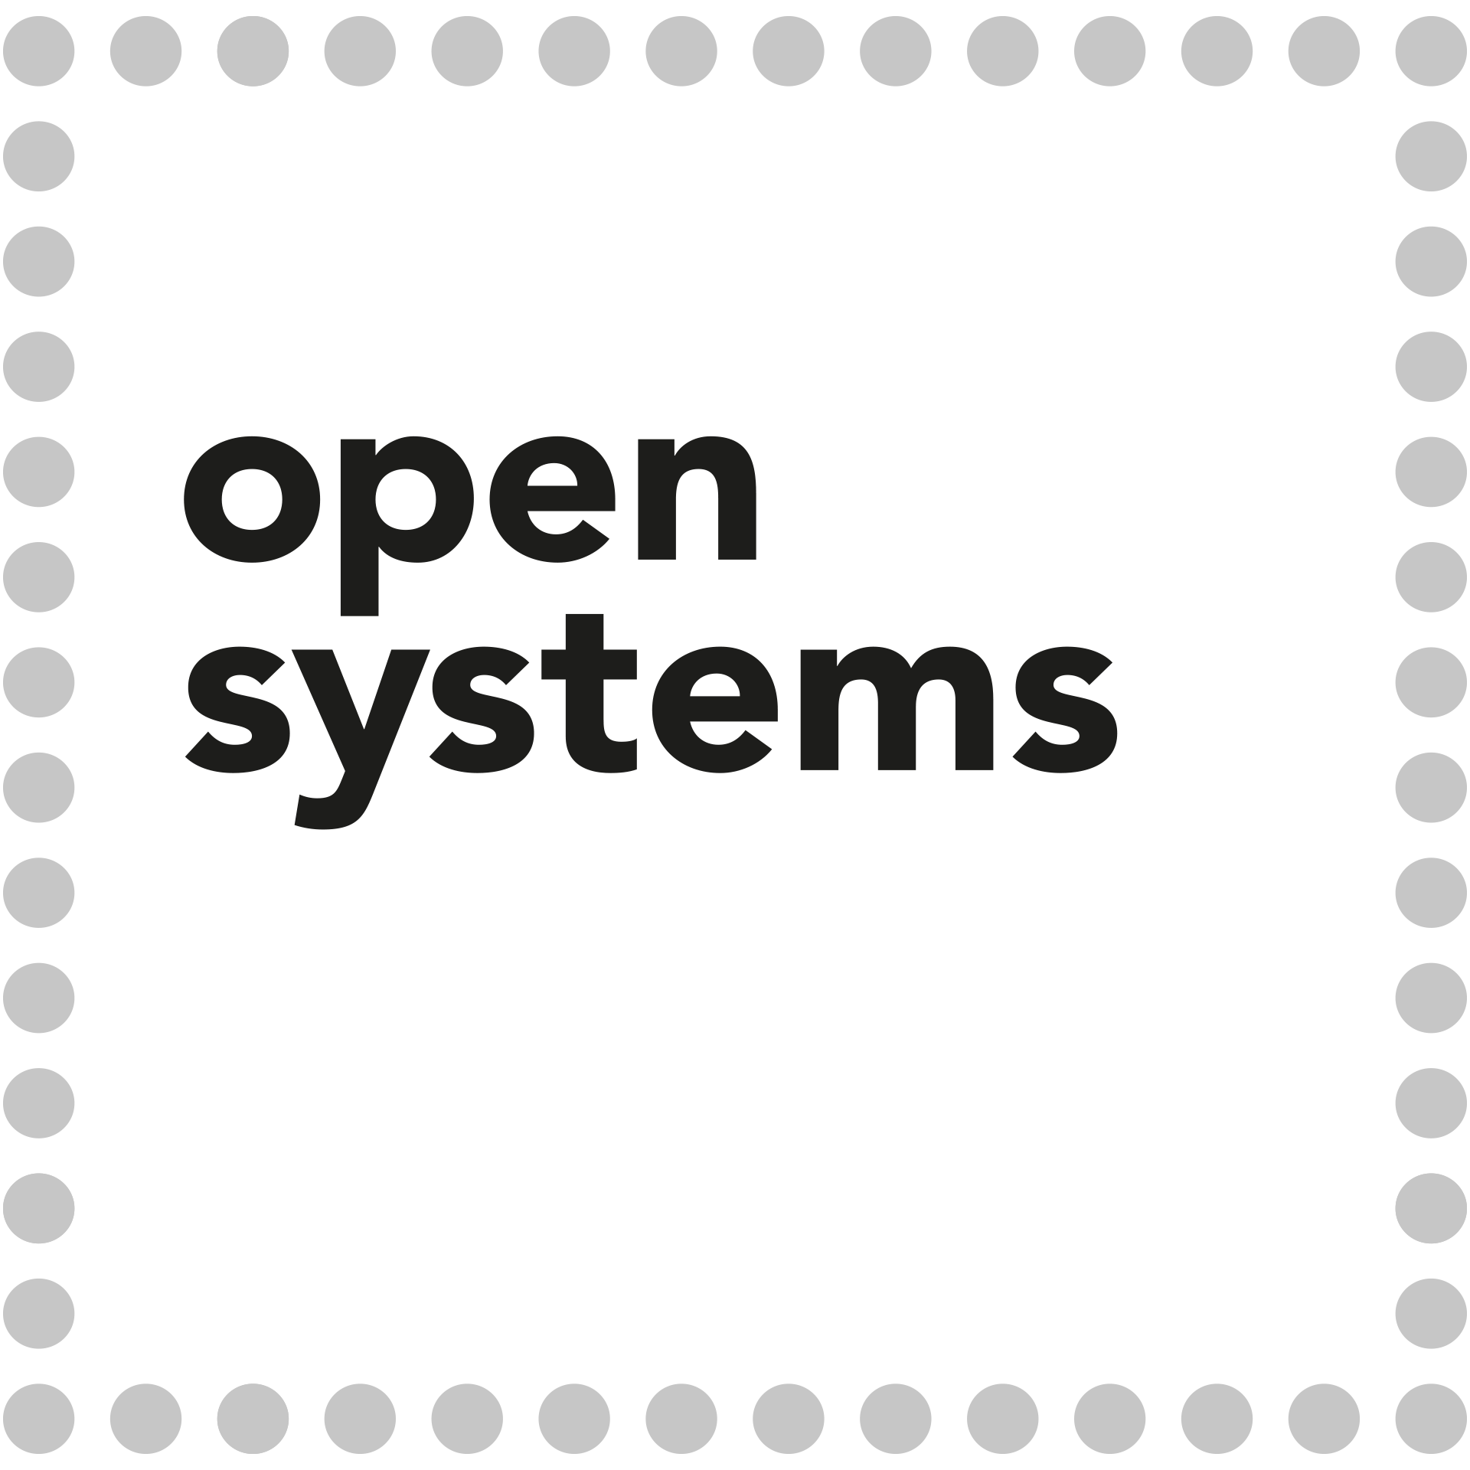

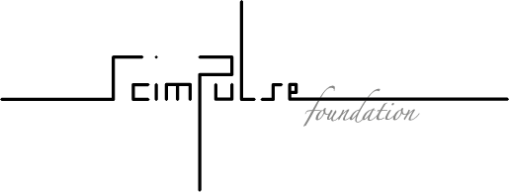





Collaboration Members
A public-private partnership between the research community and industry

Slide 6

WebLogic at CERN
WebLogic 12.1.3 in production
  ~ 258 Clusters
  ~ 530 JVMs
  ~ 105 VMs
  Web Profile application Stateful
    No Java Message Service
    No Enterprise JavaBeans
  Users
    Engineers
    Administration
    IT

Slide 7
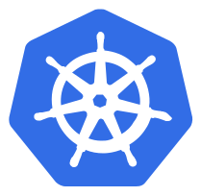

Why Kubernetes
Immutable
  Versioning
  Easier to track
Portable
  On Premise
  Public Cloud
  Disaster Recovery Plan easier
High Availability
  Auto-Healing
Fast Provisioning

Slide 8

Constraints
Transparent for developers
  Replicate VM model
    Logging
    Monitoring
Use what CERN provides
  OpenStack Private Cloud
https://www.saba.com/uk/blog/how-to-master-employee-engagement-constraints

Slide 9
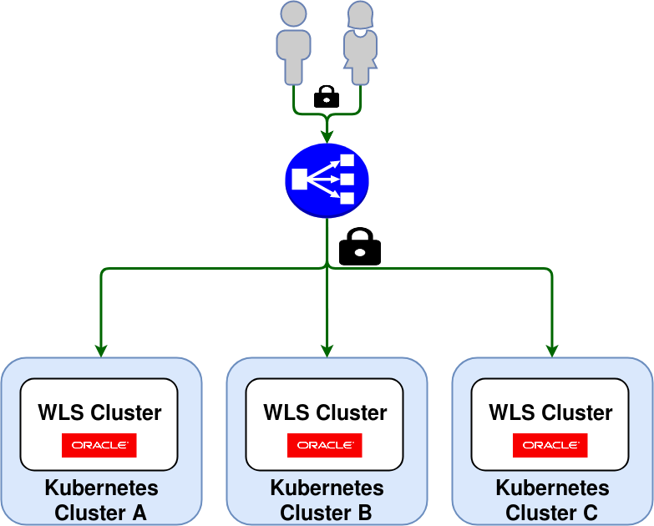
Current Architecture
Kubernetes provisioning
  Private Cloud/OpenStack Magnum
HA Production scenario
  Application spread across 3 Azs
    Weighted Round Robin
  Canary deployments
Persistent Storage
  Logs
  Application binaries
Notes:
Gitlab as main point

Slide 10
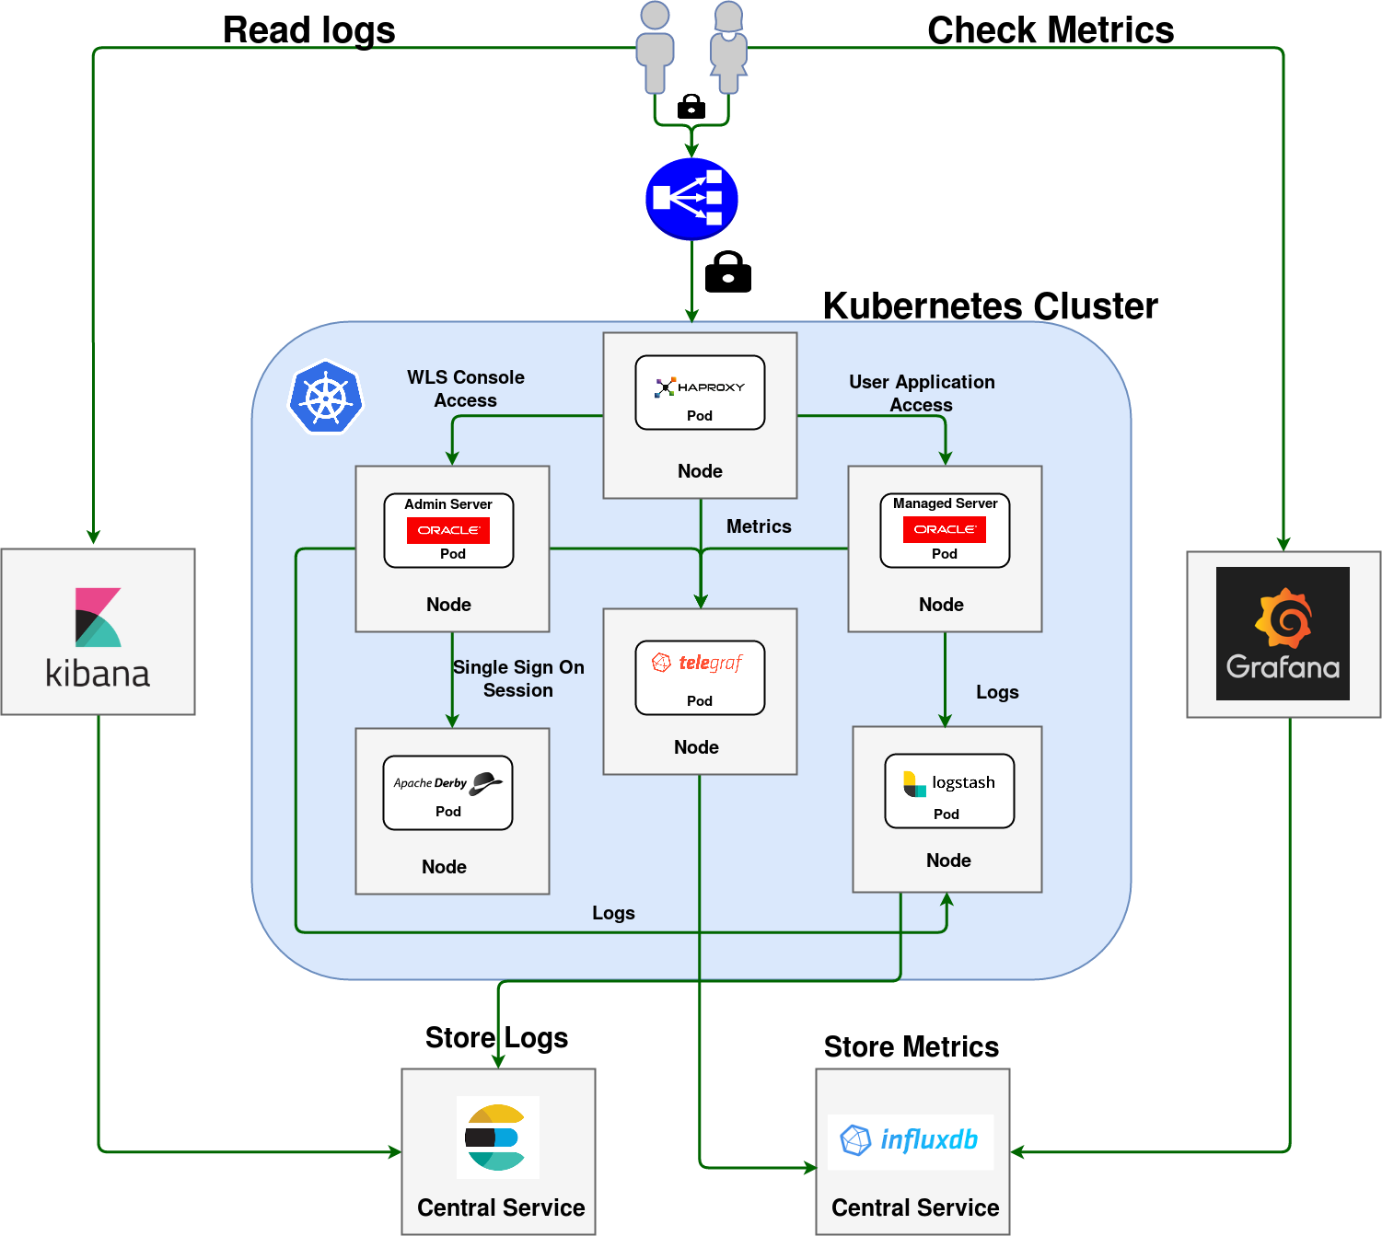
Current Architecture
Gitlab
  Docker Image Registry
  CI/CD pipelines
One application per namespace

Slide 11
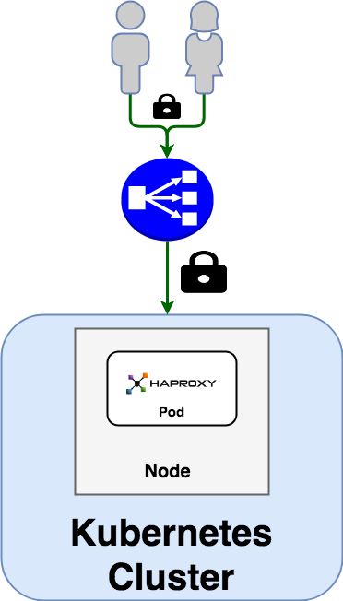
Load Balancer
HA External Load Balancer
  Pacemaker & Corosync
Ingress HAProxy
  The only point of access
  No LoadBalancer service type
Prevent unauthorized access
  No firewall
  Share a secret
Discriminate traffic based on url

Slide 12
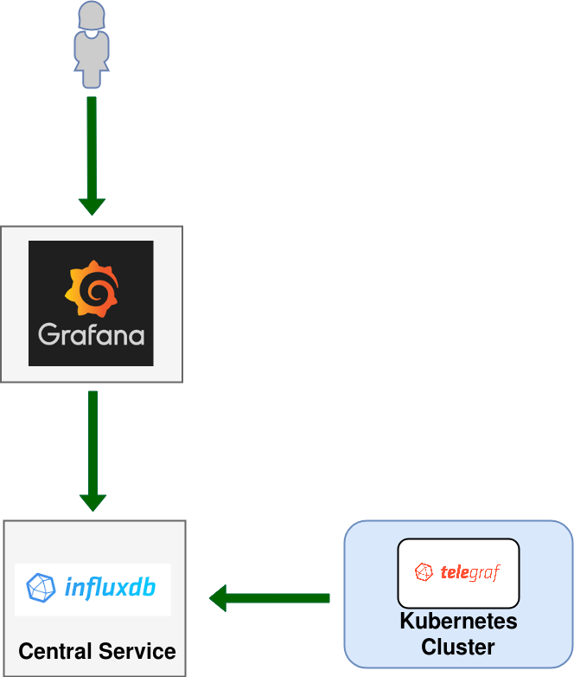
Metrics
CERN IT DB Infrastructure in containers:
  Jolokia
    Java agent
  Telegraf
    Shipper
CERN IT Central Services
  InfluxDB
  Grafana ( via Openshift )

Slide 13
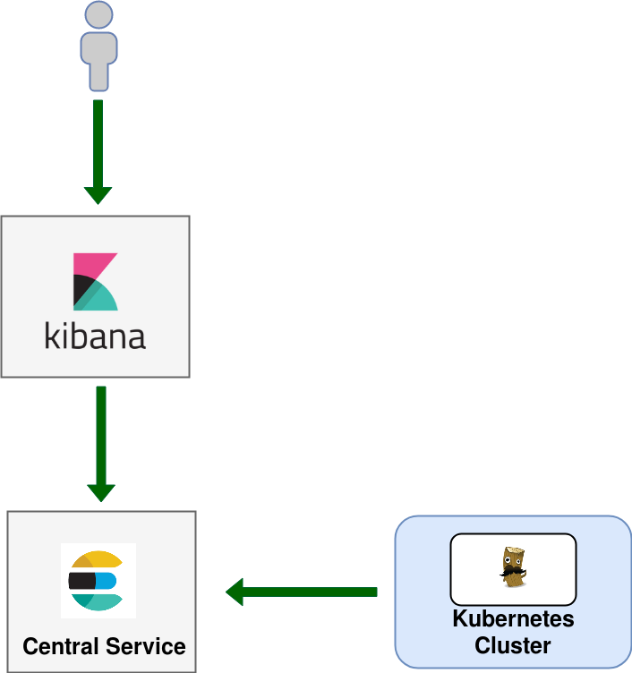
Logging
IT DB Infrastructure in containers:
  Filebeat
    Shipper
  Logstash
    Filtering
    Shipper
IT Central Services
  ElasticSearch Engine
  Kibana

Slide 14
WebLogic docker image structure
cerndb-base-image
wls-base
wls-server
wls-db
CERNDB-BASE-IMAGE
  CC7
  Utilities
WLS-BASE
  Custom WebLogic rpm
  JDK rpm
WLS-SERVER
  WebLogic Server ( Admin or Managed )
WLS-DB
  Derby database

Slide 15
WebLogic domain configuration
WebLogic Deploy Tooling ( WDT )
  Faster
    Decreases sensitively our configuration time
  Domain config in YAML file.
  Configuration at runtime
  Works with different WebLogic versions
    12.1.3
      Problem related to Single Sign On configuration
        Bug in WLST
JSON file
  Portable
  Needs to be adapted to WDT

Slide 16
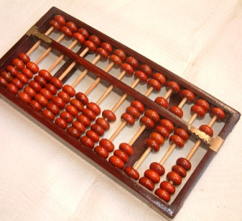
Numbers
3 Kubernetes cluster
  DEV and TEST applications
  20 nodes ( 15GB, 2 cores ) X cluster

Slide 17

Challenges
MENTALITY
  SSH
  Transaction is slow
  People don’t trust
    Took many months to try it
      They are pushing to move
Technical
  Legacy Application
    No session replication
    Rely on IPs
  Secrets
    Passwords
    Certificates
https://hackernoon.com/13-major-challenges-faced-while-building-a-community-experts-roundup-e3a59aa28fbf

Slide 18

https://www.promisec.com/free-demo/

Slide 19
Next steps
Migration of dev/test environments to Kubernetes (ongoing)
EOL WLS 12.1.3 in November 2019
  12.2.1.3 WebLogic only in Kubernetes
Disaster Recovery on the Cloud ( OCI )
  Container Engine for Kubernetes
Delegation of actions
  Allow users to interact with K8S clusters
Prometheus
  Alerting
  Container Native
  WebLogic Exporter
Define upgrading procedures for Kubernetes Cluster
Tomcat on Kubernetes

Slide 20
Lessons Learned
Developer mentality challenge
WebLogic( any application servers ) can run on containers
  WebLogic Kubernetes Operator good way to start
Kubernetes standard de facto
Security
  No root user
  Resources isolation
  Build our own image ???
All that glitters is not gold
  Everyday new tools
    Not jump too fast on them

Slide 21
Issues
WebLogic image too big
  It would be nice to have it modular
Readiness probe 12.2.1.3
Patching WLS in Docker image
Encrypt with WebLogic seed

Slide 22
Acknowledgement
JEEDY Team
  Lukas Gedvilas
  Theodoros Rizopolous
  Thomas Holene Loekkeborg
  Luis Rodriguez Fernandez
  Borja Aparicio Cotarelo
  Aimilios Tsouvelekakis
  Artur Wiecek
Monica Riccelli and Oracle WebLogic Kubernetes Operator Team

Slide 23
QUESTIONS?
antonio.nappi@cern.ch

