Slide 1
CSC for Service Owners
How to use the CERN Service Catalogue
maintenance tool

Slide 2
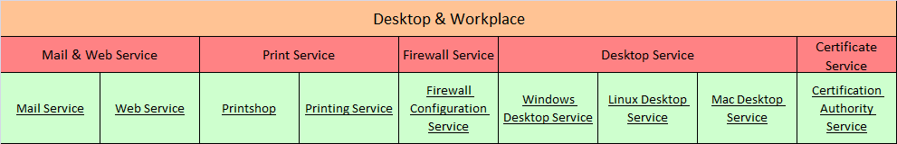
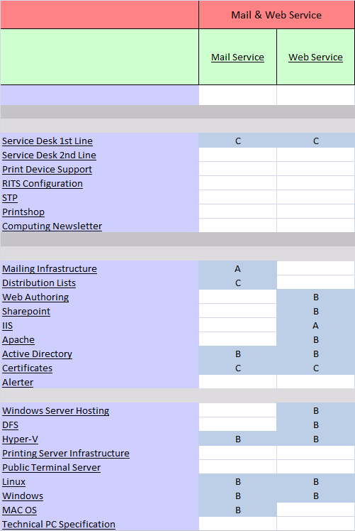
CERN Service Catalogue
The CERN Service Catalogue is structured into
4 main levels
1. Service Area
2. Customer Service
3. Service Elements
4. Functional Service Elements

Slide 3
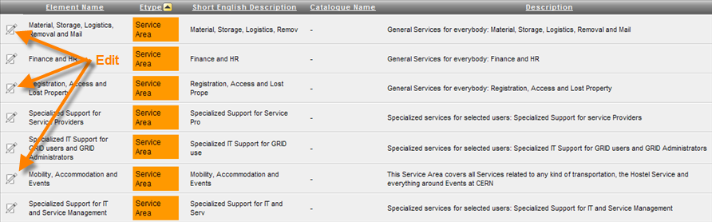
You are Service Catalogue Manager
As a Service Manager, your main role is to maintain the catalogue structure and to update the information relevant to the Service area level.
The Element search will provide you with the list of all elements, you may want to filter by type.

Slide 4
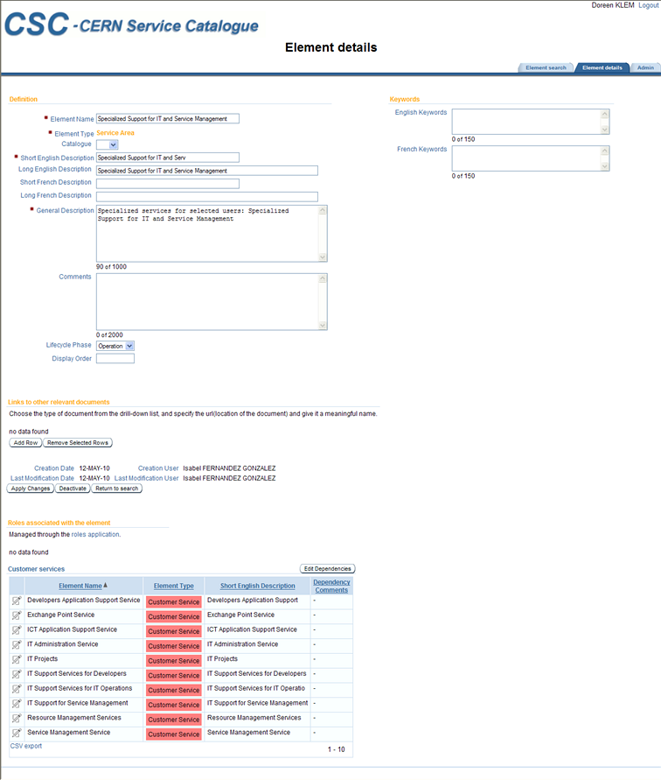
Full overview of the Service Area page

Slide 5
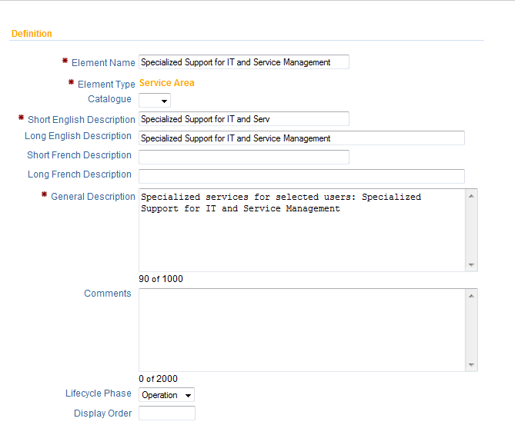
What information needs to be added at the
Service Area level?
Definitions
Element name
This is the unique identifier and you can change it.
Element type
Is set only once at the creation of the element.
Catalogue (for future use)
Short English description
This is the service area short name as it will be published in the Service Catalogue web portal. You can change the description if needed.
Long English description
This is the service area long name as it appears in the portal. You can change the description if needed.

Slide 6
What information needs to be added at the
Service Area level?
Definitions
Short/Long French description
(for future use)
General description
Provide an explanation of what the customer service does in one or two explicit sentences. (If necessary you can add another one). This information will appear on the portal.

Slide 7
What information needs to be added at the
Service Area level?
Definitions
Comments
Used internally only to communicate with the service managers, own reminders. The content entered here will not be published.
Lifecycle Phase (for future use)
The default value used now from the list available is ‘operation’.
Display order (for future use)

Slide 8
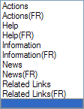
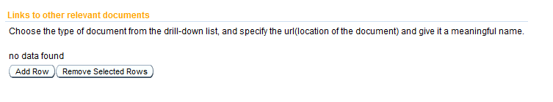
What information needs to be added at the
Service Area level?
Links to other relevant documents
Here you can enter links to relevant sources related to the service.
Type
You can have different types of documents.
Actions: start of new applications Help: Help information (will be indicated as such on the web portal)
Information: any information related to the service.
News: news items (will be indicated as such)
Related links: links which are not part of the service but are within the same area.
For example links to hotels in the region.

Slide 9
What information needs to be added at the
Service Area level?
Links to other relevant documents
URL
Enter the location of the document in the ‘Url’ field.
Description
Give a meaningful name to the document in the ‘Description’ field as this is what people will see on the portal as a hyperlink. When clicking on this hyperlink they will arrive at the url you have specified.
Save & Navigation
TO SAVE the information you have entered so far, click on

Slide 10
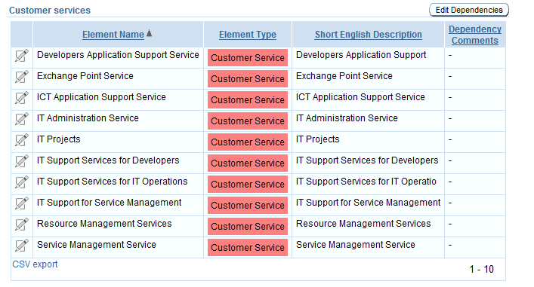
What information needs to be added at the
Service Area level?
Service structure
Shows the Customer Services included in this Service Area. The “edit dependencies” button will allow the Service Catalogue Manager to link Service Area to its Customer Services.

Slide 11
You are Service Owner
You will be able to visualize information within the Service Area but you will not be able to modify this information as only the Service Manager can do it.
Your role is to maintain the service catalogue information for the Customer Service(s) and Service Element(s) you are responsible for.

Slide 12
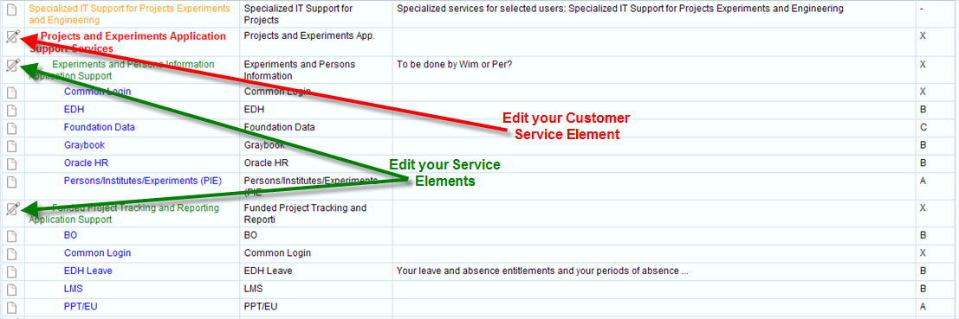
Service Owner overview
When connecting to the CSC tool
You can edit only the elements appearing with the pencil icon. The rest is visible as read-only mode.
The customer service edit part will show as follows: you see the service level above (service area) and the service level below (service elements).

Slide 13
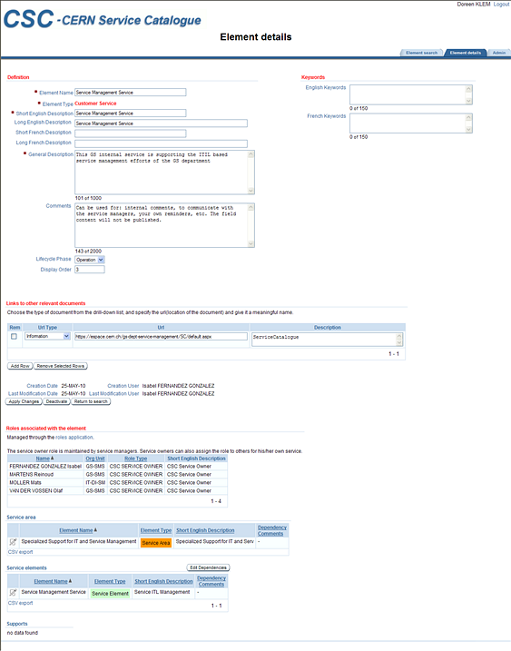
Customer Service page

Slide 14
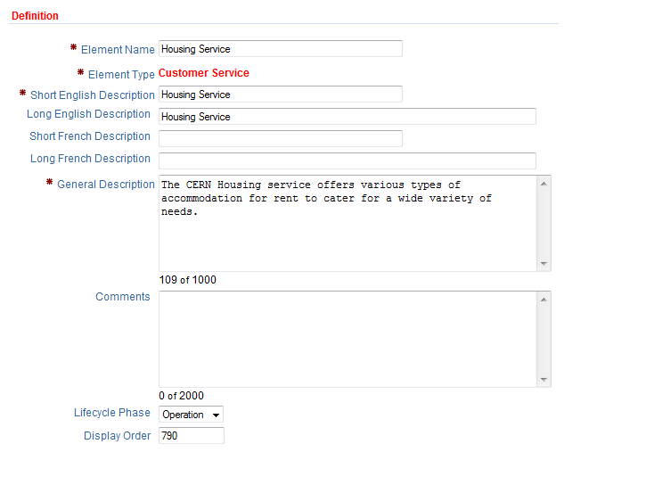
What information needs to be provided at the
Customer Service level?
Definitions
Element name
This is the unique identifier and you should not change it. If required you will need to consult the Service Catalogue Manager team.
Element type
Is set only once at the creation of the element
Short English description
This is the Customer Service short name as it appears in the portal. You can change the description if needed.
Long English description
This is the Customer Service long name as it appears in the portal. You can change the description if needed

Slide 15
What information needs to be provided at the
Customer Service level?
Definitions
Short/Long French description
(for future use)
General description
Provide an explanation of what the customer service does in one or two explicit sentences.
(If necessary you can add another one). This information will appear on the portal.
Comments
Is used internally only to communicate with the service managers, own reminders. The content entered here will not be published.
Lifecycle Phase (for future use)
The default value used from the list of value is ‘operation’.
Display order (not used)

Slide 16
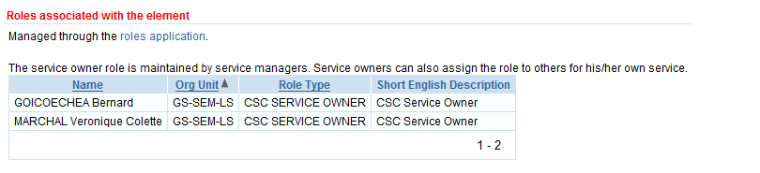
What information needs to be provided at the
Customer Service level?
Roles
The Service Owners and deputies roles should only be maintained by the Service Catalogue Managers.
Contact them for changes to the service owner role.

Slide 17
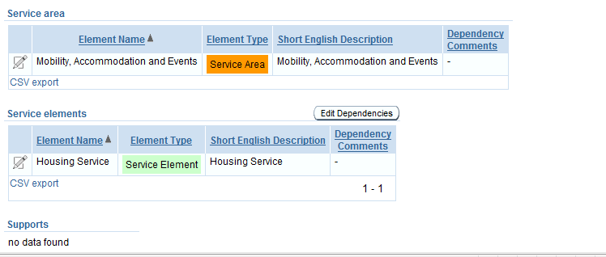
What information needs to be provided at the
Customer Service level?
Service Structure
Under the Service area you will find the name of the area your customer service is attached to.
The Service Element block lists the service element(s) that are part of your customer service.

Slide 18
What information needs to be provided at the
Customer Service level?
Service Structure
The Supports block list other elements supported by this customer service.
The Service structure is maintained by the Service Catalogue Managers.
Contact them for changes to the service structure.

Slide 19
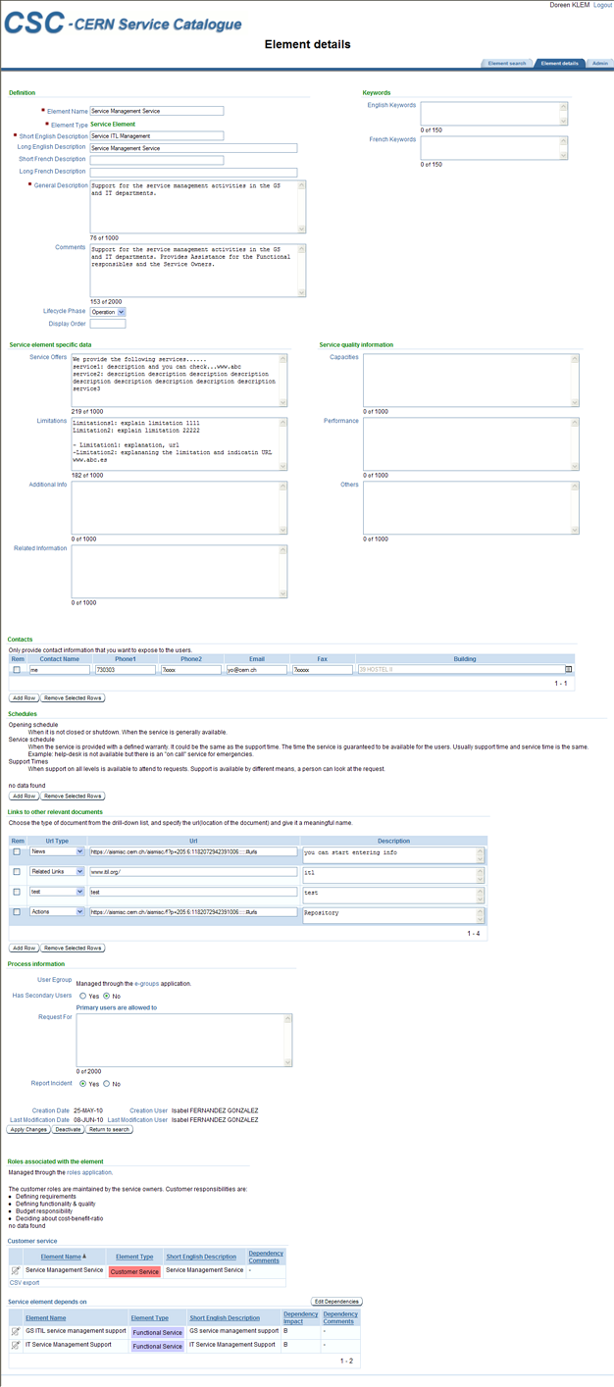
Overview of Service Element page

Slide 20
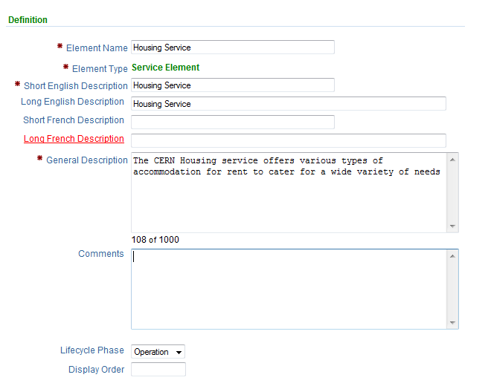
What information needs to be added at the
Service Element level?
Definitions
Element name
This is the unique identifier and you should not to change it.
Element type
Is set only once at the creation
of the element.
Short English description
This is the service element short name as it appears in the portal.
Long English description
This is the service element long name as it appears in the portal.

Slide 21
What information needs to be added at the
Service Element level?
Definitions
Short/Long French description (for future use)
General description
Provide a clear explanation of what the service does in one or two explicit sentences.(If necessary you can add another one). This information will appear on the portal.

Slide 22
What information needs to be added at the
Service Element level?
Definitions
Comments
Only for internal use. If you are unclear about something you can enter it here. The content will not be published.
Lifecycle Phase (for future use)
The default value used from the list of value is ‘operation’.
Display order (not used)

Slide 23
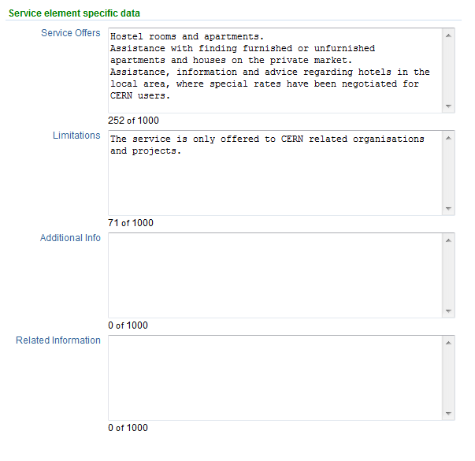
What information needs to be added at the
Service Element level?
Service element specific data
Service Offers
List of things and activities that are offered at a general level such as hotel rooms, apartments, consultancy.
Each phrase entered here will appear as a bullet point on the portal.
So NO empty lines and only VERY SHORT sentences straight to the point.

Slide 24
What information needs to be added at the
Service Element level?
Service element specific data
Limitations
A short description of known limitations or restrictions to delivering the service.
If limitations are known, please provide the information using the ‘link to relevant documents’ part.

Slide 25
What information needs to be added at the
Service Element level?
Service element specific data
Additional info/Related information
Any additional information or related information that could be useful to understand how to use the service.
This information will be displayed on the portal.
Only use this fields if you do not have this information available in a link. (see links below).

Slide 26
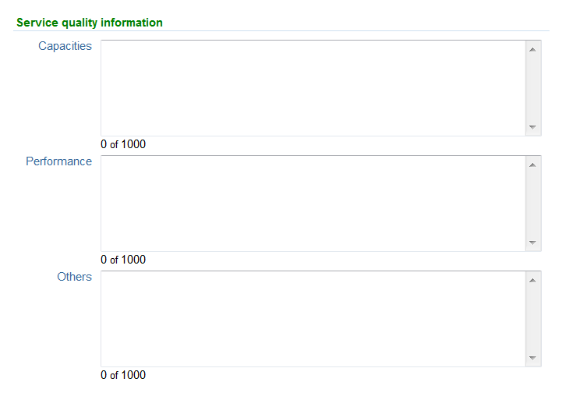
What information needs to be added at the
Service Element level?
Service quality information
Capacities (optional)
Indicate the number of resources you have available for this service. How many are you offering? For example, how many floating licenses do you have? How many single rooms or double rooms do you have? Anything that can be counted.
Performance (optional)
Only put what you want people to see related to performance. For example, access card made within 4 working hours.
Others (optional)
Anything specific about the quality of a service. It has to be measurable.

Slide 27
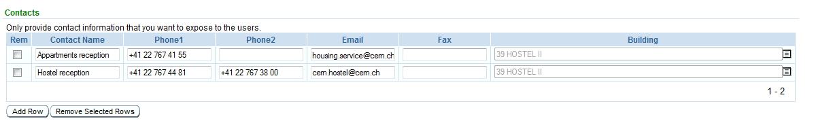
What information needs to be added at the
Service Element level?
Contacts
Contact information
The service desk will be the contact entry point for all services.
Provide any other contact information if your service has a specific contact point that you would like to expose to everybody at CERN.

Slide 28
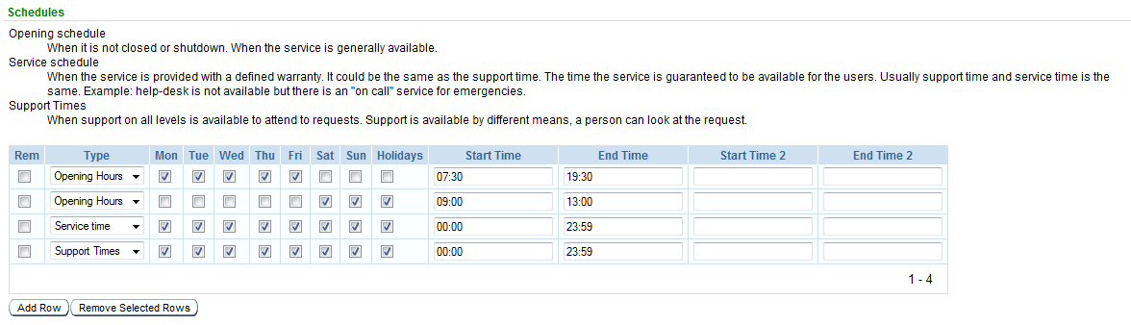
What information needs to be added at the
Service Element level?
Schedules
You can have multiple lines to compose a single schedule.. If you need to enter different hours for Sunday and Holidays, you can enter two different lines for these two days.

Slide 29
What information needs to be added at the
Service Element level?
Schedules
Operational time/Opening hours (mandatory)
When is the service normally running? For example an application service is running 24 hours a day.
Service Time (mandatory)
Is when quality and performance are measured ,when the service is running. Quality of the service is guaranteed.
Support Time (mandatory)
When support is available on all levels to attend to requests. For example from 8.30 to 17.30.

Slide 30
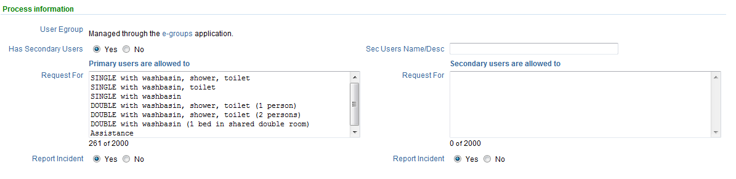
What information needs to be added at the
Service Element level?
Process information
User Egroup (for future use)
Has secondary users
You need to answer ‘Yes’ or ‘No’.
Note that the right half of the image shows up only if YES activated
Primary users are allowed to Request for
Here you can explicitly state what your primary users can ask for. List of all known occurring requests.

Slide 31
What information needs to be added at the
Service Element level?
Process information
Report incident
You have to decide whether the user is allowed to report an incident on the service or not by answering ‘Yes’ or ‘No’.
Secondary users Name/DESC (for future use)
Secondary users are allowed to request for
Here you can explicitly state what your secondary users can ask for. List of all known occurring requests.
The notion of primary and secondary users was explained in the ITIL Service Owner training sessions, remember the example with the bus company, the primary user is the bus driver, the secondary are the bus passengers.

Slide 32
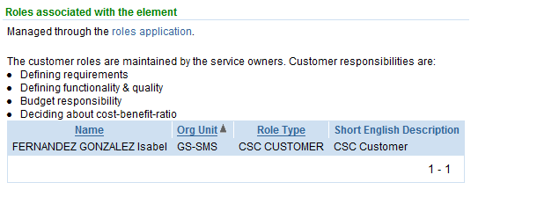
What information needs to be added at the
Service Element level?
Roles
Here you create the customers of your service element level using the roles application.

Slide 33
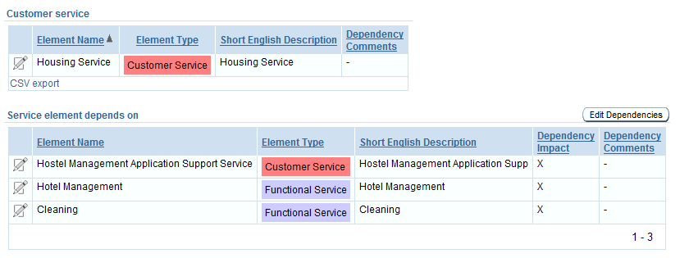
What information needs to be added at the
Service Element level?
Service Structure
Under the “Customer Service” you will find the name of the customer service your service element is attached to.
The” Service Element depends on” block lists the customer service(s) and functional service element(s) that are supporting this element
The Service structure is maintained by the Service Catalogue Managers.
Contact them for changes to the service structure.

Slide 34
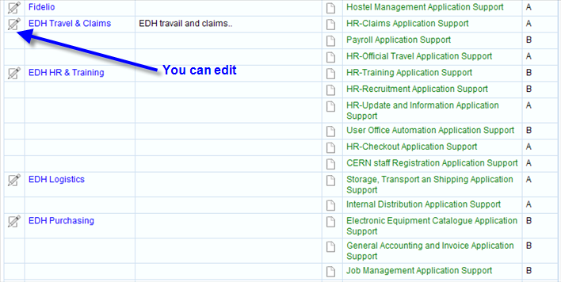
You are Functional Service Manager
With this role you are responsible to keep the functional elements information up-to-date.
When you connect to the CSC tool this is the overview you will see:

Slide 35
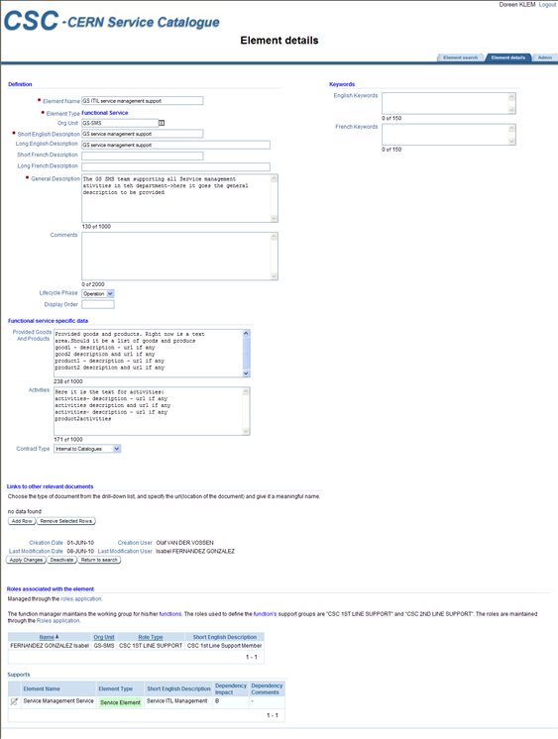
Overview of the Functional Service page

Slide 36
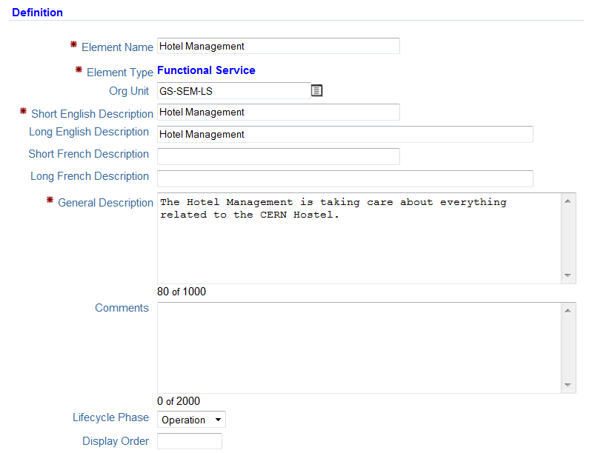
What information needs to be added at the
Functional Element level?
Definitions
Element name
This is the unique identifier.
Element type
Is set only once at the creation of the element.
Org Unit
This is the Department, Group and Section Delivering the service.
Short English description
This is the functional element short name as it appears in the portal.
Long English description
This is the functional element long name as it appears in the portal.

Slide 37
What information needs to be added at the
Functional Element level?
Definitions
Short/Long French description
(for future use)
General description
Provide an explanation of what the functional element does in one or two explicit sentences. (If necessary you can add another one). This information will appear on the portal.

Slide 38
What information needs to be added at the
Functional Element level?
Definitions
Comments
Is used internally only to communicate with the service managers, own reminders. The content entered here will not be published.
Lifecycle Phase (for future use)
The default value used from the list of value is ‘operation’.
Display order (not used)

Slide 39
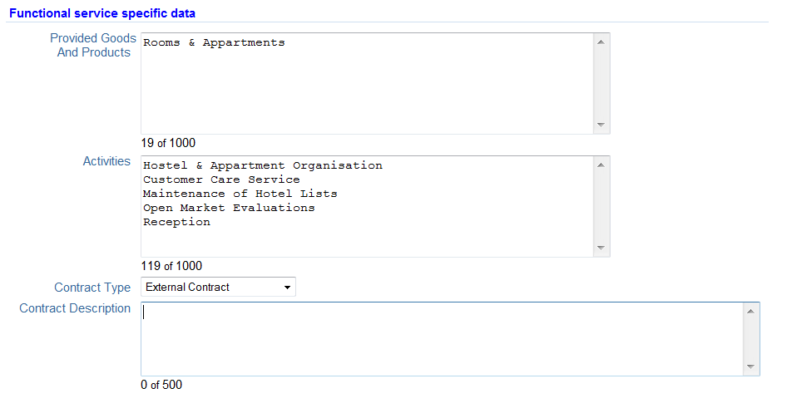
What information needs to be added at the
Functional Element level?
Functional service specific data
Provided Goods and Products
Here you name the list of applications or products provided by this service.
Activities
List of responsibilities such as maintenance, support, development or purchasing.

Slide 40
What information needs to be added at the
Functional Element level?
Functional service specific data
Contract Type (functional element type)
From the list you can choose one of the following:
  Internal to Catalogues:
  Defines a functional service as fully supported integral part of the catalogue.
  External (but still at CERN):
  Describes a CERN functional service that is NOT part of the catalogue but is described here to identify the function and its dependencies.
  External contract:
  Describes a Functional service that CERN acquires from a contractor. The management of this functional service is generally done by the CERN contract manager of this item.
  Note that the Contract Description field shows up only if External contract is selected
Contract description
Specify the contract number and description.

Slide 41
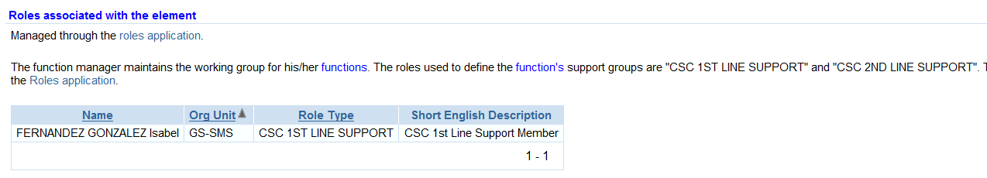
What information needs to be added at the
Functional Element level?
Roles associated with the element
You will be asked to maintain the roles associated to the functional element. The roles used for the function’s support group are ‘"CSC 1ST LINE SUPPORT"(only if you have a specific 1st line support then mention it here) , "CSC 2ND LINE SUPPORT” ,“CSC 3ND LINE SUPPORT” and “CSC FUNC SERVICE MGR”.
Up to you to designate the appropriate person to fulfill these roles.

Slide 42
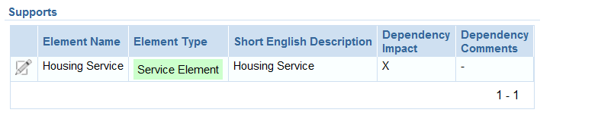
What information needs to be added at the
Functional Element level?
Service Structure
Under the “Supports” tab you will find the name of the service element(s) that depend on your functional service.

Slide 43
Together
Everyone
Achieves
More
THANK YOU!

