Slide 1
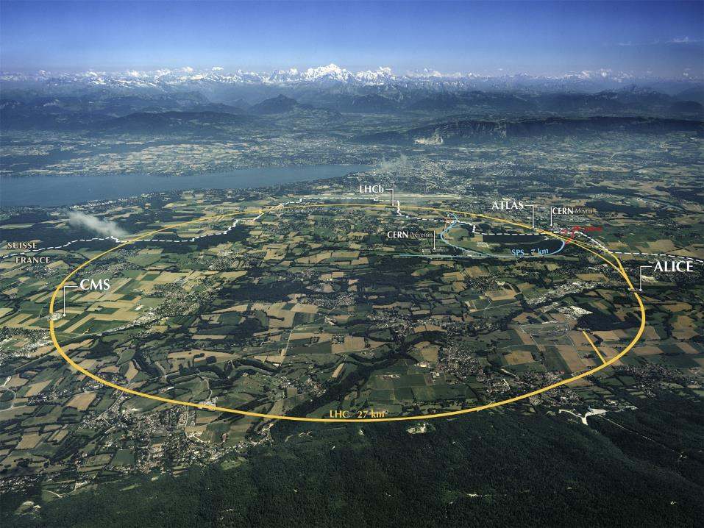
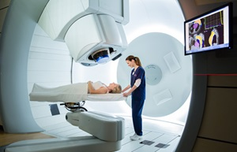
Le CERN, les accélérateurs de particules, et le traitement du cancer avec les accélérateurs
Introduction – PTMC 8 Mars 2021
Maurizio Vretenar CERN ATS/DO

Slide 2


CERN: founded in 1954: 12 European States
“Science for Peace”
Today: 23 Member States
Employees: ~2 700 staff, 800 fellows
Associates: ~12 400 users, 1 300 other
2
Notes:
2
----- Meeting Notes (09/01/2013 14:16) -----
nnn

Slide 3
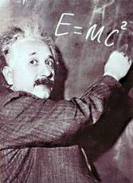
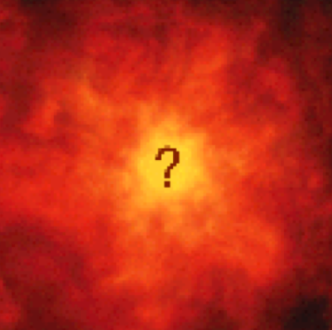
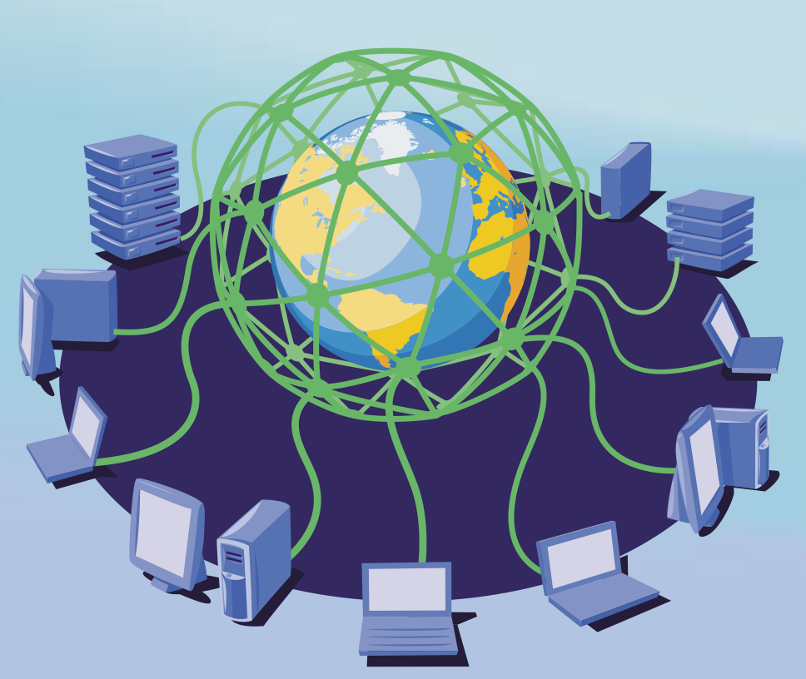

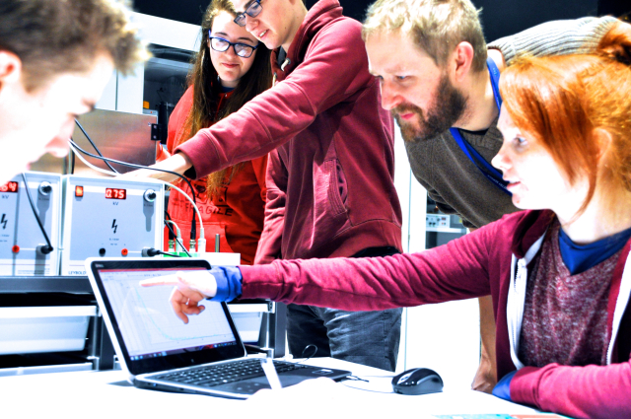
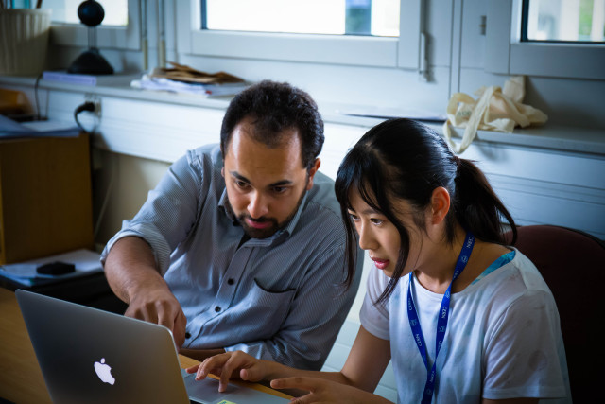
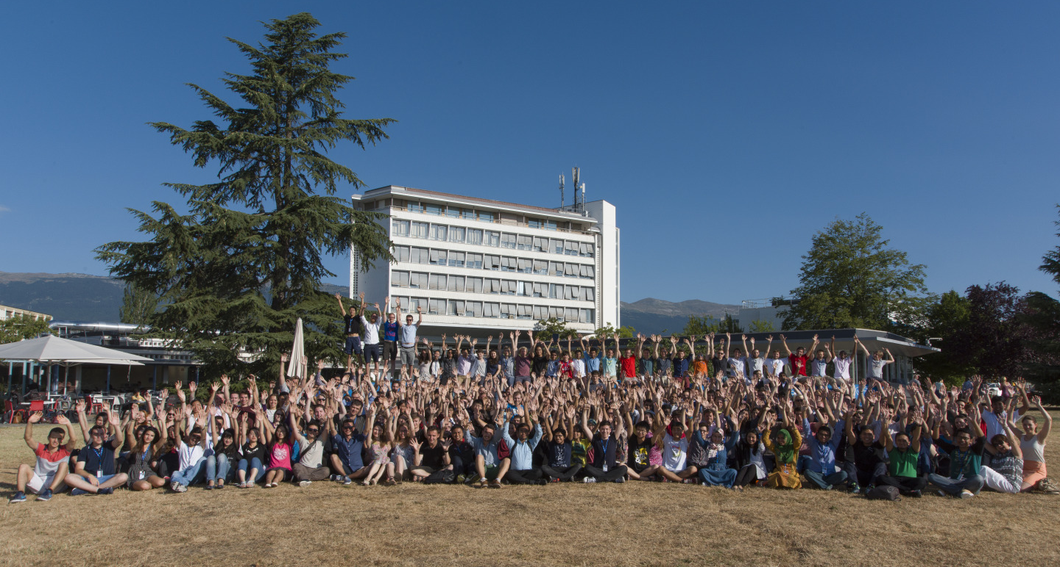
The Mission of CERN
Push back the frontiers of knowledge
E.g. the secrets of the Big Bang …what was the matter like within the first moments of the Universe’s existence?
Develop new technologies for accelerators and detectors
Information technology - the Web and the GRID
Medicine - diagnosis and therapy
Train scientists and engineers of tomorrow
Unite people from different countries
and cultures
Notes:
3

Slide 4
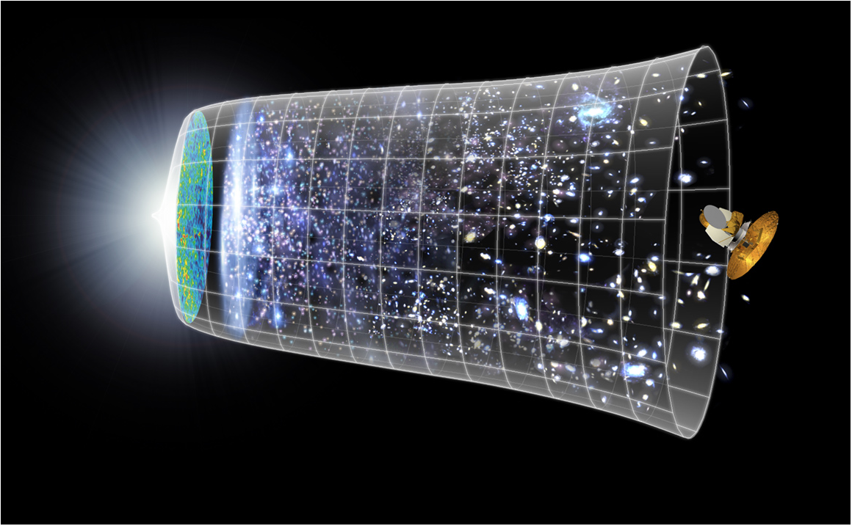
Our Scientific Challenge:
to understand the very first moments of our Universe after the Big Bang
Big Bang
WMAP
380,000 years

Slide 5

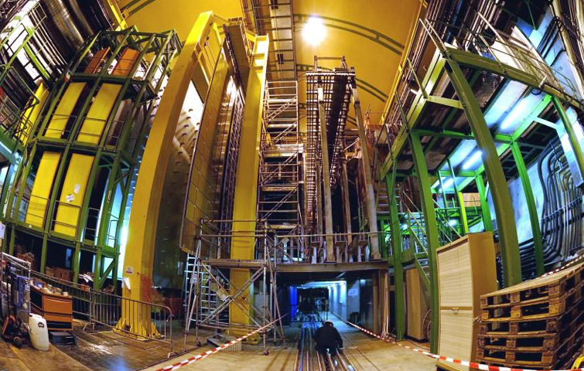


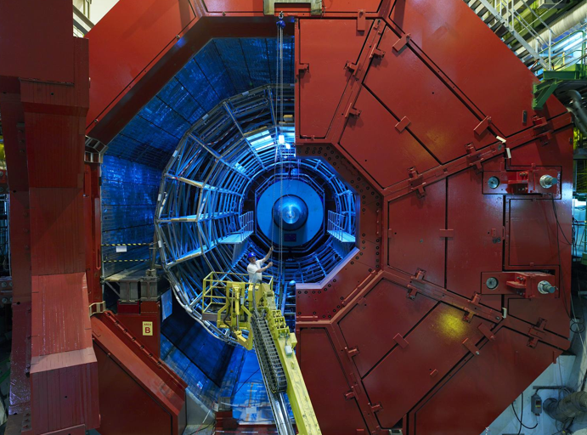

LHCb
CMS
ATLAS
ALICE
LHC ring:
27 km circumference

Slide 6
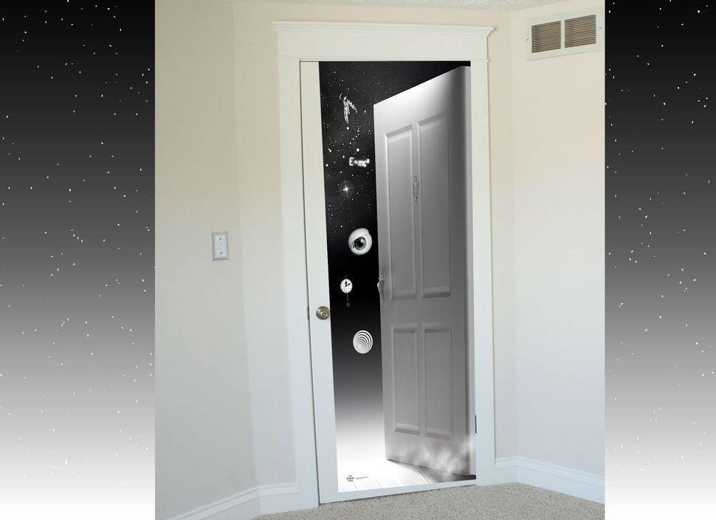
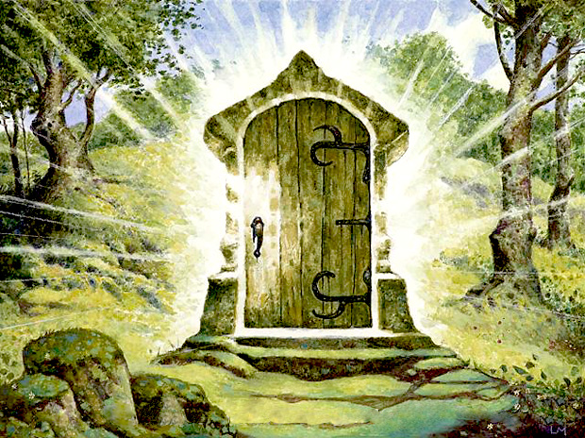
Particle accelerators are our door to access the subatomic dimension… and exploit the atom and its components

Slide 7
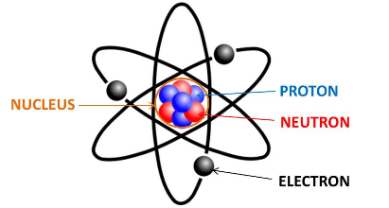
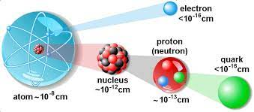
Where do we find the particles?
Inside the atoms!
We can use electrons (very light) or protons (1836 times heavier).
For the Large Hadron Collider, we prefer the heavier protons

Slide 8

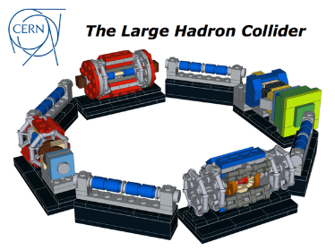
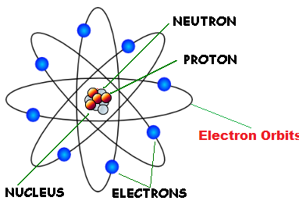

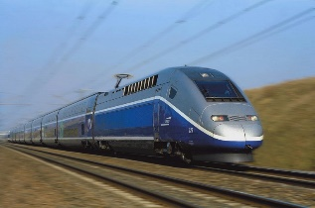
Accelerators: our key to enter the subatomic world
When we extract particles from an atom (protons, electrons) and we accelerate them we concentrate enormous amounts of energy in tiny volumes
proton
 | Proton out of LHC | 150g Yoghurt | TGV train
Energy | 1.1 10⁻⁶ J | 5 10⁵ J | 3.6 10⁸ J
Energy density | 5.3 10³⁸ J/m³ | 3.3 10⁹ J/m³ | 1.5 10¹¹ J/m³
Type of energy | Kinetic Subatomic scale | Chemical Macroscopic scale | Kinetic Macroscopic scale
Energy full LHC beam | 3.6 10⁸ J
Where will this energy go? An accelerated particle sent towards an atom will:
Deliver some energy to the electrons.
Deliver some energy to the nucleus

Slide 9
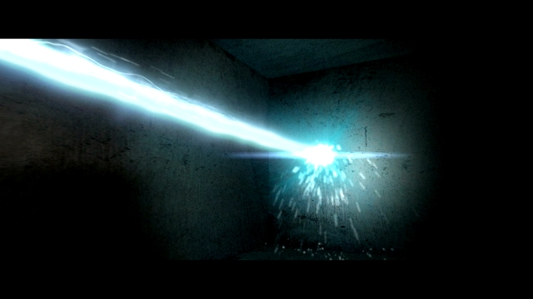
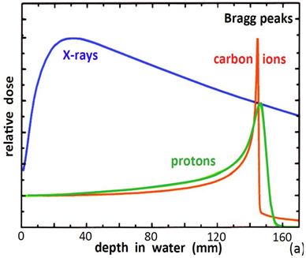
Accelerators can precisely deliver energy
A «beam» of accelerated particles is like a small “knife” penetrating into the matter
A particle beam can deliver energy to a very precisely defined area, interacting with the electrons and with the nucleus.
Particles can penetrate in depth
(different from lasers!).
Particle beams are used in medical and industrial applications,
e.g. to cure cancer, delivering their energy at a well-defined depth inside the body (Bragg peak)

Slide 10
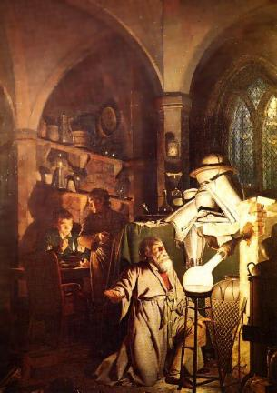
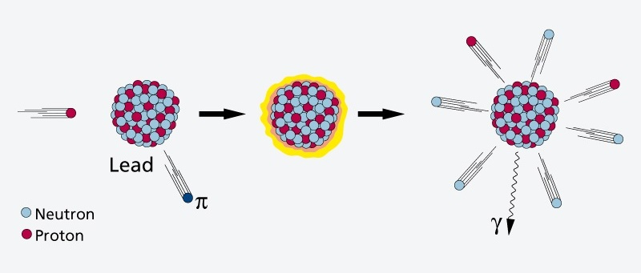
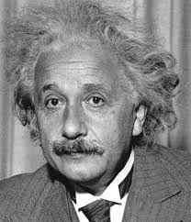
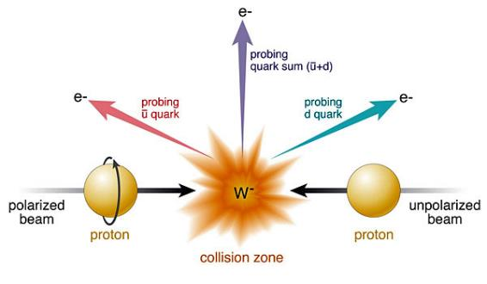
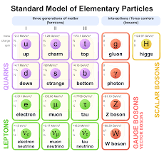
Accelerators can modify the nuclei and create new particles
If the energy is sufficiently high, the particles in the beam transfer energy to the nucleus and its components (and are then scattered, reflected or absorbed).
It’s the dream of the ancient alchemists coming true!
NUCLEAR PHYSICS
Particles in the beam can break and modify the nucleus (and then generate new elements and transform the matter!)
PARTICLE PHYSICS
In the collisions can be generated new particles.
E = m c²

Slide 11
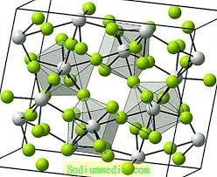
A particle beam in the matter
proton
A particle loses energy very slowly, until the time spent next to an atom becomes short enough to let it lose large fractions of its energy, and then the particle stops.

Slide 12
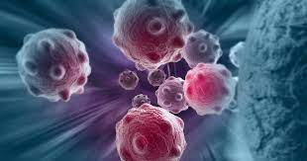
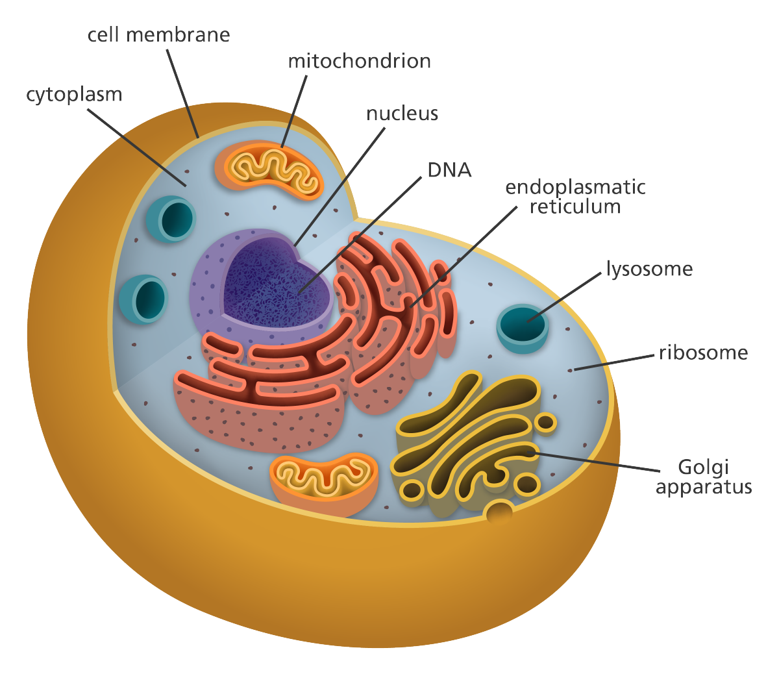
A particle beams in human cells
proton

Slide 13
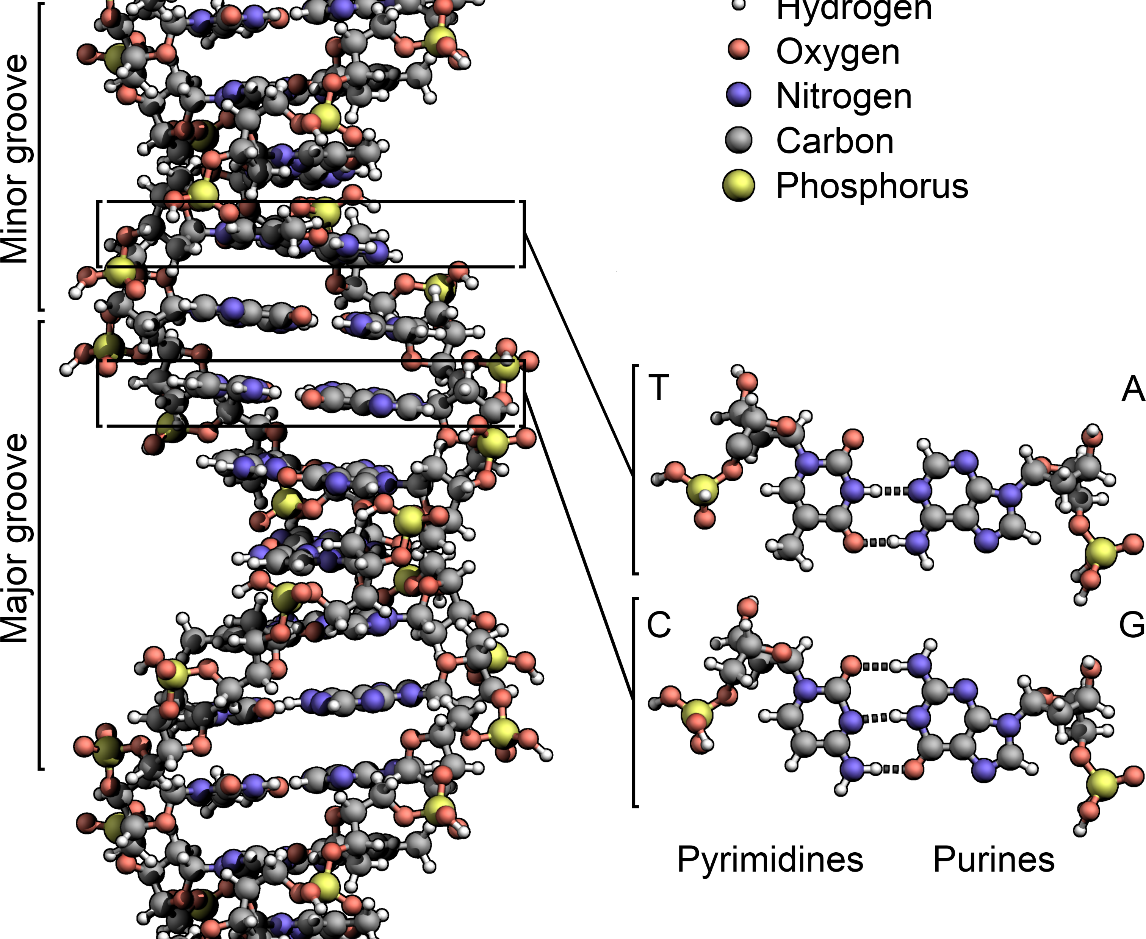
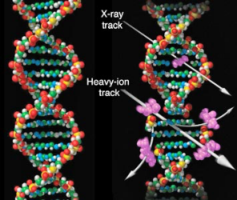
A particle beam can break the DNA and kill a cell

Slide 14
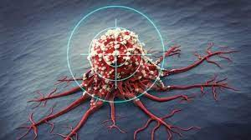
And if the cell has the cancer? Killed!
proton

Slide 15
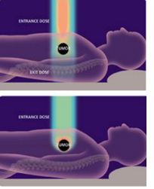
Hadron therapy (protons or ions)
The Bragg peak
Different from X-rays or electrons, protons (and ions) deposit their energy at a given depth inside the tissues, minimising dose to the organs close to the tumour, sparing nearby organs.
Required energy for full-body penetration: 230 MeV protons, 450 MeV/u C-ions.
22,000 patients/year (2018) treated with particle beams, 25,000,000 patients/year with X-rays.
Notes:
Why?

Slide 16
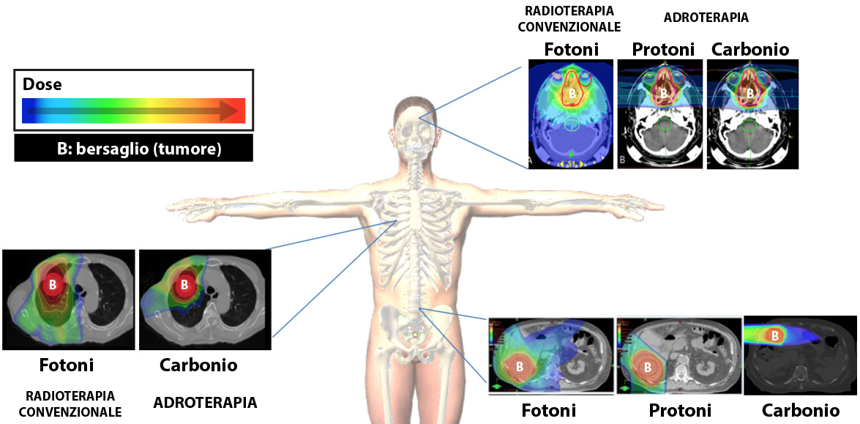
Accelerators for particle therapy
Particle beams realise an old human dream, of “bloodless surgery”: curing the internal part of the body without opening it.
We need to build very precise accelerators that can send the particles ONLY on the cancer and do not damage the surrounding tissues.

Slide 17
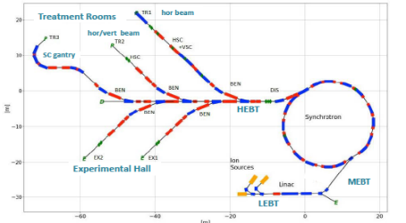
Accelerator option #2: the advanced RT synchrotron
E. Benedetto, M. Sapinski, TERA/SEEIIST
U. Amaldi, TERA
A. Avdic, A. Ibrahimovic, U. Sarajevo
X. Zhang, U. Melbourne
M. Vretenar, CERN
Starting point: the PIMMS design
Improvements:
Higher beam intensity for faster treatment (2x10¹⁰, 20 times higher)
Multiple energy extraction (multiple flat-tops)
Additional fast extraction for FLASH operation
Redesigned linac at higher frequency, for lower cost and parallel isotope production
Multiple particles: p, He, C, O
Optimised layout of beam transport, for both research and therapy

Slide 18
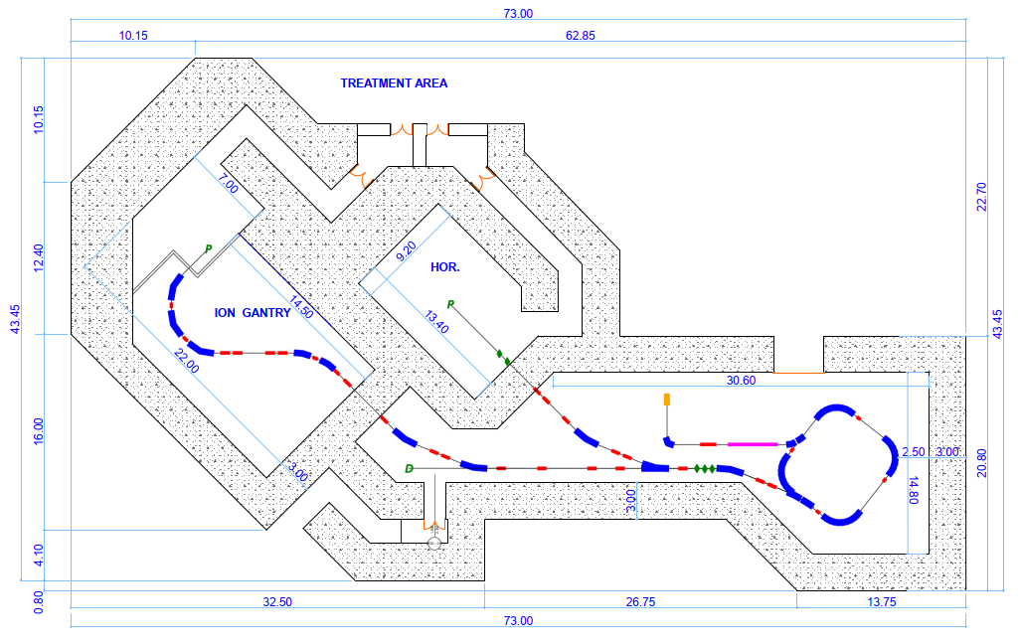
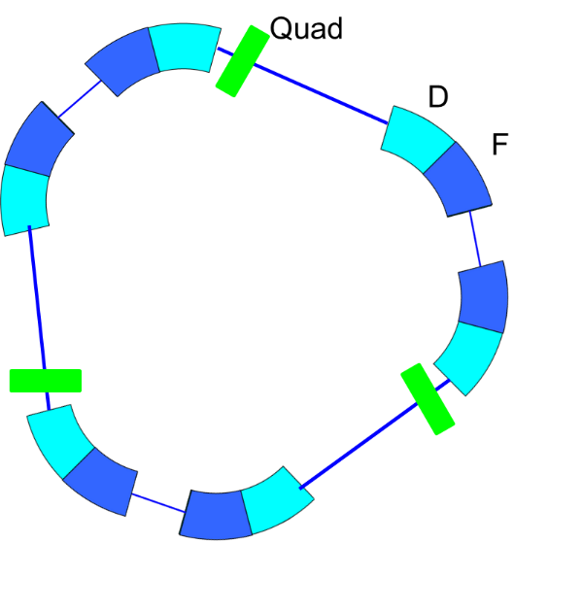
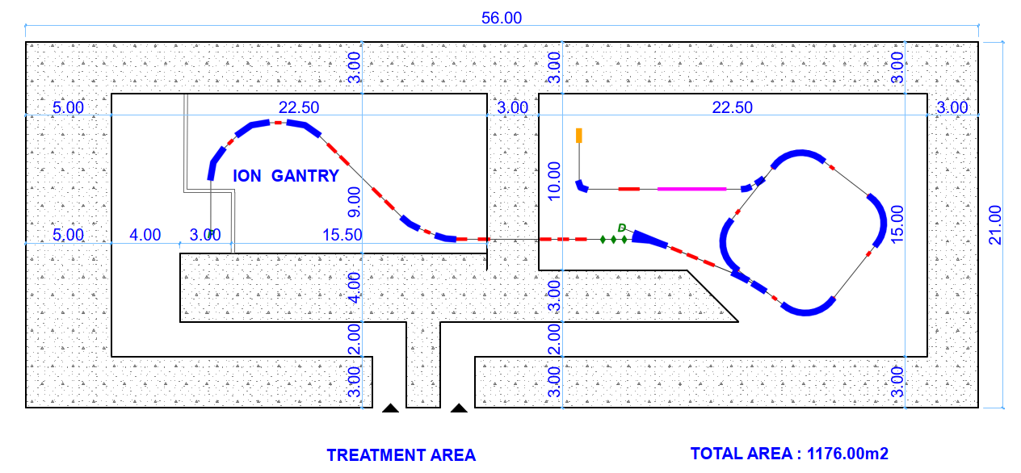
A small superconducting synchrotron for ion therapy
Compact faciliy with 2 rooms
A compact single-room ion therapy facility in about 1,000 m²

Slide 19
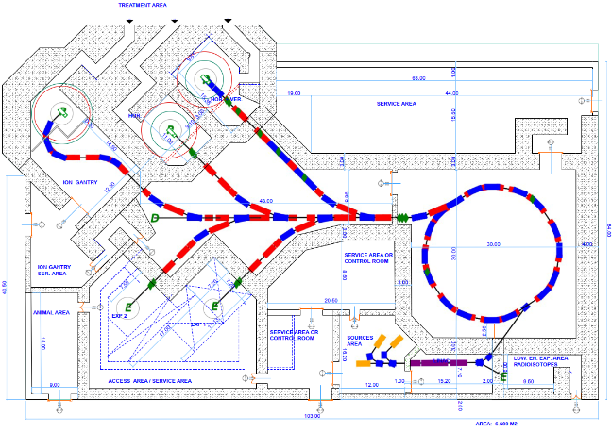
Layout of the complete SEEIIST-type facility
All team, with P. Foka, GSI and D. Kaprinis, Kaprinis Architects
Access for therapy
The synchrotron can be replaced by an SC version if R&D successful
Research and Therapy Facility
(50% daily beam time for research, 50% for therapy)
Equipment room and access to synchrotron
Total 6,600 m²
Target for isotope production
Access for animal testing
Reconfigurable experimental room
Access to experimental room and linac

Slide 20
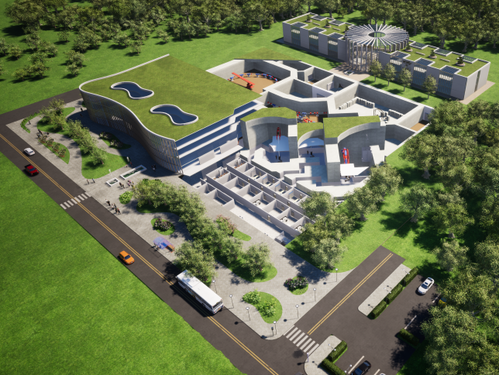
A new medical centre for cancer therapy with ions

Slide 21
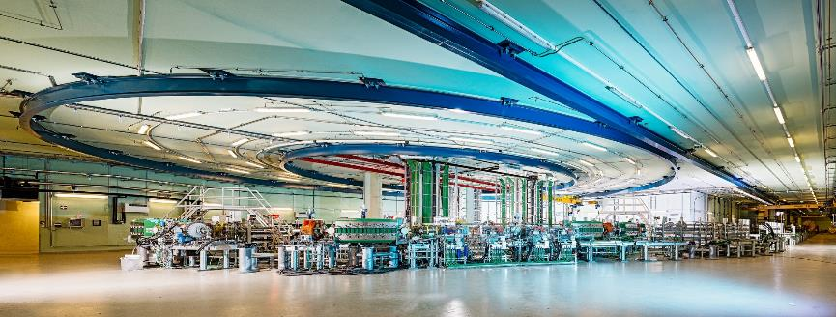
the MedAUSTRON hall
Thank you for your attention

