Slide 1
Testing of magnets and components at cryogenic temperatures, report from TNA WP9¶
Marta Bajko CERN
For the ARIES ANNUAL MEETING APRIL 2021

Slide 2
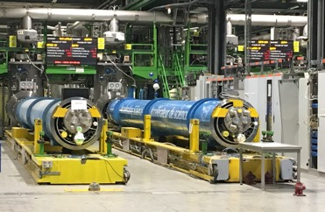
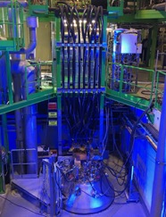
THE STAUS IN April: WP9.1 – The MagNet TNA
  4 projects has been completed by performing tests thanks to the required access
MagNet (@CERN) is operational,
but entering in the phase of SERIES MAGNET TESTING for the HL-LHC project and so
more and more difficult to allocate the projects
Facility | No. of aproved projects | Total no. of projects for which we have engaged Magnet | No. of users till today | Total no. of users for which we have engaged MagNet | No. of given access units | Total no. of access units for which we have engaged MagNet | Total no. of access units after re-distribution*
MagNet | 5 | 8 5 | 27 +3 =30 | 4030 | 1090 | 1,920 | 1300
* This is the agreed engagement of the MagNet after the COVID19 and the extension of ARIES TNA

Slide 3
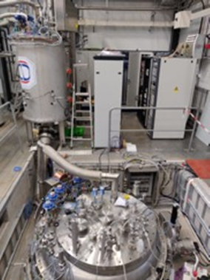
THE STAUS IN April: WP9.2 – The GERSEMI TNA
  4 projects has been completed by performing tests thanks to the required access
GERSEMI (@FREIA) is operational,
and entering in the phase of TESTING also for the HL-LHC project
Facility | No. of aproved projects | Total no. of projects for which we have engaged Magnet | No. of users till today | Total no. of users for which we have engaged MagNet | No. of given access units | Total no. of access units for which we have engaged MagNet | Total no. of access units after re-distribution*
GERSEMI | 5 | 8 5 |  | 5630 |  | 2880 | 1800
* This is the agreed engagement of the GERSEMI after the COVID19 and the extension of ARIES TNA

Slide 4
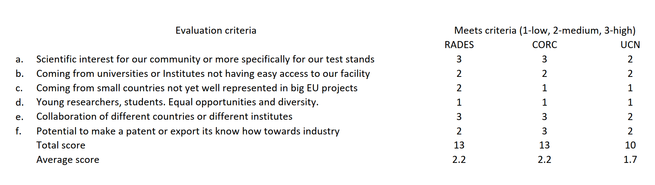
Score vs Evaluation criteria
Latest MagNet Projects
In preparation
DONE
Approved
International User Selection Panel
GianLuca Sabbi LBNL
Tatsu Nakamoto KEK
Roger Ruber GERSEMI

Slide 5
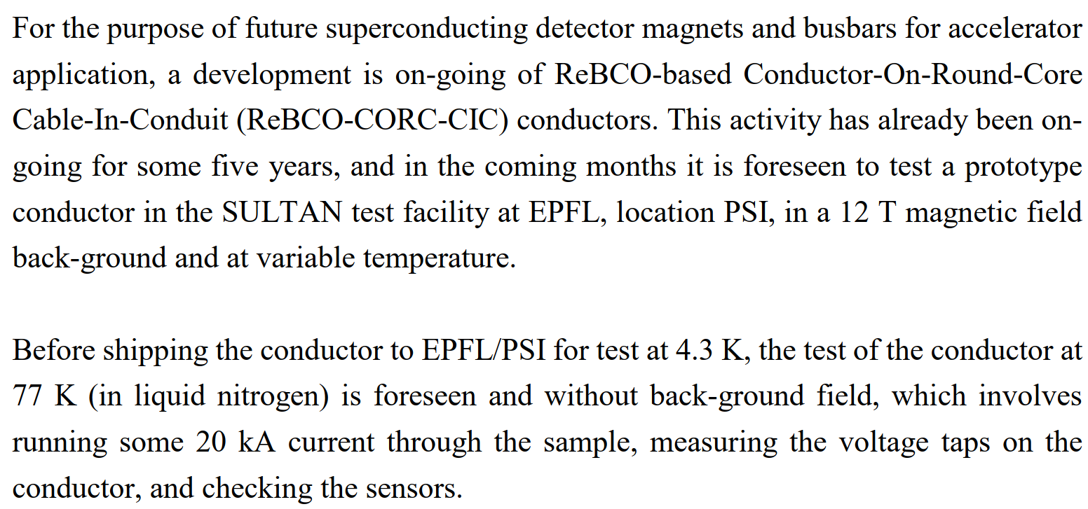
Performed project at CERN
ReBCO-CORC-CIC 77 K test with 20 kA
+ 5 users and aprox + 140 access
It has been performed successfully October-November 2020

Slide 6
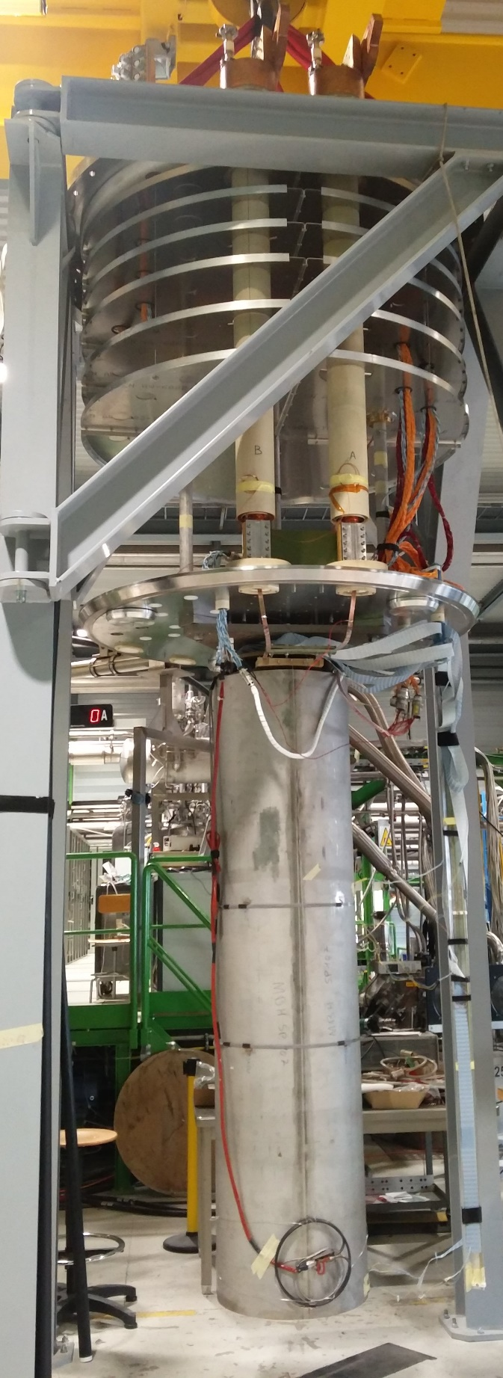
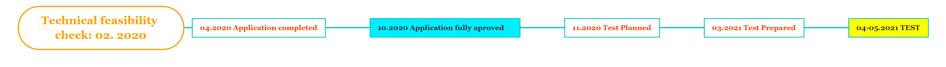
Project at CERN in preparation
RADES
(Relic Axion Detector Exploratory Setup)
is a project with the goal of directly searching for axion dark matter employing custom-made microwave filters in magnetic dipole fields.
SP107
We profit from the 11T dipole HL-LHC model magnet program. The SP107 is a single aperture magnet that has been tested several times in the HFM test stand and cooled down to LHe 6 times. The magnet achieved several times Ultimate performance > 12 T field and powered for 2.5 h in continues manner at Nominal field of 11 T.
+ 12 users and aprox + 760-1000 access

Slide 7
Approved new project at CERN
SUPE Sun
[…] magnet is part of a large ultra-cold neutron source called SuperSUN, which will first be used to search for the electric dipole moment of the neutron and later to measure the lifetime of free neutrons.
This magnet is going to be built by Elytt Energy (Spain) for the ILL (France). ILL is part of EIROforum with CERN.
The goal is to test and train the magnet in a test cryostat before installing them inside the final cryostat.
The magnet consists of a solenoid surrounded by 8 coils inside a yoke. The field will act as a magnetic trap of ultra-cold neutrons (2.1 T max on the perimeter and a few mT on the axis). The 8 NbTi coils will be energised with 432 A and a switch heater will allow us to work in persistent mode. The solenoid, which prevents the loss of neutrons through depolarisation, will be energised with a lower current. We shall test the persistent switches and joints at our facility before testing the coils.
The whole length of the 4 K magnet is a bit more than 3 m and the diameter is ≈ 220 mm. As we shall need space to attach the persistent joints and switches, the instrumentation and the LN2 precool loop, we estimate that we shall need a ≈Ø350 x 4000 mm³ 4 K cylinder.
As for the schedule, Elytt should complete the construction of the magnet in January 2021. The drawings are completed and they are preparing the mockup coil.
We did project approval in October 2020

Slide 8
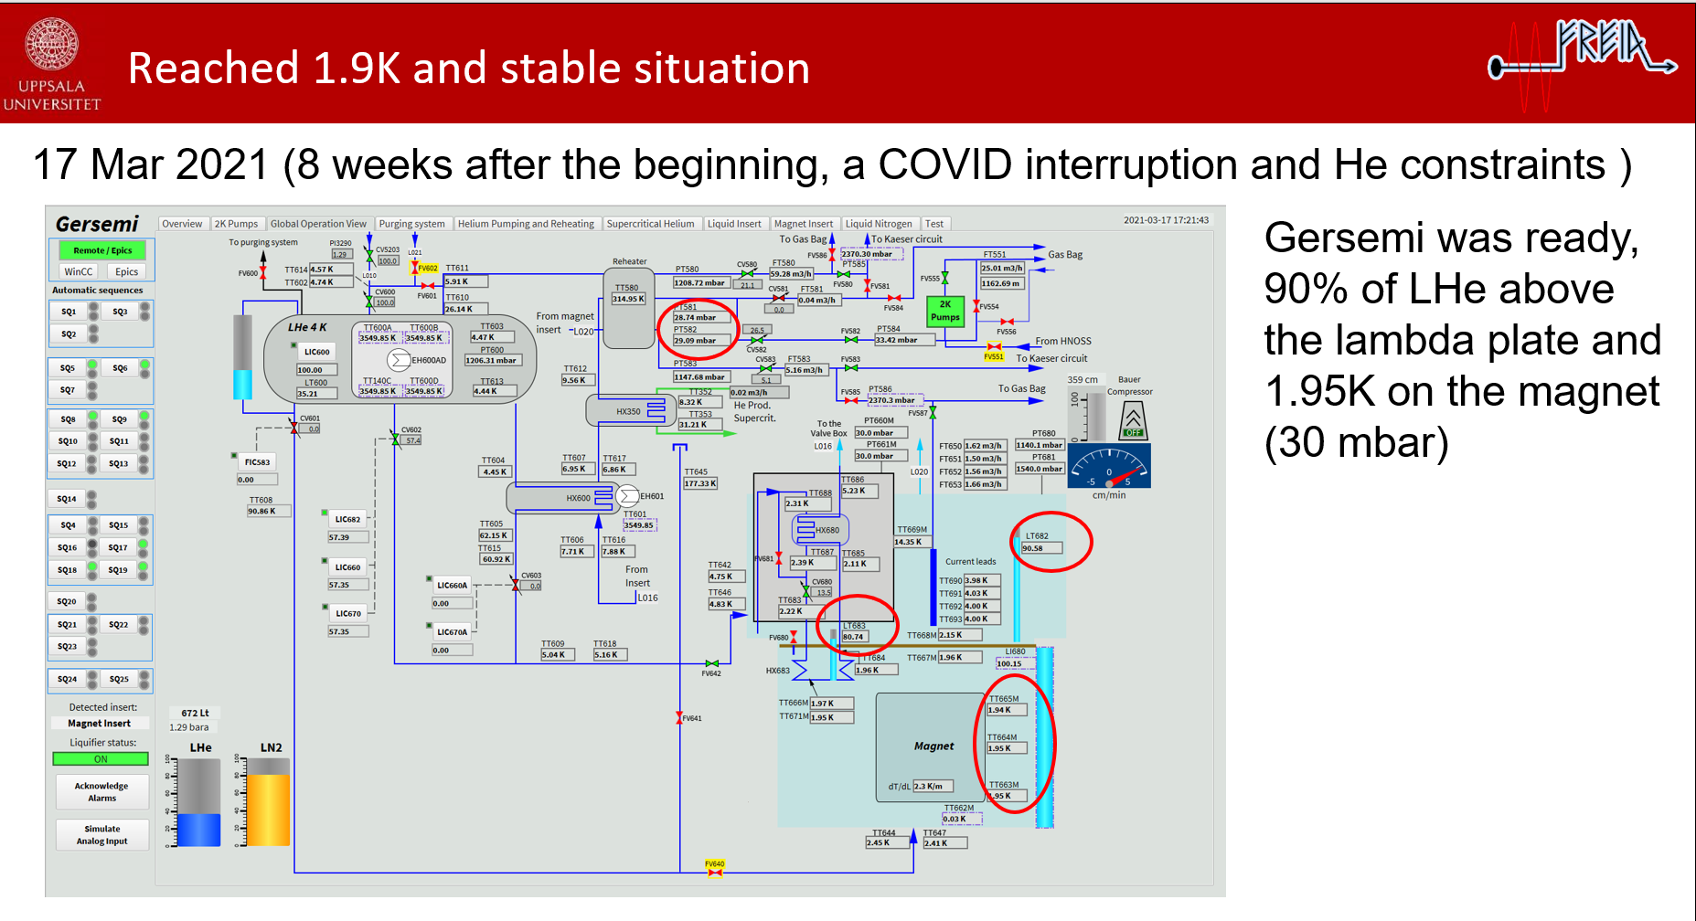
FREIA TEST STAND FULLY operational @ 1.9 K
This is areal great milestone although is quite late in the ARIES TNA: outside CERN but as a real extension of the Vertical test stands of MagNet we have a fully operational vertical magnet test cryostat in FREIA!
Courtesy of K. Pepitone

Slide 9
Potential projects at GERSEMI
TEST of MCBXF-A/B magnets DONE for the HWC, but this is not a project
Test of the Metrosil varistor at cold to be confirmed
Test of the Scanditronix 50 cm short model CCT magnet has been cancelled as the magnet has a short!!!
We have to see how in the remaining short time we can spend the 1800 accesses……

