Slide 1
Beamline optimization with MAPCLASS
Andrii Pastushenko
24/02/2021

Slide 2
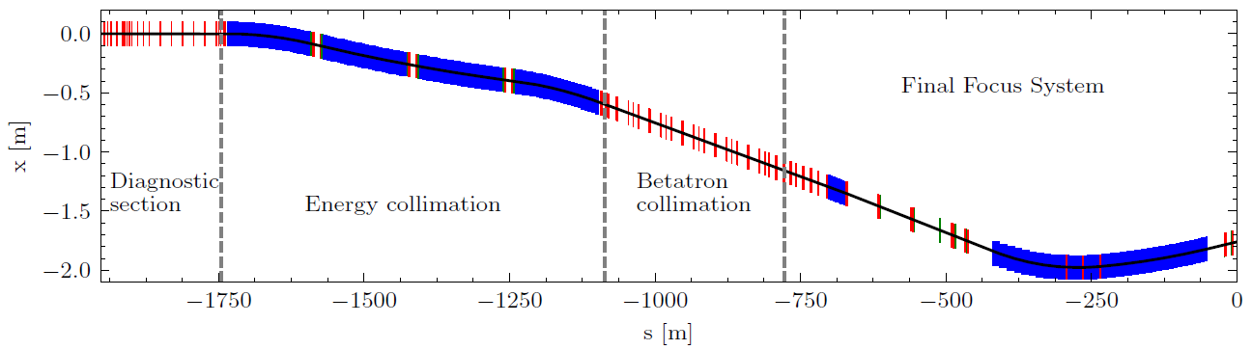
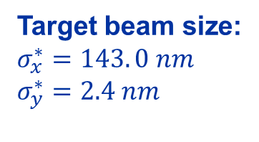
Beamline optimization with MAPCLASS
CLIC BDS@380 GeV
The key to reach high luminosity for a linear collider is to have an ultra-small beam size at the IP
Target beam size:
$$σ_{x}^{∗}=143. 0 nm$$
$$σ_{y}^{∗}=2.4 nm$$
Calculations:
Beam size matching
Energy bandwidth optimization
..
MAPCLASS was written to perform a fast calculation of the outgoing beam size, given a transport lattice and a beamsize at the input.
Fast comparison@Intel Core i7 8700k (6 threads):
(MAD-X + PTC) (map generation) + MAPCLASS = 6.7s + 0.1s
PLACET = 8.3s

Slide 3
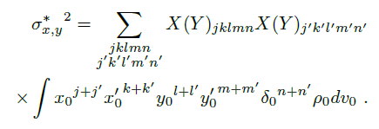
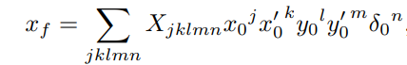
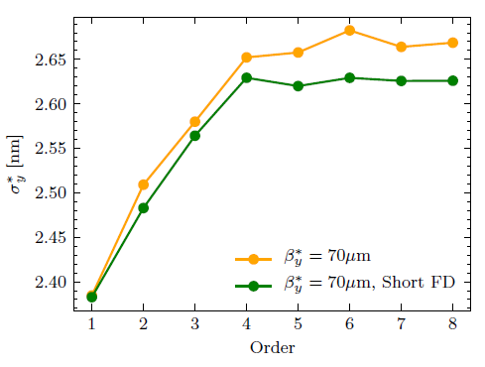

Beamline optimization with MAPCLASS
Beam size at the IP:
Coordinate of the particle at the IP:
Beam size VS order of the map:
Mapclass takes the map coefficients from “fort.18” file or construct the map from twiss file.
For an analysis, the map is truncated at order $q$: $j+k+l+m+n≤q$

Slide 4
Beamline optimization with MAPCLASS
Typical calculation procedure:
Map generation:
MAD-X + PTC
Beam size evaluation:
MAPCLASS
MAD-X match
Drawback of such optimizations:
Can occupy all available RAM.
Map is generated in file format “fort.18”
Limited to MAD-X optimizations routines.
Not possible to multithread the matching.

Slide 5
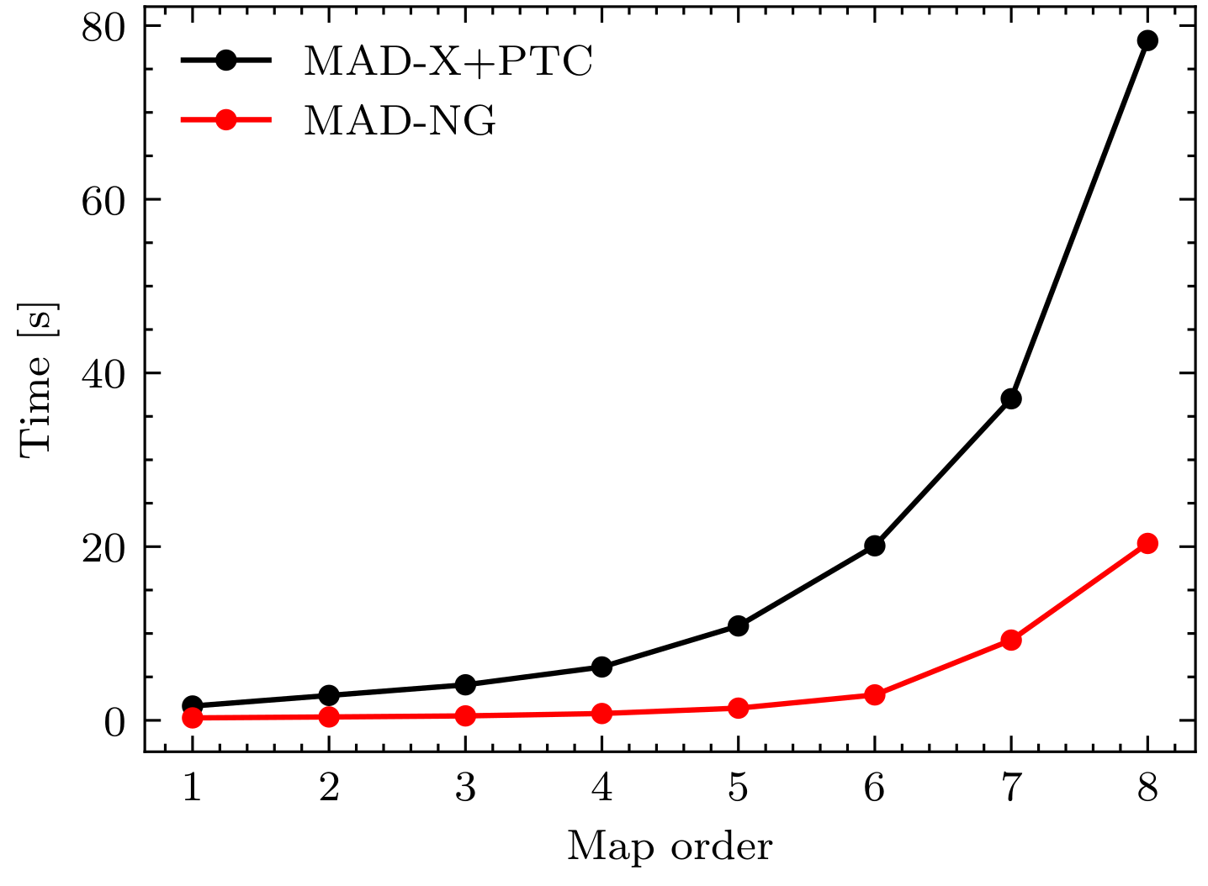
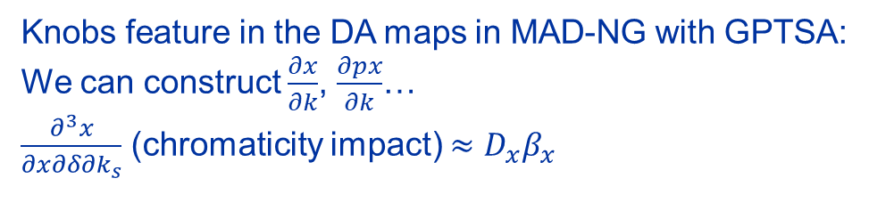
Beamline optimization with MAPCLASS
Mad-NG seems to offer a boost in computational time
Time required to generate 6D map:
Knobs feature in the DA maps in MAD-NG with GPTSA:
We can construct $\frac{∂x}{∂k}$, $\frac{∂px}{∂k}$…
$\frac{∂^{3}x}{∂x∂δ∂k_{s}}$ (chromaticity impact) $≈D_{x}β_{x}$
10.9s (MAD-X) VS 1.4s (MAD-NG)

Slide 6
Thank you for your attention!

