Slide 1

Cooling of electrically insulated high voltage electrodes down to 30 mK –
Dynamic measurements
Eisel T., Bremer J., Burghart G., Feigl S., Haug F., Koettig T.
CERN, 1211 Geneva 23, Switzerland
thomas.eisel@cern.ch

Slide 2
Content
Electrodes integrated in AEgIS
Cooling source: Dilution Refrigerator (DR)
Cooling design: Sandwich
Theory of dynamic measurements
Simulation
Results of dynamic measurements
Discussion/ conclusion

Slide 3
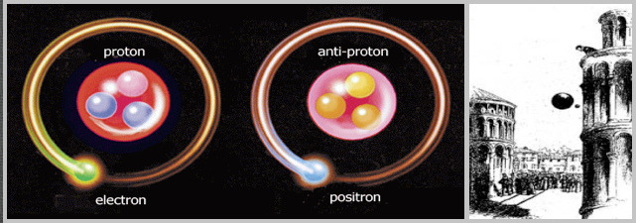
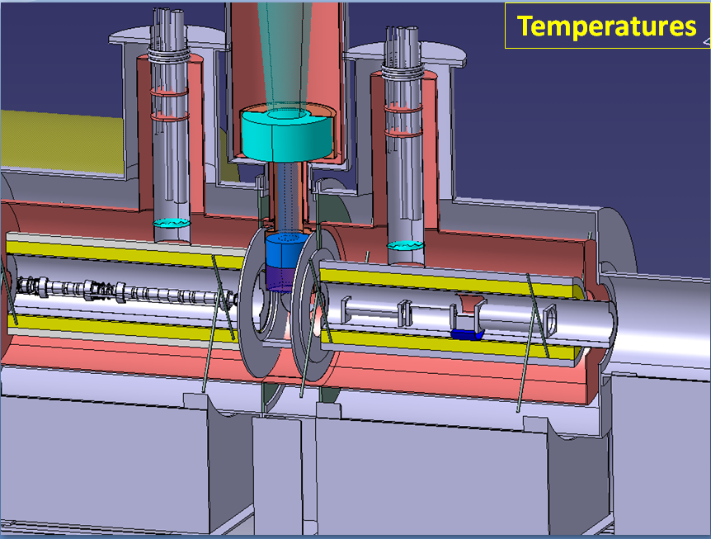
AEgIS
AEgIS¹ experiment at CERN
Scientific goal: influence of g upon antimatter
Penning trap at 100 mK → deceleration of particles
DR
MC
¹ http://aegis.web.cern.ch/aegis/home.html

Slide 4
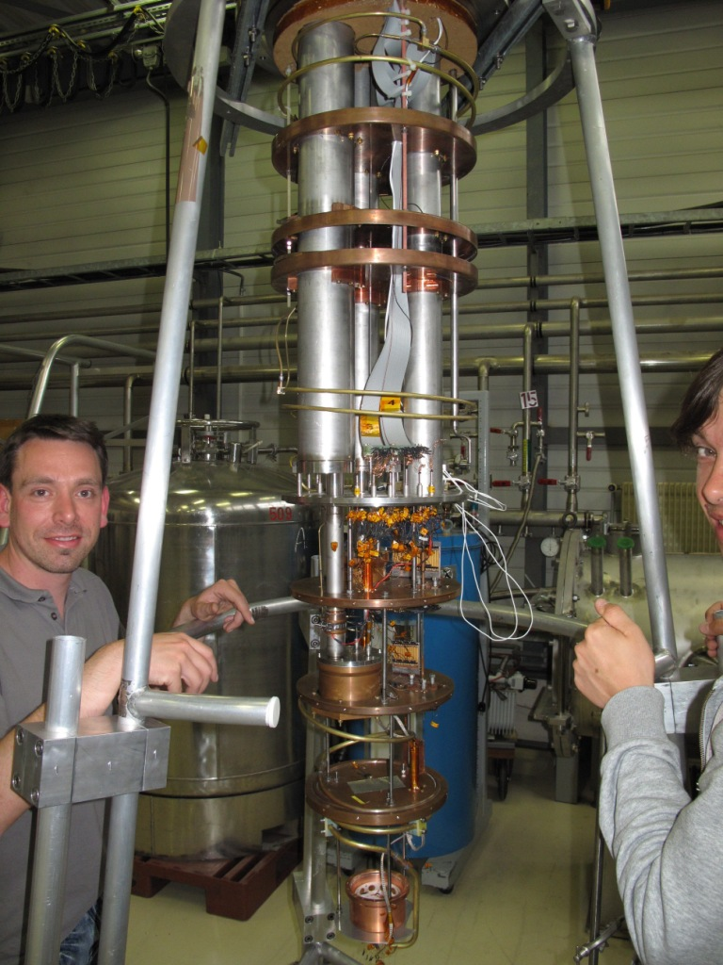
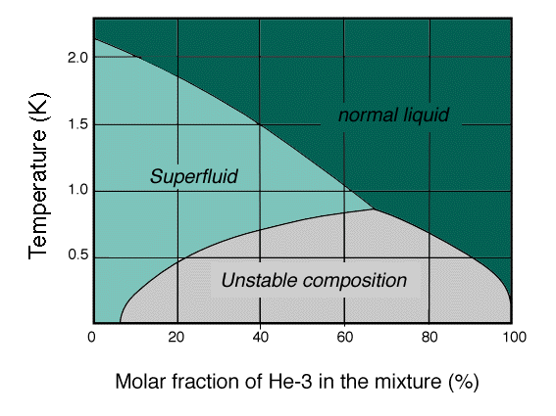

Dilution Refrigerator
Standard cooling source: DR¹
  (0.002 to ~ 0.5) K
  Continuous operation
  Dilution of ³He in ⁴He
  0.0001W @ 0.05 K
¹ http://cdms.berkeley.edu
Notes:
3He 2 protons only one neutron

Slide 5
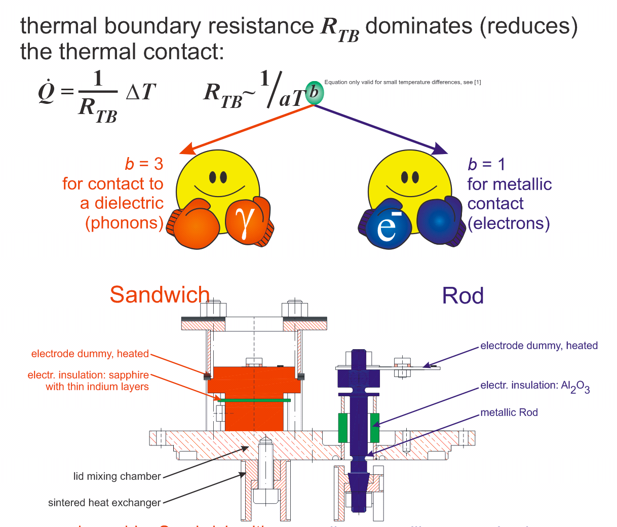
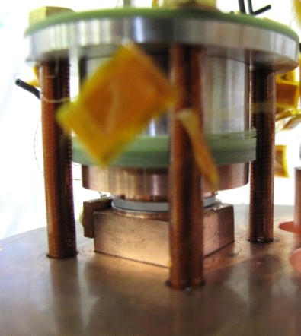
Sandwich
¹ G. Frossati. Experimental Techniques: Methods for Cooling Below 300 mK. Journal of Low Temperature Physics, Vol. 87, Nos. 3/4, 1992

Slide 6
Theory of dyn. meas.
  Antimatter creation/ annihilation (Illuminati) is periodically (200 s)
Dynamic measurements
  Information on how fast inserted heat can be transferred
  Key property which determines the propagation-speed of a heat wave in an homogeneous material:
  material’s thermal diffusivity a (^{m2}/_{s})
  λ . . . thermal conductivity
  ρ . . . density
  c_{p} . . . specific heat capacity
Sandwich’s thermal
diffusivity a*

Slide 7
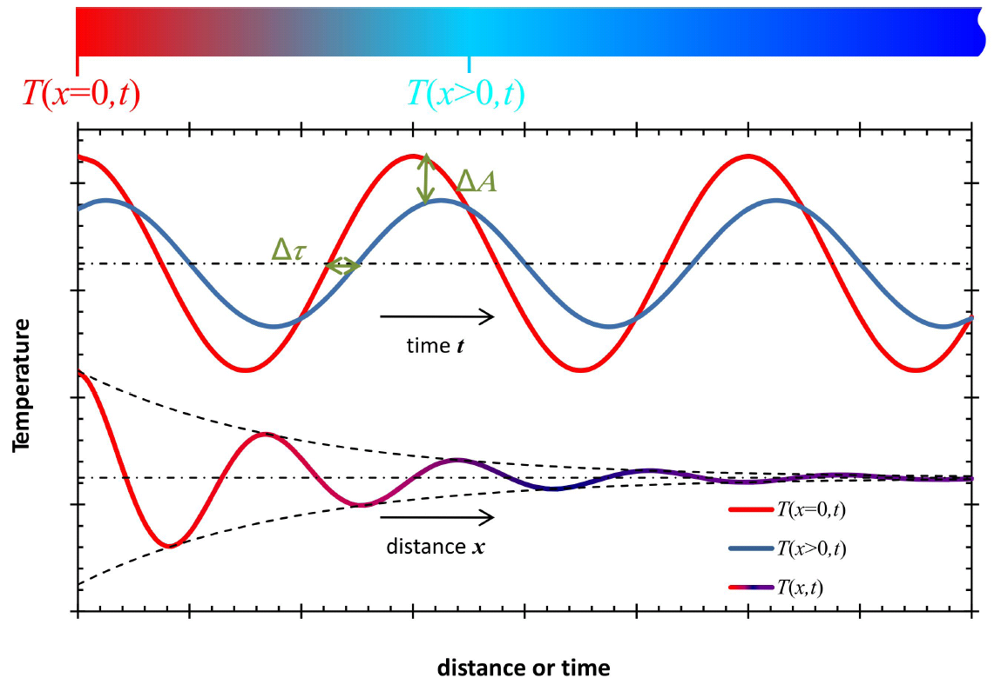
Theory of dyn. meas.
Semi-infinite rod (one dimensional)
One end imposed temp. function T_{H}=f(t) (sin, pulse)
  T_{C}=f(t) at certain distance → Alteration of the original function (phase shift, attenuation)
material’s thermal diffusivity a
can be analytically solved

Slide 8
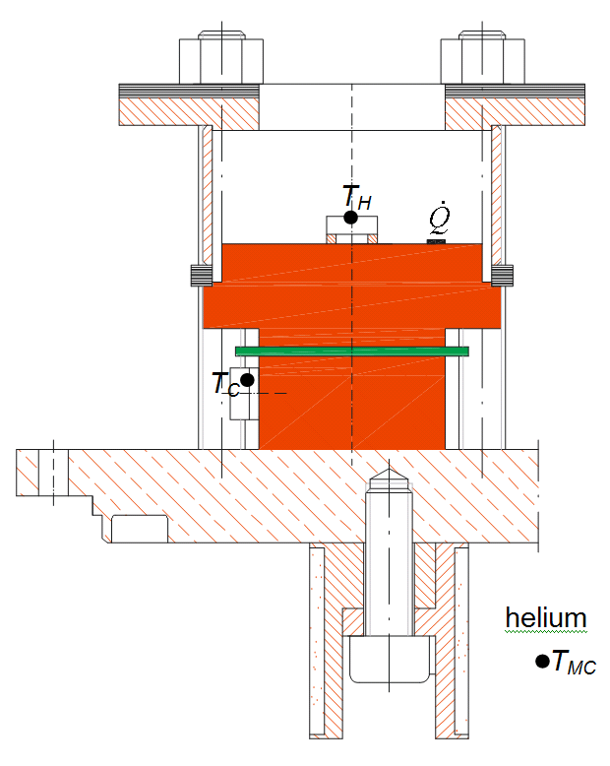
Simulation
Sandwich is not a semi-infinite rod (T_{MC}=const)
Imposed temp. function T_{H} is not sinusoidal (square heat wave)
Simulation (MATLAB®,pdepe):
  T_{H}(t)=T_{H,meas}(t)
  T_{MC}=T_{MC,meas}
  x_{S}=x_{Sapphire}
  T_{C,sim}=T_{C,meas}
    x_{therm}
    Sandwich’s thermal
    diffusivity a*

Slide 9
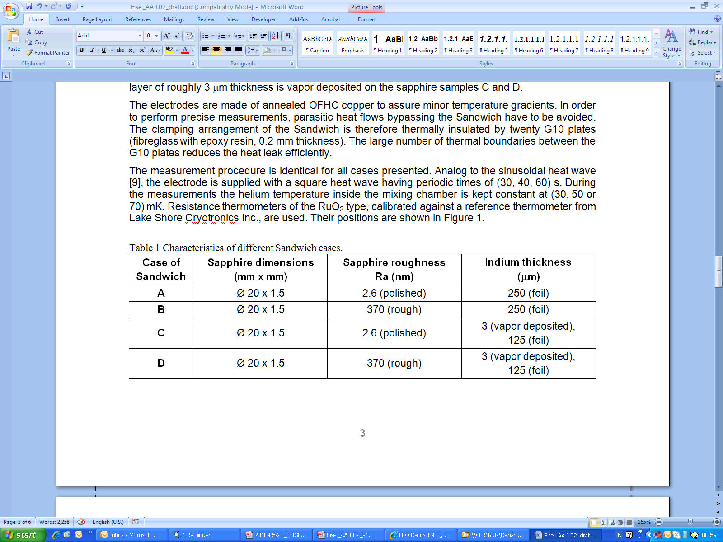
Results

Slide 10
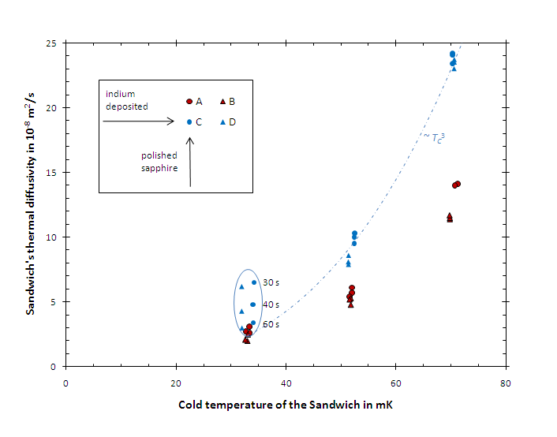
Discussion/ conclusion
Sandwich’s thermal diffusivity is more than 6 orders of magnitude smaller than the thermal diffusivity of copper or sapphire → thermal boundary resistance
The diffusivity is not constant, it diminishes with reduced temperature → thermal boundary resistance
For temperatures > 30 mK an indium deposition improves the diffusivity significantly (about a factor of 2)
The surface roughness influences the diffusivity only minor
→ contrary to static measurements¹; conclusion: heat transfer mechanisms of dynamic and static measurements are different
→ The fastest heat propagation could be achieved along a Sandwich using indium deposited and polished sapphire plates
¹ Eisel T., Bremer J., Burghart G., Feigl S., Haug F., Koettig T., Cooling of electrically insulated high voltage electrodes down to 30 mK. Proceedings of the twenty third cryogenic engineering conference, Poland; 2010.

