Slide 1
SCD Global Meeting
A. Ballarino
Video meeting on 28/01/2021

Slide 2
General Information
COVID 19 - Teleworking at least till end of February. Please fill in the EDH teleworking absences for the full month of February – same scheme as for January (or let me know if adaptations are needed).
CERN is in contract with authorities to try to buy vaccines, once CERN has managed this, it will organize vaccination campaigns.
France has imposed a curfew every evening/night from 6 pm to 6 am; derogation needed in case of displacements outside during these hours, to be downloaded from CERN COVID web site.
MERIT exercise: deadline for the section is today
FSU related aspects: Julien Hurte is the coordinator of the section
Welcome to new section members: Sebastien Richter and Giovanni Succi

Slide 3
Thank you, Iole !

Slide 4
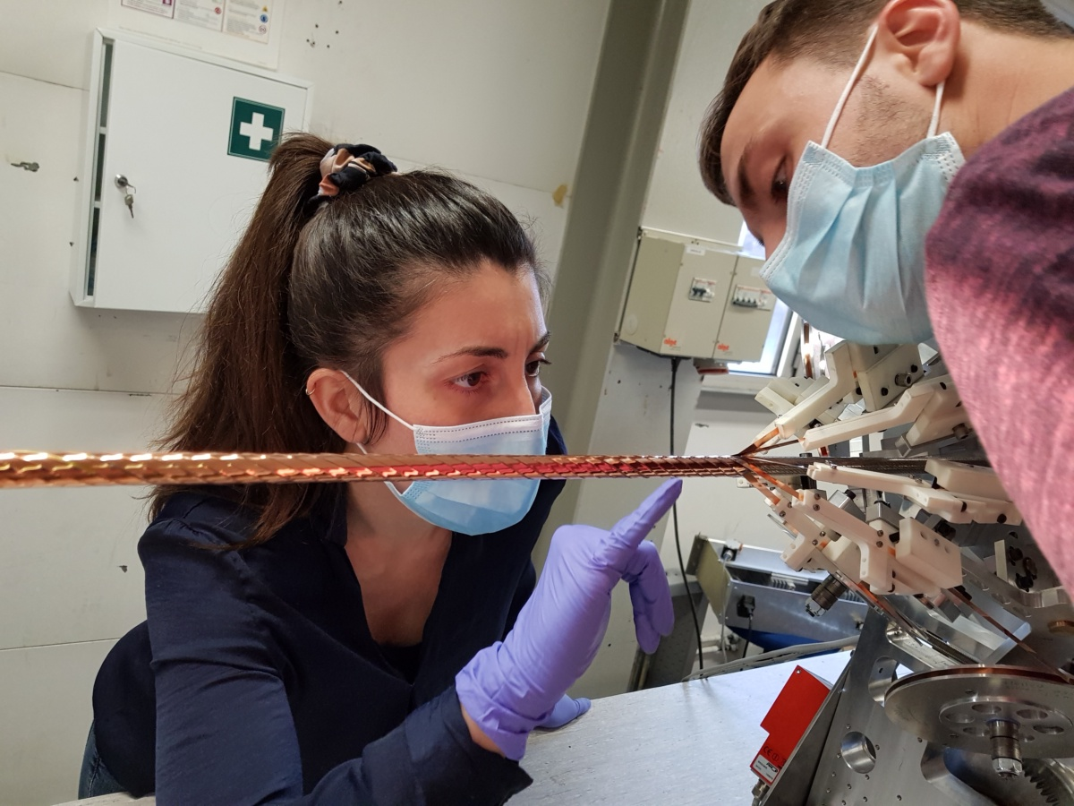

Slide 5
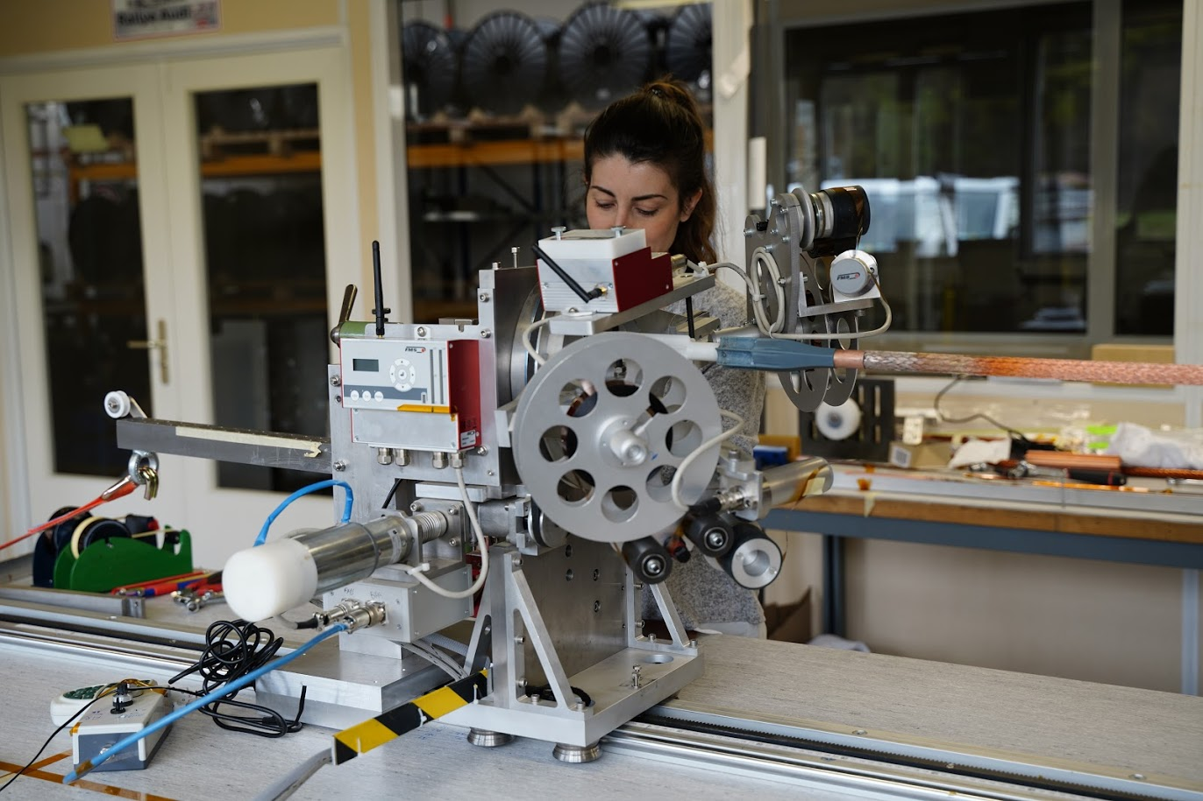

Slide 6
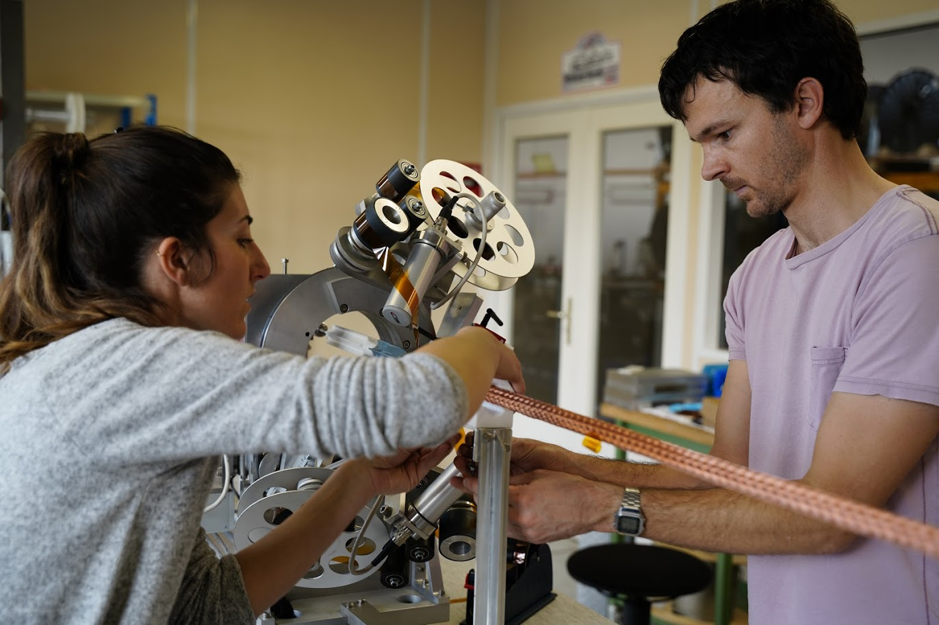

Slide 7
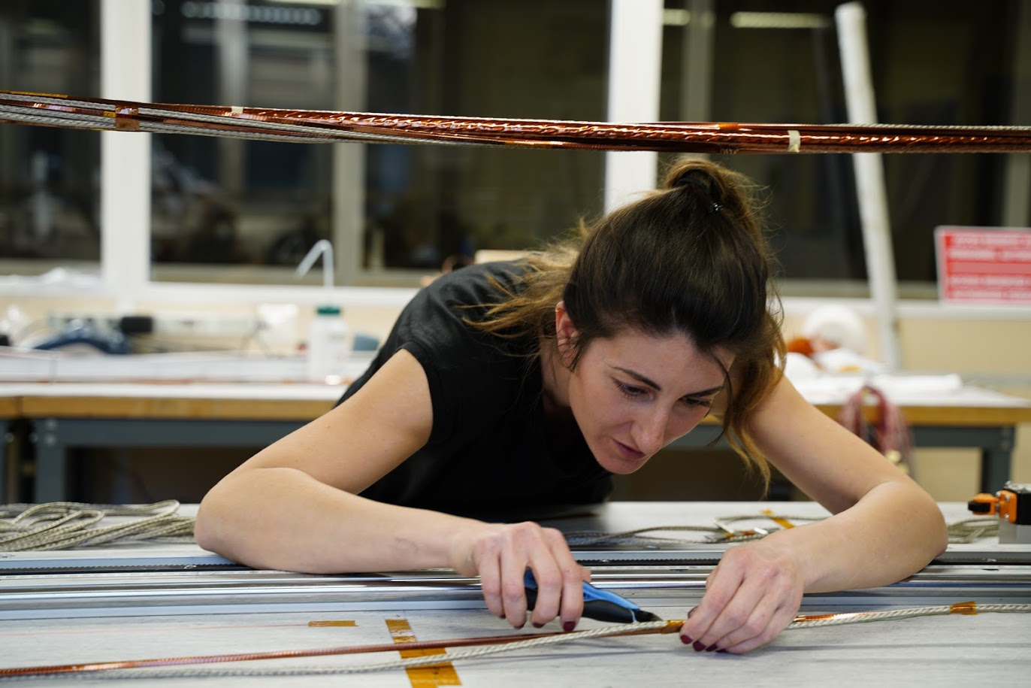

Slide 8
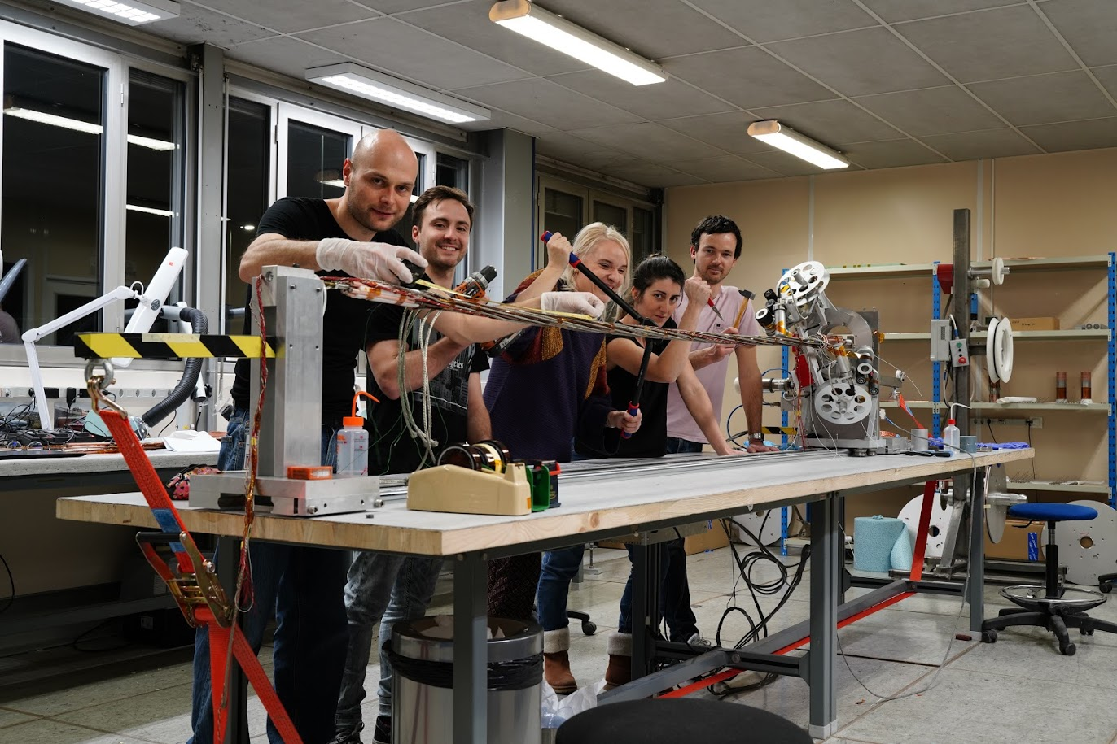

Slide 9
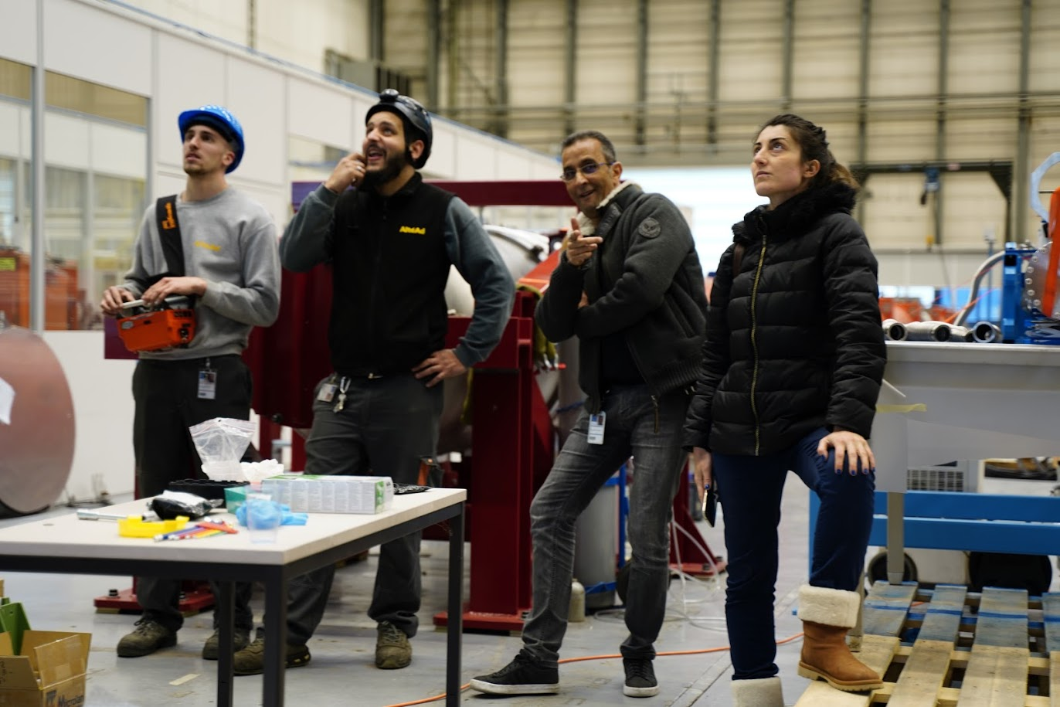

Slide 10
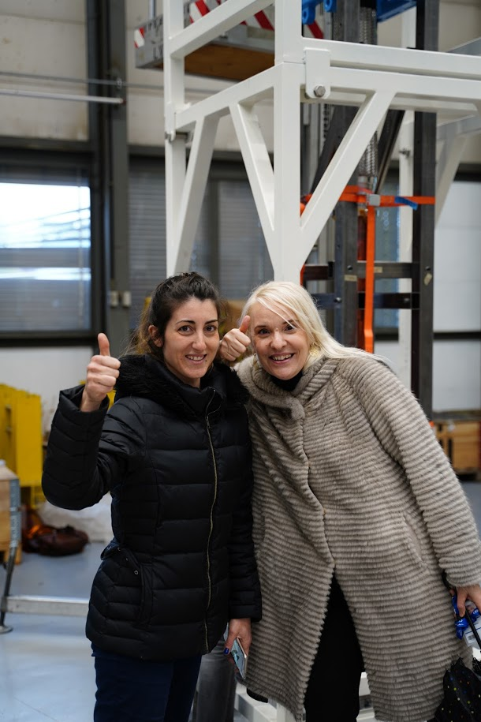

Slide 11
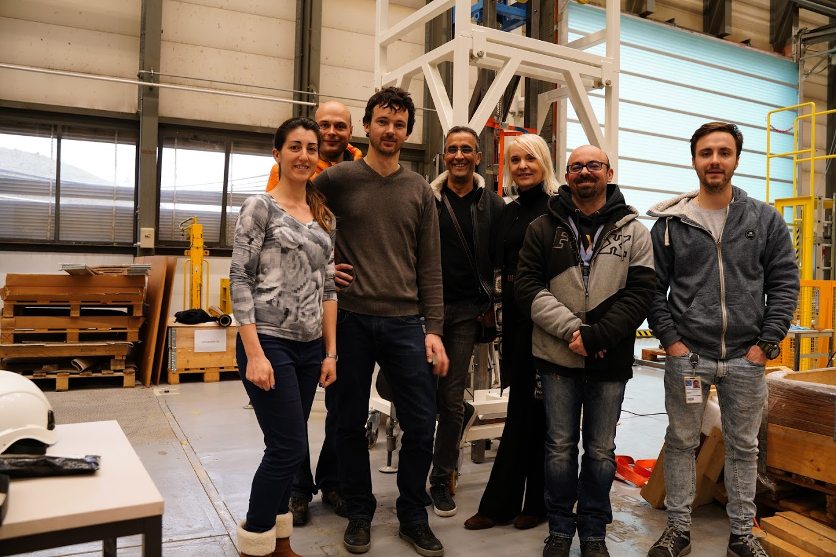

Slide 12
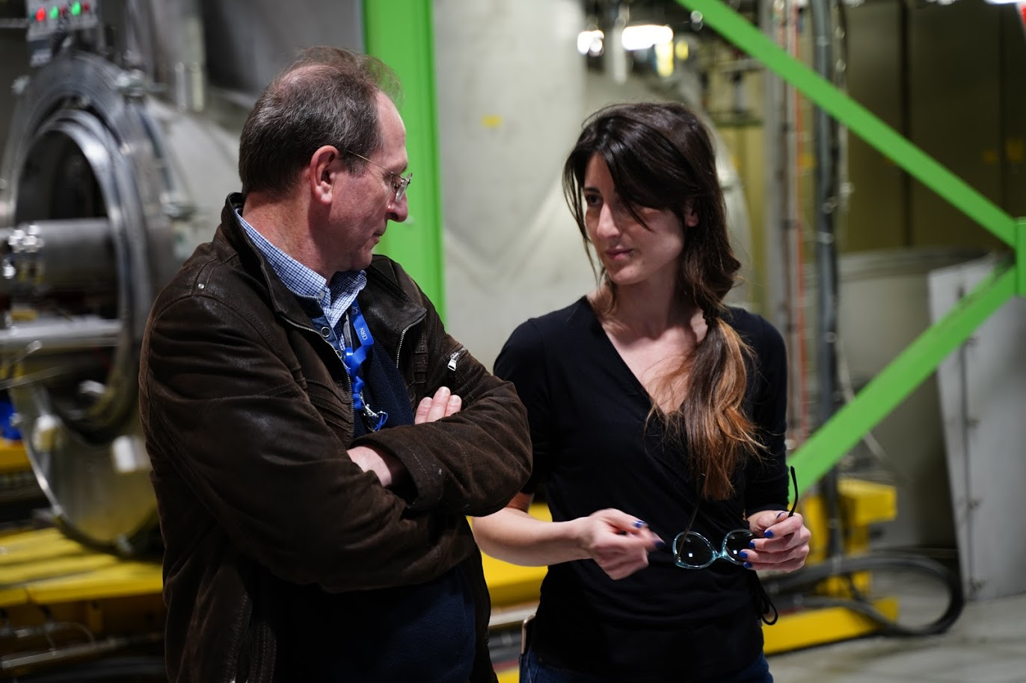

Slide 13
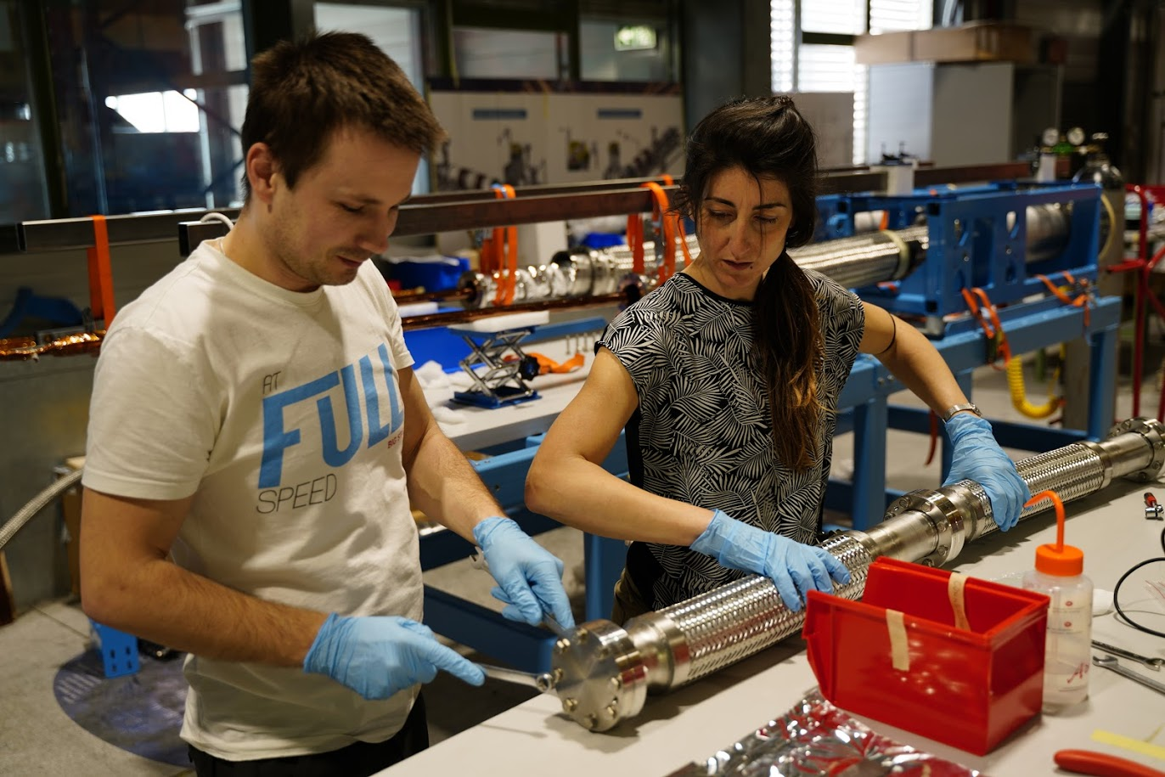

Slide 14
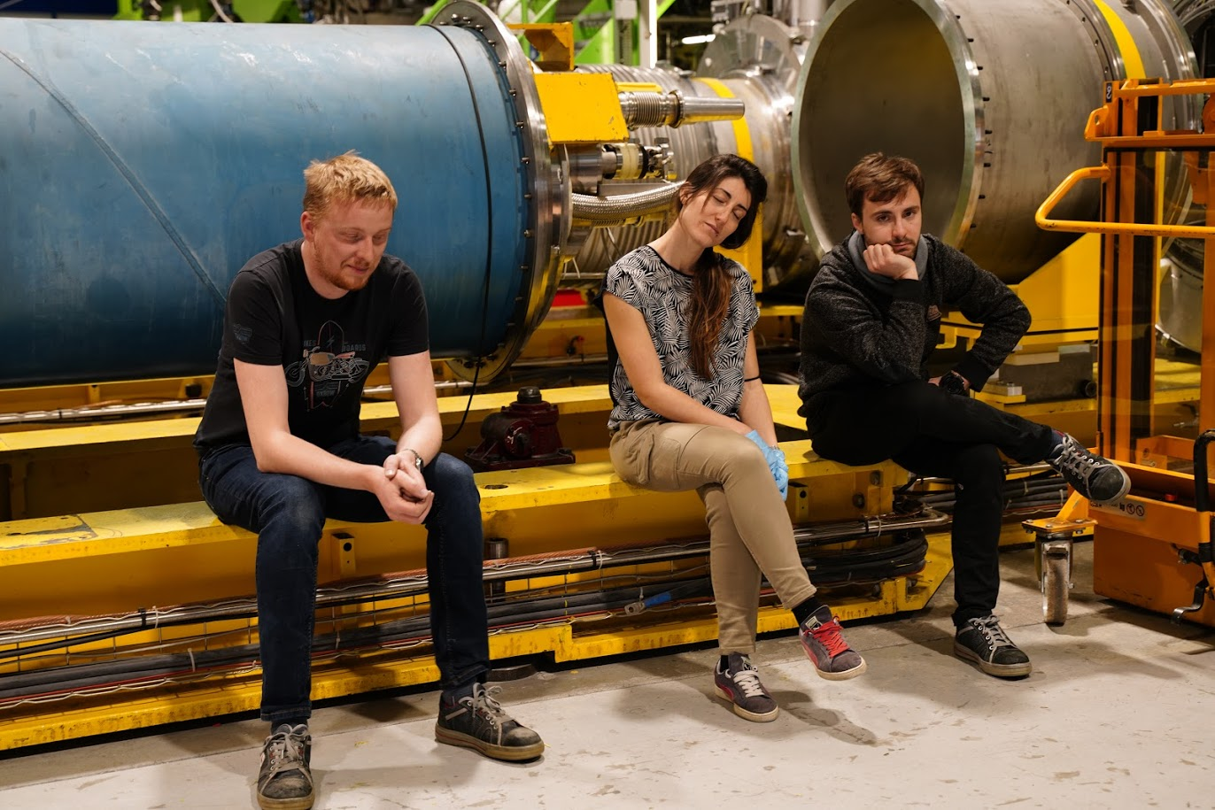

Slide 15
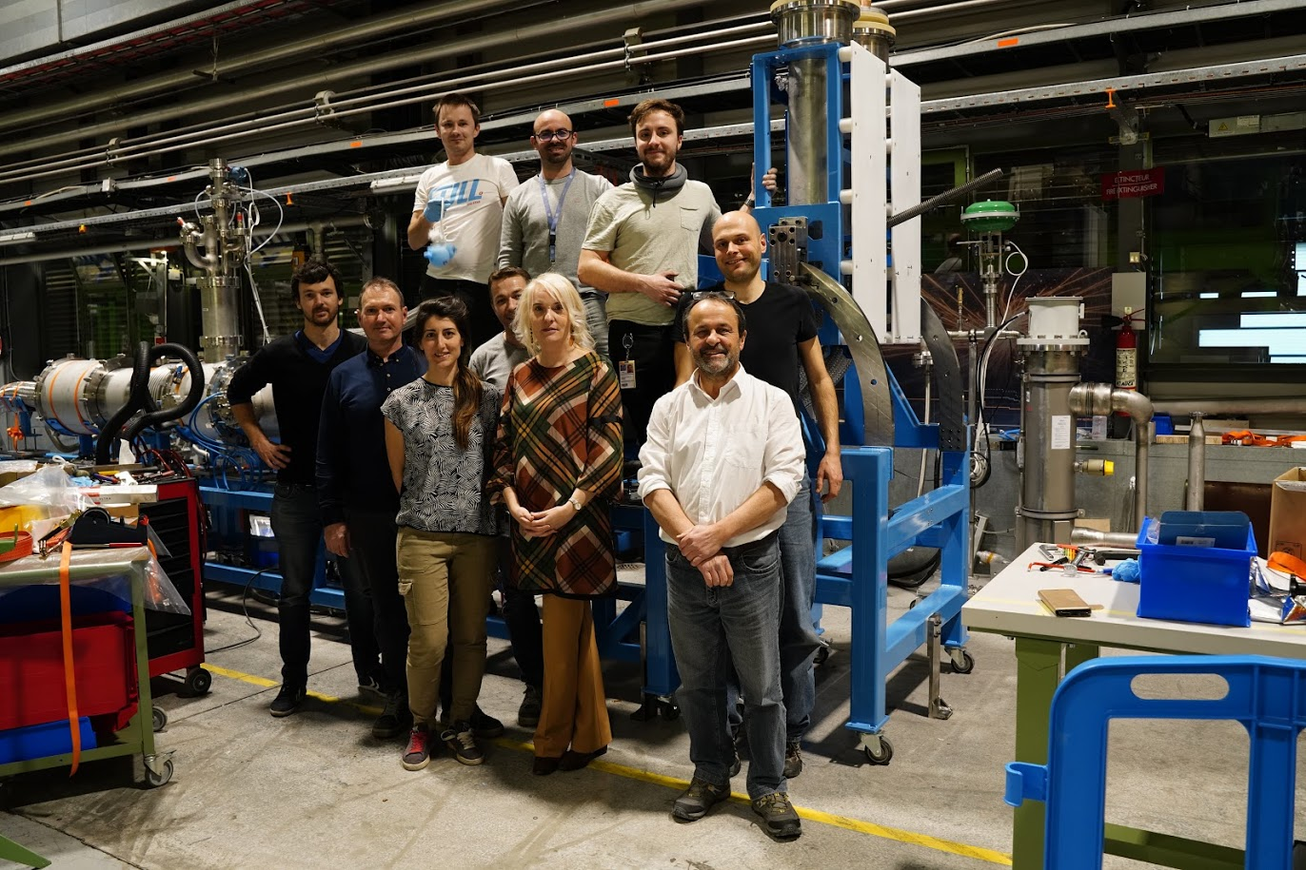

Slide 16
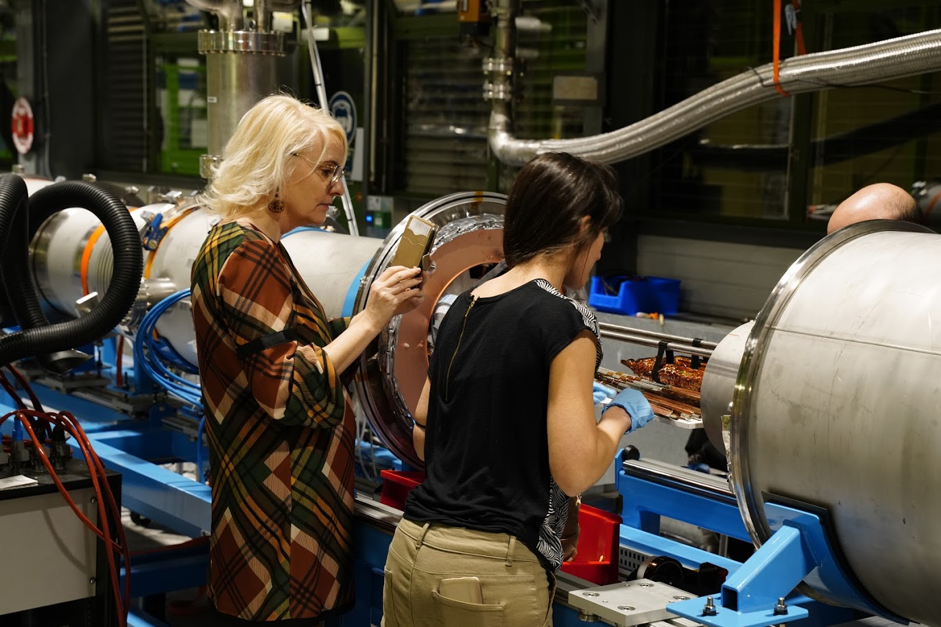

Slide 17
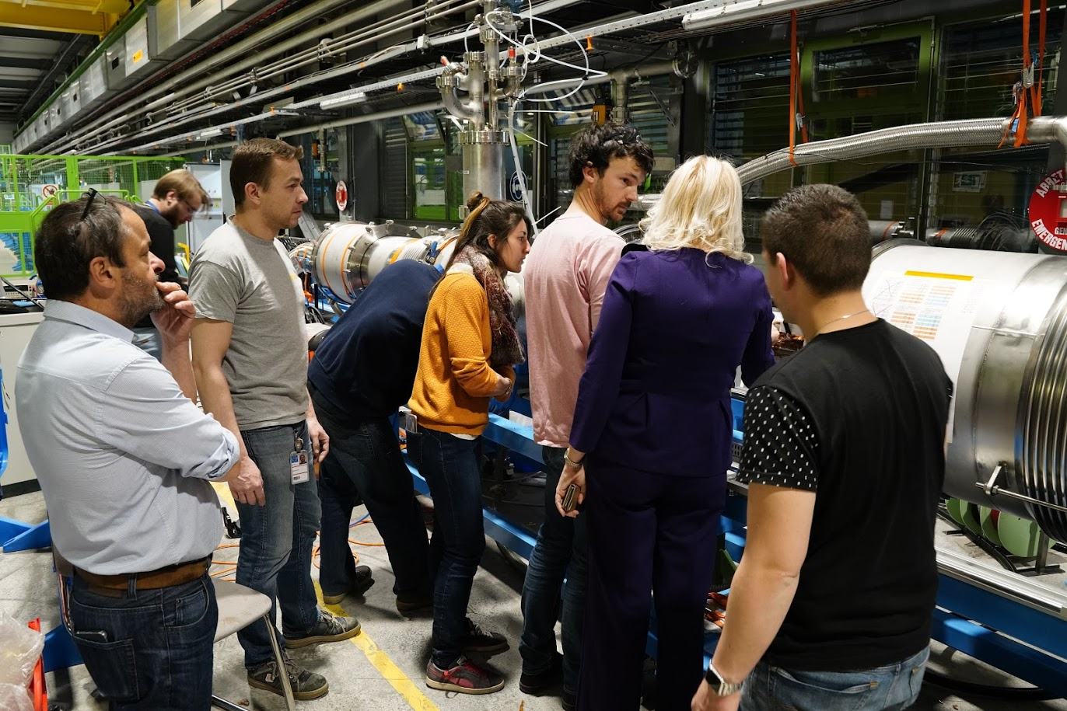

Slide 18
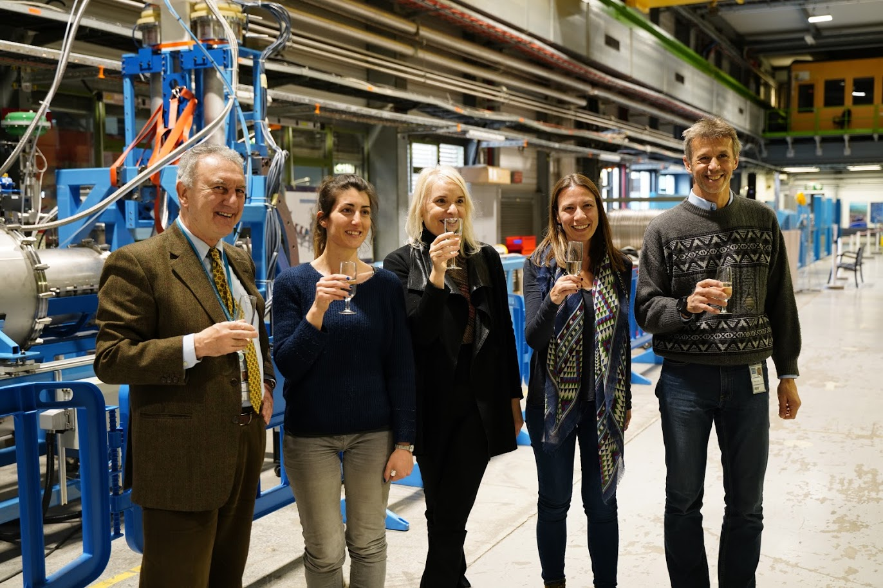

Slide 19
