Slide 2
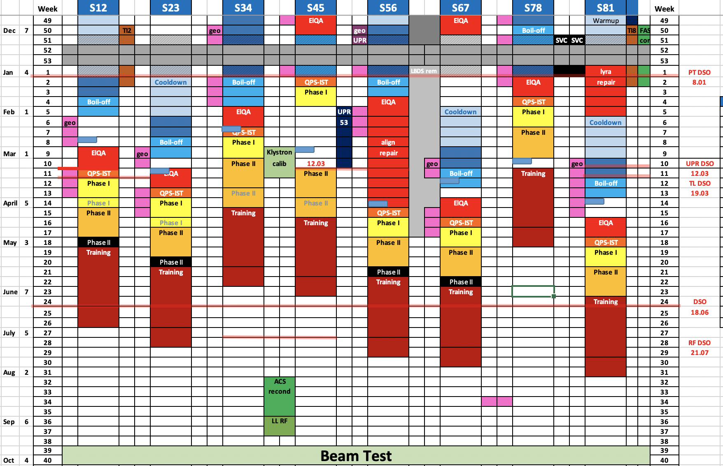
Courtesy of M. Solfaroli & A. Apollonio
Powering tests planning
PRELIMINARY
Courtesy of M. Solfaroli & A. Apollonio
2

Slide 3
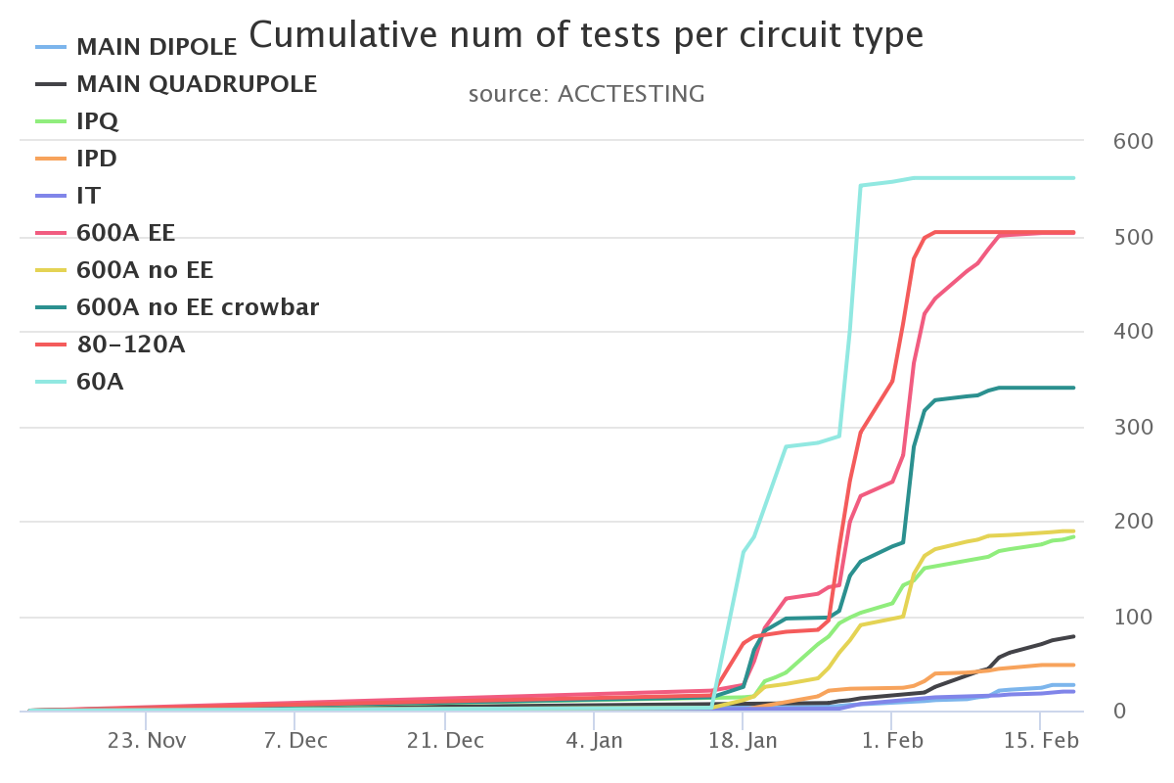
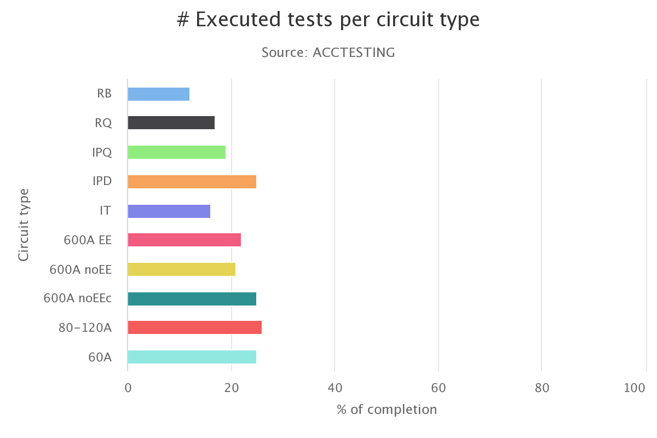
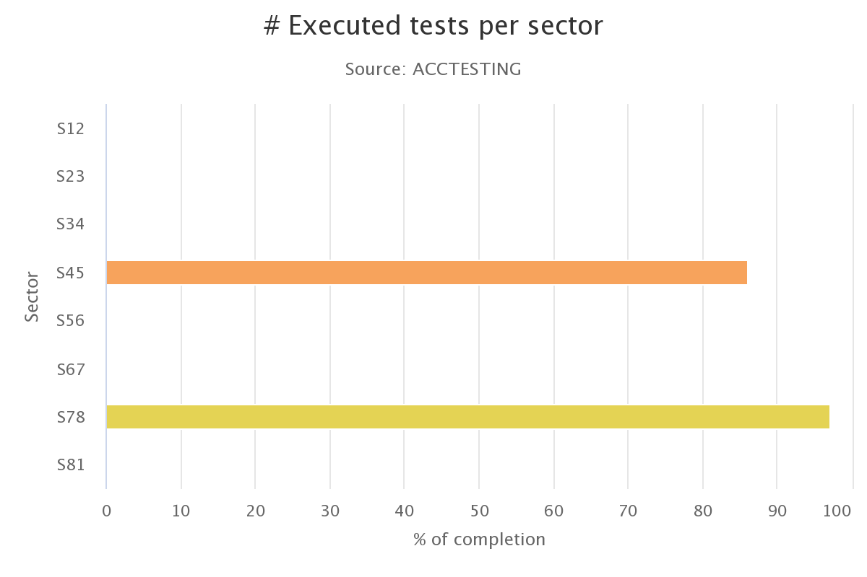
Powering tests advancement
Courtesy of M. Solfaroli & A. Apollonio
3

Slide 4
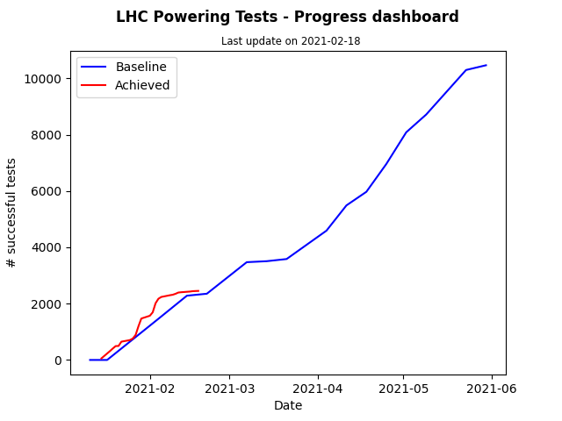
Powering tests advancement
Courtesy of M. Solfaroli & A. Apollonio
4

Slide 5
Status 13 kA circuits
RB.A45:
Phase1 completed
RQD/F.A45:
Phase1 completed
RB.A78:
Phase2 ongoing
Tests at 2 kA completed
Heater firing repeated twice due to failed sequence (EPC confirmed all is OK)
Pending test with FPA in the ramp @2 kA (waiting for snapshots)
RQD/F:
Phase2 ongoing
PLI2.f1 repeated from nQPS
EE @5 kA performed correctly
Splice mapping at 6500 A performed
Courtesy of M. Solfaroli & A. Apollonio
5

Slide 6
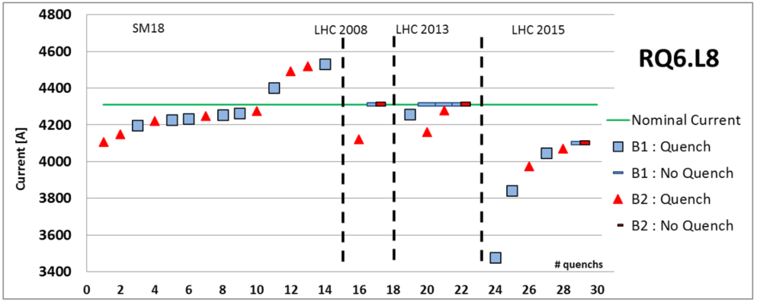
Status IPQ/IPD/IT circuits
S45:
Phase1 tests completed
S78
RQ5: reached 4360 A after 1 quench (4286 A)
RD2: reached 6100 A after 1 quench (5950 A)
RQ4:
repeated heater firing following feedback from QPS team
2 quenches (3541, 3603 A) on the way to 3660 A
RQ6: 6 quenches (3714, 3834, 3935, 3963, 3995, 4020 A) on the way to 4360 A => MP3 to confirm the additional 3 quenches. Nominal current is required for full performance in operation.
RQ7: reached 5440 A (NO quench)
RQ8: reached 5440 A after 1 quench (5204 A)
RQ9: reached 5440 A (NO quench)
RQ10: reached 5440 A (NO quench)
RQX.L8: all tests performed
Courtesy of M. Solfaroli & A. Apollonio
6
Notes:
6

Slide 7
Status 600 A circuits
S45
ROD.A45B1, ROD.A45B2, ROF.A45B1, RQS.A45B1 - problem with fast abort unsafe
RU.R4 - QPS intervention I_DCCT (on QPS) too noisy
RCBXs ➔ see next slide
S78
RQTL9.R7B1, ROD.A78B2 - problem with fast abort unsafe
Courtesy of M. Solfaroli & A. Apollonio
7

Slide 8
RCBXs.L5
Circuit | Quench level | comment | Target
RCBXH1.L5 | 321,337,381,423 | No QPS board B data “both boards are active and work fine” | 490+10
RCBXH2.L5 | 367,450,467,493,496 | 5 quenches, OK | 500+10
RCBXH3.L5 | 330,375,435,461,468 | 5 quenches, OK | 500+10
RCBXV1.L5 | 292,437,453,487,490 | 5 quenches | 500+10
RCBXV2.L5 | 472,348,452,493,495,504 | 6 quenches (up to 9) | 500+10
RCBXV3.L5 |  | OK
RQSX3.L5 | 365,382,518,541,545 | 5 quenches | 550+10
Paused due to missing cryogenic conditions
Courtesy of M. Solfaroli & A. Apollonio
8

Slide 9
Sector 34 + 67
S34
Standard ElQA tests completed
QPS boards exchange completed
ElQA on RB lines and DC cable reconnection
60 A PCs unlock
Friday 19th: UA43/UJ43/UJ33 PC unlock (but 13 kA)
Sector is ready for QPS-IST
IPQ and 600 A will be released during the day
Intervention on cryo compressor in IP4 successful, conditions back today
S67
Fault localized by the ELQA team on Q8L7
Courtesy of M. Solfaroli & A. Apollonio
9

