Slide 2
CLIC – VSC meeting
Technology development
C. Garion
Outline
Status of Deformable RF (DRF) bridge
Cold spray technology
Discussion

Slide 3
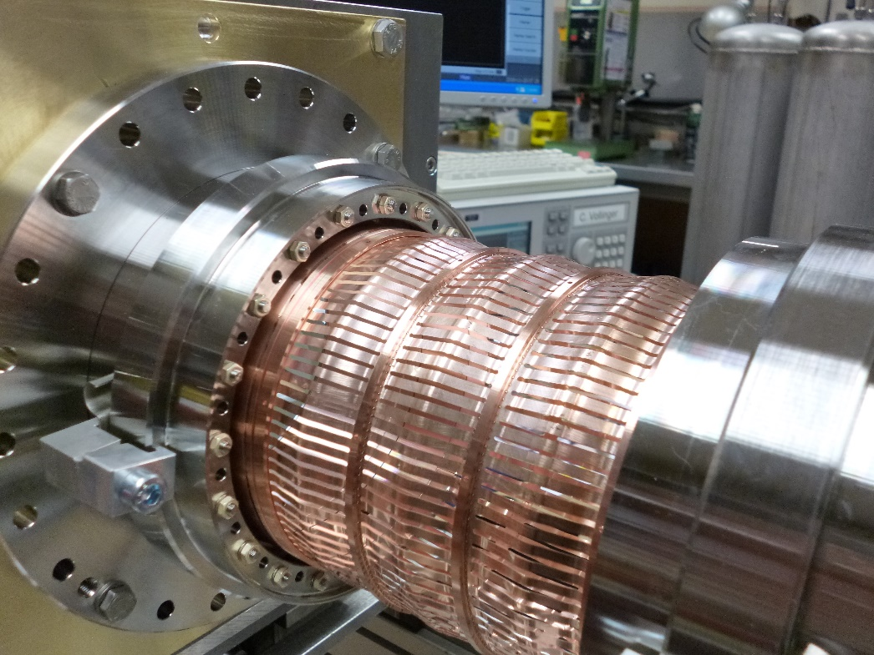
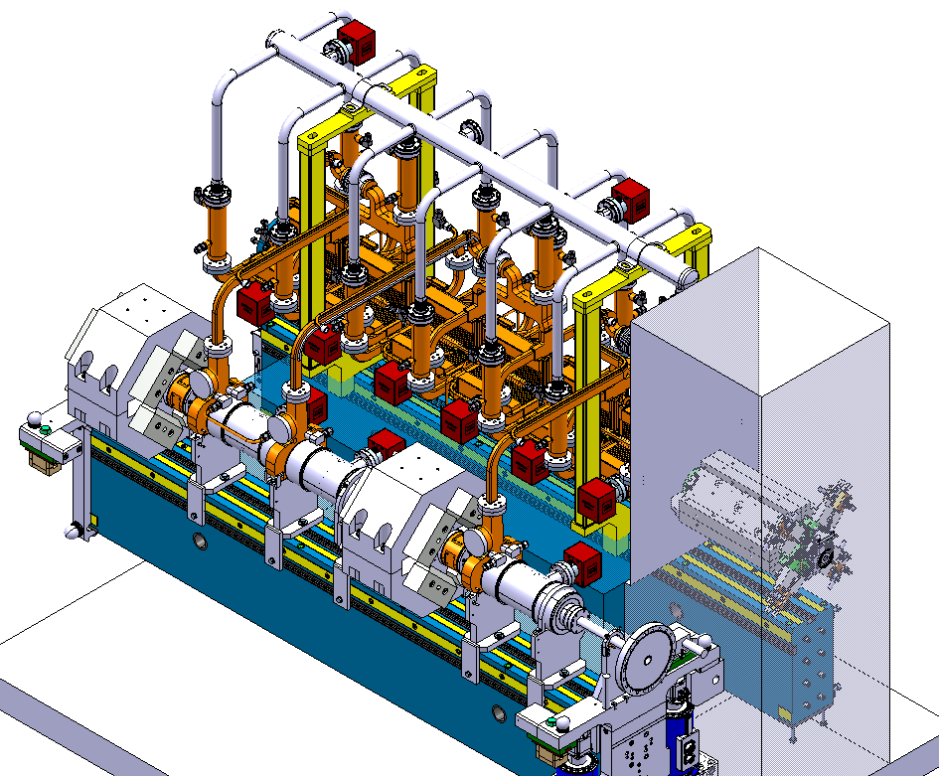
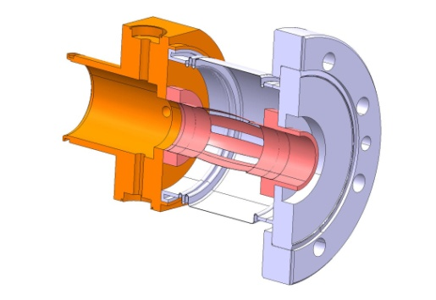
Deformable RF (DRF) bridge
A development that germinated from a proposed concept for CLIC and in particular for the drive beam interconnections in two beam modules.
First concept for CLIC module
DRF prototype for HL-LHC triplet interconnection

Slide 4
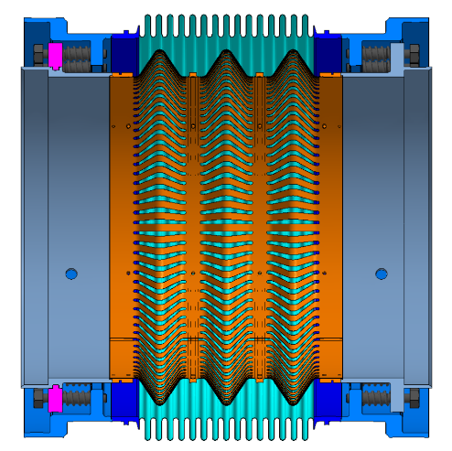
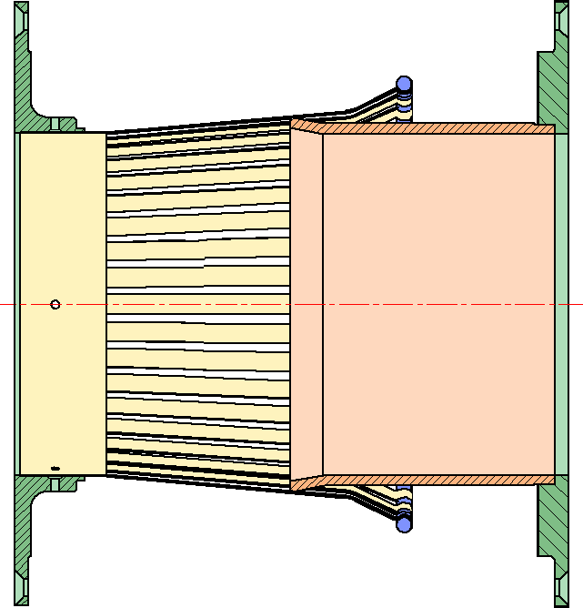
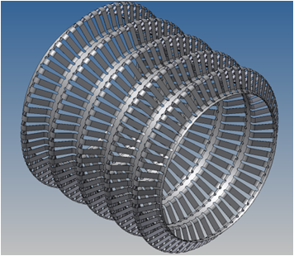
Concept of the DRF bridge
Principle:
Comparison with present design
Deformable thin-walled sheet:
  with both extremities attached to the adjacent chamber
  sort of corrugated bellows in free position
  almost straight in operation position
Principle: deformable body
Principle: “Rigid” sliding body
 | Deformable RF bridge | Sliding RF fingers
Electrical resistance | Material conductivity | Material conductivity + Contact resistance
“Smoothness” | Convolution (angle) | Slope and step
Span | Given by the number and shape of the convolution | Given by the module length/stroke
Mechanical tolerances | Could be limited in extension but very robust with transversal offset | Limited by spring/contact issues
Reliability | Limited by fatigue | Contact ageing, Buckling, Offset
Noncircular cross section | No impact on performance but challenging fabrication | Non uniform contact pressure
Convolutions with grooves to:
  avoid circumferential stresses during displacements
  pump the volume between the fingers and the bellows

Slide 5
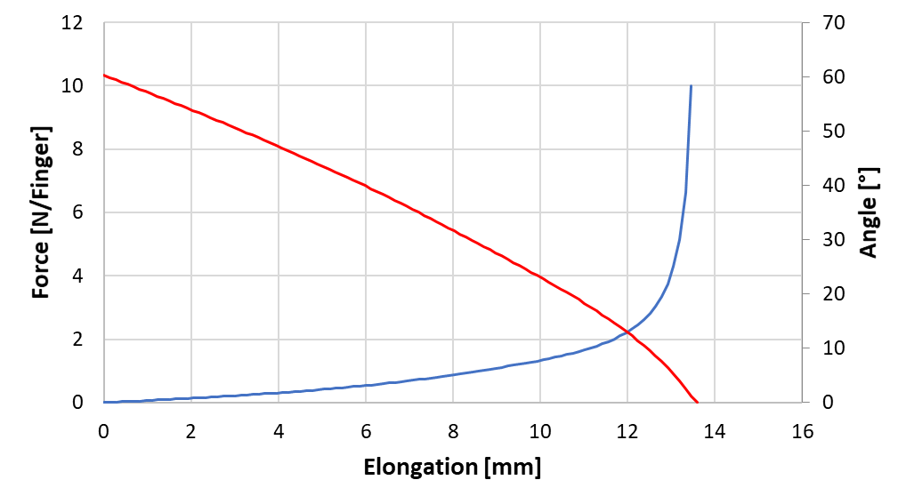
Base behaviour of the DRF bridge
The behaviour of the DRF bridge is driven by the behaviour of a single finger.
Free state at 60°
Angle at the center of the initial straight part
Axial force for one finger, 3 mm wide
As guideline from impedance, an angle of 15 is considered for the operation working conditions.
Maximum elongation of around 13.6 mm per convolution
Elongation of one convolution
The elongation in operation is about 11.65 mm.

Slide 6
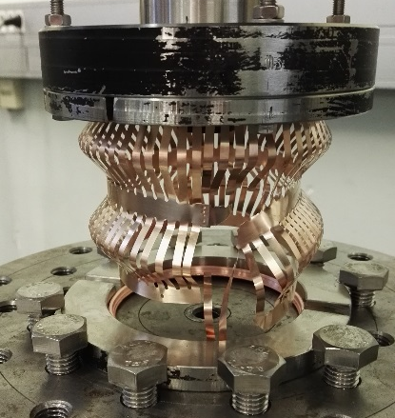
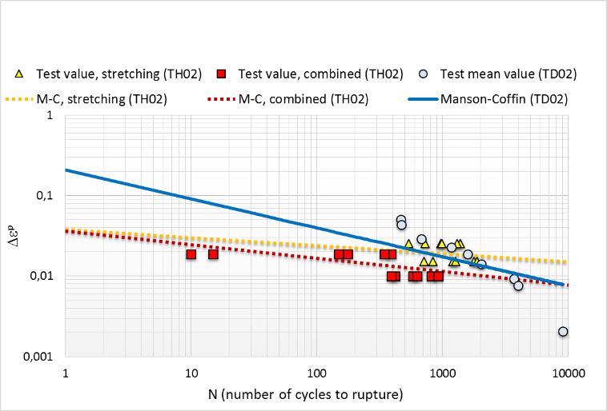
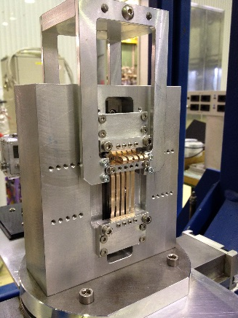
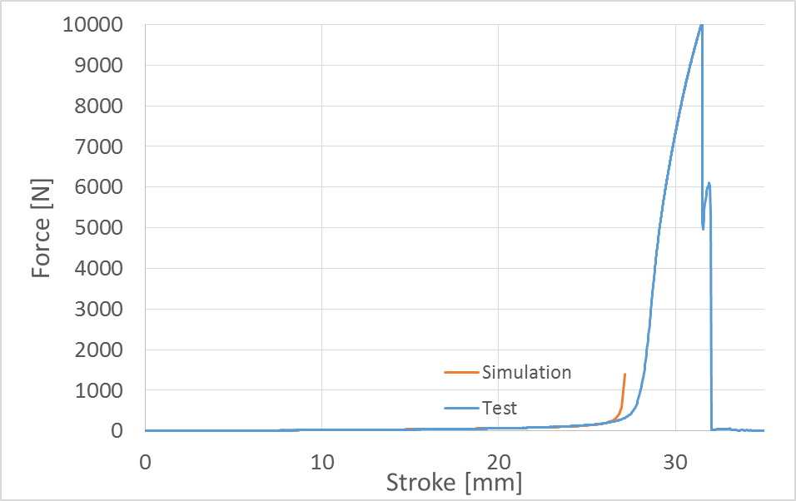
Base behaviour of the DRF bridge
Fatigue tests done for different grades and heat treatments.
Tensile test up to rupture
Failure of the weld
Fatigue tests on fingers
Prototypes with 2 convolutions have been validated based on thermo-mechanical tests combining bake-out processes with series of combined fatigue loads at maximum design values (+24 mm of stretching and ±12 mm of lateral movement), without convolution breakage. The number of bake-out processes was eight, accumulating a total of about 1000 h at 200 °C, and the fatigue life was more than 350 cycles.
Tensile test on a two convolutions module with 57 fingers
Rupture occurs beyond the design limit (+15%).

Slide 7
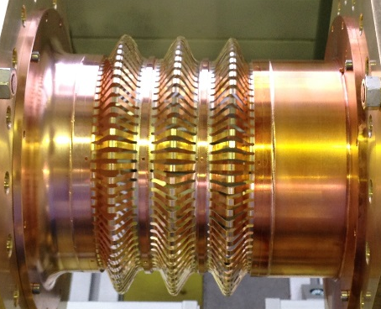
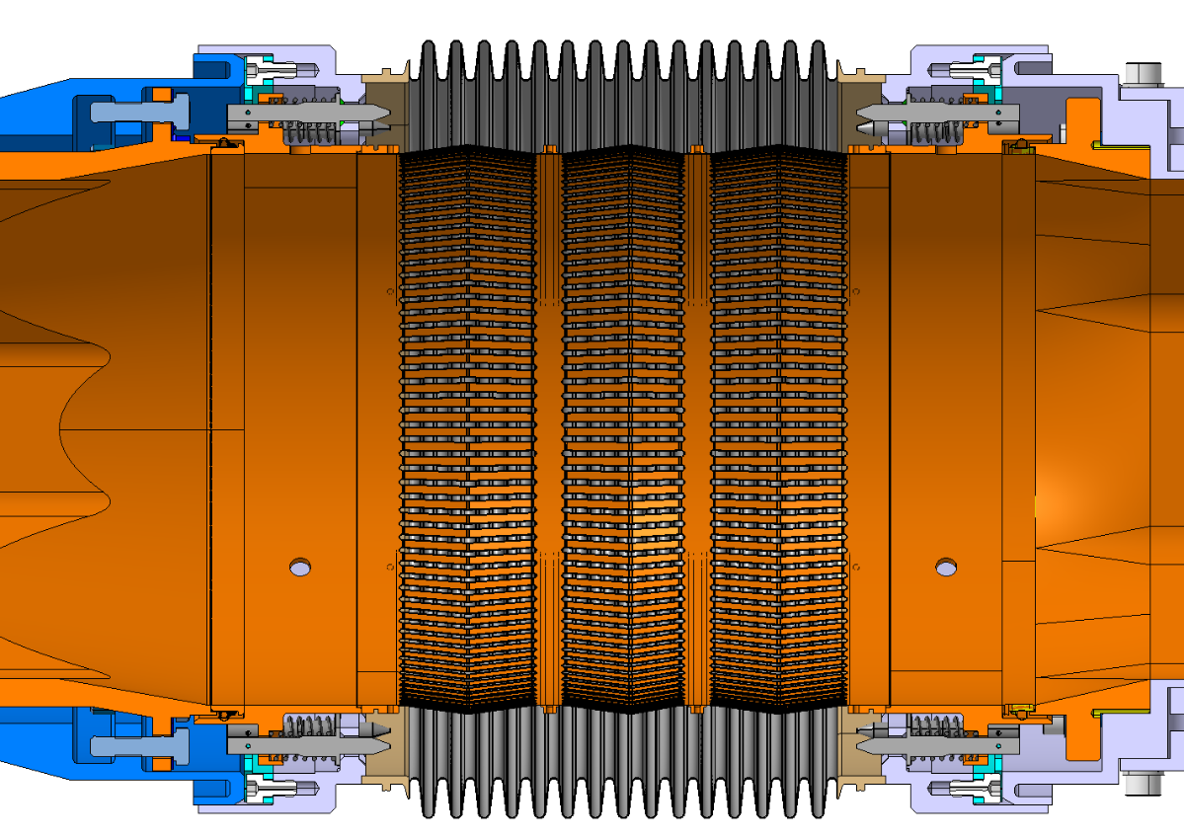
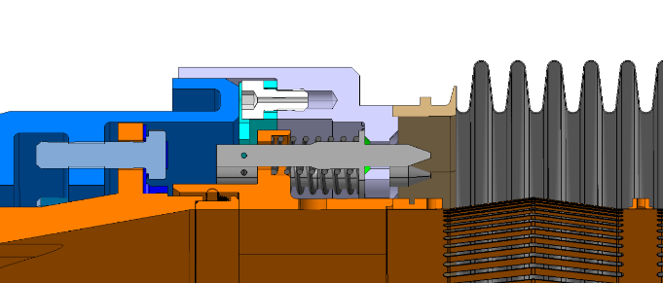
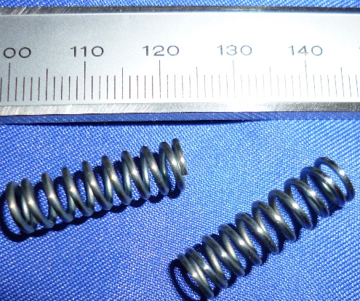
Integration of DRF in HL-LHC vacuum modules
Copper Beryllium deformable RF fingers:
Circular aperture
C17410
0.1 mm thick, 3 mm width, gap: 1.4 mm
3 convolutions
Static RF fingers
Deformable RF bridge
Copper insert
Titanium springs
Plug-In module in operation
Static RF fingers and titanium springs are introduced to get rid of the limitation in extension.

Slide 8
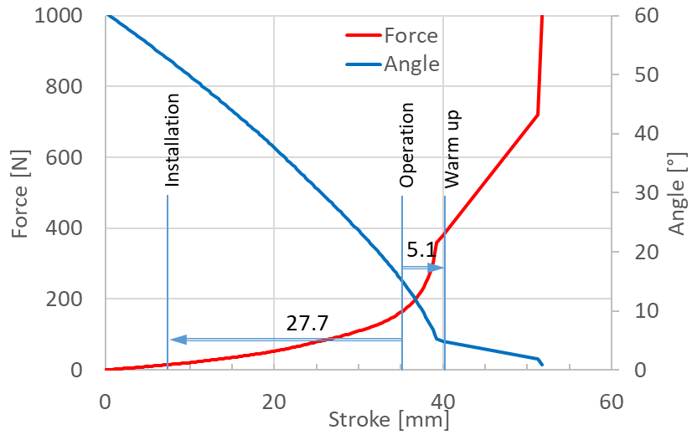
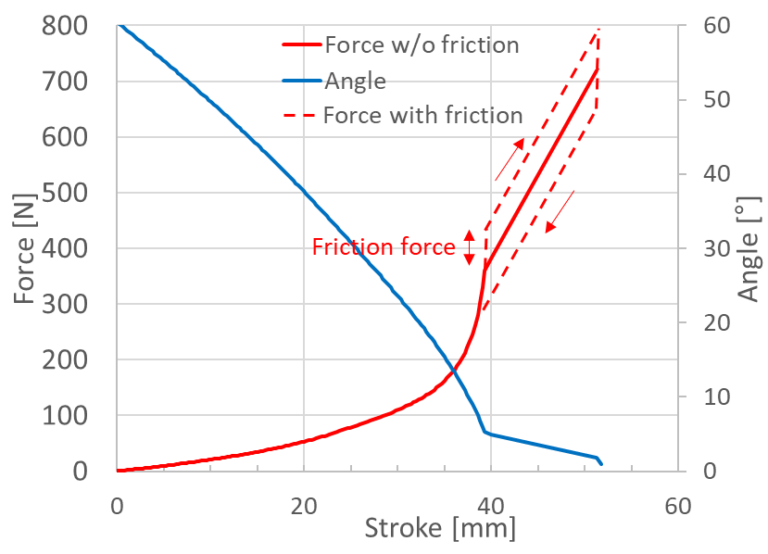
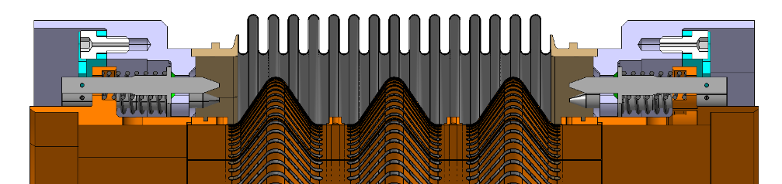
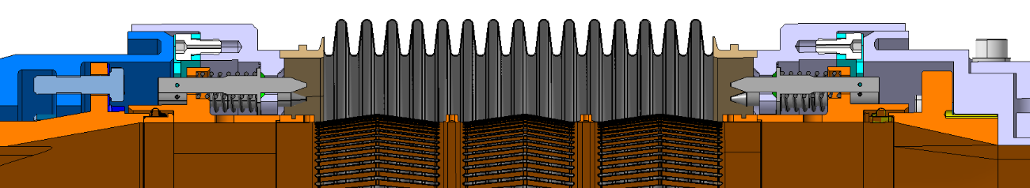
Behaviour of DRF in HL-LHC triplet module
Design driven by thermal contraction, including transient

Slide 9
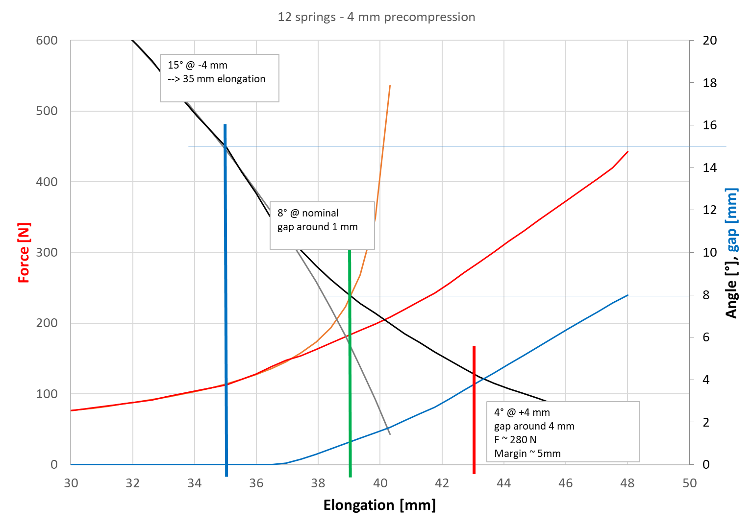
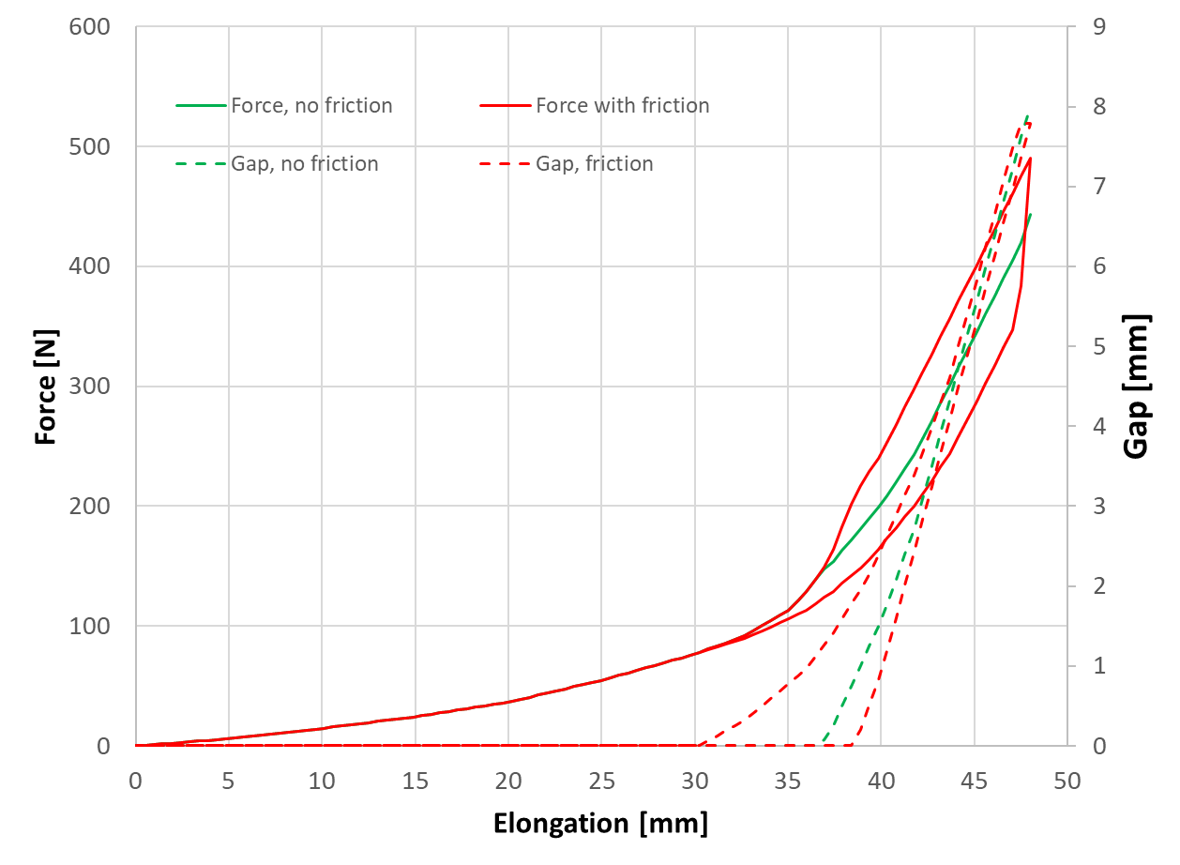
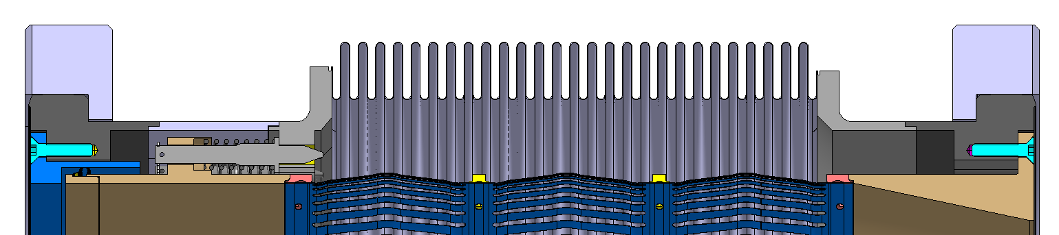
Behaviour of DRF in LSS module
Design driven by chamber tolerance → module length +/- 4 mm

Slide 10
Deformable RF (DRF) bridge
From a concept proposed for CLIC, the deformable RF fingers, offering a high robustness, will be widely used for the HL-LHC:
Inner triplet interconnection
In LSS for large transversal offset
In crab cavities

Slide 11
Cold Spray Additive Manufacturing
Cold spray technology:
Principle & advantage
Possible applications in accelerators:
  Functional coating
  Additive manufacturing
Applications of cold spray to UHV systems
  Thermal outgassing
  Leak tightness

Slide 12
Principle of Cold Spray
The gas dynamic cold spray coating is based on the projection of solid powder at high velocity.
Substrate
De Laval Nozzle
Compressed gas
Powder feeder
A compressed gas is heated before entering in a DeLaval Nozzle.
The gas is accelerated in the nozzle.
Powder is injected in the gas stream and accelerated as well.
The powder reaches velocity up to 1200 m/s.
The powder is plastically deformed and the coating is building up.

Slide 13
Cold Spray Advantages and Limitations
Advantages:
No powder melting.
  No phase change.
  No grain growth.
  Low heating of the substrate.
Powder mixture possible.
Compressive residual stress (fatigue life increase).
Nozzle geometry can be tuned for a given jet size.
Thick coating.
High deposition rate. Typically: efficiency ~ 70%, rate O(10 kg/hr).
Limitations:
One constituent has to be ductile.
Accessibility to the surface to be coated.
Notes:
300CHF/kg deposited

Slide 14
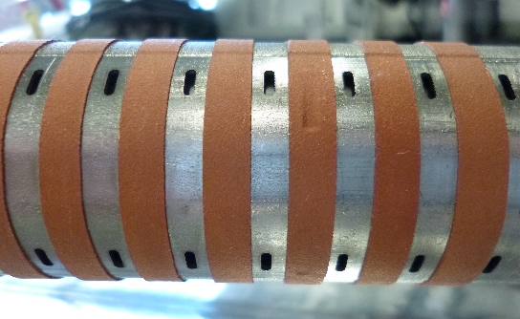
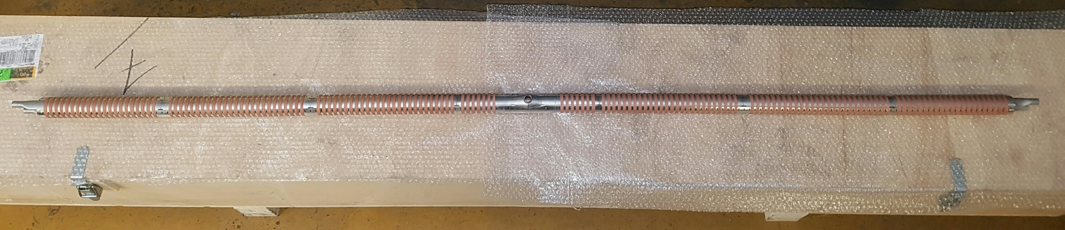
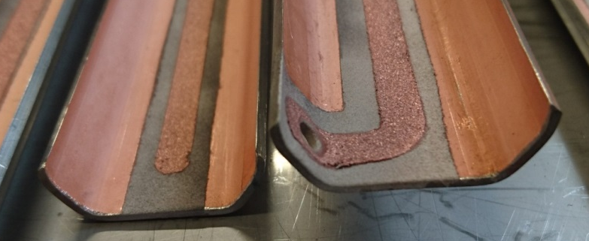
Possible Applications in Accelerators
Functional coating:
Heat transfer:
Copper trips on FCC-hh beam screen prototype.
Electrode:
Measurement of electrons for the FCC-hh beam screen prototype experiment at KARA.
Clearing electrode (optimisation of ceramic layer required for non-baked system).
Copper and aluminium cold spray coating on ceramic insulated copper coated stainless steel sheet

Slide 15
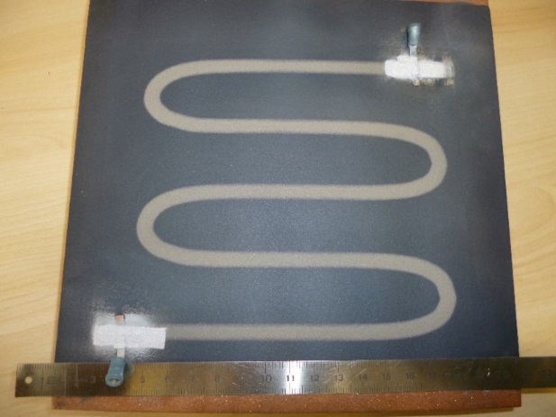
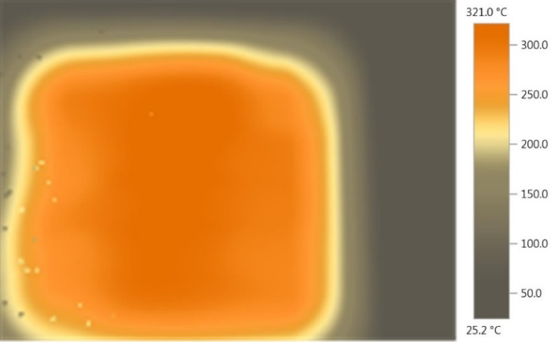
Possible Applications in Accelerators
Functional coating:
Permanent, radiation hard, heating element for bake out in or outside vacuum
Metallization of polymer/composite
Titanium heating track
Ceramic insulation layer
Copper plate
Copper plate with plasma sprayed ceramic and 0.2 mm thick cold sprayed titanium heating track
D. Giraud, Etude des composantes mécanique et métallurgique dans la liaison revêtement-substrat par projection dynamique pas gaz froid pour les systèmes aluminium/Polyamide6,6 et titane/TA6V, Mines ParisTech, 2014
Measurement of the temperature field

Slide 16
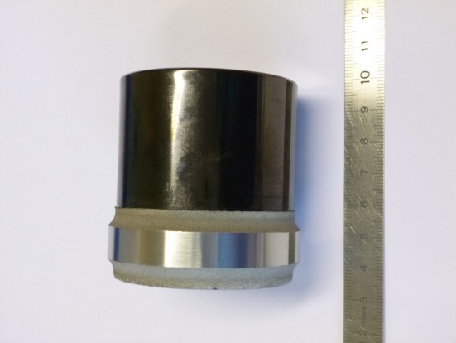
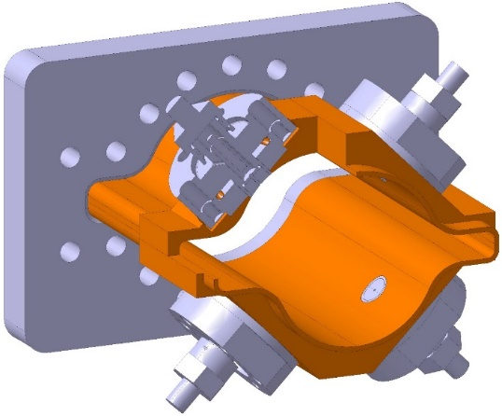
New Manufacturing Process
Additive manufacturing for:
Joining of dissimilar materials
New feature
Repair
Local reinforcement of thin walled structure
New materials
Diamond copper composite
Titanium on glassy carbon
J. Villafuerte, ADVANCED MATERIALS & PROCESSES, 2014
FCC-ee quadrupole chamber with BPM
Shuo Yin, Barry Aldwell and Rocco Lupoi, Advanced diamond-reinforced copper composite coatings via cold spray and material characterization, Trinity College Dublin

Slide 17
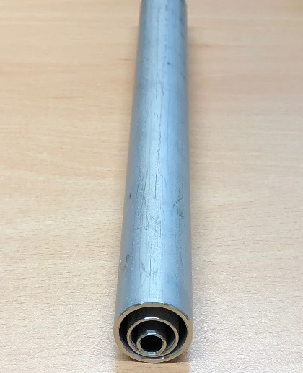
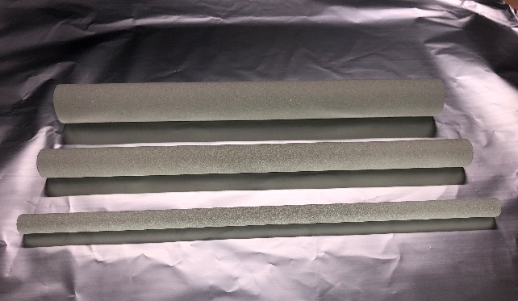
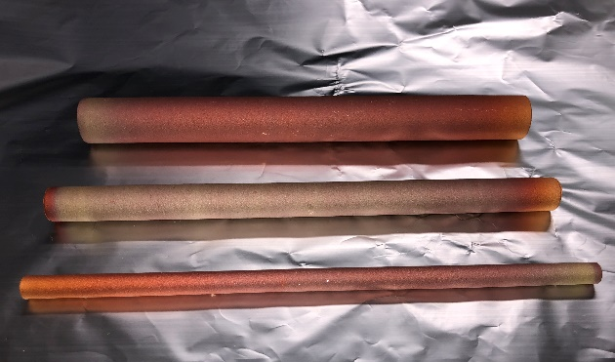
Vacuum Performance
Thermal outgassing
Samples:
Substrate: 3 stainless steel tubes, vacuum fired
Titanium coating, grade 2, 0.5 mm thick
Copper, 99.95%, 0.5 mm thick
Titanium coated samples
Copper coated samples
Substrates
Thermal outgassing after bakeout:
Outgassing of H2 for copper is similar to bulk material.
Titanium outgassing is low (slight getter effect observed).
Inert gas used during the powder fabrication may have a significant impact (high outgassing of N2 and Ar observed, for copper).

Slide 18
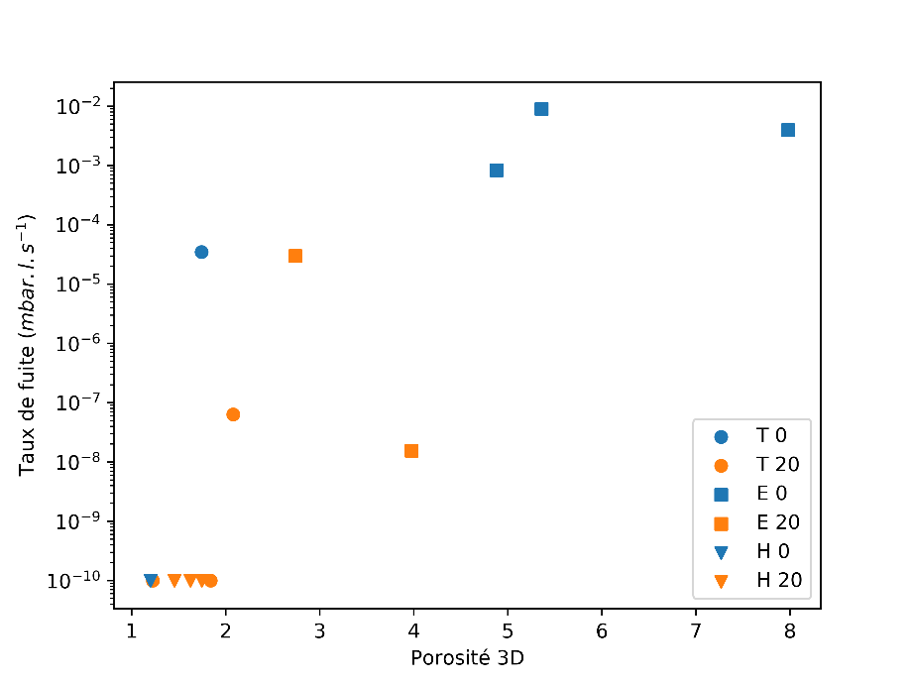
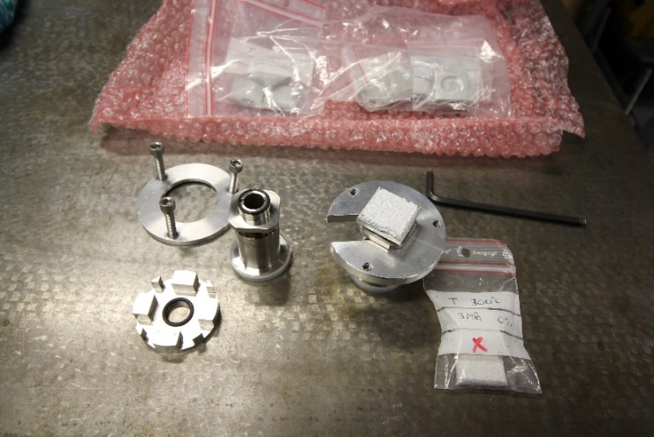
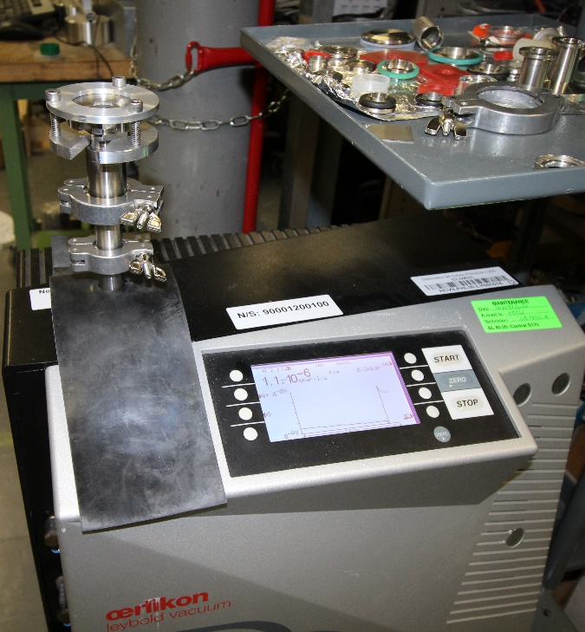
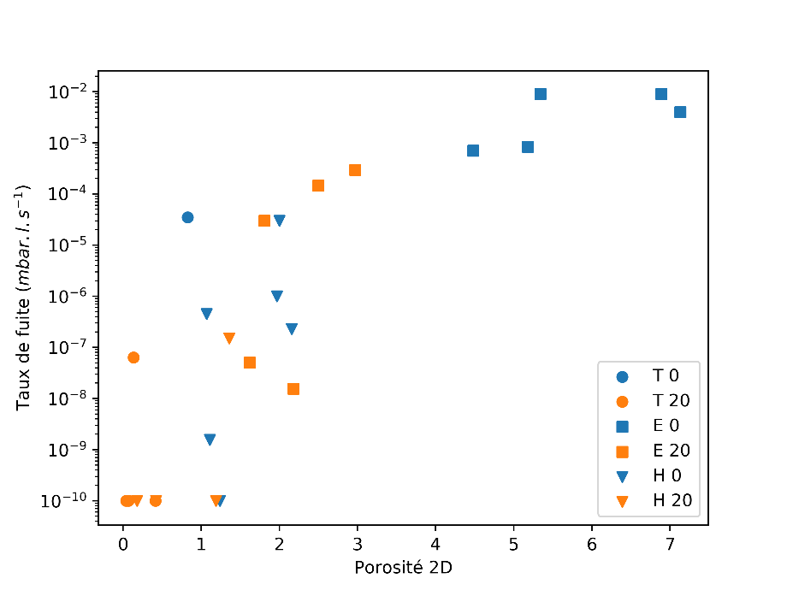
Vacuum Performance
Leak tightness
Study program on aluminium coatings being finalized in collaboration with Mines ParisTech:
Powder :
  Morphology, metallurgical characteristics, mechanical properties.
  Pre-treatment.
Processing parameters:
  Cold spray: gas pressure and temperature.
  Post-treatment.
Coating microstructure.
Vacuum performance.
Mechanical testing.
Modeling and numerical simulations.
Leak tightness tests of aluminium cold sprayed materials
Relationship between porosity and leak rate

Slide 19
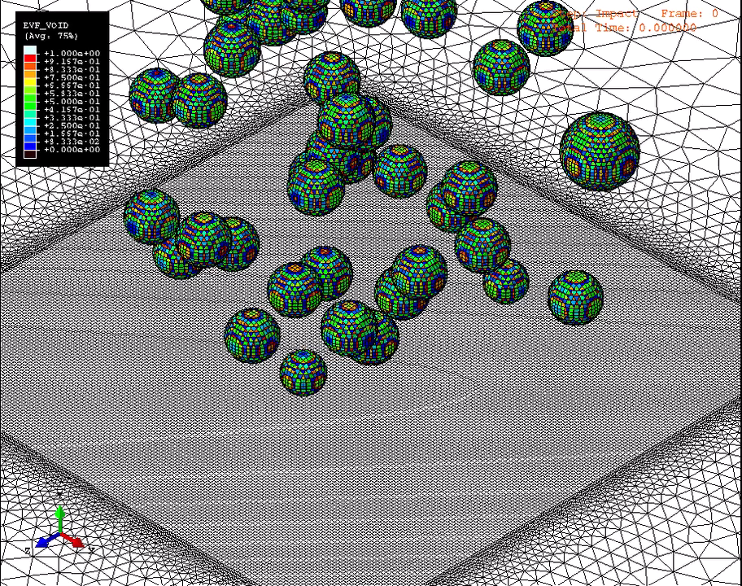
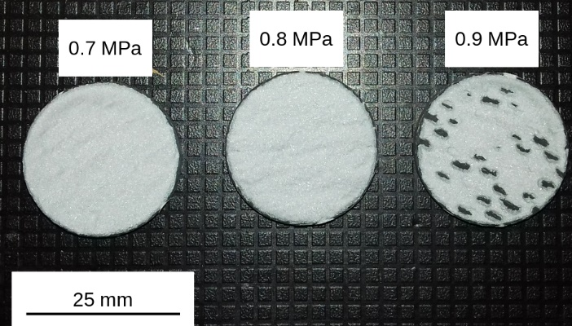
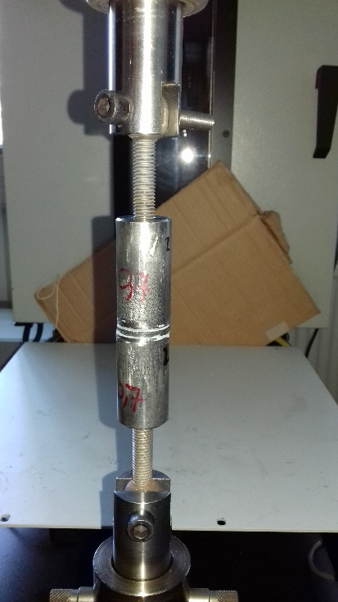
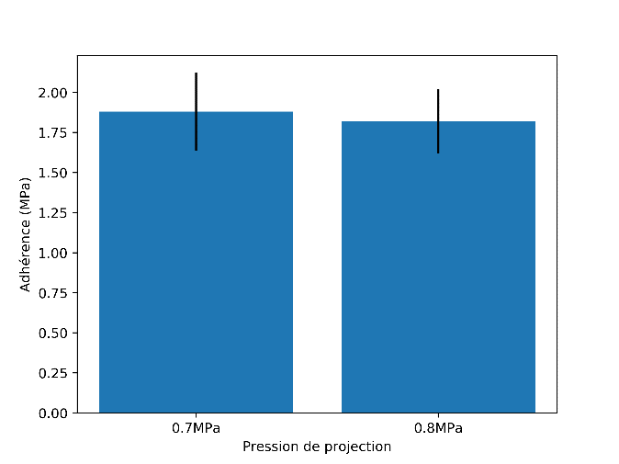
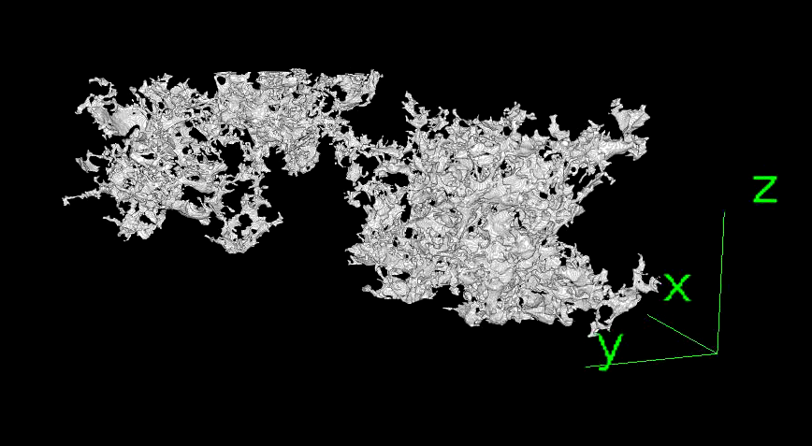
Vacuum Performance
Leak tightness
Aluminium coating on CFRP composite
Courtesy S. Weiller, F. Delloro (Mines ParisTech)
Simulation of the coating process and assessment of the porosity
Porosity network
Aluminium Coating with “closed” porosities
Adhesion tests

Slide 20
Discussion
Gas dynamic cold spray is a coating method based on supersonic jet of powders, heavily plastically deformed during the impact.
Ductile materials are well suitable for this manufacturing process.
Cold sprayed copper coating has been successfully been applied on a first FCC-hh beam screen prototype.
Other applications have been identified in different field of high energy particle accelerators.

Slide 22
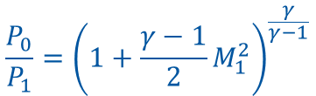
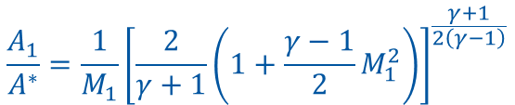



Principle of Cold Spray
1D isentropic flow equations:
De Laval Nozzle
P₁, v₁, T₁,
A₁
P₀, v₀, T₀
A*
$$\frac{P_{0}}{P_{1}}={\left(1+\frac{γ−1}{2}M_{1}^{2}\right)}^{\frac{γ}{γ−1}}$$
$$\frac{T_{0}}{T_{1}}=1+\frac{γ−1}{2}M_{1}^{2}$$
$$M_{1}=\frac{v_{1}}{c_{1}}=\frac{v_{1}}{\sqrt{γR_{s}T_{1}}}$$
$$\frac{A_{1}}{A^{∗}}=\frac{1}{M_{1}}{\left[\frac{2}{γ+1}\left(1+\frac{γ−1}{2}M_{1}^{2}\right)\right]}^{\frac{γ+1}{2\left(γ−1\right)}}$$
$$γ=\frac{c_{p}}{c_{v}}$$
γ=5/3 (1.67) for monoatomic perfect gas
γ=7/5 (1.4) for diatomic perfect gas and
γ=1,33 for polyatomic perfect gas
R_{s} is the specific gas constant given by R/M_{molar}
Nitrogen is commonly used. Helium is used to reach higher velocity.
Notes:
P0 ~30 – 50 bars
T0 : 300 C

Slide 23
Bounding mechanism
Copper on copper
Rebound zone
T. Schmidt et al., From Particle Acceleration to Impact and Bonding in Cold Spraying, Journal of Thermal Spray Technology, 18, 5-6, 794-808, 2009
Typical surface around the critical velocity
A1050 powder on 2024-T3 substrate
Material jet
Q. Blochet, Influence of substrate surface roughness on cold-sprayed coating-substrate bond strength in aluminum-based systems, PhD Thesis, Mines ParisTech, 2015
Assadi et al., Bonding mechanism in cold gas spraying, Acta Materialia, 51, 4379-4394, 2003
Notes:
Adiabatic shear instability

Slide 24
Some properties: example of copper
Electrical conductivity
Bounding strength
With helium
With nitrogen
T. Stoltenhoff et al., Microstructures and key properties of cold-prayed and thermally sprayed copper coatings, Surface & coatings Technology, 200, 2006
Coating strength
After Jeandin et al., Coating properties in Modern cold spray, Ed. J. Villafuerte, Springer, 2015
N₂
He
C.H. Boyle, Mechanical performance of integrally bounded copper coatings for the long term disposal of used nuclear fuel, Nuclear Engineering and design, 293, 2015
F. Gärtner, Mechanical properties of cold-sprayed and thermally sprayed copper coatings, Surface & Coatings Technology 200, 2006
→ Material properties are affected by the cold spray process but they can significantly be recovered by dedicated post treatment.

Slide 25
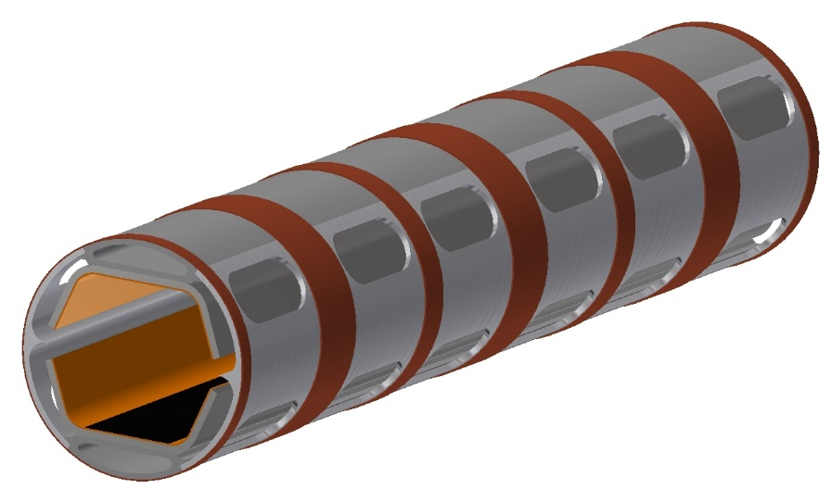
Application to FCC
FCC-hh beam screen
Cooling channel
Colaminated copper- stainless steel internal screen
Copper strip for heat transfer
Pumping holes
Requirements:
Copper material (thermal conductivity)
Stainless steel substrate
Discountinuous (longitudinally → reduced Lorentz forces during a magnet quench)
Continuous as close as possible to the cooling channel (better cooling and temperature control)
Done after beam screen assembly (welds)
No spray or coating contamination inside the beam screen
Industrial process

Slide 26
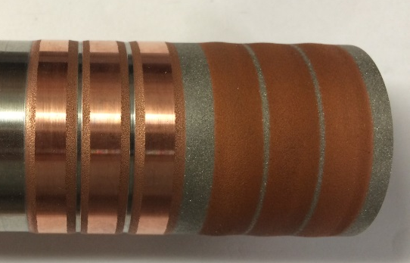
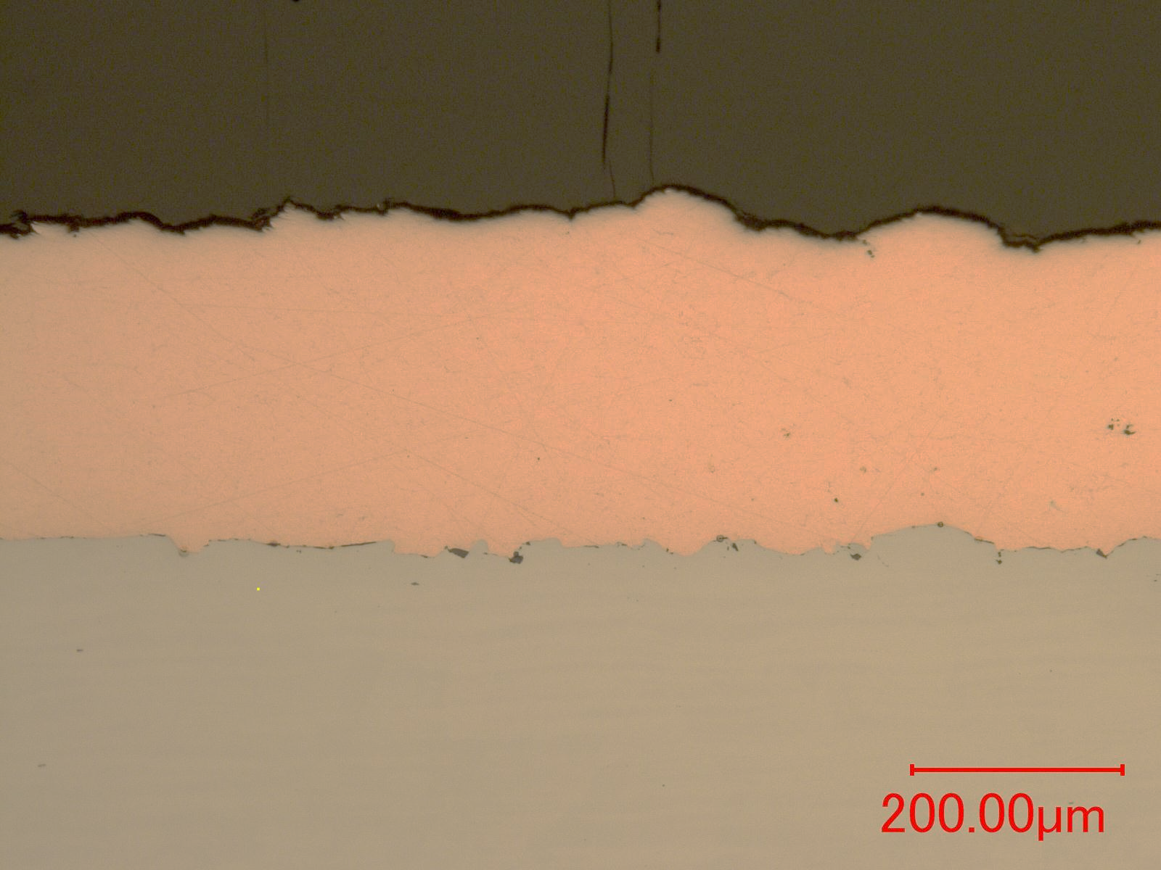
Application to FCC beam screen
Surface preparation by blasting (Al2O3)
Cold sprayed copper on austenitic stainless steel.
Possible improvements:
Surface preparation: laser treatment
Nozzle geometry: correct width
Process parameters

Slide 27
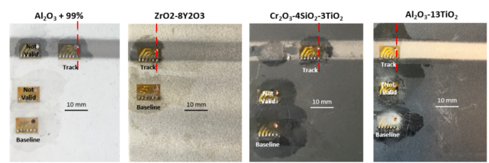
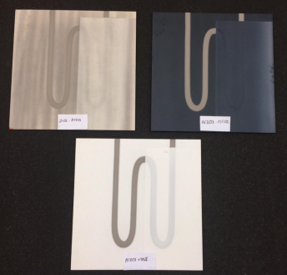
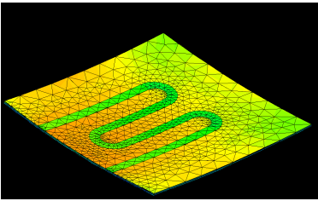

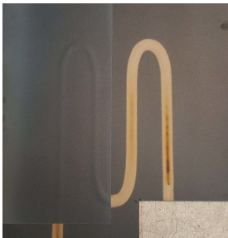

Cold spray for vacuum applications
Integrated radiation hard heating track
Thermal mechanical simulations
Titanium track on copper plate with ceramic sub and top layers
Plate with Al2O3-TiO2 ceramic after thermal cycles at 250 C.
Assessment of internal stresses after coatings by hole drilling

