Slide 1
Reconstruction of Quench Heater Kick Fields from Beam Position Measurements
Lea Richtmann
25/2/2021

Slide 2
Table of contents
Introduction
  The LHC Quench Protection System (QPS)
  The impact of Quench Heater (QH) firing on the circulating beam
How to understand the impact on the beam?
Reconstruction of kicks on the beam by the Quench Heaters (QH)
  Method
  Reconstruction results
  Fitted rise times and field levels
Outlook and Summary

Slide 3
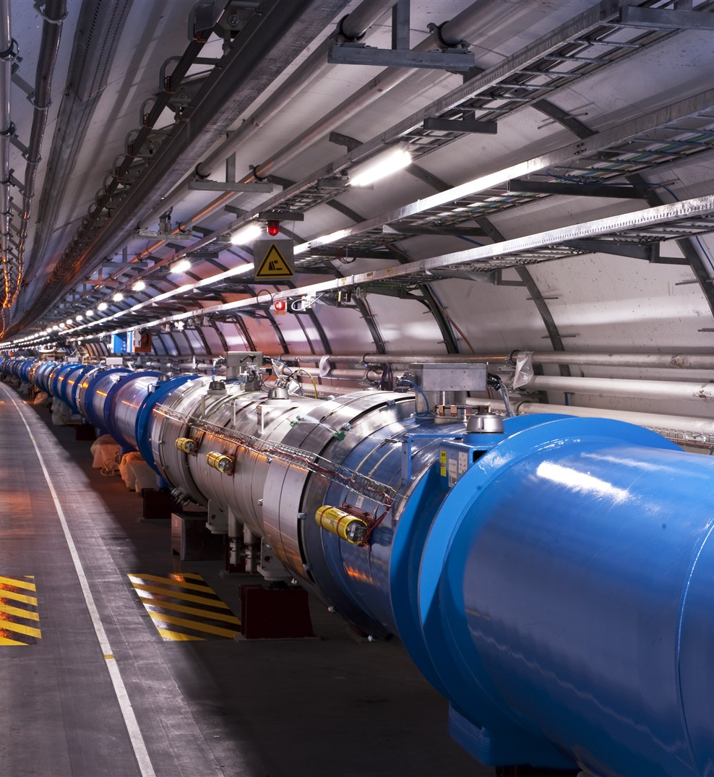
Introduction
The LHC Quench Protection System (QPS)
Many superconducting magnets (1232 main dipoles,
392 lattice quadrupoles, …)
→ about 10 GJ stored energy for the whole LHC
Transition to normal conducting state: Quench
Quench Protection System required to avoid magnet damage

Slide 4
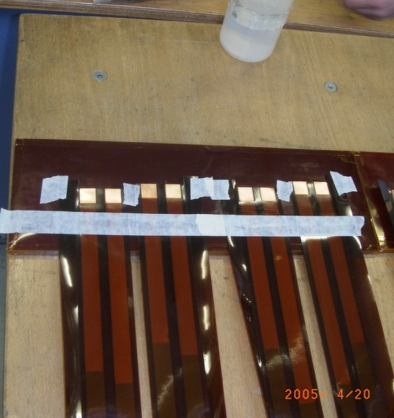
Introduction
Quench Heaters (QH)
  Magnet usually quenches in a small spot:
  → local rise of temperature could cause damage
  Heat up magnet coil: Quickly increase resistive zone of the magnet and avoid hot spot
Picture: A. Musso

Slide 5
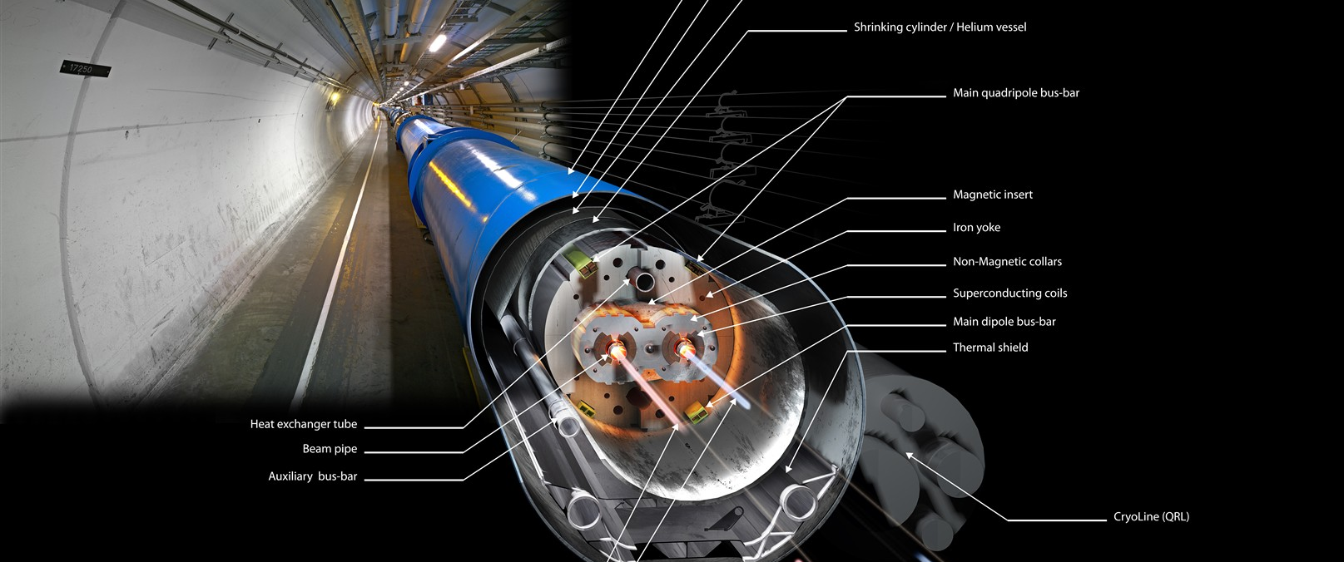
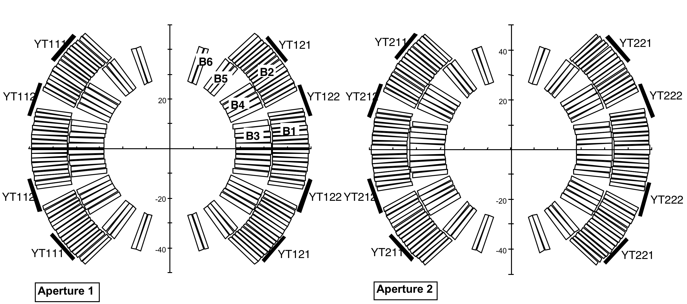
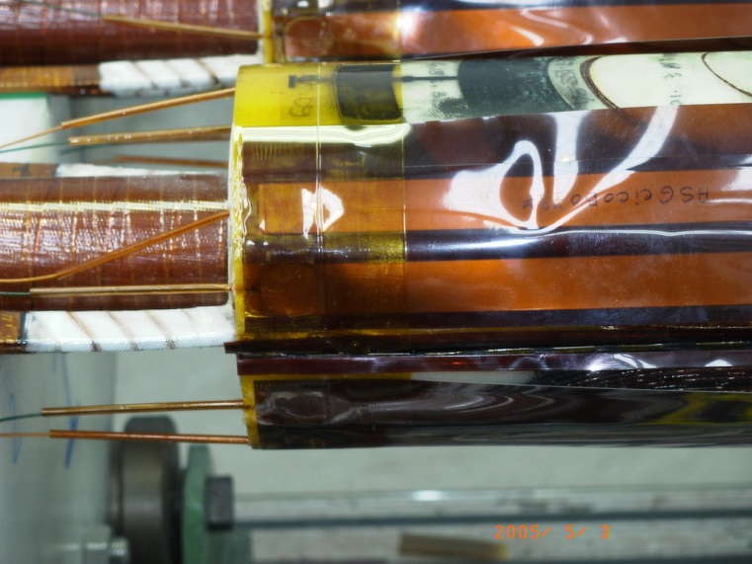
Introduction
Quench Heaters (QH)
QH strips are attached to the magnet coils
Picture: A. Musso

Slide 6
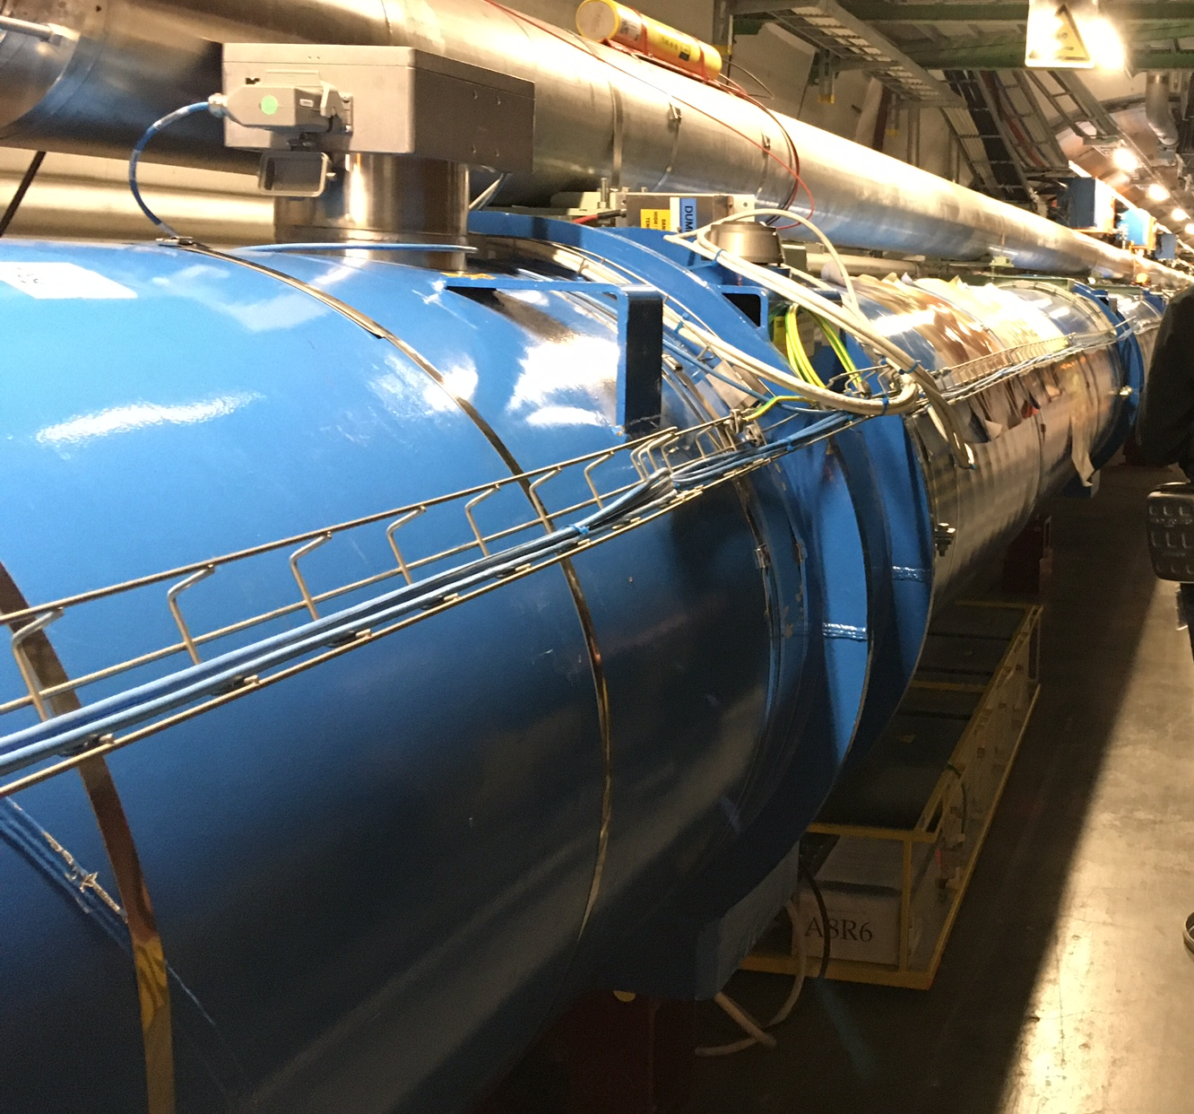
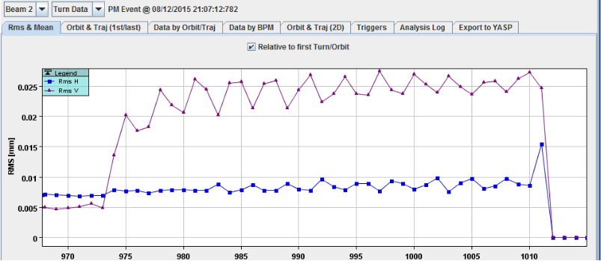
Introduction
QH and their impact on the beam
Powered with ~ 75 A [1, p. 174]
This is normally a magnet-protection device, independent from beam
BUT: due to their connection scheme they generate a horizontal dipole field…
→ it was discovered that this field had in some cases an impact on the
circulating beam
38 turns, ~ 3 ms

Slide 7
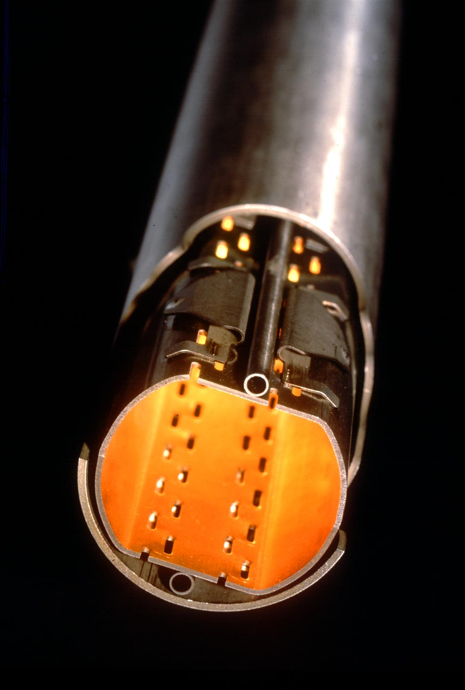
How to understand the impact on the beam?
Beam screen
Required for multiple reasons (absorb synchrotron radiation, mitigate e-clouds, …)
Has a copper layer:
→ Eddy currents produce a counteracting field
→ Shielding
How much shielding do we get?
  How does the resulting field in the aperture develop?
  No direct field measurements → reconstruct from beam measurements
  → use these reconstructions to validate and refine models of shielding behavior
Beam screen located in the beam pipe

Slide 8
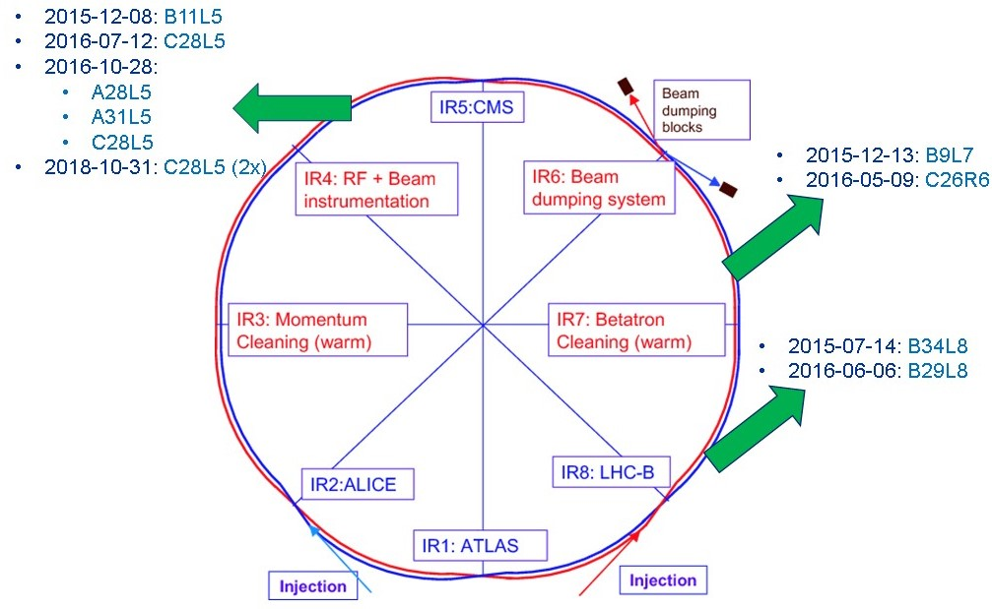
Cases to be reconstructed: Different quench events
Operational cases from Physics Runs
Machine Development (MD) with ion beams
Two dedicated MDs where QH were fired manually
  MD1826: Oct 2016:
    At injection energy (450 GeV)
    Three different dipoles (C28L5, A28L5, A31L5)
    1 bunch per beam
  MD3205: Oct 2018:
    During ramp and at flat top energy (6.5 TeV)
    One dipole (C28L5), 3 bunches per beam
    Beam screen heated to 70 K (nominal 20 K) to observe change in shielding behavior
    Use bunch-by-bunch measurement with ADT ObsBox to reconstruct kick field with ~30 µs resolution
    Method and results detailed in CERN-ACC-NOTE-2020-0003

Slide 9
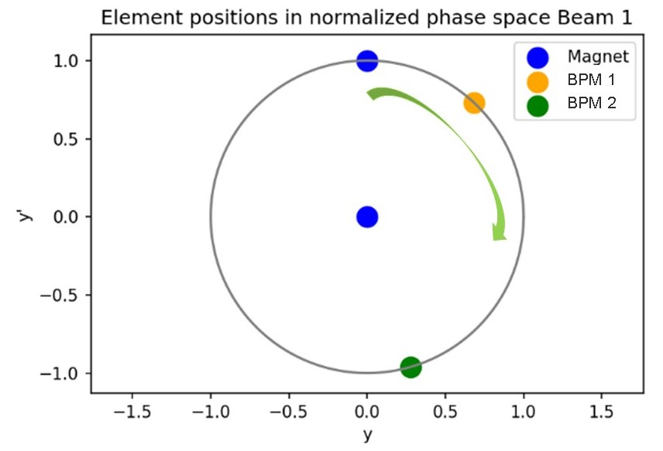

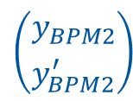
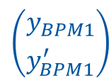


Reconstruction Method -
Idea: Rotation in phase space
Approach: Represent beam oscillation as rotation in normalized phase space
$$\left({y_{M} \atop y_{M}^{′}}\right)$$
$$\left({y_{BPM1} \atop y_{BPM1}^{′}}\right)$$
For each turn:
$φ$: phase advance at element
$y$: transverse position
$y′$: transverse angle
  $\left({y_{BPM} \atop y_{BPM}^{′}}\right)=\left(\begin{matrix}cos⁡(φ) & sin⁡(φ) \\ −sin⁡(φ) & cos⁡(φ)\end{matrix}\right)\left({y_{M} \atop y_{M}^{′}}\right)$ eq. (1)
  → If we know position and angle at one element $\left({y_{M} \atop y_{M}^{′}}\right)$, we can calculate them at any other element $\left({y_{BPM} \atop y_{BPM}^{′}}\right)$ knowing the phase advance.
kick
$$φ$$
Angle
$$\left({y_{BPM2} \atop y_{BPM2}^{′}}\right)$$
Position

Slide 10
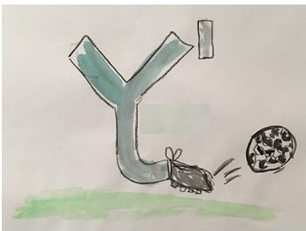
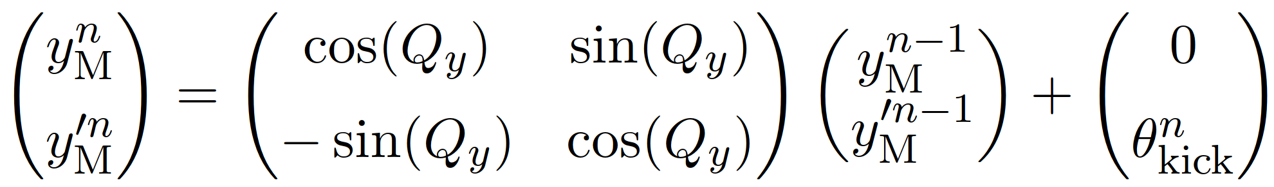
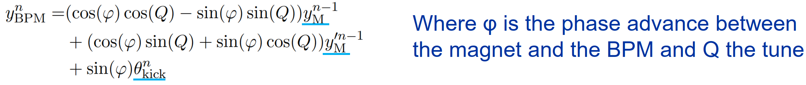
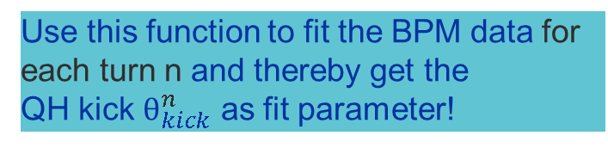
Reconstruction Method -
Idea: Rotation in phase space
At magnet (M): At each turn (n) there is an additional
kick by the QH field (After a whole turn, the phase advance
at the magnet is the tune Q):
eq. (2)
Plug eq. 2 in eq. 1 and get one expression for the position at any BPM:
Drawing: T. Schaller
We have three unknowns:
position and angle at the magnet from the turn before
kick angle from this turn
Use this function to fit the BPM data for each turn n and thereby get the
QH kick $θ_{kick}^{n}$ as fit parameter!

Slide 11
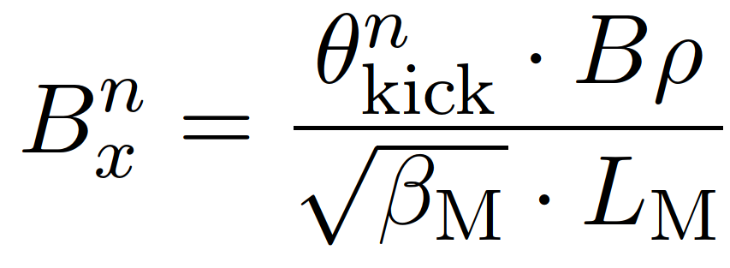
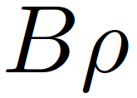
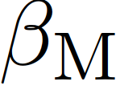
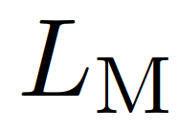

Reconstruction Method
From kick angle $θ_{kick}^{n}$calculate the magnetic field:
with : beam rigidity, : beta function at the magnet, : Length of magnet

Slide 12
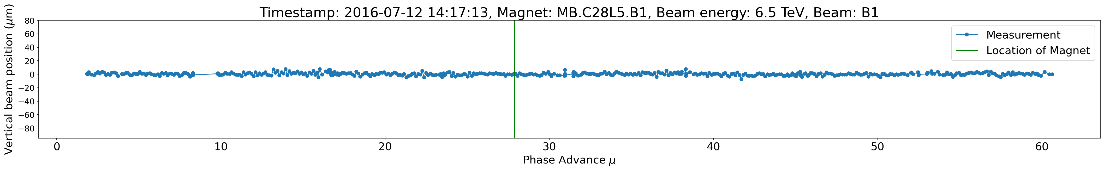
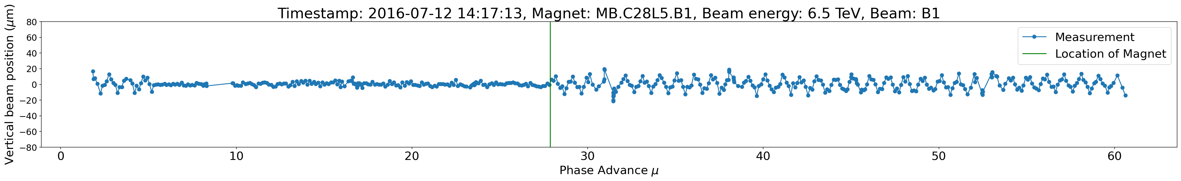
Beam Position Monitor (BPM) measurement
Example: Vertical beam position before QH fire:
Turn when QH are fired:
1 LHC Turn

Slide 13
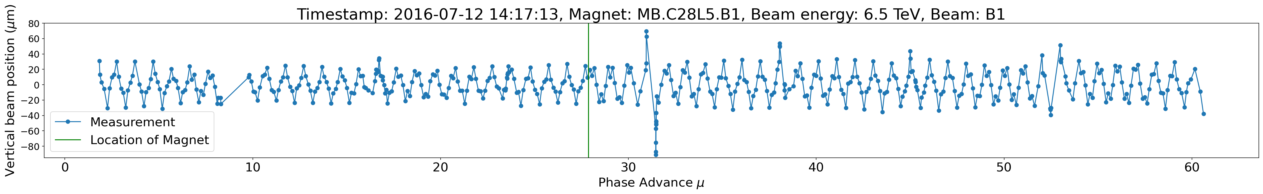
Beam Position Monitor (BPM) measurement
26 turns after the QH fired:

Slide 14
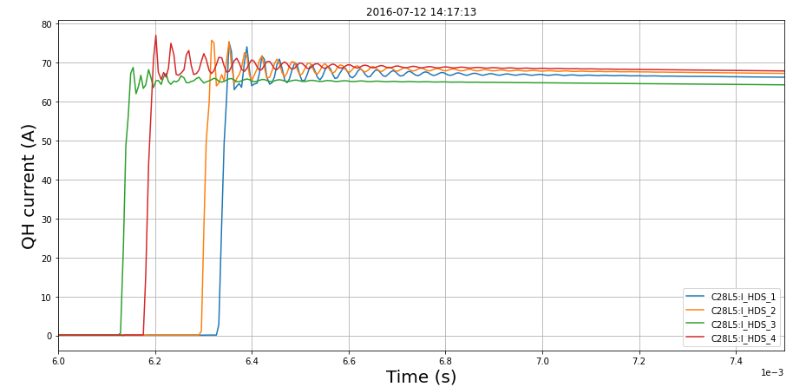
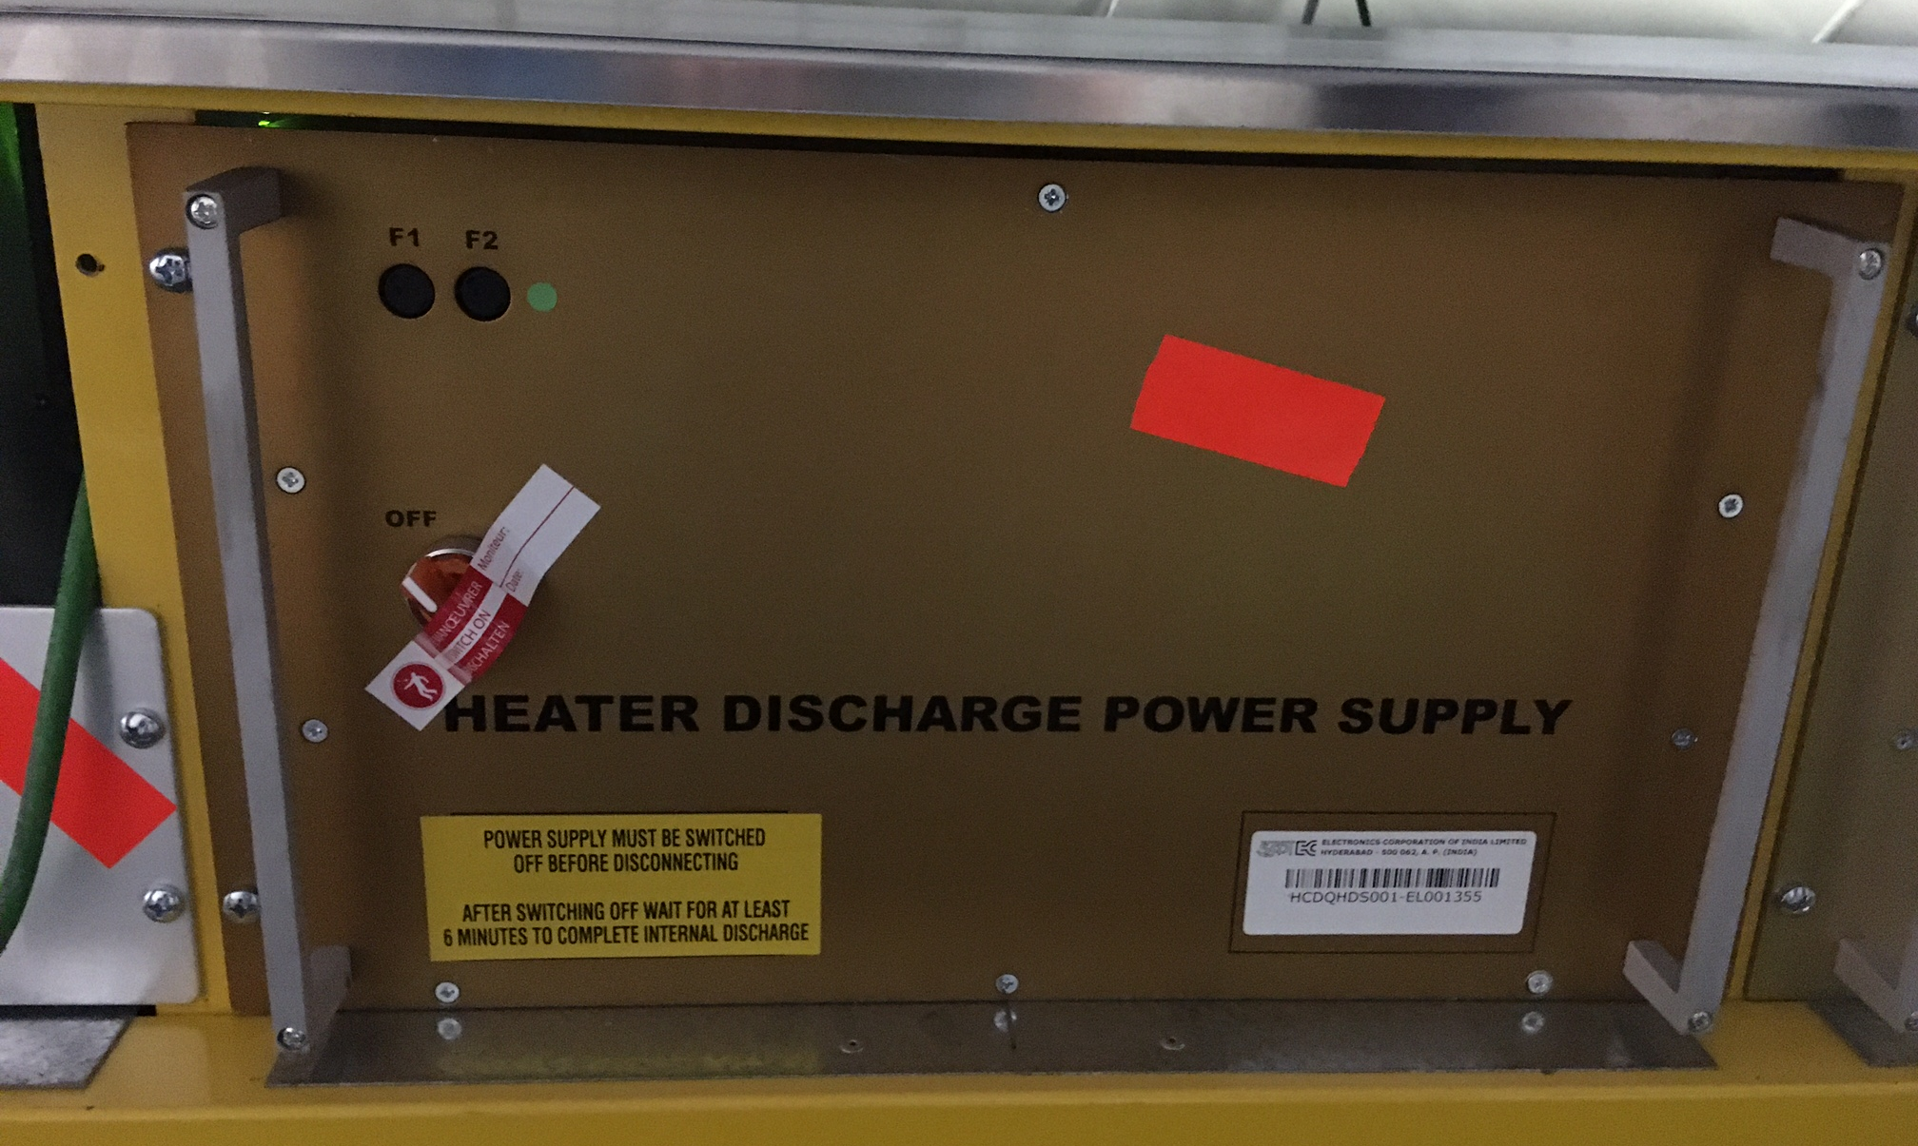
Reconstruction:
Look into QH currents
Field generated by QH current
We would expect a field with a shape that is somewhat similar:
  A (fast) rise at the beginning
  Then a more or less stable field
From QH current (nominal) ~ 75 A: expected field level (neglecting the iron contribution): ~ 760 µT

Slide 15
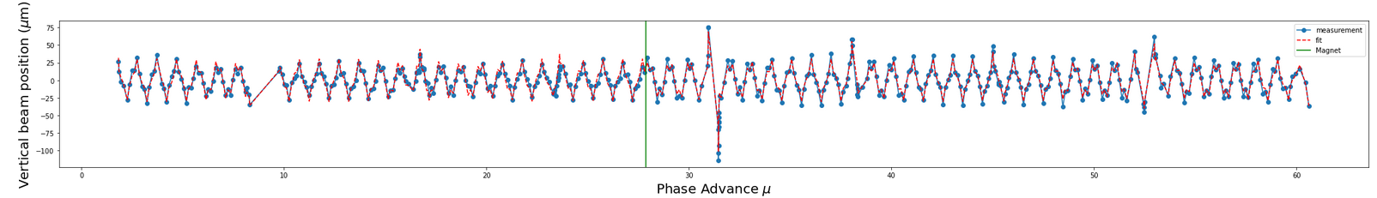
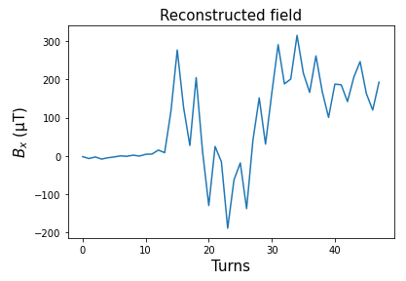
Reconstruction: Fitting parameters
Challenge:
  Three fit parameters give algorithm too much freedom: i.e., position and angle in magnet is fitted for each turn independently, but this is dependent on the turn before!
  What happens, fit looks good….
  But:
  Reconstructed field has unphysical shape

Slide 16
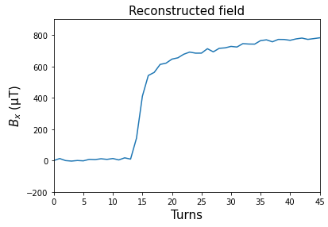
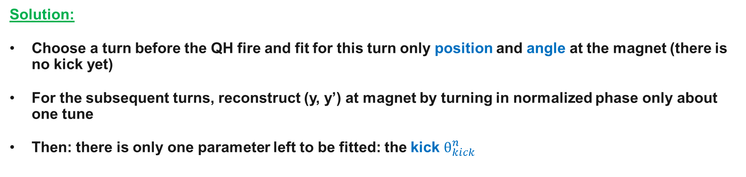
Reconstruction: Fitting parameters
Solution:
Choose a turn before the QH fire and fit for this turn only position and angle at the magnet (there is no kick yet)
For the subsequent turns, reconstruct (y, y’) at magnet by turning in normalized phase only about one tune
Then: there is only one parameter left to be fitted: the kick $θ_{kick}^{n}$
And now:

Slide 17
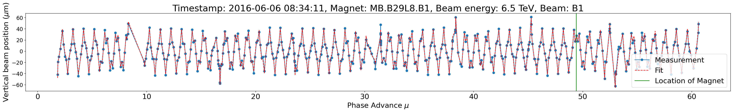
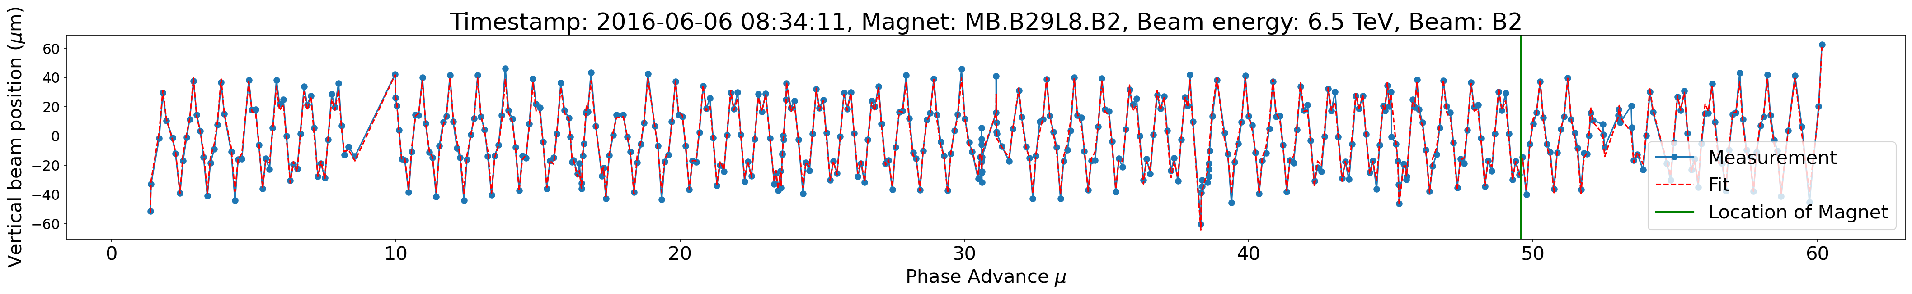
Fitting results
In general good agreement between measured beam positions and fit
Example: B29L8, 6.5 TeV, 20 K: 16 turns after the firing

Slide 18
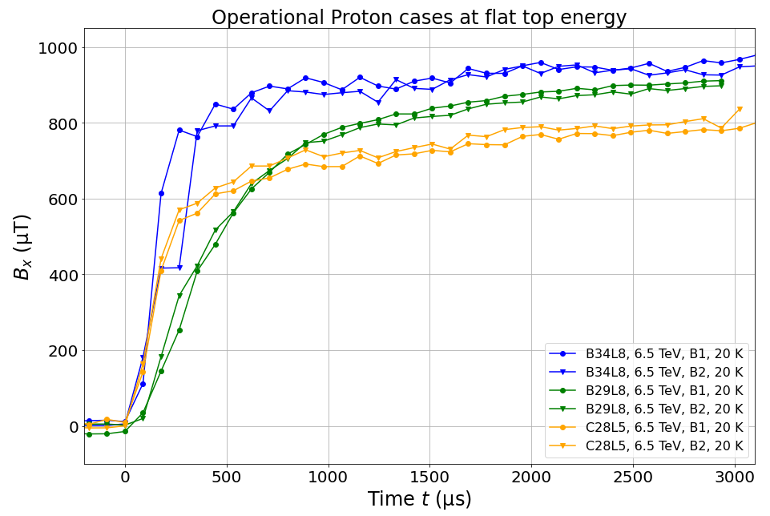
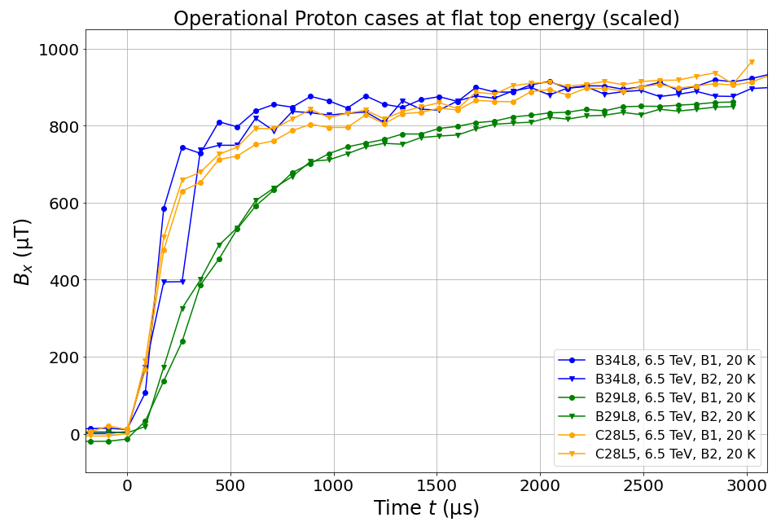
Reconstruction results: Field levels
Look into measurements of QH currents: they vary in a range of about 15 A
Field levels after scaling the field with (measured QH current)/75 A agree within 10 %
With new fitting method, reconstructed field levels agree within 25%

Slide 19
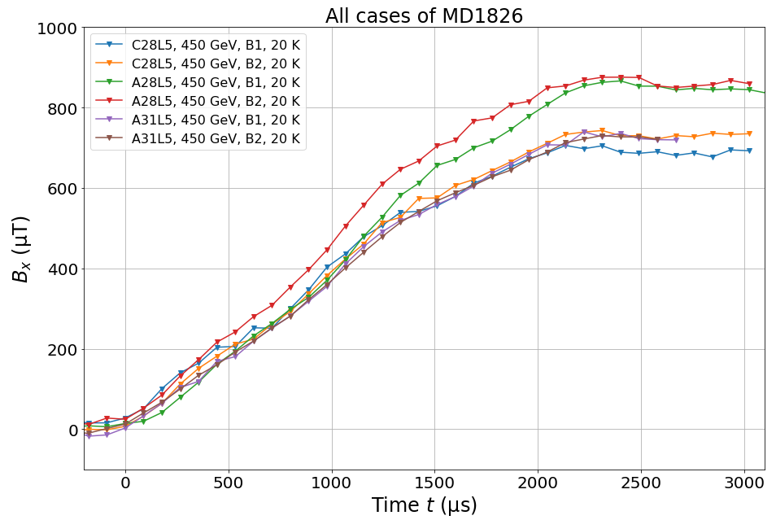
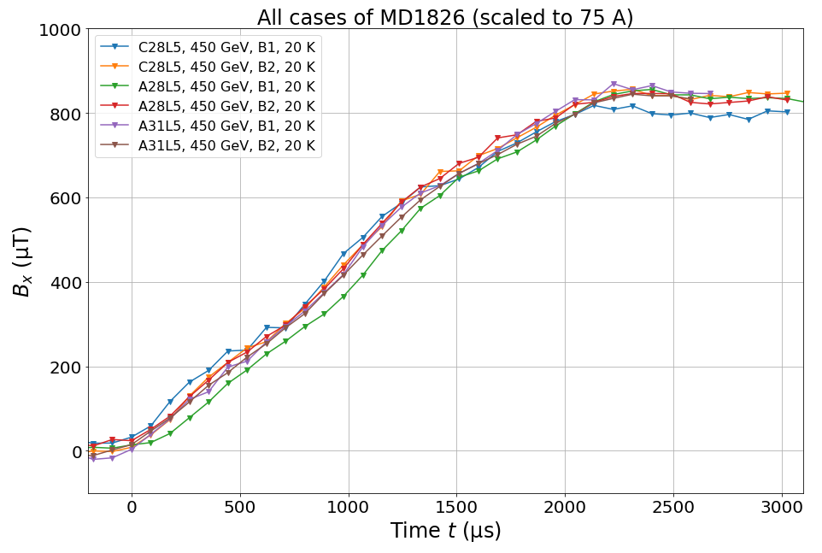
Reconstruction results –
Injection energy cases
Six different cases reconstructed for 450 GeV: Good agreement for rise time and field level

Slide 20
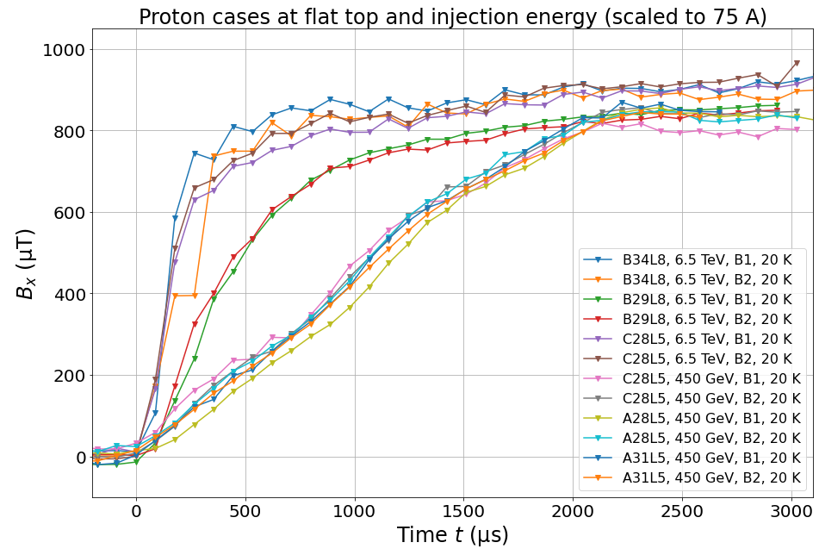
Reconstruction results –
Flat top and injection energy cases
Field levels similar for flat top and injection energy if different QH currents are taken into account
Note: As the QH current average varies between 65 A and 79 A scale all fields to 75 A (nominal) for comparison
(the average is taken between 2.5 and 3 ms after the current peak)

Slide 21
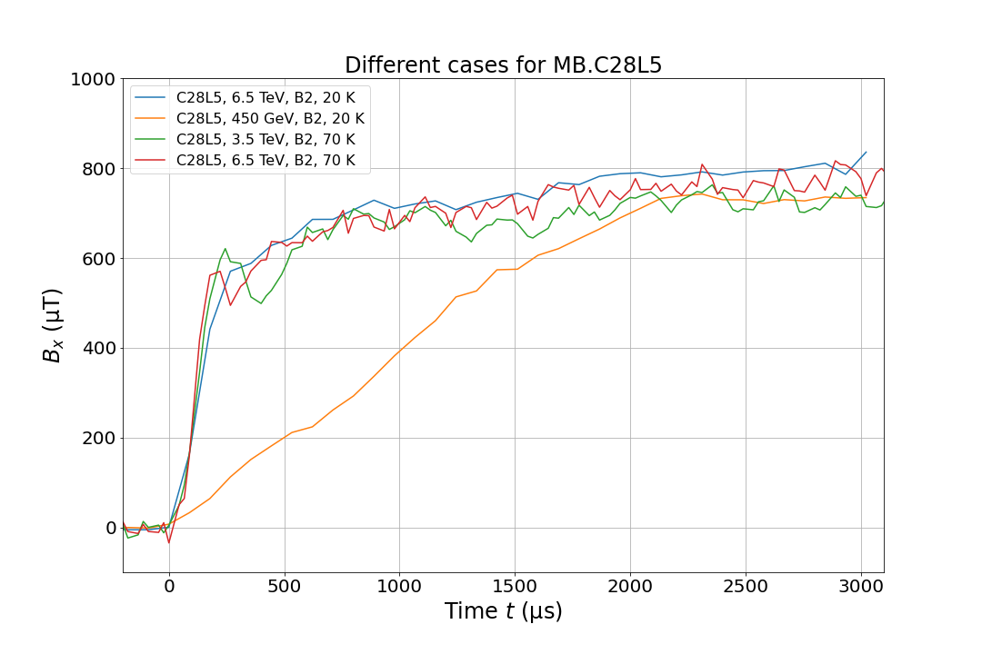
Reconstruction results: Dipole C28L5: 4 cases
Qualitative considerations:
In all the cases the field levels are similar
Resistivity depends on copper properties, temperature, magneto-resistivity
Higher shielding is expected for lower copper resistivity (lower temperatures, lower dipole fields)

Slide 22
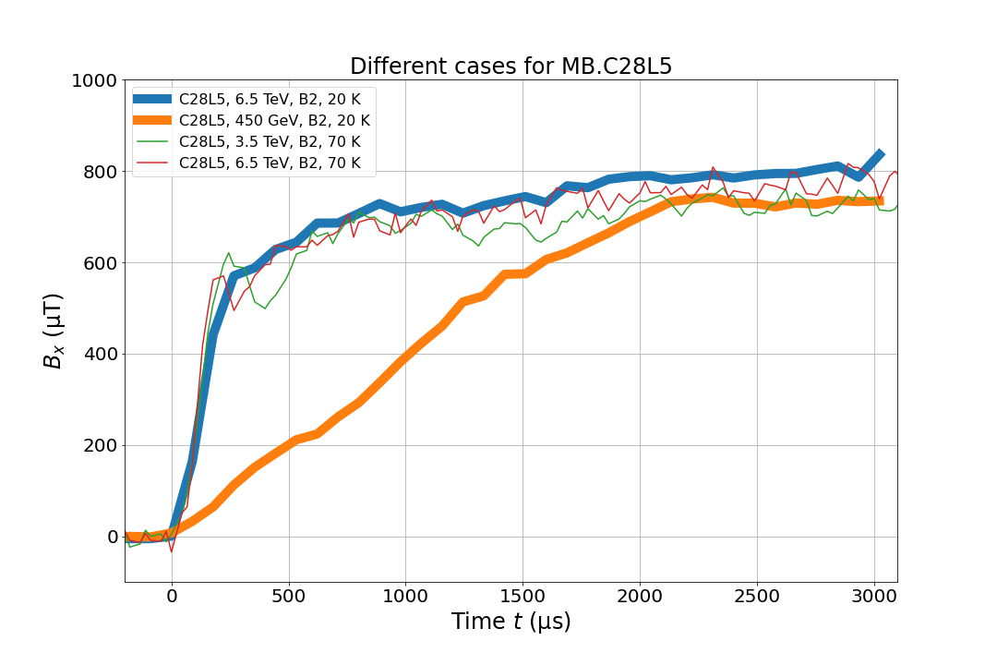
Reconstruction results: Dipole C28L5 : 4 cases
Qualitative considerations:
In all the cases the field levels are similar
Resistivity depends on copper properties, temperature, magneto-resistivity
Higher shielding is expected for lower copper resistivity (lower temperatures, lower dipole fields)
For 20 K: significant difference in rise times for different energies

Slide 23
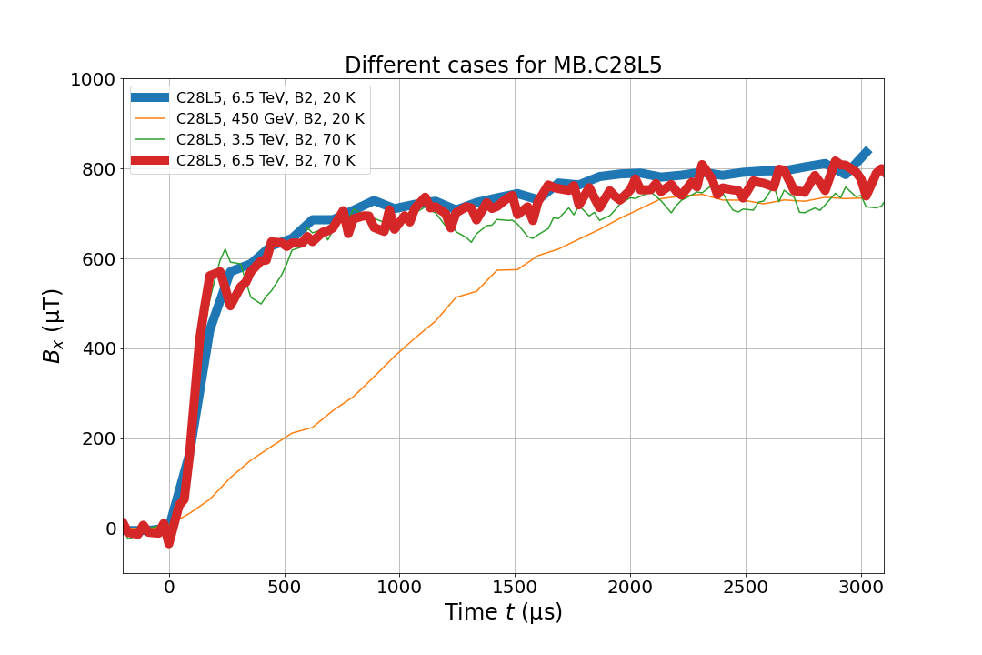
Reconstruction results: Dipole C28L5: 4 cases
Qualitative considerations:
In all the cases the field levels are similar
Resistivity depends on copper properties, temperature, magneto-resistivity
Higher shielding is expected for lower copper resistivity (lower temperatures, lower dipole fields)
For 20 K: significant difference in rise times for different energies
For 6.5 TeV: similar rise times for 20 K and 70 K beam screen temperature

Slide 24
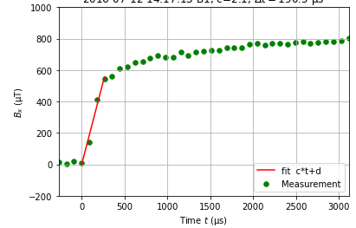
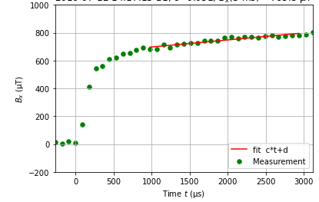
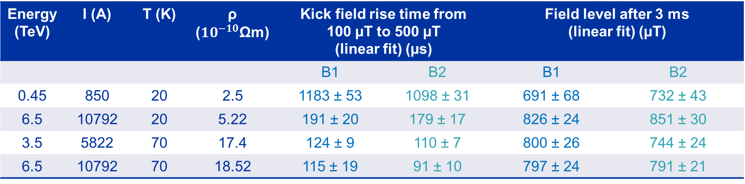
3.4 Fitted rise times and field levels for C28L5
Tempe-rature of the beam screen
Proton beam energy
Current in main dipoles
Copper resistivity
Energy (TeV) | I (A) | T (K) | ρ (${10}^{−10}$Ωm) | Kick field rise time from 100 µT to 500 µT (linear fit) (µs) |  | Field level after 3 ms (linear fit) (µT)
 |  |  |  | B1 | B2 | B1 | B2
0.45 | 850 | 20 | 2.5 | 1183 ± 53 | 1098 ± 31 | 691 ± 68 | 732 ± 43
6.5 | 10792 | 20 | 5.22 | 191 ± 20 | 179 ± 17 | 826 ± 24 | 851 ± 30
3.5 | 5822 | 70 | 17.4 | 124 ± 9 | 110 ± 7 | 800 ± 26 | 744 ± 24
6.5 | 10792 | 70 | 18.52 | 115 ± 19 | 91 ± 10 | 797 ± 24 | 791 ± 21
From the copper resistivity one would expect a bigger difference in rise time between 20 K and 70 K at the same beam energy.
→ More detailed modelling of shielding behaviour required
Error in rise time is one std of fitted parameter

Slide 25
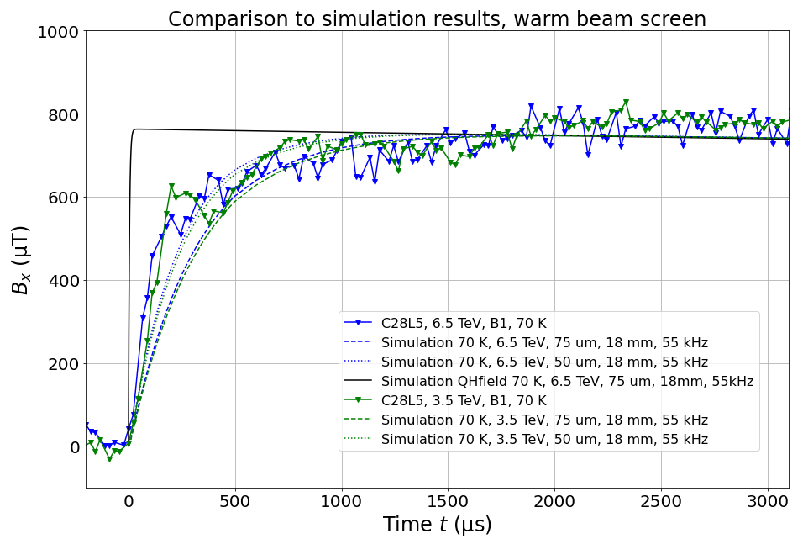
Outlook: Modelling beam screen behavior
Physics model: see EDMS 2470088
For warm (70 K) beam screen:
Very first tries of simulating behavior (trying two different thicknesses for the copper layer)
It looks like this is going in the right direction…
Preliminary

Slide 26
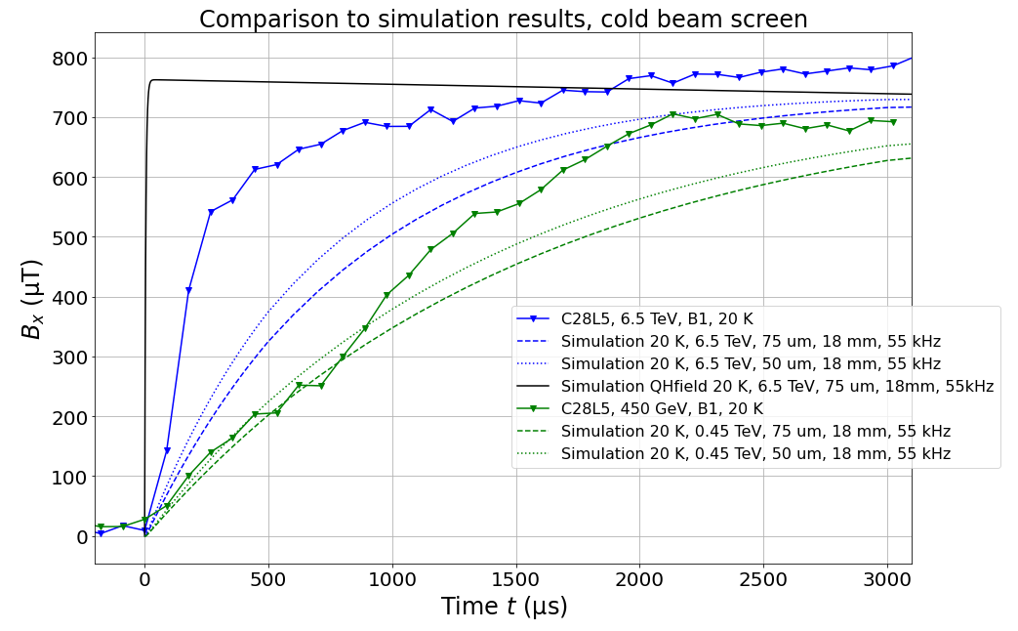
Outlook: Modelling beam screen behavior
Physics model: see EDMS 2470088
For cold (20 K) beam screen:
Ongoing systematic study of parameter range and uncertainties
Are there effects at 20 K that are not there at 70 K?
Is there any physics that we are not understanding/ considering right now?
→ Studies ongoing
Preliminary

Slide 27
Summary and Outlook
QH are crucial protection device, importance of understanding their impact on the beam
Two methods to reconstruct kick fields from beam position measurements were developed
  Field levels agree within 10 % for different magnets if QH current is taken into account
  Significant difference in rise time between injection and flat top energy → as expected
  Similar rise time between beam screen at 20 K and at 70 K for 6.5 TeV → not expected
  Studies ongoing to further understand the shielding effect

Slide 28
Acknowledgements
Many thanks to Christoph Wiesner, Daniel Wollmann, Emmanuele Ravaioli, Arjan Verweij, Michał Maciejewski, Cedric Hernalsteens, Christoph Obermair, Björn Lindström, Lorenzo Bortot, Matthieu Valette and to all the former MPE-PE and now MPE-CB section.
Many thanks to Christian Ospelkaus from Leibniz University Hannover.
Thanks for support from Giorgio d’Angelo and Zinur Charifoulline for insight in QH connection schemes, Marco Morrone for providing information on beam screen measurements and Michaela Schaumann for information on ion beams.

Slide 29
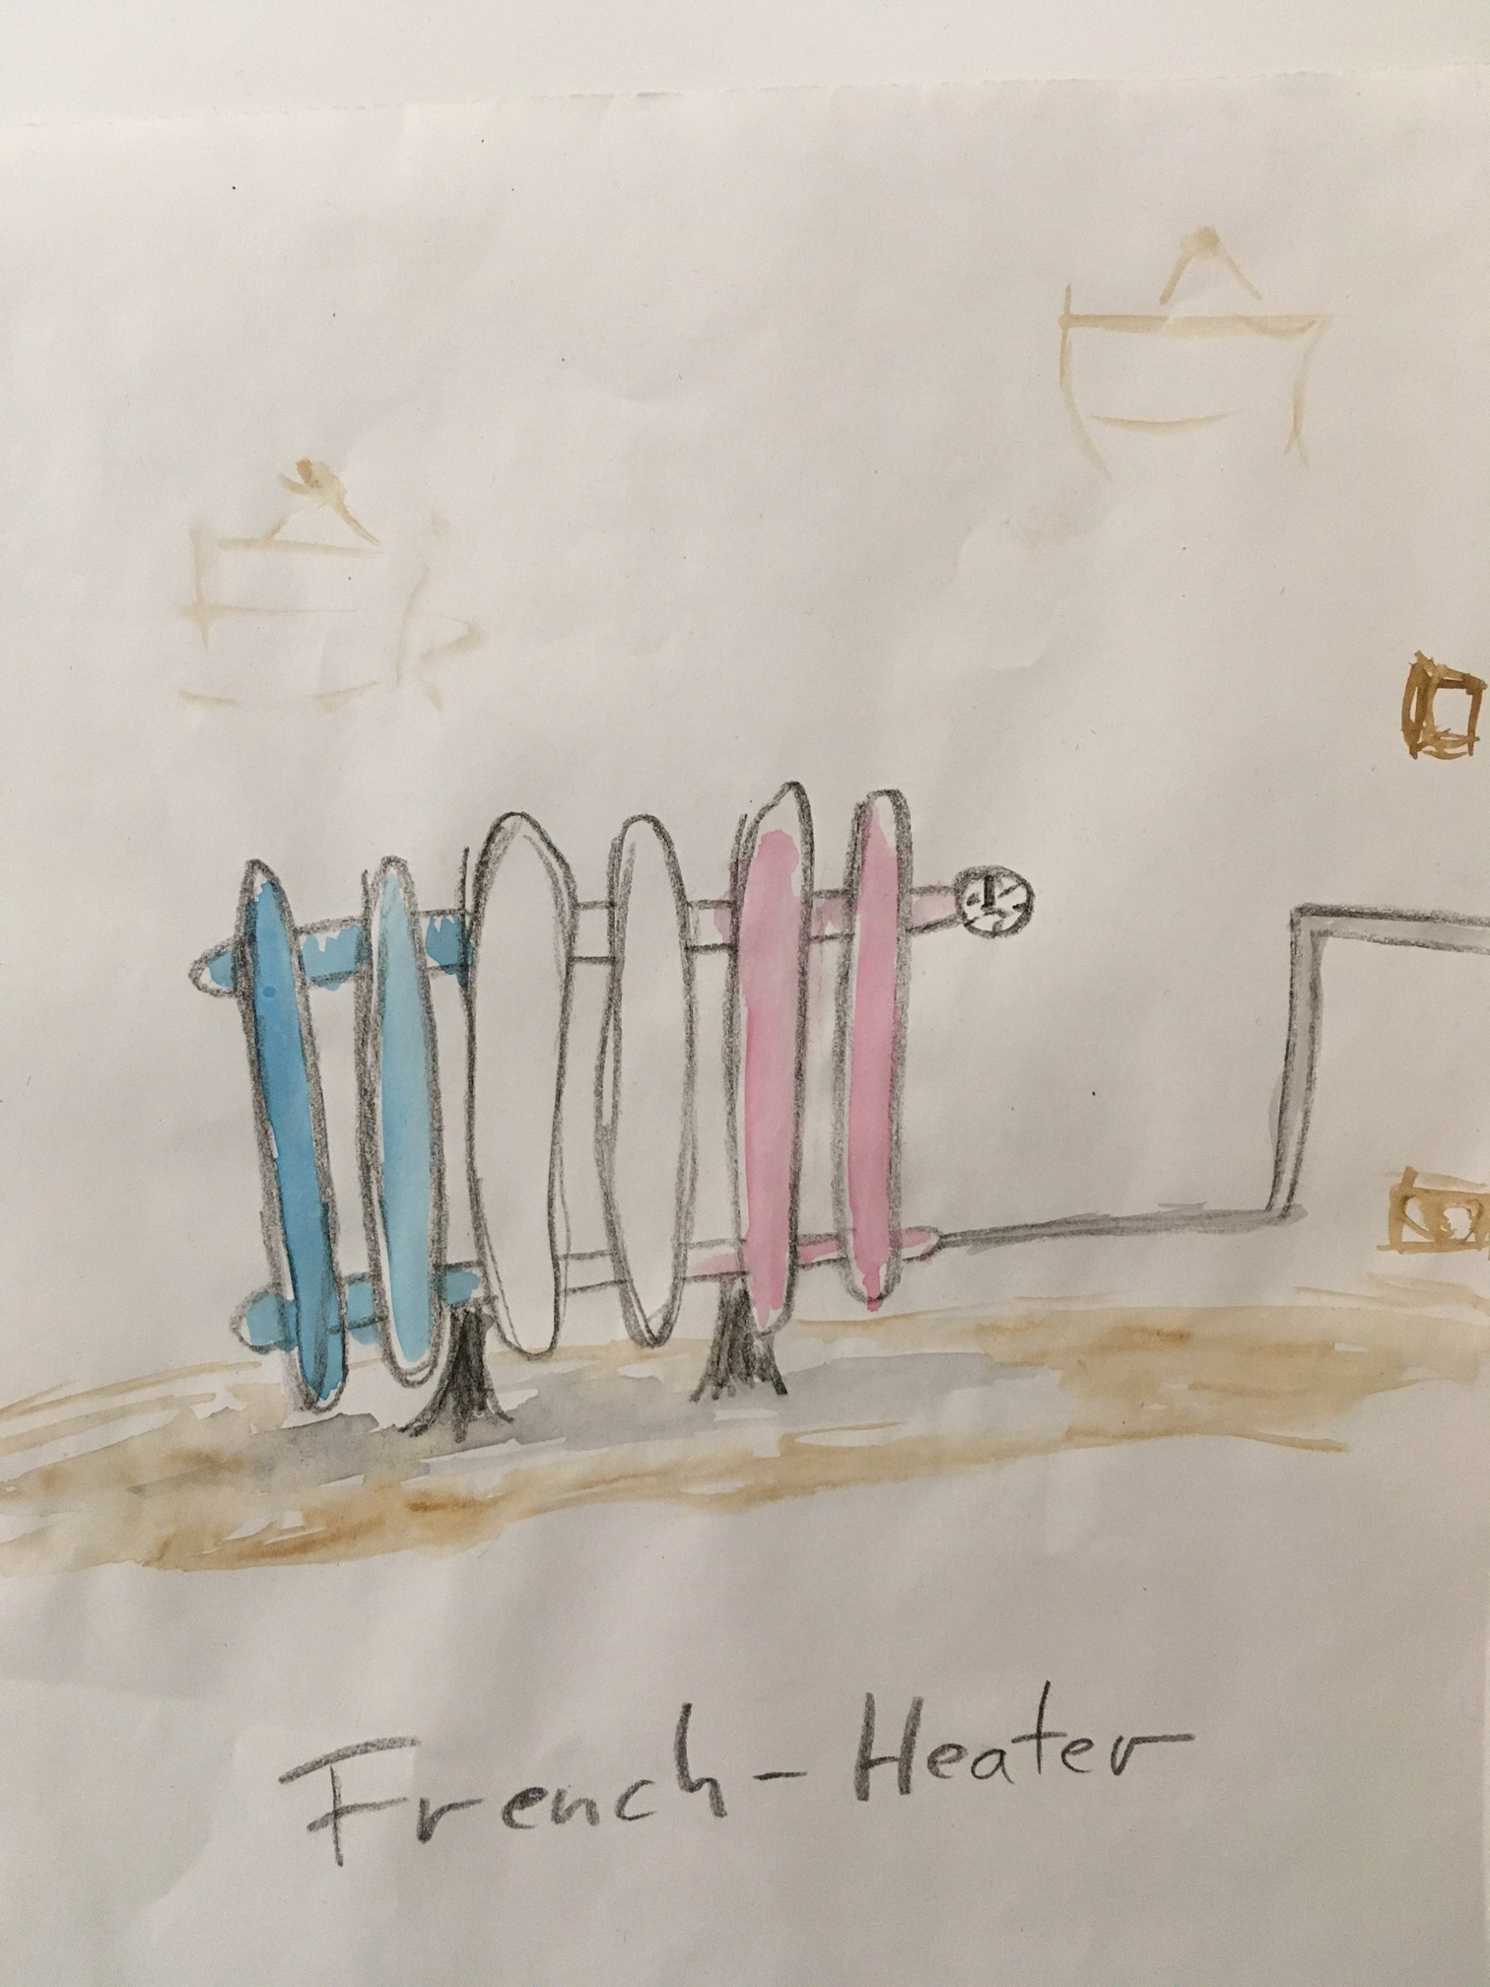
Thanks a lot for your attention!
I’m looking forward to your questions!

Slide 30
References
[1]: LHC Design Report. https://cds.cern.ch/record/782076/files/CERN-2004-003-V1-ft.pdf
Rodriguez-Mateos, Felix et al.: Quench Heater Experiments on the LHC main Superconducting Magnets. 2000. Quench Heater Experiments on the LHC Main Superconducting Magnets - CERN Document Server
Bajko, Marta: Quench Heater Failures in Dipole Magnets. 2009. Microsoft PowerPoint - Quench_heater_failures.ppt [Compatibility Mode] (cern.ch)
Ravaioli, Emmanuele and Wiesner, Christoph: Calculation of magnetic transients due to quench-heater discharges and eddy currents in cylindrical beam screens https://edms.cern.ch/ui/file/2470088/1/effectQH_beamScreen_eddyCurrents_20210121.pdf

Slide 31
References
Pictures
Slide 3: CERN Press Office 0910152_02-A4-at-144-dpi.jpg (1615×1075) (cern.ch)
Slide 4, 5:
  Rodriguez Mateos, Felix: Review of Quench Heaters for LHC. Topical meeting on QXF quench protection (29 April 2014) · Indico (cern.ch)
  CERN Press Office 1107167_05-A4-at-144-dpi.jpg (1615×998) (cern.ch)
Slide 7: Beam screens for the LHC beam pipes - CERN Document Server
Slide 8: modified from Machine Protection and Interlock Systems for Circular Machines - Example for LHC - CERN Document Server
Slide 32: Wollmann, Daniel: Seminar on Machine Protection Introduction to accelerator physics 2021 (1-6 February 2021): Timetable · Indico (cern.ch)

Slide 32
Backup

Slide 33

Introduction
The LHC Quench Protection System (QPS)
Energy stored per circuit (154 dipoles): ~ 1 GJ
For all the 8 arcs/circuits:
→ This is about the kinetic energy of a cruise ship (15e4 t, 45 km/h)
→ Energy must be extracted safely in case of a quench

Slide 34
Impact of QH firing on the circulating beam
Some history:
2016: why does beam move after a quench?
Discovery: beam gets additional kick from the field created by the QH
Some problems:
We could have spurious firing
Stronger effect for HL-LHC (more QH and larger beta functions)
Potentially ultra fast effect: QH reaching full current within ½ LHC turn
38 turns, ~ 3 ms

Slide 35
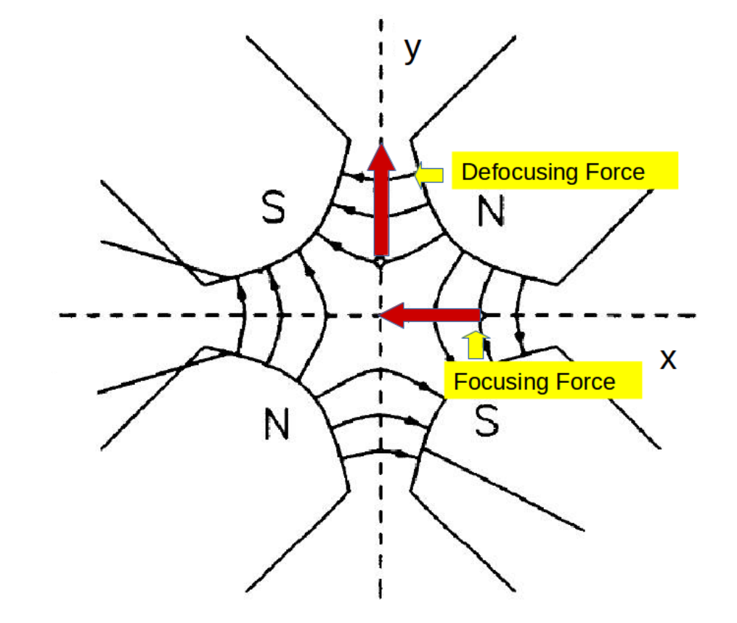
Why are we getting beam oscillation after the kick?
If the beam runs offset through a quadrupole: it gets a kick
As we have alternating focusing and defocusing quadrupoles we get an oscillation
Picture modified from: Klaus Wille.
Physik der Teilchenbeschleuniger und Synchrotronstrahlungsquellen.
Vieweg+Teubner Verlag, Wiesbaden, 1992. p. 65

Slide 36
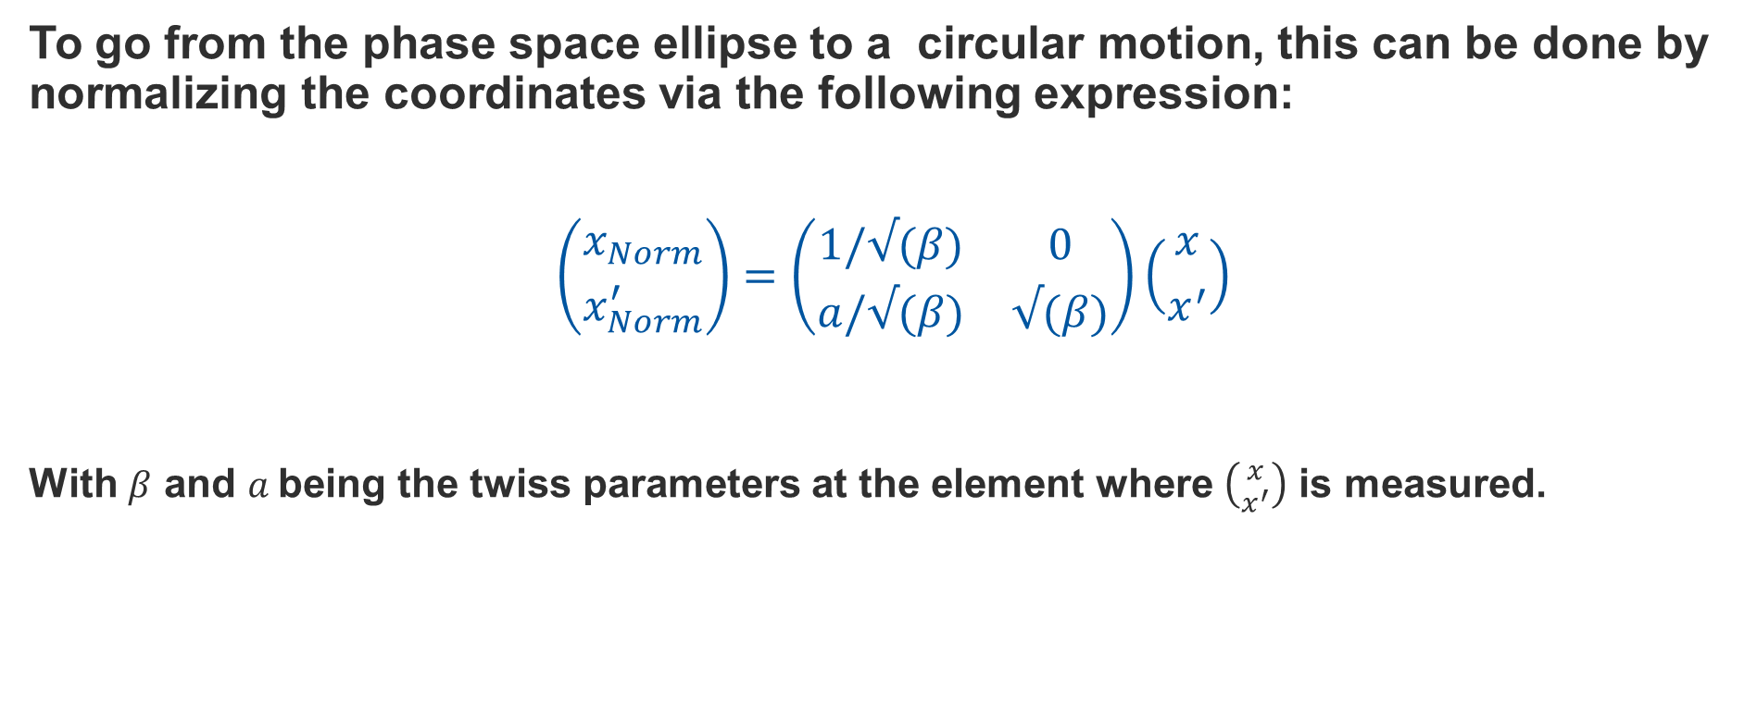
Normalization of phase space
To go from the phase space ellipse to a circular motion, this can be done by normalizing the coordinates via the following expression:
$$\left({x_{Norm} \atop x_{Norm}^{′}}\right)=\left(\begin{matrix}1/√(β) & 0 \\ a/√(β) & √(β)\end{matrix}\right)\left({x \atop x^{′}}\right)$$
With $β$ and $a$being the twiss parameters at the element where $\left({x \atop x^{′}}\right)$ is measured.

Slide 37
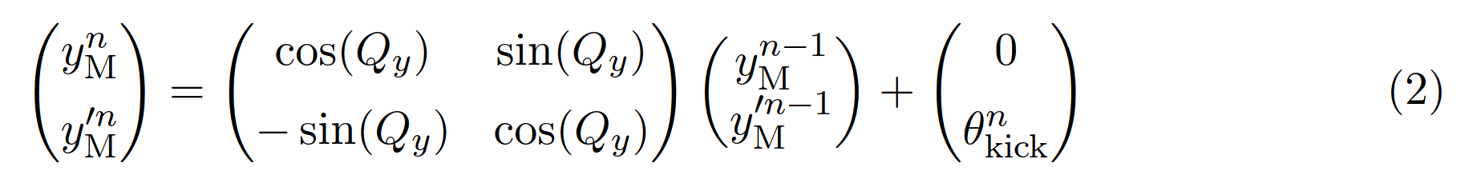


Reconstruction method formulas
Get normalized beam position at BPM via position and angle at magnet
Calculate position and angle at magnet at turn n using their values at turn n-1 plus kick
Plug Eq. 2 into Eq. 1 and by this get an equation that gives us the position at one BPM in turn n depending on position and angle at the magnet in turn n-1 and the additional kick given at turn n
Fit position and angle at magnet for turn n=0.
Calculate $y_{M}, {y′}_{M}$ for n=1, 2,.. with Eq. 2
The only free parameter in Eq. 3 is the kick angle → to be fit!

Slide 38
Reconstruction:
The Challenges and how they were overcome
Fitting function:
Challenge:
When leaving the three unknowns free to the fit:
→ position at the magnet is overestimated yielding unphysical values and the field is assumed to be much lower
Solution: give better constraints to fit parameters
But this is not enough, fit still wants to take the biggest values as possible for magnet position:
→ does not give enough weight to kick

Slide 39

Reconstruction: Fitting parameters
Challenge:
  Three fit parameters give algorithm too much freedom: i.e., position and angle in magnet is fitted for each turn independently, but this is dependent on the turn before!
  What happens, fit looks good….
  But:
  Fitted beam position at magnet
  evolves in an unphysical way
  And reconstructed field has unphysical shape

Slide 40


Reconstruction: Fitting parameters
Solution:
Choose a turn before the QH fire and fit for this turn only position and angle at the magnet (there is no kick yet)
For the subsequent turns, reconstruct (y, y’) at magnet by turning in normalized phase only about one tune
Then: there is only one parameter left to be fitted: the kick $θ_{kick}$
And now:

Slide 41


Reconstruction Method –
BPM Data preparation
BPMs with measurements > 1mm are dropped
BPMs that always read zero are dropped
Between 451 and 501 BPMs are used per case (most cases using 470 or more)
Remove offset by subtracting the mean of the position measurements of 50 turns before starting the fit
Cases from 2015 for B1: beam dump was not synchronized for the different BPM crates
→ Measurements must be first aligned before they can be used
Beam dump at turn 632
Beam dump at turn 680

Slide 42
Reconstruction:
The Challenges and how they were overcome
Challenge: Precision
Twiss values
Calculation of phase advance
Beta-function at magnet
Peculiarities in each case
Deal with BPM data
Solution:
Check and re-check again, compare files, take average for beta-function over magnet length, implement exceptions, …
BPM data: see dedicated slide

Slide 43


Reconstruction quality
Very good match (C28L5, 450 GeV, 20 K)
i. e. 15 turns after firing

Slide 44


Reconstruction quality
Not so good match (here BPM method is not used for analysis, just comparison!)
(not surprising: we have three bunches here, averaging of BPMs gives more noise)
(C28L5, 3.5 TeV, 70 K), i. e. 15 turns after the firing
Comparing the same case reconstructed with two different methods:
→ The reconstruction looks very similar no matter if ADT or BPM measurements are used.
Good validation of the methods.
(For MD3205 the reconstruction with ADTs is still preferred as the error is smaller. See MD report)

Slide 45


Reconstruction quality
Intermediate match (some BPMs already got the kick from this turn, others not)
(C28L5, 6.5 TeV, 20 K), i. e. 10 turns after the firing
→ Test to use only the BPMs upstream or downstream
Using all of them gives the mean
This approach used (for now)

Slide 46



Reconstruction quality –
What about using only up- or downstream?
It might be possible to improve the reconstruction slightly by taking subsets of the BPMs or arranging them differently. However, these plots suggest that this should not have a major impact.
For now, all the BPMs are taken
B29L8, 6.5 TeV, 20 K
C28L5, 450 GeV, 20 K
C28L5, 6.5 TeV, 20 K
C28L5, 3.5 TeV, 70 K

Slide 47
Reconstruction results –
Field errors and beta functions
Field error is calculated using one std of the fitted kick angle and 5% error in beta function
Error in rise time is one std of fitted parameter

Slide 48

Reconstruction results –
Operational Flat Top cases including ion runs
The reconstruction of the ion cases has a bigger error
Preliminary

Slide 49

Alignment of time axes
The time axes for the different reconstructions were aligned in order to be able to compare the rise times
The moment where the field was 4 std higher as in the jitter before the firing was chosen as zero in time
In some cases, it might make sense to adjust this alignment manually:
Move green fields one point to the left
In the green case only few BPMs saw the kick already in this turn what is the first “kick turn” here

Slide 50


Why is there a kink in the first rise of some of the reconstructed fields?
Delay in the QH firing might be the explanation:
There is a delay of 213 µs between the two QH (green and red in the plot) for this beam
We get a kink between the 2nd and 3rd turn after firing

Slide 51

Reconstruction results –
Flat top cases with error bars

Slide 52
Legend for timestamps
Timestamp | Parameters
2015-07-14 00:05:14 B2 | B34L8, 6.5 TeV, B2, 20 K
2015-12-08 21:07:12 B2 | B11L5, 6.4 TeV, B2, 20 K
2015-12-13 22:07:59 B2 | B9L7, 6.4 TeV, B2, 20 K
2016-05-09 02:00:04 B1 | C27R6, 6.5 TeV, B1, 20 K
2016-06-06 08:34:11 B1 | B29L8, 6.5 TeV, B1, 20 K
2016-06-06 08:34:11 B2 | B29L8, 6.5 TeV, B2, 20 K
2016-07-12 14:17:13 B1 | C28L5, 6.5 TeV, B1, 20 K
2016-07-12 14:17:13 B2 | C28L5, 6.5 TeV, B2, 20 K
2016-10-28 06:11:50 B1 | C28L5, 450 GeV, B1, 20 K
2016-10-28 06:11:50 B2 | C28L5, 450 GeV, B2, 20 K
2016-10-28 07:01:58 B1 | A28L5, 450 GeV, B1, 20 K
2016-10-28 07:01:58 B2 | A28L5, 450 GeV, B2, 20 K
2016-10-28 07:48:50 B1 | A31L5, 450 GeV, B1, 20 K
2016-10-28 07:48:50 B2 | A31L5, 450 GeV, B2, 20 K
2018-10-31 01:36:36 B1 | C28L5, 3.5 TeV, B1, 70 K
2018-10-31 01:36:36 B2 | C28L5, 3.5 TeV, B2, 70 K
2018-10-31 06:44:42 B1 | C28L5, 6.5 TeV, B1, 70 K
2018-10-31 06:44:42 B2 | C28L5, 6.5 TeV, B2, 70 K

Slide 53

Comparison to former results, flat top energy
Before
Now

Slide 54


Comparison to former results, injection energy
Before
Now

Slide 55

3. Reconstruction results –
Comparison with former results

