Slide 1
Experience from HPCs
Doug Benjamin
Soon to be Brookhaven National Lab

Slide 2
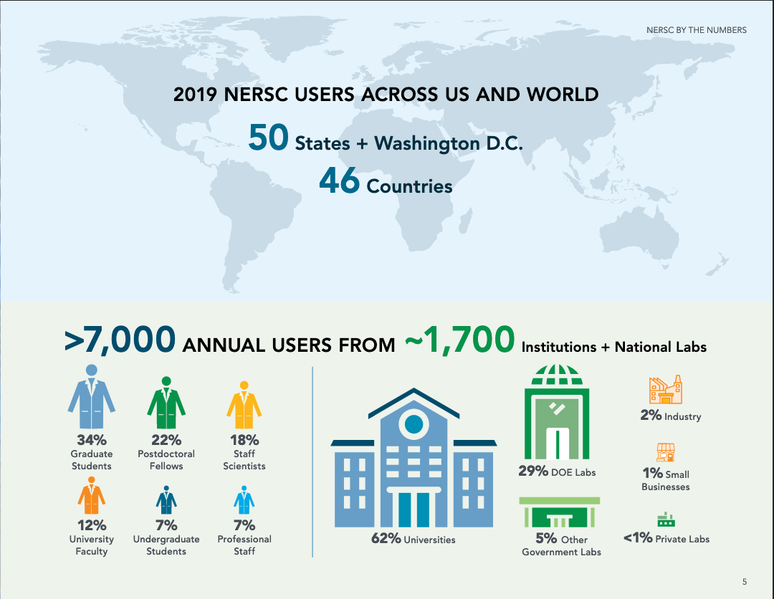
The Problem
Big HPC centers serve wide community of users
Self Service tools that are easy for users to use are important
Tools including those for WAN transfers must comply with local Site authentication policy
Data transfer services must be powerful and scalable

Slide 3
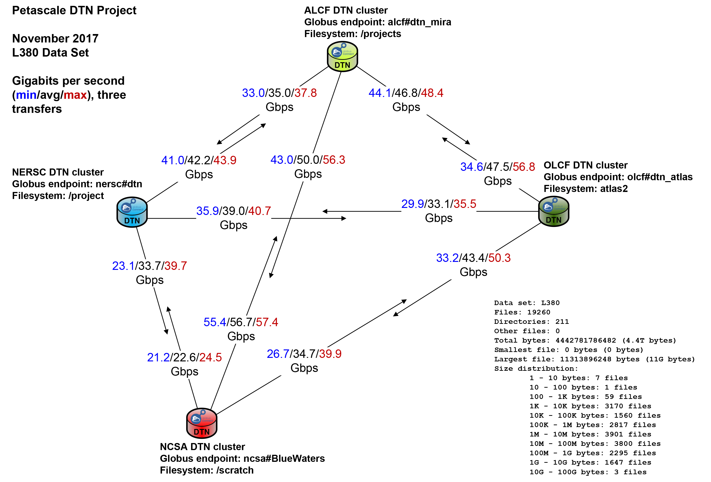
US HPC WAN Transfer challenge
Eli Dart – PetaScale DTN Project
To achieve these data transfer rates – multiple data transfer nodes deployed at each HPC

Slide 4
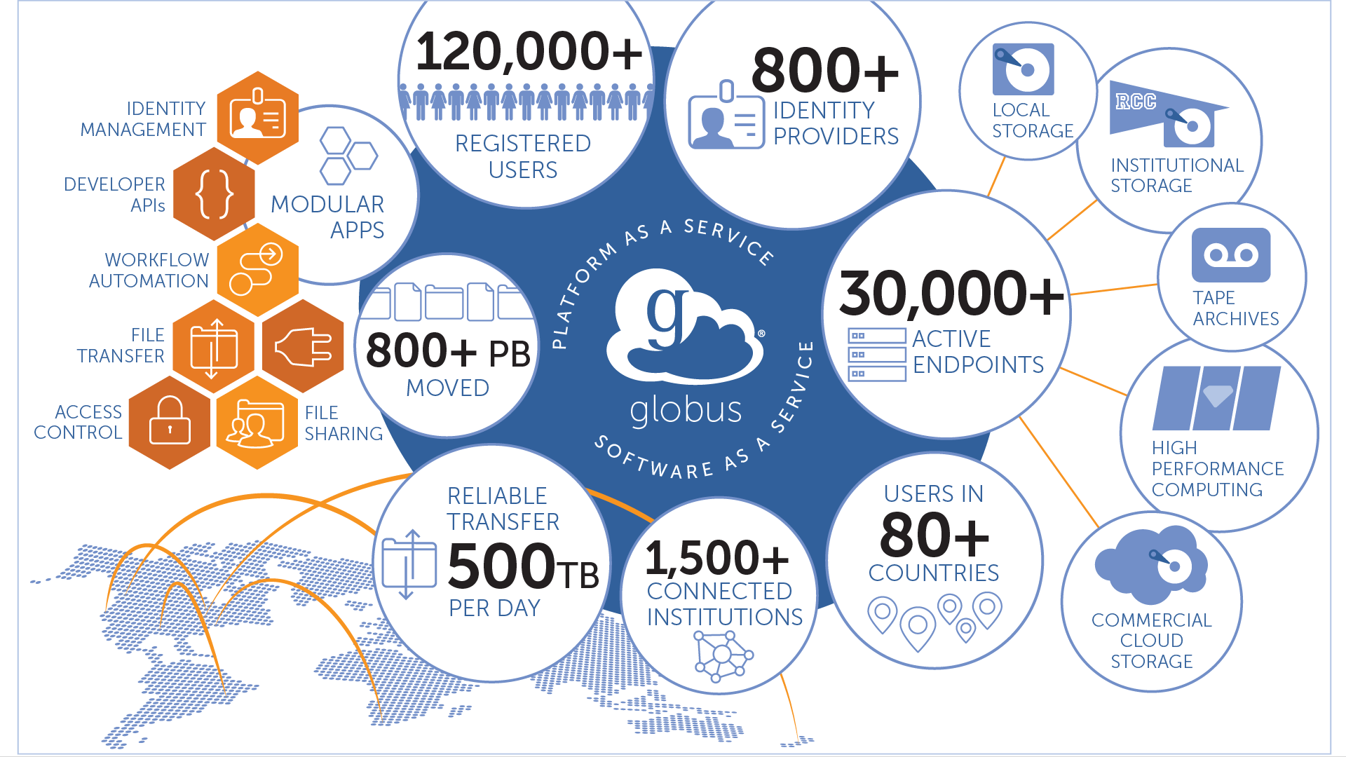
A Solution for WAN transfers – Globus Service
At a HPC Center in Europe – LRZ (experimentally)
US – All large HPC’s
No official discussion from Euro-HPC.
Not likely to use GLOBUS

Slide 5
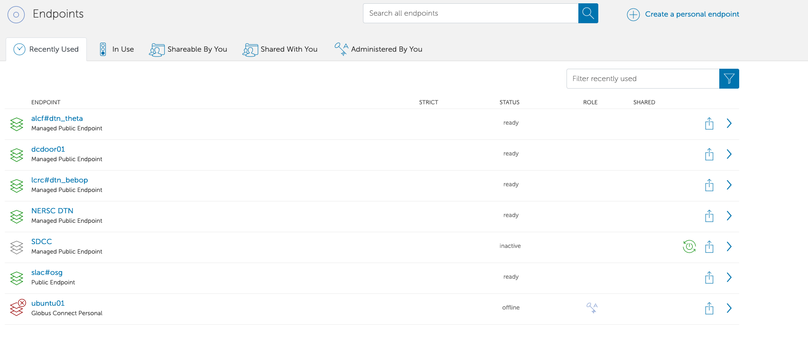
Easy to use Web interface
User can manage her own transfers -
Endpoints used recently

Slide 6
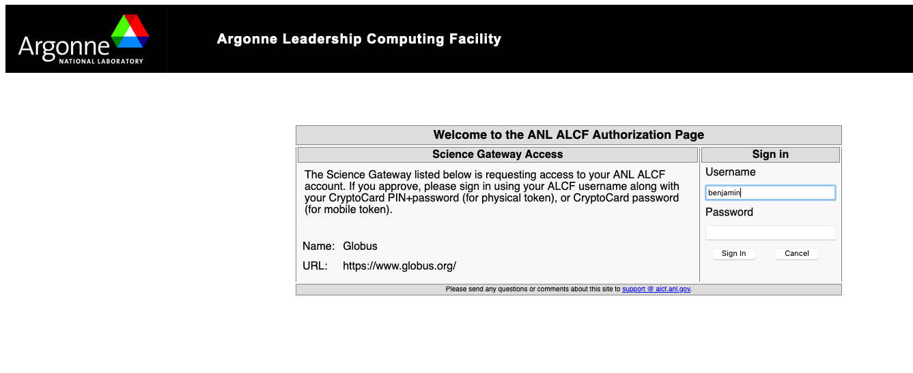
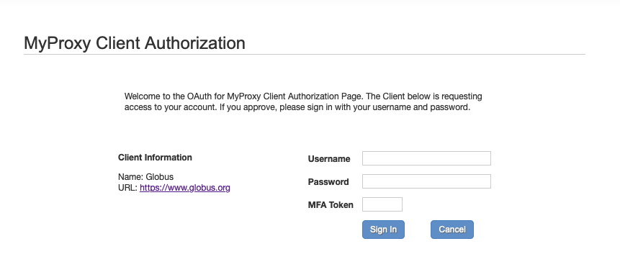
Comply with local HPC authentication policies and tools
NERSC – w/ MFA
ALCF – w/ Dongle

Slide 7
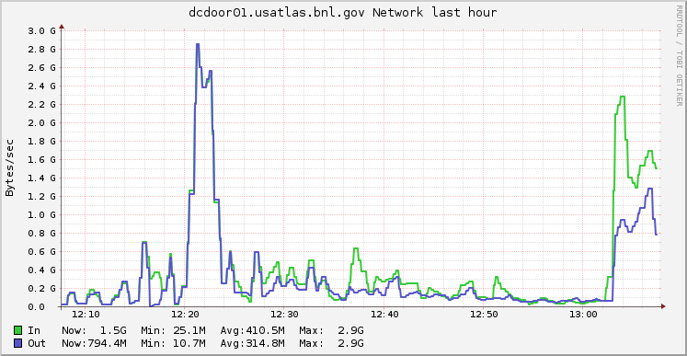
Used by ATLAS in US
Use Globus Python SDK and Harvester to transfer data
Used extensively in US between BNL and NERSC – Cori HPC and BNL - ALCF Theta and University of Chicago (MWT2) and TACC- Frontera.
In user for many years
Not perfect
  Manual intervention
    authentication endpoints 1x week
  Not integrated w/ Rucio
3 GBytes/sec
Network traffic gridftp door in 1 hour at BNL

Slide 8
EuroHPC
(Andrej Filipcic)
EuroHPC federation plan with hyperconverged network (1Tb/s) to GEANT
Relying on PRACE MDVPN (similar to LHCONE), although it connects only GEANT, SurfNET, JANET, DFN for now (and HPCs attached there)
Data transfers not discussed within EuroHPC yet, initially adopting PRACE model (using ssh)
no technical details or policies yet
  (primary focus is to commission the machines in 2021)
European HPC’s and US HPC’s will have different solutions

Slide 9
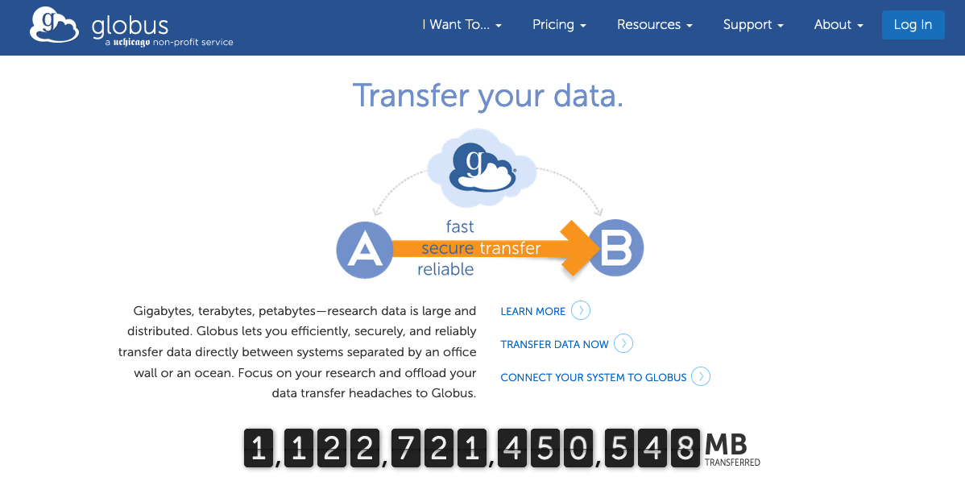
Summary
Globus provides easy to use service to transfer data between HPC centers and their users
  NERSC Users use it to move a lot of data internally w/ NERSC
Scalable – Complies with local authentication policies
Manages transfers
Many Sites are subscribers
Used in US extensively
Not w/ Europe-HPC

