Slide 1
Can we tell if a discovered HNL is a Majorana or Dirac particle?
Helicity and lepton number in heavy neutrino production at the Z pole
References
[1] Addressing the Majorana vs. Dirac Question with Neutrino Decays
A. Baha Balantekin(Wisconsin U., Madison) André de Gouvêa(Northwestern U.) Boris Kayser(Fermilab)
(Aug 30, 2018)
Published in: Phys.Lett.B 789 (2019) 488-495 e-Print: 1808.10518
[2] Polarization effects in e+e- annihilation (1993)
A.B. http://cds.cern.ch/record/252128
https://inspirehep.net/literature/357824
and
[3] the LEP EW group paper (2005)
Precision electroweak measurements on the Z resonance
Phys.Rept. 427 (2006) 257-454 hep-ex/0509008

Slide 2
Introduction
We have discussed the possibility of detecting the Heavy Neutrinos predicted by the type I see-saw model already since quite a while. (arxiv 1411.5230 etc..)
The main reason these HNLs are extremely attractive is that they kill several birds with the same stone
They constitute a natural extension of the Standard Model, which is still awaiting input from data:
Matthew Reece:
Some physicists characterize neutrino masses as empirical evidence for BSM physics. I prefer to say that we
have two or more Standard Models that fit the data equally well, one with new fermionic fields that pair up with neutrinos to make Dirac fermions, and one with nonrenormalizable operators giving neutrinos Majorana masses – or both.
2. They can provide good explanation for both the smallness of the light neutrino masses and the Baryon Asymmetry of the Universe BAU.
Characteristic features of the see-saw HNLs are that i) they are almost sterile, ii) that they are produced and decay by weak interaction and iii) that they are Majorana particles – i.e. fermion number is not conserved. This is essential for the BAU.
Until recently it was believed that the test of lepton number conservation was impossible at the Z and would be left for FCC-hh where the W decay provides a tag of the initial state flavour and lepton number.

Slide 3
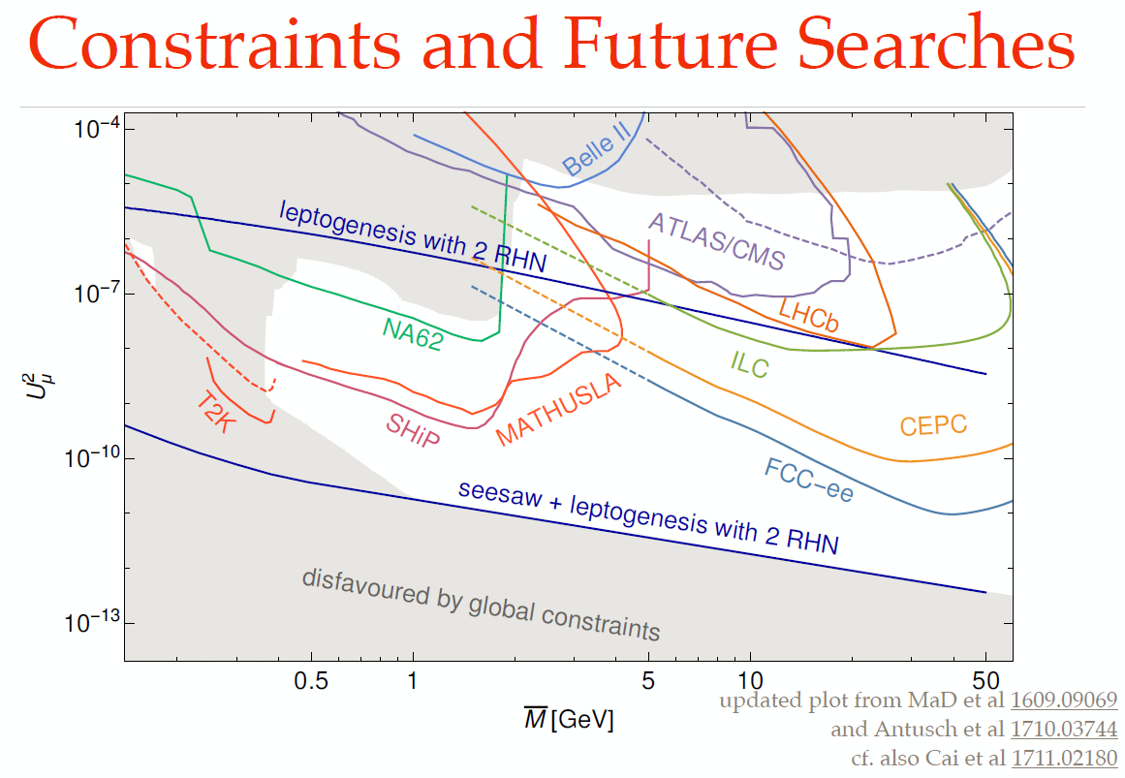
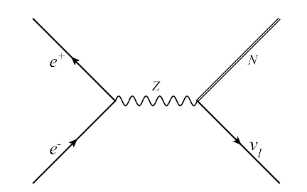
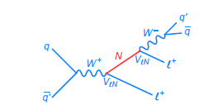
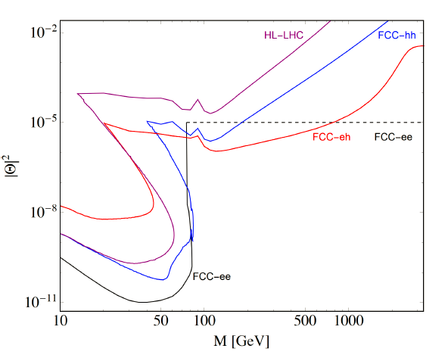
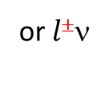
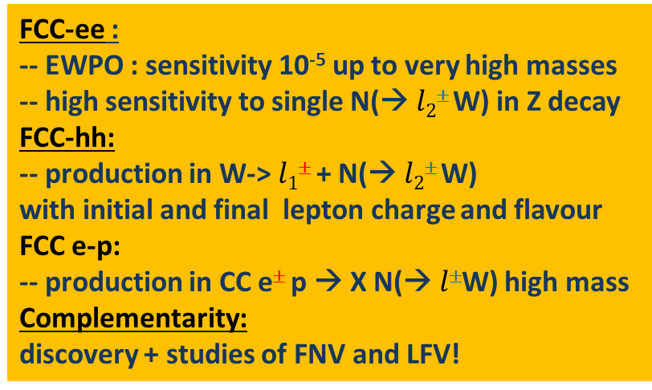
Heavy neutrinos
FCC-ee Z
+
or$l$±ν
(*)
-
FCC-hh
FCC-ee :
-- EWPO : sensitivity 10⁻⁵ up to very high masses
-- high sensitivity to single N(→ $l2$± W) in Z decay
FCC-hh:
-- production in W-> $l1$± + N(→ $l2$± W)
with initial and final lepton charge and flavour
FCC e-p:
-- production in CC e± p → X N(→ $l$±W) high mass
Complementarity:
discovery + studies of FNV and LFV!
Detached
vertices
The capability to probe massive neutrino mechanisms for generating the matter-antimatter
asymmetry in the Universe should be a central consideration in the selection and design
of future colliders. (from the neutrino town meeting report to the ESPP)

Slide 4
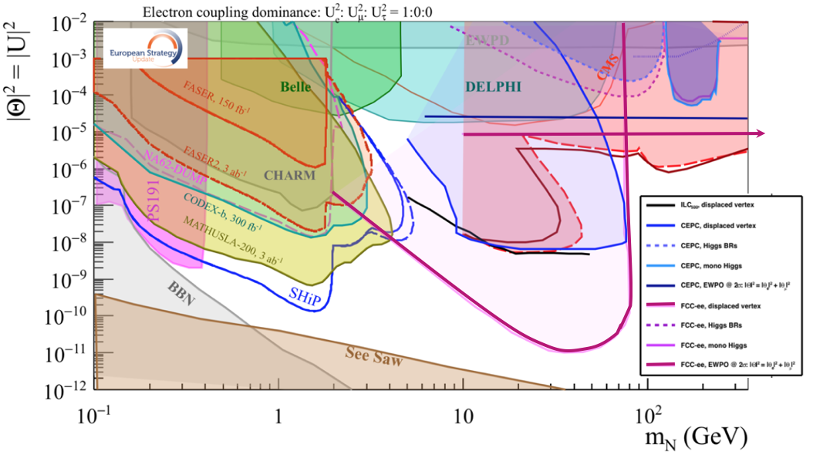
This picture from the briefing book is relevant to Neutrino, Dark sectors and High Energy Frontiers.
FCC-ee (Z) compared to the other machines for right-handed (sterile) neutrinos
How close can we get to the ‘see-saw limit’? can we improve acceptance and reach?
-- the purple line shows the reach for observing heavy neutrino decays (here for 2.10¹² Z)
-- the horizontal line represents the sensitivity to mixing of neutrinos to the dark sector,
using EWPOs (G_{F} vs sin²θ_{W}^{eff} and m_{Z}, m_{W}, tau decays) which extends sensitivity
to 10⁻⁵ mixing all the way to very high energies (500-1000 TeV at least). arxiv:2011.04725

Slide 5
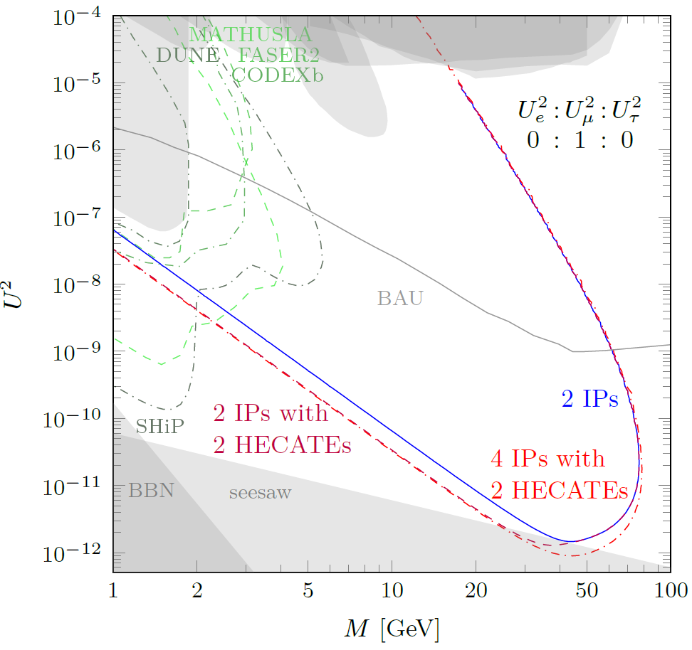
1 event sensitivity
assuming 50% efficiency
normal detector has 4m radial
acceptance
additional HECATE
has 15m radius
gains is mostly at smaller masses
4IP gain is mostly at high masses.
see later for proposed benchmarks

Slide 6
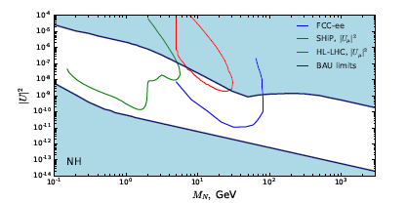
For right-handed-neutrino HNLs, the region of greatest interest is the parameter set which is consistent with the see-saw mechanism and with the leptogenesis over the largest possible range of Rhnu mass.
FCC-ee study from 2014 show that the see-saw line can be reached with a Z run of 10¹³Z. Z→ νν is 20%, N→ l ± W* is 50%. (1/(10¹³ x 0.2 x2 x0.5 (x0.5_{acc,kin}) = 10⁻¹²)
for Long Lived Particles, no significant source of background identified at this point
2. This search might have large impact on the design of the FCC-hh detectors!
These ‘common plots’
only refer to 2.10¹² Z
.
-- Approx 4IP line 1 evt
(M. Drewes, J. Hajer)
arXiv:2008.13771
More integrated luminosity → more chance of discovery of HNL and LNV!!!

Slide 7
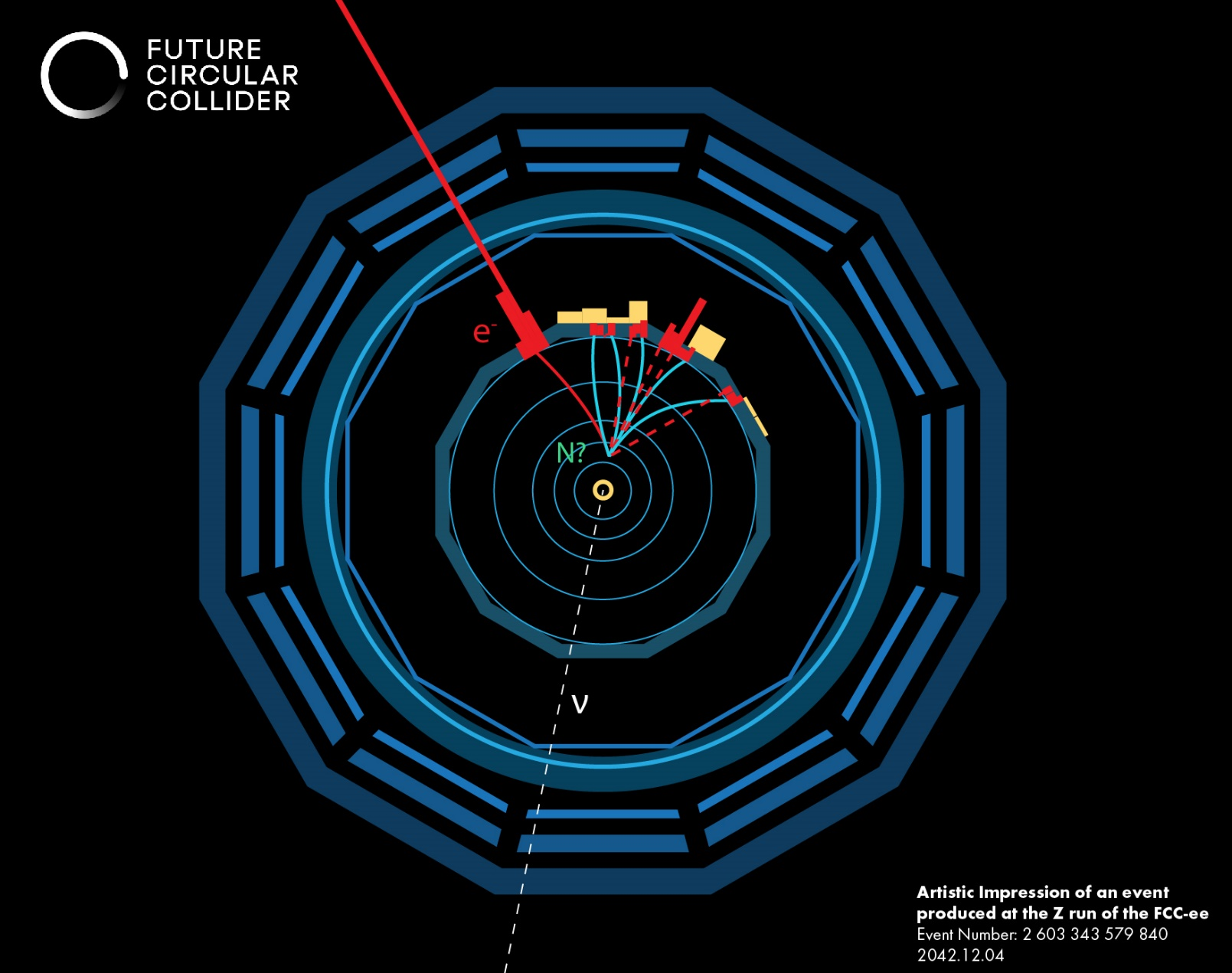
For high masses the signature is quite striking:
the production mode is e+e- → Z → Nν
The neutrino is not detected, but the only other
activity in the event is a N decay
N decays:
-- N→ l W* -- W*→ l’ν 30% of the time
-- W*→ q‾q’ 70% of the time →
-- N → νZ* -- Z* → ll (10%) vv(20%) qq(70%)
For a detached vertex one can measure
-- the polar angle and the line of flight
-- the timing of the decay (if TOF exists)
for a 50 GeV HNL, β = 0.5 → Δt (30cm) = 1ns
-- for the -- N→ l W* (qq) decay
the HNL E,P can be measured as well as the
lepton angle, sign and momentum.
Provided this is all in the detector.
constrained kinematics, incl. decay angle θ*
This might be possible for the W*→ l’ν decay as well.
NB: Z→ ZZ* and WW* are irreducible backgrounds if
the HNL is short-lived. This was tackled by Sissel (NBI)
and will be discussed by M. Dam at a later meeting.

Slide 8
Dirac or Majorana?
While the See-saw is a natural possibility it is also possible to add any number of right-handed neutrino singlets (I=0) to the Standard Model. In that case they can be Dirac particles with only one mass term.
The main characteristic of the Majorana mass term is that it is a fermion-antifermion transition
The Dirac mass term only flips the helicity of the particle, while conserving the lepton number
Note that the existence of a Majorana mass term leads to lepton number violation. In the see-saw, both light and heavy neutrinos are Majoarana particles.
For light neutrinos the effect is not visible because of the very small mass of the neutrinos compared with
the momentum in the centre-of-mass of the particle producing them.
Consequently the fermion-anti-fermion transition is suppressed as (m/E)² = (0.05/ (30 10⁶))² for a 50meeV neutrino produced in pion decay.
For the heavy neutrinos (ex. 50 GeV in a Z decay) the velocity of the HNL is β=0.537 and there is no suppression. The typical time constant for lepton number transition is T ~O(hbar/M), (10⁻²⁶ s), too fast to be observed, and the lepton number is completelymixed: the decay in a L=1 state (l⁻ W*⁺ or l⁺ W*⁻) are equiprobable. (I will not discuss here family mixing, CP violation etc...)
THE OBSERVATION OF LEPTON NUMBER TRANSITION IS A TELL_TALE OF THE MAJORANA NEUTRINO

Slide 9
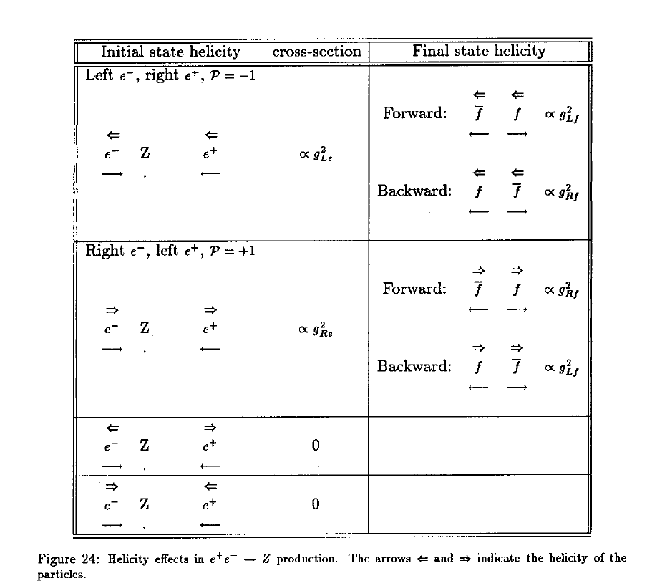
f
e-
θ
e+
‾f
neutrinos
½
0
1

Slide 10
This below is well known. This is tree level SM, nothing in the following will be sensitive to rad. corrections!
As a result of these parity violating effects the Z is spin-polarized :
where P is the polarization of the e+e- system.
For unpolarized beams P_{Z} = - A_{e} = -15% (with W.A. sin²θ^{eff}_{w} )
Observables are the final state polarization and charge asymmetry,
which are measurable observables: neutrino spin polarization is -1 at all angles
Ac^{f} (cosθ) = (N_{f} - N_{‾f} )/(N_{f} + N_{‾f} ) = -[2 cosθ /(1+ cos²θ)] P_{Z} A_{f}
The integrated value for unpolarized beams:
here for taus. Change τ to ν for neutrinos

Slide 11
f
Just in case....
e-
θ
e+
‾f
and the peak cross-section:
neutrinos
½
0
the chiral cosθ differential cross-sections at the Z pole will be written as follows
σ(e_{L} → f_{L} ) ∝ g²_{Le} g²_{Lf} (1+cos²θ + 2 cosθ)
σ(e_{L} → f_{R} ) ∝ g²_{Le} g²_{Rf} (1+cos²θ - 2 cosθ)
σ(e_{R} → f_{L} ) ∝ g²_{Re} g²_{Lf} (1+cos²θ - 2 cosθ)
σ(e_{R} → f_{R} ) ∝ g²_{Re} g²_{Rf} (1+cos²θ + 2 cosθ)
with unpolarized beams we just add everything (divided by two because half the e- have positive/negative helicities)
σ(e_{L,R} → f_{L,R} ) ∝ (g²_{Le} + g²_{Re}) (g²_{Lf} + g²_{Rf} ) (1+cos²θ) + 2 cosθ (g²_{Le} - g²_{Re} )(g²_{Lf} - g²_{Rf} )
∝ Γ_{e} Γ_{f} ((1+cos²θ) + 2 cosθ A_{e} A_{f} )
from which it is easy to extract the charge asymmetry (integrated or as function of cosθ) the average polarization of f
or the polarization as function of cos θ.
1
9
Ac^{f} (cosθ) = (N_{f} - N_{‾f} )/(N_{f} + N_{‾f} )(cos θ) = -[2 cosθ /(1+ cos²θ)] A_{f} A_{e}
<Pf> = - A_{f}
P_{f} (cosθ) = - (A_{f} - [2 cosθ /(1+ cos²θ)]A_{e}) / ( 1+[2 cosθ /(1+ cos²θ)] A_{f} A_{e} )

Slide 12
question on this slide:
is this still correct with a massive HNL?
are we only dealing with m=±1 states
of the Z?
HNL production and decay
consider Z → ‾v N at cosθ
(we use unpolarized beams in following, P_{Z}=-15%)
at production time N is 100% spin polarized with P=-1.
the initial state has lepton number L (t=0) = 1
If it is a « Dirac » particle (only Dirac mass term)
this lepton number is conserved.
the decay takes place as follows N→ e⁻ W^{*+}
I assume lepton is an electron, replace by μ or tau as desired
this decay being a weak interaction the electron is left-handed, and emitted
preferentially in the direction of the spin of the decaying particle.
N
e-
θ
e+
‾ν
θ*
e⁻
W^{*+}
dN (cosθ*)
dcosθ*
∝ ½ ( 1 + α cosθ*)
table of values of α from ref.[1]
N

Slide 13
The paper [1] considers neutral current decay, but the charged lepton decay contains much more information and is more frequent. I will assume that the spin effects lead to the same conclusions (take m(W*) as m_{V} of [1])
The asymmetry is very strong for low values of m_{W*}
but changes sign for m_{W*} = m_{N}/√2 →
W* decays 70% of the time hadronically,
there is no or little missing energy
and the HNL decay can be completely reconstructed.
If it is long lived and the flight path and time can
be measured the reconstruction can be even better.
I will use this point for illustration purposes
➔ it is very important to know the mass distribution of the W* as it impacts the results greatly

Slide 14
If it is a « Dirac » particle
Consider for illustration the case where
m_{W*}=0
m_{N}=50 GeV
E_{b} = 45.6 GeV = m_{Z}/2 , lepton : E_{min} =13.7 GeV, E_{max} =E_{b}
this is the e⁻ energy spectrum (in the lab) from N decay
and
this is the e⁺ energy spectrum (in the lab) from‾N decay
➔ they have the same shape
The ratio of integrated numbers is governed by the charge asymmetry and will depend on polar angle.
the numbers are identical at cosθ = 0
The forward-backward asymmetry is 3/4 A_{e} A_{ν} = 3/4 A_{e}
since A_{ν} = 1
13.7
E_{b}
E_{e-}
Ac^{f} (cosθ) = (N_{f} - N_{‾f} )/(N_{f} + N_{‾f} )(cos θ) = -[2 cosθ /(1+ cos²θ)] A_{f} A_{e}
13.7
E_{b}
E_{e+}

Slide 15
If it is a « Majorana » particle
{initial N (produced against‾ν)}
Consider for illustration the case where
m_{W*}=0
m_{N}=50
E_{b} = 45.6 GeV = m_{Z}/2
The initial lepton number is oscillated away with a very short
time constant T ∼ hbar/(m_{N}-m_{v}) (this is even faster than the Z decay!)
The integrated forward backward charge asymmetry is now 0.
HOWEVER the spin is conserved.
top is the e⁻ energy spectrum (in the lab) from {initial N} decay
and the e⁺ energy spectrum (in the lab) from {initial N} decay
bottom is the e⁻ energy spectrum (in the lab) from {initial‾N} decay
and the e⁺ energy spectrum (in the lab) from {initial‾N} decay
with the ratio of integrated numbers being governed by the
initial charge asymmetry
13.7
E_{b}
E_{e- e+}
{initial ‾N (produced against ν)}
13.7
E_{b}
E_{e+e-}
Ac^{f} (cosθ) = (N_{f} - N_{‾f} )/(N_{f} + N_{‾f} )(cos θ) = -[2 cosθ /(1+ cos²θ)] A_{f} A_{e}

Slide 16
« Dirac » or « Majorana » ? (III)
Of course we dont know the spin (i.e. if it was initial N or‾N)
all we can measure is the lepton charge.
The final result looks like this:
The slight difference in numbers (in the case of Dirac)
or in the energy distributions (in the case of Majorana)
of the different lepton charges as function of cosθ
is a residue from the initial state Z spin polarization of -15%.
We therefore have two discriminating observables
the charge asymmetry for the final state lepton
which is 15% for the Dirac hypothesis and 0 in case of Majorana
2. the measured N polarization x charge
which is 100% for Dirac and 0 for Majorana (if integrated over cosθ)
or if one forms the A_{FB}^{pol} = 15% (the initial Z polarization)
this might be a more powerful test,
depending on the W* mass distribution
{Dirac}
e+ and e- curves are
identical at 90º
(cosθ=0)
13.7
E_{b}
E_{e- e+}
Ac^{f} (cosθ) = (N_{f} - N_{‾f} )/(N_{f} + N_{‾f} )(cosθ) = -[2 cosθ /(1+ cos²θ)] A_{f} A_{e}
{Majorana}
e+ and e- curves
are flat and identical
at 90º (cosθ=0)
13.7
E_{b}
E_{e- e+}

Slide 17
Conclusion DIRAC vs MAJORANA
A majorana mass term will lead to significantly different results
in the Z→ νN followed by N→ l W* decay at a Z factory.
for the lepton forward-backward charge asymmetries
and in the polarization measurement using lepton momentum distributions,
The effects will be visible with unpolarized beams.
A full analysis of sensitivity is straightforward for the AFB asymmetry, but this require the measurement of lepton charge
For a 15% asymmetry parameter a 2sigma LNV vs LNC separation will require at least 100 events.
for the polarization measurement one will need a full description of the W* mass distribution in the decay.
Interestingly only the lepton energy needs to be measured, not its charge. Will this help?

Slide 18
BENCHMARKS and QUESTIONS
sensitivity plots
1 The average discovery plot (enough events for discovery)
this is a strong function of the background
→ need background estimate with and without detached vertex, magnetic field and calorimetric energy measurement
→ one event might be sufficient for discovery – or not.
2. The ‘standard’ 95% exclusion plot
this is the standard plot; in small background situation this is the 2.7 event contour for 95% C.L.
3. the LNV discovery contour
this is the plot of the region in which LNC is excluded at 95% C.L. (or more if desired)
Of course this will vary for different detector considerations and guide detector design

Slide 19
Next steps discussion
1 and 2 are the hard parts!
event generators
signal (m_{W*, Z*} distribution)
backgrounds
2. detector simulation and event reconstruction
in particular:
vertexing, timing signals,
reconstruction of tracks with short distance to calorimeters or generated in calorimeter etc...
event display ☺
3. kinematic reconstruction
determination of HNL mass, velocity pointing etc etc.
4. Analysis ....

Slide 20
A generator exists
dear Alain and Rebeca,
I agree, the topic is very important and merits deeper study, especially in light of the ESU. In short, MadGraph can do what you want for prompt and long-lived sterile neutrinos /heavy neutrinos / HNLs. See below for instructions to get you started. I am totally swamped this week but I am available next Thursday or Friday if that works for people (or later if you want to first give a crack with the script below). Do let me know if you have further questions.
Best for now,
Richard

Slide 21
Generating heavy neutrinos with MadGraph:
To do this, you will need to import the "HeavyN" FeynRules model file from the FeynRules data base (https://feynrules.irmp.ucl.ac.be/wiki/HeavyN)
- For Majorana heavy neutrinos, place the original "SM_HeavyN_NLO" UFO into madgraph's "models" directory (https://arxiv.org/abs/1602.06957)
- For Dirac heavy neutrinos, use the newer "SM_HeavyN_Dirac_NLO" UFO (See Secs 2-3 of https://arxiv.org/abs/1812.08750)
While the companion papers are for proton colliders, they describe the model files' construction and notation. For FCC-ee at the Z pole, the following commands will generate 1k events for the process
e+ e- > Z > N + nu_e or N + nu_ebar
(light nu are in the flavor basis) for a Majorana neutrino N that then decays to
N > e+ q qbar or e- q qbar
at LO + parton shower

Slide 22
import model SM_HeavyN_NLO
define vv = ve ve~
define ell = e+ e-
generate e+ e- > z > N1 vv QCD=0 QED=2, n1 > ell j j
output Test_FCCee_ee_Nv_XLOPS
launch Test_FCCee_ee_Nv_XLOPS
shower=py8
set mz 92.0
set wz 2.2
set ww 2.5
set VeN1 1e-4
set mN1 50
set wn1 auto
set nevents 1k
set ebeam 46.0
set time_of_flight 0.0
set no_parton_cut
done
For active-sterile mixing of V_Ne = 1e-4 (VNmu=VNtau=0), mass mN = 50 GeV, I get \sigma ~ 2.993e-05 pb. The "time of flight" arguement means that the lifetimes are recorded for unstable particles.
PS You can put the above into a script and simply type $ ./bin/mg5_aMC ./script_name.dat

