Slide 1
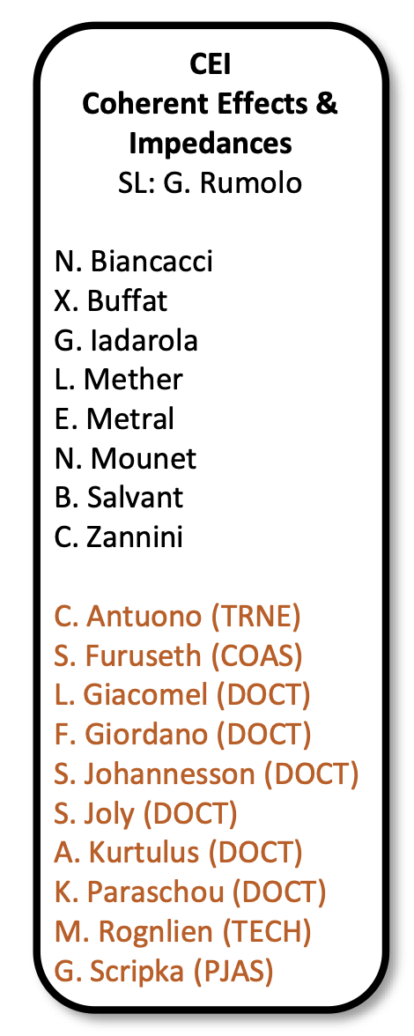
Coherent Effects and Impedances section (CEI) – general information
Giovanni Rumolo
CEI Section Meeting, 29/04/2020
https://indico.cern.ch/event/1007417/

Slide 2
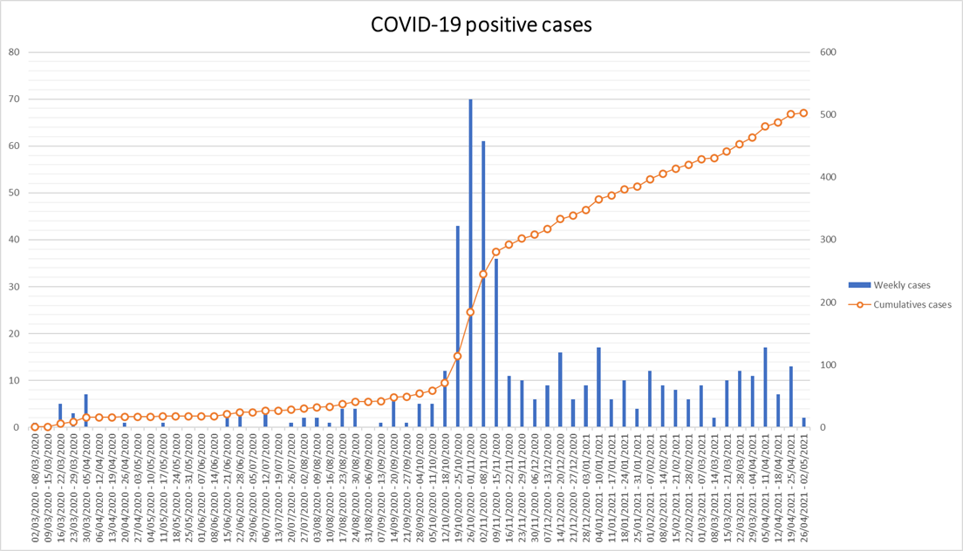
General information from department/group/section
Covid-19 general info
  Current teleworking measures have been extended up to the 14 May 2021. Please keep your EDH leave status up to date.
  No news ☺
More information to be found in
  CERN Covid-19 info page (especially links
  recently updated)
  Weekly ‘Covid-19 updates’ e-mail
  List of high-risk countries/areas for
  Switzerland here (constantly updated)
@CERN

Slide 3
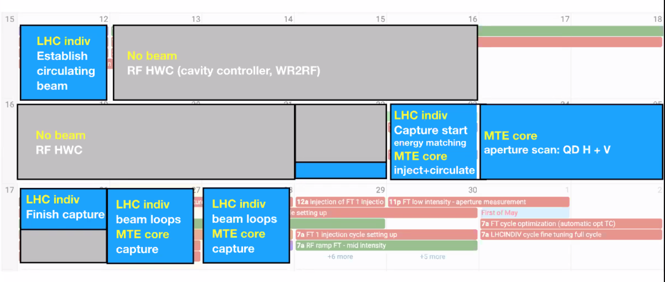
General information from department/group/section
From the Injectors Performance Panel (IPP) meeting this morning (1):
  SPS beam commissioning (Verena)

Slide 4
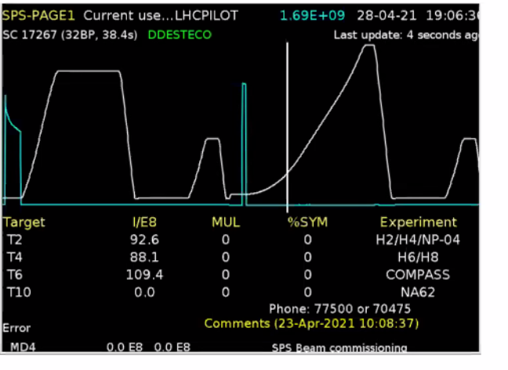
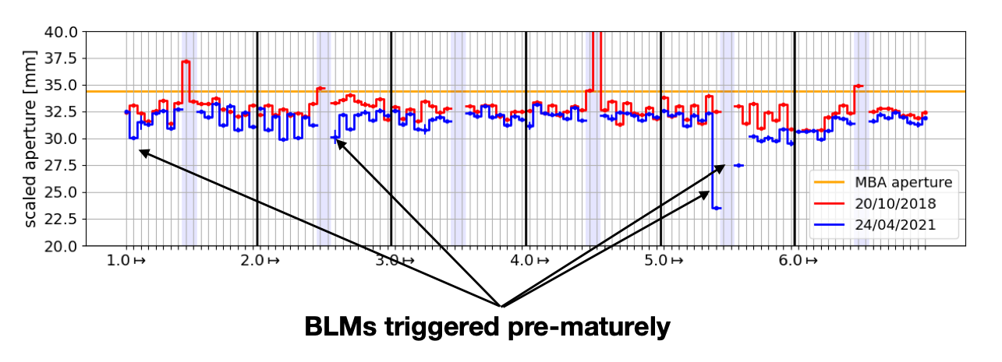
General information from department/group/section
From the Injectors Performance Panel (IPP) meeting this morning (1):
  SPS beam commissioning (Verena)
    Bad transmission and high losses on low intensity Fixed Target beam (SFTPRO)
    First aperture scan run, seems ok in vertical, although generally lower than 2018

Slide 5
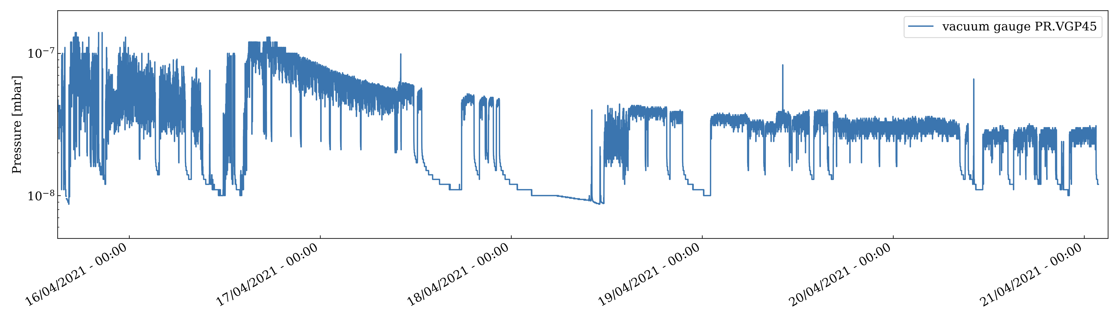
General information from department/group/section
From the Injectors Performance Panel (IPP) meeting this morning (2):
  PS electron cloud (Giovanni)
    History of e-cloud observations in the PS from 2002 onwards
    2021 scrubbing run: Machine conditioned but high activation in the machine (aperture restriction) and on TT2 dump (prevented interventions during iTS)

Slide 6
General information from department/group/section
This afternoon (16:00) Accelerator Seminar for
GSI/FAIR:
  Accelerator Physics challenges of the LIU project
  Indico site here
  Zoom details
    Link: https://gsi-fair.zoom.us/j/98984829760
    Meeting ID: 989 8482 9760 / PW: 266183
  Will show the rationale for the baseline of LIU project
  and the project implementation
  Will also provide some highlights of the first months of
  beam commissioning

Slide 7
General information from department/group/section
Beam commissioning in the injectors
We are here

Slide 8
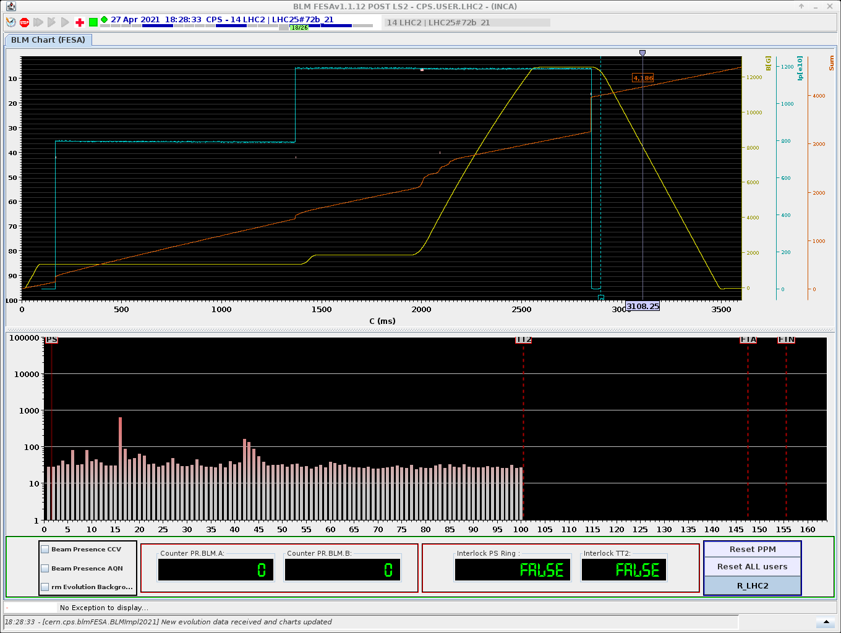
General information from department/group/section
Beam commissioning in the PS
  Reason for losses in SS88 found in the PS
  Sponge-like material used to close chambers and transport them usually out of the tunnel
    Now aperture restriction removed
    Beam commissioning can continue full steam
No more losses in SS88 with LHC beams
Notes:
LCH

