Slide 1
APTS carrier (OPAMP version)

Slide 2
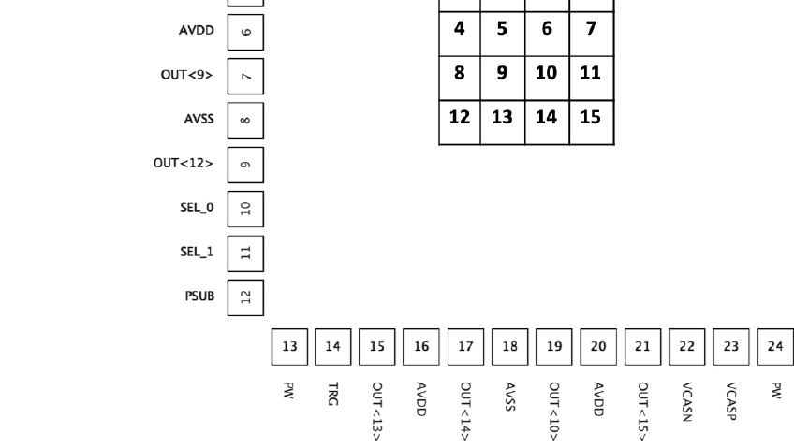
Wirebond diagram
S
P
S
G
S
P
S
B
B
Vias
SIGNAL
1st plane, signal traces
Ground
2nd plane, GND
POWER
3rd plane, POWER
4th plane, BIAS or ground
SIGNAL/GND
50 Ohm matching. Shortest wirebond possible

Slide 3
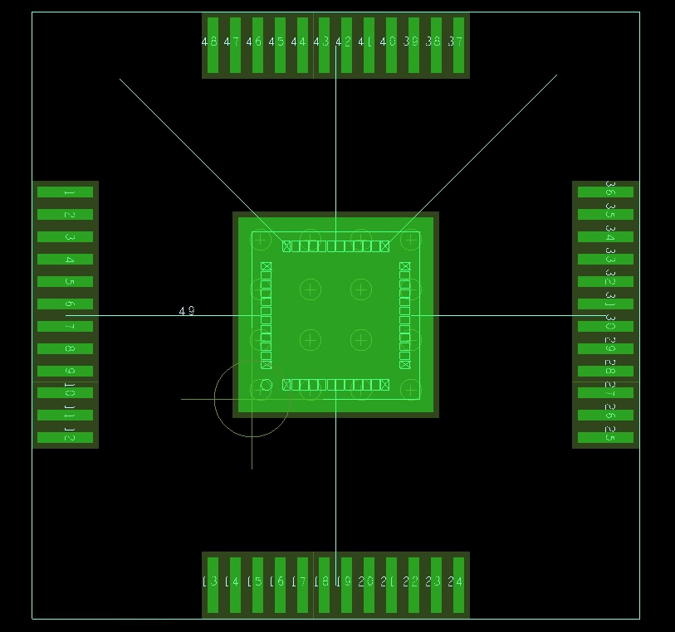
MLR1_APTS Footprint
Torino Ver 1.1 (2.03.2021)
Bonding pad dimensions: 100x500 µm
Bond lenght (min) ≈ 1,8mm
Chip height = 500 µm ?
Bond lenght, estimated: 2.5mm
MINIMUM possible distance between the pad centers= 1.5mm

Slide 4
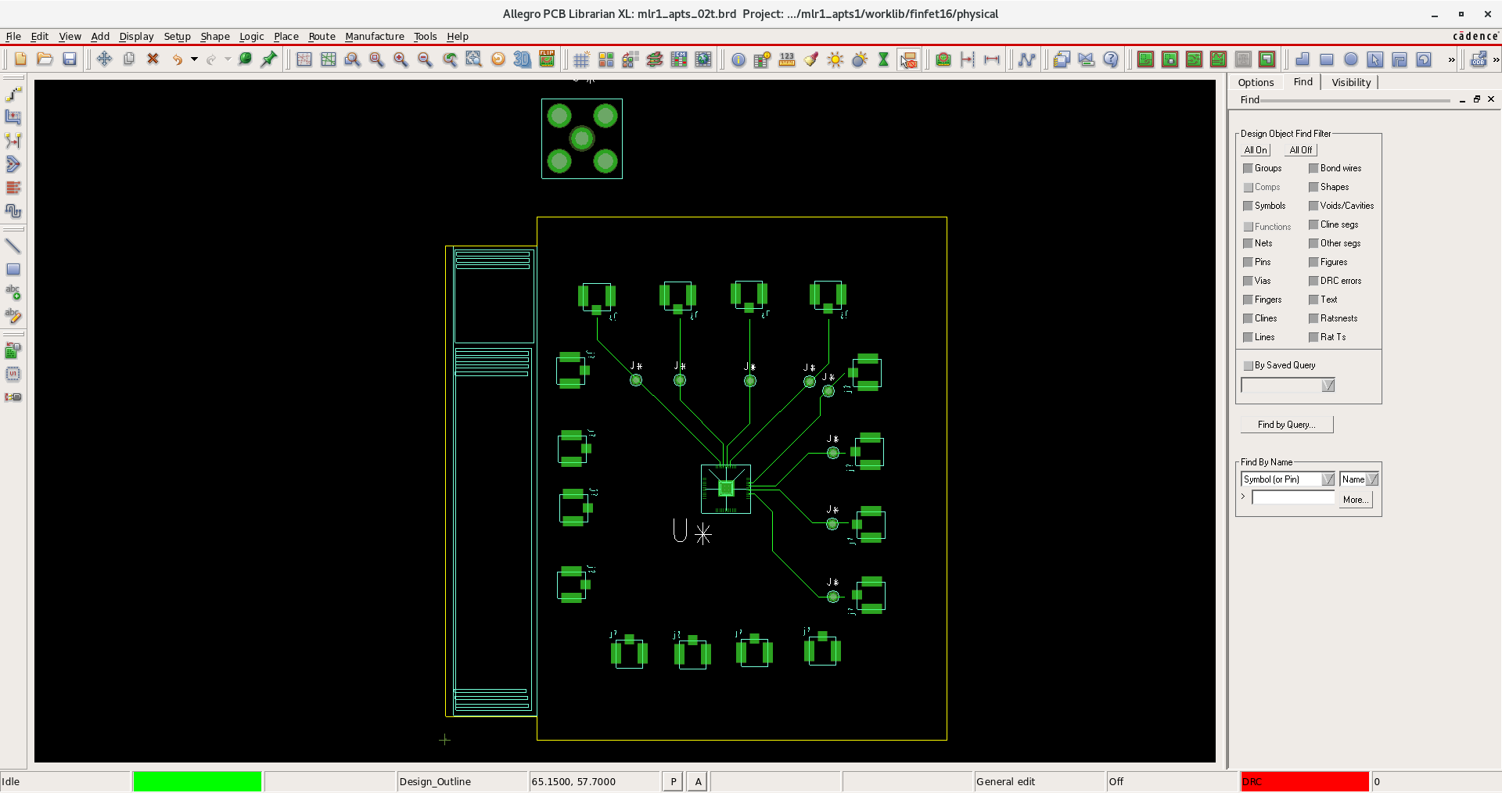
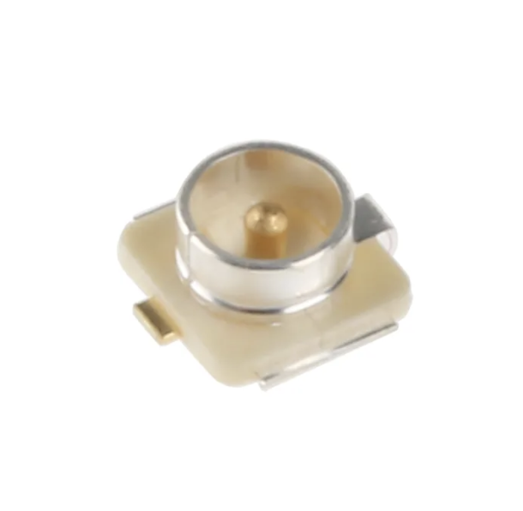
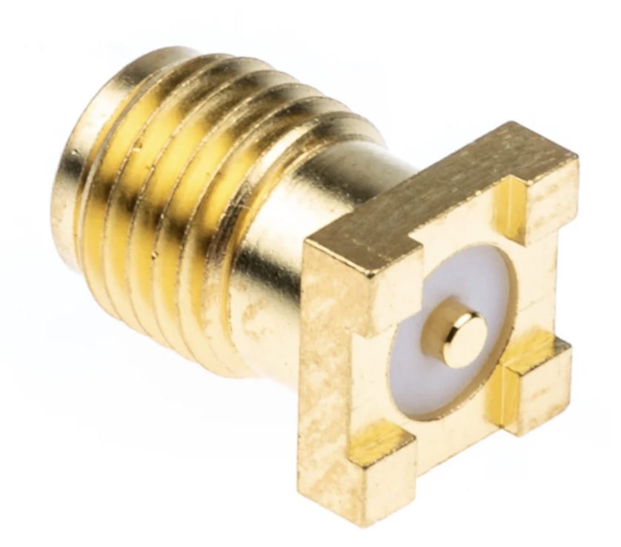
LAYOUT SKETCH
UFL SMT HIROSE
BOARD DIMENSIONS: ~6x6 cm2
CONNECTION TO PROXIMITY: PCI EXPRESS 98 pins
TEST POINTS?
CONNECTORS: UFL HIROSE
TEST POINT (O.7 DRILL)
10mm
PCI EXPRESS
4x4mm2
SMA SMT
SMA through hole
7x7mm2

Slide 5
Comparing table for bias requirements
APTS | APTS | DPTS | CE65
OPAMP Version | SOURCE FOLLOWER Version
VBIAS: (tot:3) | VBIAS: (tot:1) | VBIAS: (tot:2) | VBIAS: (tot:1)
VRESET (200 mV) | VRESET (200 mV) | VCASN (300 mV) | VRESET (1V; ?)
VCASN (750 mV) |  | VCASB (300mV)
VCASP (300mV)
IBIAS: (5) | IBIAS: (5) | IBIAS: (4) | IBIAS: (6)
IBIASN (-800 µA) | IBIASN (-800 µA) | IBIASN (+1 µA; 1:1000µA) | BIAS_SF_MAT (1mA; 0:10mA)
IBIASP (+80 µA) | IBIASP (+80 µA) | IBIAS (+1 µA; 1:500µA) | BIAS_SF_COL (100 µA; 0:1mA)
IRESET (+1 µA) | IRESET (+1 µA) | IRESET (+1 µA; 1:100µA) | BIAS_SF_NMOS_PIX (1 µA; 0:10µA)
IBIAS3 (+800 µA) | IBIAS3 (+800 µA) | IDB (+10 µA; 1:500µA) | BIAS_SF_PMOS_PIX (-1 µA; 0:10µA)
IBIAS4 (+2,5mA) | IBIAS4 (-6mA) |  | DAC_IBIAS_A (0,8 µA; 20xLSB )
Positive Current (+) from pin to gnd on board |  |  | DAC_IBIAS_B (10,72 µA; 268xLSB)

Slide 6
APTS carrier (SF version)
Things get trickier…

Slide 7
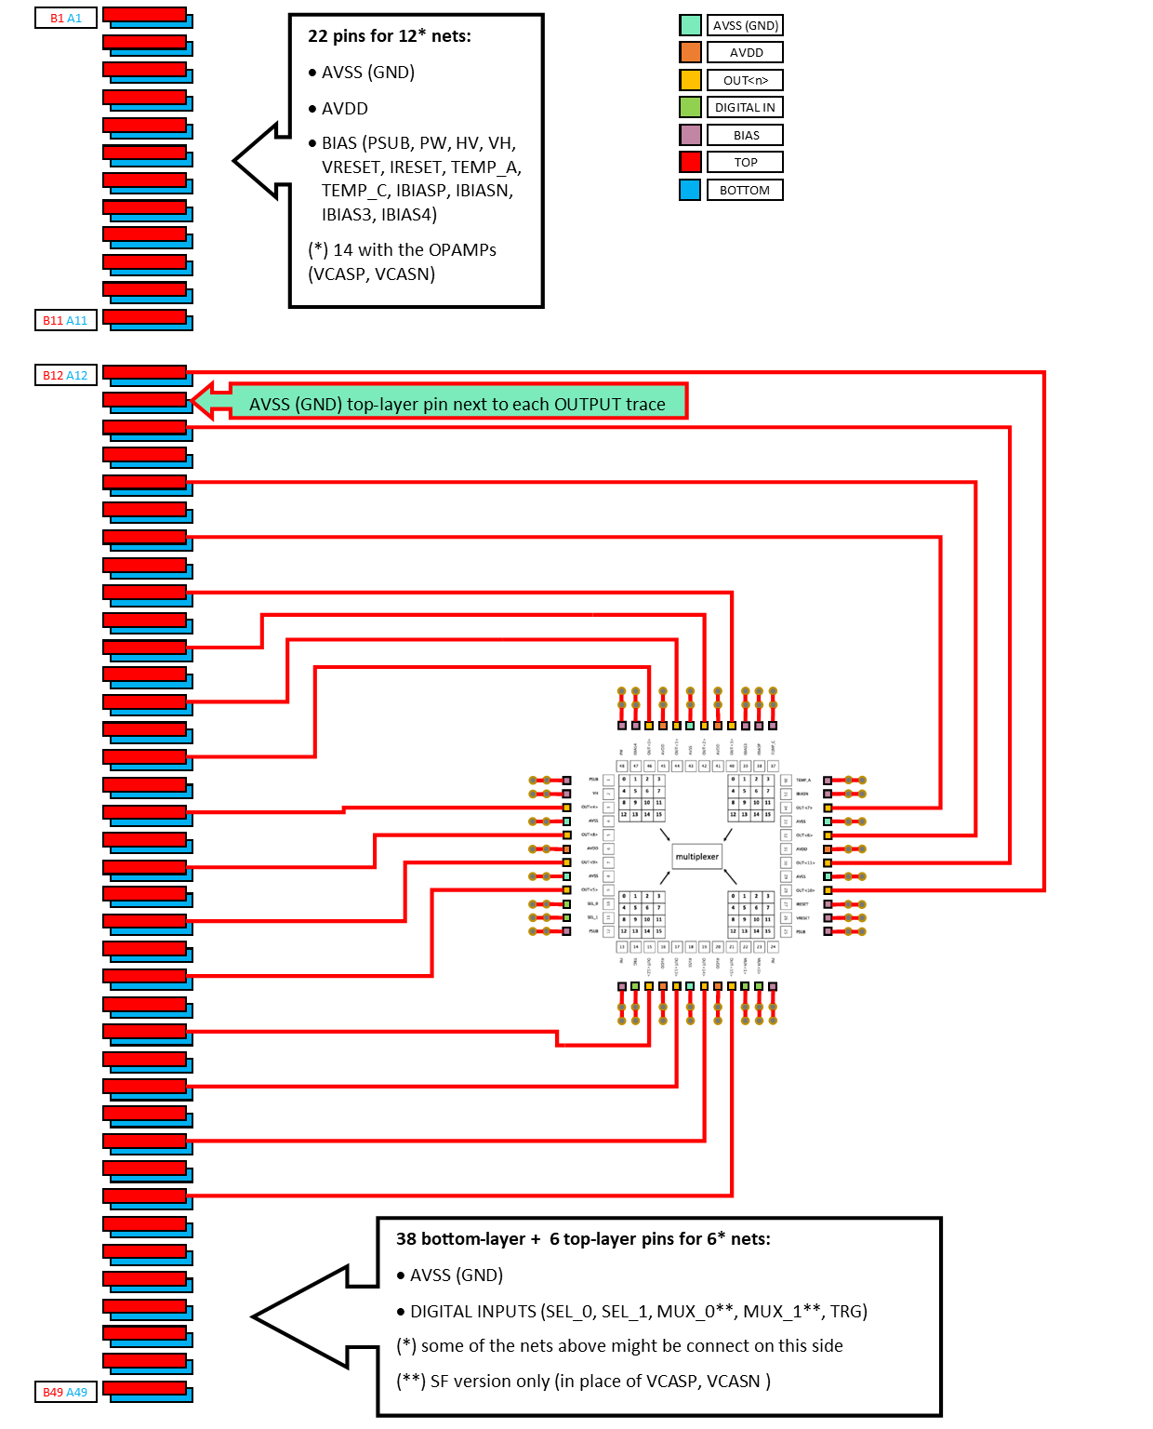
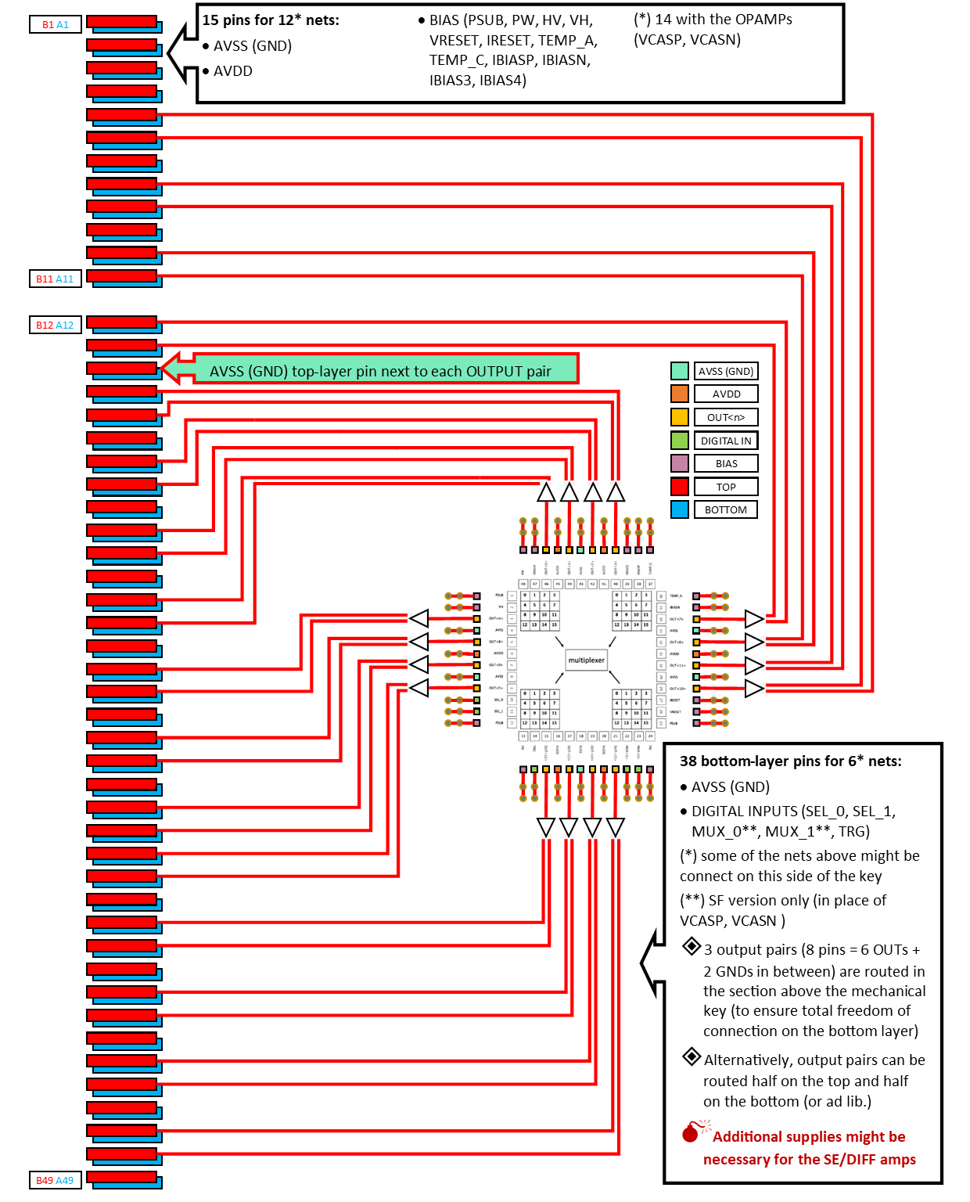
Possible layouts: single ended vs differential

Slide 8
Open points for both versions (page 1/2)
LAYOUT
SF: NO impedance matching [discuss with chip designers]
SF: priority to trace shielding wrt capacitance reduction [discuss with chip designers]
OA: 50-Ω matching (?) [discuss with chip designers]
OA: pad or connector for oscilloscope (?) [discuss with chip designers]
SF: equalise output-trace lengths (?) [discuss with chip designers]
SF: reduce trace length AMAP [of course]
Central pad to GND (?) [discuss with chip designers]
OA: PW/HV (pins 13, 24, 48) double function (?) [discuss with chip designers]
SF: PW (pins 13, 24, 48) single function (?) [discuss with chip designers]
Are VH pulses fast (?) [discuss with chip designers]
Is TRG speed-critical / does it need to be matched or terminated (?) [discuss with chip designers]
Are the other digital signals (SEL and MUX) slow (?) [discuss with chip designers]
Is VRESET stationary (?) [discuss with chip designers]
SF: 16 single-ended or 32 differential output traces (?) [discuss with chip designers]
SF: 16 traces (or diff. pairs) or MUX on carrier board (?) [discuss with proximity-board designers]
Board size constraints (e.g. chip-connector distance…) (?) [discuss with proximity- and OA-board designers]

Slide 9
Open points for both versions (page 2/2)
LAYERS
4 layers (TOP/GND/POW/BOTTOM?) [discuss with proximity- and OA-board designers]
Materials, thickness (1,6 mm for PCIe), tech. constraints (?) [discuss with proximity- and OA-board designers]
Buried or top-layer signal traces (?) [discuss with proximity- and OA-board designers]
COMPONENTS:
Are bypass capacitors necessary on carrier board (?) [discuss with chip designers]
If so, of which value (?) [discuss with chip designers]
Other passive components (resistors, diodes, jumper...) (?) [discuss with chip designers]
Voltage regulators needed on carrier board (?) [discuss with proximity-board designers]
Other active components (buffer, SE/DIFF…) (?) [discuss with chip designers]
CONNECTIONS:
With proximity board (TBD), Edge Card type (?) [Probably a PCIe]
50-V (lemo?) connector [on Proximity or DAQ board]
Allow for huge-curved-chip connection (?) [discuss with OA-board and HCC designers]
Bias levels and quantity, DAC resolution on proximity (CE65 version) compatible with APTS (and possibly DPTS) (?) [discuss with proximity-board and chip designers]

