Slide 1
Adding 220V power to the CMS bunkers - ECR
Sorina Popescu, Kansas University

Slide 2
Existing situation
CMS ZDC purpose is to measure very forward photons and neutrons produced in in heavy ion collisions.
CMS ZDC is installed in TAN at +/- 140 m from IP5
During Run 1 and Run 2 CMS electronics were installed in CMS control room (level 1) :
  Impact1 : Very long cables of HV
  Impact2: The HV cables are acting as antennas and bring noise into CMS control room (USC55)
  Impact3: Blow fibers in the existing ducts, last one basically we had 20 m of black fibers (need to control with multimode fibers)
  Impact4: For Run 4 ( timidly for Run 3) we plan to reduce the noise in USC55

Slide 3
Reason for change
Main worry is the grounding:
  No contact with the USC55
  More feasible to have the QIE’s and HV in the bunker near detector
AUG: we would like to have it installed
Power for Racks: we plan to install mini-racks which will host HV and QIEs
RP issues: Bunkers have a low radiation.
  Fibers will come from top of the rack
  Fibbers will shorter
  Fibbers will be well away from beam

Slide 4
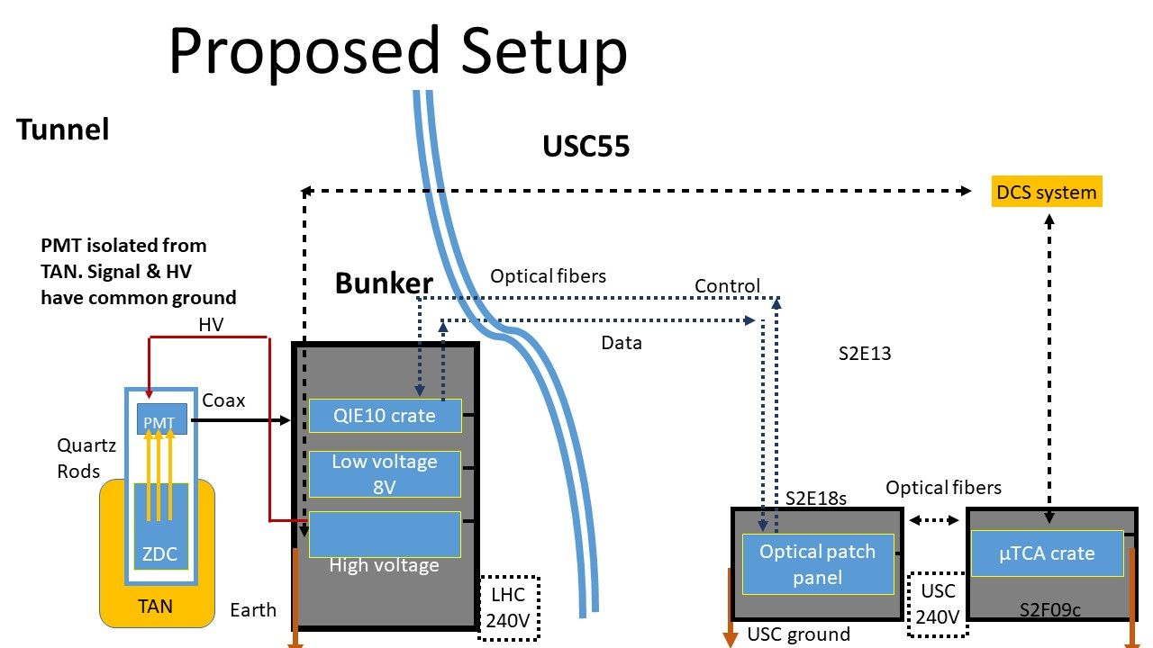
Proposed set-up

Slide 5
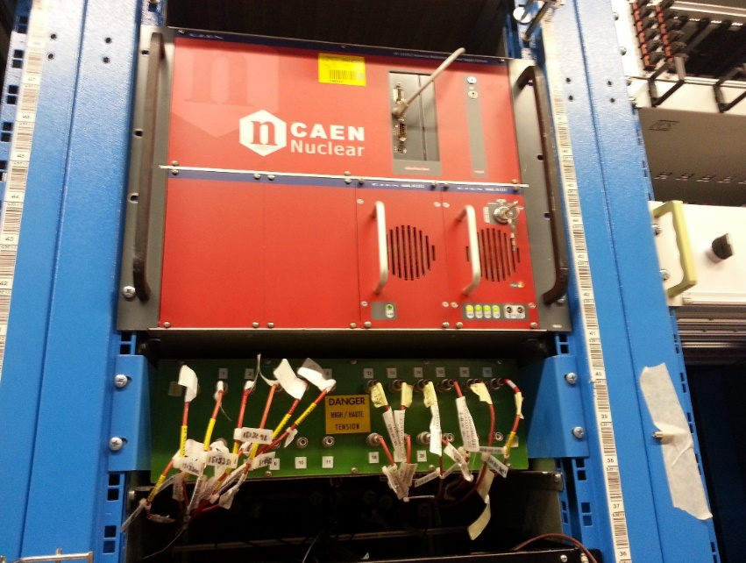
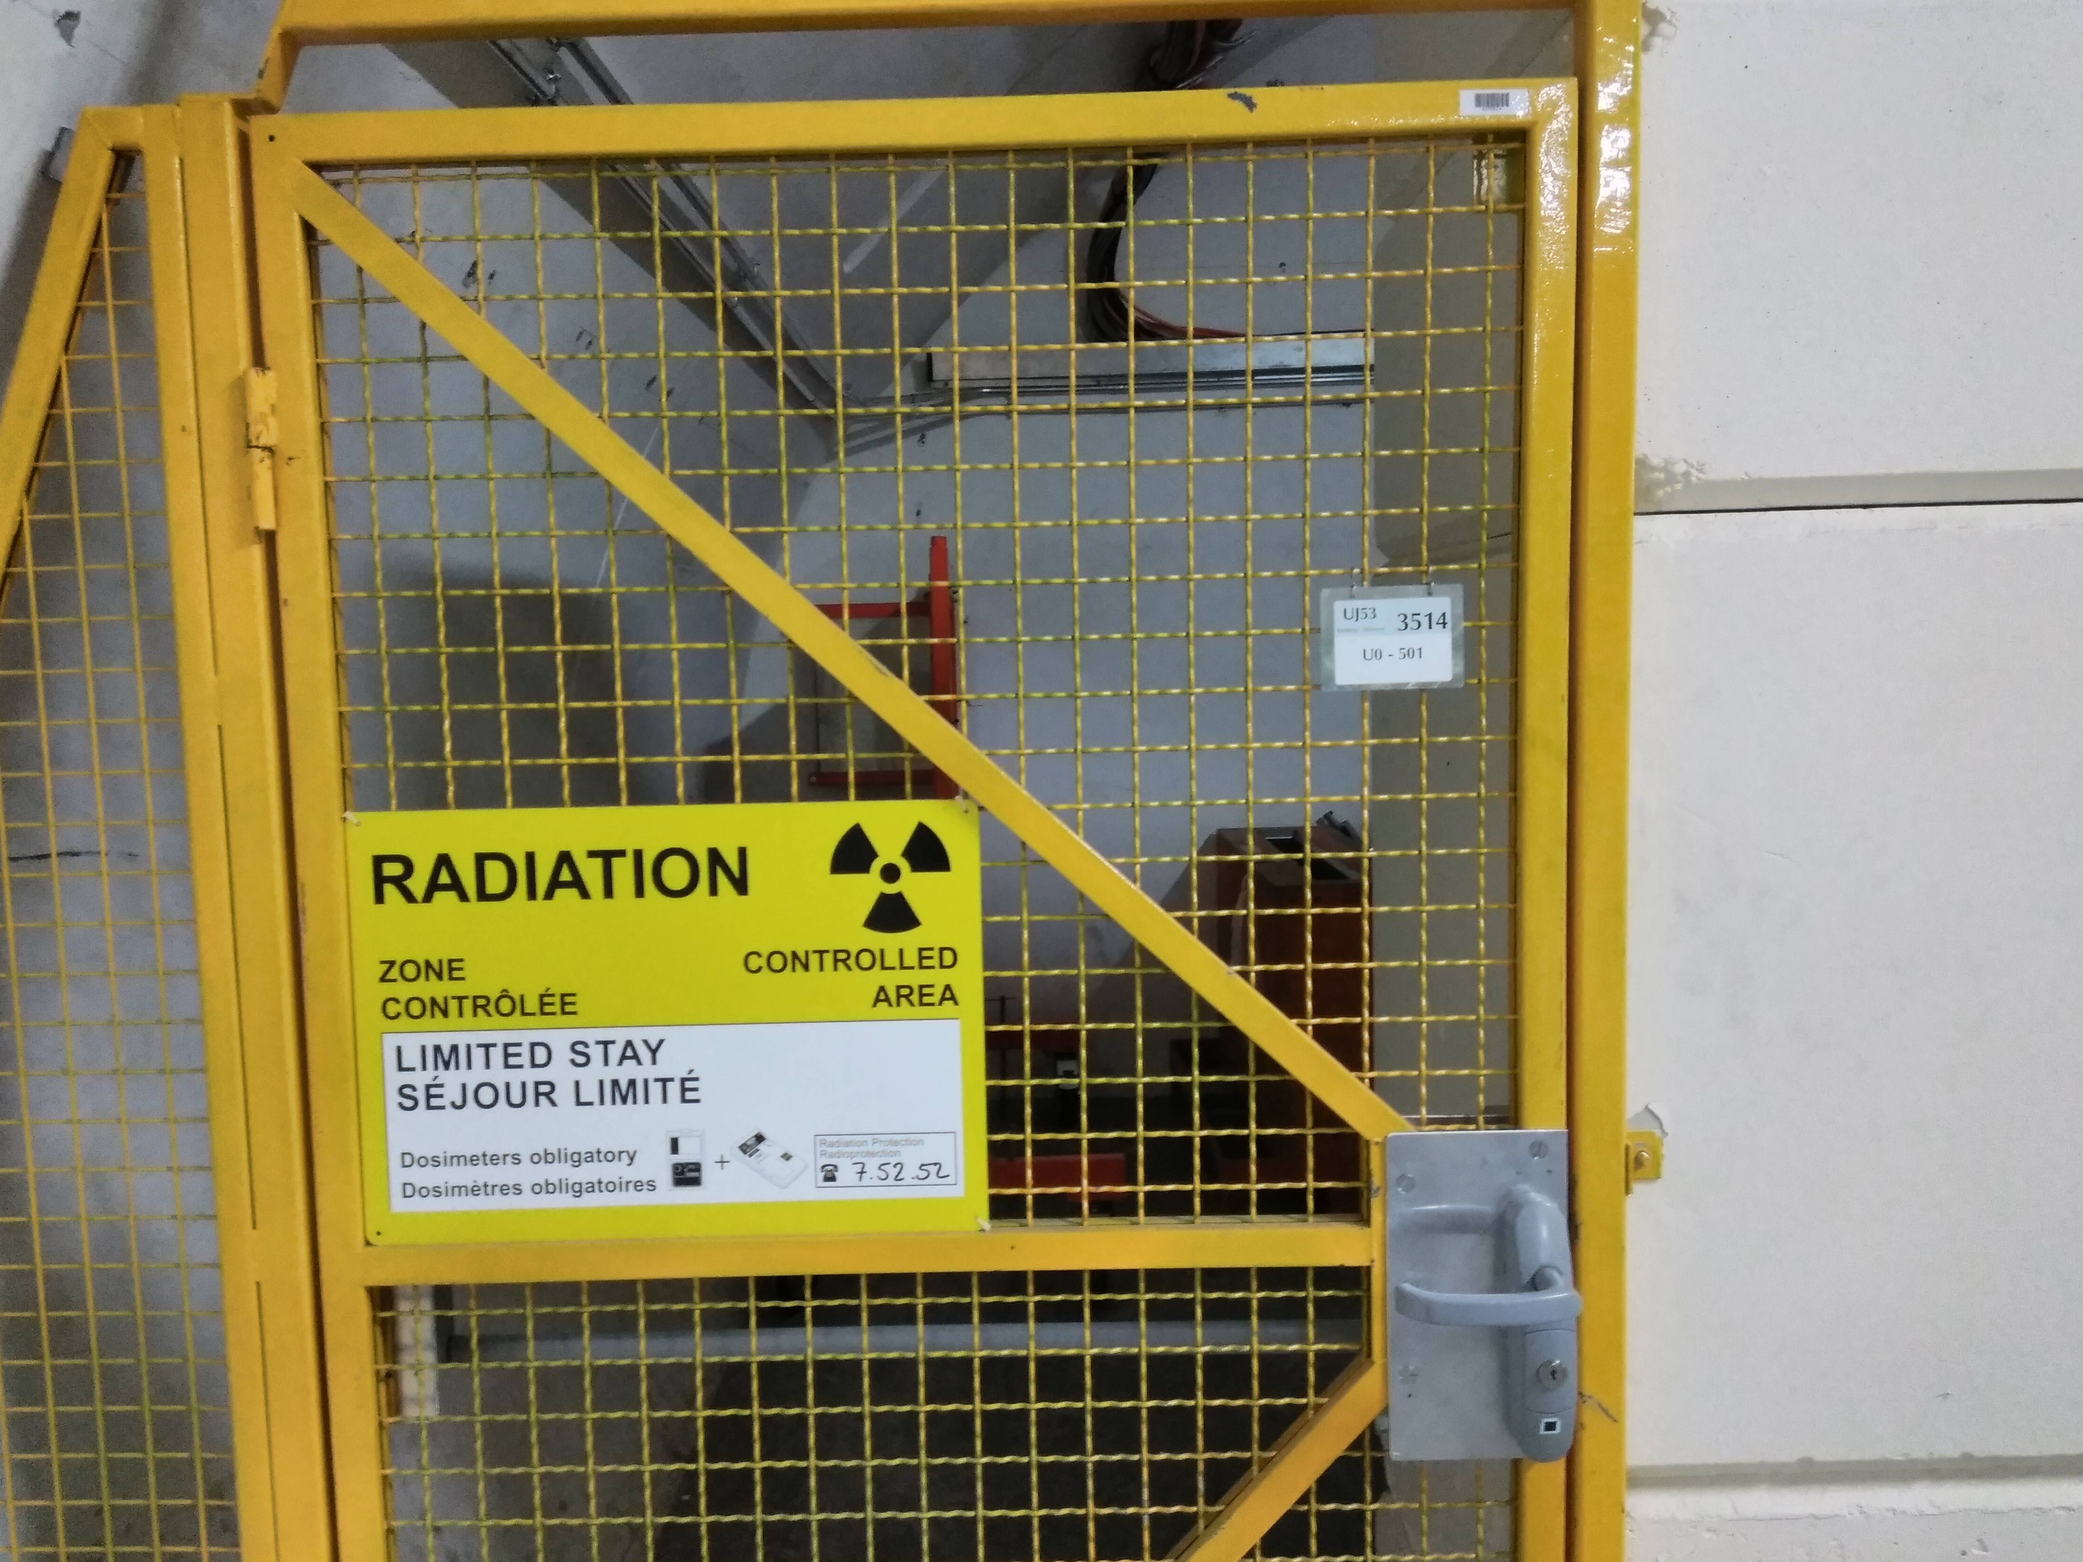
Current situation and future plans
We would like to have theses in the bunkers.
We are foreseeing several Phases
Phase 1: installation of 220 V plugs outlets
Phase 2: installation of the internet plugs, optical fibers (single and multi mode of optical fibers on the two existing duct)
Phase 3: installation of mini-rack (QIE , HV, and LV)
The timeline of these phases, as we all know is depending of budget,
funding's men powers, supervising etc..
We are optimistic to have the Phase 1 and 2, by this year, before May 2021 –budget reasons
For Phase 3, we would like to have a first trial for Run 3

Slide 6
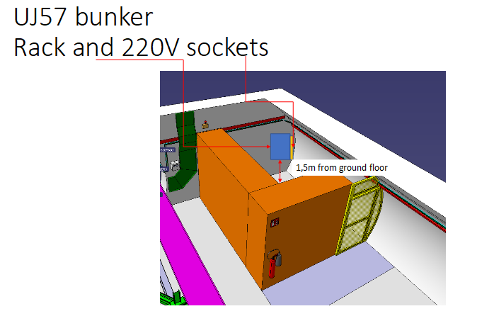
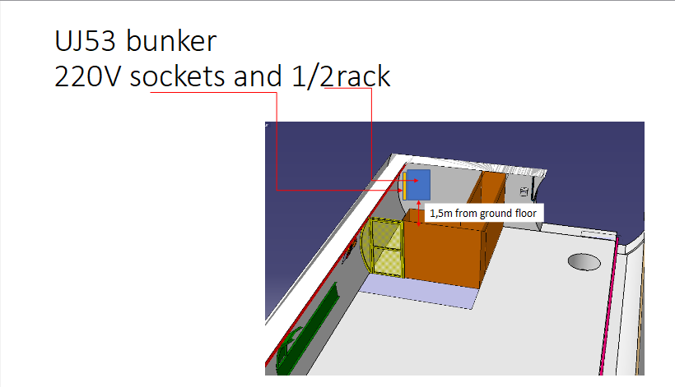
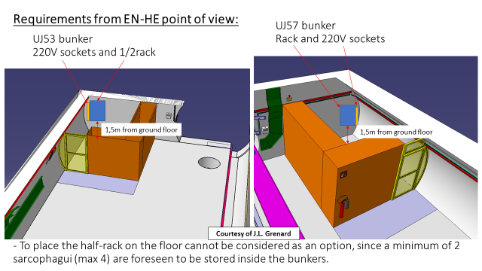
Current studies of integration
Work done by J.L Grenard
Integration studies for installation of mini-racks in the bunkers (proposal from M. Amparo Gonzalez De La Aleja Cabana, J.L. Grenard)

Slide 7
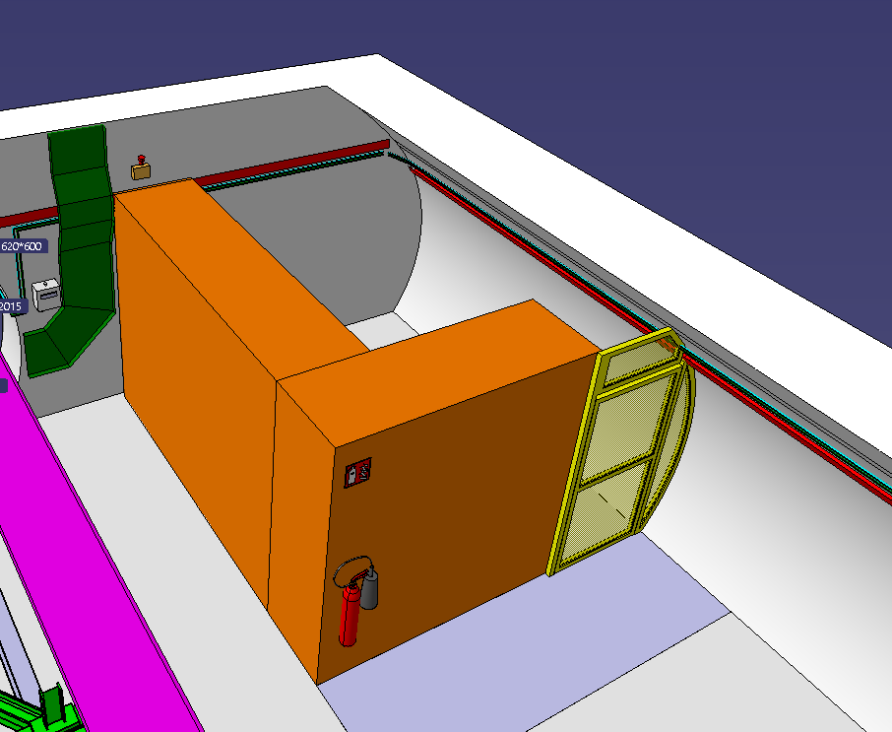
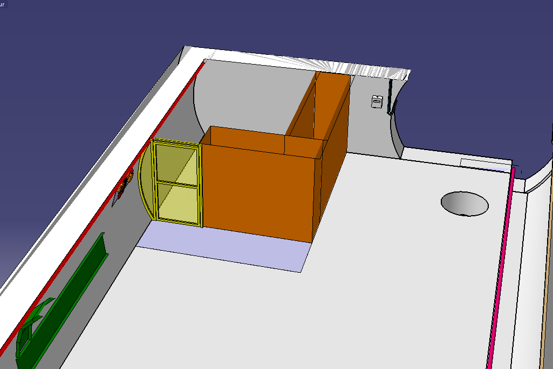
UJ53 bunker
220V sockets and 1/2rack
Requirements from EN-HE point of view:
UJ57 bunker
Rack and 220V sockets
1,5m from ground floor
1,5m from ground floor
- To place the half-rack on the floor cannot be considered as an option, since a minimum of 2 sarcophagui (max 4) are foreseen to be stored inside the bunkers.
Courtesy of J.L. Grenard

Slide 8
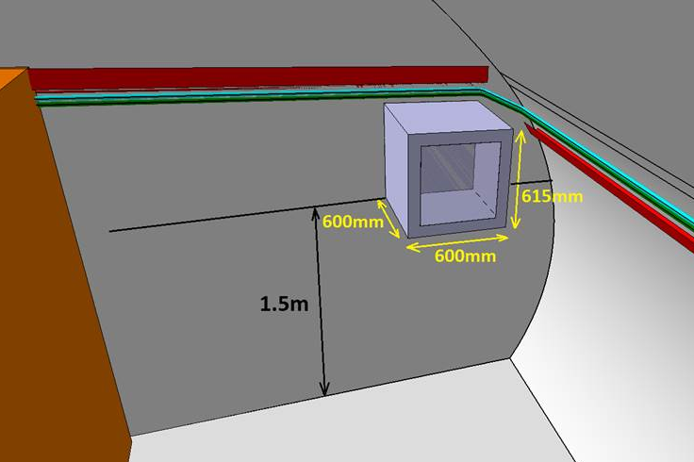
- To be placed 1.5m above the floor.
- It would be preferable to have the rack in the most radiation quite part of the bunker, perhaps the corner, near the wall.
- Dimensions considered so far: 600x600x615mm volume reservation.
- There is a CAEN HV main frame and then individual cards that produce the HV.
- The front end electronics is in a standard VME crate with a small patch panel above it to allow for strain relief of the cables.
- The rack can be air cooled with fan.
- Supporting solution to attach the rack on the wall will need to be found.
½ rack characteristics (installation LS3):
Electrical Plug-in characteristics (LS2):
- To be placed 1.5m above the floor.
- To be close to the rack.
- Type reglette: 10 prises

Slide 9
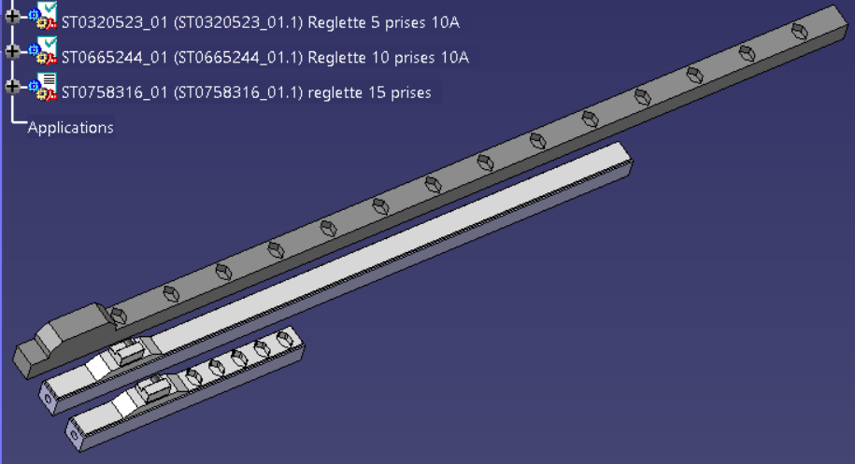
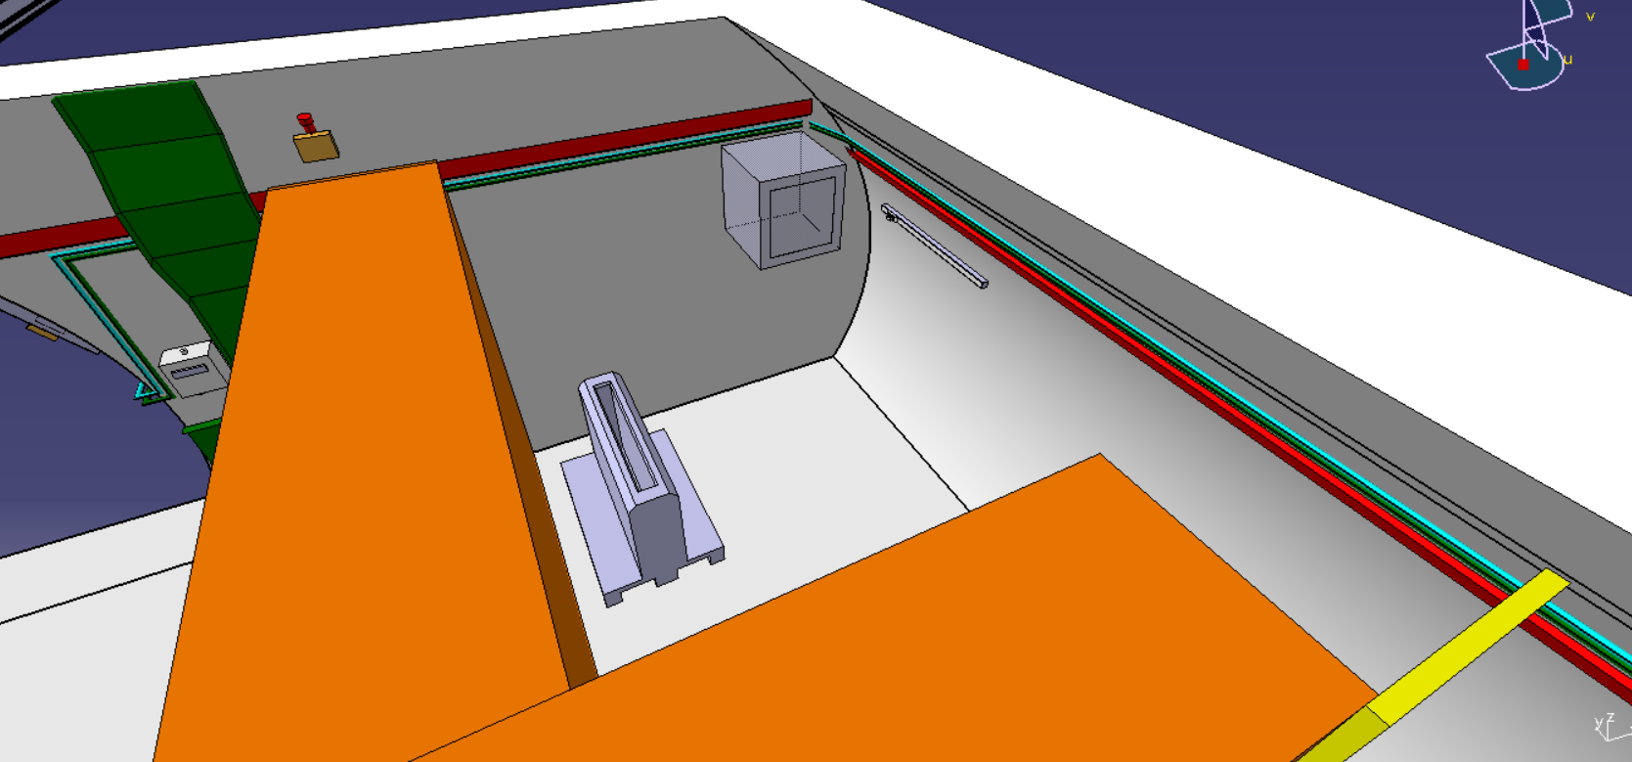
Full integration proposal (UJ57):
Volume reserved ½ rack
Reglette 10 prises → horizontally oriented
Proposal: to be installed 1.5 m above the floor, on the adjacent wall (perpendicular)
Proposed distance from the corner: 30 cm
1,5m
1,5m
UJ57 bunker

Slide 10
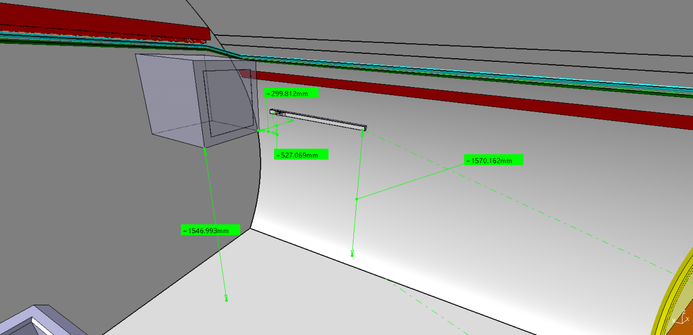
Full integration proposal (UJ57):
UJ57 bunker
Volume reserved ½ rack
Reglette 10 prises → horizontally oriented
Proposal: to be installed 1.5 m above the floor, on the adjacent wall (perpendicular)
Proposed distance from the corner: 30 cm

Slide 11
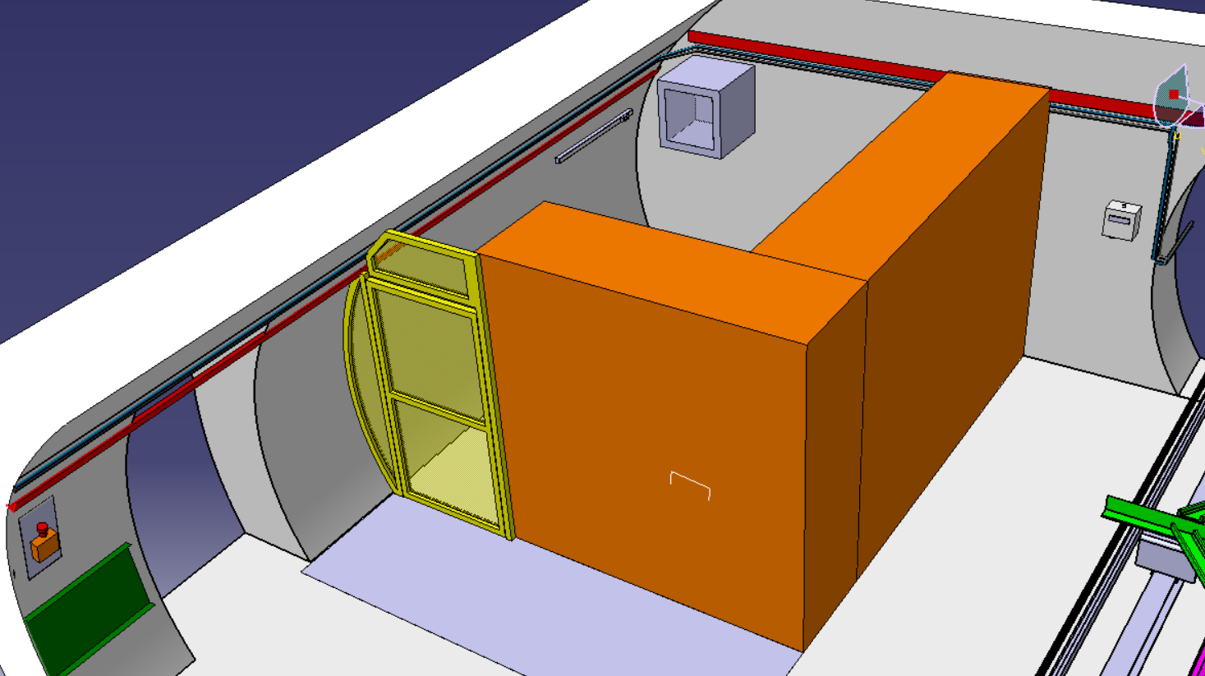
Full integration proposal (UJ53):
Volume reserved ½ rack
Reglette 10 prises → horizontally oriented
Proposal: to be installed 1.5 m above the floor, on the adjacent wall (perpendicular)
Proposed distance from the corner: 30 cm
UJ53 bunker

Slide 12
Conclusion
CMS - ZDC has a heavy schedule for Run 3 and Run 4
CMS – ZDC has to deal with tigheten installation, commissioning and operation windows
These windows have to be integrated in the general CMS schedule, which puts pressure to many groups (DAQ, DQM etc..)
But we are happy to take the challenge ☺ ☺ ☺
Thank you, any questions?

Slide 13
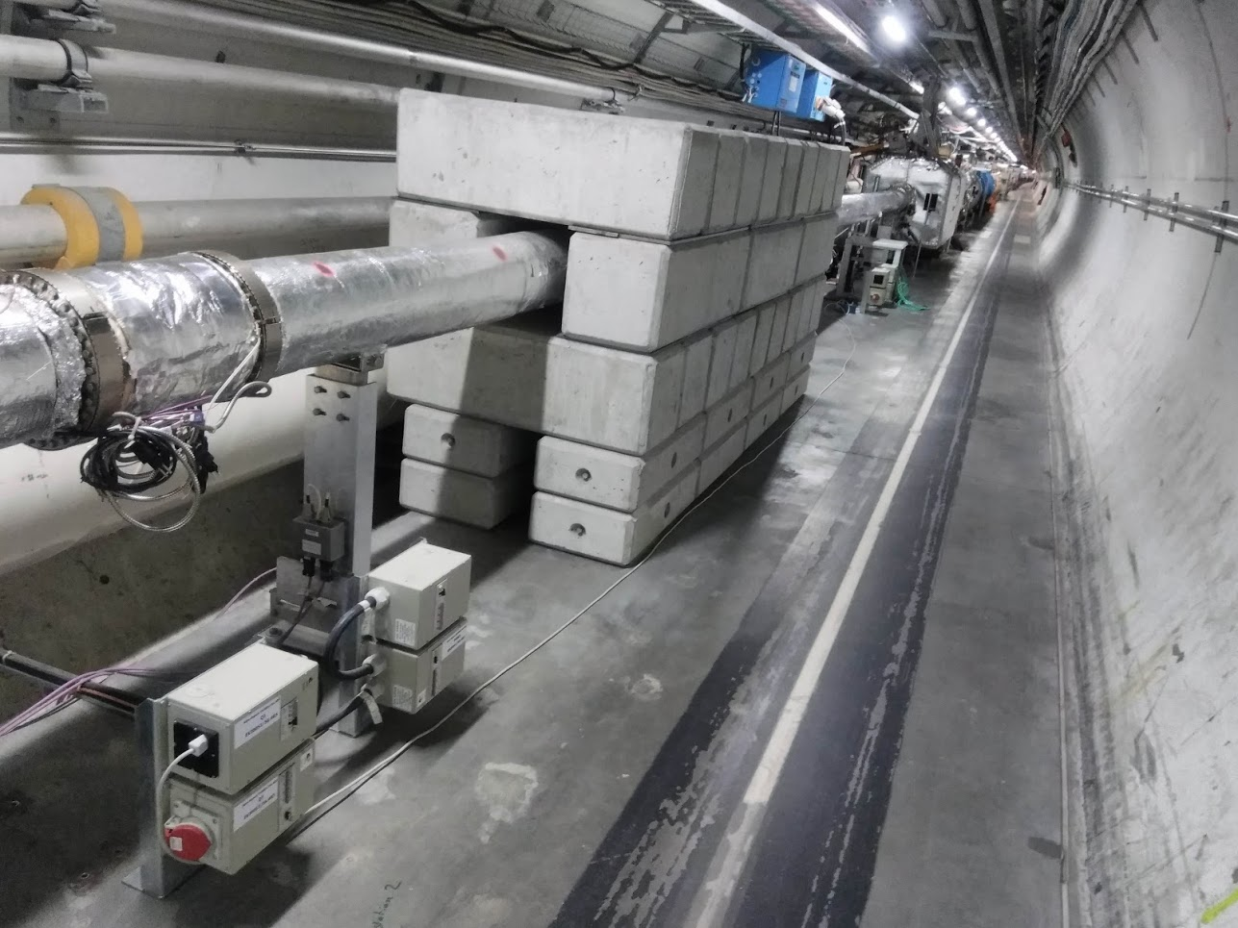
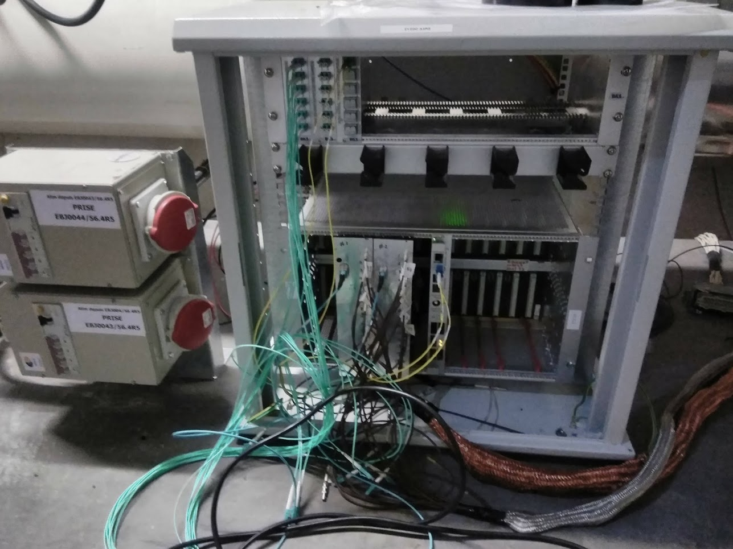
Previous position of ZDC racks Run1&Run2

